Slide 1


Value Delivery and Business Capability Planning Connecting Prioritized Outcomes, Business Capabilities, Services and Products
Value Recipient
Strategic
Leadership
GOAL
Deliver Remarkable Customer Service
USDA Customers
(Public, Private Industry, Partners)
Value Items
Recreation Opportunities
Achieved Thru
Serves
Forest Products
Implementation
Leadership
Business Capability
Registration, Permit & License Management
Invoked
By
Value Stream
Enable Forest Access
Business Service
Permits & Licensing
Produces
Delivers
Forage
Operationalized By
Minerals
App
Rec.gov
App
Open Forest
App
NRM
App
Local Solutions
Operations
Leadership
Technology Component
Data Component

Slide 2
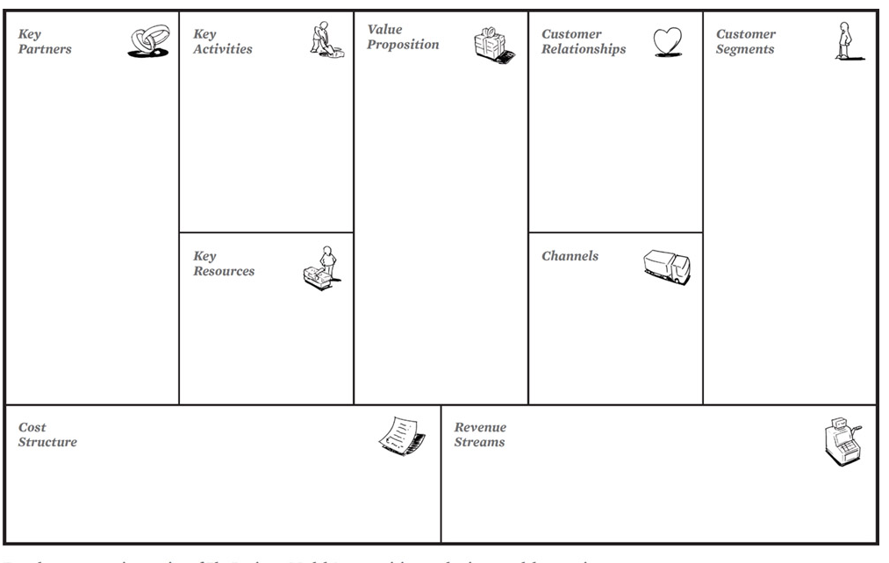
General Services Agency
Capture Permit Information
Enable Forest Access
Self-Service
Public
18F
Evaluate Permit Application
Deliver Recreation Opportunities
Personal Assistance
Private Industry
Department of Agriculture
Establish Terms & Conditions
Supply Forest Products
Department of Interior
USDA Partners
Issue Permit
Provide Forage
Process Payment
Supply Mineral Resources
Monitor Uses
Permit
Term Permit
Temporary Permit
Recreation.gov
Infrastructure
Lease
Open Forest
Human
Field Unit Offices & Websites
Financial
Easement
Unit Specific Apps
Information Technology
Vending Machines
Data
Other Permit Types
One-Off Solutions
Fixed Costs (Salaries, Rent, IR Segments, etc.)
Cost Recovery Fees
Land Use Fees
Variable Costs
Other Associated Costs
Notes:
A business model describes the rationale of how an organization creates, delivers, and captures value

Slide 3

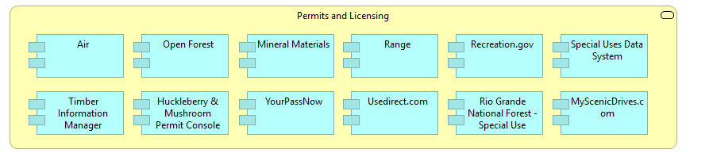
Complexity of our permitting service landscape
The challenges facing the USFS are shifting away from efficiency and automation towards questions of complexity management and business agility.
Risks
A complex web of existing apps & interfaces creates highly complex landscapes where change becomes more difficult and costly.
Impacts of change are harder to predict and understand.
Business Interfaces
(websites, portals, kiosks, etc.)

