Slide 1
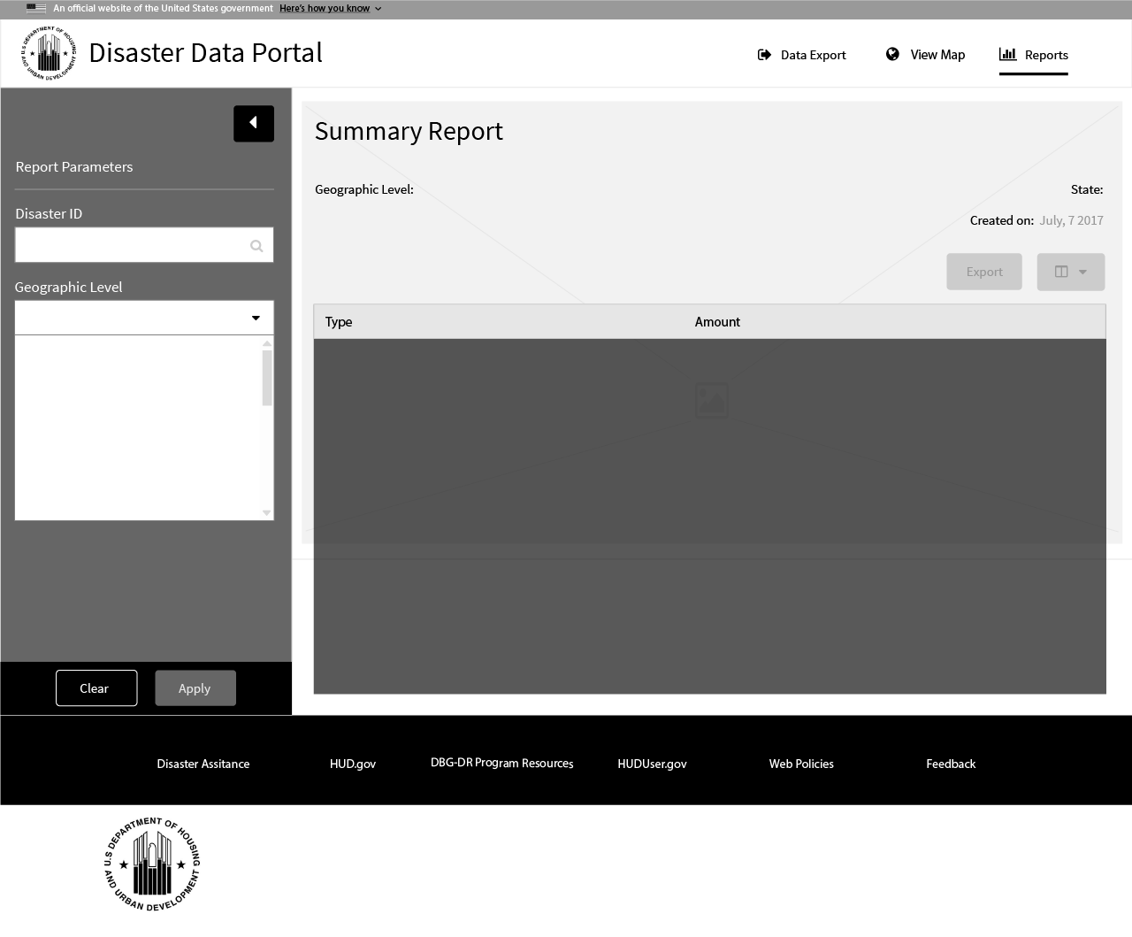
1 Disaster ID
1 Disaster ID

Slide 2
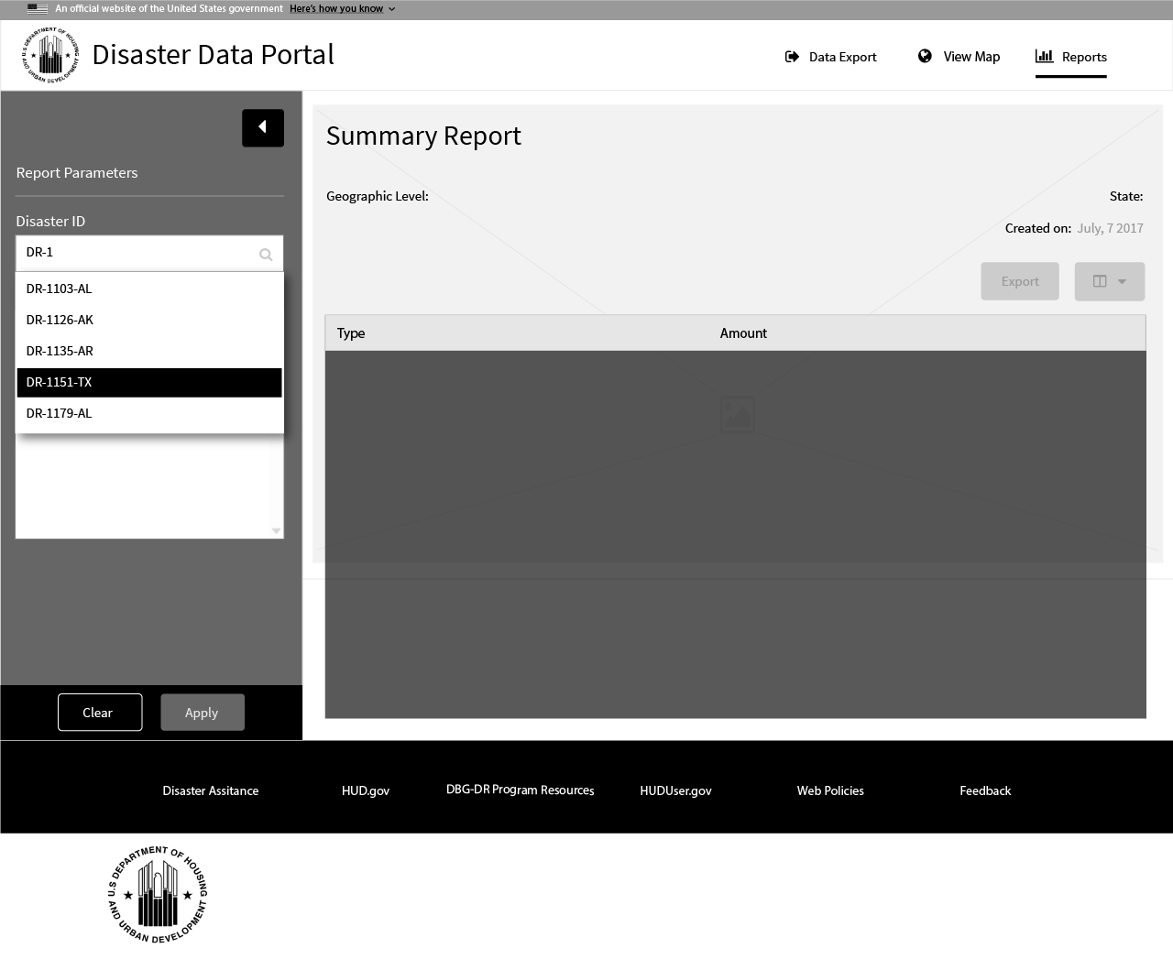
1 Disaster ID

Slide 3
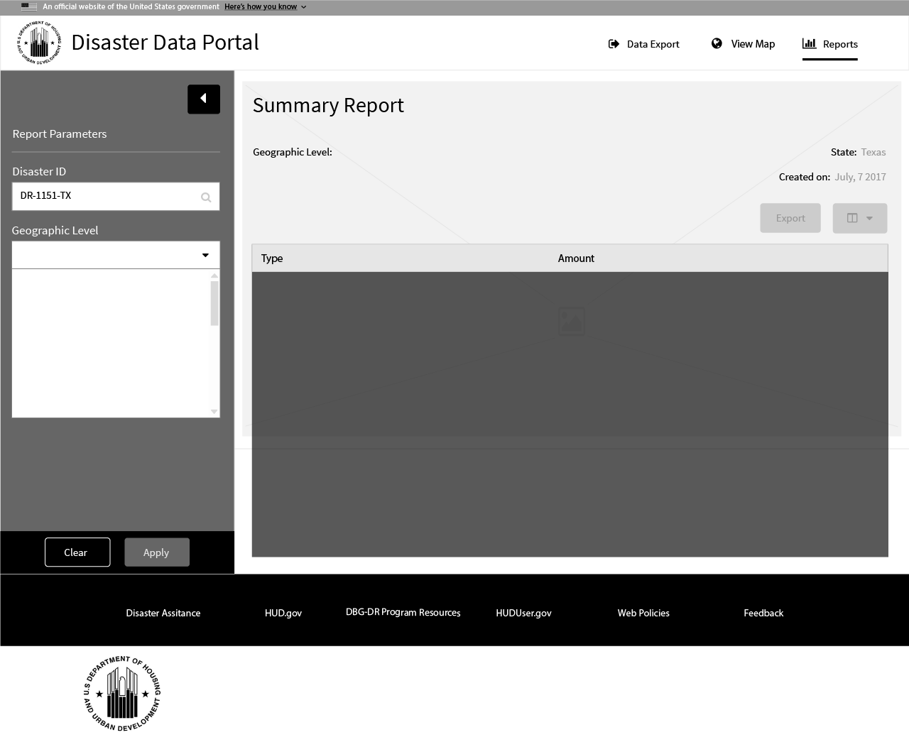
1 Disaster ID

Slide 4
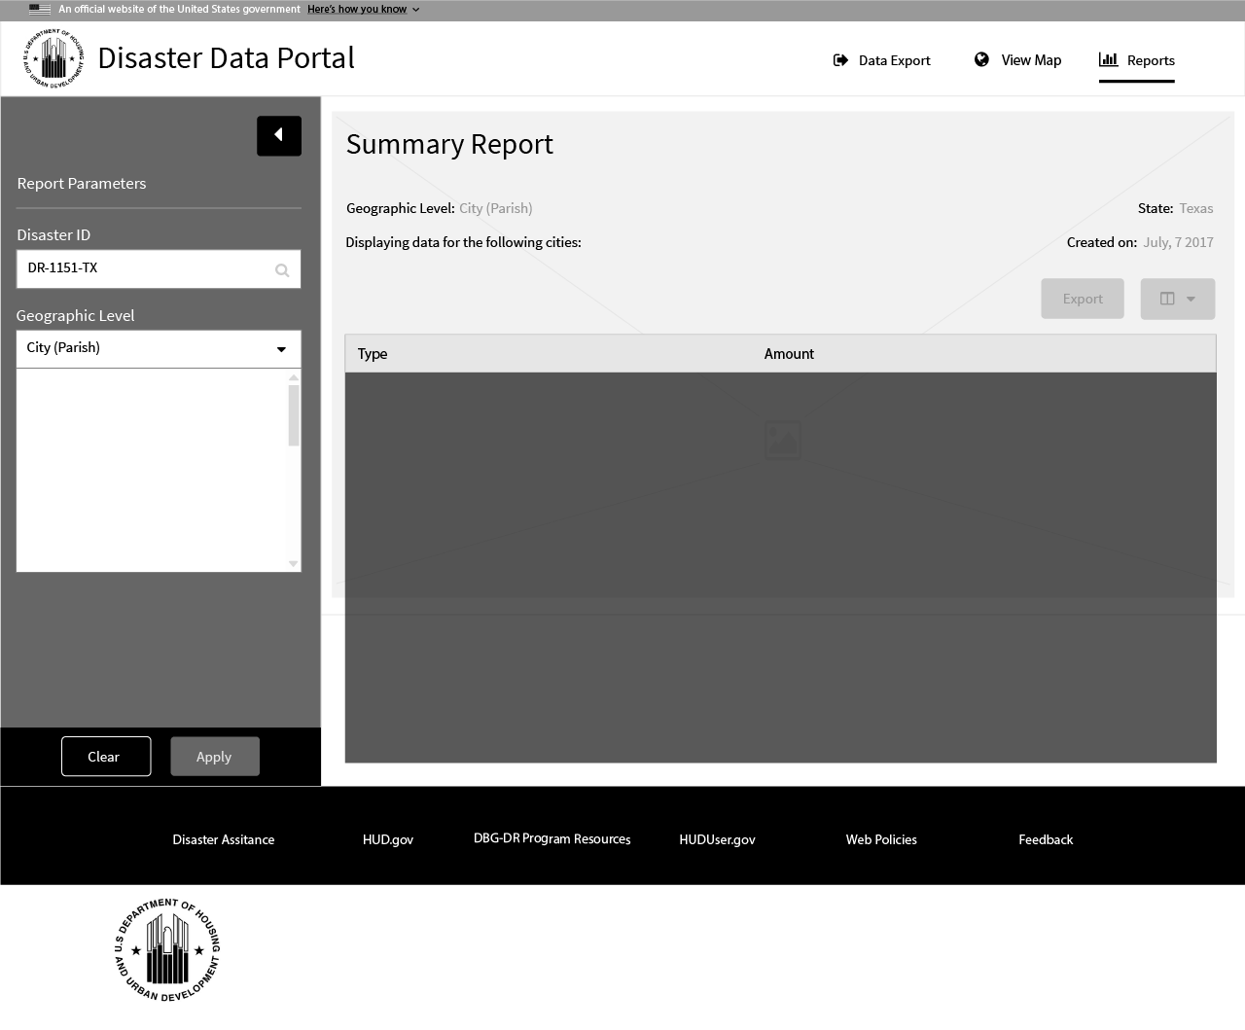
1 Geographic Level
2 Title -
3 Title -

Slide 5
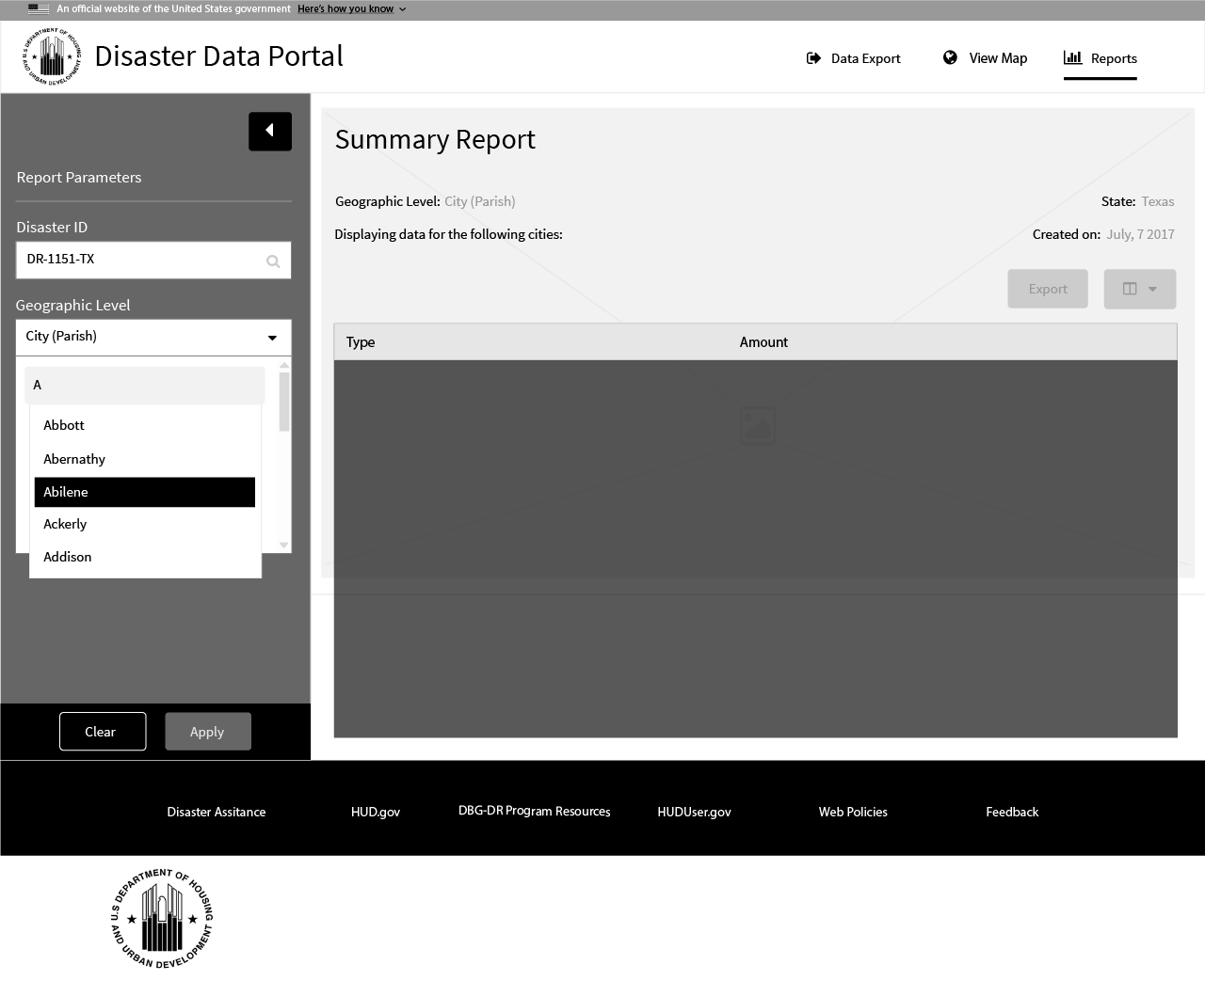
1 Geographic Level

Slide 6

1 Disaster ID
1 Disaster ID

Slide 7
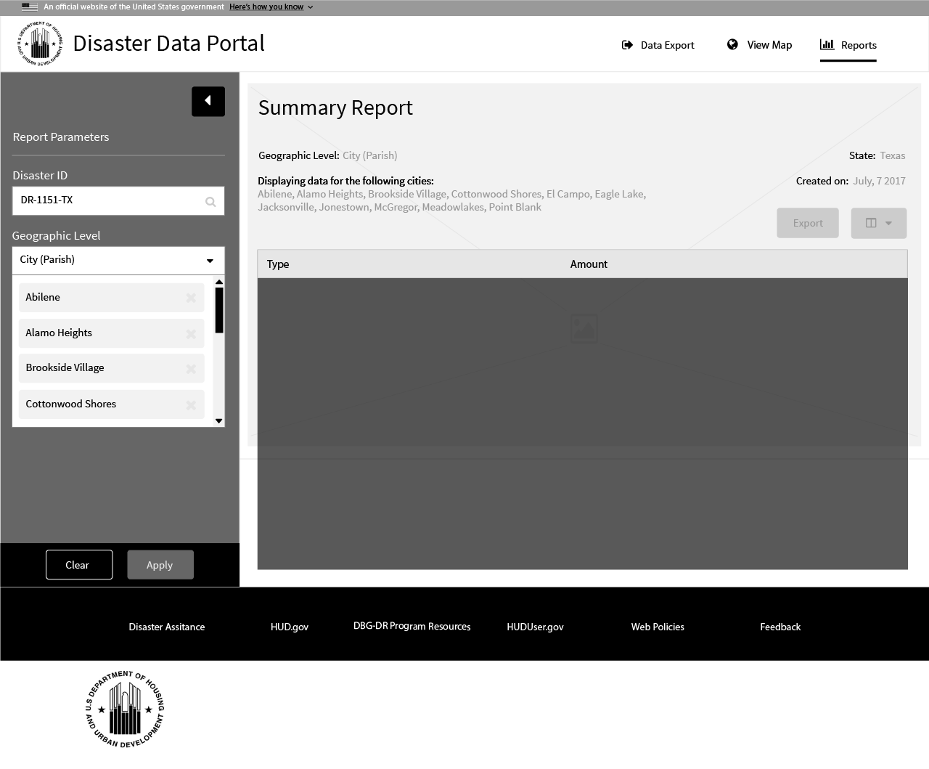
1 Disaster ID
1 Disaster ID

Slide 8
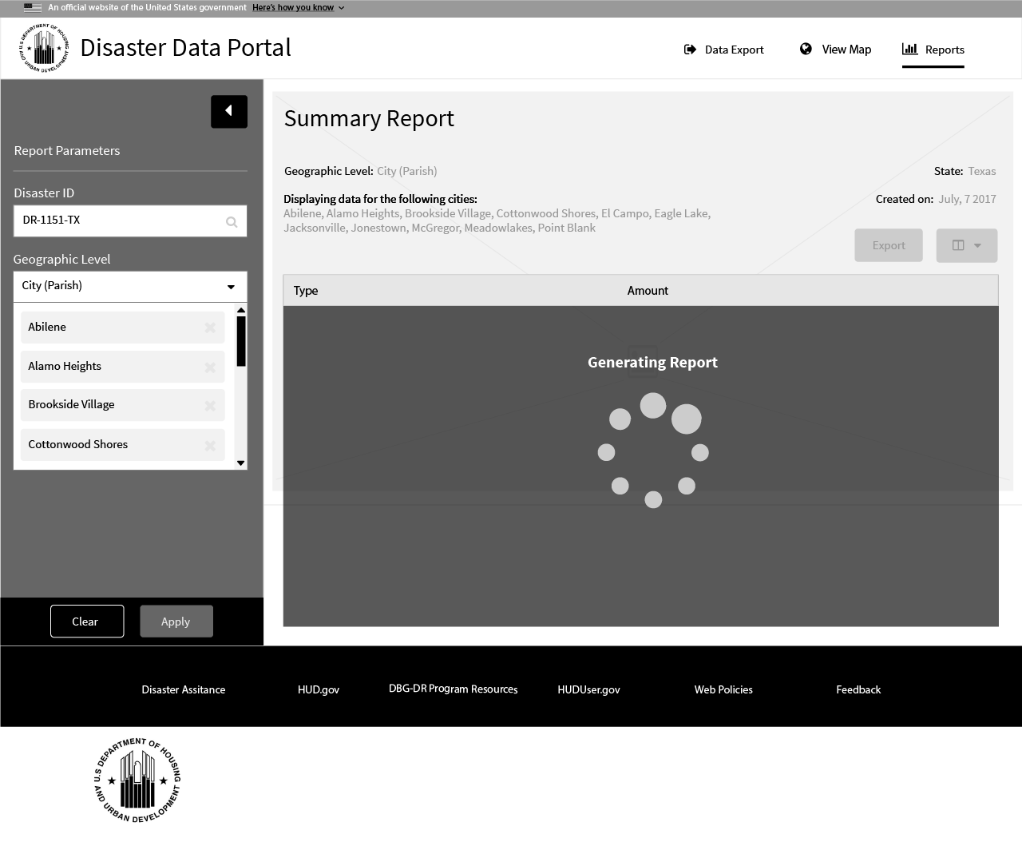
1 Disaster ID
1 Disaster ID

Slide 9
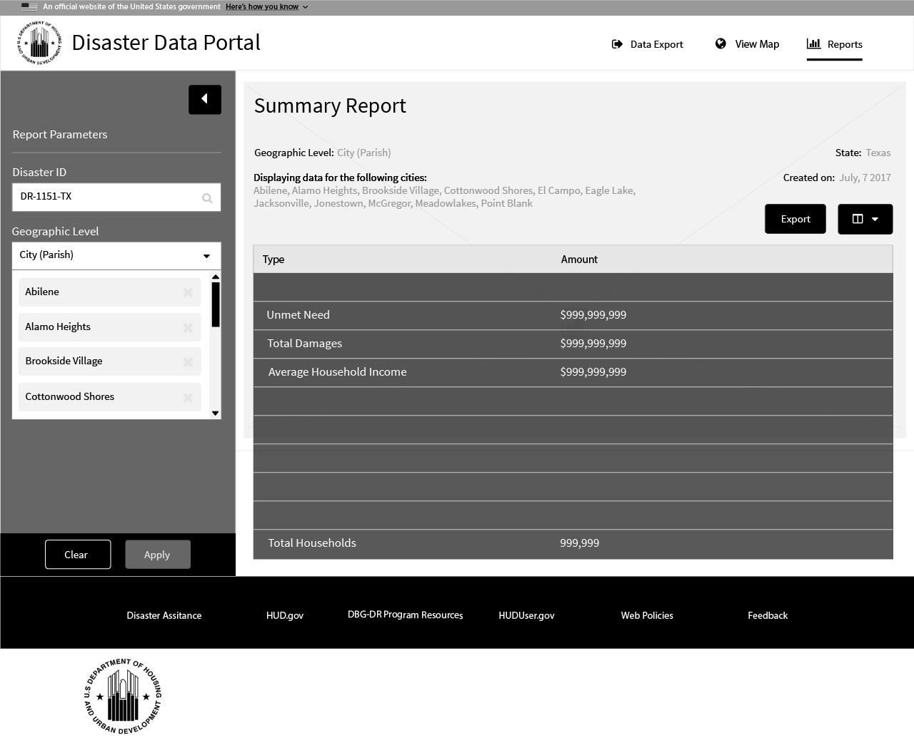
1 Disaster ID
1 Disaster ID

Slide 10
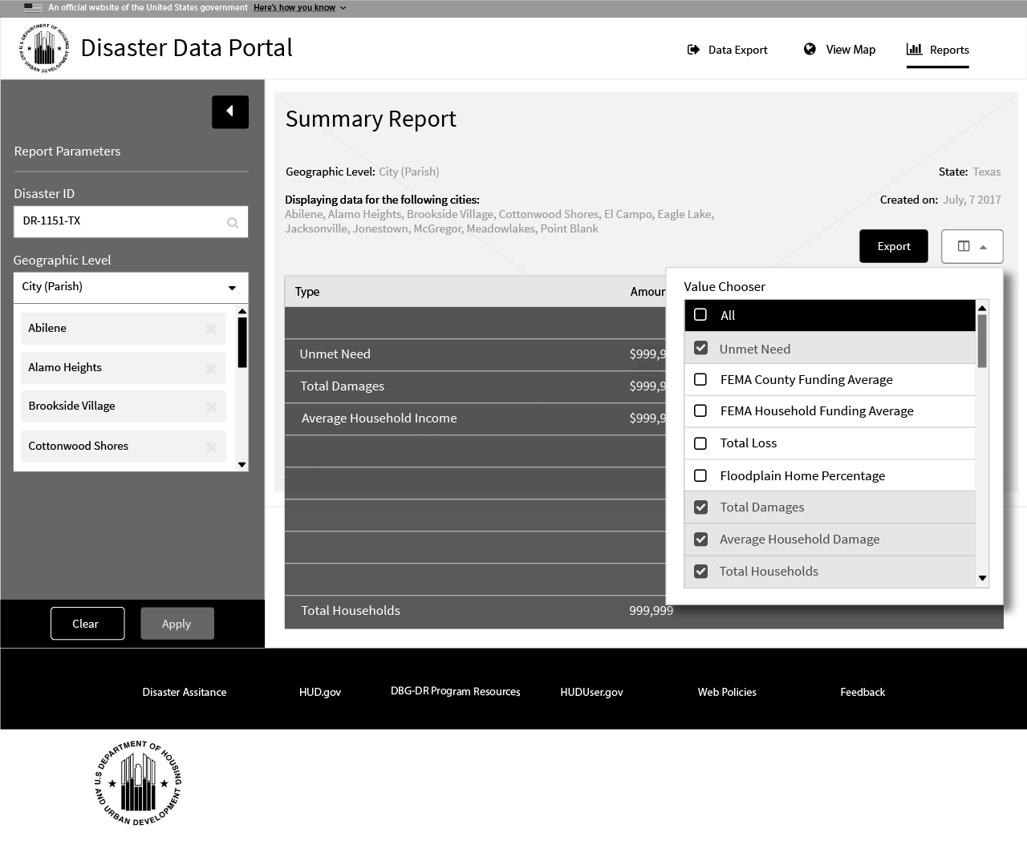
1 Disaster ID
1 Disaster ID

