Slide 1
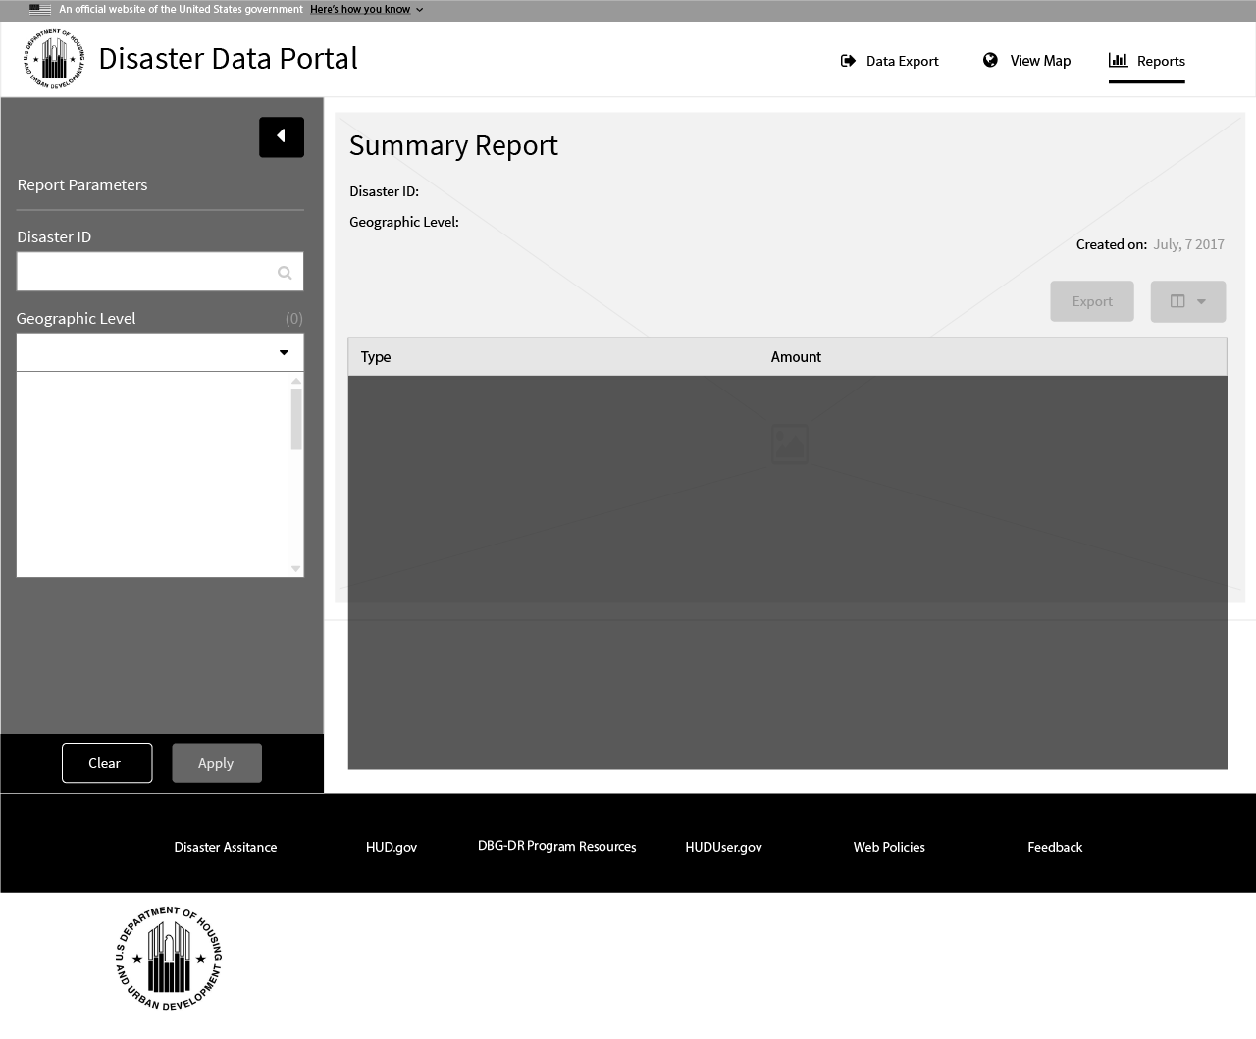
1 Report Creation Date
As the user lands on the reports page, the current
date is
1

Slide 2
1 Disaster ID
1

Slide 3

1 Disaster ID
2 Title
2
1

Slide 4
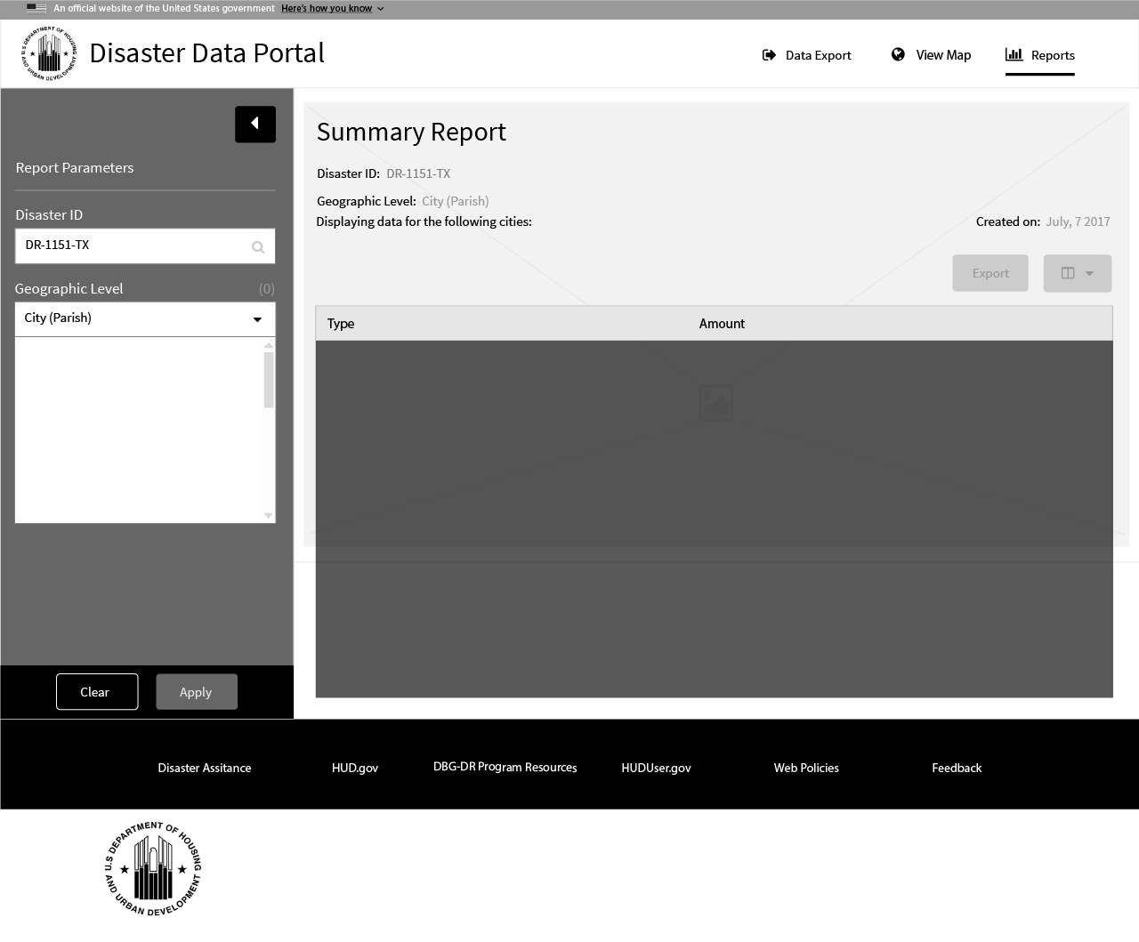
1 Geographic Level
2 Title
2
1

Slide 5
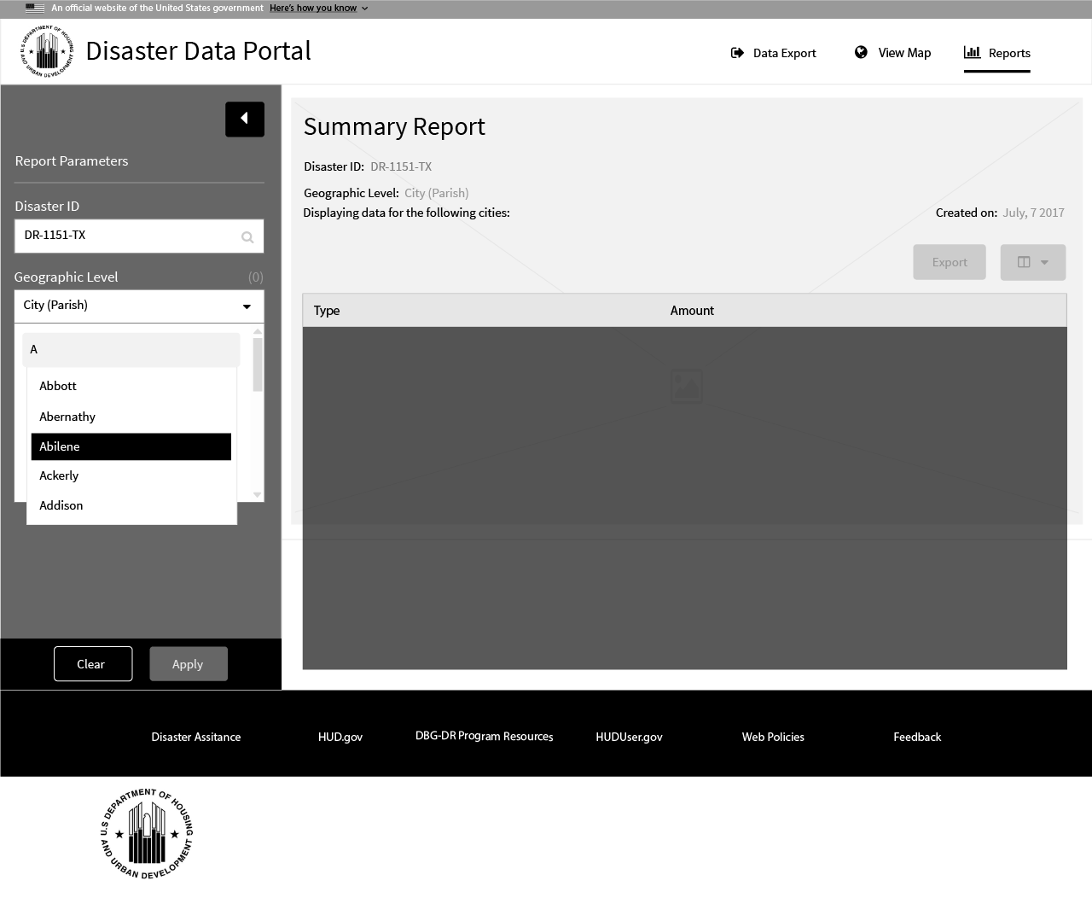
1 Geographic Selections
1

Slide 6
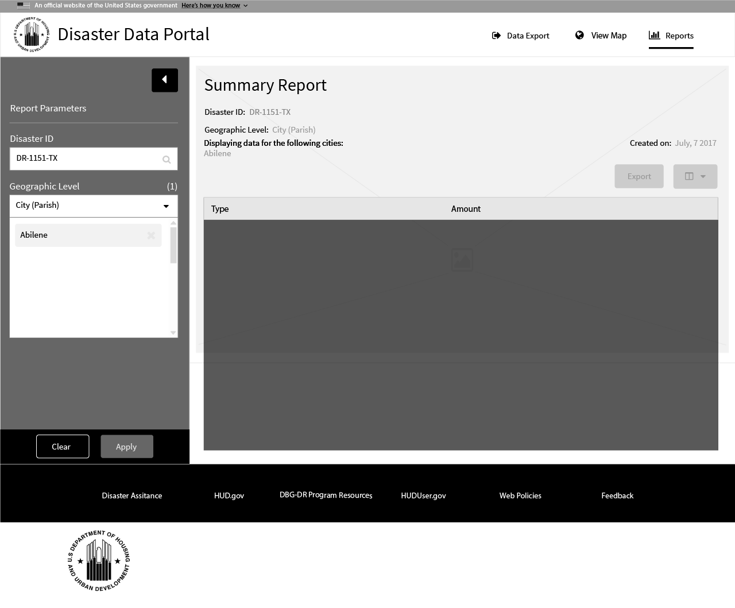
1 Geographic Selections
2 Title
3 Geographic Selections Count
2
3
1

Slide 7
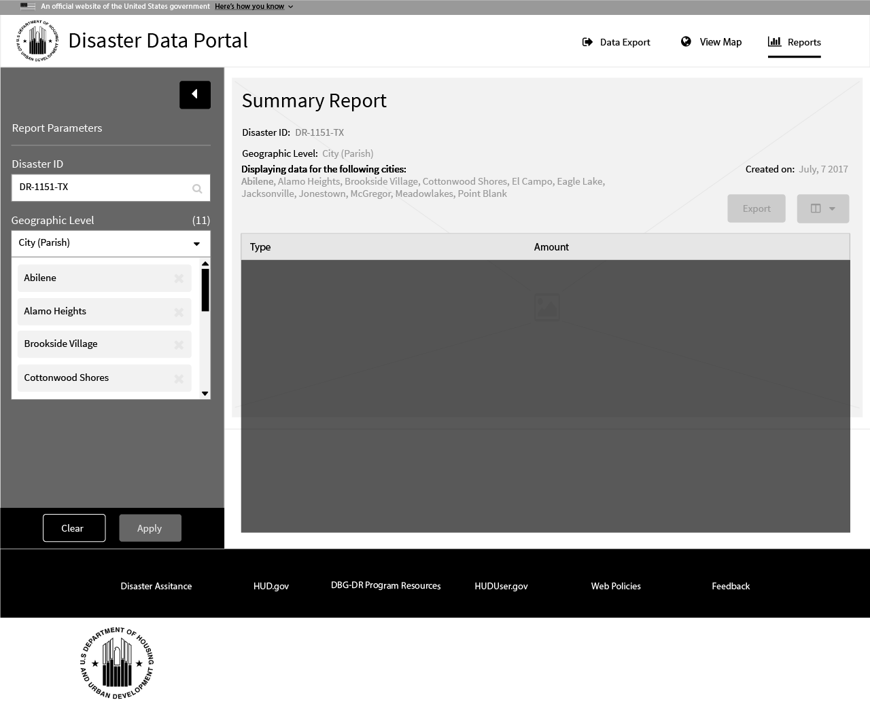
1 Geographic Selections
2 Title
2
1

Slide 8
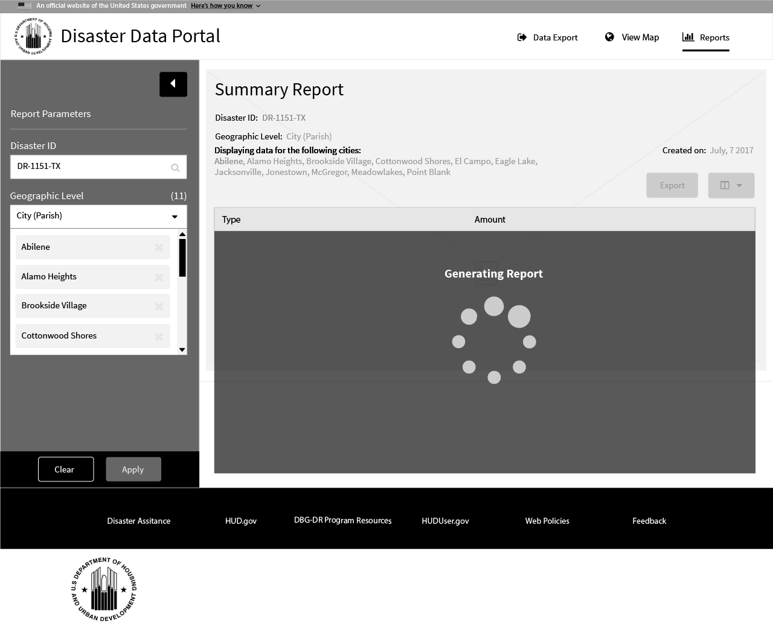
1 Action Buttons
2 Report Loading
2
1

Slide 9
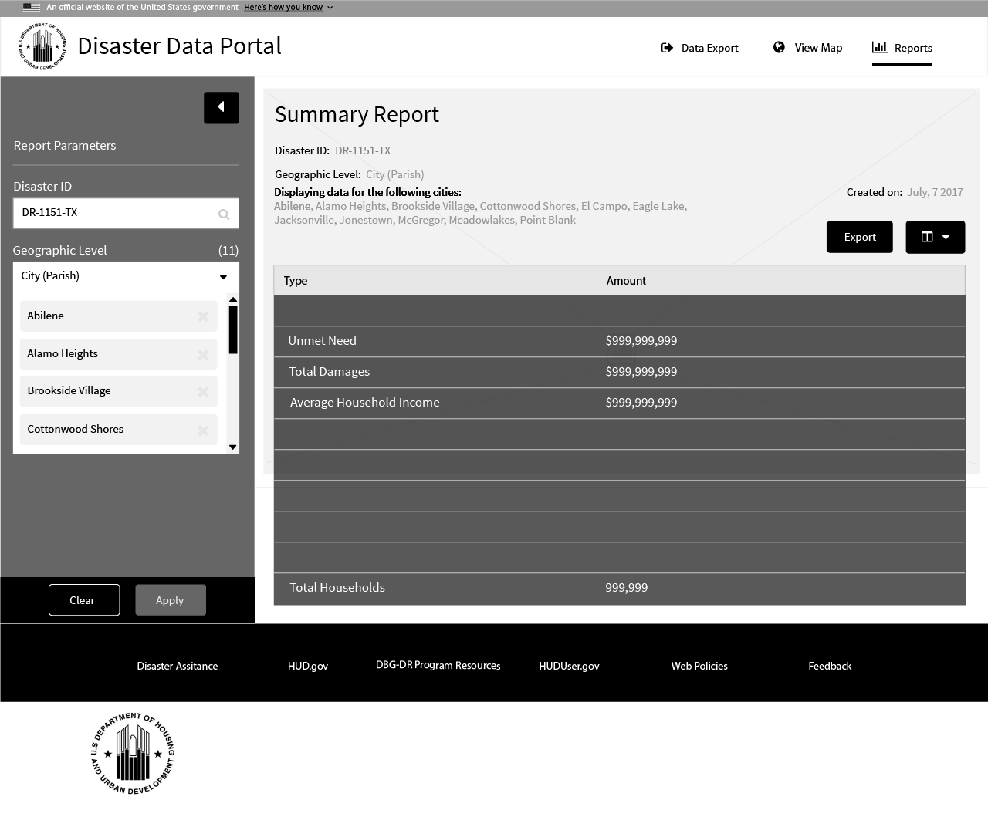
1 Report
2 Export/Value Buttons
2
1

Slide 10
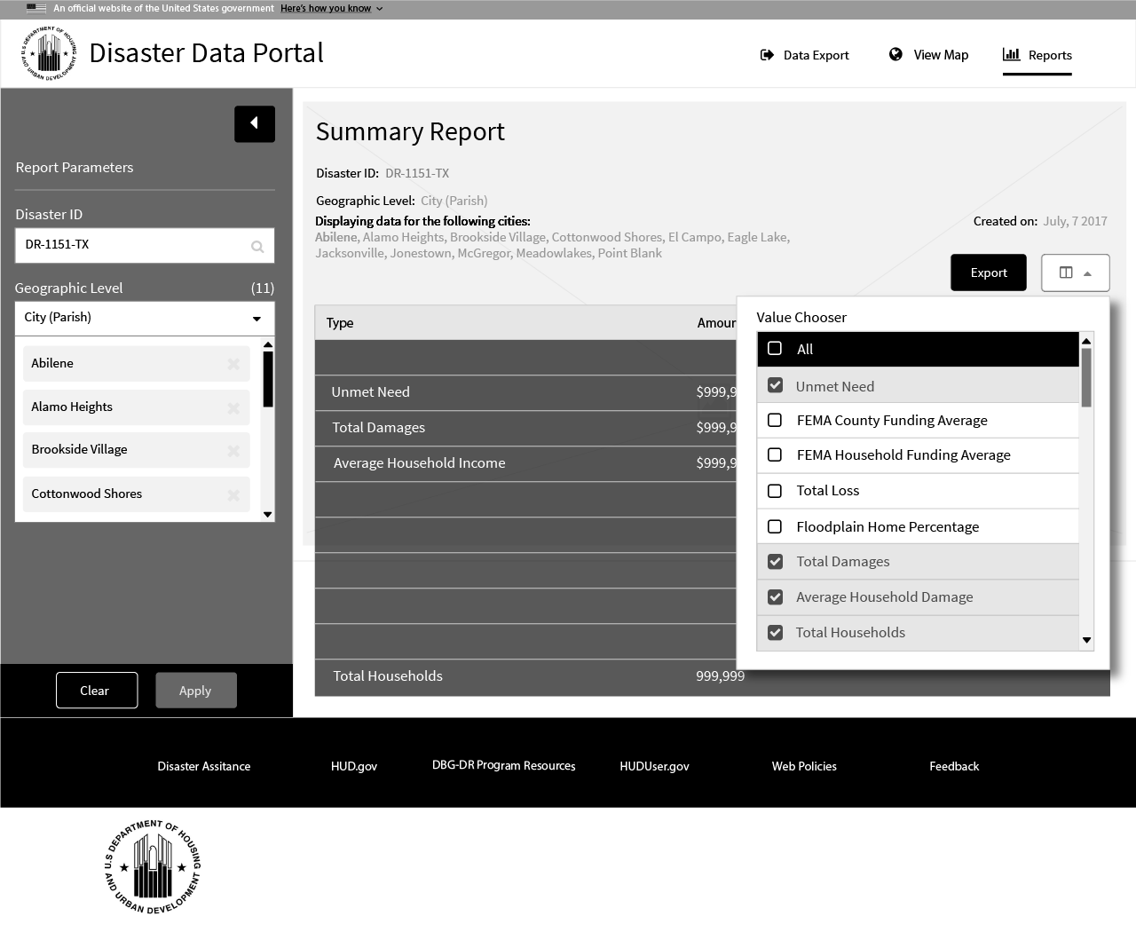
1 Value Button
2 Value Chooser
1
2

