Slide 1
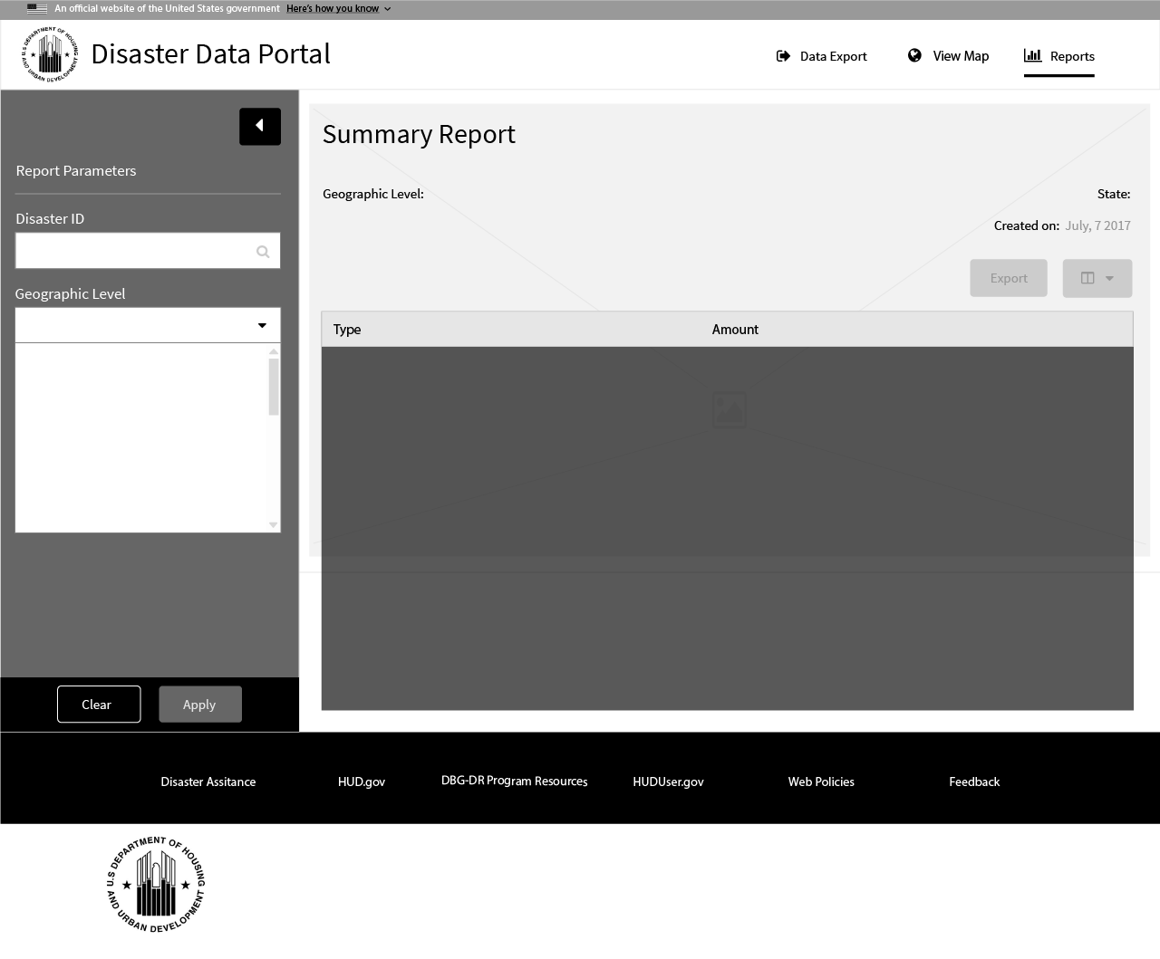
1 Disaster ID
User searches by entering a partial disaster id
Example: “DR”, XXXX”, “TX”, “DR-1”.
The disaster id is required before generating a report.
1
2 Apply Report Parameters Button
This button will remain disabled until the user has selected a disaster id preventing report generation errors from empty entries.
2

Slide 2
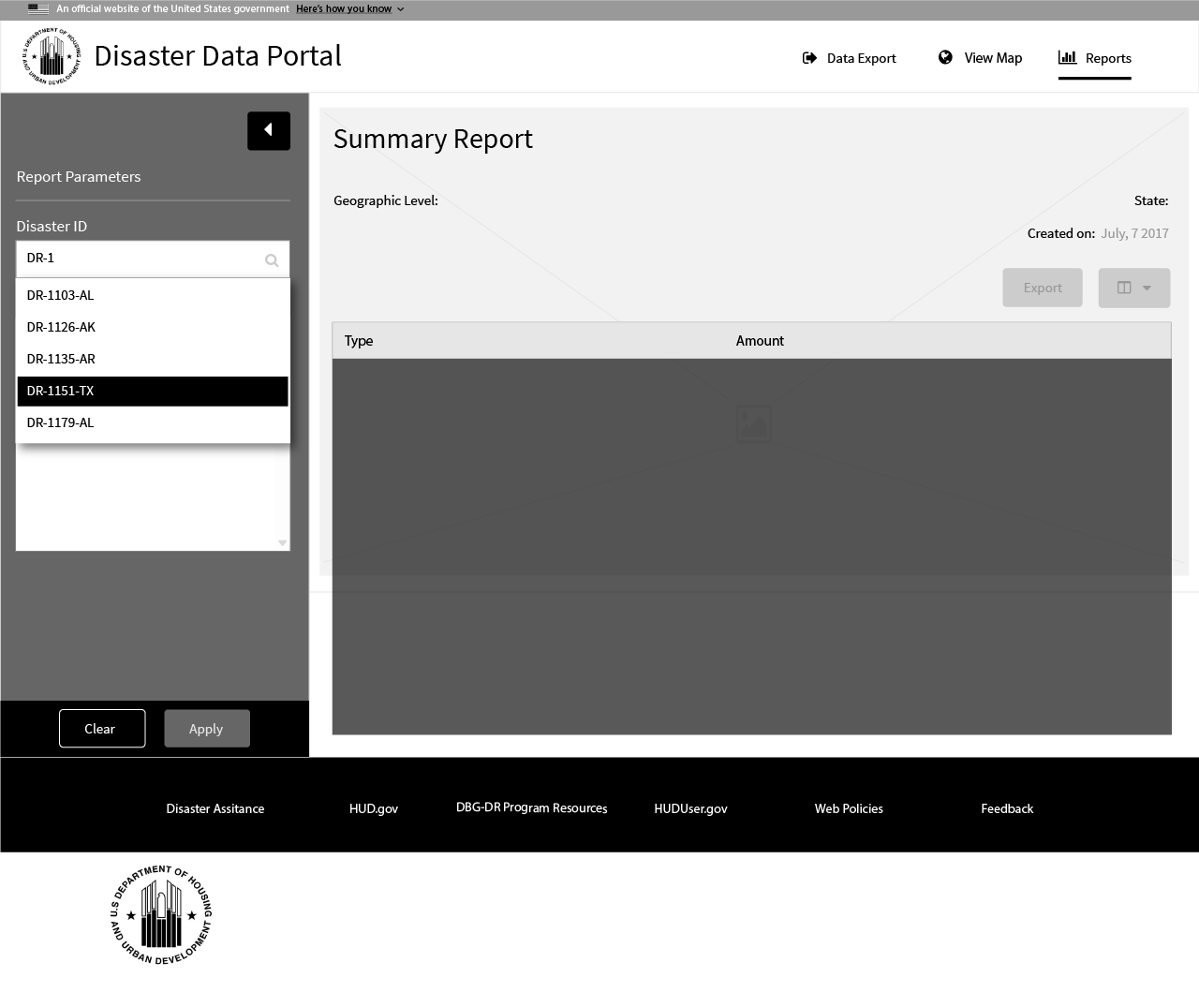
1 Disaster ID - List
The application will suggest possible disasters in which the user may scroll through or select.
The suggestions will be triggered on the 3rd character entry and will filter as more characters are entered.
1

Slide 3
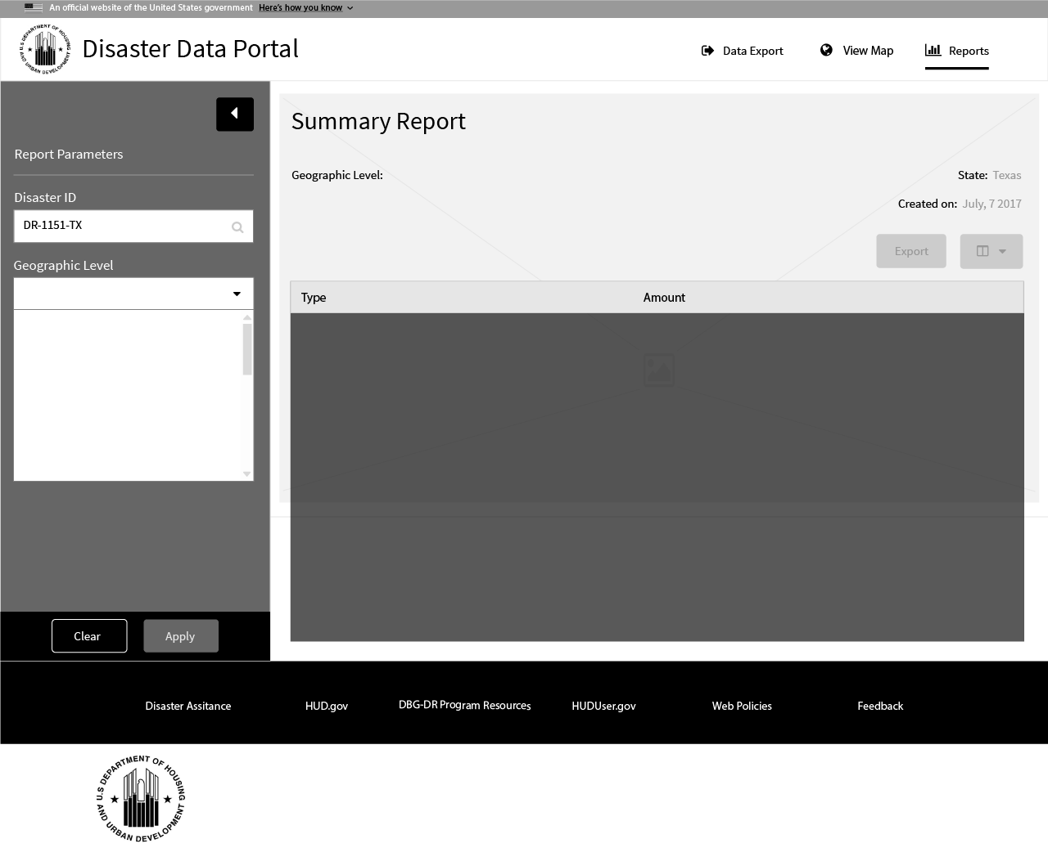
1 Disaster ID - Selected
In this example, the user has selected or entered the disaster id “DR-1151-TX”
1
2 Apply Report Parameters Button
Now that the disaster id has been populated, the apply report parameters button has been made active. The user may generate a report at any time.
2

Slide 4
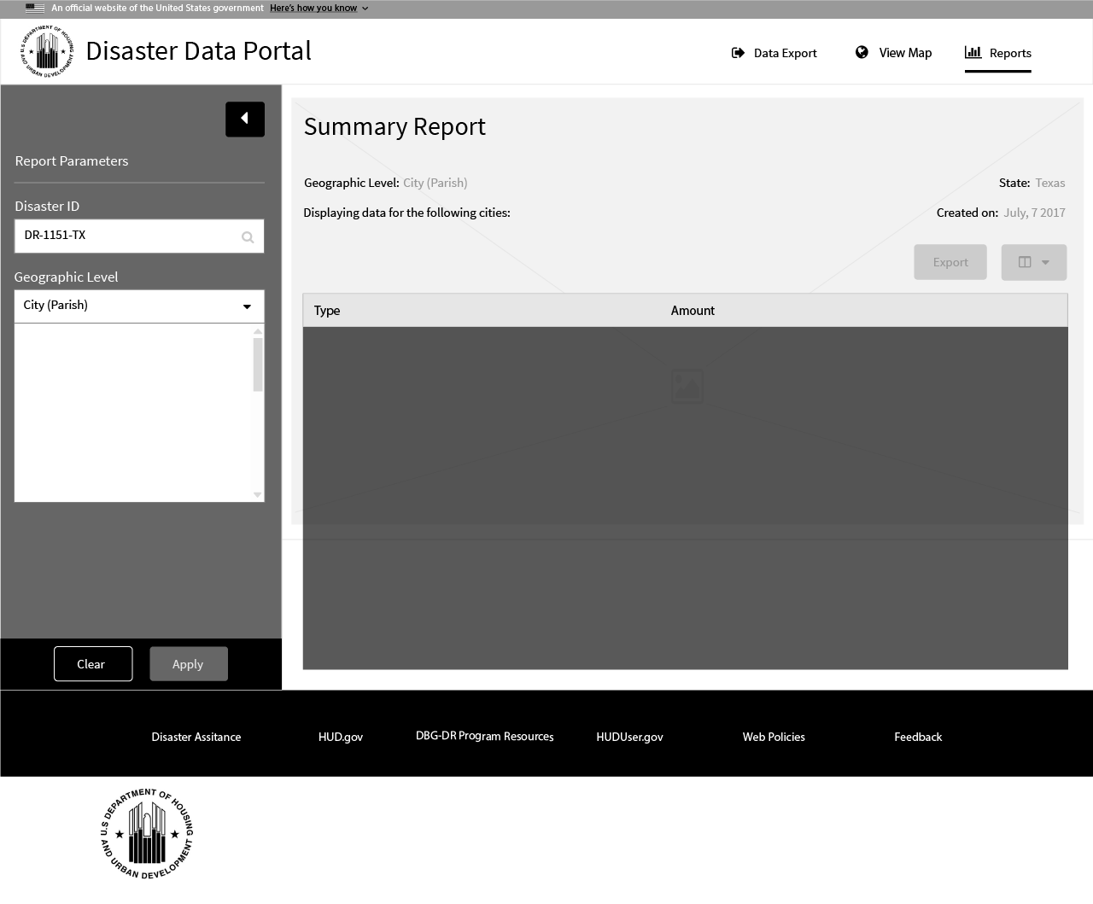
1 Geographic Level
User selects a Geographic Level. Possible values include; “City (Parish)”, “County” and “Congressional District”
2
3
1
2 Title – Geographic Level
Once a Geographic Level is selected, it will show in the title summary selection
3 Title - State
The state is derived from the last 2 characters of the disaster id (in this example it would be TX for Texas)

Slide 5
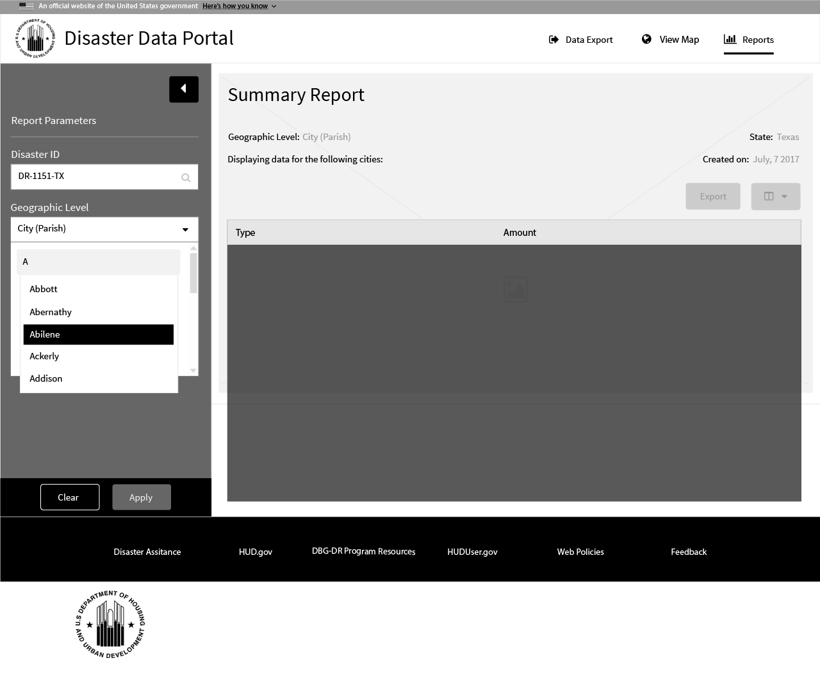
1 Locales
After a user has selected a geographical level, the will have the opportunity to select specific locales. Clicking inside the enabled list box will trigger a new tag-like list item.
As the user types in the tag, the autocomplete will once again make suggestions. The user can scroll and select from the suggested options.
1

Slide 6

1 Locales
Once a tag list item is completed, it will display in the summary title.
2
2 Title – Locale
An example of a user selecting the city “Abilene” as a locale.
1

Slide 7
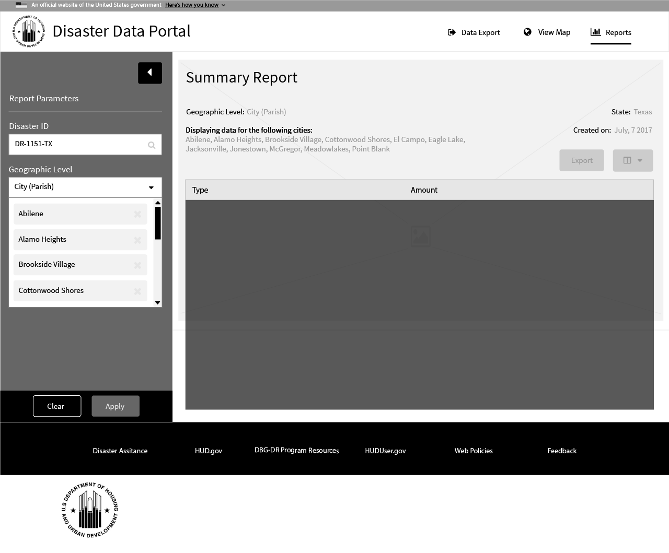
1 Locales
The user may enter as many as locales as they wish, narrowing down the summary data to specific regions of their choice.
2
2 Title – Locales
In this example, several locales have been selected and displayed in the summary title.
1

Slide 8
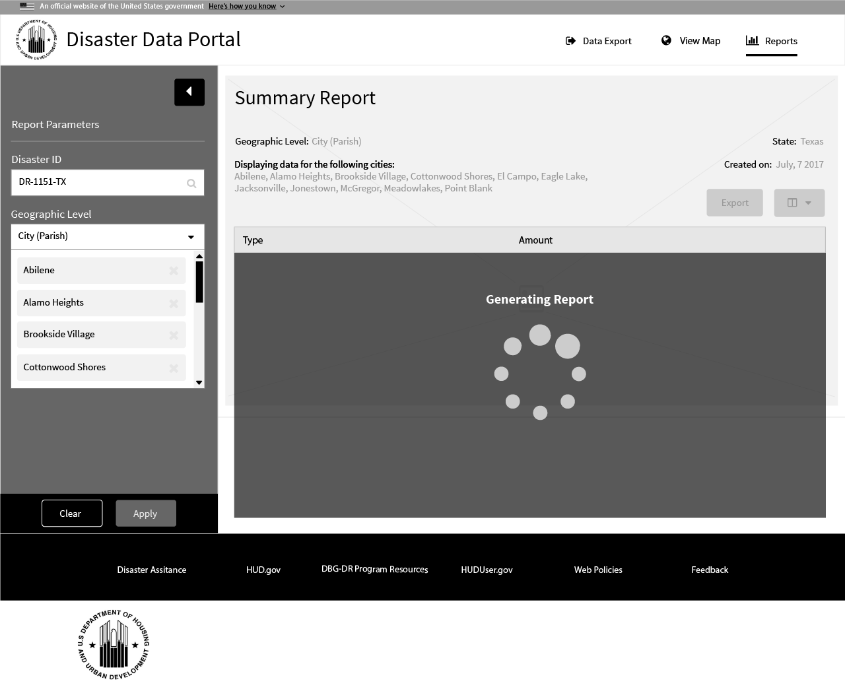
1 Action Buttons
The user has the option to clear all values within the report parameters input at any time or may generate a report after a disaster id has been selected.
2 Report Loader Animation
2
User searches by entering a partial disaster id
Example: “DR”, XXXX”, “TX”, “DR-1”
1

Slide 9
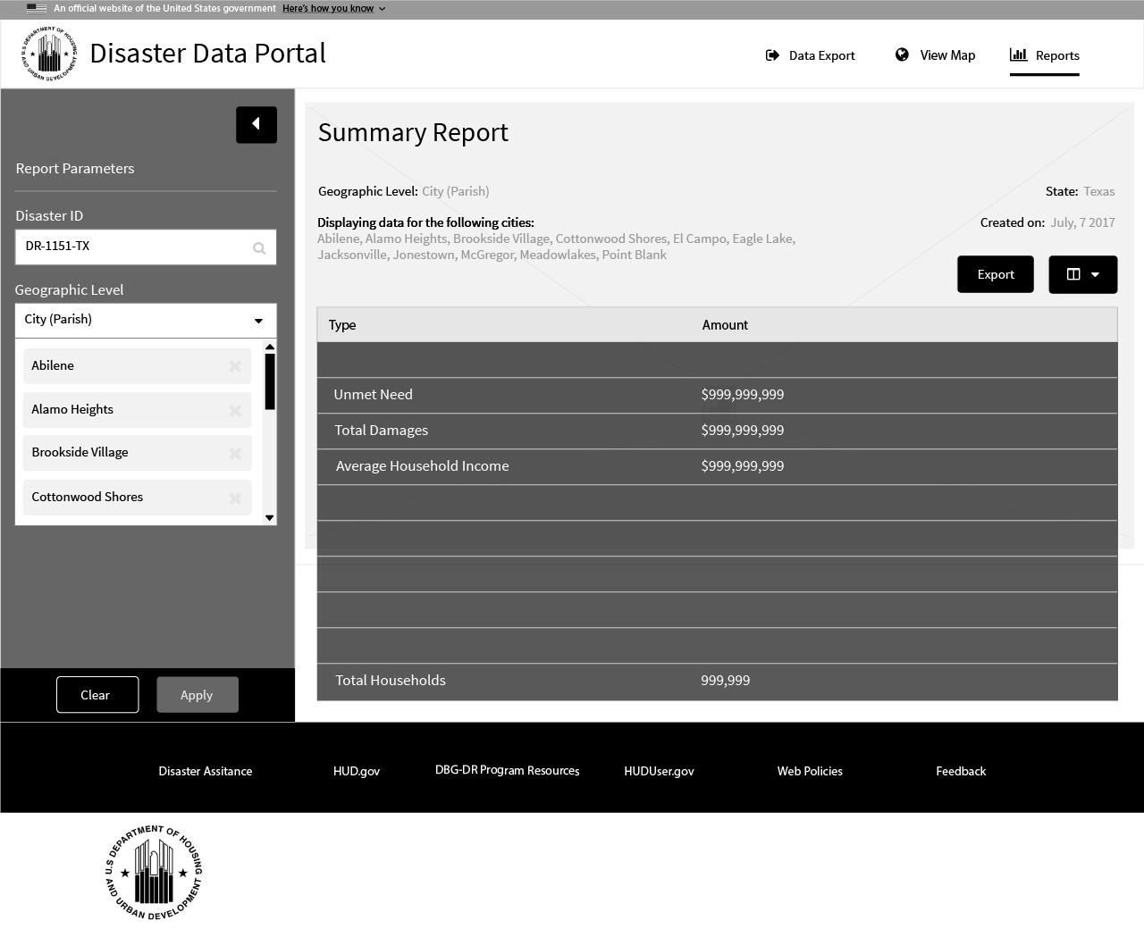
1 Summary Report
User searches by entering a partial disaster id
Example: “DR”, XXXX”, “TX”, “DR-1”
3
2
2 Export / Summary Value Chooser Buttons
1
Once the report has been generated, the Export and Summary Value Chooser drop-down will become enabled.
Clicking the Export button will trigger the system to create a .csv file which contains the summary report data as viewed.
3 Report Creation Date
Once the report has been generated, the “Created On” date will also be populated.

Slide 10
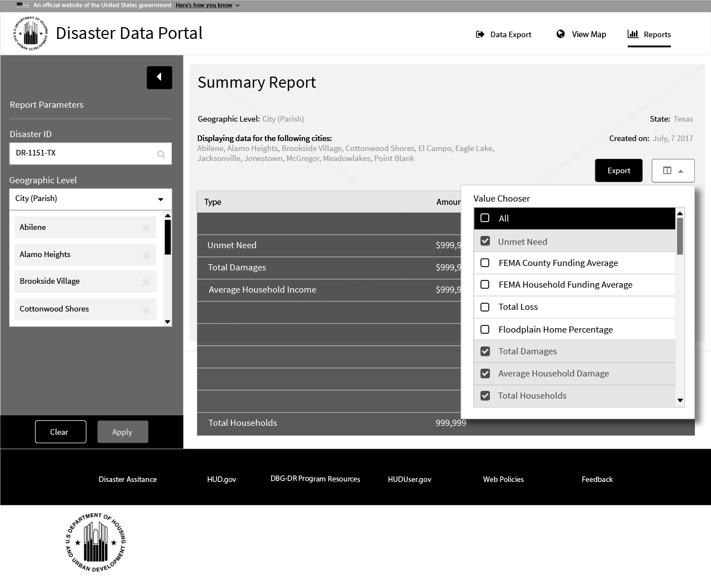
1 Summary Value Chooser - Button
The Summary Value Selector drop-down button displays the Value Chooser list.
1
2 Summary Value Chooser
2
The user may choose from the list of values to be added to the report. The default report summary values will be pre-selected.
Selecting values from the list will result in another report generation once the drop-down is closed.

