Slide 1
Quality Assurance Surveillance Plans
MESC 2019

Slide 2
Allows vendors to maintain momentum and know what’s important to the business
Allows the business to confidently accept the vendor’s work and know what kinds of changes/ fixes to ask for
Notes:
The QASP is a set of tools that are helpful for good oversight without affecting the development team’s velocity. It helps create a smoother working process that’s more informative. It’s about giving the business/government confidence that you’re getting quality software without necessarily requiring you be software experts; and also giving the vendor a clear set of quality metrics that they can work towards. Ultimately everything in the QASP is about getting quality, having confidence that we’re getting quality, and facilitating communication when we’re NOT confident.

Slide 3
1/ How might you really use it?

Slide 4
Acceptance
The vendor finishes up a sprint or other body of work and submits it for review
The government walks through the QASP and verifies that each element is acceptable
The government and vendor discuss any deficiencies and either fix them immediately or establish a plan for fixing them in the future
The new code is accepted and becomes officially part of the product 🎉
Notes:
Often we expect to accept work on a sprint-by-sprint basis, but it’s completely valid to accept work more frequently if you want. On the eAPD project, we “accept” work on a feature- or bugfix-basis, many times per sprint.
“Acceptable” is an important word here. We’ll walk through what the QASP elements might be in a minute, but it’s important to call out that nothing has to be perfect. “Good enough” is good enough. If there are slight deficiencies that you’re comfortable living with for now, you can still accept this work, and add those deficiencies to your backlog to be addressed in the future.

Slide 5
2/ Can I really judge software quality?

Slide 6
YES!

Slide 7
That’s what the QASP is all about: giving you the tools to evaluate software quality and discuss it with your vendor confidently
Notes:
It can definitely be scary if you’re not a software developer yourself, but that’s what the QASP is for.

Slide 8
The tools we’ll talk about work to ensure the product you’re building works well for your users and you can maintain it
Notes:
We want to actually see that the product works. We don’t want to see a bunch of reports about the product. The expression we use often is “demos, not memos.”

Slide 9
Which of these gives you more confidence?
✔ | Governance Quality Management Plan
x | Integration and Architecture Plan
✔ | Communication Management Plan
✔ | Risk and Issues Management Plan
✔ | Change and Configuration Management Plan
x | Post-Implementation Review Plan
✔ | Performance Reporting Summary
✔ | Training Plan
x | Disaster Recovery Plan
✔ | Business Continuity Plan
Notes:
This is just a list of documents. Does it make you confident that your vendor gave you a business continuity plan? Are you deeply concerned because they didn’t give you a post-implementation review plan? What even IS a post-implementation review plan?

Slide 10
Which of these gives you more confidence?
✔ | Governance Quality Management Plan
x | Integration and Architecture Plan
✔ | Communication Management Plan
✔ | Risk and Issues Management Plan
✔ | Change and Configuration Management Plan
x | Post-Implementation Review Plan
✔ | Performance Reporting Summary
✔ | Training Plan
x | Disaster Recovery Plan
✔ | Business Continuity Plan
✔ | App passes functional tests
✔ | App code is high-quality
✔ | App is accessible to users with different levels of ability
x | App is free of known vulnerabilities
✔ | App is deployed where people can use it
Notes:
Look what we know about the app! It passes functional tests! It’s high-quality! Oh look, there are security vulnerabilities. Is this more useful information for evaluating the software quality?

Slide 11
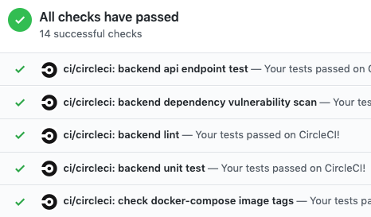
And you can really get that from automated tools
Notes:
This is a screenshot of a tool we use that generates that kind of checklist for us, automatically. Every time we make a change, the tool runs and updates this checklist. We can very quickly see what’s going on. This screenshot actually covers a few elements from the QASP, so let’s go ahead and dive into those.

Slide 12
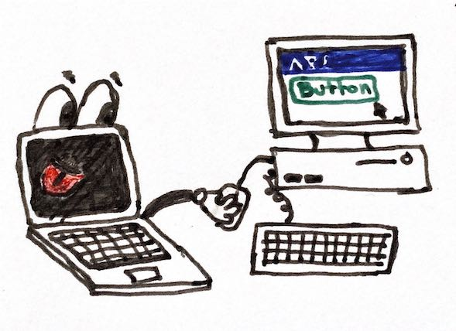
Tested code
QASP Elements
Refers to automated tests
The computer runs the tests automatically
Why does it matter?
Notes:
Automated tests are a batch of code that runs the app you’re building and verifies that it does what it’s supposed to. There are different kinds of tests, ranging from small tests that check one tiny piece of internal behavior to big tests that simulate a user clicking a button and verifying that the page changes correctly.

Slide 13
Tested code
Why does it matter?
QASP Elements
Confidence that the app works as intended
Helps guarantee that it will keep working correctly in the future
“Test coverage” is the percentage of code that is tested - require something reasonable, like 80-90%, for more confidence
Notes:
It’s reasonable to expect all kinds of tests because they’ll increase the likelihood that the code works as intended now and also be more helpful at catching future bugs! If a test works today, but next week it suddenly starts to fail, that indicates a new bug was introduced. As a developer, there’s nothing quite so cool as having an old test catch a new bug for me, but that’s also true for you, the government product owner.
How do you check it? Well, your vendor will write the tests and set up the automation, so all you should need to do is look at the checklist and make sure it’s green. If it’s not, you know that’s something to talk to your vendor about.

Slide 14
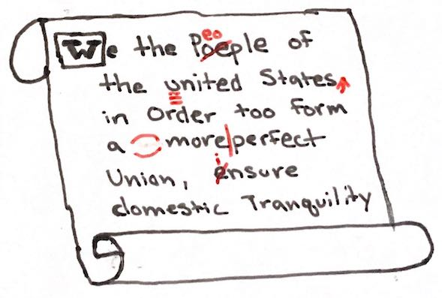
Properly styled code
QASP Elements
How the code itself is written
It’s like grammar for software code
Why does it matter?
Notes:
Properly styled code is about how the code itself is written. Think of it like grammar. Basically what this is saying is that the code should be consistent and it should stick to common patterns and best practices. This is something that most people will never see, really only the developers, but it’s pretty valuable.

Slide 15
Properly styled code
Why does it matter?
QASP Elements
Confidence that the code follows best practices, uses standard patterns, is consistent, etc.
Ensures that other developers can pick up the code quickly and easily, including possibly other vendors
Can also be tested with automated tools
Notes:
This one ends up mostly being for the benefit of developers, but that has the side effect of making it easy for new developers to join the project.
One problem with code quality comes down to consistency within the code itself. Because you likely have multiple developers working on the code, it’s easy for their individual styles to seep into the code and create inconsistencies. They may be small differences, but it can be a nightmare for a new developer joining the project, or even for your existing developers moving around within the code.
Properly styled code is about enforcing a standard on the code. The team decides on their standards and then automated tools enforce that for all of the code. You don’t need to be prescriptive about what the code standards are, you just want something and you want the code to adhere to it.
You check this one basically the same way - checking the style should be part of your automation and you should just be able to look at the checkmarks.

Slide 16
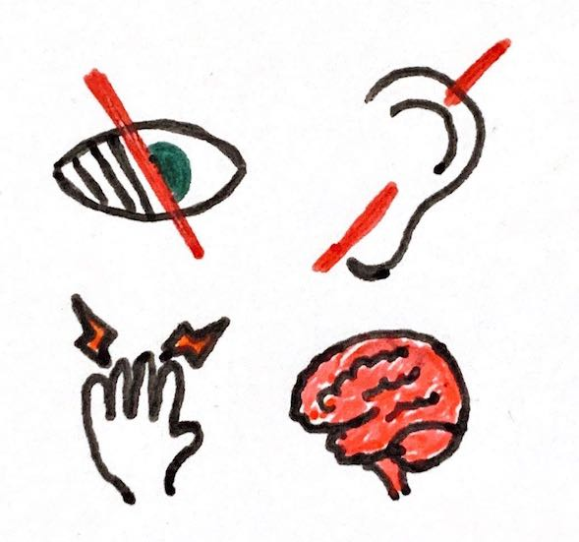
Accessible
QASP Elements
Everyone, including people with disabilities, can use the app
Why does it matter?
Notes:
Accessibility is about making sure everyone can use your app, regardless of their abilities or disabilities. So taking into account how a non-sighted person, or a person with arthritis, or a person with a cognitive disability can navigate through the app and successfully do what they need to do.

Slide 17
Accessible
Why does it matter?
QASP Elements
It’s simply the right thing to do, and practically everyone will experience disability at some time in their life
It’s the law - the Americans with Disabilities Act requires local, state, and federal government services to be accessible to everyone, and that includes websites
Can be partially tested with automated tools, but also requires manual testing
Notes:
Making your app accessible is just the right thing to do, right? And keep in mind that pretty much everyone will experience disability at some time in their life, even if it’s temporary. Like maybe you lost your glasses so you need to make the font bigger to read your screen, or you sprain your wrist so it’s hard to move your mouse and you need to navigate with the keyboard. It really does happen to all of us at some point or another, so when we talk about a site being accessible to people with disabilities, we really mean everyone.
It’s also the law. If you’re a government entity in the United States providing a service to the public, you must accommodate people with disabilities. The Department of Justice has repeatedly said that includes websites.
This one can’t be 100% tested with automated tools. There’s just no way to do it. For example, non-sighted users may rely on a screen reader to announce what’s on the screen. Automated tools can’t “listen” to the screen reader and be sure that it’s saying the right things. Automated tools can do some of the testing, maybe about half, and the rest will need someone who’s been trained. But it’s a completely worthwhile investment, and there are plenty of vendors out there that can do accessibility assessments for you, or your own staff can take training - the Department of Homeland Security offers a free training program called Trusted Tester.

Slide 18
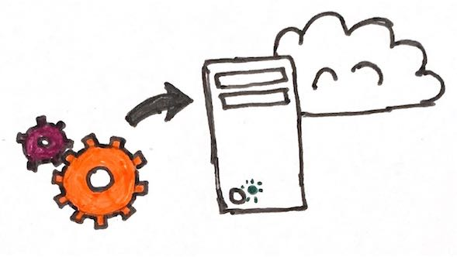
Deployed
QASP Elements
The app is online somewhere real users can use it
Deployment is automated, not a manual process
Why does it matter?
Notes:
Deployment is about putting the app somewhere in a state that people can use it. So if you’re building a website, for example, it’s deployed if you can type an address into your browser and see the site. The deployment process should be automated, not something someone sits down and does manually.

Slide 19
Deployed
Why does it matter?
QASP Elements
Enables demos, functionality review, and usability research
Automated deployments are repeatable, removing human error from the process and reducing risks of app updates
Repeatable deployments make it easy to have multiple unique environments - just reconfigure it!
Notes:
If your app isn’t running somewhere you can see it, you can’t demo it! You can’t check that it works like you want it to! You can’t do usability research on it! It has to be somewhere.
Manual deployments are scary. I’ve done them, and I hate them. There are a few steps and if you forget one or do it wrong, you could break everything. You could lose data! With automated deploys, once you get it right, it’s right every time thereafter, which is pretty awesome.
And once you’ve got it deploying, you can have multiple environments. An environment is all of the components necessary to run the app - infrastructure, databases, networks, and so on. So production is one environment, where your actual users are getting the services they need. Another typical environment is called “staging” - it’s identical to production, but it has the very latest code running on it. Staging is important because it gives you confidence that everything works in production. Your developers’ computers are very different from the computers where the app gets deployed in production, so a lot of quirky things can go wrong between their computers and the deployed ones. To mitigate that, you deploy to staging first - and when everything works well there, you can be confident it’ll also work well in production because they’re identical.

Slide 20

Documented
QASP Elements
The technical details of the app are documented
The code is internally documented
Why does it matter?
Notes:
The technical details of the app include things like a list of the major frameworks that it uses, system diagrams, data diagrams, and things like that. And internally, the code can have more technical documentation as well, written right into the code, explaining what individual chunks of code do.

Slide 21
Documented
Why does it matter?
QASP Elements
Having technical details documented helps future developers quickly get an understanding of the “big picture” of the app
Internal documentation helps future developers understand the code so they can make smart decisions when changing it
Makes it easier for new developers to start working on the code, whether the same vendor, a new vendor, or even in-house talent
Notes:
This slide mostly talks about the benefits from a developer perspective, and that’s important. Documentation will help new developers get up to speed more quickly, both with the “big picture” of the app - what it’s built with, what its internal components are, how they’re hooked up. It also helps when they get into the code and start making changes - having documentation in there helps them understand why the code is the way it is, and helps prevent mistakes or bugs.
All of this makes it easier for new developers to come onto the project. That could be someone leaving the vendor and a new person joining the team, it could be switching our vendors entirely, or it might even be you have some developers in-house and you have them pick up work. It gives you some freedom and flexibility.
Another thing I didn’t put on this slide is that good documentation suggests something about the quality of the code. Really good documentation indicates a deep knowledge of the code, and also clean code that makes sense. So in a way, documentation can be a proxy for measuring code quality.
You should be able to read this documentation yourself, particularly the high-level documentation, and make some sense of it. It’s okay if you don’t understand all of it! But if you get completely lost, that’s worth talking to your vendor about. They should be able to explain everything, and maybe even revise the documentation.

Slide 22
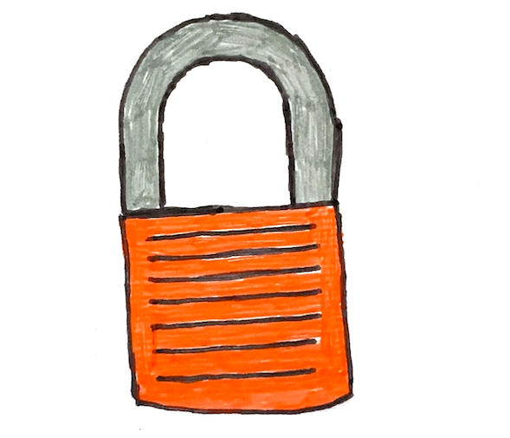
Secure
QASP Elements
The app doesn’t have any known vulnerabilities
Data is safe and only accessible to authorized people
Why does it matter?
Notes:
Security is about protecting the app in your data and keeping it available so your users can use it. The fundamental goal is to make it difficult enough to access your app or data that it’s just not worth the effort. For example, if you’re storing something like credit card numbers, it might be worth an attacker spending 6 months on it, so your security needs to hold up longer than that.

Slide 23
Secure
Why does it matter?
QASP Elements
Secure apps are more likely to stay available because attackers are less able to make them crash
Your data is more likely to be safe
Your users are also at lower risk of things like identity theft since your data is their information
Can be tested with automated tools
Notes:
An attacker breaching your app can crash it, potentially disrupting critical services to people who need them. It can also result in your data being lost, which could have cascading effects - what if part of the data they get is your credentials to other systems? In what I think is the worst case, a successful attack can put your users at risk of harm. Ultimately most of the data you’re holding is users’ information, and losing that data could expose them to things like identity theft or credit card fraud.
A lot of security can actually be tested with automated tools. Not everything, but a lot. There are tools that can scan an app for classes of vulnerabilities, identifying problems before you even deploy the app. There are tools that can look at all the 3rd-party libraries your app uses and check them for known vulnerabilities too. Another checkmark on your checklist!

Slide 24
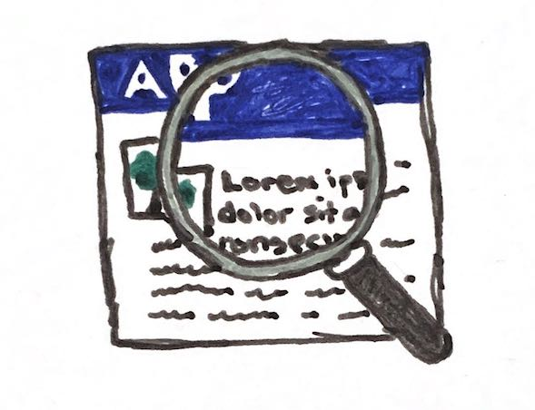
User research
QASP Elements
Users and their needs drive app development
Users get to provide feedback regularly
Why does it matter?
Notes:
Usability research is talking to users to understand their needs. It can take a variety of forms, such as talking to users just to hear about what their problem is and maybe how they think about solving it, or sitting with them as they use your app and seeing how they work through it.

Slide 25
User research
Why does it matter?
QASP Elements
If you don’t know what users need, you can’t really know what to build for them
If users aren’t regularly testing your app, you’re just guessing that you’re building the right thing
Software built without user research can result in an experience that’s even more difficult or confusing than users’ current solution
Notes:
You really need to understand your users’ problems. What are they trying to solve? How do they conceptualize their problem, and how do they think about solutions? That will tell you a lot about what you need to build. Then as you build it, let them use it and see how they interact with it. That will show you whether you’re building something that solves their problem. Without user research, you could easily end up building an app that’s complicated or confusing that makes the problem even harder for your users.
For this one, just ask your vendor if you can ride along when they do usability research sessions. You don’t need to participate, you can just be a silent observer. And when the vendor completes their research synthesis, you can review that and use what you learn to influence your future planning!

Slide 26
Thanks!
Contact 18F@gsa.gov
Follow @18F
Work Together github.com/18F

