Slide 1


USWDS Monthly Call
April 2021
1

Slide 2

Hi!
Thanks for being here!
2
Notes:
Slide 2. My name is Dan Williams, and I'm the USWDS product lead. Thanks for being here!
First, I'd like to mention that we're recording this monthly call, and — as always — we post these recordings to YouTube, so please refrain from turning on your camera. We will manually turn off any cameras to ensure the recording doesn't show us on camera.
We'll be posting links and references into the chat as we go along, and I encourage you to ask questions in the chat at any time. If any member of our team can answer your question in the chat, we'll do so, otherwise there'll be some time for question and answer at the end of the hour. Also, be sure to introduce yourself in the chat as well — it's nice to know who's here. It's good to have you here today.
Also, as you may have noticed, I've been reading out the slide numbers. While that may strike you as a bit odd at first, I hope everyone gets used to it as the show goes on. We're always trying to make what we do more accessible, and we're trying to apply some of the lessons we've learned from U.S. Access Board to do the same for our presentations. To that end, I'll be reading out slide numbers as we go — and I'll also try to talk a bit slower and be a bit more descriptive of the slides and images on the screen. A bit like audio description, if you've ever used it for movies and television. Personally, I've grown to love audio description with television, and perhaps this extra effort will make the call seem a bit more like a podcast. And if not, at least we'll learn something in the process.
So thanks! And, with that, let's get started!

Slide 3
A quick poll
Are you currently using USWDS code in a project?
Yes, enthusiastically!
Yes, begrudgingly.
No, but soon!
No, unless you can convince me in the next 30 minutes.
No. Just no. Someone forced me to attend this call.
3

Slide 4
Agenda
Site launches Product updates Why use USWDS? Q&A
4
Notes:
Slide 3. So what's our agenda for today?
[CLICK]
First, as always, we'll show off a few nice new site launches.
[CLICK]

Slide 5
Site launches
Notes:
Slide 4. Let's enjoy some new site launches.

Slide 6
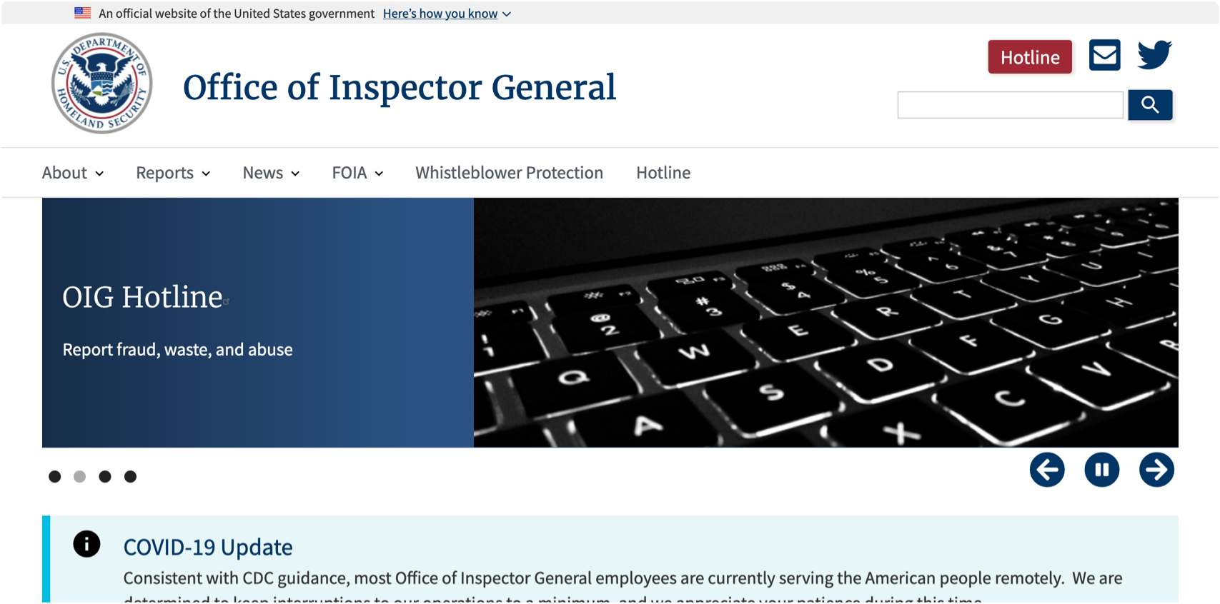
Department of Homeland Security Office of Inspector General
oig.dhs.gov

Slide 7
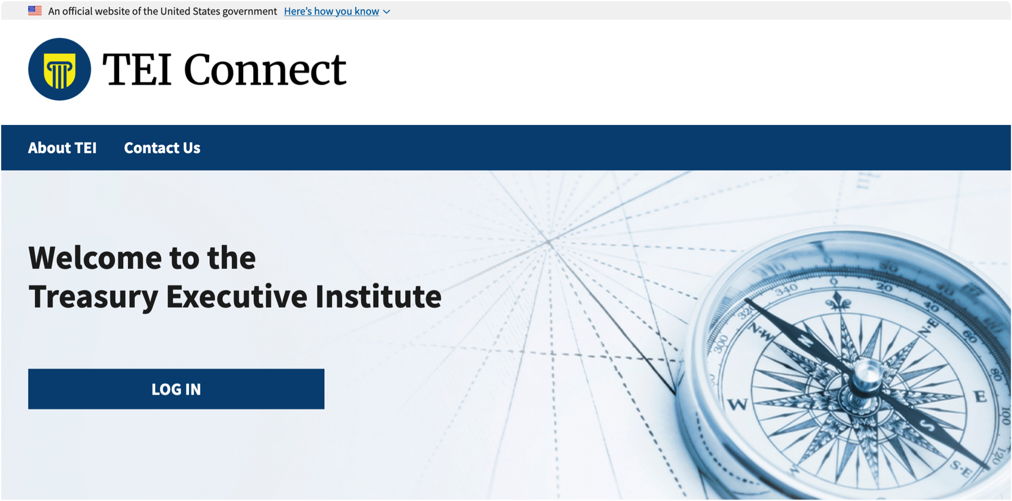
Treasury Executive Institute
home.tei.treasury.gov

Slide 8
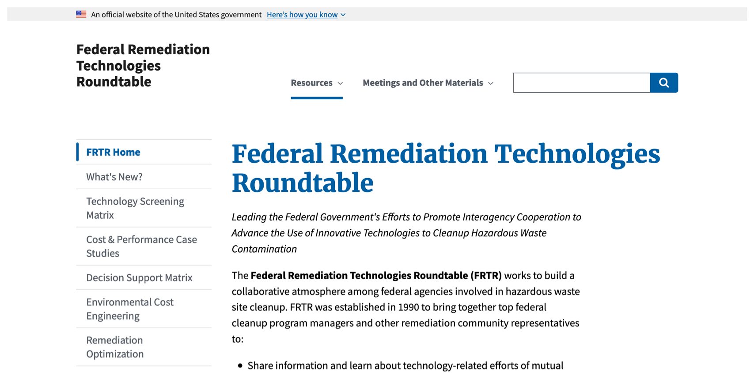
Federal Remediation Technologies Roundtable
frtr.gov

Slide 9
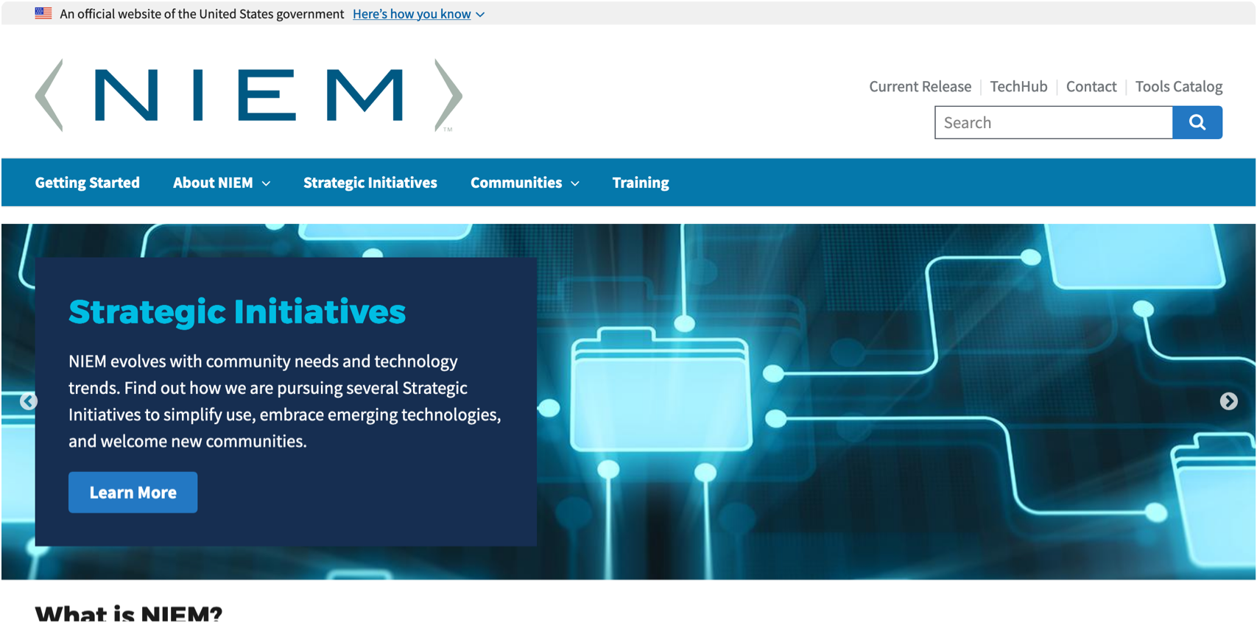
National Information Exchange Model
niem.gov

Slide 10
Great work!
Notes:
Great work everyone! Be sure to let us know when a new site launches, either with an email or a note on the USWDS Slack.

Slide 11
Product updates
Notes:
Slide 9. Product updates. Now, let's take a look at what's new in the world of USWDS.

Slide 12
Sketch and Adobe XD Design Kits
12

Slide 13
Why use USWDS?

Slide 14
A few great reasons to use USWDS
More than a design system, it’s a design system builder.
It’s designed with an expressive balance of consistency and customization.
It’s an effective way to communicate design guidelines and decisions to your team.
USWDS design tokens make design choices faster.
It’s built to implement iteratively, alongside other frameworks or existing design work.
Its common design language helps teams communicate more effectively.
Notes:
So why use USWDS? [read slide]….

Slide 15
But today we’ll look at some the core values USWDS delivers to government teams.
Notes:
Those are all important reasons to use USWDS — and they may have contributed to why your team uses the design system. But today we’re going to look at a few of the core values USWDS delivers to government teams.

Slide 16
This is where we’ll invest our time and effort.
Notes:
These fundamental values and benefits not only help explain how and why USWDS is the right decision for government teams, but it’s also a guide to how we, as a product, invest our time and effort. Since, these are not just customer benefits…

Slide 17
These are core product goals.
Notes:
…but they are core product goals.

Slide 18
Stay humble and honest.
Notes:
So our challenge, as we make the case today, tomorrow, and into the future, is to stay humble and honest with ourselves — to be able to evaluate internal and external feedback — to listen to our users and our metrics — to understand how well our product is living up to these goals.

Slide 19
We know we can always do better.
Notes:
Because we know we can always do better.

Slide 20
Why use USWDS?

Slide 21
1. Compliance from the start

Slide 22
1. USWDS is a government team that understands what government teams need.

Slide 23
We’re here to serve federal government teams. Exclusively.

Slide 24
Built-in compliance out of the box

Slide 25
Section 508 PRA ATO M-17-06 Connected Government Act 21C IDEA

Slide 26
This is the language we speak. This is what’s built into our product.

Slide 27
And we’ll answer your phone calls.

Slide 28
2. Proven designs users expect

Slide 29
2. Don’t reinvent the wheel when it comes to buttons, forms, and other common elements.

Slide 30
How many times do we have to see that image of those dozens of government buttons?

Slide 31
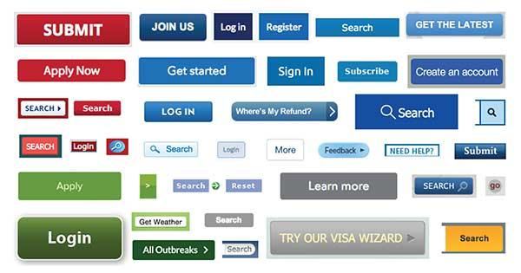
Who can forget the grid of government buttons?

Slide 32
Folks don’t want to be wowed, they want to be done.
Notes:
With rare exceptions, the people who visit government websites are less interested in engaging, dynamic experiences, than in completing a task and getting on with their lives. As a general rule, we should be striving for “obvious” not “interesting”.

Slide 33
We shouldn’t use public resources to reinvent the wheel.

Slide 34
3. Team alignment and common goals

Slide 35
3. Using USWDS strengthens team agreements to common principles and human-centered design.

Slide 36
Anyone using USWDS commits to common design principles.

Slide 37
Start with real user needs.

Slide 38
Earn trust.

Slide 39
Embrace accessibility.

Slide 40
Promote continuity.

Slide 41
Listen.

Slide 42
Using USWDS puts this commitment in writing from the start.

Slide 43
3. Mission focus

Slide 44
3. Using USWDS helps you focus on your mission, not your markup.

Slide 45
Start faster.

Slide 46
Test faster.

Slide 47
Ship faster.

Slide 48
Get off the redesign treadmill.

Slide 49
Use us. Blame us. And move on.

Slide 50
5. A cross-functional design system community

Slide 51
5. Break down silos and grow your skills alongside other web professionals across government.

Slide 52
Connect with colleagues across the federal government

Slide 53
Share solutions

Slide 54
Share expertise

Slide 55
Share the pain

Slide 56
Learn about updates, bug fixes, and beta programs

Slide 57
Talk directly with the USWDS team

Slide 58
6. Effective stewardship

Slide 59
6. Improve performance, efficiency, governance, and institutional memory.

Slide 60
Meet expectations. Share solutions. Build for the future. Enhance the public good. Be efficient. Get things done.

Slide 61
This is what’s expected of us.

Slide 62
This is why USWDS is important.

Slide 63
The USWDS vision
Empowered agency teams share solutions, use effective human-centered design practices, and improve the lives of the public.

Slide 64
Why use USWDS
USWDS is a government team that understands what government teams need.
Using USWDS supports continuity of experience across the federal government.
Using USWDS strengthens your commitment to common principles and human-centered design.
Using USWDS helps you focus on your mission not your markup.
You’ll grow alongside a cross-functional design system community.
Using USWDS is an effective way to demonstrate good stewardship of public resources.
Notes:
So why use USWDS? [read slide]….

Slide 65
What we value
USWDS is a government team that understands what government teams need.
Using USWDS supports continuity of experience across the federal government.
Using USWDS strengthens your commitment to common principles and human-centered design.
Using USWDS helps you focus on your mission not your markup.
You’ll grow alongside a cross-functional design system community.
Using USWDS is an effective way to demonstrate good stewardship of public resources.
Notes:
This is not just about why to use the design system, it’s a statement of what we value. What we care about. What we’ll continuously work to strengthen improve…

Slide 66
What we’re always working to demonstrate
USWDS is a government team that understands what government teams need.
Using USWDS supports continuity of experience across the federal government.
Using USWDS strengthens your commitment to common principles and human-centered design.
Using USWDS helps you focus on your mission not your markup.
You’ll grow alongside a cross-functional design system community.
Using USWDS is an effective way to demonstrate good stewardship of public resources.
Notes:
When we talk about why to use USWDS, it’s another way of saying “This is what we’re always working to demonstrate, in everything we do.”
And you will hold us to this standard.

Slide 67
designsystem.digital.gov/why-use-uswds

Slide 68
Does this resonate with you?

Slide 69
What did we leave out?

Slide 70
How did we miss the mark?

Slide 71
Why was USWDS valuable to you?

Slide 72
One more poll
What would make USWDS a no-brainer for you?
More templates and layouts
React or Web components
Better integration with content management systems
A Figma design kit
Consultations and implementation support
Better documentation
A Tab component
72

Slide 73
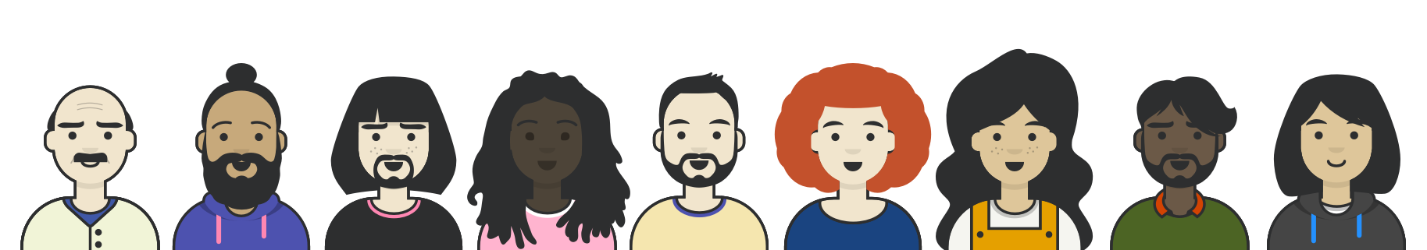
Q&A
Notes:
Slide 40. Now there may be time for a bit of Q&A. I'll open to floor to Ammie to ask any questions she's taken from the chat. And if you have a question, please add it to the chat now.

Slide 74



Next month
How we approach accessibility
#uswds-public
github.com/uswds
designsystem.digital.gov
Notes:
Slide 41. DESCRIPTION TK And, as always, I encourage you to join our community in the #uswds-public Slack channel so you can follow our progress, get answers, and contribute to the discussion. Follow us on Github, check out our website, and visit designsystem.digital.gov/about/community to join us and your colleagues across government who are using USWDS. Thank you, and see you next month!

