Slide 1
Regression Analysis
James
26 Jul 2019

Slide 2
Project goals
To answer some questions:
Does dengue affect life expectancy?
Do people from rich nations live longer?
Do rich countries have better Environmental Performance Index (EPI) ?
What are the factors affecting life expectancy of a country?

Slide 3
Data processed
Features:
Birth Rate
Cancer Rate
Dengue Cases
Environmental Performance Index (EPI)
Gross Domestic Product (GDP)
Health Expenditure
Heart Disease Rate
Population
Area
Pop Density
Stroke Rate
Target:
Life Expectancy
Assumptions:
Country level average
Combined male & female

Slide 4

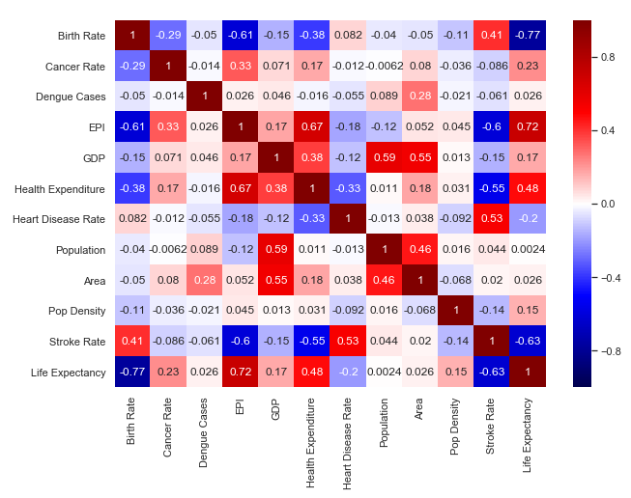
Features correlation
Check for multicollinearity between features

Slide 5
Features correlation
Check for correlation between features and target

Slide 6
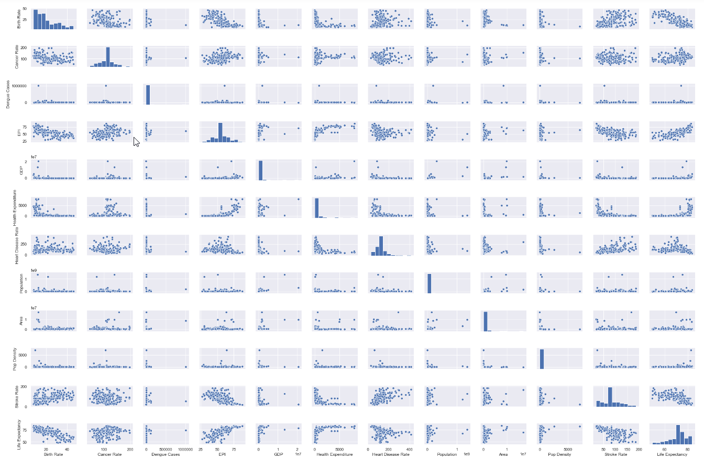
Pair plot
Outliers
Outliers

Slide 7
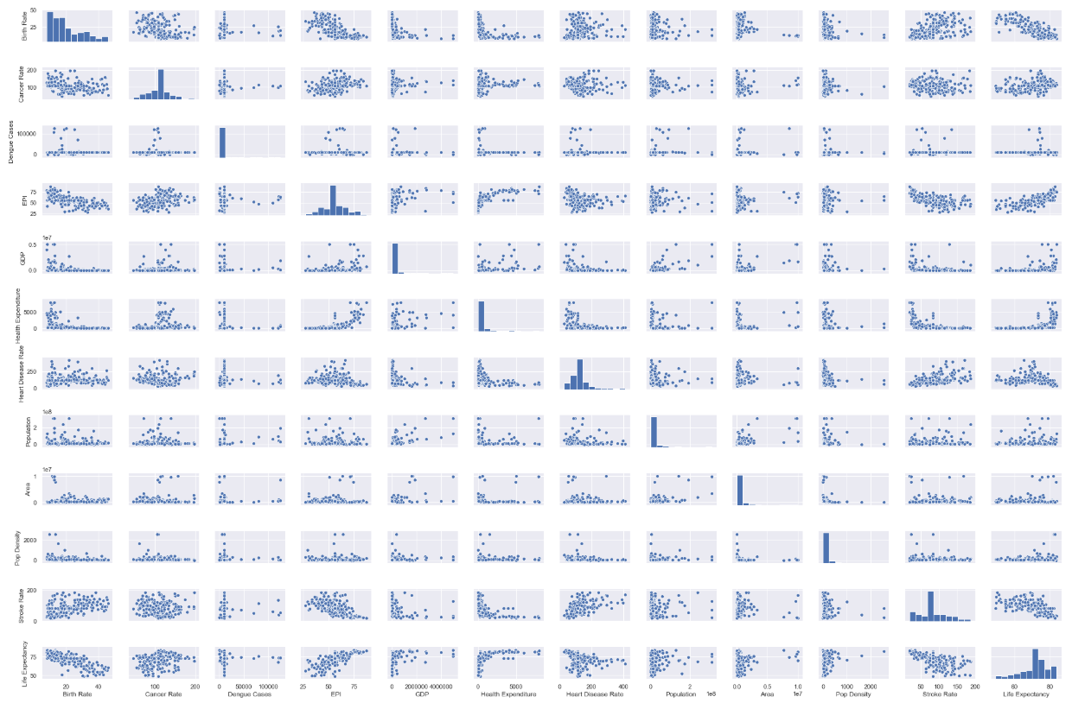
Pair plot
Outliers removed

Slide 8
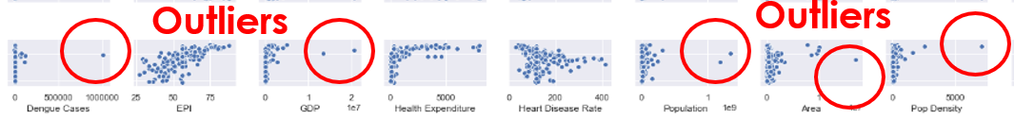
Remove Outliers (option 1)
Replace each outlier value by next highest value
With Outliers
Outliers replaced by next highest value

Slide 9
Remove Outliers (option 2)
The original plots are skewed to the right
(ie, points are very concentrated on the left side)
Apply LOG function to spread data to the right
With Outliers
Applying LOG function to all features

Slide 10
Feature selection
 |  | Drop Feature
 |  | R^2 | R^2
 |  | Before | After
X1 | Birth Rate | 0.749 | 0.597
X2 | Cancer Rate | 0.749 | 0.748
X3 | Dengue Cases | 0.749 | 0.748
X4 | EPI | 0.749 | 0.724
X5 | GDP | 0.749 | 0.749
X6 | Health Expenditure | 0.749 | 0.747
X7 | Heart Disease Rate | 0.749 | 0.748
X8 | Population | 0.749 | 0.748
X9 | Area | 0.749 | 0.749
X10 | Pop Density | 0.749 | 0.746
X11 | Stroke Rate | 0.749 | 0.711
✔
✔
✔

Slide 11
Feature selection
 |  | Removed outliers x6
 |  | P-value | P-value
 |  | Before | After
X1 | Birth Rate
X2 | Cancer Rate
X3 | Dengue Cases | 0.475 | 0.917
X4 | EPI
X5 | GDP | 0.910 | 0.865
X6 | Health Expenditure
X7 | Heart Disease Rate
X8 | Population | 0.512 | 0.821
X9 | Area | 0.929 | 0.539
X10 | Pop Density | 0.155 | 0.017
X11 | Stroke Rate
 | R^2 | 0.749 | 0.750
✔
✔
✔
✔

Slide 12
Feature selection
 |  | Apply LOG function
 |  | P-value | P-value
 |  | Before | After
X1 | Birth Rate | 0.000 | 0.000
X2 | Cancer Rate | 0.464 | 0.653
X3 | Dengue Cases | 0.475 | 0.946
X4 | EPI | 0.000 | 0.001
X5 | GDP | 0.910 | 0.028
X6 | Health Expenditure | 0.308 | 0.858
X7 | Heart Disease Rate | 0.419 | 0.018
X8 | Population | 0.512 | 0.000
X9 | Area | 0.929 | 0.000
X10 | Pop Density | 0.155 | 0.000
X11 | Stroke Rate | 0.000 | 0.000
 | R^2 | 0.749 | 0.740
✔
✔
✔
✔
✔
✔
✔
✔

Slide 13
Feature selection
 |  | Apply (1/x) function |  | Apply SQRT function |  | Apply (**2) function
 |  | P-value | P-value | P-value | P-value | P-value | P-value
 |  | Before | After | Before | After | Before | After
X1 | Birth Rate
X2 | Cancer Rate |  |  | 0.464 | 0.457 | 0.464 | 0.402
X3 | Dengue Cases | 0.475 | 0.556 | 0.475 | 0.523 | 0.475 | 0.083
X4 | EPI
X5 | GDP | 0.910 | 0.060 | 0.910 | 0.940 | 0.910 | 0.821
X6 | Health Expenditure |  |  | 0.308 | 0.472 | 0.308 | 0.333
X7 | Heart Disease Rate |  |  | 0.419 | 0.389 | 0.419 | 0.343
X8 | Population | 0.512 | 0.004
X9 | Area | 0.929 | 0.002
X10 | Pop Density | 0.155 | 0.000
X11 | Stroke Rate
 | R^2 | 0.749 | 0.763 | 0.749 | 0.710 | 0.749 | -4.175
✔
✔
✔
✔
✔
✔
✔

Slide 14
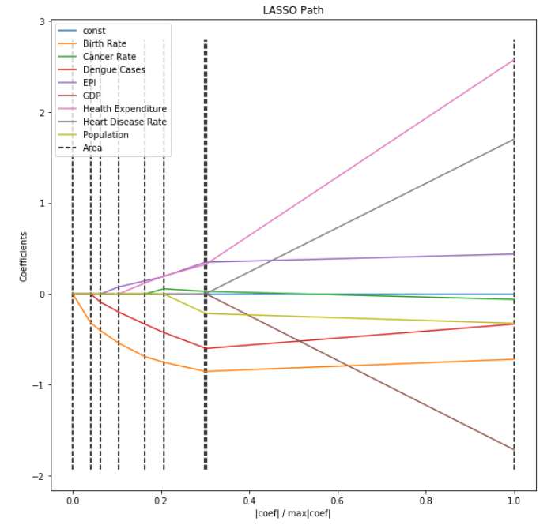
Feature selection
LARS Path to study feature importance

Slide 15
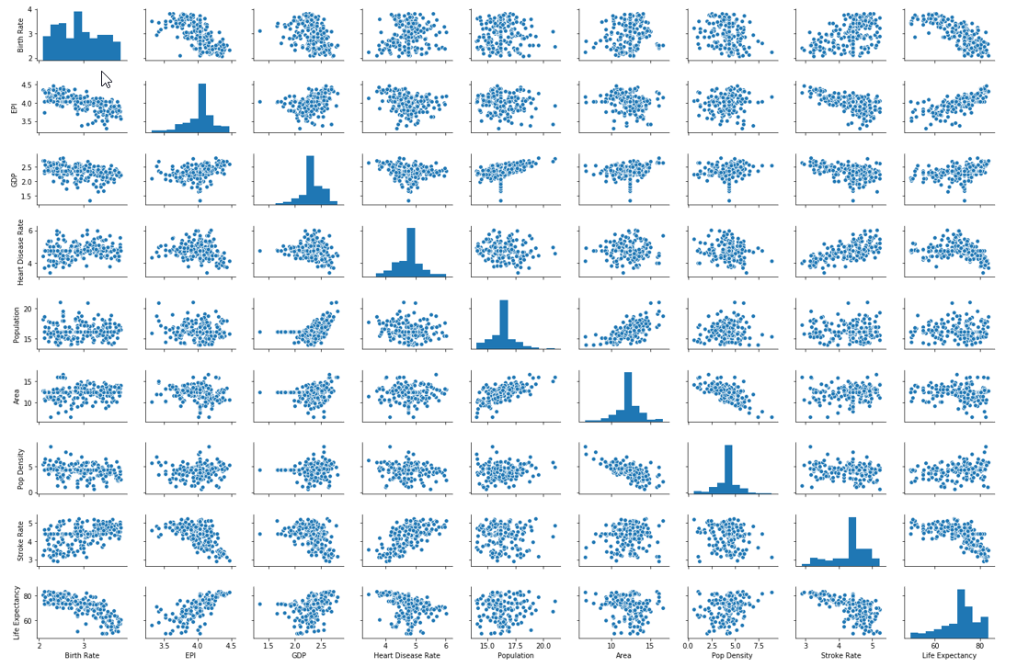
Pair plot

Slide 16
Data arrangement
80% Train (200 rows)
20% Validation (50 rows)
Evaluation Test (250 rows)
Ideal arrangement
60% Train
20% Validation
20% Evaluation Test
Potential
Linear Regression val R^2: 0.713
Ridge Regression val (optimised Alpha = 0.511) R^2: 0.711
Lasso Regression val (optimised Alpha = 0.010) R^2: 0.712
Degree 2 Polynomial regression val R^2: 0.663

Slide 17
Cross Validation using KFold
kf = KFold(n_splits=5, shuffle=True, random_state = 71)
Linear: [0.63234622 0.72018406 0.59833499 0.77907137 0.78894173]
R^2 = 0.704 +- 0.077
Ridge: [0.62901007 0.71624651 0.58945183 0.79562805 0.78227882]
R^2 = 0.703 +- 0.082
Lasso: [0.62971183 0.71763875 0.59201209 0.78934139 0.78375325]
R^2 = 0.702 +- 0.080
Poly(2): [0.67260843 0.56723061 0.64473045 0.37774726 0.81111133]
R^2 = 0.615 +- 0.142
Model selected

Slide 18
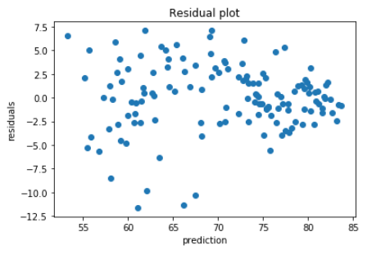
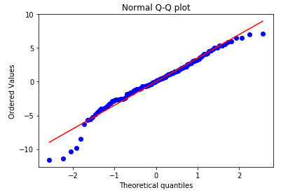
Check Assumptions
Assume residue error is normally distributed
Notes:
coeff is linear
error is normally distributed
error mean is zero
error variance should be consistently spread out randomly
iid, error is independently consistently distributed across time

Slide 19
Evaluation on test data
kf = KFold(n_splits=10, shuffle=True, random_state = 12)
Linear:
0.65882767 0.68668726 0.82380209 0.78394867 0.70648705 0.65295829 0.70545689 0.49187529 0.76423186 0.62256344
R^2 = 0.690 +- 0.089

Slide 20
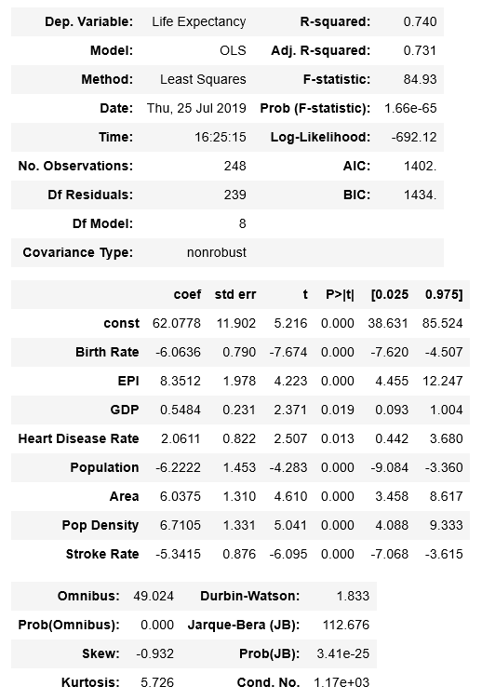
Model intepretation
Final model statistics

Slide 21
Next Steps
To collect more data, possible to expand scope to cities instead of countries
To expand scope to include more features (factors)
To split into life expectancy for males and females

Slide 22

Thank you
https://www.linkedin.com/in/jnyh/
James Ng
26 Jul 2019

Slide 23
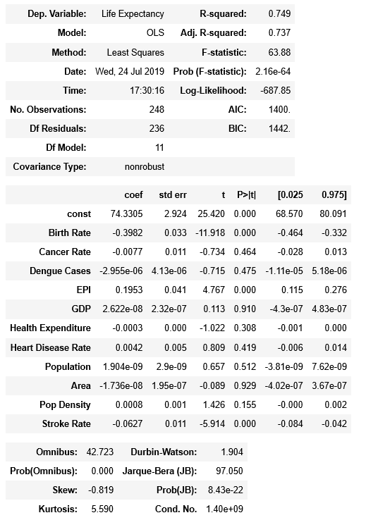
Ordinary Least Squares Regression with Statsmodels
Original dataframe

Slide 24
Evaluation on test data
kf = KFold(n_splits=10, shuffle=True, random_state = 12)
Linear: [0.65882767 0.68668726 0.82380209 0.78394867 0.70648705 0.65295829 0.70545689 0.49187529 0.76423186 0.62256344]
R^2 = 0.690 +- 0.089
Ridge: [0.66786465 0.69851056 0.82027728 0.77569977 0.69630742 0.66372231 0.69689202 0.51426424 0.76753535 0.58897042]
R^2 = 0.689 +- 0.085
Lasso: [0.66655383 0.69521287 0.82165811 0.77736951 0.69828055 0.66100267 0.69828112 0.50599196 0.76584885 0.59049101]
R^2 = 0.688 +- 0.087
Poly(2): [0.61272437 0.66666154 0.90876868 0.74324145 0.71567647 0.48129386 0.66695371 0.31812901 0.77632699 0.55070901]
R^2 = 0.644 +- 0.157

Slide 25
Learning
Biggest challenge is to merge data from different sources: different naming convention, units, etc
Always save the work that has been done at significant milestone e.g. df1, df2, df3, …
Keep a logbook of regression results with different combination of model selection and input features
Notes:
Congo x2
Viet Nam
Korea North, Korea South

Slide 26
Interesting insight
Japan has the highest life expectancy (83.7 years)
Central African Republic (49.53 years) and many countries in Africa continent are at the bottom of scale
Singapore is ranked #5 (82.7 years)
Notes:
Congo x2
Viet Nam
Korea North, Korea South

Slide 27
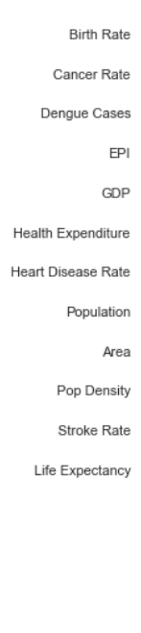
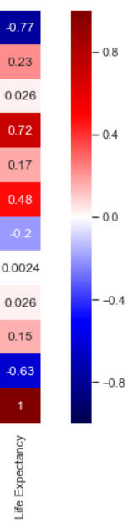
Interesting insight
How to live a long life?
have fewer babies
stay in a country with high Environment Performance Index (EPI) and high Health Expenditure
avoid getting killed by stroke
Notes:
Congo x2
Viet Nam
Korea North, Korea South

Slide 28
Project Approach
Obtain (data acquisition)
web scraping using BeautifulSoup and Pandas read
Scrub (data cleaning)
remove extra spaces, empty rows/columns, outliers, standardise country names, fill null fields with median
Explore (data exploration)
correlation, feature engineering /selection
Model
regression analysis, cross validation, regularization, summary statistics
Interpret and Communicate
optimised statistical results, data visualization

