Slide 1



RNS INSTITUTE OF TECHNOLOGY
BENGALURU - 98
DEPARTMENT OF INFORMATION SCIENCE & ENGINEERING
Presentation on Internship
House Price Prediction using Machine learning
AKASH KUMAR
USN:1RN18IS011
New Age Solutions Technologies
External Guide
Mr. DEEPAK GARG
CEO, NASTECH
Internal Guide
Dr. SURESH L
Prof, HOD of ISE, RNSIT

Slide 2

Contents
Mini Project
Work Flow
Dataset
Data Preprocessing
Data Analysis
Training and Testing of Data
Model Training
Evaluation
Results

Slide 3
Mini project
House Price Prediction using Machine Learning
Introduction
House prices increase every year, so there is a need for a system to predict house prices in the future. House price prediction can help the developer determine the selling price of a house and can help the customer to arrange the right time to purchase a house.
We are using a data set having several attributes in the state of Boston.
Some scenarios on which the price of the house depends upon are per capita crime rate, the age of the house, the number of rooms available, amount of nitrogen oxide concentration in the neighborhood etc.

Slide 4
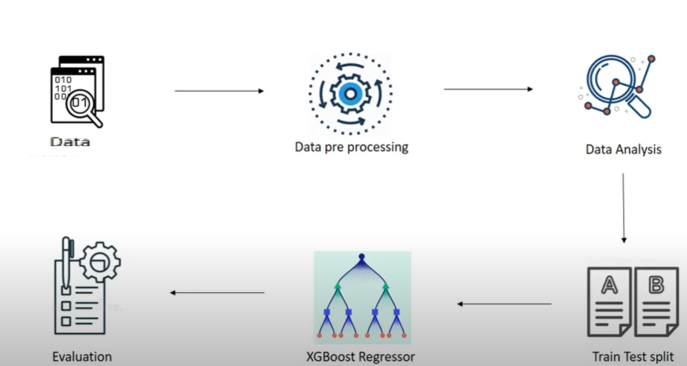
Work Flow

Slide 5
Dataset details:
The dataset used in this project comes from the UCI Machine Learning Repository. This data was collected in 1978 and each of the 506 entries represents aggregate information about 14 features of home from various suburbs located in Boston.
CRIM: per capita crime rate by town -
ZN: proportion of residential land zoned for lots over 25,000 sq.ft.
INDUS: proportion of non-retail business acres per town
CHAS: Charles River dummy variable (= 1 if tract bounds river; 0 otherwise)
NOX: nitric oxides concentration (parts per 10 million)
RM: average number of rooms per dwelling
AGE: proportion of owner-occupied units built prior to 1940
DIS: weighted distances to five Boston employment centers
RAD: index of accessibility to radial highways
TAX: full-value property-tax rate per $10,000
PTRATIO: pupil-teacher ratio by town -
B: 1000(Bk - 0.63)^2 where Bk is the proportion of blacks by town
LSTAT: % lower status of the population
Target(price): Price of the houses

Slide 6
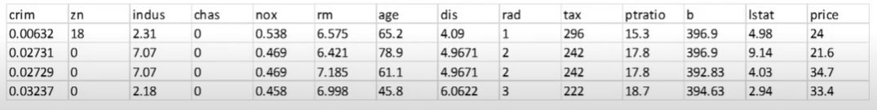
Dataset Sample

Slide 7
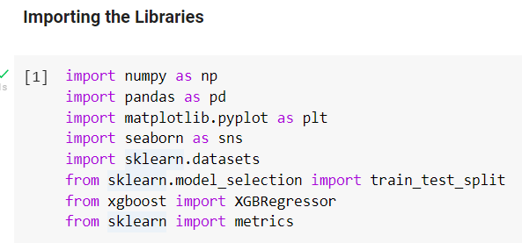
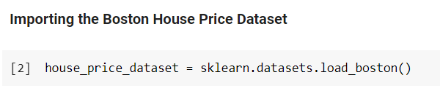
Data Pre-Processing

Slide 8

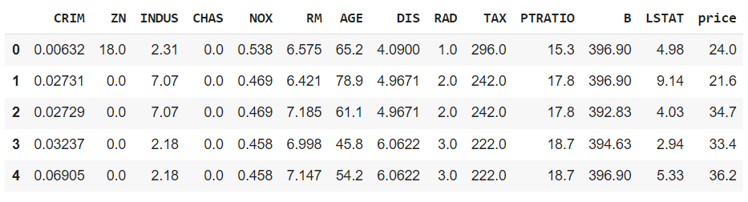

Slide 9
Data Analysis
Data Analysis is the process of inspecting, cleansing, transforming, and modeling data with the goal of discovering useful information by informing conclusions and supporting decision making.
EDA (Exploratory data analysis)
EDA is used by data scientists to analyze and investigate data sets and summarize their main characteristics, often employing data visualization methods.
In order to perform EDA in a simpler way, we can use some in-built tools.
We are using ‘sweetviz’ to perform EDA.

Slide 10
Correlation
Correlation explains how one or more variables are related to each other. It gives us the idea about the degree of the relationship of the two variables.
To understand the different features more, we need to find the correlation between all the features.
Types of Correlation:
Positive Correlation
Negative Correlation

Slide 11
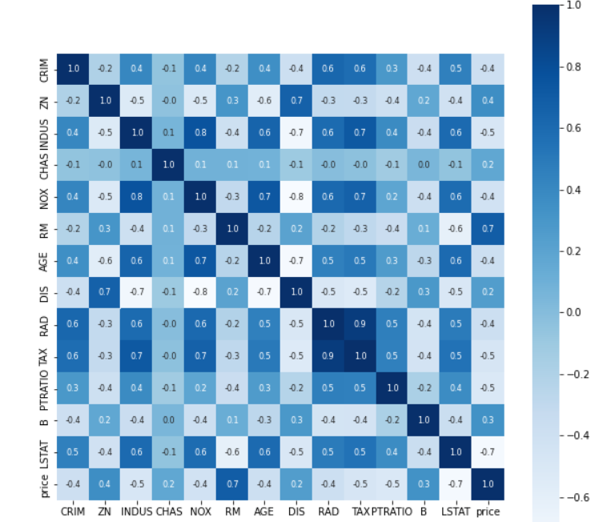
Correlation Heat Map

Slide 12
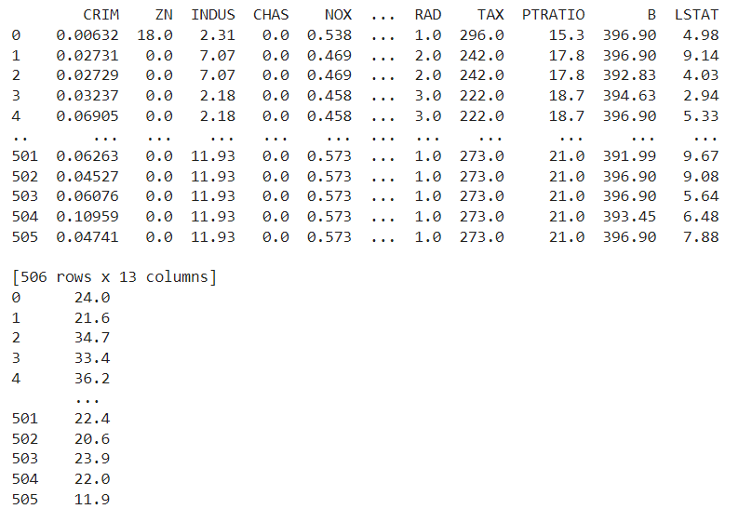
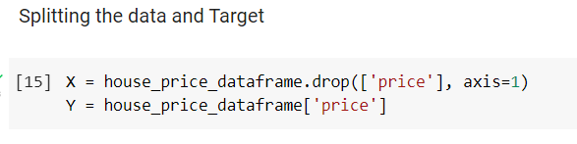
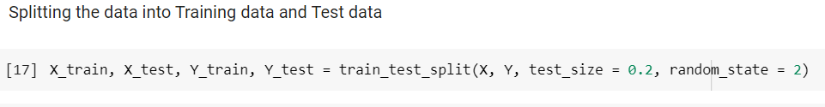
TRAINING DATA AND TESTING DATA

Slide 13
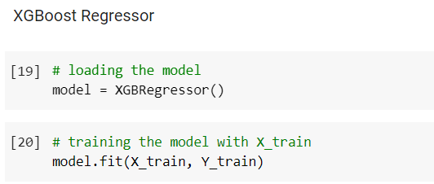
Model Training
XGBoost Regressor
Extreme Gradient Boosting (XGBoost) is an open-source library that provides an efficient and effective implementation of the gradient boosting algorithm.
First, the model is loaded and then is initialised.
Then this model is trained using X_train.

Slide 14
Evaluation
Now we can evaluate our model, to find out how well our model is performing.
We cannot use accuracy scores for regression models.
But for accuracy purpose, we will check the number of directly predicted values by the model and the original values and find the difference between them.
R-Squared Error
Represents the proportion of the variance for a dependent variable that's explained by an independent variable or variables in a regression model.
R-squared calculates the variance between actual value and the predicted value. Based on the variance between these two values, it will give the R-squared error.

Slide 15
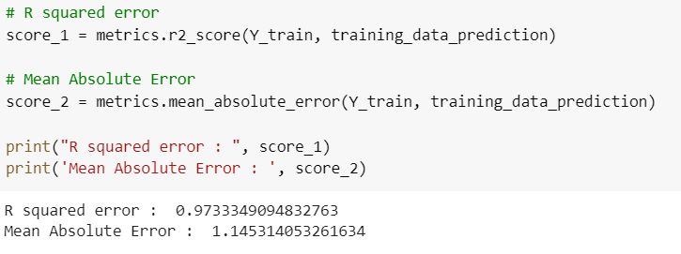
Mean Absolute Error
It is the magnitude of difference between the prediction of an observation and the true value of that observation.
It will find the difference between all the actual value and its corresponding predicted value and give its mean value.

Slide 16
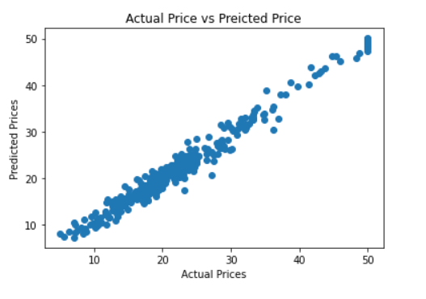
Visualizing the Actual Prices and the Predicted Prices

Slide 17
Results
We calculated R-squared and Mean Absolute Error between the Actual Prices and the Predicted Prices of the house.
The calculated value was quite less and thus can be concluded that our model is performing well.
Also, from the plot, the data points were very close to each other.
The prediction made on the prices is quite closer to the original prices.
Therefore, the accuracy of our model is good.

Slide 18
Outcomes of Internship
Understand the fundamentals of machine learning.
The significance of mathematics especially statistics in machine learning.
Explore career alternatives prior to graduation.
Integrate theory and practice.
Learn to appreciate work and its function in the economy.
Develop work habits and attitudes necessary for job success.
Develop communication, interpersonal and other critical skills.
Build a record of work experience.

Slide 19
THANK YOU

