Slide 1


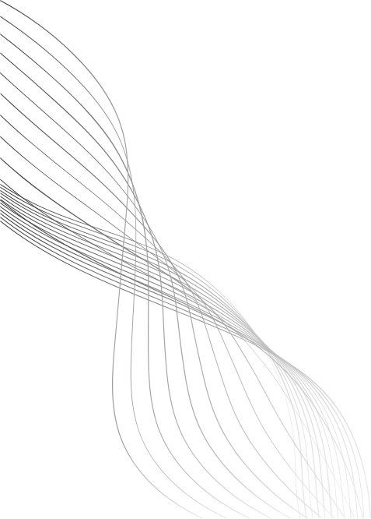
COPY MOVE FORGERY DETECTION
V. Sree Teja Pradeep (22BCE1737)
Pragya Bose (22BCE1680)

Slide 2

INTRODUCTION
With the rise of easily manipulated digital media, distinguishing authentic images from forgeries has become a significant challenge in fields such as journalism, law enforcement, and digital forensics. Detecting image forgeries is essential to prevent misinformation and uphold the integrity of visual content. In this project, we developed a deep learning model based on the U-Net architecture to identify tampered regions in images.
01

Slide 3
PROBLEM
There are various types of image manipulation techniques namely:
Copy-Move Forgery: Copying and pasting a region of an image to another location.
Splicing: Combining parts of two or more images.
Removal/Insertion of Objects: Removing or inserting objects into an image.
Masking: Isolating parts of an image to make selective edits or adjustments
02

Slide 4
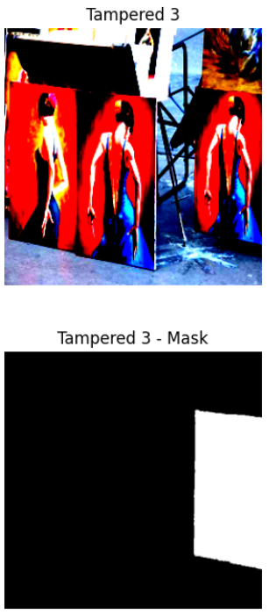
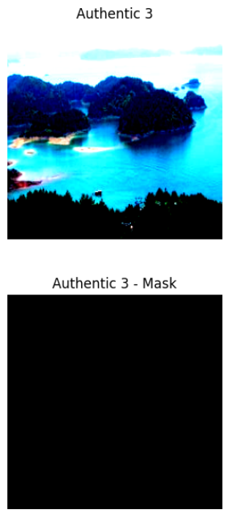
DATASET
We used the CASIA2 dataset which is publicly available on kaggle for training and validation. The dataset consists of:
Authentic images: 7492 files
Tampered images: 5125 files
Ground Truth Masks: Each tampered image comes with a corresponding mask indicating the tampered regions.
03

Slide 5
GOAL
The goal of this project is to develop a deep learning-based model that can detect tampered regions in images, utilizing U-Net for semantic segmentation and DBSCAN clustering for keypoint grouping. While both methods aim to identify tampered regions, they are used separately within the pipeline. The keypoints detected by DBSCAN and the mask predicted by U-Net provide complementary information, each contributing to the overall detection task. However, there is no direct integration between the two methods in our current approach.
04

Slide 6
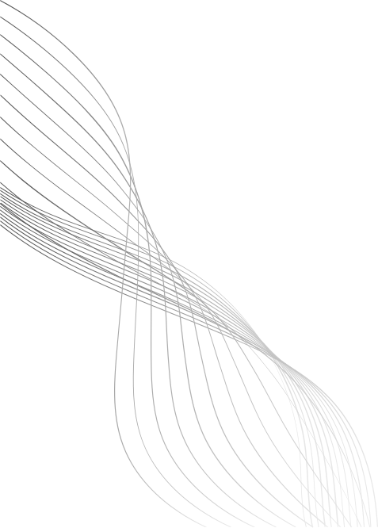
APPROACH
We used three primary techniques: U-Net for semantic segmentation and DBSCAN clustering for detecting tampered regions based on keypoints and CenSure Keypoint detectors + FREAK descriptors with Agglomerative clustering to find out the clusters of the keypoints indicating tampered regions.
U-Net for Semantic Segmentation: We use a U-Net model, a deep learning-based architecture for semantic segmentation, trained to identify tampered regions. The U-Net is capable of learning complex patterns and pixel-level classification, helping to delineate tampered regions accurately.
Keypoint Detection with DBSCAN: We apply keypoint detection using the Good Features to Track (GFTT) algorithm to detect distinctive keypoints in the image. These keypoints are then grouped into clusters using the DBSCAN clustering algorithm. This step helps to identify regions of interest that could potentially indicate tampered areas.
05

Slide 7
APPROACH
CenSurE + FREAK-Based Clustering:
As an alternative handcrafted approach, we also incorporate the CenSurE (STAR) keypoint detector in combination with FREAK descriptors to enhance keypoint-based detection. After extracting keypoints using CenSurE and computing binary feature vectors using FREAK, we perform k-nearest neighbor matching with a Brute Force matcher (Hamming distance). Matched keypoints are filtered and grouped using hierarchical clustering, effectively localizing repeated regions suggestive of copy-move forgery. This technique complements deep learning by offering a training-free and interpretable solution to forgery detection.
06

Slide 8
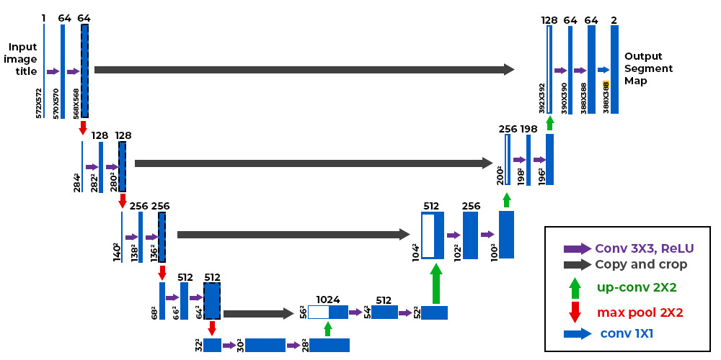
U-NET ARCHITECTURE
07

Slide 9
U-NET ARCHITECTURE
The U-Net architecture, first published in the year 2015, has been a revolution in the field of deep learning. The architecture shows that an input image is passed through the model and then it is followed by a couple of convolutional layers with the ReLU activation function. The encoder block has a constant reduction of image size with the help of the max-pooling layers of strides 2. We also have repeated convolutional layers with an increasing number of filters in the encoder architecture. Once we reach the decoder aspect, we notice the number of filters in the convolutional layers start to decrease along with a gradual upsampling in the following layers all the way to the top. The architecture of U-Net is unique in that it consists of a contracting path and an expansive path. The contracting path contains encoder layers that capture contextual information and reduce the spatial resolution of the input, while the expansive path contains decoder layers that decode the encoded data and use the information from the contracting path via skip connections to generate a segmentation map. The decoder layers in the expansive path upsample the feature maps, while also performing convolutional operations. The skip connections from the contracting path help to preserve the spatial information lost in the contracting path, which helps the decoder layers to locate the features more accurately. We are using ResNet-50 as the encoder for our model in this project.
08

Slide 10
DATA PREPROCESSING
We resized all images to fit the input dimensions required by our model, ensuring consistency across the dataset. We normalized the images to standardize their pixel values, which helps speed up the training process and improve model performance. All the images in the CASIA 2.0 dataset were resized to 256 x 256 while loading.
09

Slide 11
KEYPOINT DETECTION
The Good Features to Track (GFTT) method is used to detect keypoints in an image. Keypoints are distinctive features in the image that stand out due to their contrast with surrounding regions.
These keypoints are important for identifying unique regions that may be altered in the process of image tampering.
In our approach, we use keypoint detection to highlight potential tampered regions in an image. These keypoints help to focus the detection process on areas of interest that are more likely to be modified.
10

Slide 12
DBSCAN
DBSCAN (Density-Based Spatial Clustering of Applications with Noise) is a powerful unsupervised clustering algorithm. It groups together keypoints that are closely packed in space, and marks keypoints that lie alone in low-density regions as outliers. In our keypoint-based approach, DBSCAN is used to group detected keypoints into meaningful clusters. These clusters often correspond to tampered regions in the image. By isolating densely packed keypoints, DBSCAN helps in creating a binary mask that highlights suspicious areas. This mask can then be visualized and compared with ground truth masks to analyze effectiveness. This method is applied separately from the U-Net model. It complements the pixel-level segmentation approach by offering a region-based analysis using keypoint density.
11

Slide 13
CENSURE+FREAK
The proposed method detects copy-move forgeries using a fully handcrafted pipeline based on keypoint detection, descriptor matching, and clustering. First, the CenSurE (STAR) detector identifies salient keypoints in the grayscale version of the input image. Then, FREAK (Fast Retina Keypoint) descriptors are computed for these keypoints to extract robust binary feature vectors. Using a Brute Force Matcher with Hamming distance, k-nearest neighbor (k-NN) matching is performed, and matches are filtered based on descriptor similarity and spatial separation to eliminate trivial pairs. The spatial coordinates of valid matched points are then grouped using Agglomerative Hierarchical Clustering with a distance threshold to highlight potential copy-move regions. Finally, clusters are visualized as colored circles overlaid on the original image, and the result is displayed alongside the ground truth binary mask for comparison. This approach is effective, does not require training, and offers intuitive visualization for tampered region localization.
12

Slide 14
MODEL TRAINING
Training Overview
The U-Net model was trained for the task of tampered region segmentation. We used Binary Cross-Entropy (BCE) as the loss function, which is well-suited for binary mask prediction. The Adam optimizer was employed to update the model weights efficiently.
Hyperparameters
Epochs: 40
Learning Rate: 1e-4
Batch Size: 8
These values were chosen based on initial experimentation to ensure stable convergence.
Training Performance
During training, the model showed a consistent decline in loss values, suggesting that it was effectively learning to differentiate tampered areas from authentic ones.
13

Slide 15
EVALUATION METRICS
Metrics used for evaluating the model are:
Accuracy: Measures the overall correctness of predictions, including both tampered and untampered regions.
Precision: Indicates how many of the predicted tampered pixels were actually correct (true positives among all positive predictions).
Recall: Shows how well the model detected all actual tampered pixels (true positives among all actual positives).
F1 Score: Harmonic mean of precision and recall, balancing both false positives and false negatives.
IoU (Intersection over Union): Ratio of overlap between predicted and ground truth tampered regions to their union.
Dice Score: Another overlap measure, emphasizing the agreement between predicted and actual tampered regions.
14

Slide 16
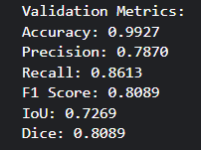
RESULTS
15

Slide 17
INFERENCE
The accuracy of the model is very high, since each ground truth mask has the majority portion of 0s, indicating that authentic regions are present more in the images, which means that the model is successful in detecting the authentic parts of the image properly. Having a high precision indicates how many tampered pixels (1s) are detected properly, which also indicates that the model is successful in detecting most of the tampered images properly. Recall score indicates the number of correctly detected tampered regions out of all the detected tampered regions. F1-score is also moderate since it is a harmonic mean of false positives and false negatives, F1-score indicates how well our model performs. IoU and Dice loss are metrics which determine the overlap of predicted mask and ground truth mask.
16

Slide 18
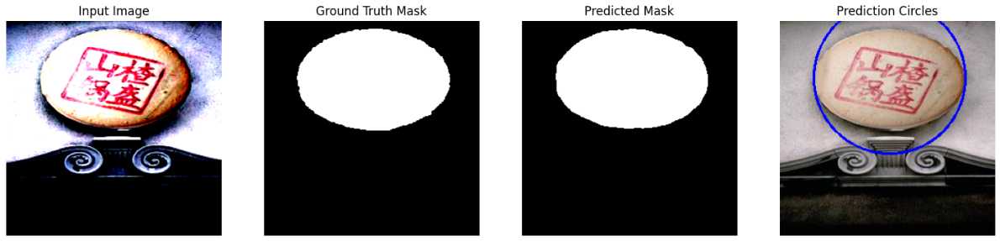
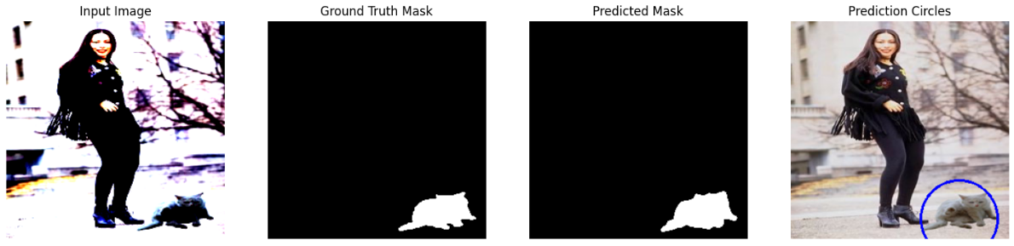
OUTPUTS
17

Slide 19
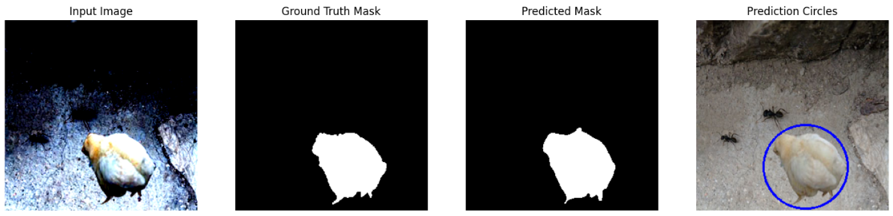
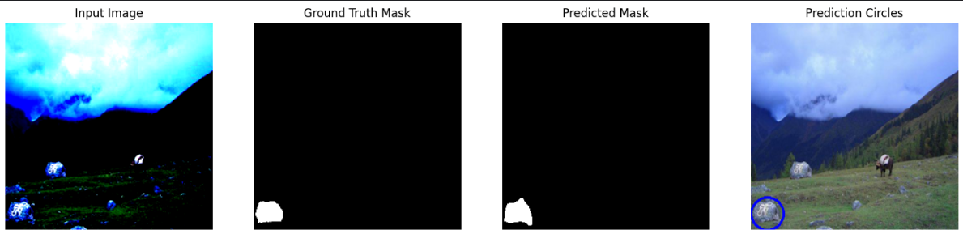
OUTPUTS
18

Slide 20
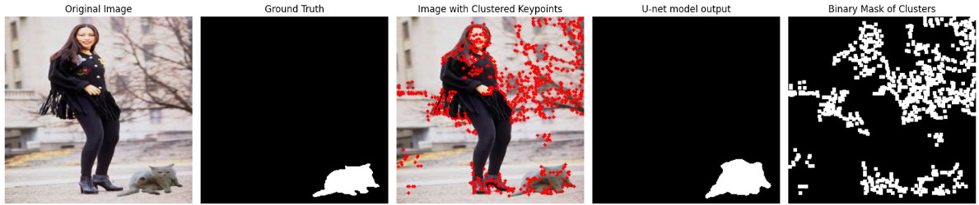
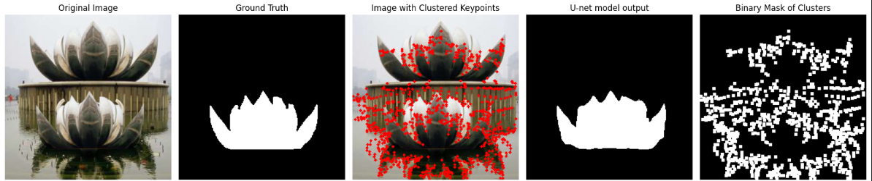
DETECTED KEYPOINTS
GFFT method
19

Slide 21
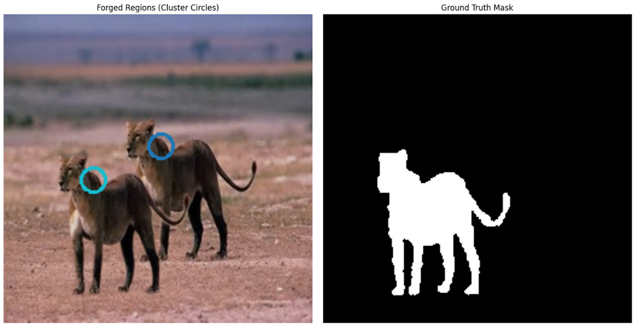
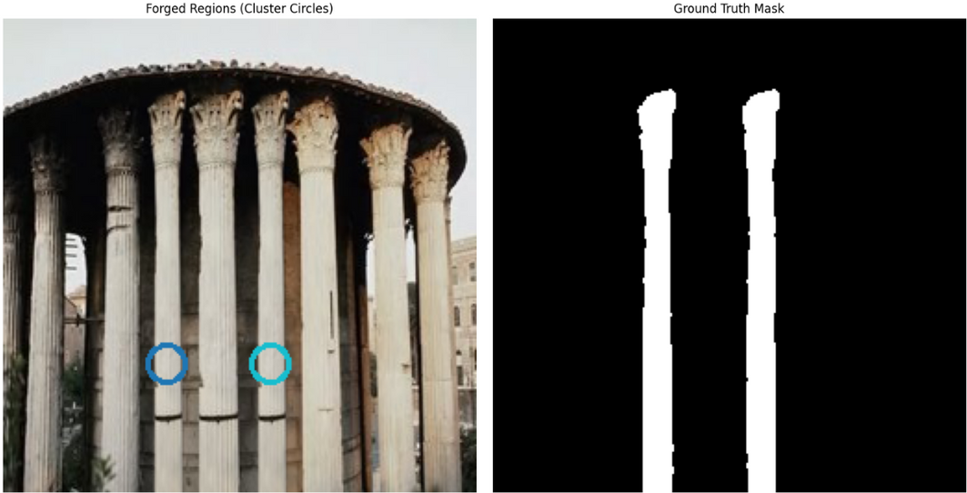
DETECTED CLUSTERS
CenSure + FREAK method
20

Slide 22
CONCLUSION
This project explored two distinct approaches to image forgery detection:
U-Net-based semantic segmentation and keypoint detection with DBSCAN clustering.
The U-Net model demonstrated strong capability in localizing tampered regions, leveraging deep feature extraction and pixel-wise prediction.
The keypoint-based method offered a lightweight, heuristic-driven alternative, useful for identifying suspicious regions through feature clustering.
Both methods were evaluated on the CASIA2 dataset, showing complementary strengths in different forgery scenarios.
Our work highlights the importance of multi-perspective analysis in digital image forensics, and opens up possibilities for future fusion-based detection techniques.
21

Slide 23
THANK YOU
22

