Slide 1

Looker Studio Dashboard Guide:
Conversation Data

Slide 2
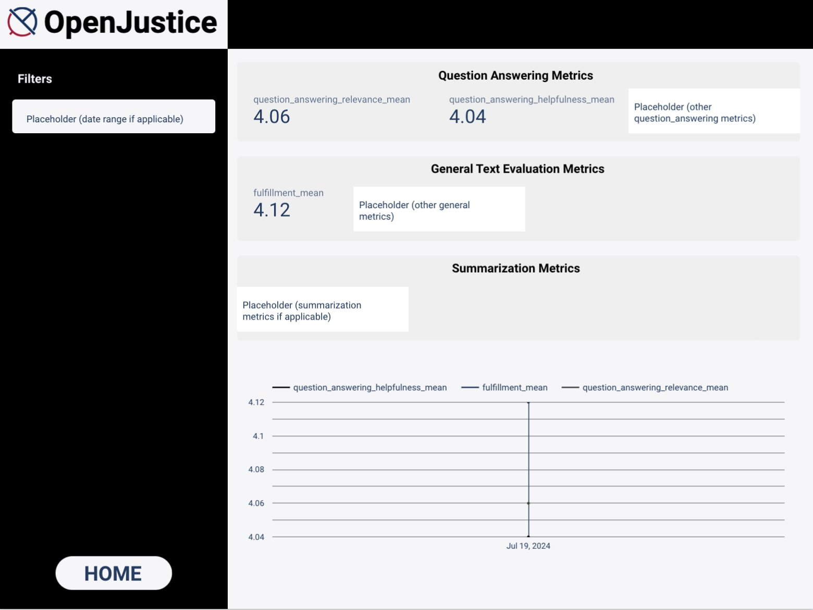
Metrics (Vertex AI default): there are the metrics that can be implemented now or in the future, more data features needed
Overview
Question answering (main focus): to evaluate the model's ability to answer questions (partially available now)
question_answering_quality
QuestionAnsweringHelpfulness
QuestionAnsweringCorrectness
QuestionAnsweringRelevance
General text generation: to evaluate the model's ability to ensure the responses are useful, safe, and effective for your users (partially available now)
Bleu
Rouge
Coherence
Fluency
Groundedness
Fulfillment
Summarization: to evaluate model summarization (NOT applicable for now)
summarization_quality
summarization_helpfulness
summarization_verbosity
Conversation evaluation result metrics (GPT model performance)

Slide 3
Page Information
1
2
Scorecards:
Important metrics from evaluation results, which display the average score. Placeholders are for later possible metrics to be added.
Filters:
Since it is a starting point for evaluating the conversation data, this proof-of-concept dashboard doesn't have any applicable filters yet, but later implementation is available.
3
Line chart:
Allow users to see a trend of evaluation scores changing over time, only one evaluation is included for now as a starting point

Slide 4
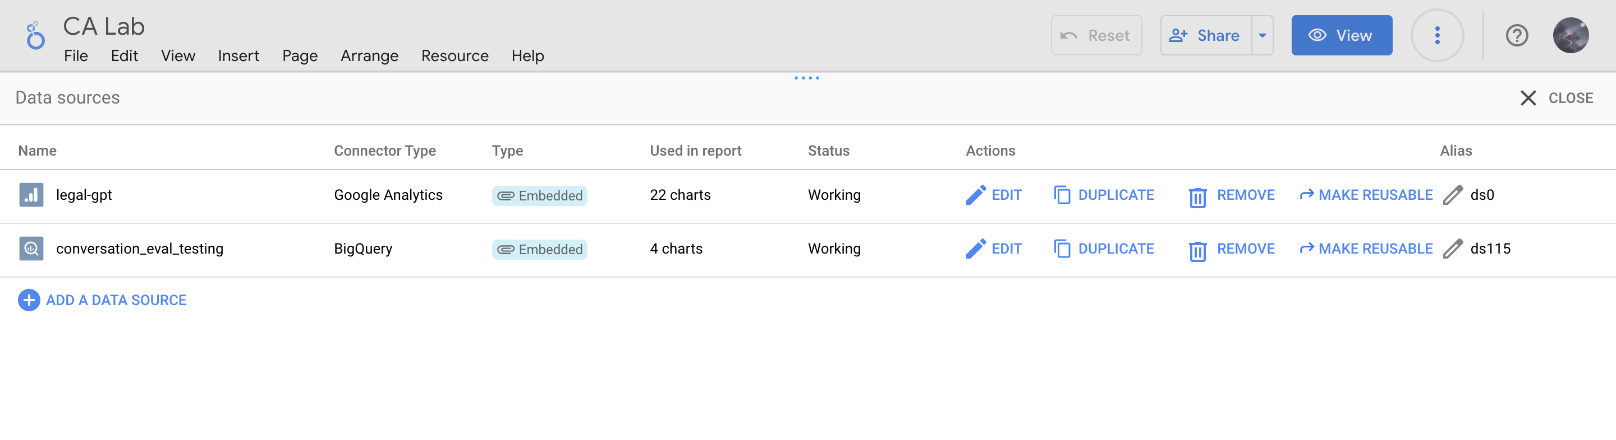
Different Data Sources
Resource -> Manage added data sources
This page will show the data sources that are connected to the dashboard (all data displayed are real-time values)
The BigQuery data can be modified from the notebook in Vertex AI:
Google Cloud -> Search "Vertex AI" -> workbench -> Open instance (START) -> Open Jupyter Notebook -> Run the notebook and a new row of evaluation results of all the conversation data in Firestore will be added with a new timestamp (Vertex AI, Firestore, and BigQuery are already initialized in the notebook)

