Slide 1

Apollo Concrete Architecture
Marc Brasoveanu (Presenter), John Mahone, Andrew Wilker, Nathan Perriman, Theo Raptis (Presenter)
Video Link: https://youtu.be/Oeq9UbUM8sA

Slide 2
Group Roles
Marc Brasoveanu Abstract, Introduction, Derivation Process, Conclusion, ½ Slides and Presentation
John Mahone Top-Level Concrete Subsystems, Derivation Process
Andrew Wilker Group Leader, Sequence Diagrams, External Interfaces, Derivation Process
Nathan Perriman Conceptual Vs. Concrete, Derivation Process
Theo Raptis Subsystem Report, Lessons Learned, ½ Slides and Presentation, Derivation Process

Slide 3
Introduction
Explore concrete architecture of Apollo
Derivation process
Top level concrete subsystems
Subsystem report on CanBus module
Comparison between conceptual and concrete architecture
Use-case sequence diagrams
External interfaces
Lessons Learned
Conclusions

Slide 4
Derivation Process
Used Understand tool to create derive concrete architecture
Created dependency graphs
Used Git command line tools to understand unexpected dependencies

Slide 5
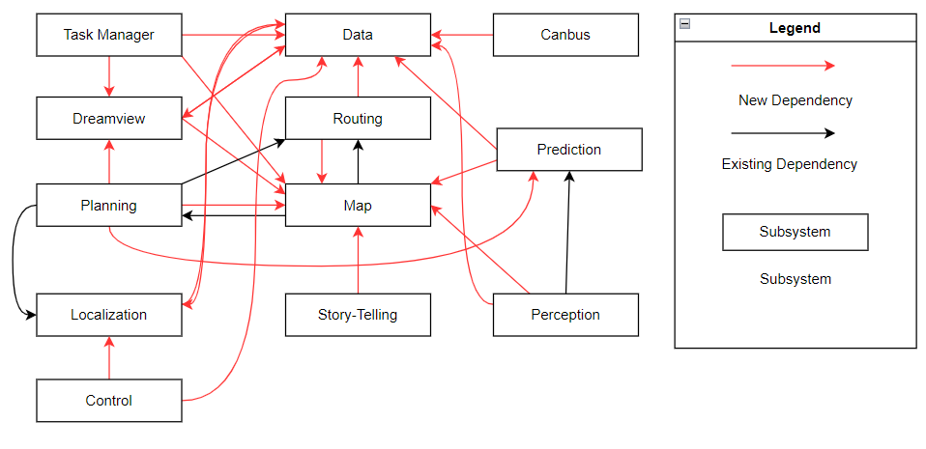
Top-Level Concrete Subsystems

Slide 6
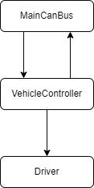
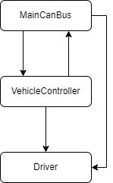
Subsystem: CanBus
Conceptual Concrete

Slide 7
Conceptual Versus Concrete Architecture
Several missing and unexpected dependencies revealed
Updates made to concrete architecture to reflect these changes
Changes include:
Map Dependencies
Canbus-Control Interaction
Localization Data
Storyteller Publishing
Task Manager

Slide 8
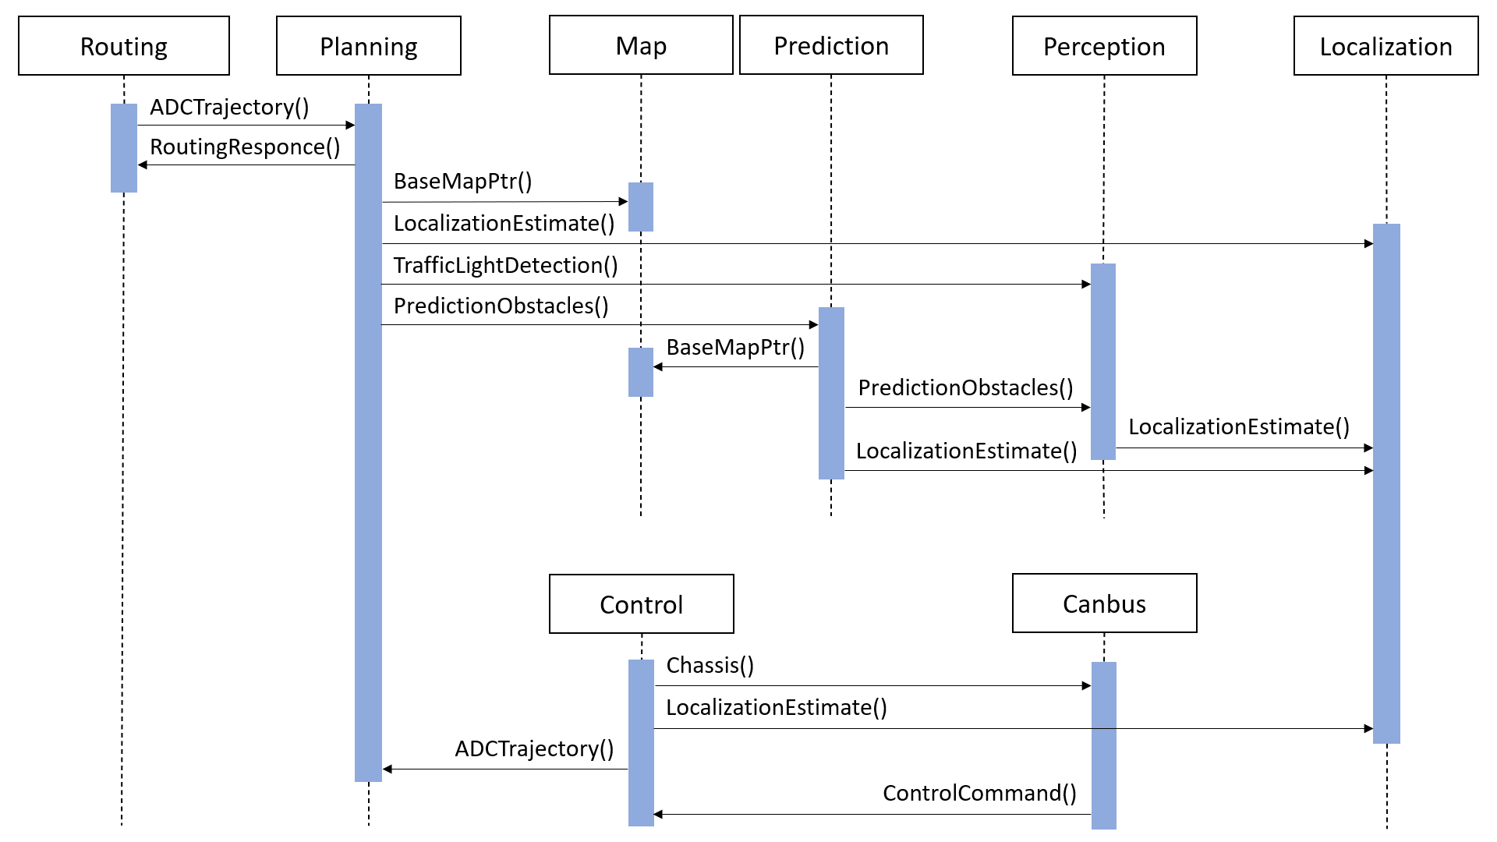
Use Case - Automobile Travels to Destination

Slide 9
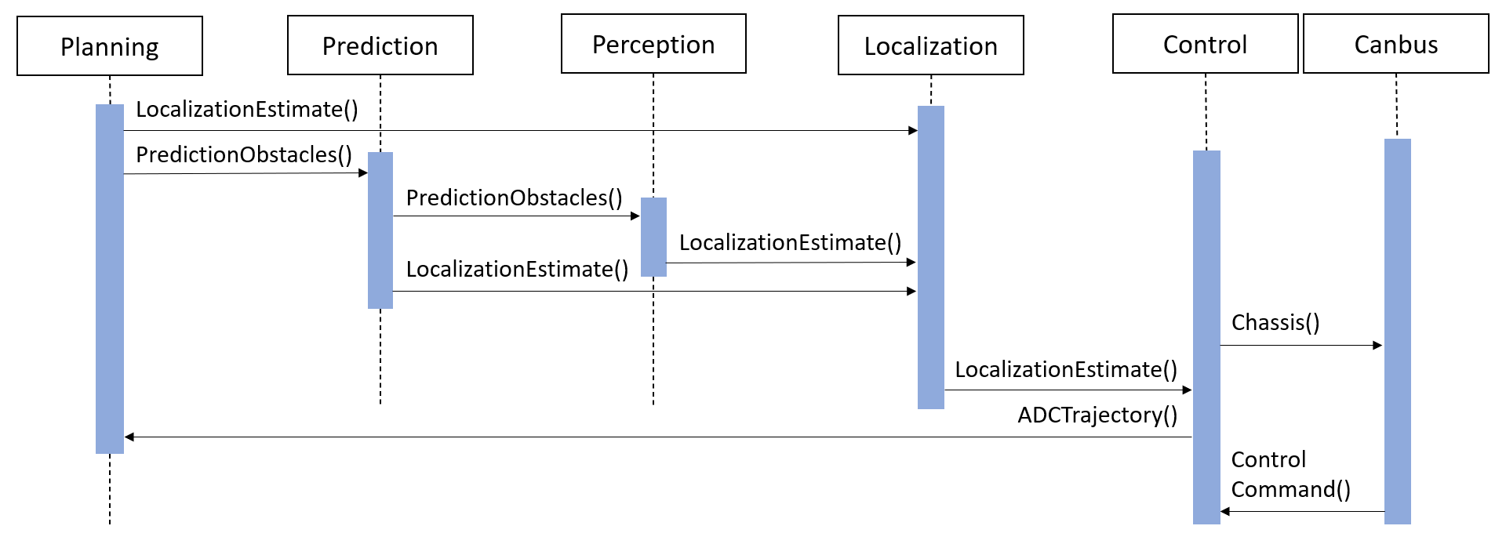
Use Case - Automobile Must Park Itself

Slide 10
External Interfaces
Hardware
Camera
IMU
Radio
LiDAR
Vehicle Sensors
Software
HD Map
HMI

Slide 11
Lessons Learned
Learned more about reflexion process
Differences in conceptual vs. concrete architecture
Impact of quality of developer comments and documentation
Understand tool

Slide 12
Conclusion
Pub-Sub style concrete architecture
CanBus subsystem shown to bridge Apollo software with vehicle
Main CanBus module
The vehicle controller module
Driver module
Differences between conceptual architecture and concrete architecture
Lessons learned

