Slide 1

Apollo Enhancement
Marc Brasoveanu (Presenter), John Mahone, Andrew Wilker, Nathan Perriman, Theo Raptis (Presenter)
Video Link: https://youtu.be/6IcAkDxqW0c

Slide 2
Group Roles
Marc Brasoveanu Abstract, Introduction, Value, Conclusions, Lessons Learned, ½ Slides and Presentation
John Mahone Effects of Enhancement, Impacted Directories and Files
Andrew Wilker Group Leader, Use Cases, Sequence Diagrams, Non-functional Requirements
Nathan Perriman Alternatives, SAAM Analysis
Theo Raptis Current State of System, Interactions, ½ Slides and Presentation

Slide 3
Introduction
Propose enhancement to Apollo
Value of the enhancement
Two approaches
Non-functional requirements
Use case and sequence diagram
Impacted subsystems
Testing plan
Risks and limitations
Lessons learned
Limitations of our report
Conclusion

Slide 4
Enhancement Value
Increased traffic flow
Saving time for drivers
Safety benefits

Slide 5
Approaches
Two possibilities
Preserve current working architecture
Integrate features into existing structure
Modify existing architecture
Add new communication module to handle enhancement demands

Slide 6
Non-functional Requirements
Maintainability
Evolvability
Testability
Performance
Stakeholders
Development team
Vehicle owners
Members of open-source community

Slide 7
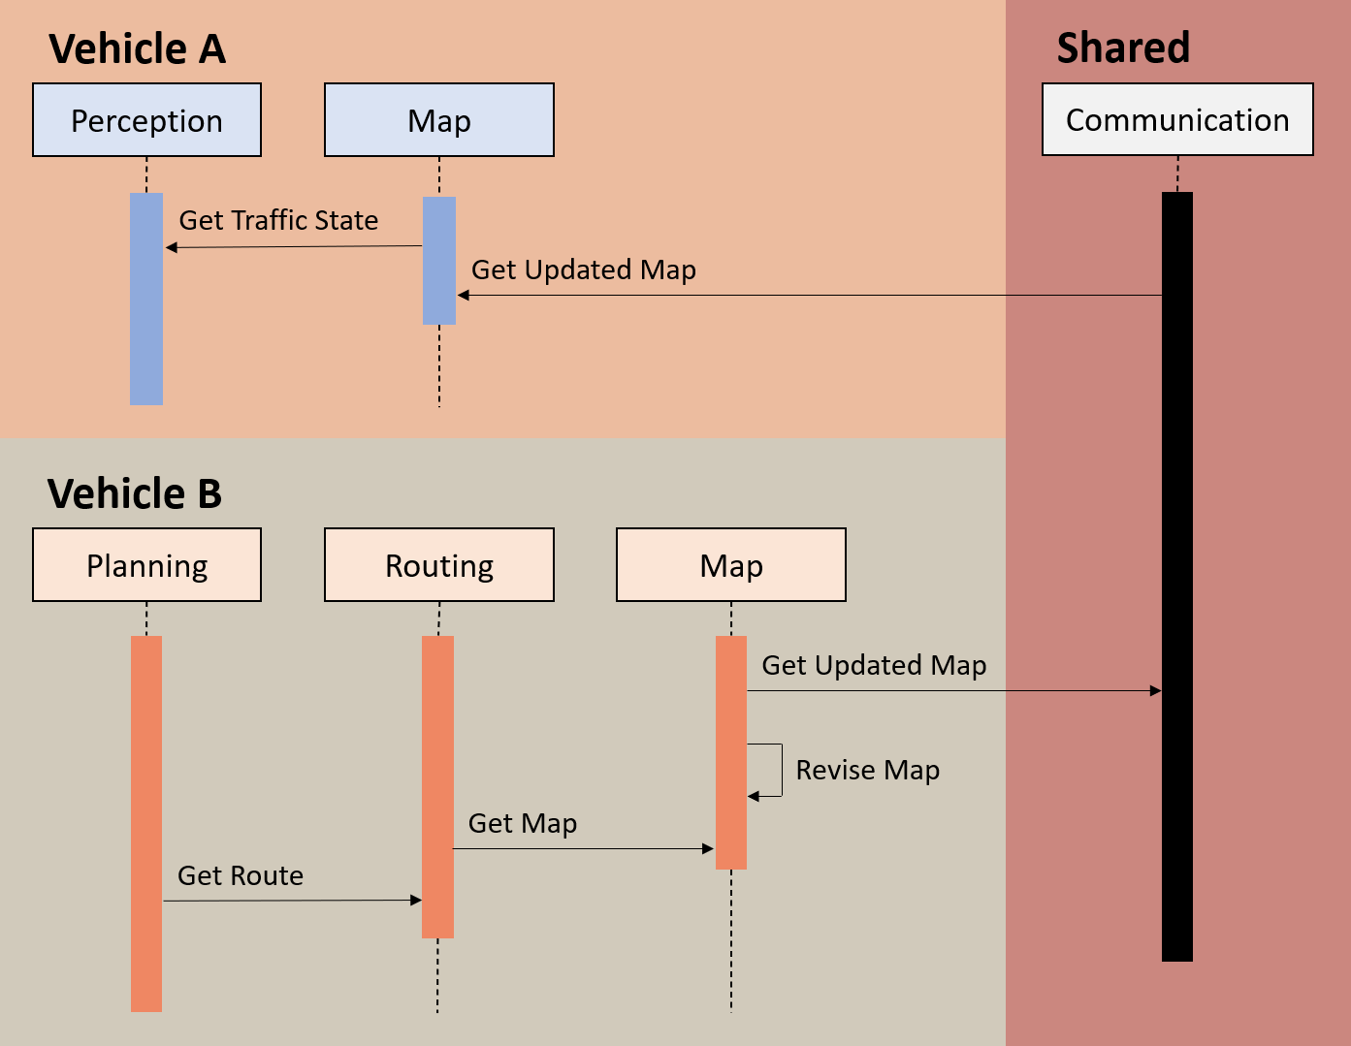
Use Case #1 - Traffic Jam

Slide 8
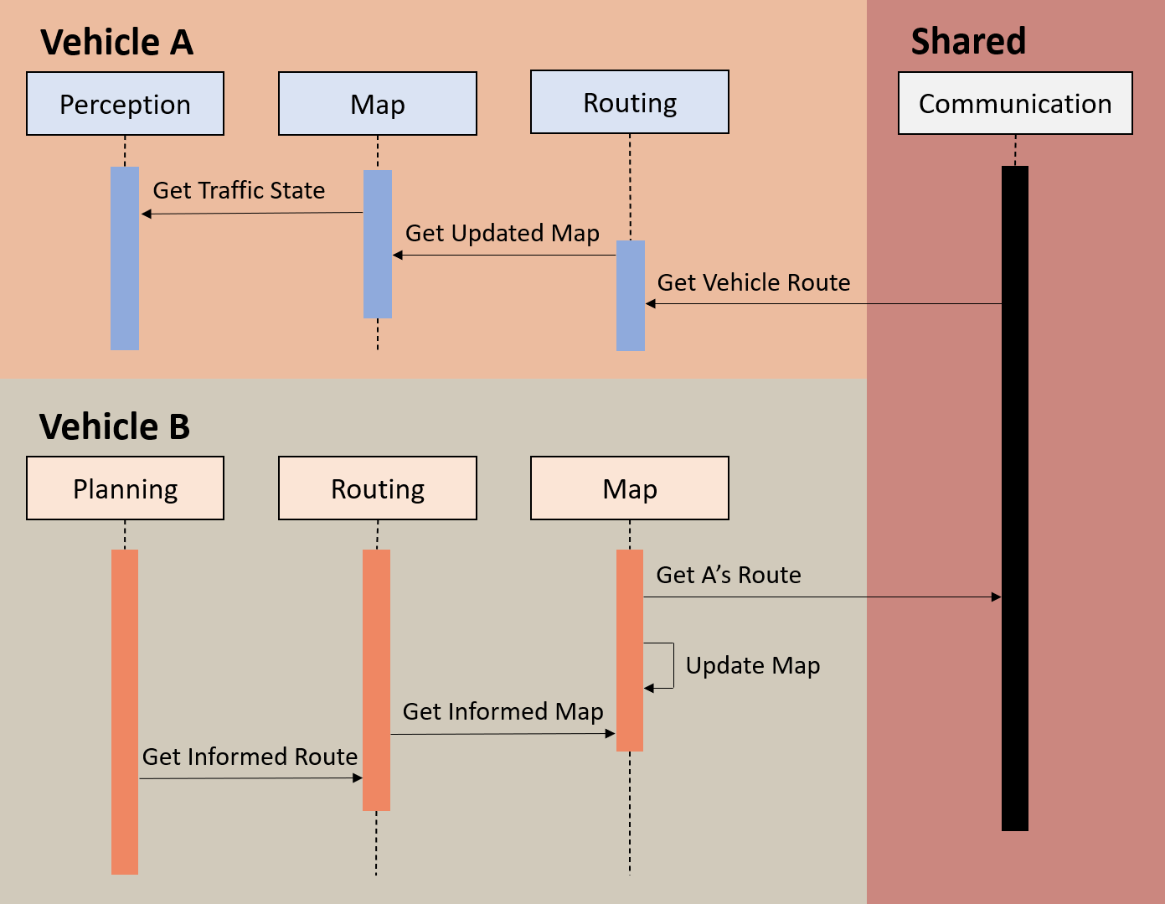
Use Case #2 - Synchronous Movement

Slide 9
Impacted Subsystems
Map module
Must be able to output map data
Must accept additional mapping information
Routing module
Must accept new information from map module
Need to update available roads when building route
Planning module
Modify traffic light setoff functionality

Slide 10
Testing
Need to test both use cases
Require use of dummy cars
Generate dummy traffic data to test system response
Eventual deployment to areas where autonomous cars are already being tested

Slide 11
Risks and Limitations of Approach
Traffic presents a complex challenge
Possible we may not be able to account for all scenarios
Consequences of unexpected software behaviour are severe

Slide 12
Lesson Learned
Better understanding of SAAM analysis
Gained experience developing testing plans
Gained experience evaluating risks
Gained deeper understanding of Apollo architecture - especially affected modules

Slide 13
Limitations of our Report
Impossible to evaluate correctness of proposed changes without real-world testing
Implementation plans, risk analysis, impact assessment are likely idealistic

Slide 14
Conclusion
Concrete architecture of Apollo follows pub/sub style, highly asynchronous
Several modules will interact with proposed enhancement
Map
Routing
Perception
Planning
Two use cases
Traffic jam
Coordinating setoff from red light
NFRs
Maintainability
Testability
Performance
Evolvability
Two methods of implementation
Some limitations, lots of lessons learned

