Slide 1
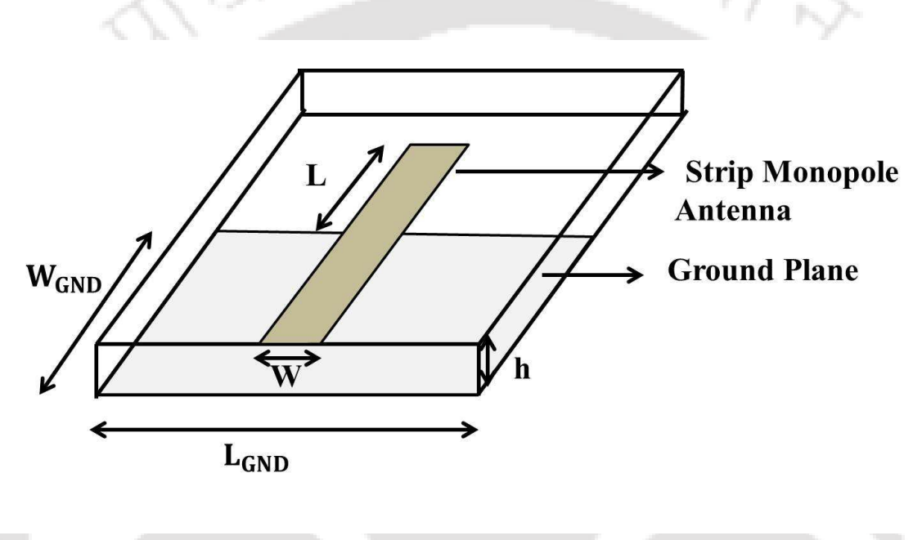
This is a printed monopole
Bandwidth is not large because
Arm of the strip is not broadened

Slide 2
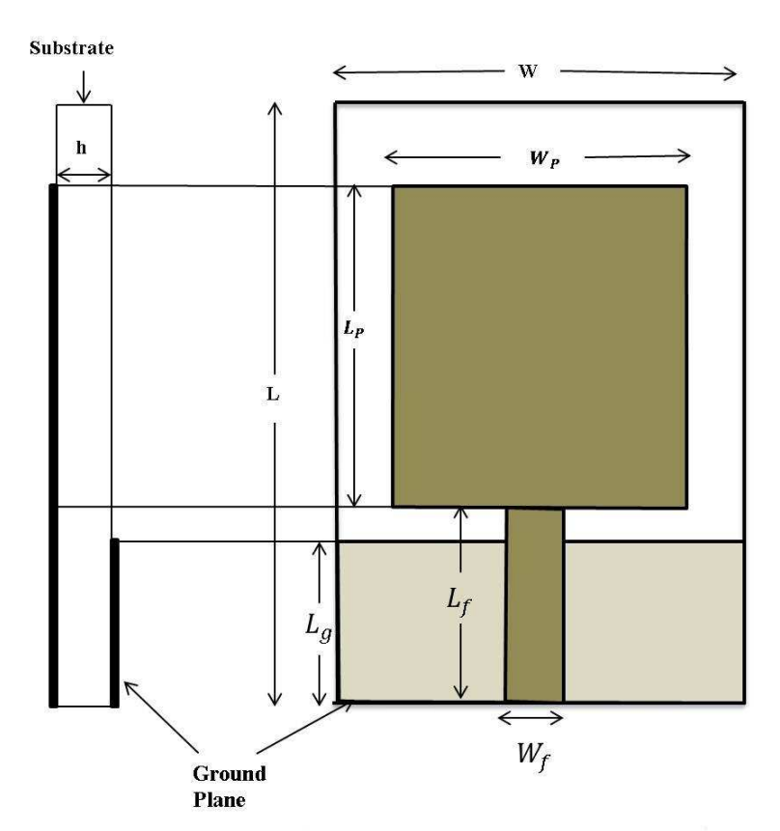
Rectangular Patch is added which
Increases the impedance bandwidth

Slide 3
Rectangular Patch part does not radiate
Only the monopole radiates
So we can remove unnecessary metal
from the rectangular patch → So The cut is
Made
The metered bend is added to maintain
the impedance matching

Slide 4
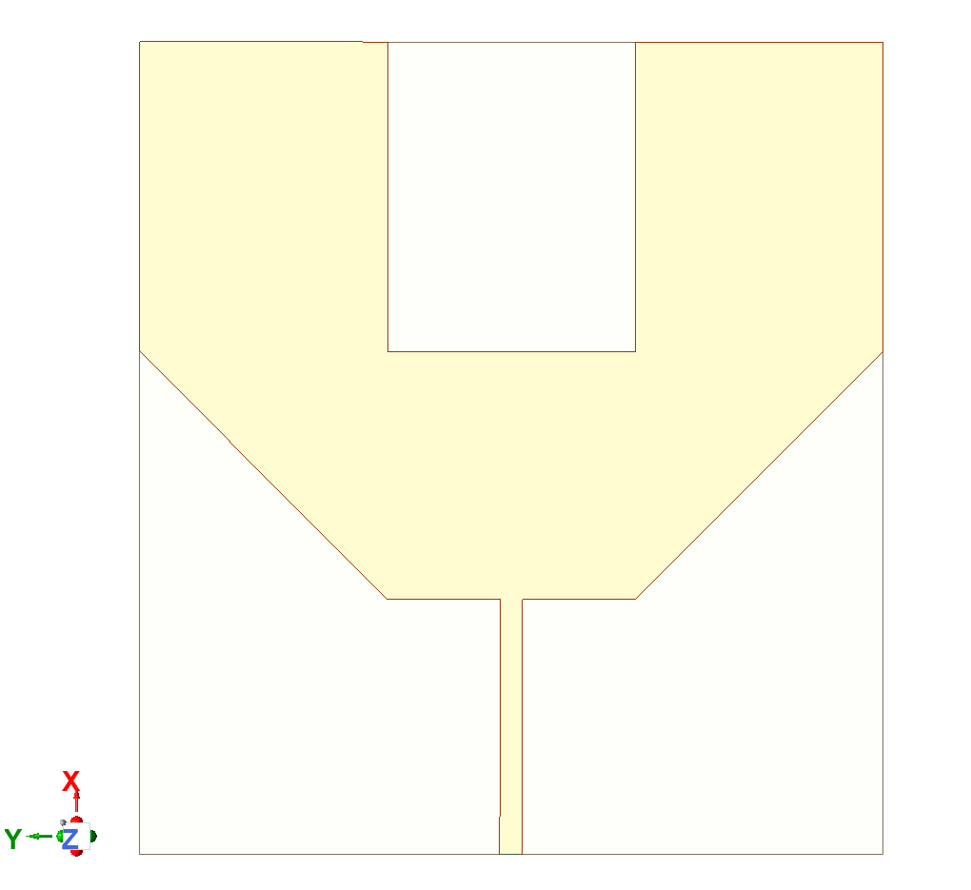

Slide 5
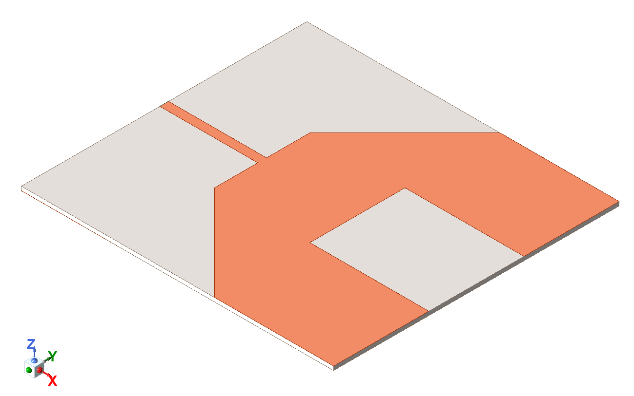

Slide 6
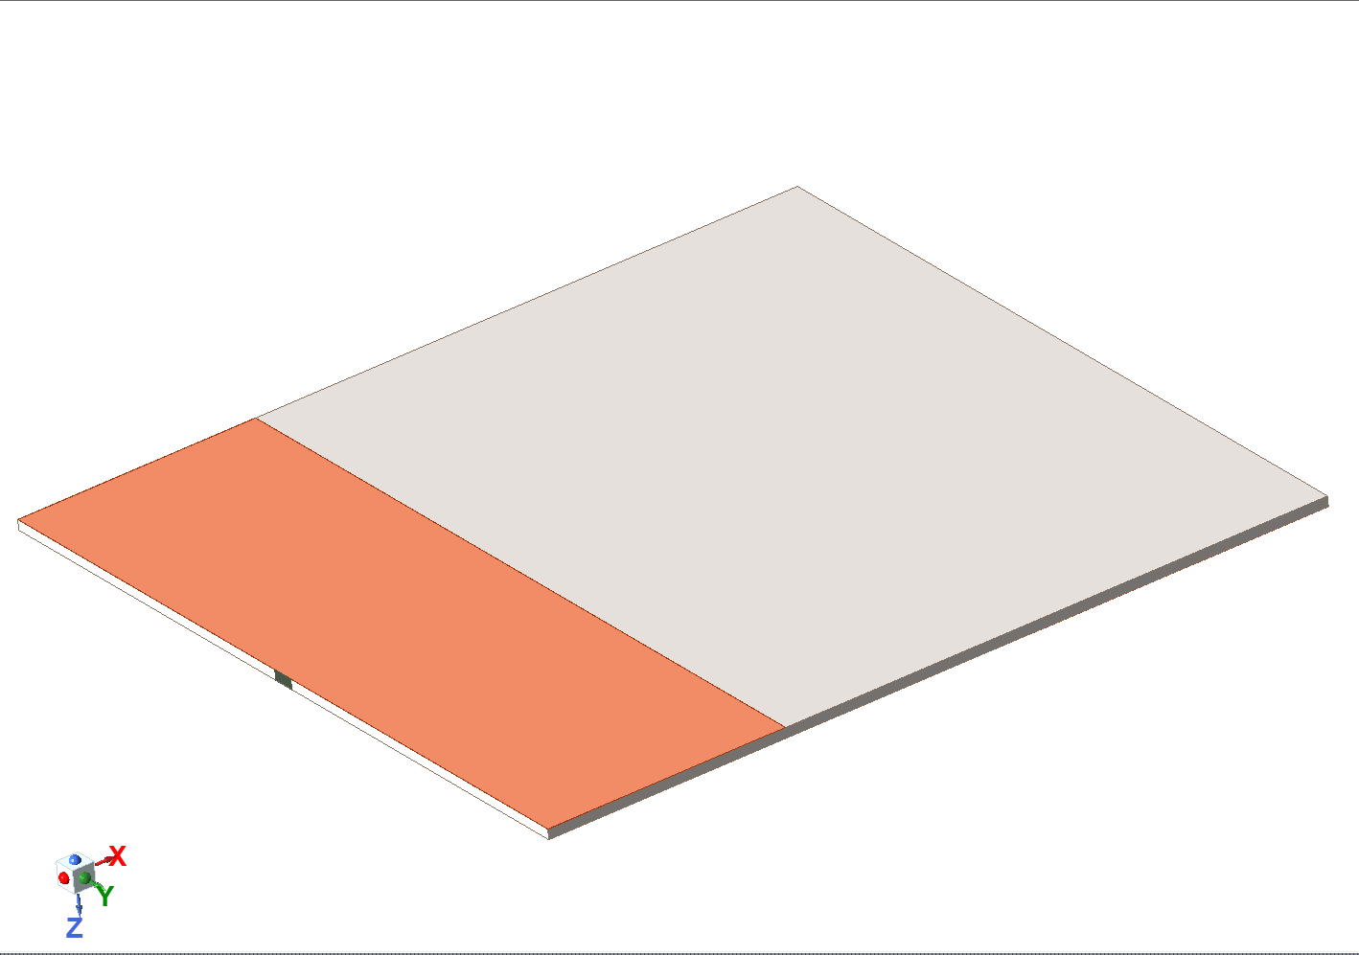

Slide 7
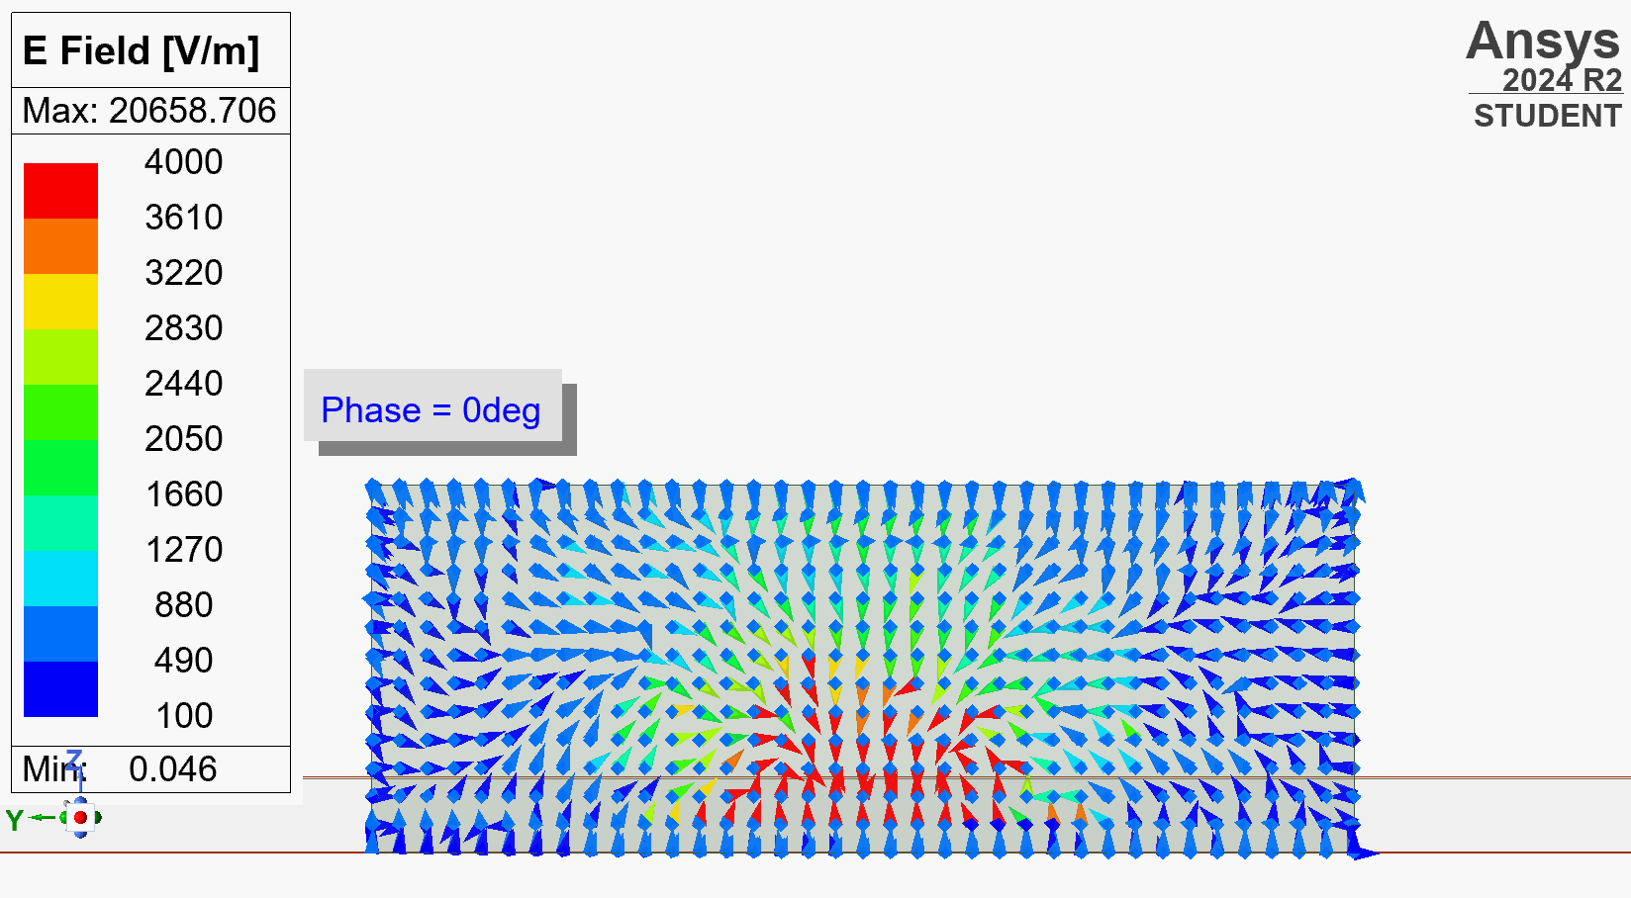

Slide 8
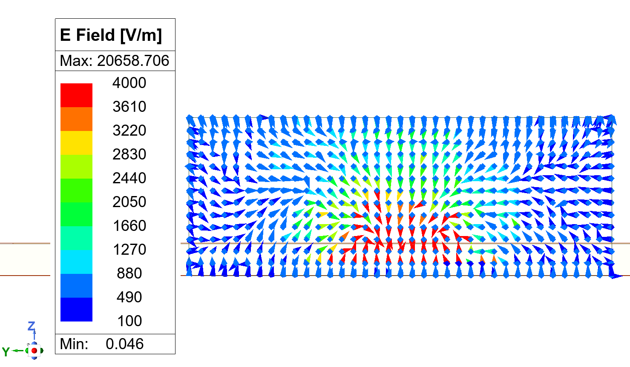

Slide 9
t
h
z = t
t

Slide 10
DEFINE REQUIREMENTS
SELECT SUBSTRATE MATERIAL
CALCULATE INITIAL DIMENSIONS
OPTIMIZE ANTENNA DESIGN
SIMULATE ANTENNA GEOMETRY USING HFSS
CREATE ANTENNA GEOMETRY
FABRICATE ANTENNA
MEASURE ANTENNA PERFORMANCE

