Slide 1
Movie Recommendation System using Content Based Filtering Research Paper Kumar Ankit 18BCS2093

Slide 2
Outline
Introduction
Methodology
Experiments and Results
Neural Networks
Formula
Graphs
Future Works
Conclusions

Slide 3
INTRODUCTION
We tend to like things that are similar to other things we like
We tend to like things that similar people like
These patterns can be used make predictions to offer new things

Slide 4
Introduction Cont.
Recommendations systems involve predicting user preferences for
unseen items .
Such as movies, songs or books
Recommendations systems have become very popular with the increasing availability of millions product online.
Recommending relevant products increases the sale.

Slide 5
Methodology
Collaborative
Content-based
Hybrid
Recommend items those are preferred by similar users
Recommend items based on similarity between items and user's preferences
Combines both

Slide 6
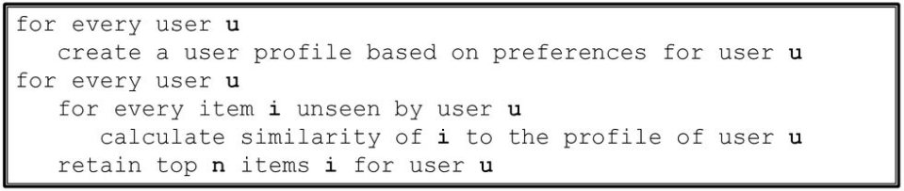
Experiments and results * Content-Based Filtering Algorithm

Slide 7
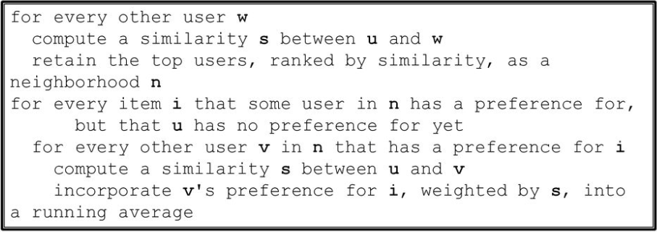
Experiments and results * Collaborative Filtering Algorithm

Slide 8
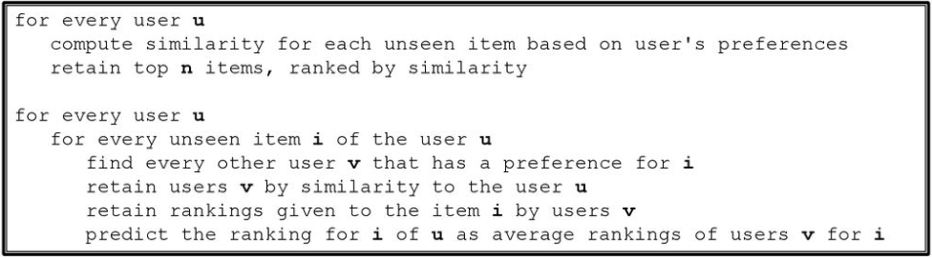
Experiments and results * Hybrid Filtering Algorithm
Finds items with content-based filtering
Predicts ratings with collaborative filtering

Slide 9
Neural Network
Neural Network are the way in which we train machine to mimic human brains.
Many Scientists think the best way to make progress on this is through learning algorithm called neural network.
Neural Networks is the state of art technique for many learning algorithm.

Slide 10
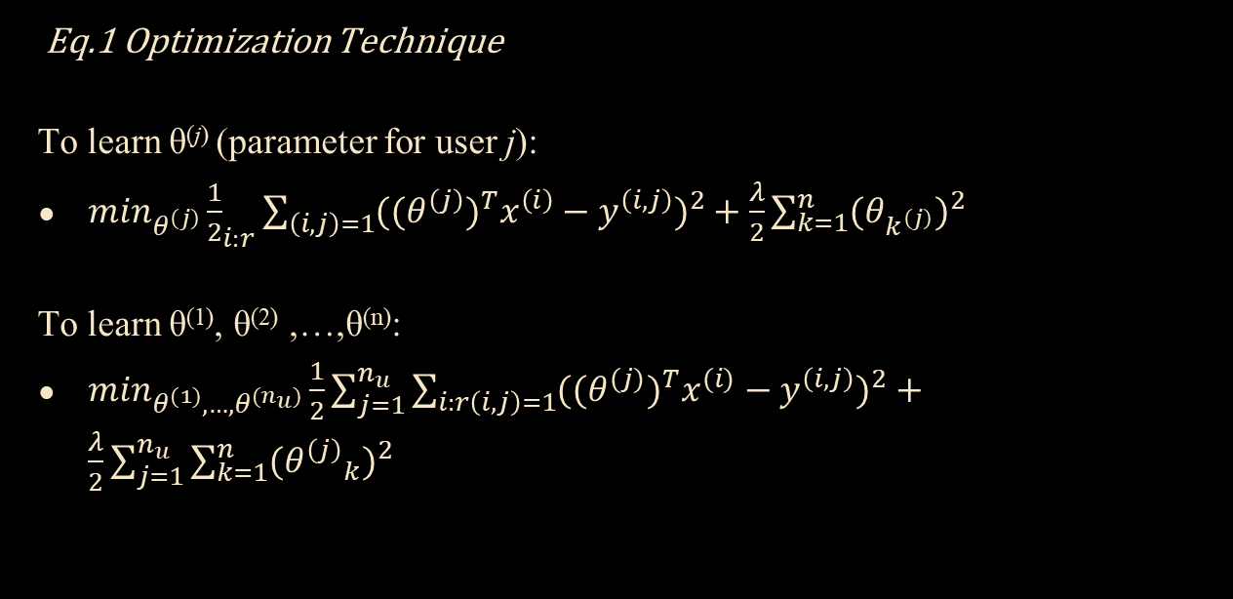
Formula Used
Eq.1 Optimization Technique
To learn θ^{(j)} (parameter for user j):
$\min_{θ^{\left(j\right)}}{\frac{1}{2}}_{i:r}\sum_{\left(i,j\right)=1}^{ }{((θ^{\left(j\right)})^{T}x^{\left(i\right)}−y^{\left(i,j\right)})^{2}}+\frac{λ}{2}\sum_{k=1}^{n}{(θ_{k^{\left(j\right)}}})^{2}$
To learn θ⁽¹⁾, θ⁽²⁾ ,…,θ^{(n)}:
$\min_{θ^{(1)},…,θ^{(n_{u})}}\frac{1}{2}\sum_{j=1}^{n_{u}}{\sum_{i:r\left(i,j\right)=1}^{ }{((θ^{(j)}}})^{T}x^{(i)}−y^{\left(i,j\right)})^{2}+\frac{λ}{2}\sum_{j=1}^{n_{u}}{\sum_{k=1}^{n}{({θ^{\left(j\right)}}_{k})^{2}}}$

Slide 11
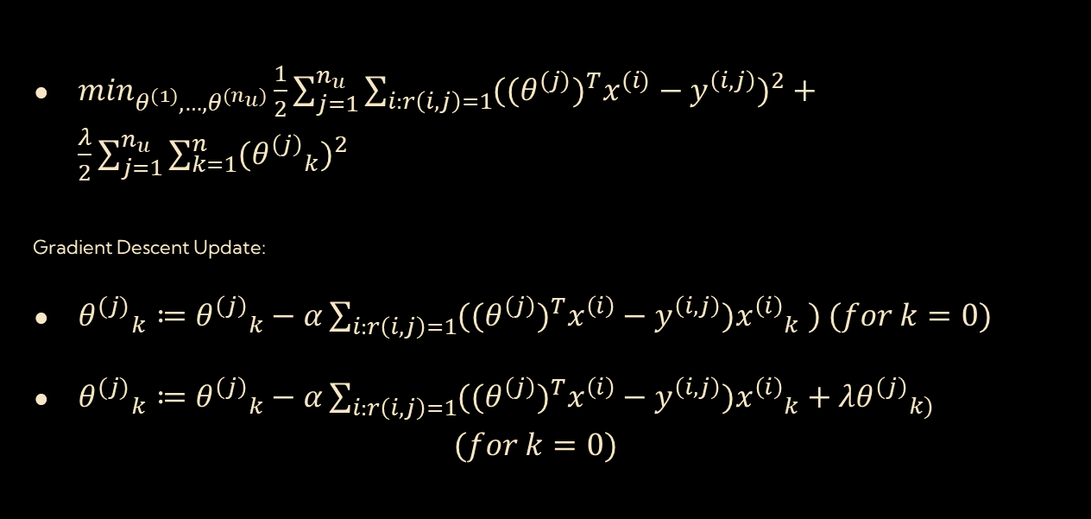
Optimization Algorithm
$\min_{θ^{(1)},…,θ^{(n_{u})}}\frac{1}{2}\sum_{j=1}^{n_{u}}{\sum_{i:r\left(i,j\right)=1}^{ }{((θ^{(j)}}})^{T}x^{(i)}−y^{\left(i,j\right)})^{2}+\frac{λ}{2}\sum_{j=1}^{n_{u}}{\sum_{k=1}^{n}{({θ^{\left(j\right)}}_{k})^{2}}}$
Gradient Descent Update:
${θ^{(j)}}_{k}≔{θ^{\left(j\right)}}_{k}−α\sum_{i:r\left(i,j\right)=1}^{ }{((θ^{\left(j\right)}})^{T}x^{\left(i\right)}−y^{\left(i,j\right)}){x^{\left(i\right)}}_{k} ) (for k=0)$
${θ^{(j)}}_{k}≔{θ^{\left(j\right)}}_{k}−α\sum_{i:r\left(i,j\right)=1}^{ }{((θ^{\left(j\right)}})^{T}x^{\left(i\right)}−y^{\left(i,j\right)}){x^{\left(i\right)}}_{k}+λ{θ^{\left(j\right)}}_{k)}$
$$(for k=0)$$

Slide 12
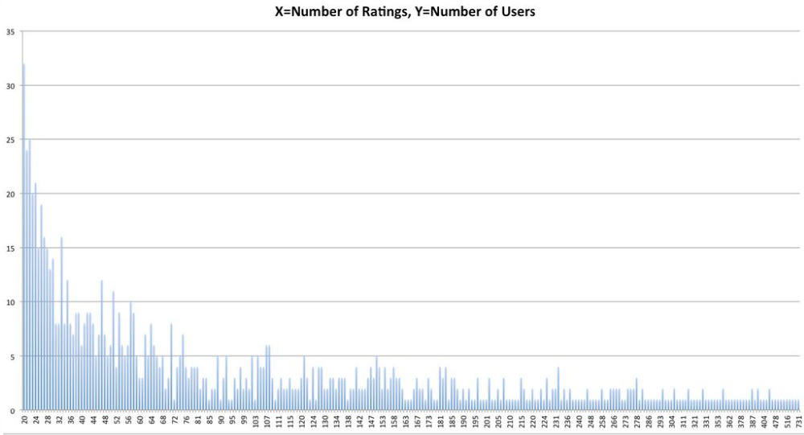
Dataset Cont.

Slide 13
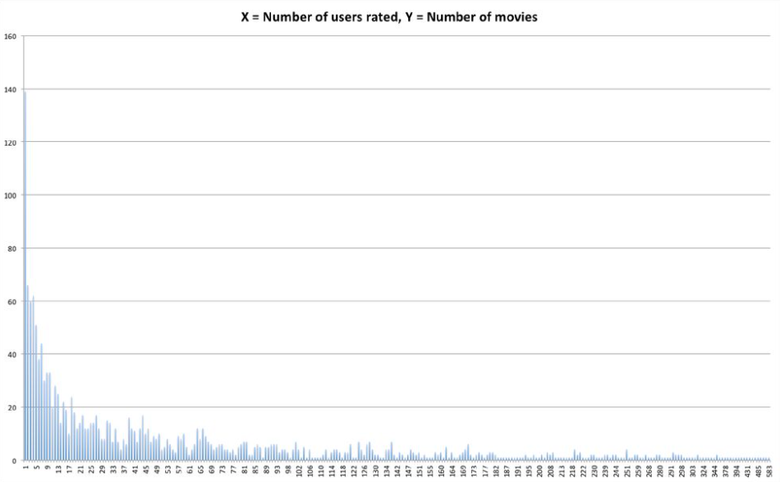
Dataset Cont.

Slide 14
Future Work
Introducing more features
Year of the movie, user’s age, occupation etc.
Using larger datasets MovieLens 1M dataset
MovieLens 10M dataset
Defining different weights to features for every user

Slide 15
Conclusion
Recommendation systems provide content for us by taking what other people recommend as well as our selections into account
Here we are attempting to predict what else the person might be interested in or new films for that person to watch.

Slide 16
Thank You

