Slide 1

Introduction to Git and GitHub
GIS714
Spring 2022

Slide 2


vs.
Open-source version-control software on your computer
Company owned by Microsoft that hosts Git Repositories in the cloud
Alternatives: Bitbucket, GitLab, GitHub Enterprise
Provides features for sharing code, collaborating, raising issues, project tracking and more

Slide 3
What is “version-control” any ways?
“a system that records changes to a file or set of files over time so that you can recall specific versions later.” - git-scm.com
Keeps track of multiple versions of a set of files (branches)
Allows you to move back to older versions without deleting current work (revert/reset/checkout)

Slide 4
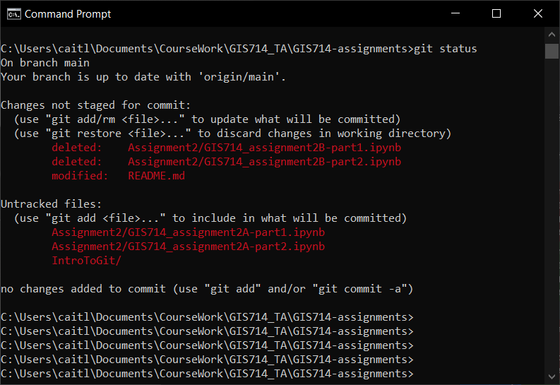
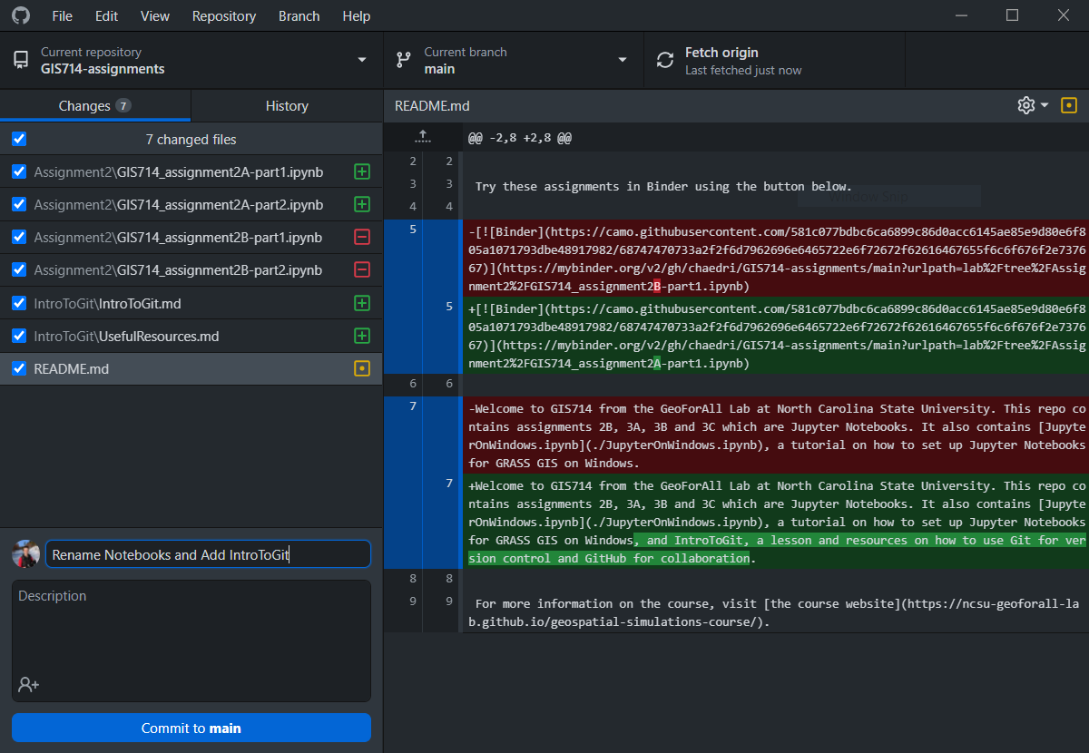
How do I use Git on my local machine?
Command Line Interface (CLI)
https://git-scm.com/downloads
Graphical User Interfaces
GitHub Desktop, GitKraken, SourceTree

Slide 5
Basic Git: Commit
Commit your changes:
Changes to your files
1. git status to see current state of directory
2. git add files that you want to commit
3. git commit changes with descriptions (“-m” flag)
1st Commit
2nd Commit

Slide 6
Basic Git: Branch
Make a branch
Branch
1. git commit
2. git branch new-branch-name
3. git checkout new-branch-name
1st Commit
… shortcut for 2 and 3:
git checkout –b new-branch-name

Slide 7
Basic Git: Branch and Merge
Develop New Feature
Branch
Merge
Branch
Main
1st Commit
Now, main has your new feature!

Slide 8
So, what about GitHub?
GitHub
Branch
“I just pushed some changes”
“Let me pull the changes you just made so I can test them!"
Main
Pull
Push
Local Machine
Branch
Main

Slide 9
So, what about GitHub?
GitHub
Branch
“I just pushed some changes”
“Let me pull the changes you just made so I can test them!"
Main
Clone
Local Machine
Branch
Main

Slide 10
Collaborating with GitHub
Your Awesome Repository
My Copy of Your Awesome Repository
Fork
I make some changes to your repository
Your Awesome Repository with my new additions!
My Copy of Your Awesome Repository
Pull Request

