Slide 1
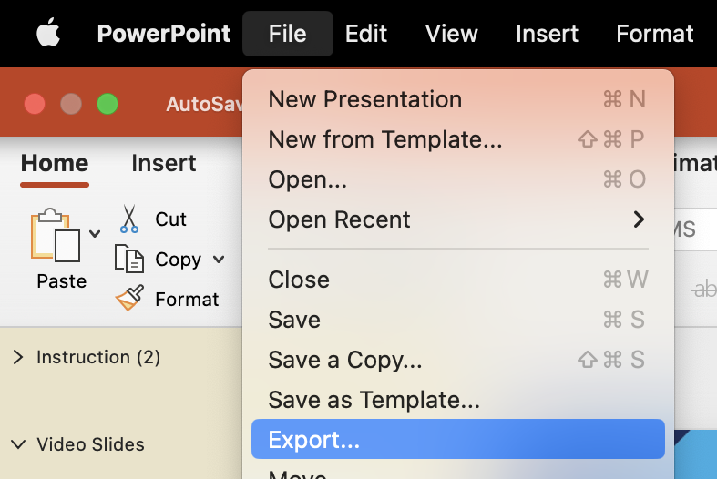
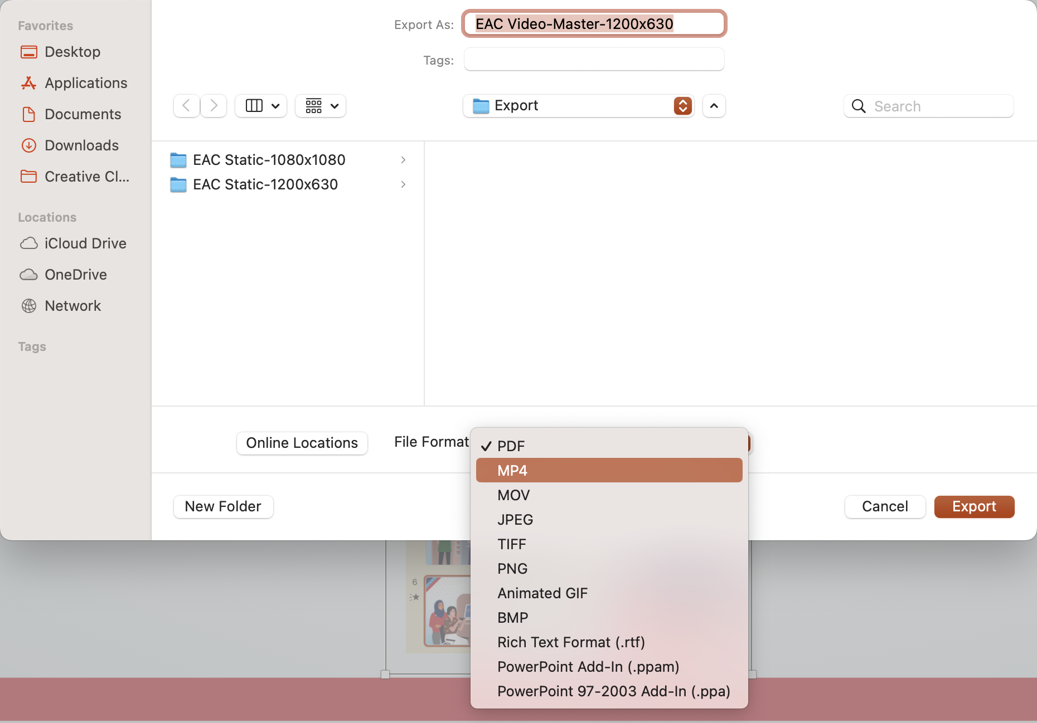
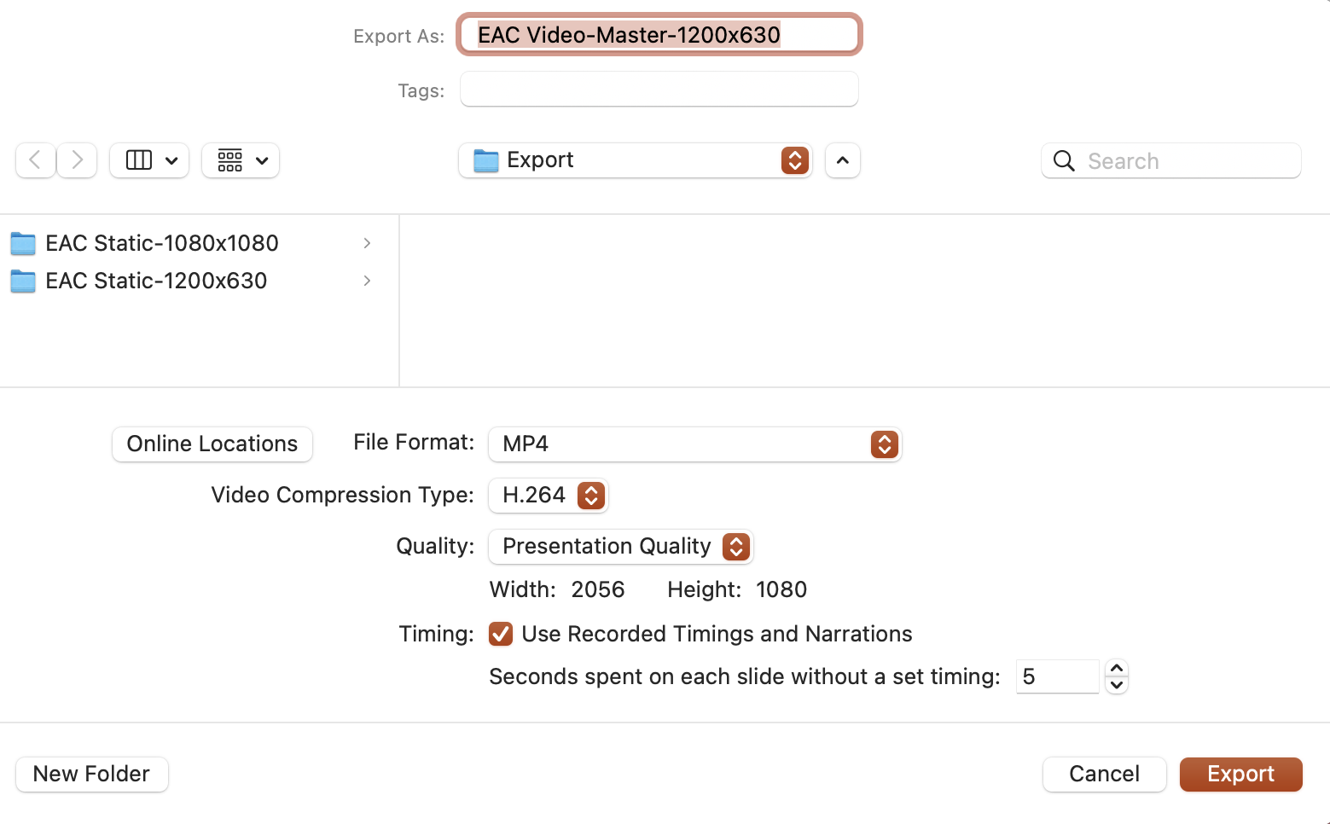
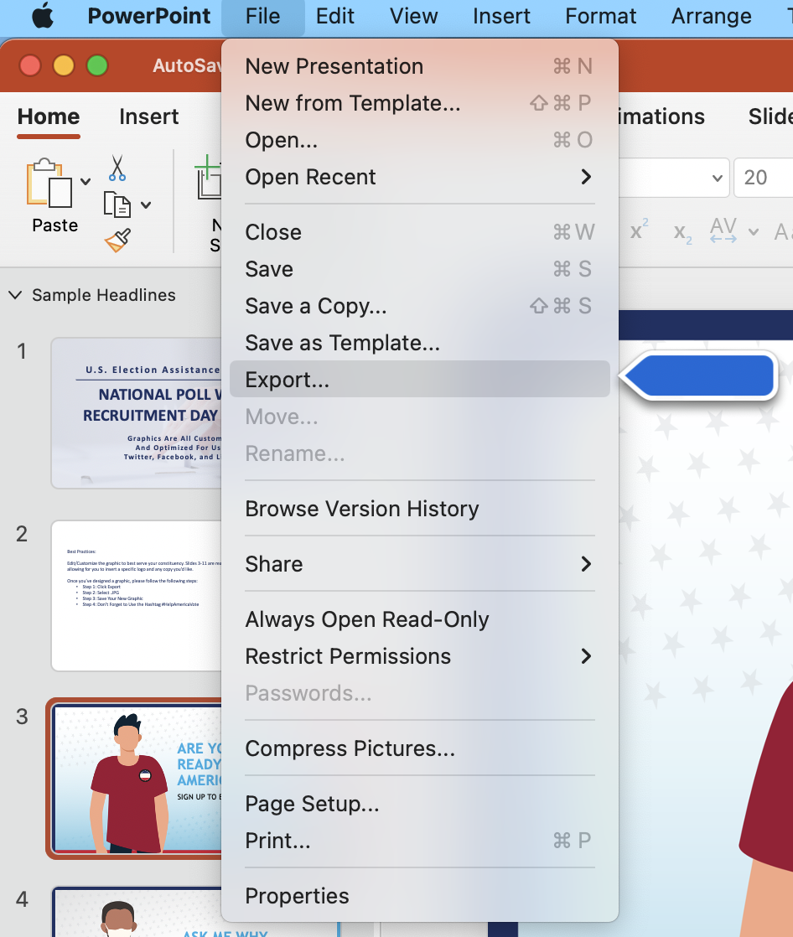
For Mac Users: Best Practices: Step-by-Step Guide To Customizable Graphics
Edit/Customize the motion graphic to best serve your constituency. Customize the graphic by inserting a specific logo and any copy you’d like.
Once you’ve designed a graphic, please follow the following steps:
Step 1: Click File, then Export
Step 2: Select .MP4
Step 3: Match Export Setting to Screen Shot and Save Your New Graphic
Step 4: Don’t Forget to Use the Hashtag #HelpAmericaVote
Step 1
Step 2
Step 3

Slide 2
For Windows Users: Best Practices: Step-by-Step Guide To Customizable Graphics
Edit/Customize the motion graphic to best serve your constituency. Customize the graphic by inserting a specific logo and any copy you’d like.
Once you’ve designed a graphic, please follow the following steps:
Step 1: Click File, then Export
Step 2: Select .MP4
Step 3: Match Export Setting to Screen Shot and Save Your New Graphic
Step 4: Don’t Forget to Use the Hashtag #HelpAmericaVote
Step 1
Step 2
Step 3
Step 4

