Slide 1



Anthony Albence
Chair, Postal Task Force-Election Center
Department of Elections
State of Delaware
Notes:
© 2007 Microsoft Corporation. All rights reserved. Microsoft, Windows, Windows Vista and other product names are or may be registered trademarks and/or trademarks in the U.S. and/or other countries.
The information herein is for informational purposes only and represents the current view of Microsoft Corporation as of the date of this presentation. Because Microsoft must respond to changing market conditions, it should not be interpreted to be a commitment on the part of Microsoft, and Microsoft cannot guarantee the accuracy of any information provided after the date of this presentation.
MICROSOFT MAKES NO WARRANTIES, EXPRESS, IMPLIED OR STATUTORY, AS TO THE INFORMATION IN THIS PRESENTATION.

Slide 2



USPS Commitment From Executive Level to Field Team Level
  Personal commitment & follow-through of the Deputy Postmaster General (DPMG) on issues raised from the Elections community
  DPMG spearheaded USPS-wide commitment to service delivery for Elections officials & voters
    Regular contact with Local Election Officials (LEOs)
    Plant sweeps for ballots
    Ballot delivery to LEOs
Notes:
© 2007 Microsoft Corporation. All rights reserved. Microsoft, Windows, Windows Vista and other product names are or may be registered trademarks and/or trademarks in the U.S. and/or other countries.
The information herein is for informational purposes only and represents the current view of Microsoft Corporation as of the date of this presentation. Because Microsoft must respond to changing market conditions, it should not be interpreted to be a commitment on the part of Microsoft, and Microsoft cannot guarantee the accuracy of any information provided after the date of this presentation.
MICROSOFT MAKES NO WARRANTIES, EXPRESS, IMPLIED OR STATUTORY, AS TO THE INFORMATION IN THIS PRESENTATION.

Slide 3

Election Center’s team focused on postal-related issues
  Direct connection with Daniel Bentley, Election Mail Program Manager @ USPS , & colleagues at senior levels in USPS operational units
Forum for election officials to raise concerns and share ideas
  Meetings held at:
    EC Joint Election Officials Liaison
    EC Annual Conference
  Regular communication via email
Notes:
© 2007 Microsoft Corporation. All rights reserved. Microsoft, Windows, Windows Vista and other product names are or may be registered trademarks and/or trademarks in the U.S. and/or other countries.
The information herein is for informational purposes only and represents the current view of Microsoft Corporation as of the date of this presentation. Because Microsoft must respond to changing market conditions, it should not be interpreted to be a commitment on the part of Microsoft, and Microsoft cannot guarantee the accuracy of any information provided after the date of this presentation.
MICROSOFT MAKES NO WARRANTIES, EXPRESS, IMPLIED OR STATUTORY, AS TO THE INFORMATION IN THIS PRESENTATION.

Slide 4




Notes:
DE MDA Story (1 hr turnaround)
Important to not only touch base with USPS officials during the election season or when problems occur
© 2007 Microsoft Corporation. All rights reserved. Microsoft, Windows, Windows Vista and other product names are or may be registered trademarks and/or trademarks in the U.S. and/or other countries.
The information herein is for informational purposes only and represents the current view of Microsoft Corporation as of the date of this presentation. Because Microsoft must respond to changing market conditions, it should not be interpreted to be a commitment on the part of Microsoft, and Microsoft cannot guarantee the accuracy of any information provided after the date of this presentation.
MICROSOFT MAKES NO WARRANTIES, EXPRESS, IMPLIED OR STATUTORY, AS TO THE INFORMATION IN THIS PRESENTATION.

Slide 5
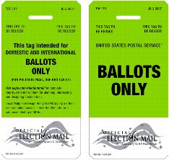

Tag 191
  Use for ballots (only)
  Raises visibility of ballots in USPS plants
  Does NOT change class of service paid
Notes:
© 2007 Microsoft Corporation. All rights reserved. Microsoft, Windows, Windows Vista and other product names are or may be registered trademarks and/or trademarks in the U.S. and/or other countries.
The information herein is for informational purposes only and represents the current view of Microsoft Corporation as of the date of this presentation. Because Microsoft must respond to changing market conditions, it should not be interpreted to be a commitment on the part of Microsoft, and Microsoft cannot guarantee the accuracy of any information provided after the date of this presentation.
MICROSOFT MAKES NO WARRANTIES, EXPRESS, IMPLIED OR STATUTORY, AS TO THE INFORMATION IN THIS PRESENTATION.

Slide 6

Election Mail Logo
  Only USPS-approved logo for mail
  Utilize on all election-related mail
  Consults USPS Publication 631 for use
Notes:
© 2007 Microsoft Corporation. All rights reserved. Microsoft, Windows, Windows Vista and other product names are or may be registered trademarks and/or trademarks in the U.S. and/or other countries.
The information herein is for informational purposes only and represents the current view of Microsoft Corporation as of the date of this presentation. Because Microsoft must respond to changing market conditions, it should not be interpreted to be a commitment on the part of Microsoft, and Microsoft cannot guarantee the accuracy of any information provided after the date of this presentation.
MICROSOFT MAKES NO WARRANTIES, EXPRESS, IMPLIED OR STATUTORY, AS TO THE INFORMATION IN THIS PRESENTATION.

Slide 7
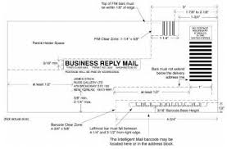
Mailpiece Design Analysts (MDA)
  Utilize for ALL new envelope design & printing
  Submit EXISTING envelopes for review
Notes:
© 2007 Microsoft Corporation. All rights reserved. Microsoft, Windows, Windows Vista and other product names are or may be registered trademarks and/or trademarks in the U.S. and/or other countries.
The information herein is for informational purposes only and represents the current view of Microsoft Corporation as of the date of this presentation. Because Microsoft must respond to changing market conditions, it should not be interpreted to be a commitment on the part of Microsoft, and Microsoft cannot guarantee the accuracy of any information provided after the date of this presentation.
MICROSOFT MAKES NO WARRANTIES, EXPRESS, IMPLIED OR STATUTORY, AS TO THE INFORMATION IN THIS PRESENTATION.

Slide 8
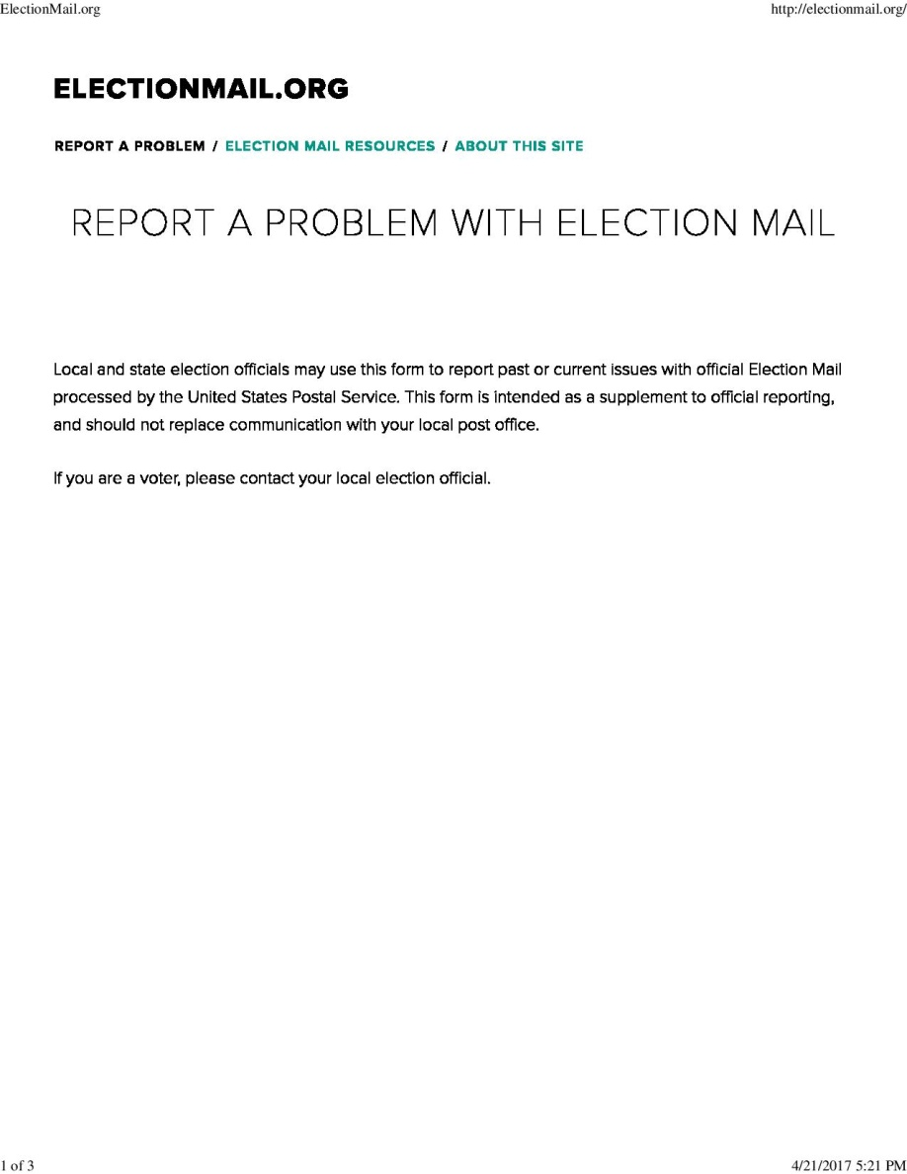
ELECTIONMAIL.ORG
Notes:
DE MDA Story (1 hr turnaround)
Important to not only touch base with USPS officials during the election season or when problems occur
© 2007 Microsoft Corporation. All rights reserved. Microsoft, Windows, Windows Vista and other product names are or may be registered trademarks and/or trademarks in the U.S. and/or other countries.
The information herein is for informational purposes only and represents the current view of Microsoft Corporation as of the date of this presentation. Because Microsoft must respond to changing market conditions, it should not be interpreted to be a commitment on the part of Microsoft, and Microsoft cannot guarantee the accuracy of any information provided after the date of this presentation.
MICROSOFT MAKES NO WARRANTIES, EXPRESS, IMPLIED OR STATUTORY, AS TO THE INFORMATION IN THIS PRESENTATION.

Slide 9
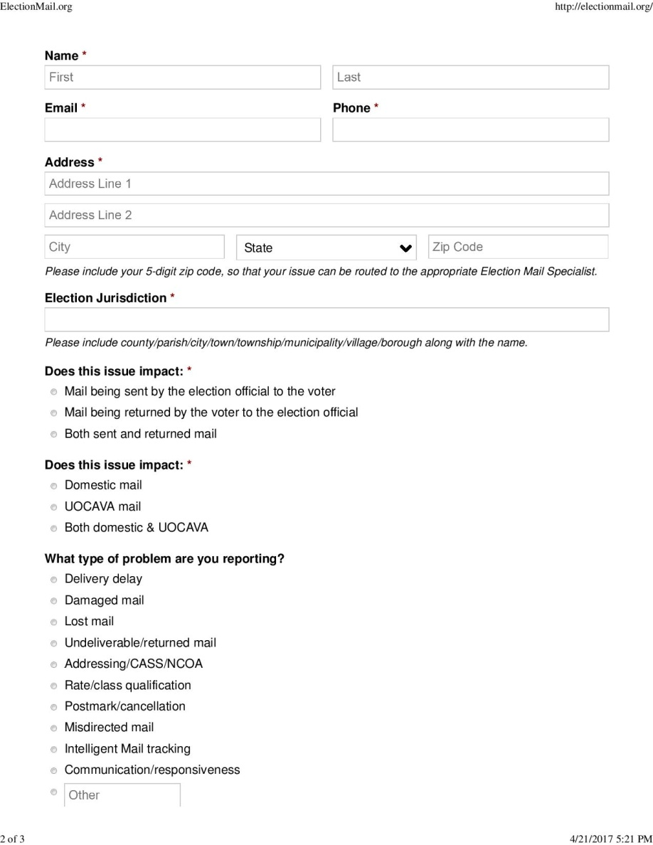
ELECTIONMAIL.ORG
Collaboration between:
  Democracy Works
  Bipartisan Policy Center
  w/support from The Democracy Fund
Notes:
© 2007 Microsoft Corporation. All rights reserved. Microsoft, Windows, Windows Vista and other product names are or may be registered trademarks and/or trademarks in the U.S. and/or other countries.
The information herein is for informational purposes only and represents the current view of Microsoft Corporation as of the date of this presentation. Because Microsoft must respond to changing market conditions, it should not be interpreted to be a commitment on the part of Microsoft, and Microsoft cannot guarantee the accuracy of any information provided after the date of this presentation.
MICROSOFT MAKES NO WARRANTIES, EXPRESS, IMPLIED OR STATUTORY, AS TO THE INFORMATION IN THIS PRESENTATION.

Slide 10
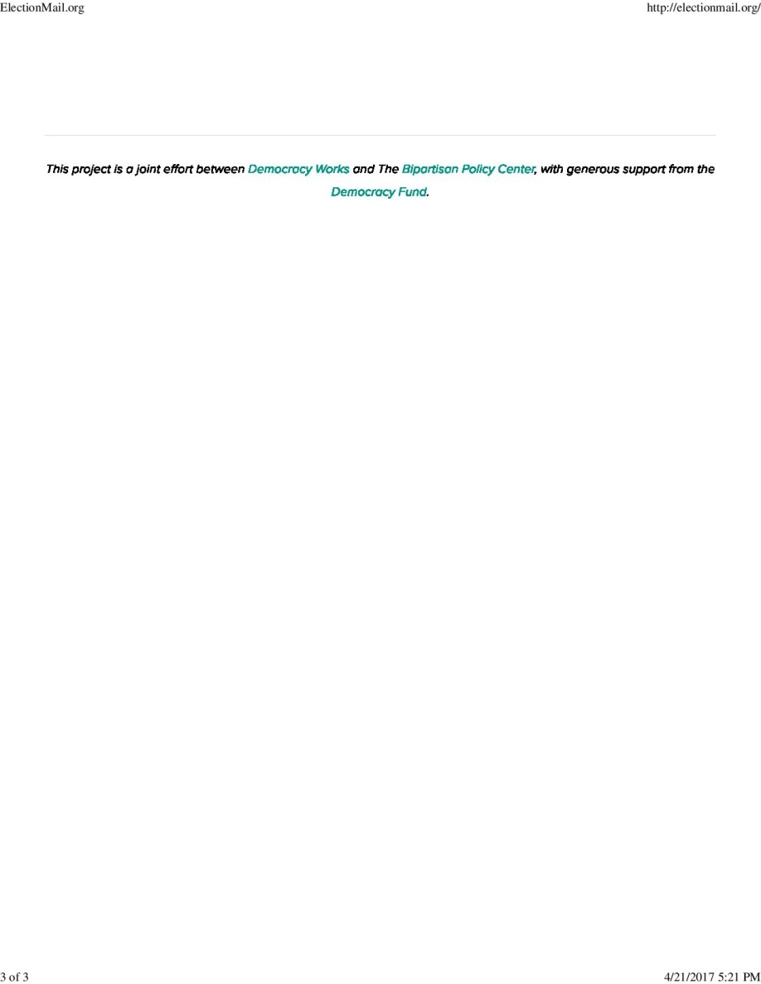
ELECTIONMAIL.ORG
ELECTIONMAIL.ORG
SUPPLEMENTS communication w/local USPS officials
Integrated w/USPS trouble ticket system
Notes:
DE MDA Story (1 hr turnaround)
Important to not only touch base with USPS officials during the election season or when problems occur
© 2007 Microsoft Corporation. All rights reserved. Microsoft, Windows, Windows Vista and other product names are or may be registered trademarks and/or trademarks in the U.S. and/or other countries.
The information herein is for informational purposes only and represents the current view of Microsoft Corporation as of the date of this presentation. Because Microsoft must respond to changing market conditions, it should not be interpreted to be a commitment on the part of Microsoft, and Microsoft cannot guarantee the accuracy of any information provided after the date of this presentation.
MICROSOFT MAKES NO WARRANTIES, EXPRESS, IMPLIED OR STATUTORY, AS TO THE INFORMATION IN THIS PRESENTATION.

Slide 11

electionmail.org site
  Continue to utilize as needed
Maintain relationships with local USPS with local USPS officials & staff
Notes:
© 2007 Microsoft Corporation. All rights reserved. Microsoft, Windows, Windows Vista and other product names are or may be registered trademarks and/or trademarks in the U.S. and/or other countries.
The information herein is for informational purposes only and represents the current view of Microsoft Corporation as of the date of this presentation. Because Microsoft must respond to changing market conditions, it should not be interpreted to be a commitment on the part of Microsoft, and Microsoft cannot guarantee the accuracy of any information provided after the date of this presentation.
MICROSOFT MAKES NO WARRANTIES, EXPRESS, IMPLIED OR STATUTORY, AS TO THE INFORMATION IN THIS PRESENTATION.

Slide 12

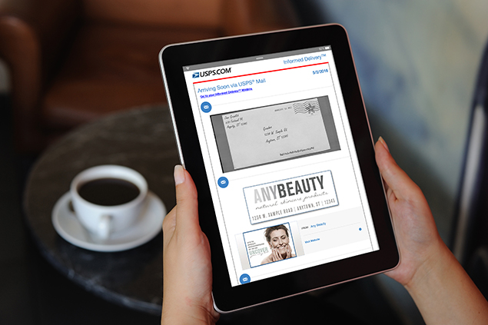
USPS Informed Delivery:
  Residential product
  Image provided for items up to letter size items processed through automation
  Additional tool to inform voters for applicable items
Notes:
© 2007 Microsoft Corporation. All rights reserved. Microsoft, Windows, Windows Vista and other product names are or may be registered trademarks and/or trademarks in the U.S. and/or other countries.
The information herein is for informational purposes only and represents the current view of Microsoft Corporation as of the date of this presentation. Because Microsoft must respond to changing market conditions, it should not be interpreted to be a commitment on the part of Microsoft, and Microsoft cannot guarantee the accuracy of any information provided after the date of this presentation.
MICROSOFT MAKES NO WARRANTIES, EXPRESS, IMPLIED OR STATUTORY, AS TO THE INFORMATION IN THIS PRESENTATION.

Slide 13

Dedicated resource section on EC website including postal-related info & USPS resources
  Members only resource section
  Forum area for member communication
Conferences & Workshops
  Postal panels/sessions featuring USPS & State/Local Elections Officials
Notes:
© 2007 Microsoft Corporation. All rights reserved. Microsoft, Windows, Windows Vista and other product names are or may be registered trademarks and/or trademarks in the U.S. and/or other countries.
The information herein is for informational purposes only and represents the current view of Microsoft Corporation as of the date of this presentation. Because Microsoft must respond to changing market conditions, it should not be interpreted to be a commitment on the part of Microsoft, and Microsoft cannot guarantee the accuracy of any information provided after the date of this presentation.
MICROSOFT MAKES NO WARRANTIES, EXPRESS, IMPLIED OR STATUTORY, AS TO THE INFORMATION IN THIS PRESENTATION.

Slide 14


Build on growing partnership with USPS Subcommittee of EAC Standards Board, Election Center Postal Task Force, & the USPS
Continue to promote use of electionmail.org
Notes:
© 2007 Microsoft Corporation. All rights reserved. Microsoft, Windows, Windows Vista and other product names are or may be registered trademarks and/or trademarks in the U.S. and/or other countries.
The information herein is for informational purposes only and represents the current view of Microsoft Corporation as of the date of this presentation. Because Microsoft must respond to changing market conditions, it should not be interpreted to be a commitment on the part of Microsoft, and Microsoft cannot guarantee the accuracy of any information provided after the date of this presentation.
MICROSOFT MAKES NO WARRANTIES, EXPRESS, IMPLIED OR STATUTORY, AS TO THE INFORMATION IN THIS PRESENTATION.

Slide 15


Anthony Albence
Chair, Postal Task Force-Election Center
Department of Elections
State of Delaware
Notes:
© 2007 Microsoft Corporation. All rights reserved. Microsoft, Windows, Windows Vista and other product names are or may be registered trademarks and/or trademarks in the U.S. and/or other countries.
The information herein is for informational purposes only and represents the current view of Microsoft Corporation as of the date of this presentation. Because Microsoft must respond to changing market conditions, it should not be interpreted to be a commitment on the part of Microsoft, and Microsoft cannot guarantee the accuracy of any information provided after the date of this presentation.
MICROSOFT MAKES NO WARRANTIES, EXPRESS, IMPLIED OR STATUTORY, AS TO THE INFORMATION IN THIS PRESENTATION.

