Slide 1
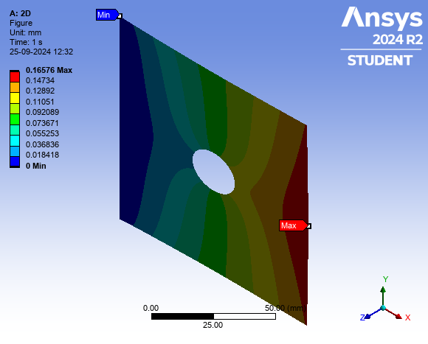
Stress and Deformation Report
Input Features | Values
Thickness (mm) | 7.0
Diameter (mm) | 20.0
Force (N) | 72000.0
Max Stress (MPa) | 13.81
Min Stress (MPa) | 333.54
Max Deformation (mm) | 0.04

