Slide 1
Проект по “Откриване на знания в текст”
Работа по задача 1 от CLEF2022-CheckThat!
Разпознаване на релевантни твърдения в туийтове.
Иван Арабаджийски 5MI3400052

Slide 2
Задачите
Task 1: Identifying Relevant Claims in Tweets
Subtask 1A: Check-worthiness of tweets: Given a tweet, predict whether it is worth fact-checking. This task is defined with binary labels: Yes and No. This is a classification task
Subtask 1B: Verifiable factual claims detection: Given a tweet, predict whether it contains a verifiable factual claim. This is a binary task with two labels: Yes and No. This is a classification task.
Subtask 1C: Harmful tweet detection : Given a tweet, predict whether it is harmful to the society and why. This task is defined with binary labels: Yes and No. This is a classification task.
Subtask 1D: Attention-worthy tweet detection: Given a tweet, predict whether it should get the attention of policy makers and why. This task is defined with nine class labels: (i) No, not interesting, (ii) Yes, asks question, (iii) Yes, blame authorities, (iv) Yes, calls for action, (v) Yes, classified as in harmful task, (vi) Yes, contains advice, (vii) Yes, discusses action taken, (viii) Yes, discusses cure, and (ix) Yes, other. This is a classification task.

Slide 3
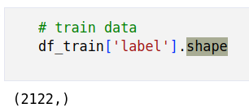
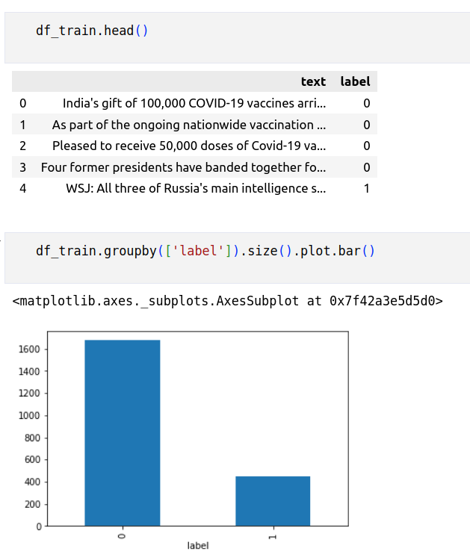
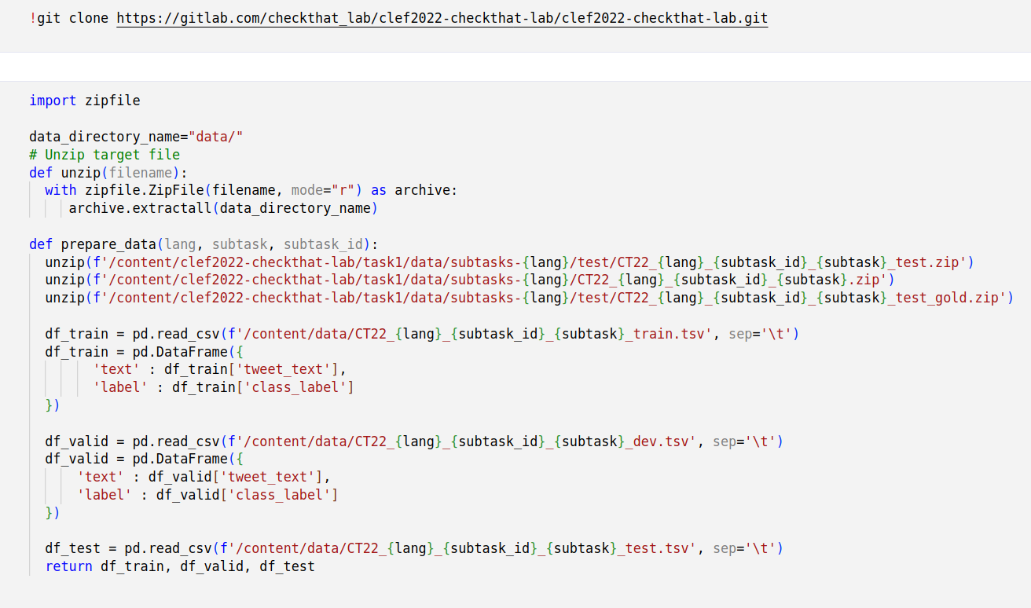
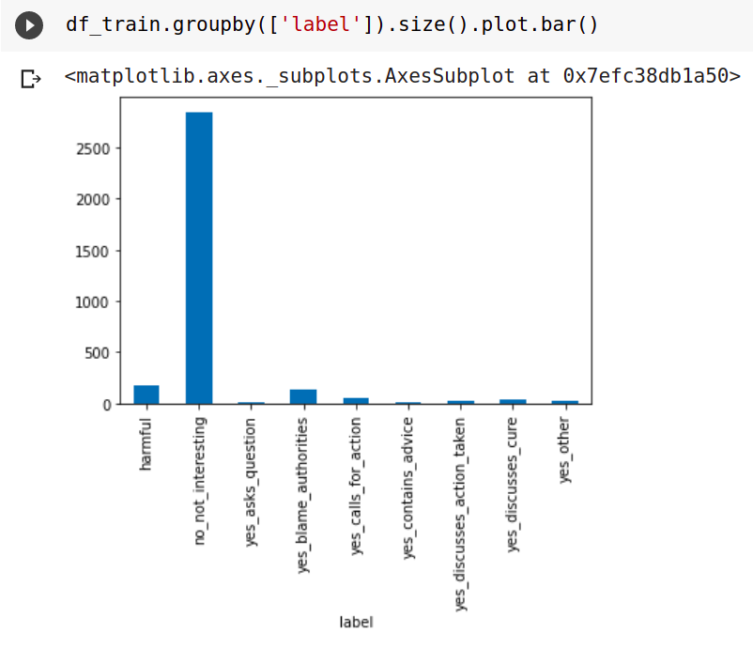
Данните

Slide 4
Решението
Модел, състоящ се от трансформър за класификация
Различни претренирани трансформъри, с които са правени експерименти са:
bert-base-cased, vinai/bertweet-base, vinai/bertweet-covid19-base-cased, roberta-base, bert-base-multilingual-cased

Slide 5
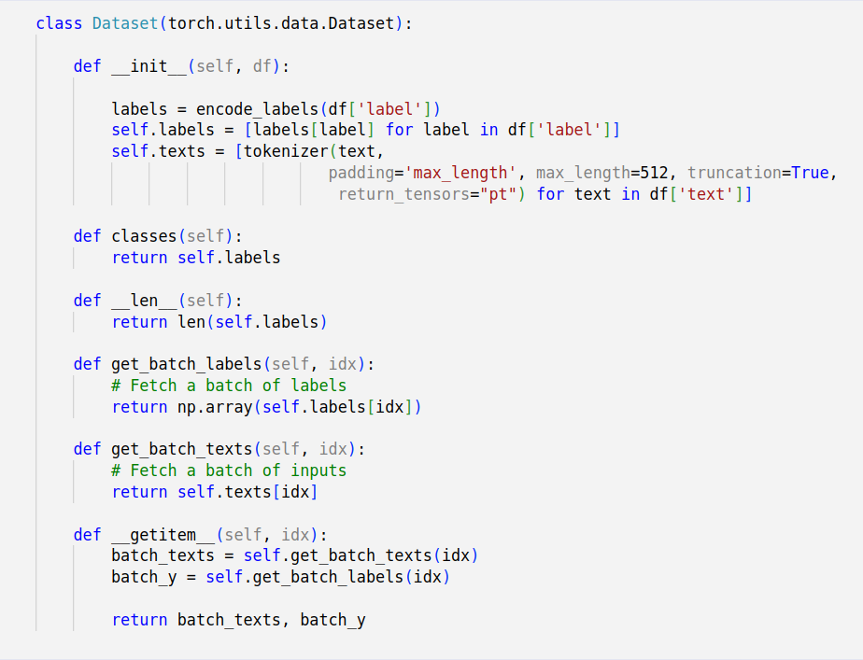
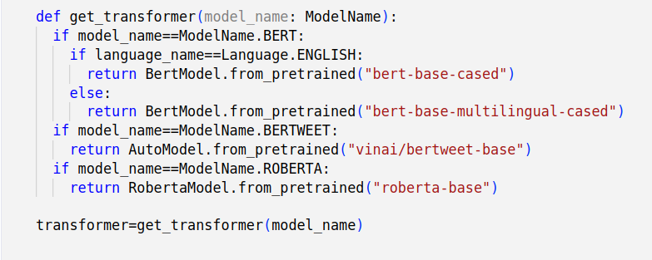
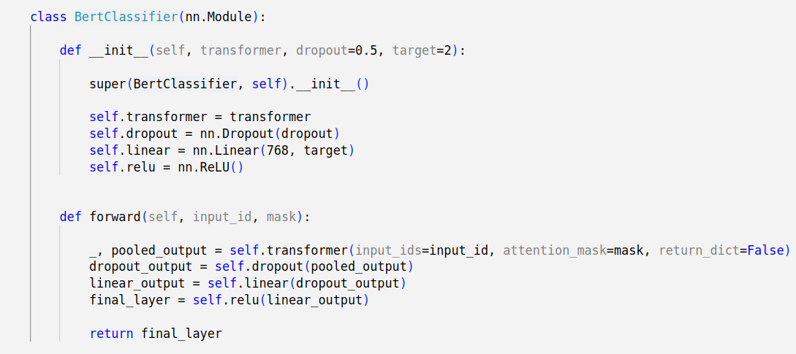

Slide 6
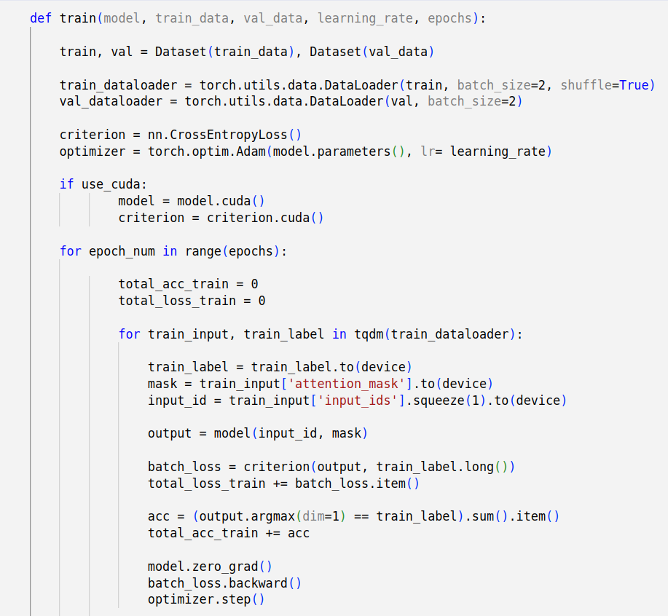

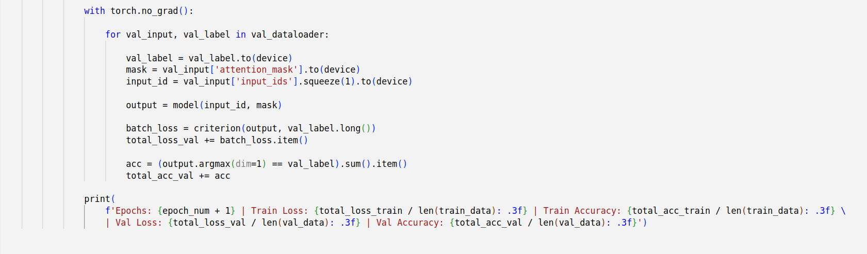
Трениране, валидация и предсказване

Slide 7
Резултати

Slide 9
Бъдещи подобрения
Експерименти с още различни конфигурации на хиперпараметрите
Нови идеи за предварителна обработка на текста

