Slide 1
Step-By-Step Instructions for Miniproject 2

Slide 2
Matrix Factorization with Missing Values
N Movies
K
N
Y
(missing values)
U^{T}
V
K
=
M Users
M
“Latent Factors”
Goal #1: Learn a Latent Factor Model U & V
Goal #2: Visualize & Interpret U & V (mostly V)

Slide 3
Final Product: Create Something Like This
(Your visualization will
probably not be as clean
as this one, that is OK)
You need to create your own visualization (will have different projection of movies/users onto 2-dimensional plane than example above)
You need to interpret your dimensions and/or clusters of movies in your projection
http://www2.research.att.com/~volinsky/papers/ieeecomputer.pdf

Slide 4
Outline
Step 1: Learn U & V
Step 2: Project U & V down to 2 dimensions
Basically SVD in Matlab or Python
Step 3: Plot projected U & V
Give your own interpretation of the two projected dimensions

Slide 5
Step 1: Learning U & V
Choice of regularization doesn’t matter too much
You don’t have to solve this exact objective.
(many off-the-shelf solve something related.)
S = set of indices (i,j)
of observed ratings
Use off-the-shelf-software
And your own implementation

Slide 6
Off-the-Shelf Software
Search for “Collaborative Filtering Matlab” or “Collaborative Filtering Python” or “Collaborative Filtering code”
https://cambridgespark.com/content/tutorials/implementing-your-own-recommender-systems-in-Python/index.html
https://www.analyticsvidhya.com/blog/2016/06/quick-guide-build-recommendation-engine-python/
http://surpriselib.com/

Slide 7
Step 1b: Learning U & V (More Advanced)
Choice of regularization doesn’t matter too much
S = set of indices (i,j)
of observed ratings
Vector of bias/offset terms
One for each user & movie
Model the global tendency of a movie’s average rating
Model the global tendency of how a user rates on average
This keeps U & V more focused on variability between users and movies.
Should be an option that you can turn on in many off-the-shelf implementations

Slide 8
Step 1c: Learning U & V (Even More Advanced)
Choice of regularization doesn’t matter too much
μ is average of all observations in Y
S = set of indices (i,j)
of observed ratings
Vector of bias/offset terms
One for each user & movie
Model global bias μ as average over all observed Y
Treat a as user-specific deviation from global bias
Treat b as movie-specific deviation from global bias
Should be an option that you can turn on in many off-the-shelf implementations – however, for the second factorization method, you should implement this yourself

Slide 9
Step 1: Interpretation
Common K-dimensional representation over users & movies
Rating defined by dot product (aka un-normalized cosine similarity):
Does our representation make sense? (i.e., is it interpretable?)
Need to visualize!
But can only (easily) visualize 2-dim points, not K-dim points!
or

Slide 10
Step 2: Projecting U & V to 2 Dimensions
Step 2a:
(Optional) mean center V: each row of V has zero mean
Compute SVD of V:
The first two columns of A correspond to best 2-dimensional projection of movies V
Orthogonal
Orthogonal
Diagonal

Slide 11
Step 2: Projecting U & V to 2 Dimensions
Step 2b:
Project every movie & user using A_{1:2}
Now each user & movie is represented using a two dimensional point. Visualize and interpret!
If you mean centered V, you need
to shift U by same amount first

Slide 12
Step 2: Projecting U & V to 2 Dimensions
Step 2c (optional):
Do Steps 2a & 2b:
Then rescale dimensions:
E.g., each row of Ũ has unit variance.
Otherwise, visualization might look stretched:

Slide 13
Step 2: Interpretation
The top D dimensions of matrix A define a D-dim projection that best preserves the learned movie features V:
We want 2-dimensional projection for visualization purposes
So we take top 2 dimensions of SVD
Now we can visualize movies in 2D plot
And see if close-by movies have similarities
E.g., horror, action, etc.
Minimizes loss of feature representation:
Projected representation
Preservation Loss of projection

Slide 14
Step 2: Alternatives & Core Requirements
You don’t have to do it the above way
Although the above method should always give you something reasonable to visualize
Core requirement:
Projection should preserves as much of the original features as possible
A dot product in the 2-D representation should approximate the dot product in the K-D representation

Slide 15
Step 3: Plot U & V
Plotting V is more important:
Pick a few movies and plot their projected 2D representation
Verify that distances/angles/axes in your plot can be interpreted
Can also plot the genres provided:
E.g., where is the average horror movie?
E.g., compute the average v for all movies that belong to horror genre
(Your visualization will
probably not be as clean
as this one, that is OK)
Example:

Slide 16
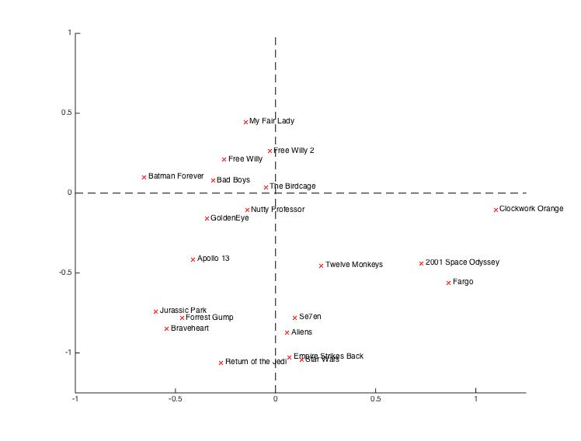
My Own Example
Trained using
Step 1c (lambda=10)
Stochastic GD
SVD of Movie Matrix
Project top 2 bases
Picked a few popular movies, and plotted them.
Then found a few extreme points (e.g., Clockwork Orange).
Removed most children’s movies (didn’t seem to project well using 1st two SVD bases – maybe most ratings are by adults).
Free Willy Movies Close Together
Action Movies
Mostly Sci-Fi &
Horror Movies
More Historical Movies
(Jurassic Park excepted)
Star Wars Movies
Close together

