Slide 1


Let’s play with Rust: A Introduction
@jayeshkattar
Notes:
The Rust programming language will be important to the future of the web, making it safe and great. In this session, I will teach you how to use Rust to write fast and trustworthy code.

Slide 2

About Me
Jayesh Katta Ramalingaiah
Android Developer
Work @tcs
Mozilla Representative
Mozilla Reps Mentor
Mozilla Tech-Speaker
Notes:
Hi, I’m Mehul Patel and I specialize in Information Technology and Services. I’m passionate about what I do. I hold a Masters in Computers Science and currently working on my research work. I am a Developer Tech by profession, An open source enthusiast, Linux geeky and a maker by heart. Nothing is more fulfilling than being part of a team with similar interests.
Excited to now more : https://about.me/rowdymehul

Slide 3
Agenda (for Introduction)
Basic Terminologies
What is Rust? Why Rust?
Intro to Rust
Install Rust
Clippy - the popular Rust static analysis tool
Cargo - Rust’s awesome package manager
Play with Rust: A short demo with kits.
How to get in touch with the Rust community?

Slide 4
Basic Terminologies
Low and High Level Language
System programming
Concurrency and Parallelism
Compile time and Run time
Type System
Garbage collector
Mutability
Scope

Slide 5
What is Rust?
Rust is a new systems programming language designed for safety, concurrency, and speed.
It was originally conceived by Graydon Hoare and is now developed by a team in Mozilla Research and the community.
Functional, imperative, object-oriented, whenever it makes sense.
Low-level. Targets the same problem-space as C and C++
Safe. Lovely, lovely types and pointer lifetimes guard against a lot of errors.

Slide 6
Why do we need a new system programming language?
State or art programming language
Solves a lot of common system programming bugs
Cargo : Rust Package manager
Improving your toolkit

Slide 7
Why should I use Rust?
Own Definition : Rust is a good choice when you’d choose C++. You can also say, “Rust is a systems programming language that pursuing the trifecta: safe, concurrent, and fast.” I would say, Rust is an ownership-oriented programming language.

Slide 8
Where is RUST used ?
game engine (Piston library)
game development
browser engine (Servo)
Build web apps
html5ever (High-performance browser-grade HTML5 parser)
tiny-http (http & https protocols)

Slide 9
Game Engine/ Game Development
arewegameyet.com
Game Developers are writing libraries in RUST which are used for game development.

Slide 10
Browser Engine
Mozilla is building a new browser engine called SERVO.
Servo is entirely written in RUST

Slide 11
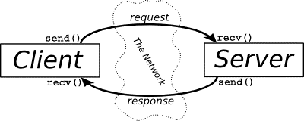
Web Apps
Web Developers even started using Rust for quicker responses.

Slide 12
Where can I get RUST?
Prebuilt binaries are available at http://www.rust-lang.org/
Source code is available from GitHub https://github.com/mozilla/rust
Kits and resources are available from Rust India GitHub https://github.com/RustIndia/Rust

Slide 13
The reason why Rust.
Rust is new enough that you can write useful stuff that would have already existed in other languages
It gives a relatively familiar tool to the modern C++ developers, but in the much more consistent and reliable ways.
It is low-level enough that you take account of most resources.
It's more like C++ and Go, less like Node and Ruby
cargo is awesome. Managing crates just works as intended, which makes a whole lot of troubles you may have in other languages just vanish with a satisfying poof.

Slide 14
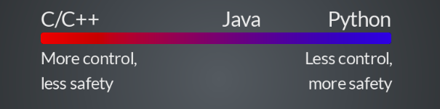
Rust
System programming language
Has great control like C/C++
Safety and expressive like python
Notes:
Rust is a great system programming language which enables high level features of python,JS with low level features of C/C++
Rust is a systems programming language that runs blazingly fast, prevents segfaults, and guarantees thread safety

Slide 15
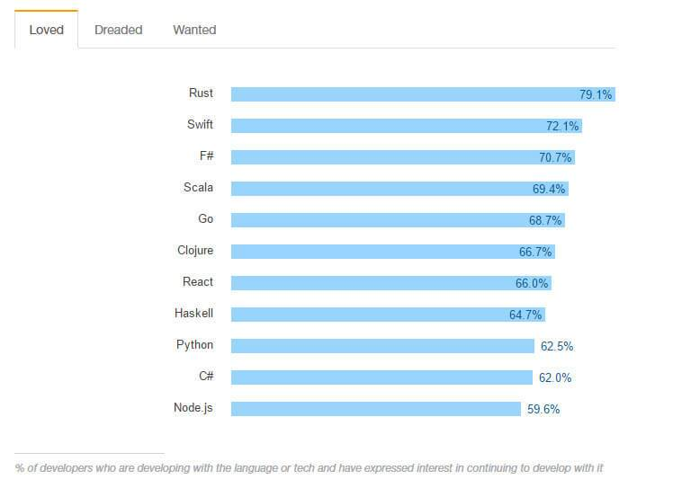
According to recent The Stack Overflow survey Rust is the most beloved among developers of all programming languages and frameworks.
Credits : https://insights.stackoverflow.com

Slide 16
Install Rust with rustup
# Ubuntu / MacOS
curl -sSf https://static.rust-lang.org/rustup.sh | sh
# Windows
Go to https://win.rustup.rs/
This will download rustup-init.exe
Double click and start the installation

Slide 17

Version
rustc --version
cargo --version

Slide 18
Cargo, Rust’s Package Manager
Cargo is a tool that allows Rust projects to declare their various dependencies and ensure that you’ll always get a repeatable build.
To accomplish this goal, Cargo does four things:
Introduces two metadata files with various bits of project information.
Fetches and builds your project’s dependencies.
Invokes rustc or another build tool with the correct parameters to build your project.
Introduces conventions to make working with Rust projects easier.
Creating a new project
Notes:
http://doc.crates.io/index.html

Slide 19
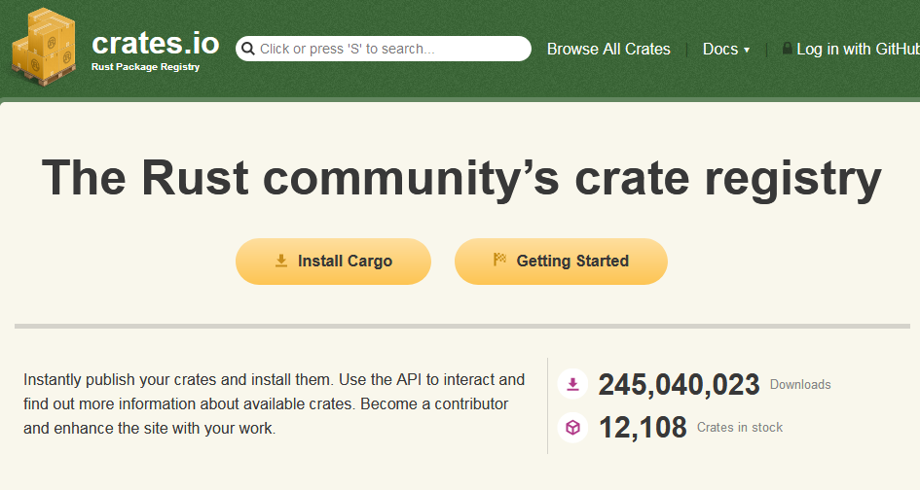
https://crates.io/
Notes:
https://crates.io/
Instantly publish your crates and install them. Use the API to interact and find out more information about available crates. Become a contributor and enhance the site with your work.

Slide 20
Rust Playground
A web interface for running Rust code.
The interface can also be accessed in most Rust-related channels on irc.mozilla.org.
To use Playbot in a public channel, address your message to it.
<you> playbot: println!("Hello, World"); -playbot:#rust-offtopic- Hello, World -playbot:#rust-offtopic- () <you> playbot: 1+2+3 -playbot:#rust-offtopic- 6
You can also private message Playbot your code to have it evaluated. In a private message, don't preface the code with playbot's nickname:
/msg playbot println!("Hello, World");

Slide 21
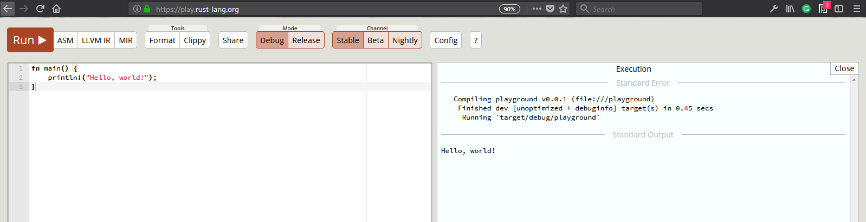
Let’s play : https://play.rust-lang.org/

Slide 22
Type System

Slide 23

The traditional Hello World
fn main() {
let greet = “world”;
println!("Hello {}!”, greet);
}

Slide 24
How to run ???
To compile and run a single file
to Compile: rustc <filename>.rs
to run: <filename>
Using Cargo package Manager
How to create a cargo package ??
Cargo new <proj_name> --bin

Slide 25
How to run a cargo package?
To see the tree structure of the package.
tree .
To compile and build a cargo package.
Cargo build
To run a cargo package.
Cargo run

Slide 26
Primitive Types

Slide 27
bool
let bool_val: bool = true;
println!("Bool value is {}", bool_val);

Slide 28
char
let x_char: char = 'a';
// Printing the character
println!("x char is {}", x_char);

Slide 29
Tuples
// Declaring a tuple
let rand_tuple = ("Mozilla Science Lab", 2016);
// tuple operations
println!(" Name : {}", rand_tuple.0);
println!(" Lucky no : {}", rand_tuple.1);

Slide 30
Arrays
let rand_array = [1,2,3]; // Defining an array
println!("random array {:?}",rand_array );
println!("random array 1st element {}",rand_array[0] ); // indexing starts with 0
println!("random array length {}",rand_array.len() );
println!("random array {:?}",&rand_array[1..3] ); // last two elements

Slide 31
String
let rand_string = "I love Mozilla Science <3"; // declaring a random string
println!("length of the string is {}",rand_string.len() ); // printing the length of the string
let (first,second) = rand_string.split_at(7); // Splits in string
println!("First {}",first );
println!("second {}",second );
let count = rand_string.chars().count(); // Count using iterator count

Slide 32
Best things about Rust
Strong type system
Reduces a lot of common bugs
Borrowing and Ownership
Memory safety
Freedom from data races

Slide 33
Ownership
In Rust, every value has an “owning scope,” and passing or returning a value means transferring ownership (“moving” it) to a new scope.
Example:
fn foo{
let v = vec![1,2,3];
let x = v;
println!(“{:?}”,v); // ERROR : use of moved value: “v”
}

Slide 34
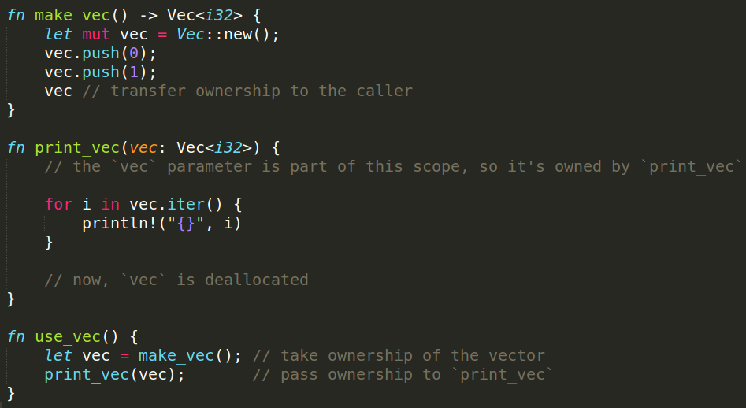
Ownership - Ex 2

Slide 35
fn print(v : Vec<u32>) {
println!(“{:?}”, v);
}
fn make_vec() {
let v = vec![1,2,3];
print(v);
print(v); // ERROR : use of moved value: “v”
}

Slide 36
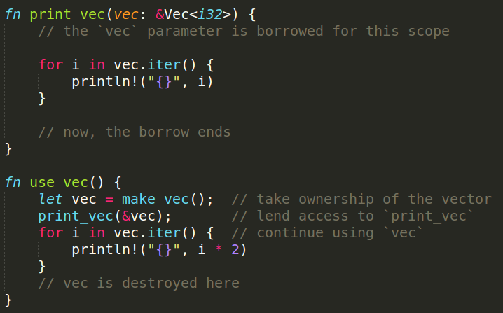
Borrowing
If you have access to a value in Rust, you can lend out that access to the functions you call

Slide 37



Let’s Meet Friends of Rust!!
Organizations running Rust in production (https://www.rust-lang.org/en-US/friends.html)
Notes:
These are few of the logos who use Rust in production check out the friends of Rust website for more, Rust is used innovatively at many levels by these organization, I highly recommend the talk by Ashley Williams titled How I Convinced the World's Largest Package Manager to Use Rust, and So Can You! https://www.rust-lang.org/en-US/friends.html

Slide 38
Getting started with Rust community
Follow all the latest news at Reddit Channel
https://www.reddit.com/r/rust/
Have doubts, post in
https://users.rust-lang.org
#rust IRC channel
Want to publish a crate,
https://crates.io
Follow @rustlang in twitter,
https://twitter.com/rustlang
Subscribe to https://this-week-in-rust.org/ newsletter

Slide 39
Adopt Rust today !!

Slide 40
What Next ???

Slide 41
References
Segfault: http://stackoverflow.com/questions/2346806/what-is-a-segmentation-fault
BufferOverFlow: http://stackoverflow.com/questions/574159/what-is-a-buffer-overflow-and-how-do-i-cause-one
Rust Website: https://www.rust-lang.org/en-US/
Community Forum: https://users.rust-lang.org/
Rust Book: https://doc.rust-lang.org/book/

Slide 42
Thank You
Tweet at #RustIndia #RustLang
Join RustIndia Telegram group
Notes:
Goals :
Programmers/students are introduced to Rust
Awareness and share Rust teaching kits among young minds
Get in touch with people outside of the tech community
Let people know about current Rust projects and how they can help us
Leaders -> Form and lead regional Rust communities

