Slide 1
Lessons learned:
DSC Pull Security and Integration

Slide 2
WHOAMI
$Contact = [ordered]@{
Name = 'Ben Gelens'
Job = 'Consultant'
Company = 'Inovativ'
EMail = 'ben.gelens@inovativ.nl'
Blogger = 'http://Hyper-V.nu'
Moderator = 'http://powershell.com'
Twitter = '@bgelens' GitHub = 'https://github.com/bgelens/'
}
New-Object -TypeName PSObject -ArgumentList $Contact

Slide 3
Agenda
Recap: DSC Web Pull Server
Secure DSC Web Pull Services
MOF File Security
Demo
DSC Integration with Windows Azure Pack
Demo
DSC Resource challenges

Slide 4
Recap: DSC Web Pull Server
Central repository for pre-compiled MOF files and DSC resource modules via an IIS application (Http / Https)
LCM get’s it’s MOF file from pull server by providing its configuration ID
If node is missing DSC Resource modules, it will get them from the pull server as well
When MOF file changes, LCM will pull updated MOF and converge to new Desired State!

Slide 5
Secure DSC Web Pull Services
LCM has no way of knowing if a MOF file is intended for it.
Potential for Server in the middle attack
Server Authentication certificate on the pull server
Validate identity
Protects configuration id from being seen on the wire
Protects MOF file payload from traveling unencrypted over the wire
Does not protect against harvesting attack!
Pull Server is just there to serve
Pull Server needs to trust LCM as well!
Never setup Pull servers without
Server Authentication Certificates!

Slide 6
MOF File Security
Sensitive data encryption is
not an option!
Don’t use over privileged accounts!
MOF file contains a very readable plan for your server and it’s position in your environment.
Another reason not to hand out MOF files to untrusted LCM
Sensitive data can be encrypted using Certificate Public key
Node needs private key to decrypt
Rest of the MOF file data is not encrypted
If the Node get’s compromised Encryption is worthless!
Don’t use over privileged accounts in your MOF files

Slide 7

Setting up secure DSC pull
Enterprise
CA
Web Enrollment
Services
DSC Web
Pull Service
Public Key Repo
Request Certificate via Web Enrollment
WES Impersonate
Enroll Client Auth Certificate
Reconfigure LCM
Authenticate against Pull Server
Download MOF file
Converge
LCM Pull Clients

Slide 8

Demo
Secure End-2-End DSC Web Pull Services

Slide 9
Identified Issues:
Private Key not accessible for LCM when key is generated using CNG instead of legacy CSP
https://connect.microsoft.com/PowerShell/feedback/details/1110885/private-key-not-accessible-for-dsc-lcm-when-key-is-generated-using-cng-instead-of-legacy-csp
DSC LCM 2.0 Configuration does not work with Client Certificate Authentication
https://connect.microsoft.com/PowerShell/feedback/details/1112879/dsc-lcm-2-0-configuration-does-not-work-with-client-certificate-authentication

Slide 10
DSC Integration with Windows Azure Pack

Slide 11
Demo
Integration with Azure Pack (Kick-off)

Slide 12
VM Role + DSC Provisioning
Azure Pack
Attach Source Disk
Azure Pack
Monitor
Overwrite
Monitor KVP
Provisioned / Failed
SMA
SPF
Monitor
KVP
VMM
Deploy VM
Provisioned
HV KVP
Source Disk Needed
HV KVP
LCM Finished
Pull Server

Slide 13
Demo
Integration with Azure Pack

Slide 14
DSC Resource challanges

Slide 15
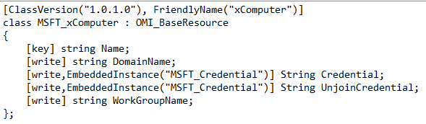
DSC Resource challenges
Challenge 1:

Slide 16
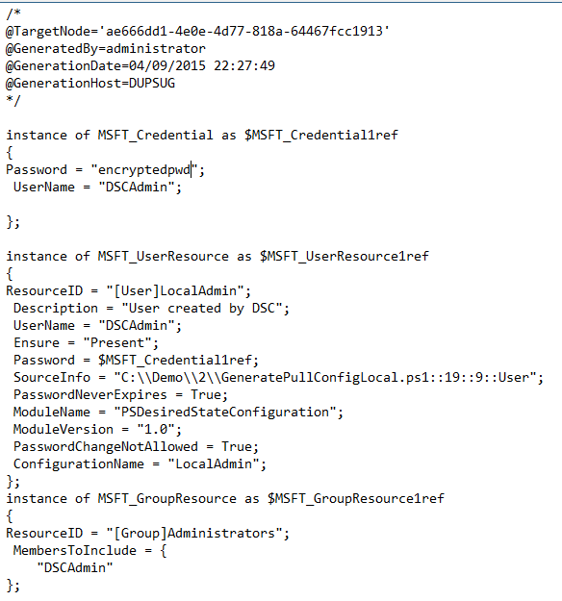
DSC Resource challenges
Challenge 2:

Slide 17
DSC Resource challenges

Slide 18
Identified Issues:
Class defined DSC resource module cannot be acquired via Pull Server because of script module structure check of LCM WebDownloadManager
https://connect.microsoft.com/PowerShell/feedback/details/1143212/class-defined-dsc-resource-module-cannot-be-acquired-via-pull-server-because-of-script-module-structure-check-of-lcm-webdownloadmanager

Slide 19
Thanks! Questions?
$Contact = [ordered]@{
Name = 'Ben Gelens'
Job = 'Consultant'
Company = 'Inovativ'
EMail = 'ben.gelens@inovativ.nl'
Blogger = 'http://Hyper-V.nu'
Moderator = 'http://powershell.com'
Twitter = '@bgelens' GitHub = 'https://github.com/bgelens/'
}
New-Object -TypeName PSObject -ArgumentList $Contact

