Slide 1
Ensure VM Role Configuration Consistency with Desired State Configuration

Slide 2
WHOAMI
Ben Gelens
Consultant @ Inovativ
Email: ben.gelens@inovativ.nl
Hyper-v.nu blogger: http://www.hyper-v.nu
Personal blogger: http://mssecbyben.wordpress.com
Twitter: @bgelens

Slide 3
Agenda
DSC: A high level overview
DSC: Deployment Models
Why use DSC with VM Roles?
Questions?

Slide 4
DSC: Desired State Configuration A High Level Overview

Slide 5



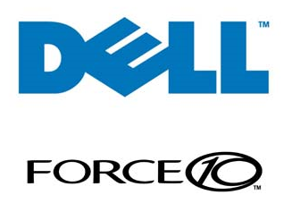
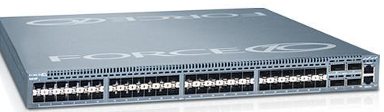
What is DSC? Datacenter Configuration Management Platform

Slide 6
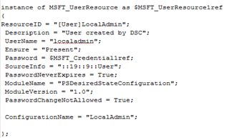
What is DSC? MOF File
Build upon the ‘Management Object Format’ (MOF) file (DMTF standards)
Generated by PowerShell Declarative Syntax

Slide 7
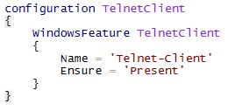

Imperative vs Declarative
Declarative:
Imperative:

Slide 8
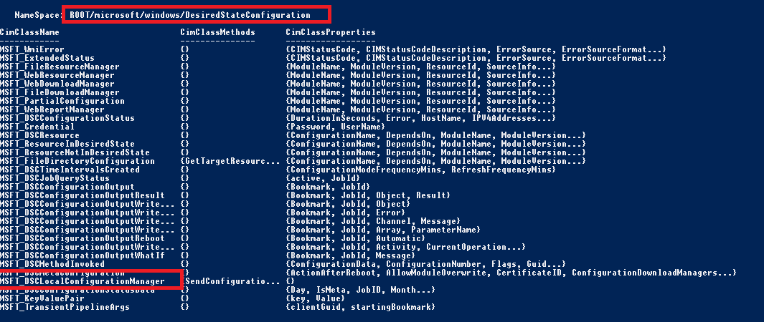
What is DSC? Local Configuration Manager
Handled by the Local Configuration Manager (LCM)

Slide 9
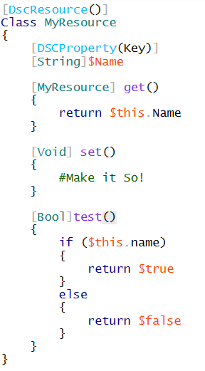


What is DSC? Resources
Implemented by DSC Resources
Imperative
Monotonic
Idempotent
PowerShell
Python

Slide 10
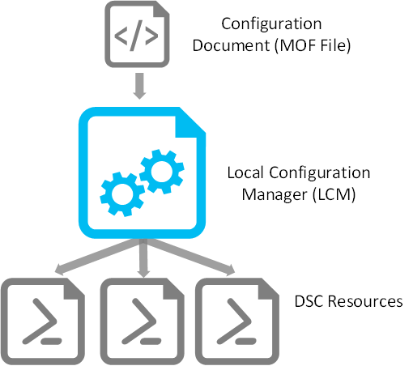


What is DSC? Putting it together
Consistency

Slide 11
Demo: Constructing and applying a DSC configuration

Slide 12
DSC: Desired State Configuration Configuration Models

Slide 13
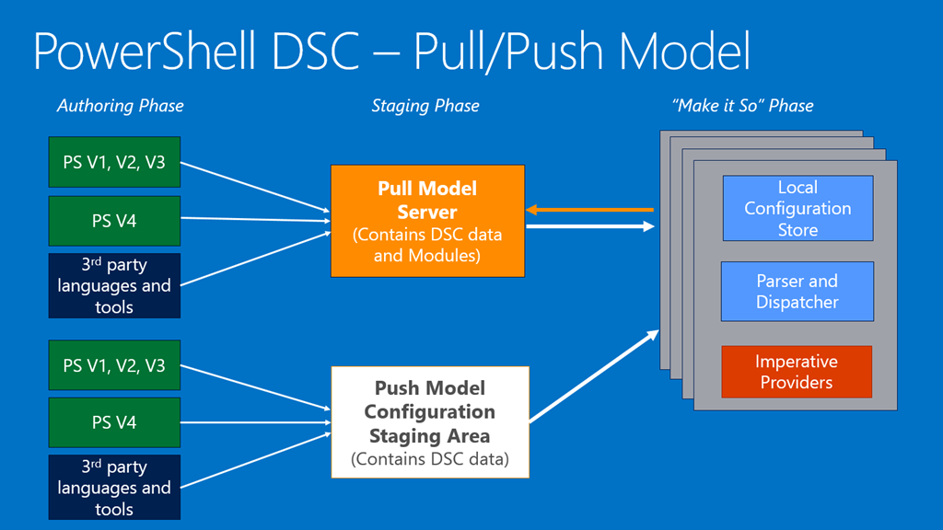
DSC – Modes

Slide 14

Demo: CPS VM Role - Example of the DSC Push Model

Slide 15
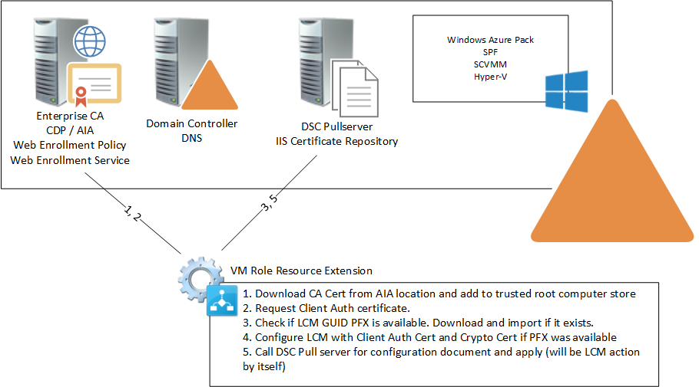
VM Role Pull Model

Slide 16
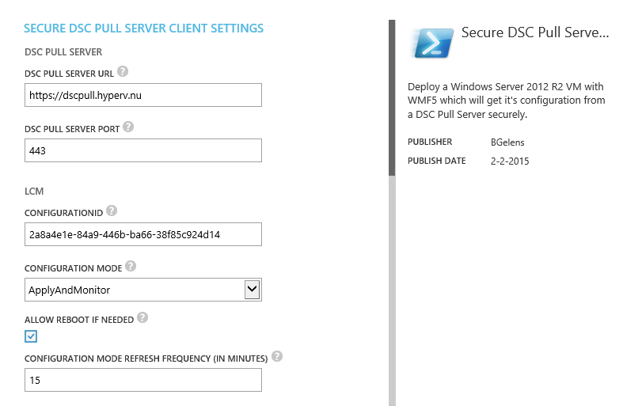
Demo: Custom VM Role - Example of the DSC Pull Model

Slide 17
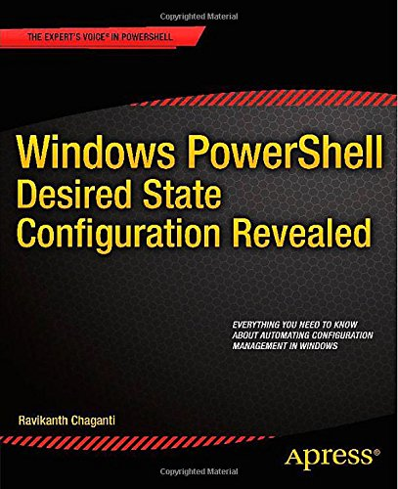

Conclusion: Why use DSC with VM Roles?

Slide 18
DSC – Why use it with VM Roles?
VM Role servicing & scaling made easy.
VM Role stays consistent (also after deployment!)
DSC Configuration on both Windows and Linux (still CTP)
Reusable DSC configuration resources.

Slide 19
DSC – Why use it with VM Roles?
DSC is the way forward. (part of common engineering criteria)
DSC already adapted in Azure (uniform configuration method on both private and public cloud)
Start dissolving Active Directory dependencies

Slide 20
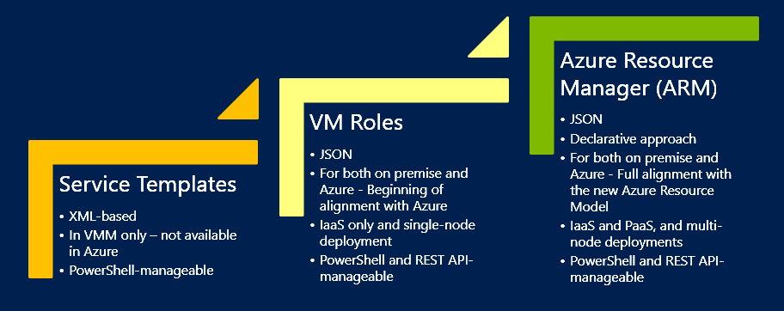

Microsoft IaaS Evolution
Until ARM arrives for IaaS on premises, use DSC with VM roles (with SMA for automation)
A benefit of this approach is that the DSC work should easily be portable to the new model
Notes:
http://blogs.technet.com/b/privatecloud/archive/2015/02/17/white-paper-modern-application-modeling-and-configuration-for-infrastructure-clouds.aspx

Slide 21

Thanks! Questions?
Next speaker:
Mark Scholman

Slide 22
Demo: Service the Cloud
Service

