Slide 1







2017
DSC in a Configuration Management tool world
Build an immutable application infrastructure with Nano Server, PowerShell DSC, and the
release pipeline
Name : Ben Gelens
Job : Consultant
MVP : CDM (PowerShell)
Company : InSpark
Email : ben@bgelens.nl
Twitter : @bgelens
GitHub : bgelens
Blog : bgelens.nl
Ravikanth Chaganti

Slide 2



2018
2017
Build an immutable application infrastructure with Nano Server, PowerShell DSC, and the
release pipeline
DSC in a Configuration Management tool world
Ravikanth Chaganti
Ben Gelens

Slide 3
Agenda
Why?
In scope for this session
Demo!

Slide 4

Why?

Slide 5
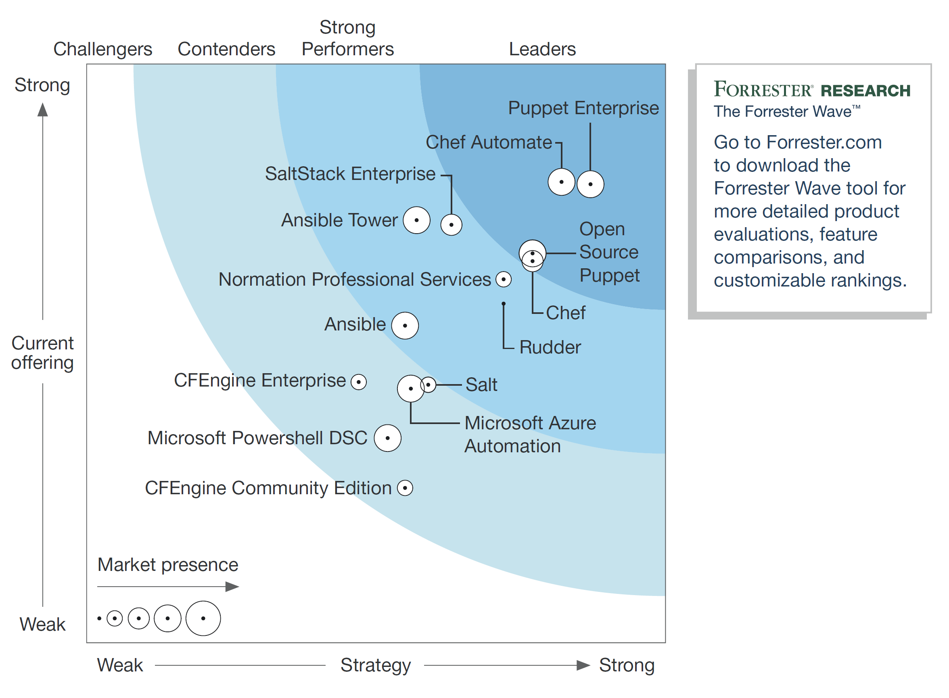
In Scope
Q4 2017

Slide 6


Demo

Slide 7
Summary
Both Chef and Puppet consume DSC Resources via Invoke-DscResource
Chef has inbox support
Puppet via module (dsc and dsc-lite)
Obvious wins of both:
Notifications
Configuration composition
Reporting
Mature ecosystem / community

Slide 8

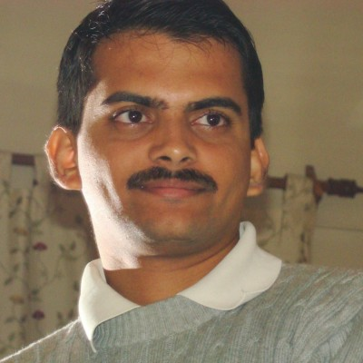
PRO DSC e-book give away!

Slide 9
Next Steps
Now: 15 min break
Grab a coffee
Stay here to enjoy next presentation
Change track and switch to another room
Ask me questions or meet me in a breakout session room afterwards

Slide 10
Questions?

Slide 11
about_Author
Name : Ben Gelens
Job : Consultant
MVP : CDM (PowerShell)
Company : InSpark
Email : ben@bgelens.nl
Twitter : @bgelens
GitHub : bgelens
Blog : bgelens.nl

