Slide 1
Writing World-class DSC resource modules
High Quality Resource Modules (HQRM)
Ben Gelens, MVP, @bgelens, bgelens.nl DevOps & Cloud Consultant @ InSpark

Slide 2
About_Author
Name : Ben Gelens
Job : Consultant
MVP : CDM (PowerShell)
Company : InSpark
Email : ben@bgelens.nl
Twitter : @bgelens
GitHub : bgelens
Community : {Hyper-V.nu, azurestack.blog, DuPSUG}
Blogging : {bgelens.nl, Hyper-V.nu, … PowerShellMagazine.com, azurestack.blog}

Slide 3
Agenda
What are HQRM modules?
Start writing a HQRM module!

Slide 4
What are HQRM Modules?
Adhere to pre-defined coding / style standards
Follow file and folder standard
PSScriptAnalyzer checks ok
Have unit and integration tests
Have examples
Have documentation

Slide 5
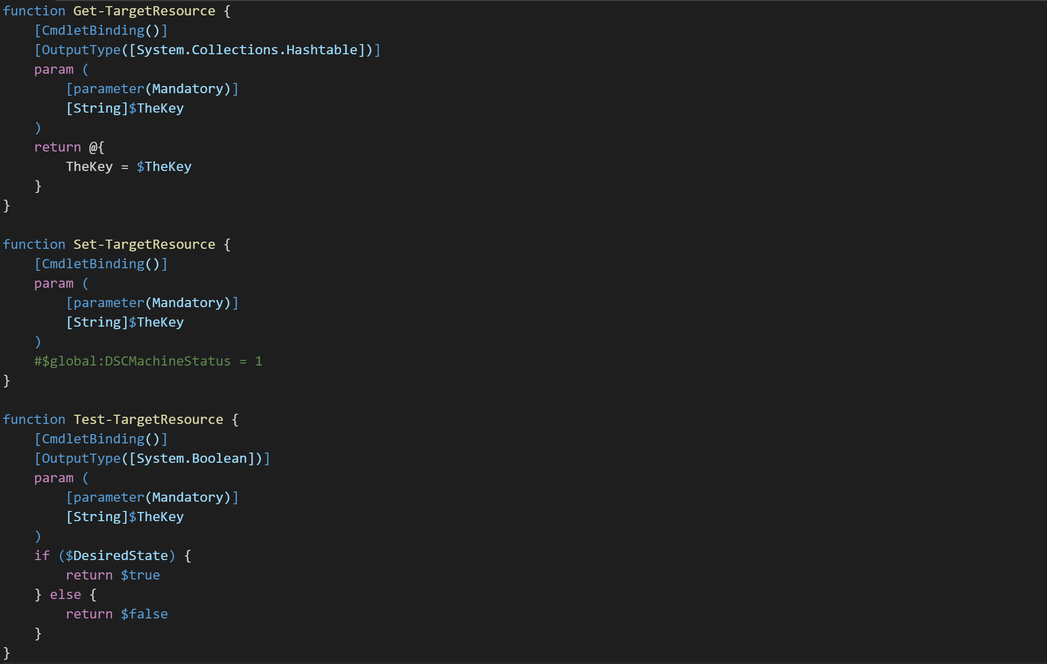
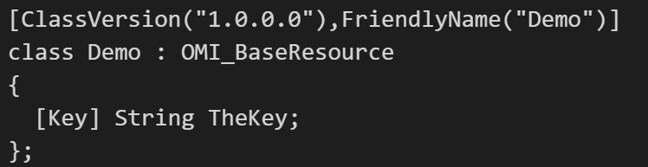
Get, Set and Test
Resource Code:
Get
Set
Test
Schema.mof
Reboot Required?

Slide 6
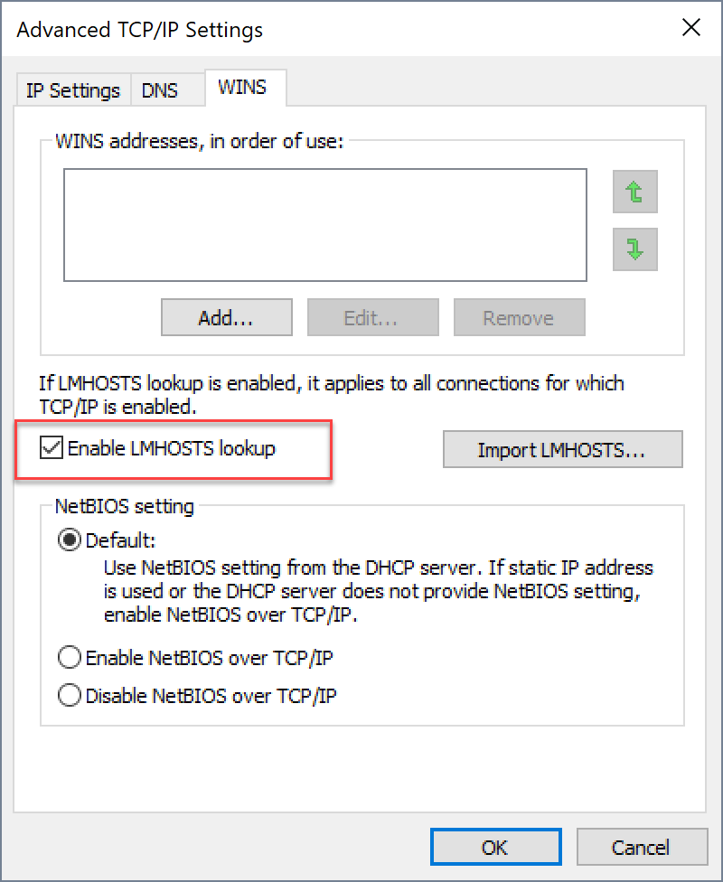
Start-Demo –Item ‘WriteHQRM’

Slide 7
Summary
HQRM is…
A lot of work ☺
A good practice / learning experience
The way forward if you want to contribute to ResKit

Slide 8
Next Steps...
Ask me questions or meet me in-person afterwards

Slide 9
Questions?

