Slide 1
Importing a wide range of data formats
Steve Simon

Slide 2
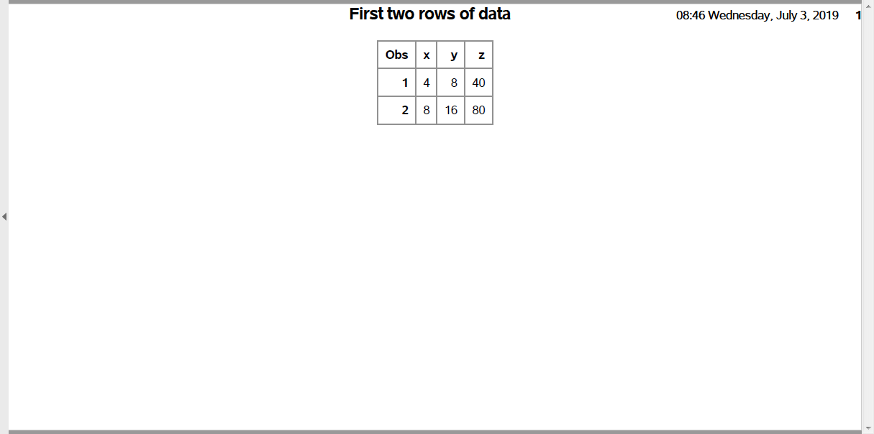
Test

Slide 3
Importing choices (1 of 2)
A wide range of formats
Space delimited
Comma separated values
Tab delimited
Fixed format
Strings in your input
Notes:
I want to show a few simple examples of importing data. There are several common formats and SAS can handle all of these easily.

Slide 4
Importing choices (2 of 2)
proc import
First row includes variable names
Binary data files
Manual reformatting
Global search and replace
Not usually a good idea
Skipping rows
Converting strings to numbers
Notes:
Some data sets use the first row to represent variable names while others don’t.
If you have to, you can manually reformat the data. Use the global search and replace function in your text editor program. I generally try to avoid this. If your data set changes, you have to redo the reformatting step, which is tedious and error prone. You’d be better off learning a few tricks to get SAS to read a nonstandard data set.
Sometimes you have to skip a few rows. Sometimes you have to convert strings to numbers.

Slide 5
Space delimited, example
4 8 40 8 16 80 12 24 120 16 32 160 24 48 240
Notes:
You’ve already imported a file similar to this. It is a space delimited file with one blank between each number.

Slide 6
Space delimited, SAS code
filename raw_data "../data/space-delimited.txt"; libname module01 "../data"; data module01.space_delimited; infile raw_data delimiter=" "; input x y z; run; proc print data=module01.space_delimited(obs=2); title1 "First two rows of data"; run;
Notes:
Here is the SAS code to read and print this file.

Slide 7
Multi-space delimited, example
4 8 40 8 16 80 12 24 120 16 32 160 24 48 240
Notes:
Some text files will insert extra spaces, as in the first two lines of this data set, to align the data. It makes the file more readable. SAS will handle multiple blanks, including blanks at the beginning and end of a line, in a way that you probably will want.
Note that multiple blanks as a delimiter is not a problem, but try to avoid this for other delimiters, especially commas.

Slide 8
Multi-space delimited, SAS code
filename raw_data "../data/multi-delimited.txt"; libname module01 "../data"; data module01.multi_delimited; infile raw_data delimiter=" "; input x y z; run; proc print data=module01.multi_delimited(obs=2); title1 "First two rows of data"; run;
Notes:
Here is the SAS code to read and print this file. Nothing has changed except the name of the raw data (in the filename statement, not shown) and the sas data set name.

Slide 9
Comma delimited, example
4,8,40 8,16,80 12,24,120 16,32,160 24,48,240
Notes:
Many text files use commas to separate individual numbers. These often use a special file extension, .csv. These files are especially popular with Excel users, as they are about as easy to import and export as any other type of simple text files.
Here’s a simple example of a comma delimited file.

Slide 10
Comma delimited, SAS code
filename raw_data "../data/comma-delimited.csv"; libname module01 "../data"; data module01.comma_delimited; infile raw_data delimiter=","; input x y z; run; proc print data=module01.comma_delimited(obs=2); title1 "First two rows of data"; run;
Notes:
Here is the SAS code to read and print this file. Nothing has changed other than the name of the file and the delimiter option on the infile statement.

Slide 11
Tilde delimited, example
4~8~40 8~16~80 12~24~120 16~32~160 24~48~240
Notes:
You might even see a bizzare symbol as a delimiter. Something that almost never appears. The tilde(~) is a good example. We have not talked about string data yet, but if your data has lots of strings and it has a lot of unmatched quote marks, commas, and other weird things that might trip you up, the owner of the data might use a tilde because nothing else works as a delimiter.
Here’s a simple example of a tilde delimited file.

Slide 12
Tilde delimited, SAS code
filename raw_data "../data/tilde-delimited.txt"; libname module01 "../data"; data module01.tilde_delimited; infile raw_data delimiter="~"; input x y z; run; proc print data=module01.tilde_delimited(obs=2); title1 "First two rows of data"; run;
Notes:
Here is the SAS code to read and print this file. Again, nothing has changed except the file names and the delimiter option on the infile statement.

Slide 13
Tab delimited, example
4 8 40 8 16 80 12 24 120 16 32 160 24 48 240
Notes:
I’ve already told you that tabs are evil, but if you encounter a tab delimited file, don’t panic. You can handle it.
Here’s a simple example of a tab delimited file. Note that the numbers are left justfied, which is a hint that there are tabs lurking in the file. The tabs here stop at columns, 5, 9, and 13, which is a bit weird, but may just represent how my system treats tabs. The classic thing to look for in a tab delimited file, besides the right justification, is the semi-aligned, but not perfectly aligned numbers. This doesn’t happen with this data because all of the numbers are three digits or less, but it can happen when the numbers take up a bit more room and the numbers are uneven in size.
You can also detect tabs by opening the file in a text editor like notebook and playing around with adding extra spaces. A lack of action followed by a sudden hop is a pretty good indication that you are dealing with tabs.

Slide 14
Tab delimited, SAS code
filename raw_data "../data/tab-delimited.txt"; libname module01 "../data"; data module01.tab_delimited; infile raw_data delimiter="09"X; input x y z; run; proc print data=module01.tab_delimited(obs=2); title1 "First two rows of data"; run;
Notes:
Here is the SAS code to read and print this file. You cannot enter the tab character directly as a delimiter. Instead, you have to provide the hex code, 09. Note the use of quote marks and X.
This import worked fine, but beware. Some of these tab separated value files have a few stray blanks mixed in with the tabs, and this can cause havoc.

Slide 15
Fixed width, example
4 8 40 816 80 1224120 1632160 2448240
Notes:
Sometimes you may run across a file with no delimiters at all. The numbers stand next to each other shoulder to shoulder. Here’s an example. There’s a space or two here or there because not every number is exactly the same number of digits. But there are plenty of numbers without any spaces behind them.
Why might you do this? If your file was very large, you may not want to afford the luxury of delimiters. The file is already straining to fit in and adding delimiters would just be too much.
These days, of course, storage is cheap, but you still might encounter a fixed width file now and then.
The only way an undelimited file would work is if there was a rigid structure where each number would reside in a specified column location. It’s like a series of row houses and the address tells you which house is which.
The key that tells you what columns correspond to which numbers has to reside in a different file. And you have to translate this key to the proper SAS code.
In the fixed width file above, you would have to be told there are three numbers, the first in columns 1 and 2, the second in columns 3 and 4 and the last in columns 5 through 7.

Slide 16
Fixed width, SAS code
filename raw_data "../data/fixed-width.txt"; libname module01 "../data"; data module01.fixed_width; infile raw_data delimiter=","; input x 1-2 y 3-4 z 5-7; run; proc print data=module01.fixed_width(obs=2); title1 "First two rows of data"; run;
Notes:
Here is the SAS code to read and print this file. Each variable is followed by a column range.

Slide 17
String data, example
Alpha 4 8 Bravo 8 16 Charlie 12 24 Delta 16 32 Echo 24 48
Notes:
Strings add a bit of complication. A string is a sequence of one or more letters, like a person’s name, or a mixture of numbers and letters, like a person’s address.
Here’s a small text file with a string of four to six letters.

Slide 18
String data, SAS code
filename raw_data "../data/string-data.txt"; libname module01 "../data"; data module01.string_data; infile raw_data delimiter=" "; input name $ x y; run; proc print data=module01.string_data(obs=2); title1 "First two rows of data"; run;
Notes:
Here is the SAS code to read and print this file. Designate a string variable by adding a dollar sign after the variable name.

Slide 19
Complications with string data
Strings longer than eight characters
Informat statement
Strings with delimiters
Use different delimiter
Enclose sting in quotes
Strings with quotes
Use double quotes around string with single quote
“It’s my bidthday!”
Use single quotes around string with double quote
‘Smile and say “Cheese!” when I take this picture’
Use escape codes
Notes:
SAS will have problems with certain strings. I don’t want to go into too much detail now, but here are some things to look out for.
SAS expects strings to be eight characters in length or less. If your string has more than eight character, you have to warn SAS with an informat statement.
If you have a space delimited file, but your strings have space in them, the simplest thing is to switch to a different delimiter, like a comma. What if your string has commas and spaces? Well you could try using a tilde, or some other obscure character. Another choice is to enclose your string in quotes.
What about strings with quotes in them. This can happen. I did a text analysis of the book A Chirstmas Carol by Charles Dickens and the text itself had lots of he said quotes and lots of apostrophes. There’s always a work around. You can use double quotes to enclose a string with an apostrophe. Use single quotes to enclose a string with double quotes. There are also special escape codes.

Slide 20
First line names, example
name x y Alpha 4 8 Bravo 8 16 Charlie 12 24 Delta 16 32 Echo 24 48

Slide 21
First line names, SAS code
filename raw_data "../data/first-line-names.txt"; libname module01 "../data"; proc import datafile=raw_data dbms=dlm out=module01.first_line_names replace; delimiter=" "; getnames=yes; run; proc print data=module01.first_line_names(obs=2); title1 "First two rows of data"; run;
Notes:
Here is the SAS code to read and print this file.

Slide 22
Read in these files
https://dasl.datadescription.com/datafile/saratoga-house-prices/
This is a tab delimited file with the names of the variables in the first row.
https://raw.githubusercontent.com/fivethirtyeight/data/master/airline-safety/airline-safety.csv
This is a comma separated value file with variable names at the top.

