Slide 1
Getting started
Steve Simon

Slide 2
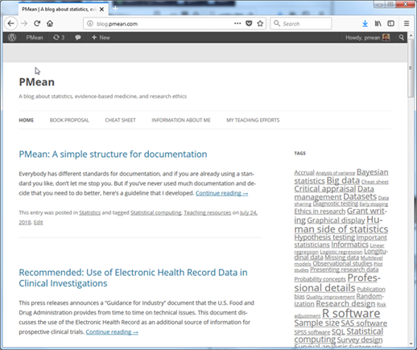
Test image

Slide 3
Documentation
This PowerPoint presentation was written by Steve Simon in 2018-08-29 and was last modified on 2020-06-26. It uses R Markdown, though the actual R code is fairly minimal. You can find the file that created this presentation on my github repository.
Notes:
Okay. I want to get started. I want to get you started using SAS. It’s either going to be really easy or it’s going to be really really. I want to give you as much guidance as I can without staring over your shoulder. Just quickly, I wrote this Powerpoint presentation and all the Powerpoint presentations using R Markdown. If you are curious I have a repository. It has some beautiful output.
Greetings! My name is Steve Simon and I am the instructor for the class, MEDB 5507, Introduction to SAS.

Slide 4

Course instructor, Steve Simon
Notes:
Stop by. This class is very impersonal. I don’t get to see you and you don’t get to see me.

Slide 5
Where can I get SAS
On your UMKC computer
Desktop, hard-wired to UMKC network
No laptops, no home computers
UMKC Student Computing Labs
Several locations on campus
Remote access
SAS University
Works on ANY computer
Jupyter lab
SASMarkdown
Notes:
There are several ways that you can get access to SAS software. One of these three options should work for you.
You can get it running on your UMKC computer, you can run it on the student computing labs.

Slide 6
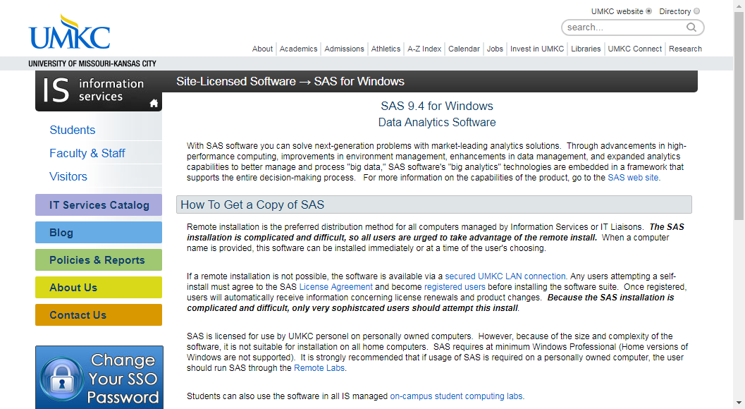
SAS on your UMKC computer
Screenshot of UMKC IS page on SAS software
Notes:
This screenshot may be too small for you to read, but you can find the proper link on the recommended readings list for this week on the Canvas website. SAS works for any desktop computer on the UMKC campus. But it has to be hard-wired to the UMKC netwok. By hard-wired, I mean that there is an ethernet cable connecting your computer to a socket on the wall.
If you are fortunate enough to have access to a hard-wired computer, you can get SAS installed easily. Someone else will do it for you. It may already be sitting on your computer.
With a very few rare exceptions, you cannot get UMKC to load SAS on a laptop computer or on a home computer. This because of the license agreement that UMKC signed wih SAS Institute. It does not allow for home use of SAS.

Slide 7
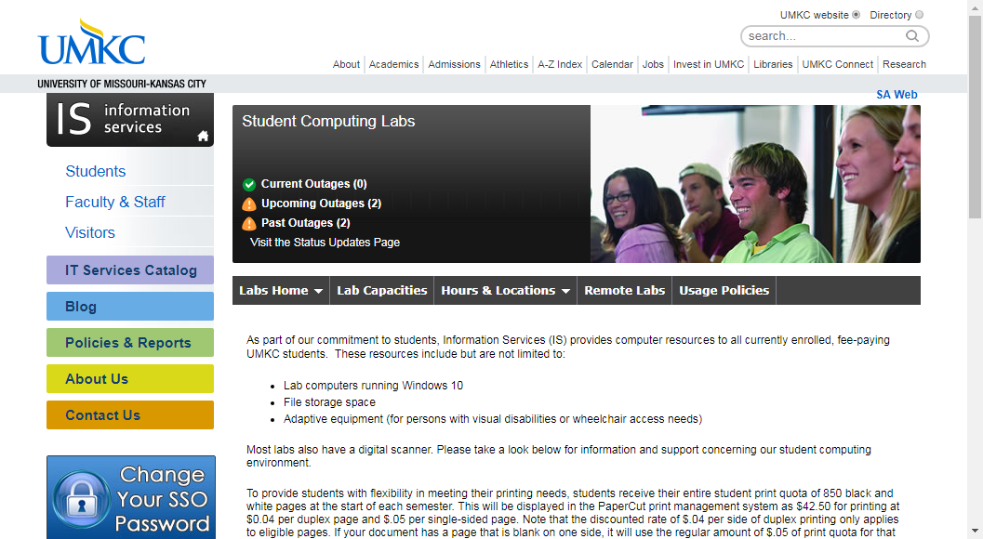
SAS at the UMKC Student Computing Labs
Screenshot of UMKC information page on computing labs
Notes:
Again, the image on your screen may be too small to read, but go to the recommended readings page on Canvas to call this up on your computer.
There are several student computing labs on campus that already have SAS installed on them.
You can visit the labs in person, or you can connect to those labs using Remote Desktop Connection.
If you have any trouble with this, come and see me and I’ll muddle through it with you.

Slide 8
SAS using SAS University
[Screenshot of main page for SAS University]
Notes:
I don’t have the right picture here. Sorry!
SAS Institute recognized that their licensing terms sometimes prevented students from having access to SAS software, and they dearly want you to learn SAS so that you’ll demand access to SAS when you get your big job in the corporate world. So they developed a system, SAS University, that you can use for free for educational purposes. I have SAS University installed on my laptop computer and it is very nice. The user interface is slightly different, but only slightly, and it seems to have just as many capabilities as the commercial version.
Now, installation is a bit tricky, but do try it. It is a very nice system. I will do much of my work in preparing teaching examples using SAS University. I don’t do all of it. Sometimes I’ll switch between systems. SAS University allows me to continue my work at home.

Slide 9
SAS using Jupyter notebooks
[Screenshot of SAS blog entry on Jupyter]
Notes:
Again, I apologize.
If you are adventurous, (and I certainly encourage people to be adventurous) you can run SAS within a Jupyter notebook. This works easily with SAS University, but I believe you can also run the commercial version of SAS in a Jupyter notebook. I will not talk about Jupyter in this class, it is beyond the scope of this class. We only have a certain amount of time and I’m not going to waste time on Jupyter. But if you want to explore SAS and Jupyter, I can work with you informally on this.

Slide 10
SAS using SAS markdown
[Screenshot of SAS markdown web page]
Notes:
Also beyond the scope of this class is running SAS within R. It uses an R library called SAS markdown. Very nice actually.

Slide 11
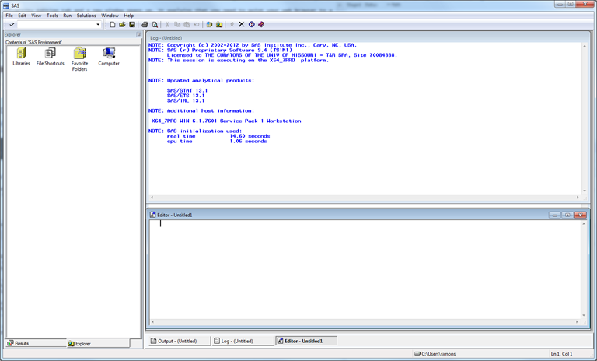
Opening screen - SAS commercial version
Opening screen of SAS with multiple windows
Notes:
If you are running the “regular” version of SAS, click on the icon and here’s an image of what the opening screen looks like. SAS uses a multi-window format. The layout is a bit chaotic. I usually close some windows and re-arrange others. For the benefit of this presentation, I am going to resize everything, close some of the windows, and maximize the one window of greatest importance, the program editor window.

Slide 12
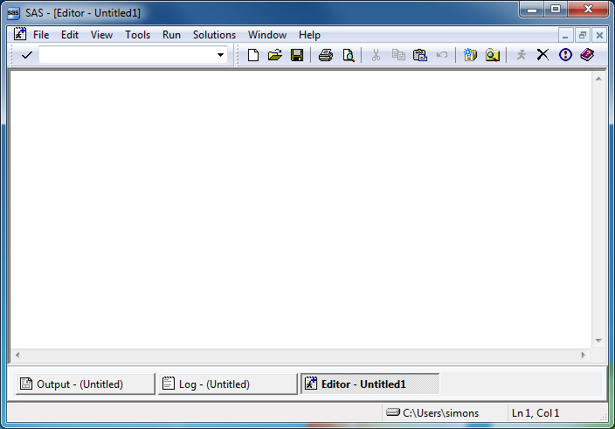
SAS program editor (1 of 2)
Maximized view of empty SAS program editor window
Notes:
This is the program editor window. You type in your program in this window, or read an existing program from another window. The other two remaining tabs, the log window, and the output window, are also important.

Slide 13
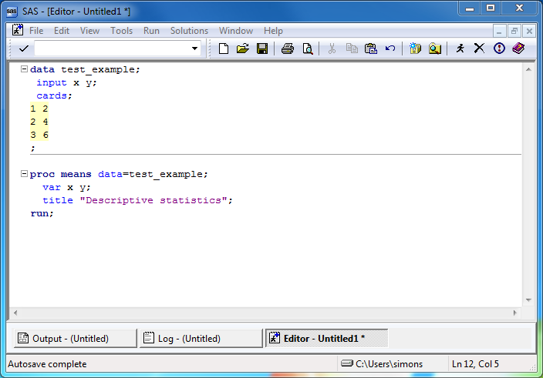
SAS program editor (2 of 2)
Program editor window with simple SAS program
Notes:
If you have SAS running, try running the following sample program. Here’s a simple test program. After you type this program in, click on FILE | SAVE and store your program somewhere safe. Save it to a location where you can remember things.
If you are using the computer labs, you need to save things on a network folder. You can’t use a USB stick.

Slide 14
SAS Test program
data test_example; input x y; cards; 1 2 2 4 3 6 ; proc means data=test_example; var x y; title "Descriptive statistics"; run;
Notes:
After you type this program in, click on FILE | SAVE and store your program somewhere safe.

Slide 15
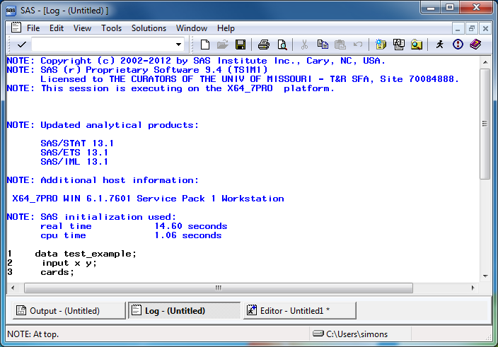
SAS log window (1 of 2)
Maximized view of SAS log window
Notes:
The font here is a bit small, but notice that there are no red messages indicating warnings or errors. We’re thrilled when we see no warnings or error messages. We’re always looking for warnings and errors. We also watch closely the number of observations.

Slide 16
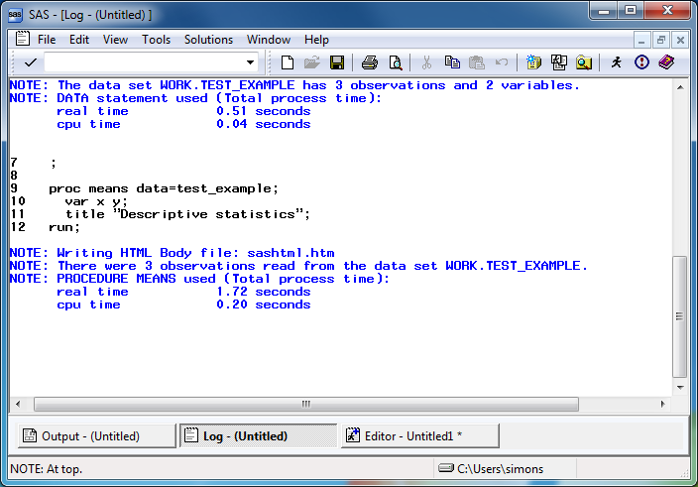
SAS log window (2 of 2)
Maimized view of SAS log window, second page
Notes:
Always start looking for error messages at the top. The very first error or warning message is most likely to be helpful, and later errors/warnings are often of less value.

Slide 17
Log messages (1 of 2)
1 data test_example; 2 input x y; 3 cards; NOTE: The data set WORK.TEST_EXAMPLE has 3 observations and 2 variables. NOTE: DATA statement used (Total process time): real time 0.51 seconds cpu time 0.04 seconds
Notes:
Always watch the log to see that you have read in the proper number of observations.

Slide 18
Log messages (2 of 2)
9 proc means data=test_example; 10 var x y; 11 title "Descriptive statistics"; 12 run; NOTE: Writing HTML Body file: sashtml.htm NOTE: There were 3 observations read from the data set WORK.TEST_EXAMPLE. NOTE: PROCEDURE MEANS used (Total process time): real time 1.72 seconds cpu time 0.20 seconds
Notes:
..and that you are analyzing the proper number of observations.

Slide 19
Where is the output?
SAS has several options for storing output.
In the output window
As an html file
As a pdf file
Notes:
Output is tricky. I want to talk in more detail later about this, but you can take the output and save it. There are several ways to do this. If you already have output, click on the CREATE LISTING option box to send the output to the output window. Click on the CREATE HTML option box to send the output to an html file. Click on the BROWSE button to select a default folder for your html file.

Slide 20
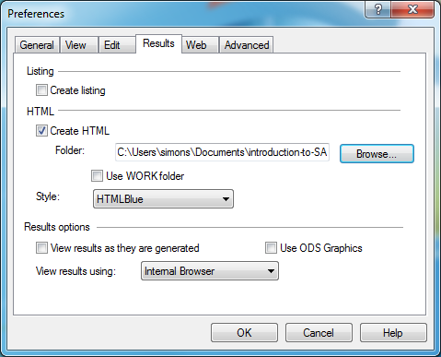
Preferences window
Preferences dialog box
Notes:
There is a preference box. I don’t want to talk about it today, but if you are adventurous, take a look at this. There are additional options for storing graphics, which I will talk about later. You control where SAS places its output in the results tab of the preferences dialog box. Select TOOLS | OPTIONS | PREFERENCES from the menu and click on the RESULTS tab.

Slide 21
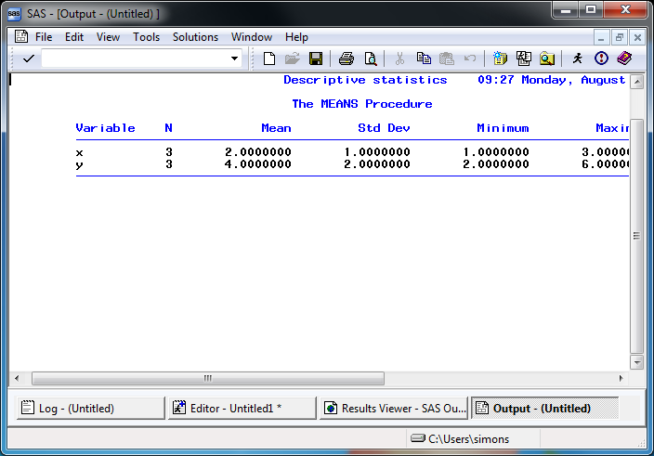
SAS output window
Maximized view of default SAS output
Notes:
Here’s what the output window looks like. Notice that SAS uses a monospaced font here.

Slide 22
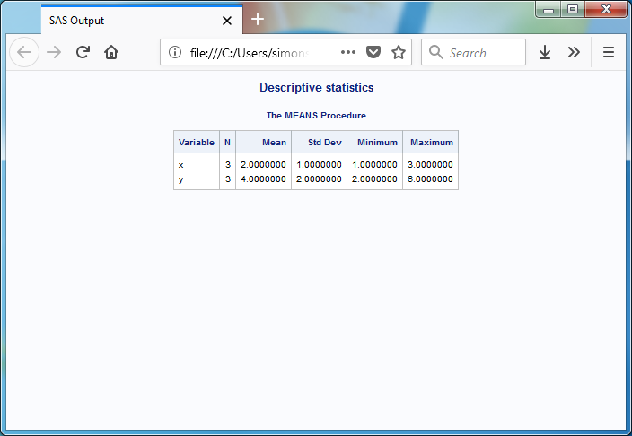
SAS html output
Maximized view of html output
Notes:
Here’s what the html output looks like. Notice variety of font sizes and colors. It tries to fit things within the available space.

Slide 23
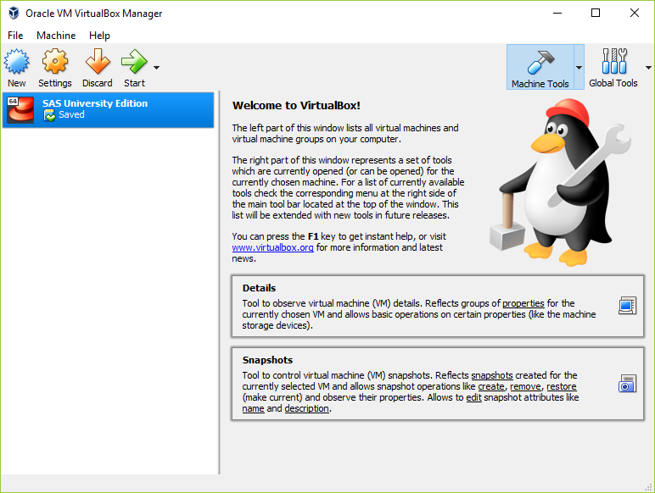
Getting started with SAS University edition (1 of 4)
View of virtual box, your entry point to SAS University
Notes:
If you are using SAS University, you start by opening Oracle Virtualbox. This is machine within a machine. It is similar to docker, if you are familiar with the Linus environment.
Installation instructions are available.
http://support.sas.com/software/products/university-edition/docs/en/SASUniversityEditionQuickStartVirtualBox.pdf

Slide 24
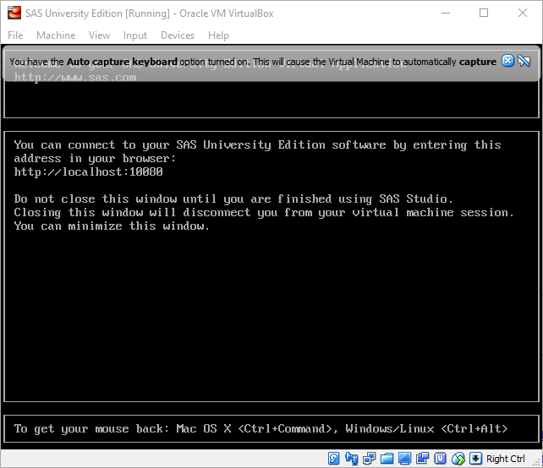
Getting started with SAS University edition (2 of 4)
Second step in starting SAS University
Notes:
Click on the SAS University Edition tab and a new window opens up. It explains that you need to point your web browser to a particular location. It also warns you to keep this window open.

Slide 25
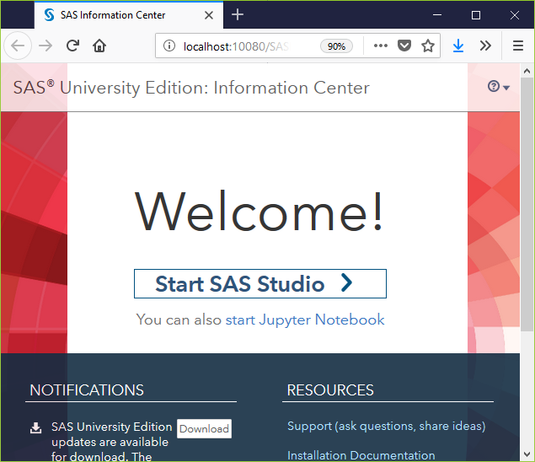
Getting started with SAS University edition (3 of 4)
Third step in staring SAS University
Notes:
When you open your web browser to http://localhost:10080, you get the option of starting with SAS Studio or with a Jupyter notebook. I have not had much luck with Jupyter, but you are welcome to try this on your own.

Slide 26
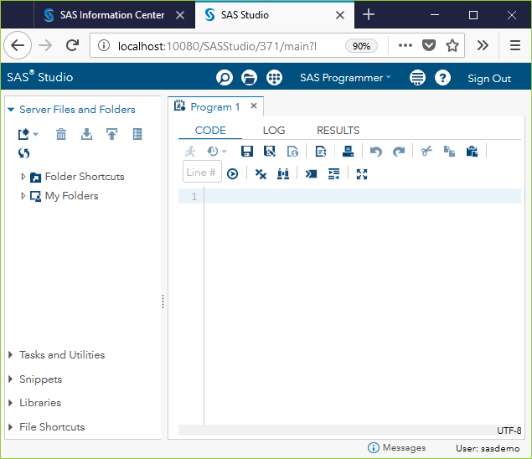
Getting started with SAS University edition (4 of 4)
Notes:
When you open your web browser to http://localhost:10080, you get the option of starting with SAS Studio or with a Jupyter notebook. I have not had much luck with Jupyter, but you are welcome to try this on your own.

Slide 27
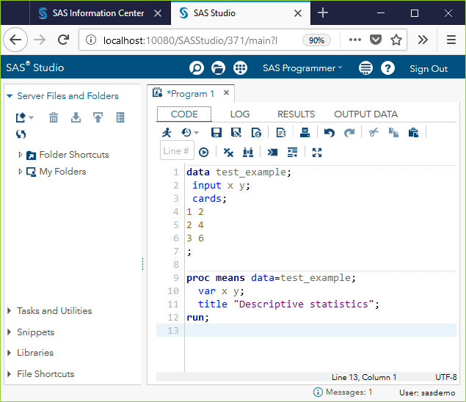
SAS University program window
SAS University program window
Notes:
You will notice a slightly different appearance with SAS University. Not so much that it’s going to cause problems. Here is the program window.

Slide 28
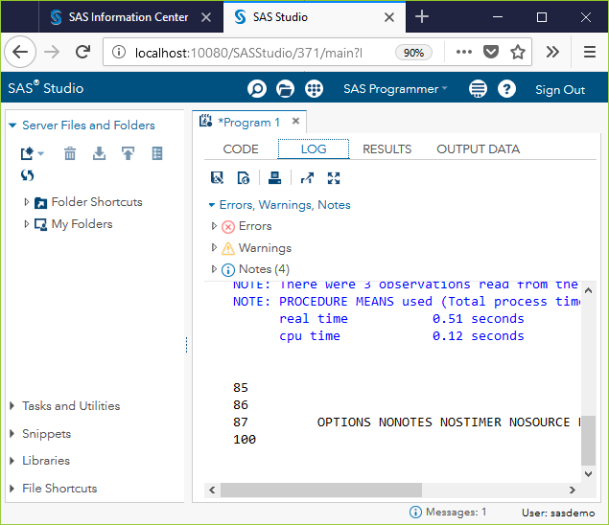
SAS Univesity log window

Slide 29
Here is the log window. Notice that the counts for errors, warnings, and notes appear at the top, and a missing count means zero errors and zero warnings. Hooray!

Slide 30
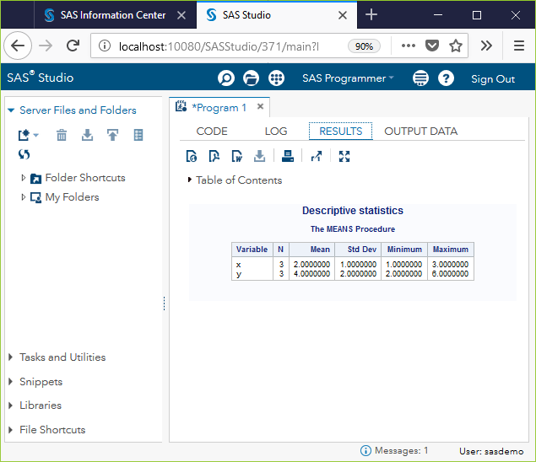
SAS University results
SAS University results window
Notes:
Here is the results window. The icons near the top offer a variety of export options, among other things.
It won’t work the first time for you. Don’t be intimidated by this. It didn’t work the first time for me either, and I’m a genius.

Slide 31
Conclusion
You can run the commercial version of SAS using
Your UMKC computer
UMKC Student Computing Labs
You can run a free version of SAS using
SAS University
Notes:
You can run the commercial version of SAS or SAS University and I’ve shown some screenshots of what this looks like. Try this on your own and let me know if you have been able to get SAS running successfully.
If you cannot get SAS running, drop me an email. It’s tricky because it’s the first time, but it’s not that hard.

