Slide 1
Introduction to SAS, Working with categorical variables
Steve Simon

Slide 2
Overview
Frequency counts
Convert string to numeric
Labels for number codes
Drawing bar charts
Converting continuous to categorical
Modifying categorical variables
Crosstabulations
Notes:
author: Steve Simon date: created 2021-05-30 purpose: to produce slides for module04 videos license: public domain
Here is an overview of what I want to cover in this module.
We’re going to look at a different data set, one with mostly categorical variables. I’ll introduce proc format, which allows you to attach labels to categorical data, talk about recoding, and show some tables using proc freq. I’ll also show you a simple bar chart.
[For my own use]General structure of this program.
Part00. Documentation header;
Notes00. This is the standard documentation header;
Part01. Tell SAS where to find and store things;
This needed to have the output fit on PowerPoint;
Notes01. The filename statement tells you where
Part02. Reading using proc import;
Notes02. As a general rule, proc import works
Part03. Print the first ten lines;
Notes03. It’s always a good idea to peek at the
Output, page 1. If you look at the first few
Part04. Counts, proc freq;
Notes04. For any categorical variables, your
Output, page 2. There is a mix of three passenger
Output, page 3. The survived variable is a number
Part05. Convert string to numeric, data step;
Notes05. For the one continuous variable (age)
Output, page 4. The numeric variable, age_c, can
Part06. Using proc format to code categorical data;
Notes06. For variables like Survived which are
Output, page 5. Notice that the format statement
Part07. Bar charts, proc sgplot (1/3);
Notes07. I don’t normally like bar charts, but
Output, page 6. This is a basic bar chart.;
Part08. Bar charts, proc sgplot (2/3);
Notes08. Getting percentages is a bit tricky.
Output, page 7. You don’t need to print out this
Part09. Bar charts, proc sgplot (3/3);
Notes09. You use this newly created dataset
Output, page 8. Note that the yaxis max=100
Part10. Converting continuous to categorical (1/5);
Notes10. If you want to create categories from a
Part11. Converting continuous to categorical (2/5);
Notes11. Always cross check your results against the original variable.
Output, page 9. These results look good.
Part12. Converting continuous to categorical (3/5);
Notes12. You can control the order by using
Part13. Converting continuous to categorical (4/5);
Notes13. The format statement attaches a label
Part14. Converting continuous to categorical (5/5);
Notes14. Again, a quality check is important.
Output, page 12. The tables are ordered from
Output, page 13. to teenager to adult,
Output, page 14. then missing.;
Part15. Modifying a categorical variable;
Notes15. Here’s how you combine categories for
Output, page 15. Here is a quality check.
Part16. Crosstabulation (1/4);
Notes16. To examine relationships among
Output, page 16. Notice that SAS provides three
Part17. Crosstabulation (2/4);
Notes17. You get row percentages by excluding
Output, page 17. Notice that among the men, 83%
Part18. Crosstabulation (3/4);
Notes18. You get column percentages by excluding
Output, page 18. Column percentages add up to 100%
Part19. Crosstabulation (4/4);
Notes19. You get cell percentages by excluding
Output, page 19. Cell percentages add up to 100%
Part20. End of program;

Slide 3
SAS code: Documentation header
************************************************* m04-5507-simon-categorical-variables author: Steve Simon Date created: 2018-10-22 Purpose: To illustrate how to work with datasets with mostly categorical variables. License: public domain; *************************************************;
Notes:
Notes00. This is the standard documentation header

Slide 4
SAS code: Tell SAS where to find and store things
options papersize=(6in 4in); * This needed to have the output fit on PowerPoint; %let path=q:/introduction-to-sas; ods pdf file="&path/results/m04-5507-simon-categorical.pdf"; filename raw_data "&path/data/titanic_v00.txt"; libname perm "&path/data";
Notes:
Notes01. The filename statement tells you where the raw data is stored. The libname statement tells you where SAS will store any permanent datsets. The ods statement tells you that SAS is going to store the results with a particular filename and in pdf format.

Slide 5
SAS code: Reading using proc import
proc import datafile=raw_data out=perm.titanic dbms=dlm replace; delimiter='09'x; getnames=yes; run;
Notes:
Notes02. As a general rule, proc import works best for simple delimited files where the first row contains the variable names. With complicated text files (such as files where the data for an individual extends across more than one line) or files without variable names in the first row are usually better handled by a data step.

Slide 6
SAS code: Print the first ten lines
proc print data=perm.titanic(obs=10); title1 "The first ten rows of the Titanic dataset"; run;
Notes:
Notes03. It’s always a good idea to peek at the first few rows of data.

Slide 7
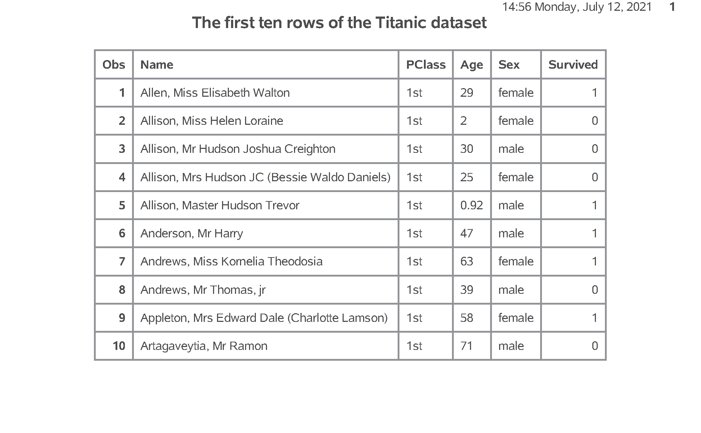
SAS output: Print the first ten lines
SAS Output
Notes:
Output, page 1. If you look at the first few rows of data, you will see that the import went reasonably well. It is not always this easy. Do take notice that age is left justified. It is caused by a number of “NA” codes for missing values. You don’t see it here, but if you print a few more observations, you can see the “NA” values. It would have been easier to anticipate these ahead of time, but we’ll fix things up after the fact.

Slide 8
SAS code: Counts, proc freq
proc freq data=perm.titanic; table PClass Sex Survived; title1 "Frequency counts for categorical variables"; run;
Notes:
Notes04. For any categorical variables, your first step is to get frequency counts.

Slide 9
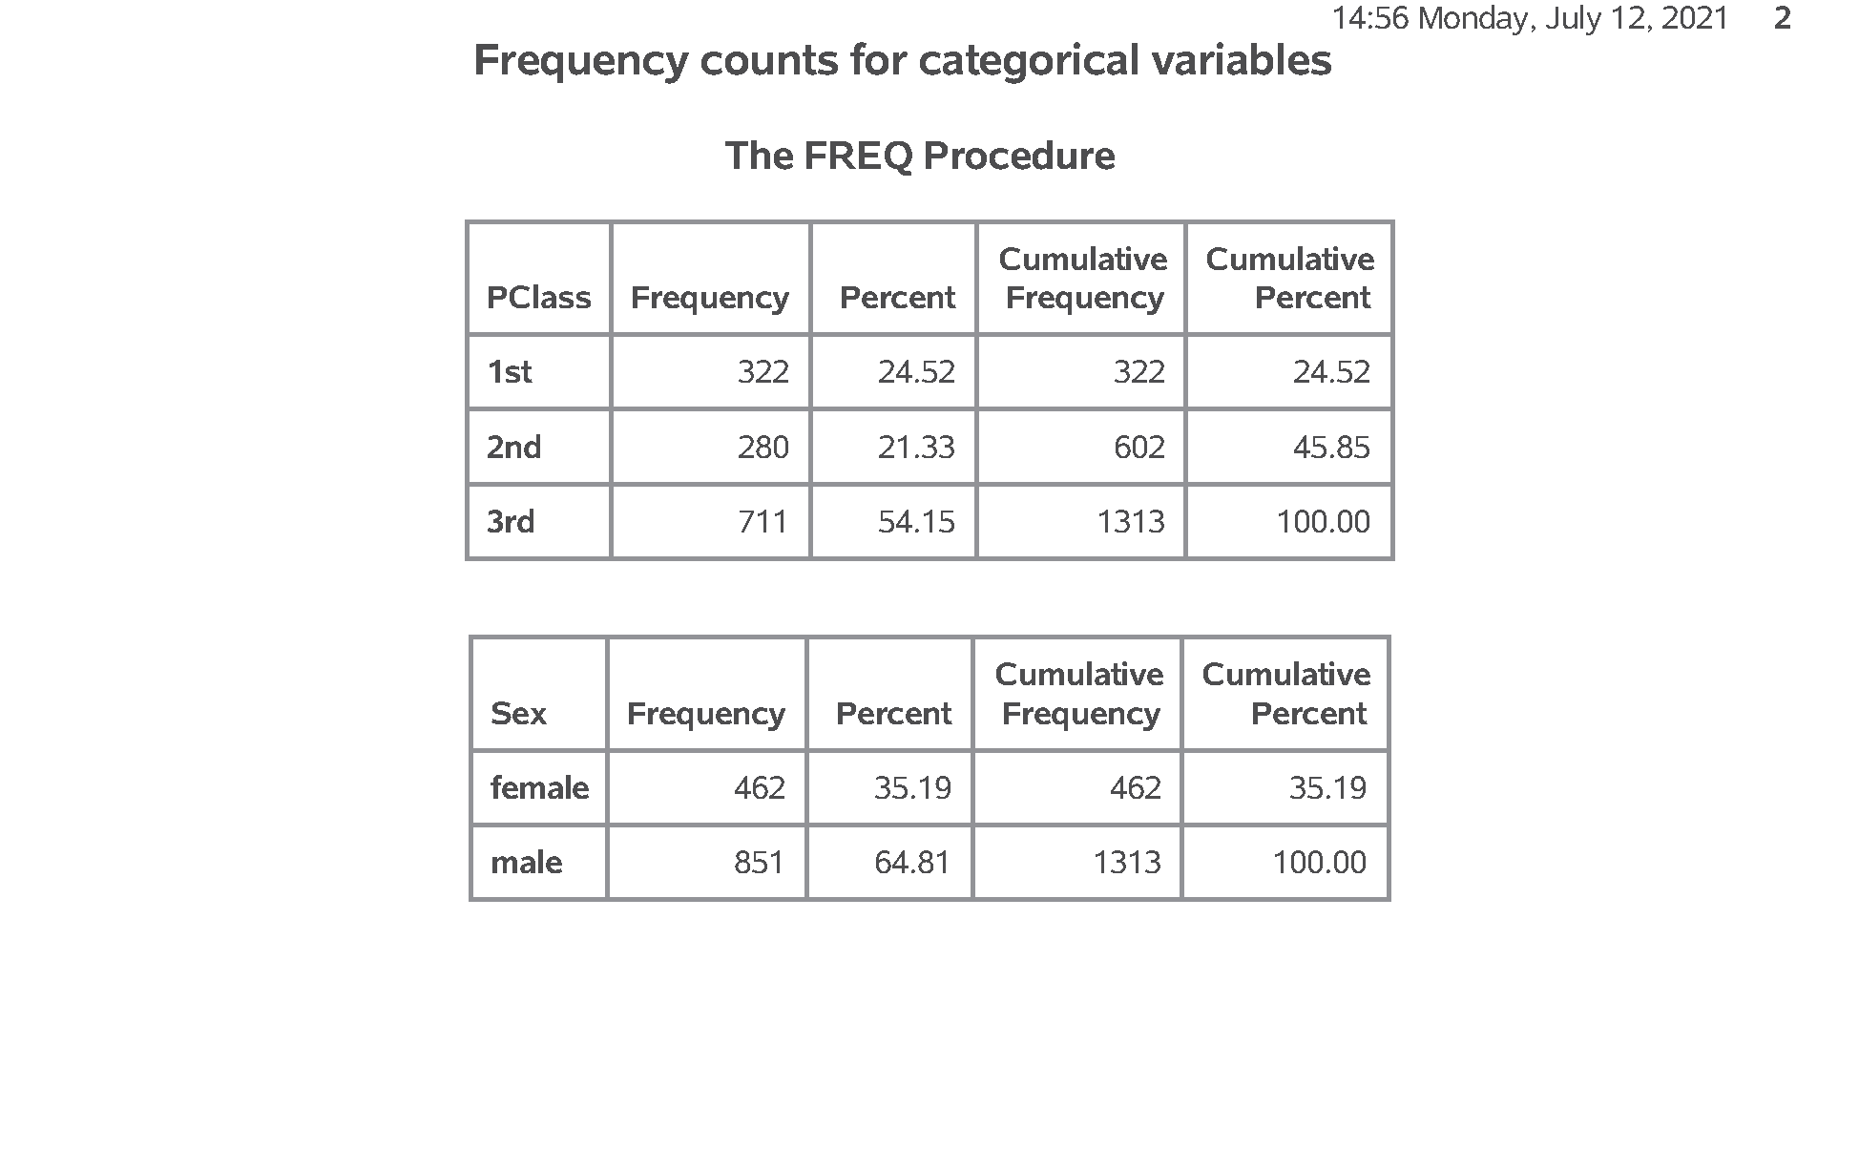
SAS output: Counts, proc freq
SAS Output
Notes:
Output, page 2. There is a mix of three passenger classes, with a lot more in third class. There are also a lot more men than women.

Slide 10
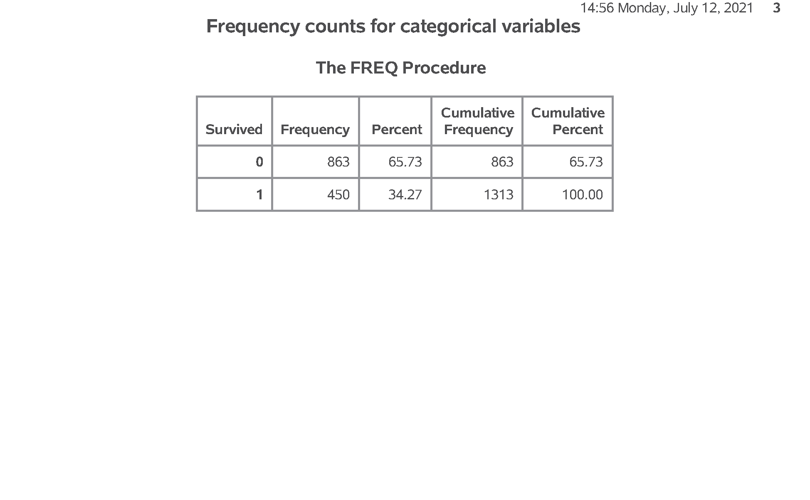
SAS output: Counts, proc freq
SAS Output
Notes:
Output, page 3. The survived variable is a number code. You should look at the data dictionary to find out that 1=survived and 2=died. Only about a third of the passengers survived.

Slide 11
Break #1
What have you learned
Frequency counts
What’s coming next
Convert string to numeric

Slide 12
SAS code: Convert string to numeric, data step
data perm.titanic; set perm.titanic; age_c = input(age, ?? 8.); run; proc means n nmiss mean std min max data=perm.titanic; var age_c; title1 "Descriptive statistics for age"; run;
Notes:
Notes05. For the one continuous variable (age) you need to convert the code “NA” to the SAS missing value code, which is a dot. The easiest way to do this is to force the data to numeric with a simple arithmetic equation like adding a zero. But you get a warning message for each occurence of NA, which can get tedious. The input function with two question marks avoids this issue.

Slide 13
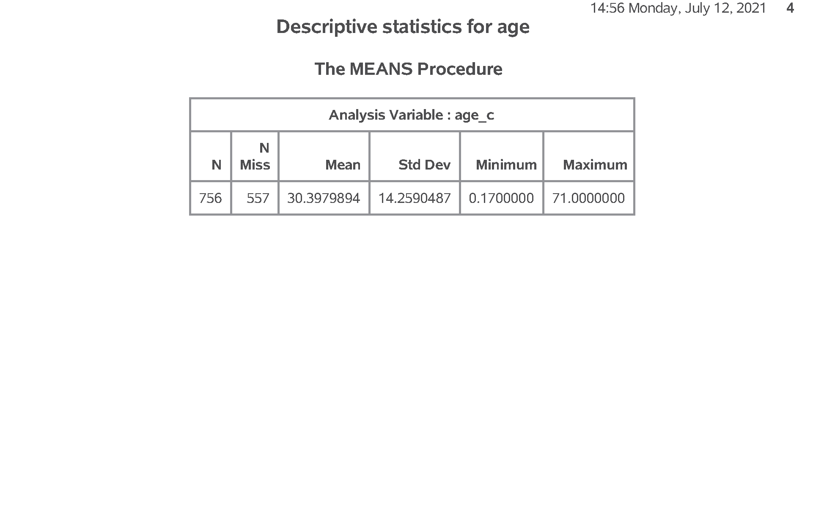
SAS output: Convert string to numeric, data step
SAS Output
Notes:
Output, page 4. The numeric variable, age_c, can now be analyzed using proc means. The average age is about 30, and there are a large number of missing values.

Slide 14
Break #2
What you have learned
Convert string to numeric
What’s coming next
Labels for number codes

Slide 15
SAS code: Using proc format to code categorical data
proc format; value f_survived 0 = "No" 1 = "Yes"; run; proc freq data=perm.titanic; tables Survived; format Survived f_survived.; title1 "Frequency counts for survived using labels"; run;
Notes:
Notes06. For variables like Survived which are numbers, but the numbers represent a particular category, you can document this using a format statement.

Slide 16
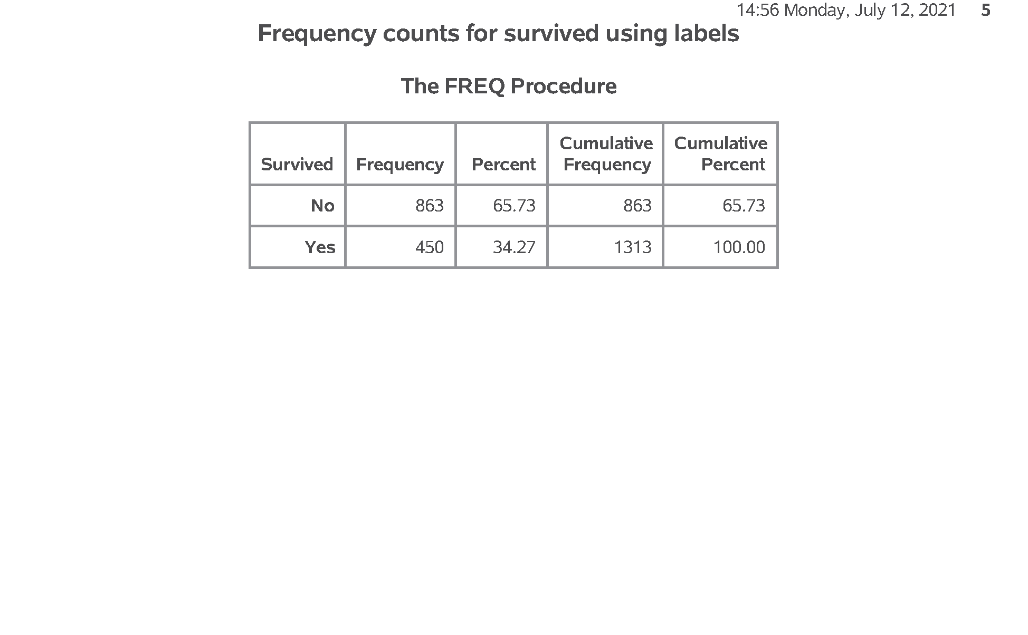
SAS output: Using proc format to code categorical data
SAS Output
Notes:
Output, page 5. Notice that the format statement replaces the cryptic 0-1 code with the words no and yes. It is almost always a good idea to attach labels to any categorical variable using number codes. It makes your output more readable and avoids any confusion or mixing up the codes.

Slide 17
Break #3
What you have learned
Labels for number codes
What’s coming next
Drawing bar charts

Slide 18
SAS code: Bar charts, proc sgplot (1/3)
proc sgplot data=perm.titanic; vbar Survived; format Survived f_survived.; title1 "Bar chart for number surviving"; run;
Notes:
Notes07. I don’t normally like bar charts, but they do have their uses.

Slide 19
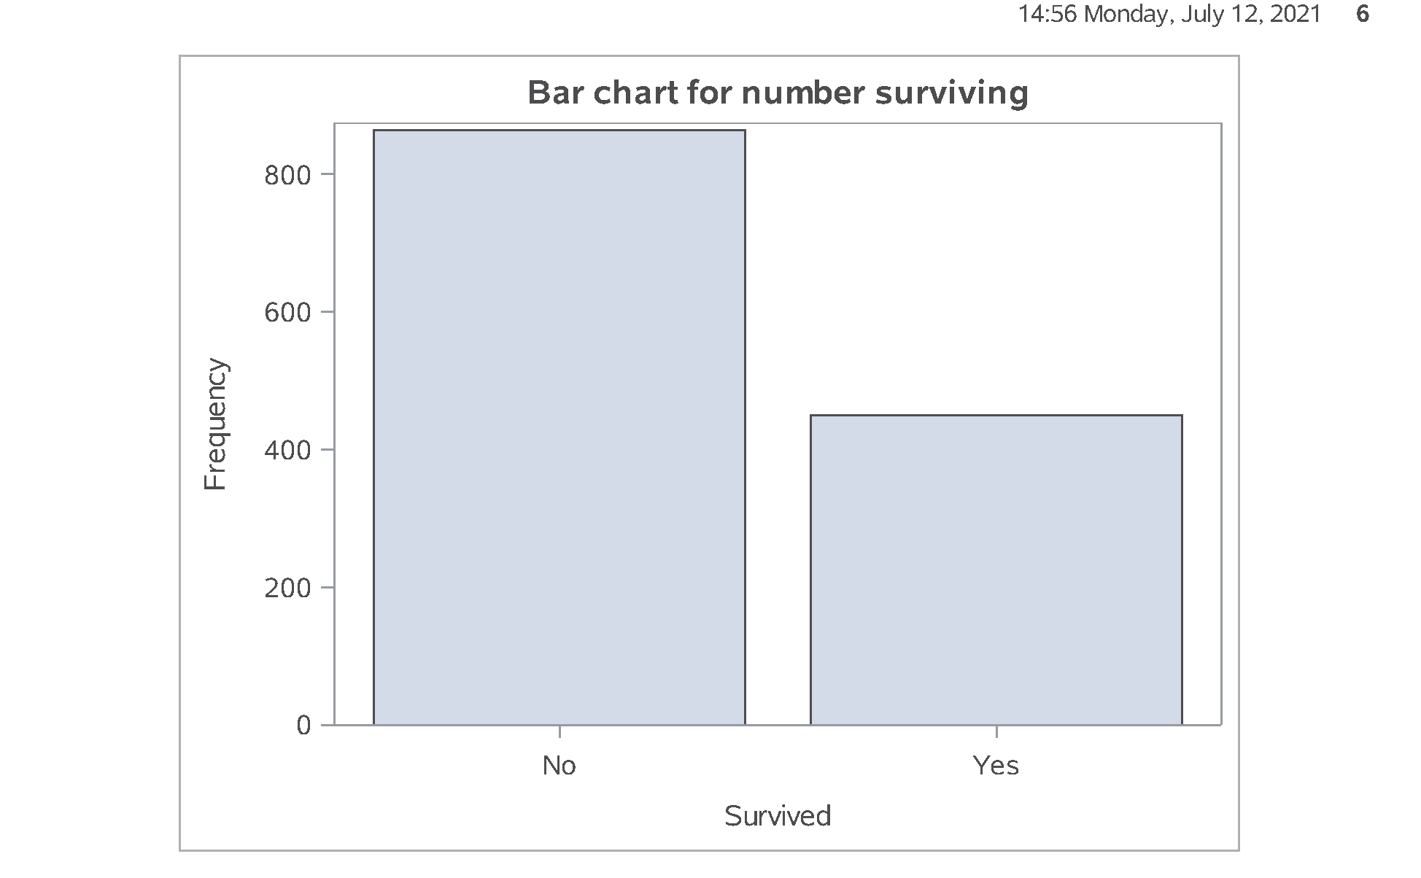
SAS output: Bar charts, proc sgplot (1/3)
SAS Output
Notes:
Output, page 6. This is a basic bar chart.

Slide 20
SAS code: Bar charts, proc sgplot (2/3)
proc freq noprint data=perm.titanic; tables Survived / out=pct_survived; run; proc print data=pct_survived; title1 "Dataset created by proc freq"; run;
Notes:
Notes08. Getting percentages is a bit tricky. You have to run proc freq and output the results to a new data file, pct_survived. I am using the noprint option, because I only want the percentages for internal use. It wouldn’t have hurt anything to print out a bit extra, but I want to encourage you to limit the amount of output that you present to a consulting client.

Slide 21
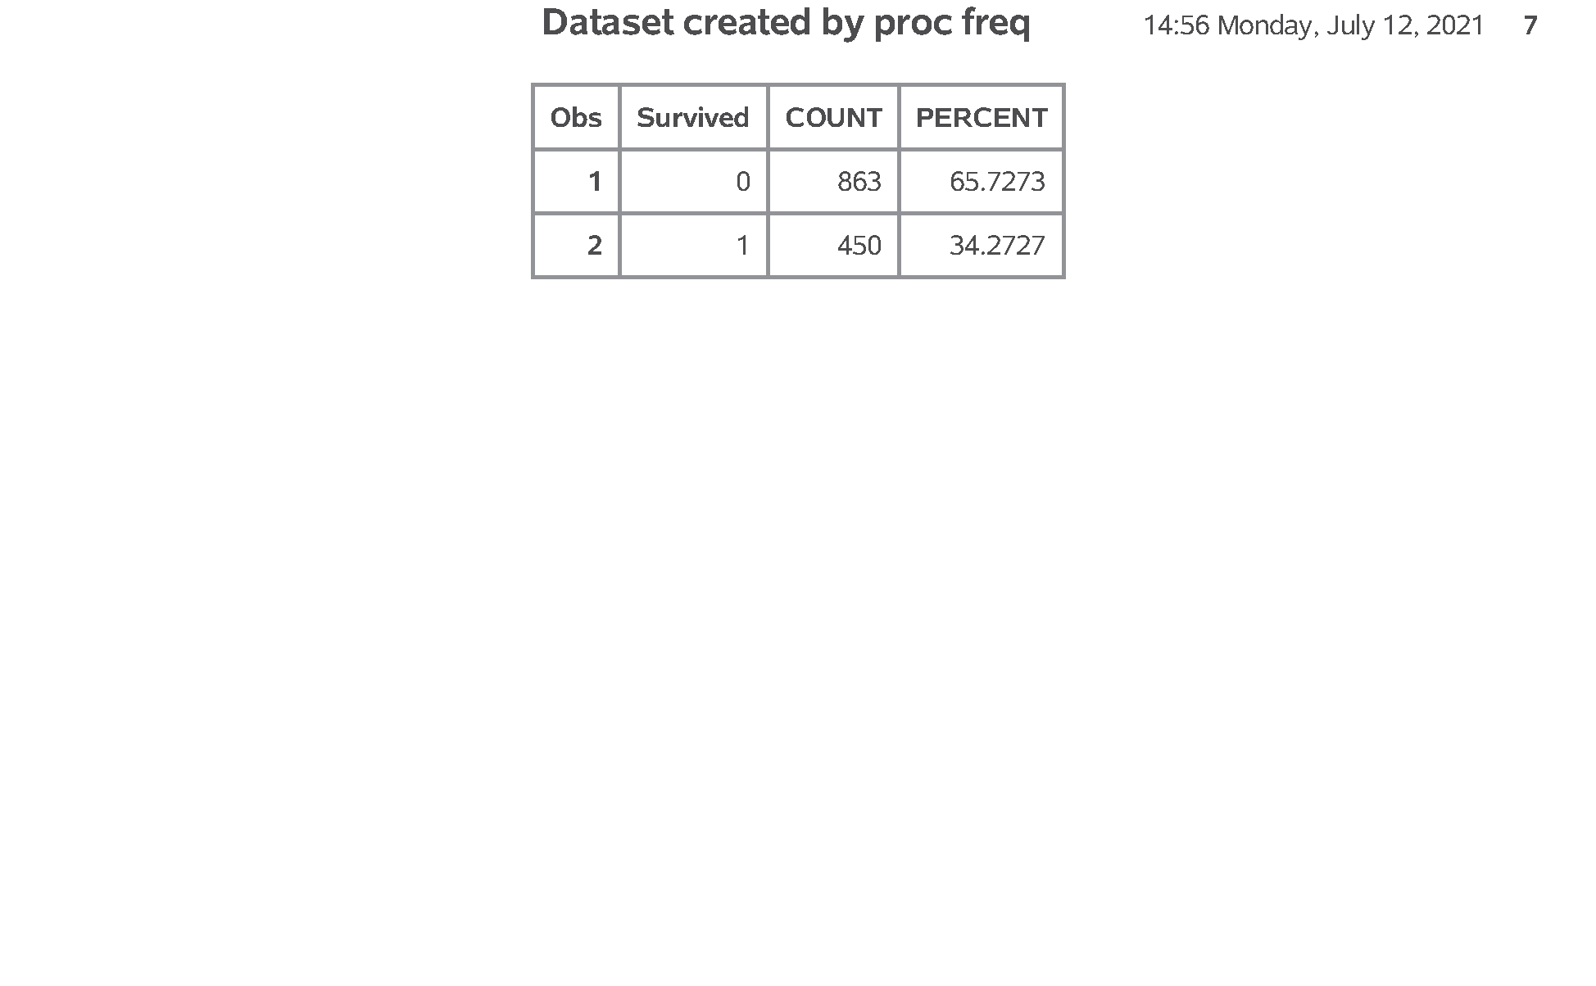
SAS output: Bar charts, proc sgplot (2/3)
SAS Output
Notes:
Output, page 7. You don’t need to print out this dataset, but I wanted to show it so you can understand what the file looks like. It has the “by” variable, survival, along with COUNT and PERCENT

Slide 22
SAS code: Bar charts, proc sgplot (3/3)
proc sgplot data=pct_survived; vbar Survived / response=Percent; yaxis max=100; format Survived f_survived.; title1 "Bar chart for percent surviving"; run;
Notes:
Notes09. You use this newly created dataset to show percentages instead of counts.

Slide 23
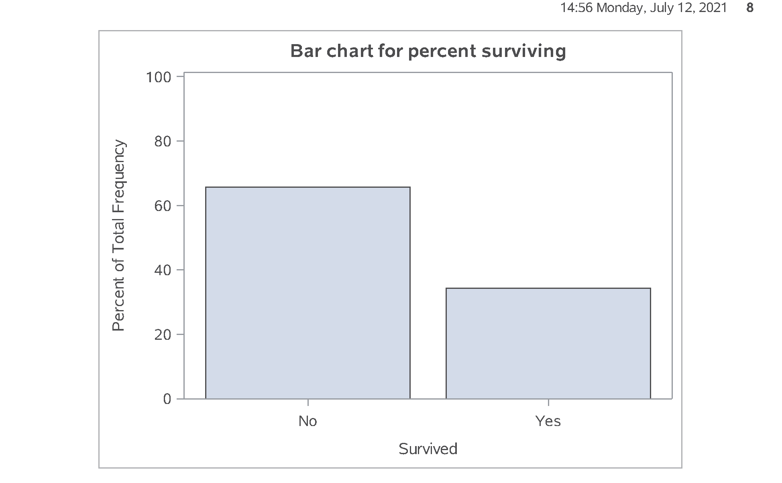
SAS output: Bar charts, proc sgplot (3/3)
SAS Output
Notes:
Output, page 8. Note that the yaxis max=100 statement expands the upper limit of the y axis to 100%.

Slide 24
Break #4
What you have learned
Drawing bar charts
What’s coming next
Converting continuous to categorical

Slide 25
SAS code: Converting continuous to categorical (1/5)
data age_categories; set perm.titanic; if age_c = . then age_cat = "missing "; else if age_c < 6 then age_cat = "toddler "; else if age_c < 13 then age_cat = "pre-teen"; else if age_c < 21 then age_cat = "teenager"; else age_cat = "adult "; run;
Notes:
Notes10. If you want to create categories from a continuous variable, use a series of
if - then - else
statements

Slide 26
SAS code: Converting continuous to categorical (2/5)
proc sort data=age_categories; by age_cat; run; proc means min max data=age_categories; by age_cat; var age_c; title1 "Quality check for conversion"; run;
Notes:
Notes11. Always cross check your results against the original variable.

Slide 27
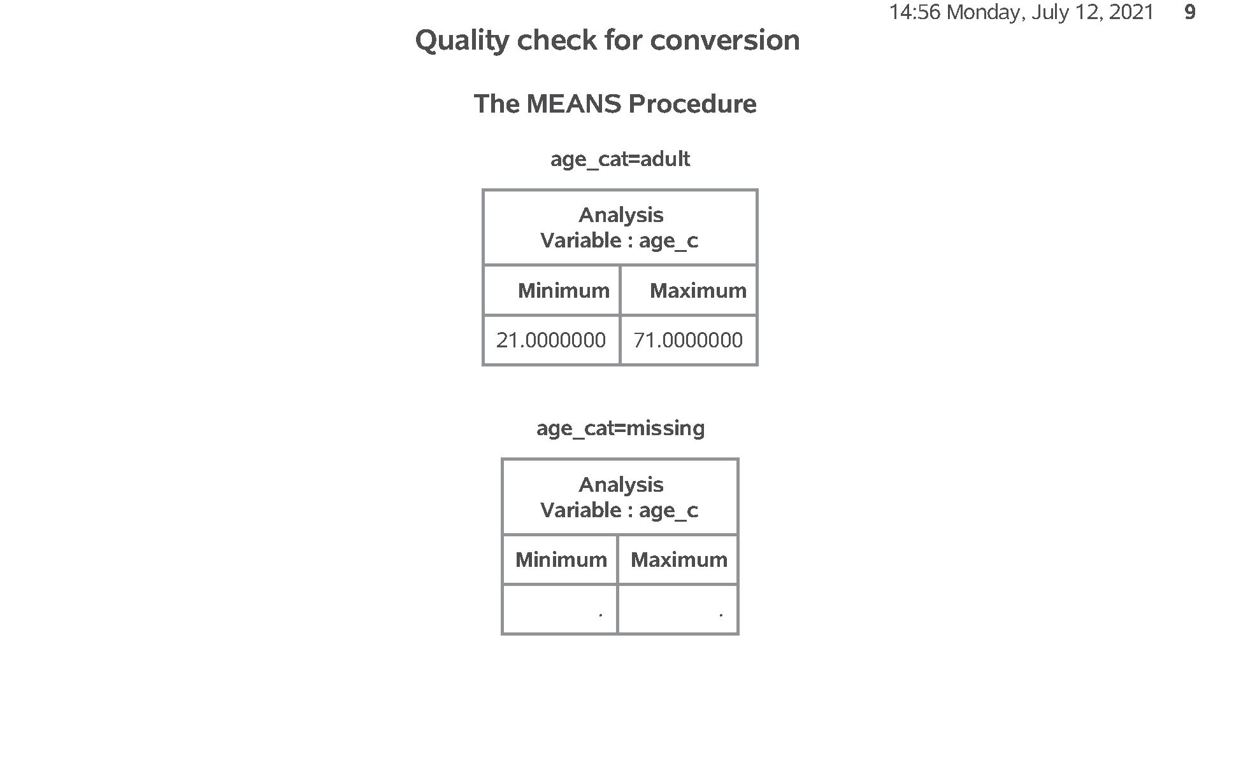
SAS output: Converting continuous to categorical (2/5)
SAS Output
Notes:
Output, page 9. These results look good.

Slide 28
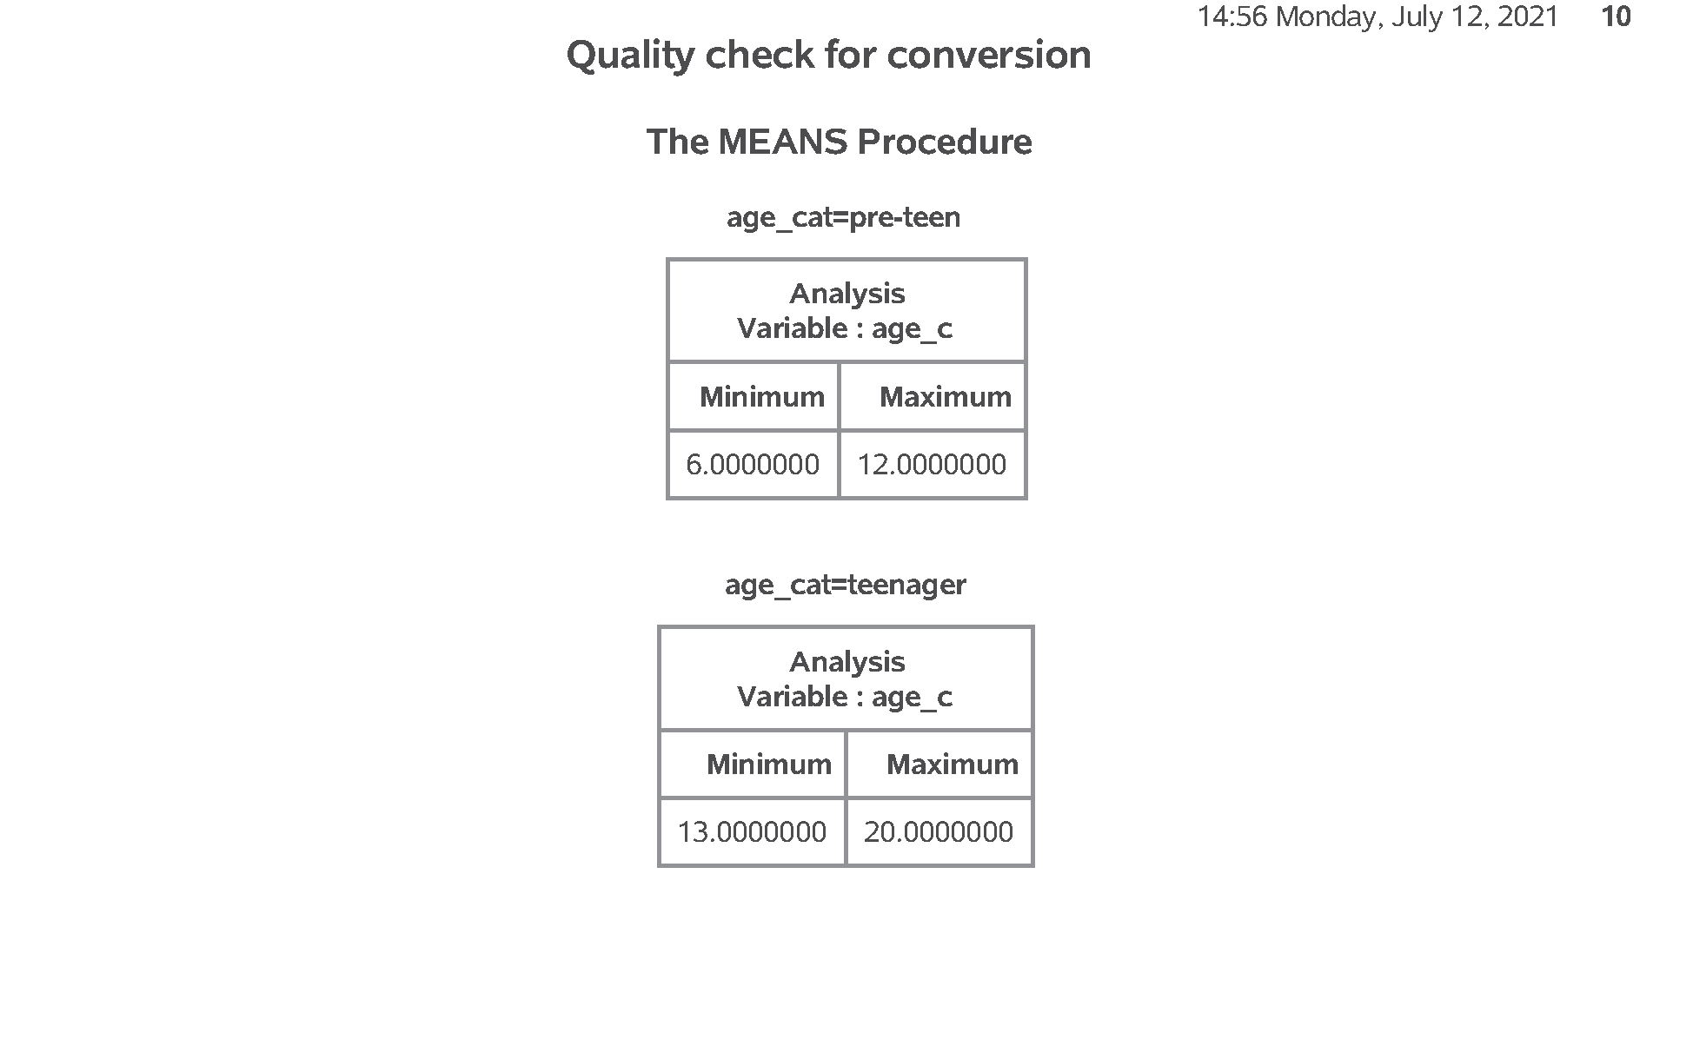
SAS output: Converting continuous to categorical (2/5)
SAS Output
Notes:
output, page 10, And these look good also.

Slide 29
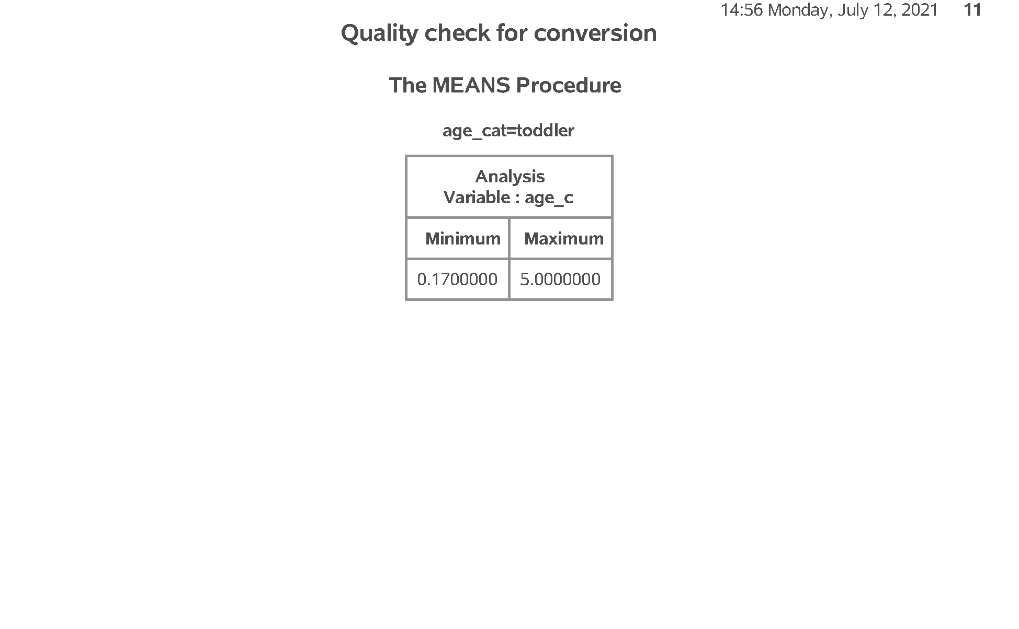
SAS output: Converting continuous to categorical (2/5)
SAS Output
Notes:
output, page 11, Notice, however, that the order for age_cat is alphabetical, which is probably not what you want.

Slide 30
SAS code: Converting continuous to categorical (3/5)
data age_codes; set perm.titanic; if age_c = . then age_cat = 9; else if age_c < 6 then age_cat = 1; else if age_c < 13 then age_cat = 2; else if age_c < 21 then age_cat = 3; else age_cat = 4; run;
Notes:
Notes12. You can control the order by using number codes and formats.;

Slide 31
SAS code: Converting continuous to categorical (4/5)
proc format; value f_age 1 = "toddler" 2 = "pre-teen" 3 = "teenager" 4 = "adult" 9 = "unknown"; run;
Notes:
Notes13. The format statement attaches a label to each number code.

Slide 32
SAS code: Converting continuous to categorical (5/5)
proc sort data=age_codes; by age_cat; run; proc means min max data=age_codes; by age_cat; var age_c; format age_cat f_age.; title1 "Quality check for conversion"; title2 "Revision to control ordering"; run;
Notes:
Notes14. Again, a quality check is important.

Slide 33
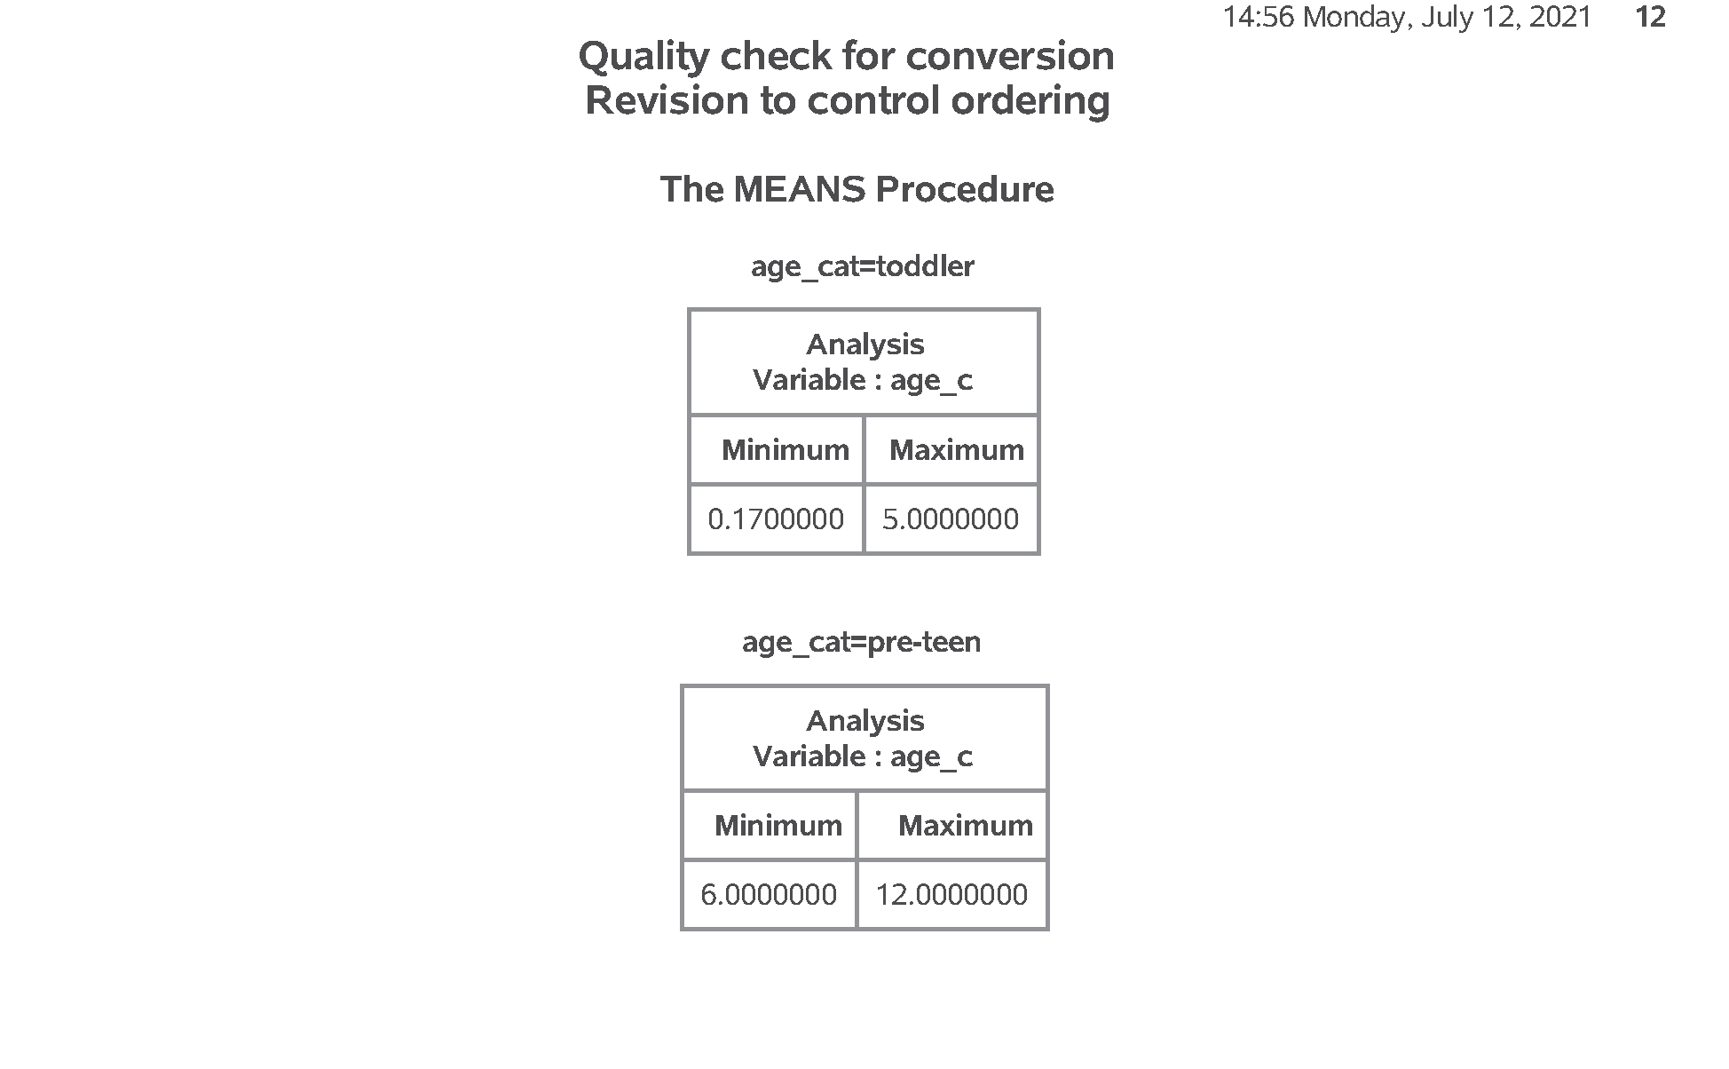
SAS output: Converting continuous to categorical (5/5)
SAS Output
Notes:
Output, page 12. The tables are ordered from toddler to pre-teen,

Slide 34
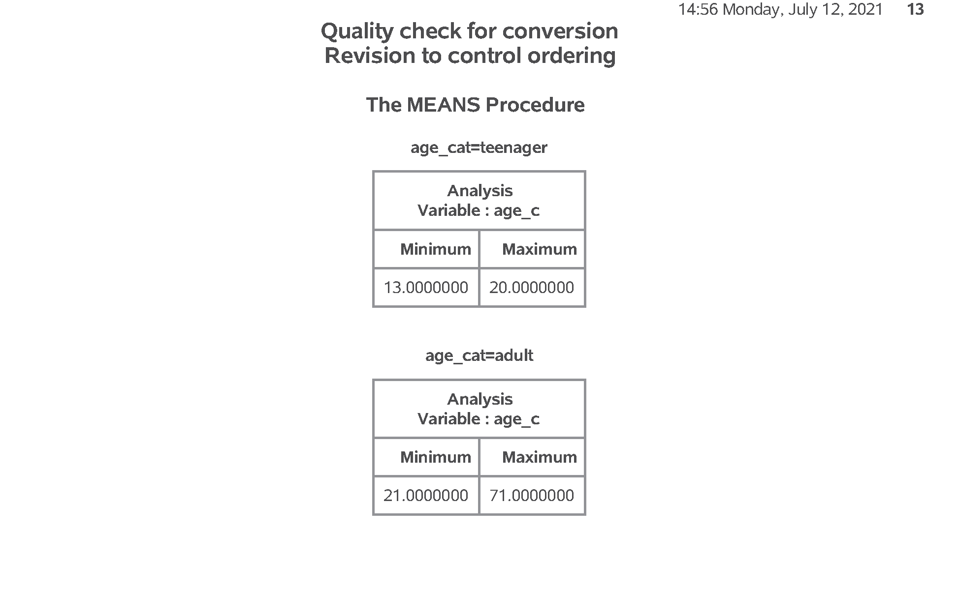
SAS output: Converting continuous to categorical (5/5)
SAS Output
Notes:
Output, page 13. to teenager to adult,

Slide 35
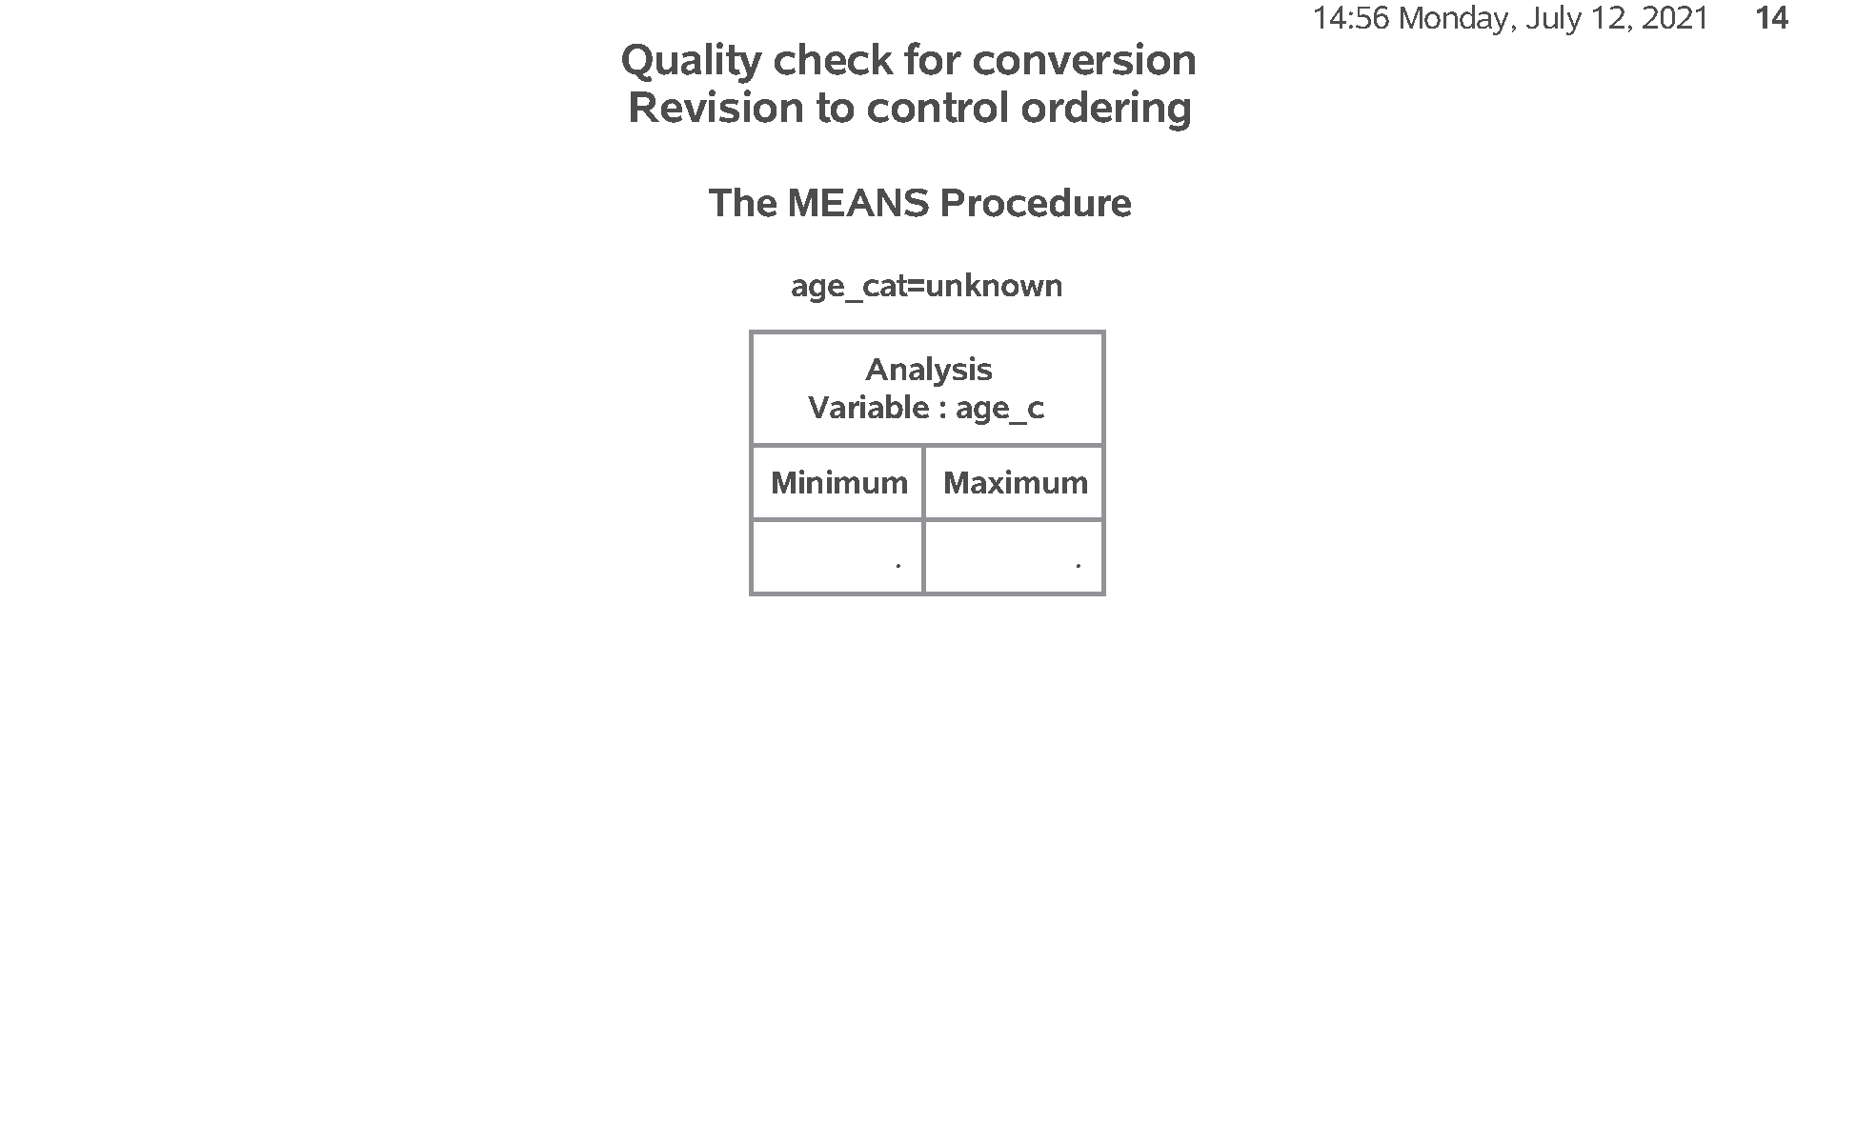
SAS output: Converting continuous to categorical (5/5)
SAS Output
Notes:
Output, page 14. then missing.

Slide 36
Break #5
What you have learned
Converting continuous to categorical
What’s coming next
Modifying categorical variables

Slide 37
SAS code: Modifying a categorical variable
data first_class; set perm.titanic; if PClass = "1st" then first_class = "Yes"; else first_class = "No "; run; proc freq data=first_class; table PClass*first_class / norow nocol nopercent; run;
Notes:
Notes15. Here’s how you combine categories for a categorical variable. It uses the same “if - then - else” code.

Slide 38
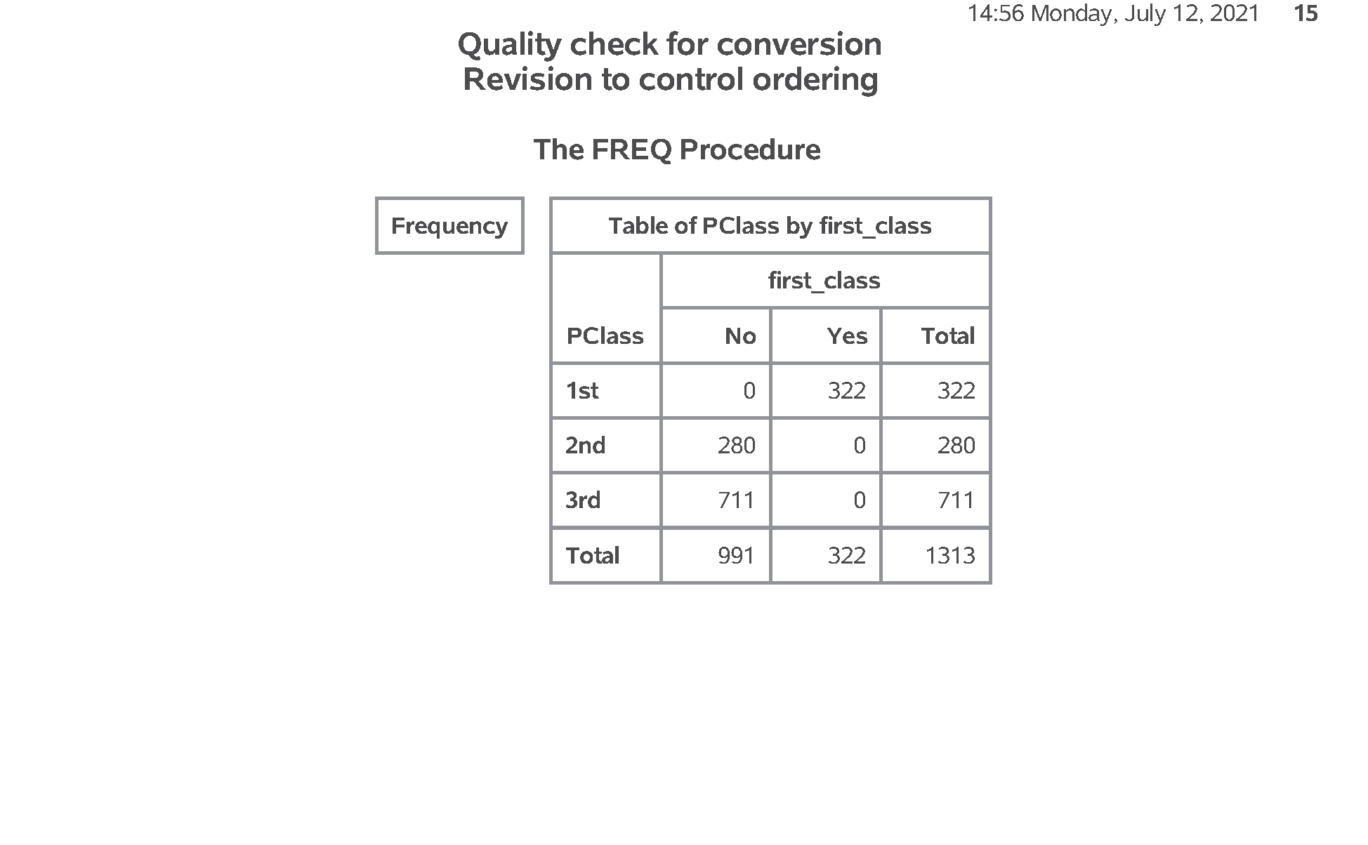
SAS output: Modifying a categorical variable
SAS Output
Notes:
Output, page 15. Here is a quality check.

Slide 39
Break #6
What you have learned
Modifying categorical variables
What’s coming next
Crosstabulation

Slide 40
SAS code: Crosstabulation (1/4)
proc freq data=perm.titanic; tables Sex*Survived; format Survived f_survived.; title1 "Crosstabulation with all percentages"; run;
Notes:
Notes16. To examine relationships among categorical variables use a two dimensional crosstabulation.

Slide 41
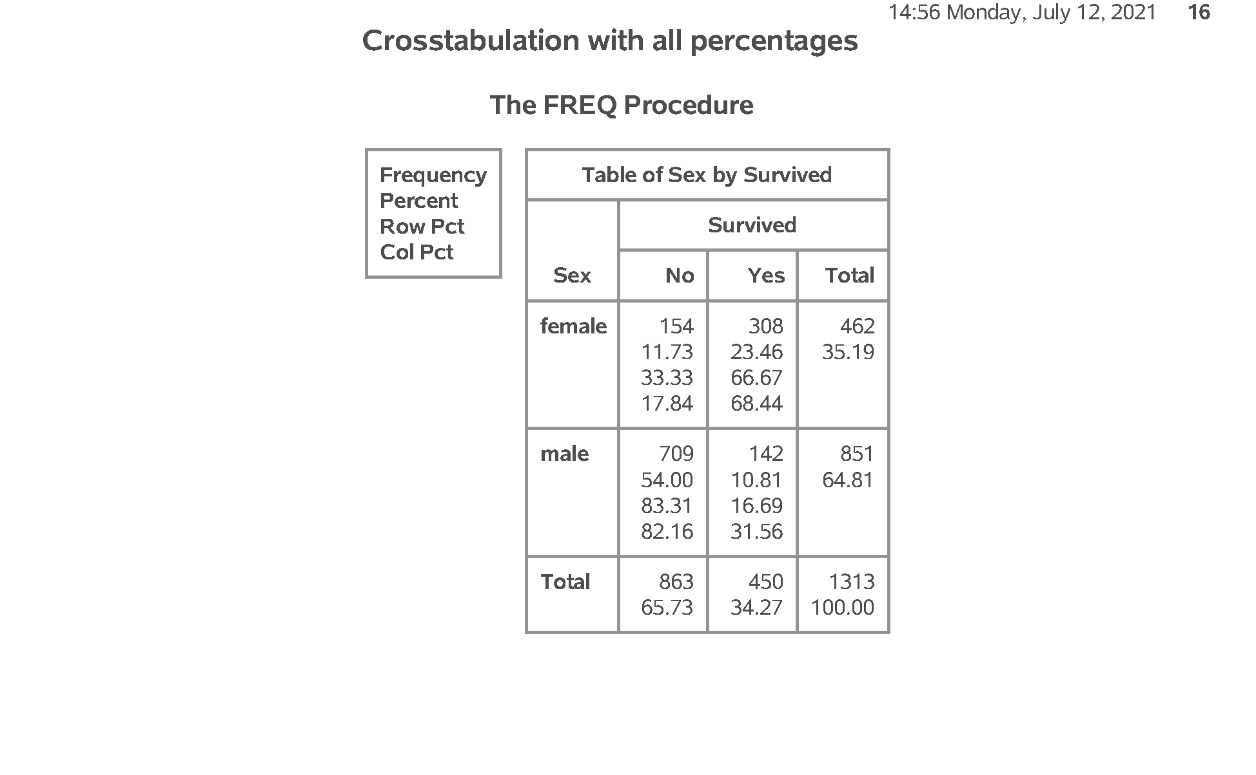
SAS output: Crosstabulation (1/4)
SAS Output
Notes:
Output, page 16. Notice that SAS provides three different percentages. I do NOT recommend that you show every percentage.

Slide 42
SAS code: Crosstabulation (2/4)
proc freq data=perm.titanic; tables Sex*Survived / nocol nopercent; format Survived f_survived.; title1 "Crosstabulation with row percentages"; run;
Notes:
Notes17. You get row percentages by excluding column percentages (nocol) and cell percentages (nopercent).

Slide 43
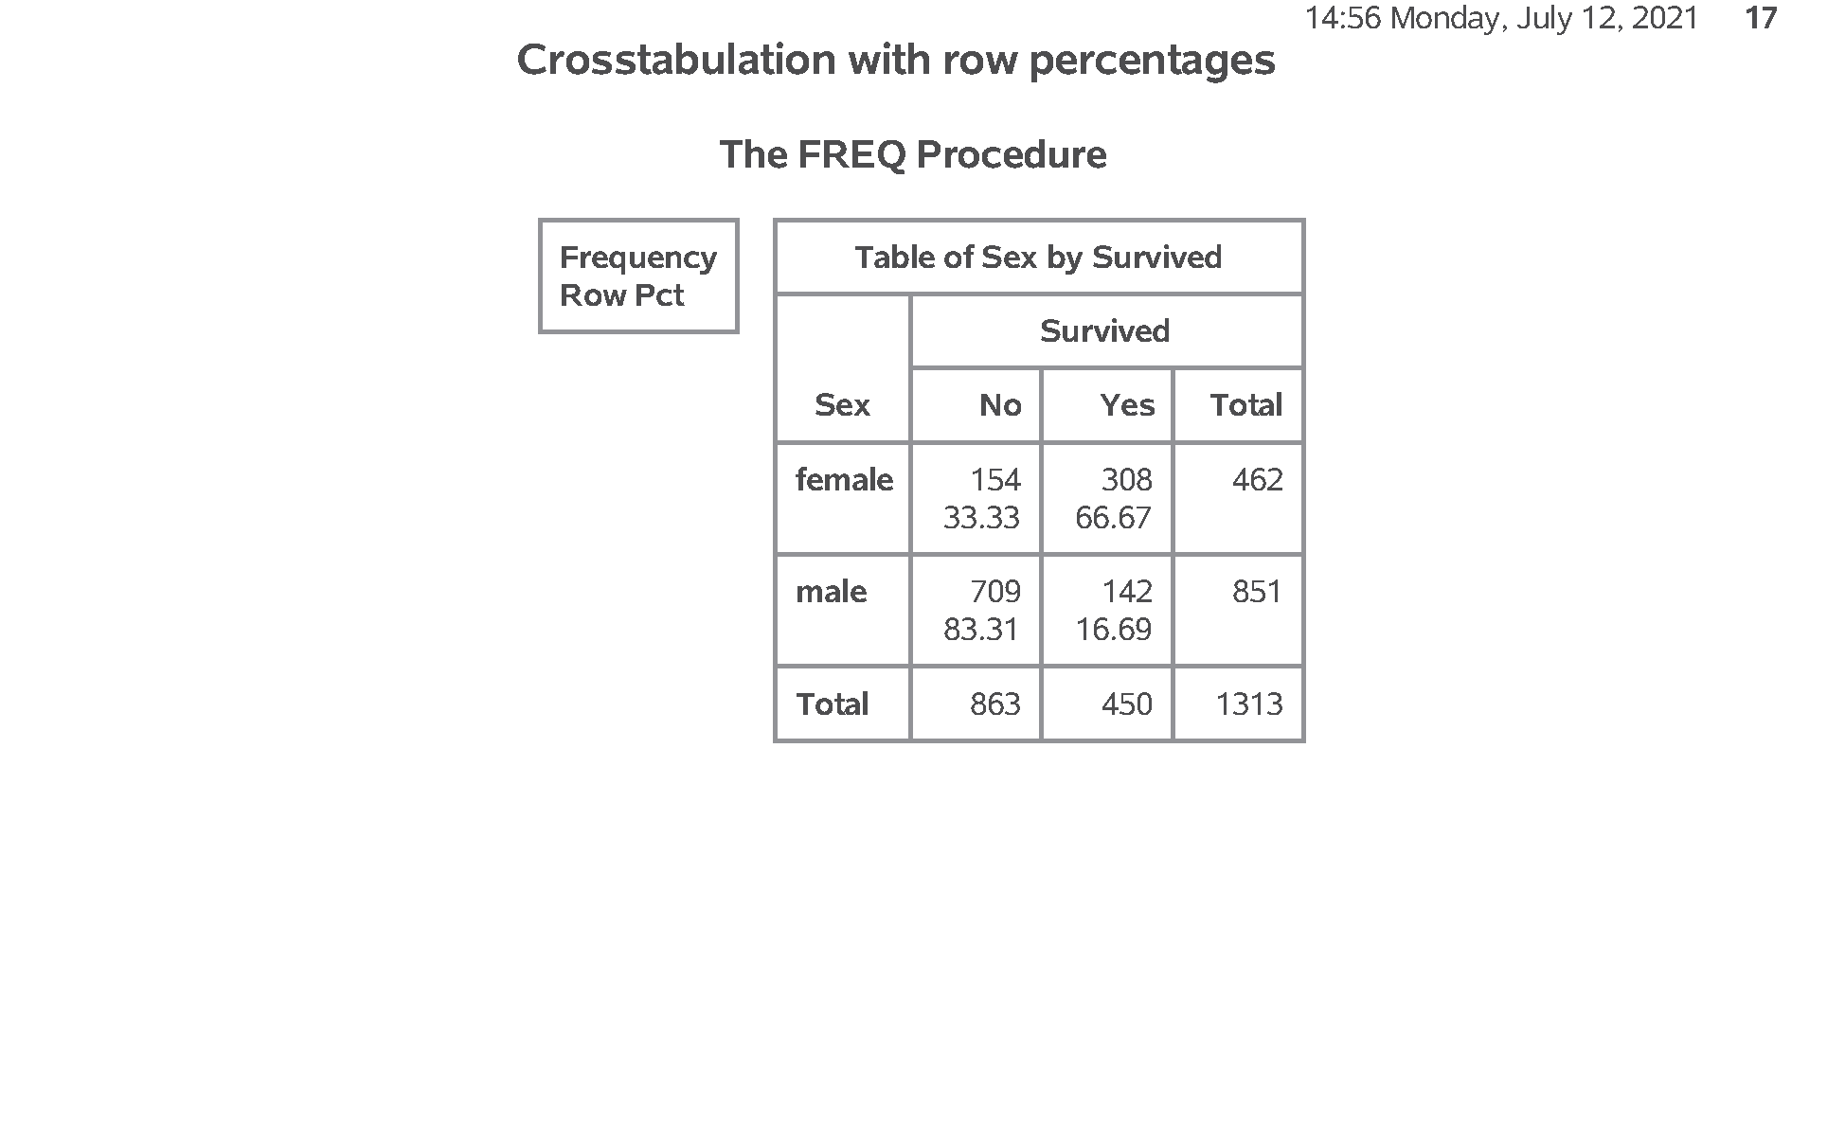
SAS output: Crosstabulation (2/4)
SAS Output
Notes:
Output, page 17. Notice that among the men, 83% died and 17% survived. 83% and 17% adds up to 100% within that row. Among the women 33% died and 67% survived. 33% and 67% addes up to 100% within that row.

Slide 44
SAS code: Crosstabulation (3/4)
proc freq data=perm.titanic; tables Sex*Survived / norow nopercent; format Survived f_survived.; title1 "Crosstabulation with column percentages"; run;
Notes:
Notes18. You get column percentages by excluding row percentages (norow) and cell percentages (nopercent).

Slide 45
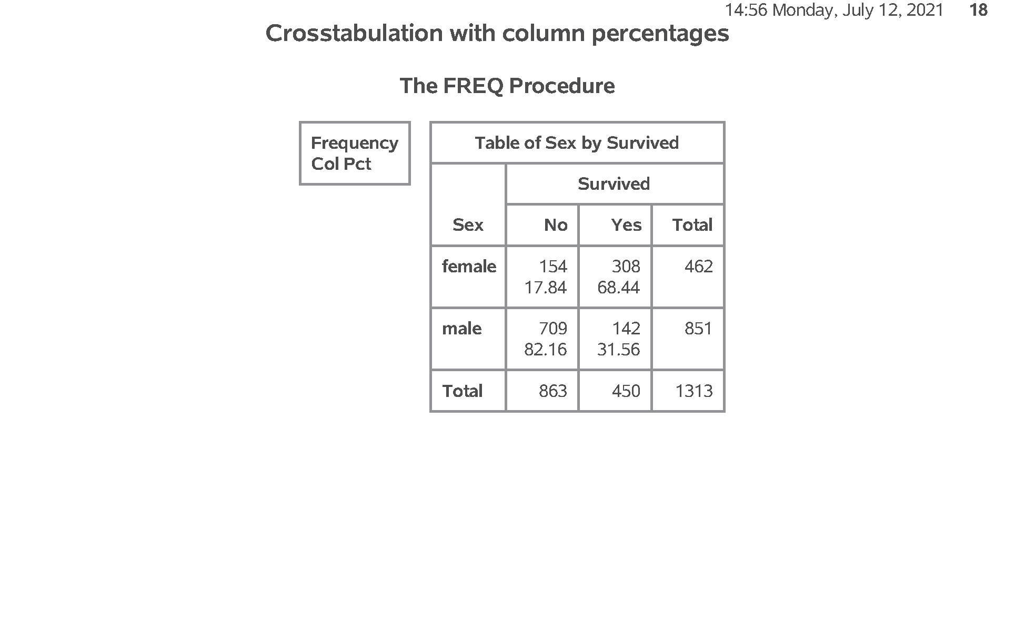
SAS output: Crosstabulation (3/4)
SAS Output
Notes:
Output, page 18. Column percentages add up to 100% within each column. Among those who died, 18% were women and 82% were men. 18% and 82% adds up to 100%. Among the survivors, 68% were women and 32% were men. 68% and 32% adds up to 100%.

Slide 46
SAS code: Crosstabulation (4/4)
proc freq data=perm.titanic; tables Sex*Survived / norow nocol; format Survived f_survived.; title1 "Crosstabulation with cell percentages"; run; ods pdf close;
Notes:
Notes19. You get cell percentages by excluding row percents (norow) and column percents (nocol).

Slide 47
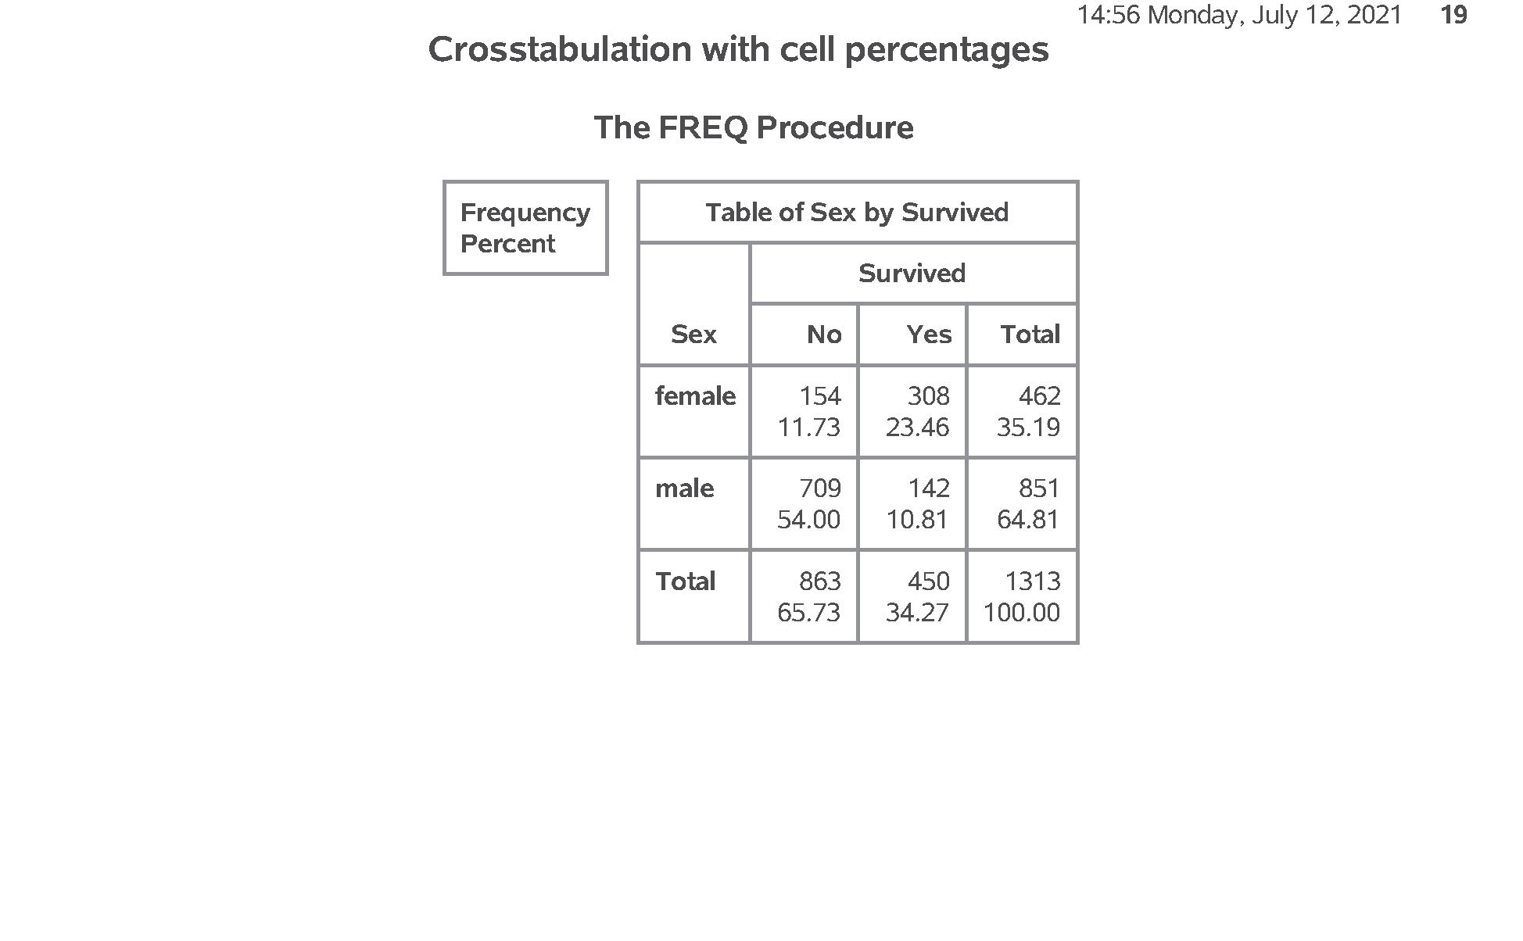
SAS output: Crosstabulation (4/4)
SAS Output
Notes:
Output, page 19. Cell percentages add up to 100% across the entire table. There were 12% female deaths among all the passengers, 54% male deaths, 23% female survivors, and 11% male survivors. These four percentages (12%, 54%, 23%, and 11%) all add up to 100%. Which is best: row, column, or cell percents. The answer is “it depends.” I have a handout that talks about these issues.

Slide 48
Review
Frequency counts
Convert string to numeric
Labels for number codes
Drawing bar charts
Converting continuous to categorical
Modifying categorical variables
Crosstabulations

