Slide 1
Introduction to SAS, Working with continuous variables
Steve Simon

Slide 2
Overview
Using variable labels
Printing a small piece of data
Simple descriptive statistics
Printing row with smallest/largest value
Missing value logic
Simple transformations
Histograms
Correlations
Scatterplots
Notes:
author: Steve Simon
date: created 2021-05-30
purpose: to produce slides for module01 videos
license: public domain
Here is an overview of the topics I want to cover in module02.
[For my own use]General structure of this program.
Part00. Documentation header;
Notes00 This is the standard documentation header.;
Part01. Tell SAS where to find and store things.;
This needed to have the output fit on PowerPoint;
Notes01. You should already be familiar with
Part02. Label your categorical variables;
Notes02. There are several categorical
Part03. Reading the data using a data step;
Notes03. The data file is comma delimited and
Part04. Print the first ten rows of data;
Notes04. It’s always a good idea to peek at
Part05. Proc freq and proc means;
Notes05. There is a mix of categorical and
Part06. Pearson correlation, proc corr;
Notes06. The Pearson correlation coefficient
Output, page 4. Remember the cut-offs. A
Part07. Scatterplot, proc sgplot
Notes07. You should also examine the association
Part08. Scatterplot, smoothing curve
Notes08. Sometimes a trend line can help. You
Part09. Boxplot, proc sgplot
Notes09. When you want to look at a relationship
Part10. Descriptive statistics, by statement;
Notes10. Also look at how the means and standard
Part11. Investigate unusual trend, proc sgplot and means;
Notes11. This is very odd. You can get a hint as
Part12. End of program.;

Slide 3
Review definitions
Categorical
Small number of possible values
Each value associated with a category
Continuous
Large number of possible values
Potentially any value in an interval
Notes:
Before we start, let’s review a couple of definitions.
A categorical variable is a variable that can only take on a small number of values. Each value is usually associated with a particular category.
Examples of categorical variables are
sex (Male or Female),
race (White, Black, Native American, etc.),
cancer stage (I, II, III, or IV),
birth delivery type (Vaginal, C-section).
A continuous variable is a variable that can take on a large number of possible values, potentially any value in some interval.
Examples of continuous variables are
Birth weight in grams,
gestational age,
fasting LDL level.
There are some variables that are on the boundary between categorical and continuous, but it is not worth quibbling about here.
The point to remember is that the types of graphs that you use and the types of statistics that you compute are dependent on many things, but first and foremost on whether the variables are categorical, continuous, or a mixture.
Today, you will see examples involving mostly continuous variables.

Slide 4
Semicolons are important
Ends every SAS statement
Easy to forget
Use this to your advantage
Several short lines
Indent continuations
Notes:
Before I go too far, let me mention and important thing. Every SAS statement ends in a semicolon. This is important. You will forget a semicolon and it will lead to a cryptic error message. So here’s a quick hint. If you get an error message on a certain line of code, look to see if you forgot a semicolon on the previous line. It happens to me all the time and I’ve been using SAS for decades.

Slide 5
Example of stretching statement across multiple lines.
One long line
statement option1 option2 option3 option4;
versus several short lines.
statement option1 option2 option3 option4;
Notes:
The use of semicolons is nice, in a way, because it allows you to stretch a complicated SAS statement across two or more rows of your program. This can often make your program more readable. It is hard to read a long line of code. Your eye has to scan left to right and you can sometimes lose track of which line you are on. Most newpapers place their articles in narrow columns because it makes them easier to read.
There is no official rule of thumb on this, but I do try to keep my lines below 50 characters. I also try to indent substatements with a data step or procedure. I use blank lines between data steps and procedures.
Don’t obsess about this now, but you’ll see a fairly consistent coding style that I use for my SAS code. You don’t have to follow my format, of course, which might be a bit too extreme for your tastes. Just experiment with things a bit until you can settle on a layout that you are comfortable with.

Slide 6
SAS code, Documentation header
5507-05-simon-working-with-a-mix-of-variables.sas author: Steve Simon date created: 2018-11-27 purpose: to illustrate how to work with data that has a mix of categorical and continuous variables. license: public domain;
Notes:
Notes00 This is the standard documentation header.

Slide 7
SAS code: Tell SAS where to find and store things.
options papersize=(6in 4in); * This needed to have the output fit on PowerPoint; %let path=q:/introduction-to-sas; ods pdf file="&path/results/5507-05-simon-working-with-mix-of-variables.pdf"; filename raw_data "&path/data/fev.txt"; libname perm "&path/data";
Notes:
Notes01. You should already be familiar with this. The filename statement tells you where the raw data is stored. The libname statement tells you where SAS will store any permanent datsets. The ods statement tells you that SAS is going to store the results with a particular filename and in pdf format.
Today, you will analyze some data sets that have a mix of categorical and continuous variables. The first data set looks at pulmonary function in a group of children.
You can find a description of this data set at
http://jse.amstat.org/datasets/fev.txt

Slide 8
SAS code, Label your categorical variables
proc format; value fsex 0 = "Female" 1 = "Male" ; value fsmoke 0 = "Nonsmoker" 1 = "Smoker" ; run;
Notes:
Notes02. There are several categorical variables in this data set with number codes, so you should define labels for those codes.

Slide 9
Rules for variable names
Can use mix of
letters (A-Z, a-z),
numbers (0-9)
underscore (_)
no blanks
no symbols
Can’t start with a number
“a1” but not “1a”
Capitalization not important
BMI, Bmi, bmi are same
Up to 32 characters in length
Notes:
There are important rules for variable names in SAS. You can use a mix of letters, numbers, and the underscore. You can’t use blanks or any special symbols like the dollar sign ($) or the dash/minus sign.
You can’t start with a number. So “a1” is okay, but “1a” is not.
Capitalization is not important in SAS. So you can call your variable “BMI” with all caps, or “Bmi” with mixed capitals or “bmi” with all lower case. SAS treats all of these the same.
Your variable name has to be 32 characters or less in length.
I’m using the variable names provided but if you create your own names, use brief (but descriptive) name for EVERY variable in your data set. There’s no precise rule, but names should be around 8 characters long. Longer variable names make your typing tedious and much shorter variable names makes your code terse and cryptic.
I’m a bit more terse with these variable names than I normally would be just to reduce the amount of typing you have to do.
You should avoid special symbols in your variable names especially symbols that are likely to cause confusion (the dash symbol, for example, which is also the symbol for subtraction). You should also avoid blanks. These rules are pretty much universal across most statistical software packages.
There are times when you’d like to have a blank in your variable name and you can use two special symbols in SAS (and most other statistical pacakges).
Here’s how you can simulate blanks without actually using blanks.
the underscore symbol (above the minus key on most keyboards) and
the dot (period). (Note that SAS does not allow you to use the period this way.)
These symbols create some artificial spacing that mimics the blanks. Another approach is “CamelCase” which is the mixture of upper and lower case within a variable name with each uppercase designating the beginning of a new “word”.

Slide 10
Recommendations for variable names
Avoid generic names (x1, var01, etc.)
Keep it short
Use commonly known abbreviations…
…but nothing cryptic
Use all lower case (age, not AGE or Age)
Separate words with underscores
fat_brozek, not fatbrozek
Alternative: CamelCase
FatBrozek
Caution: Writer’s Exchange website
www.writersexchange.com
Notes:
Your variable names should by descriptive. Avoid generic names like x1, var01, and so forth.
Keep things short. You can use commonly known abbreviations, such as “wt” for “weight”. But avoid any cryptic abbreviations.
I like to keep everything in lower case. It is more readable than all upper case, and easier to remember than a mixture of upper and lower case. Some people prefer an initiial upper case, and there’s nothing wrong with that. It is important, however, to be consistent.
You can use two or three short words in a variable name, but be sure to separate them using underscores. So the variable for percentage body fat as measured by Brozek’s equation is “fat” and “brozek” separated by an underscore. Some people prefer CamelCase, where each word starts with an initial capital letter: capital F fat, capital B brozek.
The one thing you do want to avoid is just running two or three words together and all lower case. There’s a story about a group that started up in the era before the web called Writer’s Exchange. As you can guess this was a resource for new authors. When the web came out, they decided to put their resources up on a website, www.writersexchange.com. That seemed logical enough, but then someone notices that you could read the website as “www dot writer sex change dot com”. Not exactly the image they wanted.

Slide 11
Break #1
What have you learned so far
Rules for variable names
What’s next
Using variable labels
Printing a small piece of data

Slide 12
SAS variable labels
Longer description of a variable
Can include blanks, special symbols
Internal documentation
Labels substituted on some (but not all) output
Required in this class (see grading rubric)
Recommendations for variable labels
Judicious use of upper and lower case
Spell out abbreviations
Specify units of measurement
Any other important details
Notes:
SAS offers an opportunity for you to add documentation to your program about individual variables. These are called variable labels. They have almost no restrictions. You can use blanks, or special symbols like a dollar sign or a dash. The documentation that variable labels provide is mostly internal, but these labels are substituted in a few places like some graphs.
I strongly recommend use of variable labels and will require them for any homework you submit in this class. See the grading rubric for details.
What makes a good variable label? First take advantage of a mixture of upper and lower case to make your labels more readable. Spell out any abbreviations, even obvious abbreviations. If your variable has a measurement unit, specify that unit in your variable label. If there are other important details, put these in the variable label as well.

Slide 13
SAS code, Reading the data using a data step
data perm.fev; infile raw_data delimiter="," firstobs=2; input age fev ht sex smoke; label age=Age in years fev=Forced Expiratory Volume (liters) ht=Height in inches sex=Sex smoke=Smoking status ; run;
Notes:
Notes03. The data file is comma delimited and the first row includes variable names.
Normally, this means that you can save a bit of time by using proc import, but I chose to read in the data using a data step. The number of variables was so small that this didn’t matter that much. It also allowed me to define variable labels in the initial data step rather than later.

Slide 14
SAS code, Print the first ten rows of data
proc print data=perm.fev(obs=10); format sex fsex. smoke fsmoke. ; title1 "Pulmonary function study"; title2 "Partial listing of fev data"; run;
Notes:
Notes04. It’s always a good idea to peek at the first few rows of data.

Slide 15
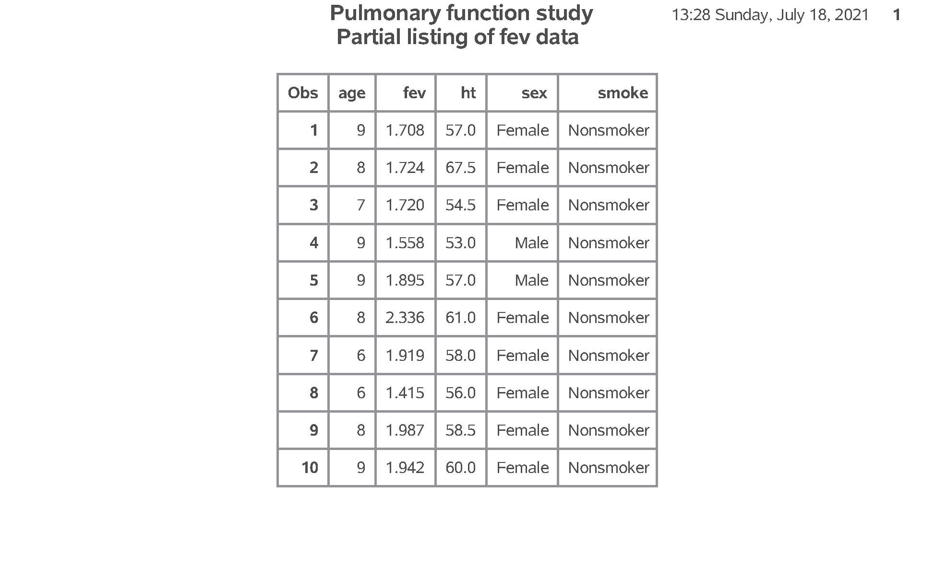
SAS output, Print the first ten rows of data
SAS Output
Notes:
Output, page 1. There are no obvious problems with this dataset.

Slide 16
Break #2
What have you learned so far
Using variable labels
Printing a small piece of data
What’s next
Simple statistics
Printing row with smallest/largest value

Slide 17
SAS code, Proc freq and proc means
proc freq data=perm.fev; tables sex smoke / missing; format sex fsex. smoke fsmoke. ; title2 "Frequency counts"; run; proc means n nmiss mean std min max data=perm.fev; var age fev ht; title2 "Descriptive statistics"; run;
Notes:
Notes05. There is a mix of categorical and continuous variables in this data set. Recall that you use proc freq for categorical variables and proc means for continuous variables. Always get in the habit of checking for missing values.

Slide 18
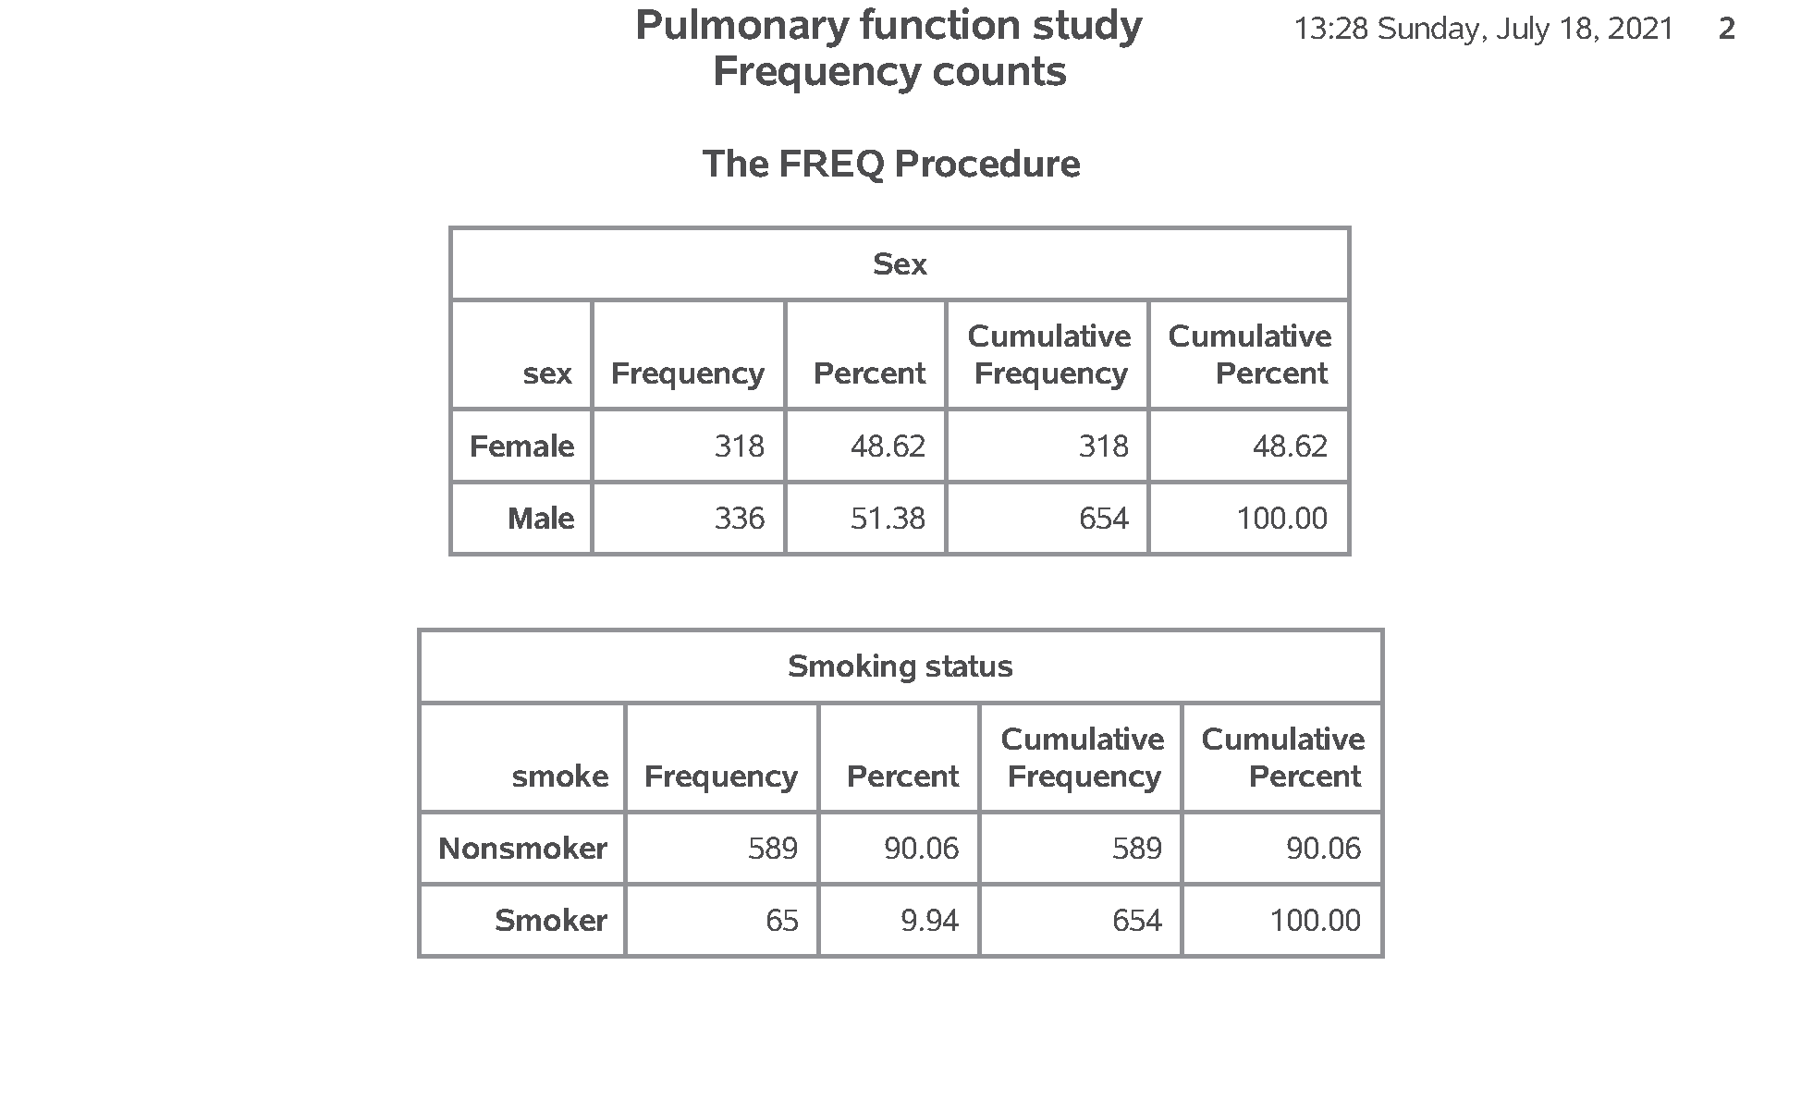
SAS output: Proc freq and proc means
SAS Output
Notes:
Output, page 2. Look for problems. This could mean a lot more categories than you expected, a particular category level that is unexpectedly small, or multiple categories caused by misspelling or inconsistent capitalization. There are no problems here.

Slide 19
SAS code, Pearson correlation, proc corr
title2 "Correlations"; proc corr nosimple noprob data=perm.fev; var age fev ht; run;
Notes:
Notes06. The Pearson correlation coefficient gives you a numeric measure of the strength of association between two continuous variables.

Slide 20
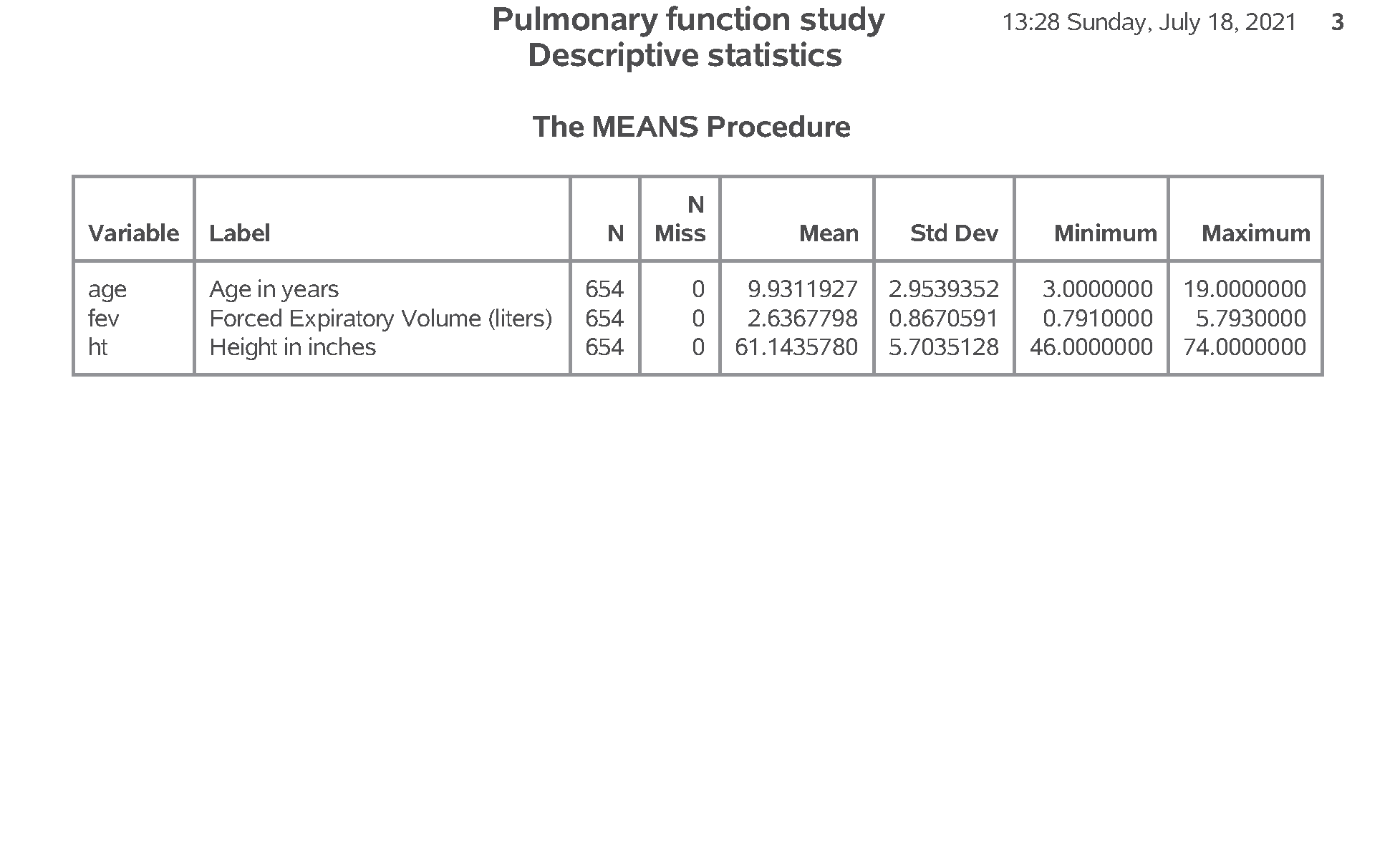
SAS output: Pearson correlation, proc corr
SAS Output
Notes:
Output, page 4. Remember the cut-offs. A correlation between +0.7 and 1.0 implies a strong positive association. A correlation between +0.3 and +0.7 implies a weak positive association. A correlation between -0.3 and +0.3 implies little or no association. A correlation between -0.3 and -0.7 implies a weak negative association. A correlation between -0.7 and -1.0 implies a strong negative association.

Slide 21
SAS code,Scatterplot, proc sgplot
title2 "Scatterplots"; proc sgplot data=perm.fev; scatter x=ht y=fev; run;
Notes:
Notes07. You should also examine the association between continuous variables using a scatterplot.

Slide 22
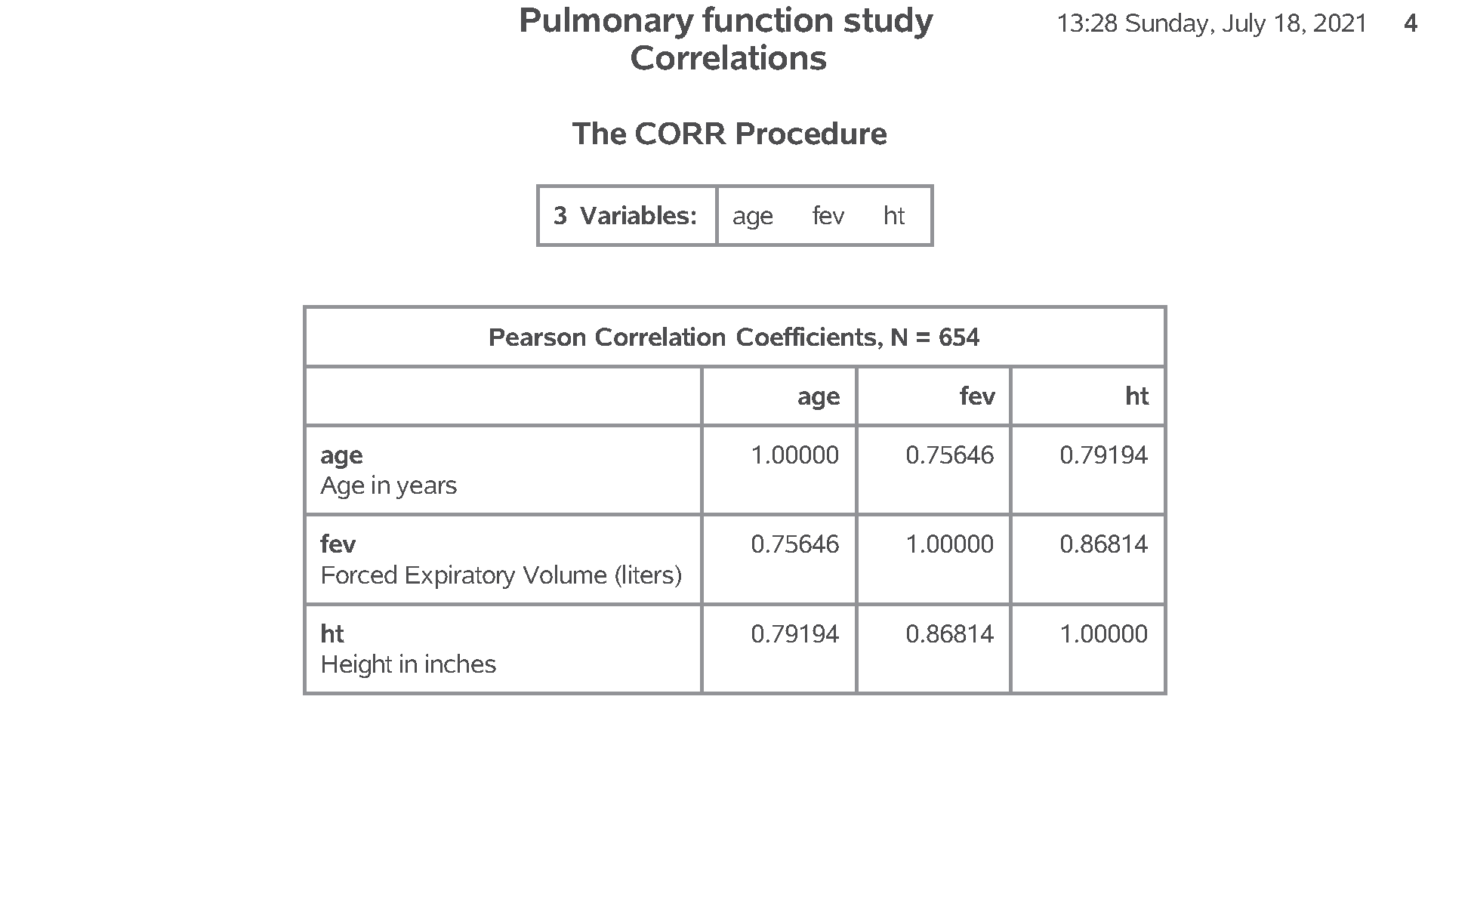
SAS output: Scatterplot, proc sgplot
SAS Output
Notes:
Output, page 5. I am only showing the plot of ht versus fev, but you should also examine the plot of age versus fev.

Slide 23
Break #3
What have you learned so far
Simple statistics
Printing row with smallest/largest value
What’s next
Handling outliers
Missing values

Slide 24
SAS code, ,Scatterplot, smoothing curve
title3 "with loess, smooth=0.1"; proc sgplot data=perm.fev; scatter x=ht y=fev; loess x=ht y=fev / nomarkers smooth=0.1 lineattrs=(color=Red); run;
Notes:
Notes08. Sometimes a trend line can help. You should consider a smoothing method like loess or pbspline, as this will help you visualize any potential nonlinear relationships.
Output, page 6. The relationship looks reasonably close to linear.

Slide 25
SAS code, ,Boxplot, proc sgplot
title2 "Boxplots"; proc sgplot data=perm.fev; vbox fev / category=smoke; format smoke fsmoke.; run;
Notes:
Notes09. When you want to look at a relationship between a categorical variable and a continuous variable, you should use a boxplot. Notice that you use proc sgplot for both a scatterplot and a boxplot. This is a big improvement over previous methods in SAS to produce plots because it is easier to learn one procedure and minor variations in that procedure rather than having to learn multiple procedures.
Output, page 7. The bottom and top of the boxplot represents the 25th and 75th percentiles, respectively. A thin line, or whisker, is drawn down to the minimum value and up to the maximum value. Extreme values are shown as individual data points. Notice the discrepancy in fev. Smokers seem to have a much higher FEV than non-smokers. This is quite surprising.

Slide 26
SAS code, ,Descriptive statistics, by statement
proc sort data=perm.fev; by smoke; run; proc means data=perm.fev; var fev; by smoke; format smoke fsmoke.; title2 "Descriptive statistics by group"; run;
Notes:
Notes10. Also look at how the means and standard deviations of your continuous variable change for each level of your categorical variable.

Slide 27
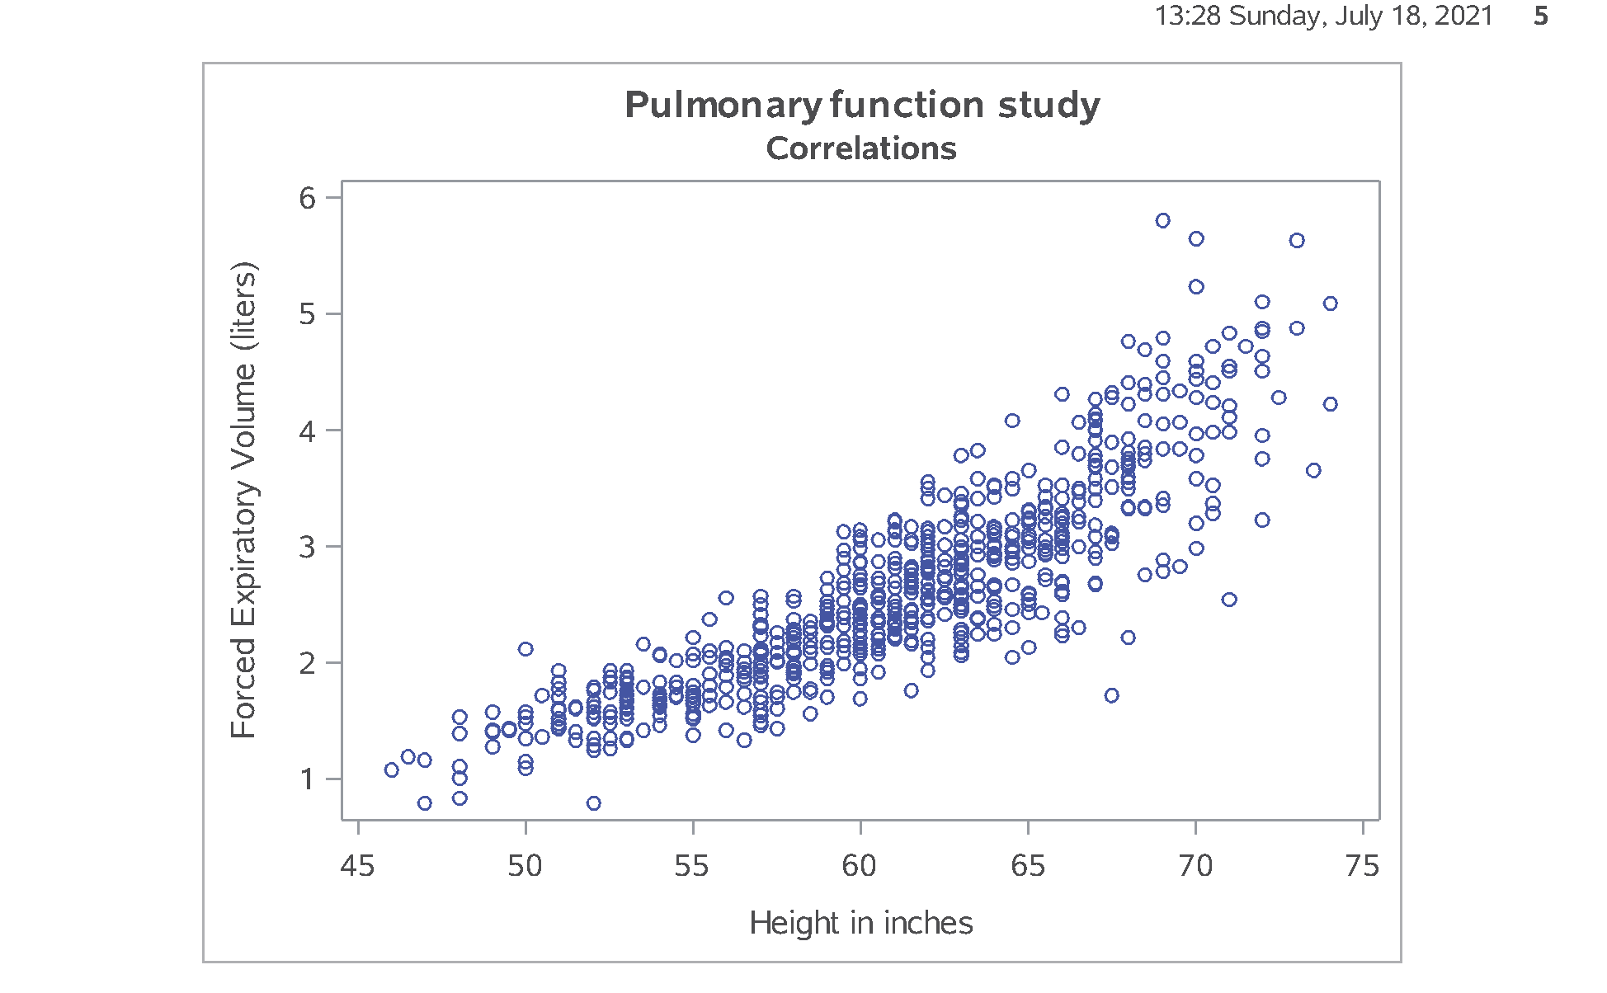
SAS output: Descriptive statistics, by statement
SAS Output
Notes:
Output, page 8. Notice again the discrepancy in fev by smoking status. This is quite surprising.

Slide 28
The proper way to search for negative ht values
where (ht < 0) & (ht ~= .)
Notes:
You may hate having to do this and wish that SAS would have handled things differently. Different packages, like R, have a three valued logic system where every logic statement (well, almost every logic statement) involving missing values codes to MISSING rather than to TRUE or FALSE. This sometimes works better, but sometimes the SAS approach works better.

Slide 29
SAS code, ,Investigate unusual trend, proc sgplot and means
proc sgplot data=perm.fev; vbox ht / category=smoke; format smoke fsmoke.; title2 "Boxplots"; run; proc sort data=perm.fev; by smoke; run; proc means data=perm.fev; var ht; by smoke; format smoke fsmoke.; title2 "Descriptive statistics by group"; run; ods pdf close;
Notes:
Notes11. This is very odd. You can get a hint as to why smokers might have higher fev values than non-smokers by looking at how height and smoking status are related.

Slide 30
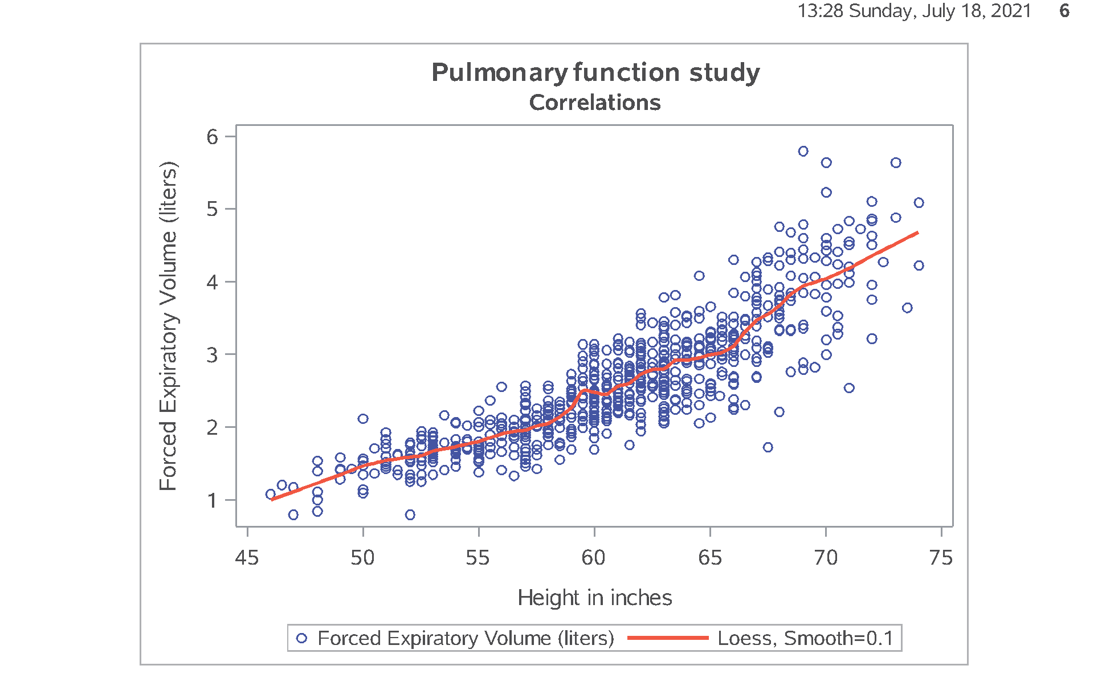
SAS output: Investigate unusual trend, proc sgplot and means
SAS Output
Notes:
Output, page 9. Smokers are taller than non-smokers, and by quite a bit.

Slide 31
Break #4
What have you learned
Missing values
What’s next
Simple transformations
Histograms

Slide 32
SAS code, simple transformations

Slide 33
SAS output, simple transformations

Slide 34
SAS code, Histogram

Slide 35
SAS output, Histogram

Slide 36
SAS output, Histogram with many bars

Slide 37
SAS code, Histogram with fewer bars

Slide 38
SAS output, Histogram with many bars

Slide 39
Break #5
What have you learned
Simple transformations
Histograms
What’s next
Correlations
Scatterplots

Slide 40
Correlations
Informal interpretation
between +0.7 and +1.0: strong positive association
between +0.3 and +0.7: weak positive association
between -0.3 and +0.3: little or no association
between -0.3 and -0.7: weak positive association
between -0.7 and -1.0: strong negative association
Notes:
The correlation coefficient is a single number between -1 and +1 that quantifies the strength and direction of a relationship between two continuous variables. As a rough rule of thumb, a correlation larger than +0.7 indicates a strong positive association and a correlation smaller than -0.7 indicates a strong negative association. A correlation between +0.3 and +0.7 (-0.3 and -0.7) indicates a weak positive (negative) association. A correlation between -0.3 and +0.3 indicates little or no association.
Don’t take these rules too literally. You’re not trying to make definitive statements about your data set. You are just trying to get comfortable with some general patterns that occur in your data set. A complex and definitive statistical analysis will almost certainly not agree with at least some of the preliminary correlations noted here.
The corr procedure produces, by default, a square correlation matrix of all the numeric variables. The noprob and nosimple options cut down on the amount of information printed. The with statement produces a rectangular correlation matrix.

Slide 41
SAS code, Simple correlations

Slide 42
SAS output, Correlations

Slide 43
SAS code, New dataset with correlations

Slide 44
SAS output, New dataset with correlations

Slide 45
SAS output, New dataset with correlations

Slide 46
SAS code, Modified correlations

Slide 47
SAS code, Modified correlations

Slide 48
SAS output, Modified correlations

Slide 49
SAS code, Simple scatterplot

Slide 50
SAS output, Simple scatterplot

Slide 51
SAS code, Linear trend line

Slide 52
SAS output, Simple scatterplot with linear trend

Slide 53
SAS code, Smooth curve

Slide 54
SAS output, Simple scatterplot with smooth curve

Slide 55
Don’t forget!
ods pdf close;
Notes:
I always seem to forget this last statement and then I get upset with SAS for not providing the PDF output. But SAS can’t produce the PDF output until you tell it you are done. So don’t yell at your computer when it’s your own darn fault (just like Jimmy Buffet in the Margaritaville song).

Slide 56
Summary
What have you learned
Using variable labels
Printing a small piece of data
Simple descriptive statistics
Printing row with smallest/largest value
Missing value logic
Simple transformations
Histograms
Correlations
Scatterplots

