Slide 1
Introduction to SAS, Working with categorical variables
Steve Simon

Slide 2
Overview
proc format
recoding
proc freq
barcharts
Notes:
author: Steve Simon date: created 2021-05-30 purpose: to produce slides for module04 videos license: public domain
Here is an overview of what I want to cover in this module.
We’re going to look at a different data set, one with mostly categorical variables. I’ll introduce proc format, which allows you to attach labels to categorical data, talk about recoding, and show some tables using proc freq. I’ll also show you a simple bar chart.

Slide 3
SAS code: Documentation header
m04-5507-simon-categorical-variables author: Steve Simon Date created: 2018-10-22 Purpose: To illustrate how to work with datasets with mostly continuous variables. License: public domain ;
Notes:
Notes00. This is the standard documentation header

Slide 4
SAS code: Tell SAS where to find and store things;
options papersize=(6 in 4 in); * needed to have the output fit on PowerPoint; %let path=q:/introduction-to-sas; ods pdf file="&path/results/m04-5507-simon-categorical.pdf"; filename raw_data "&path/data/titanic_v00.txt"; libname perm "&path/data";
Notes:
Notes01. The filename statement tells you where the raw data is stored. The libname statement tells you where SAS will store any permanent datsets. The ods statement tells you that SAS is going to store the results with a particular filename and in pdf format.

Slide 5
SAS code: Reading using proc import;
proc import datafile=raw_data out=perm.titanic dbms=dlm replace; delimiter='09'x; getnames=yes; run;
Notes:
Notes02. As a general rule, proc import works best for simple delimited files where the first row contains the variable names. With complicated text files (such as files where the data for an individual extends across more than one line) or files without variable names in the first row are usually better handled by a data step.

Slide 6
SAS code: Print the first ten lines;
proc print data=perm.titanic(obs=10); title1 "The first ten rows of the Titanic dataset"; run;
Notes:
Notes03. It’s always a good idea to peek at the first few rows of data.

Slide 7
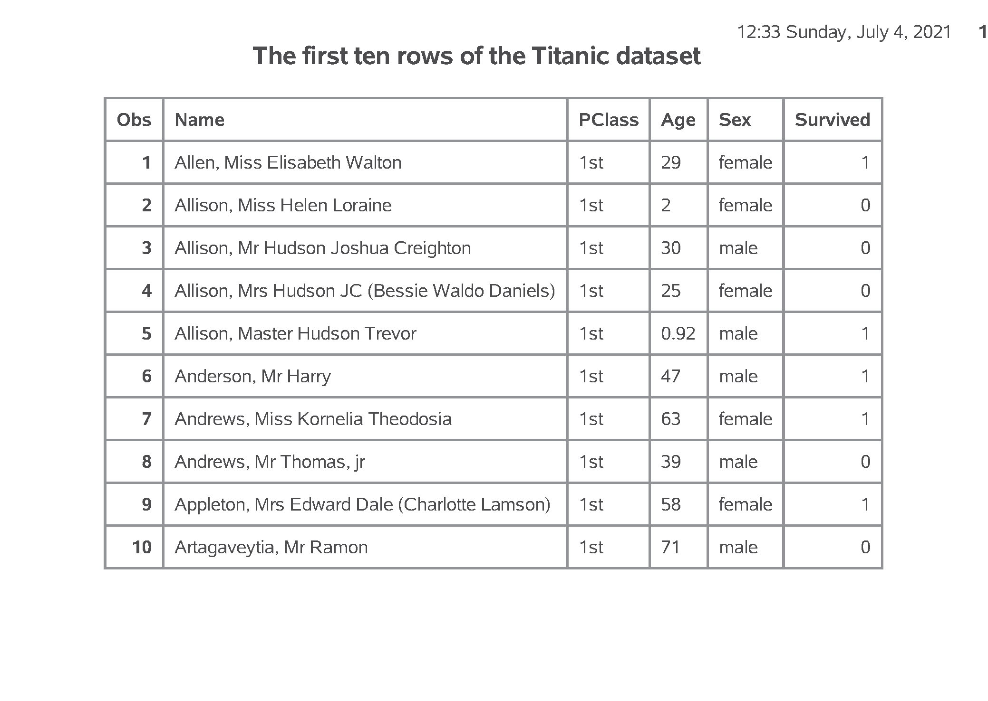
SAS output: Print the first ten lines;
SAS Output
Notes:
Output, page 1. If you look at the first few rows of data, you will see that the import went reasonably well. It is not always this easy. Do take notice that age is left justified. It is caused by a number of “NA” codes for missing values. You don’t see it here, but if you print a few more observations, you can see the “NA” values. It would have been easier to anticipate these ahead of time, but we’ll fix things up after the fact.

Slide 8
SAS code: Counts, proc freq;
proc freq data=perm.titanic; table PClass Sex Survived; title1 "Frequency counts for categorical variables"; run;
Notes:
Notes04. For any categorical variables, your first step is to get frequency counts.

Slide 9
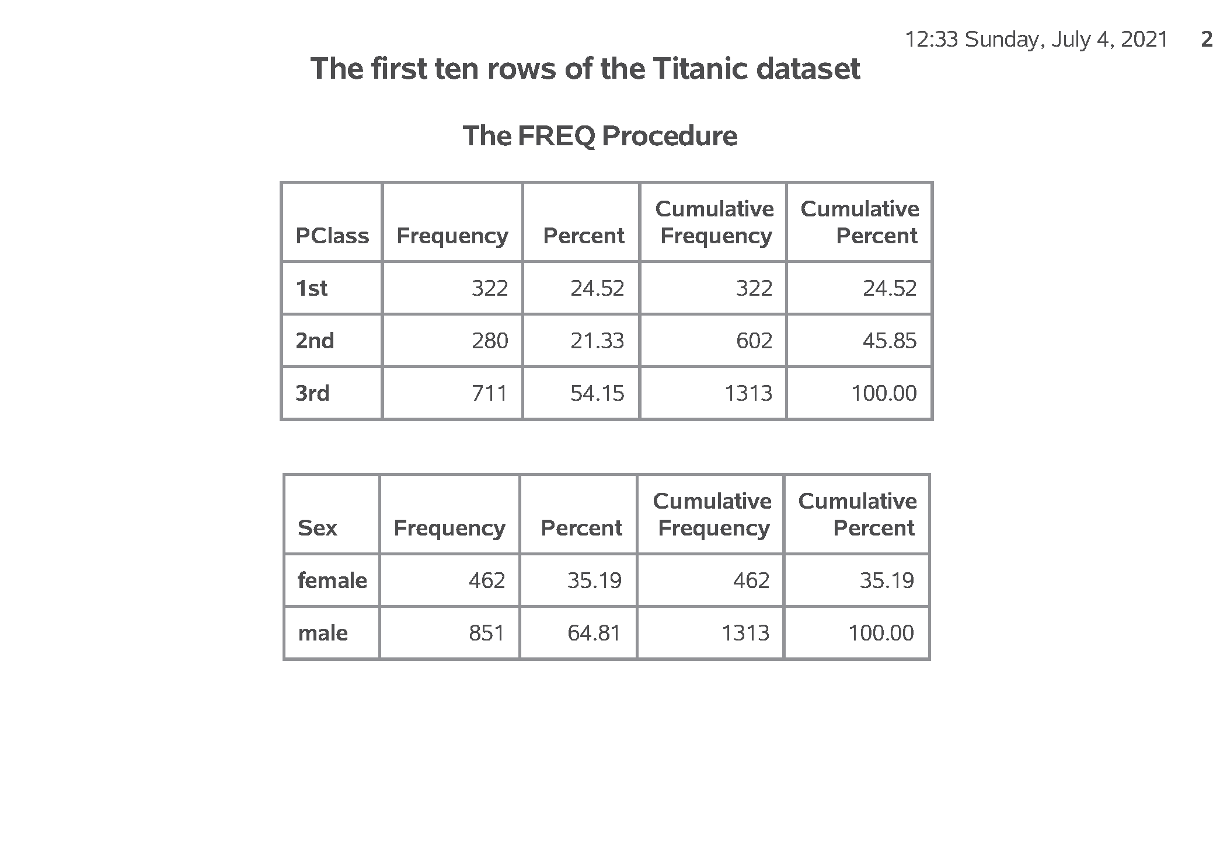
SAS output: Counts, proc freq; (1/2)
SAS Output
Notes:
Output, page 2. There is a mix of three passenger classes, with a lot more in third class. There are also a lot more men than women.

Slide 10
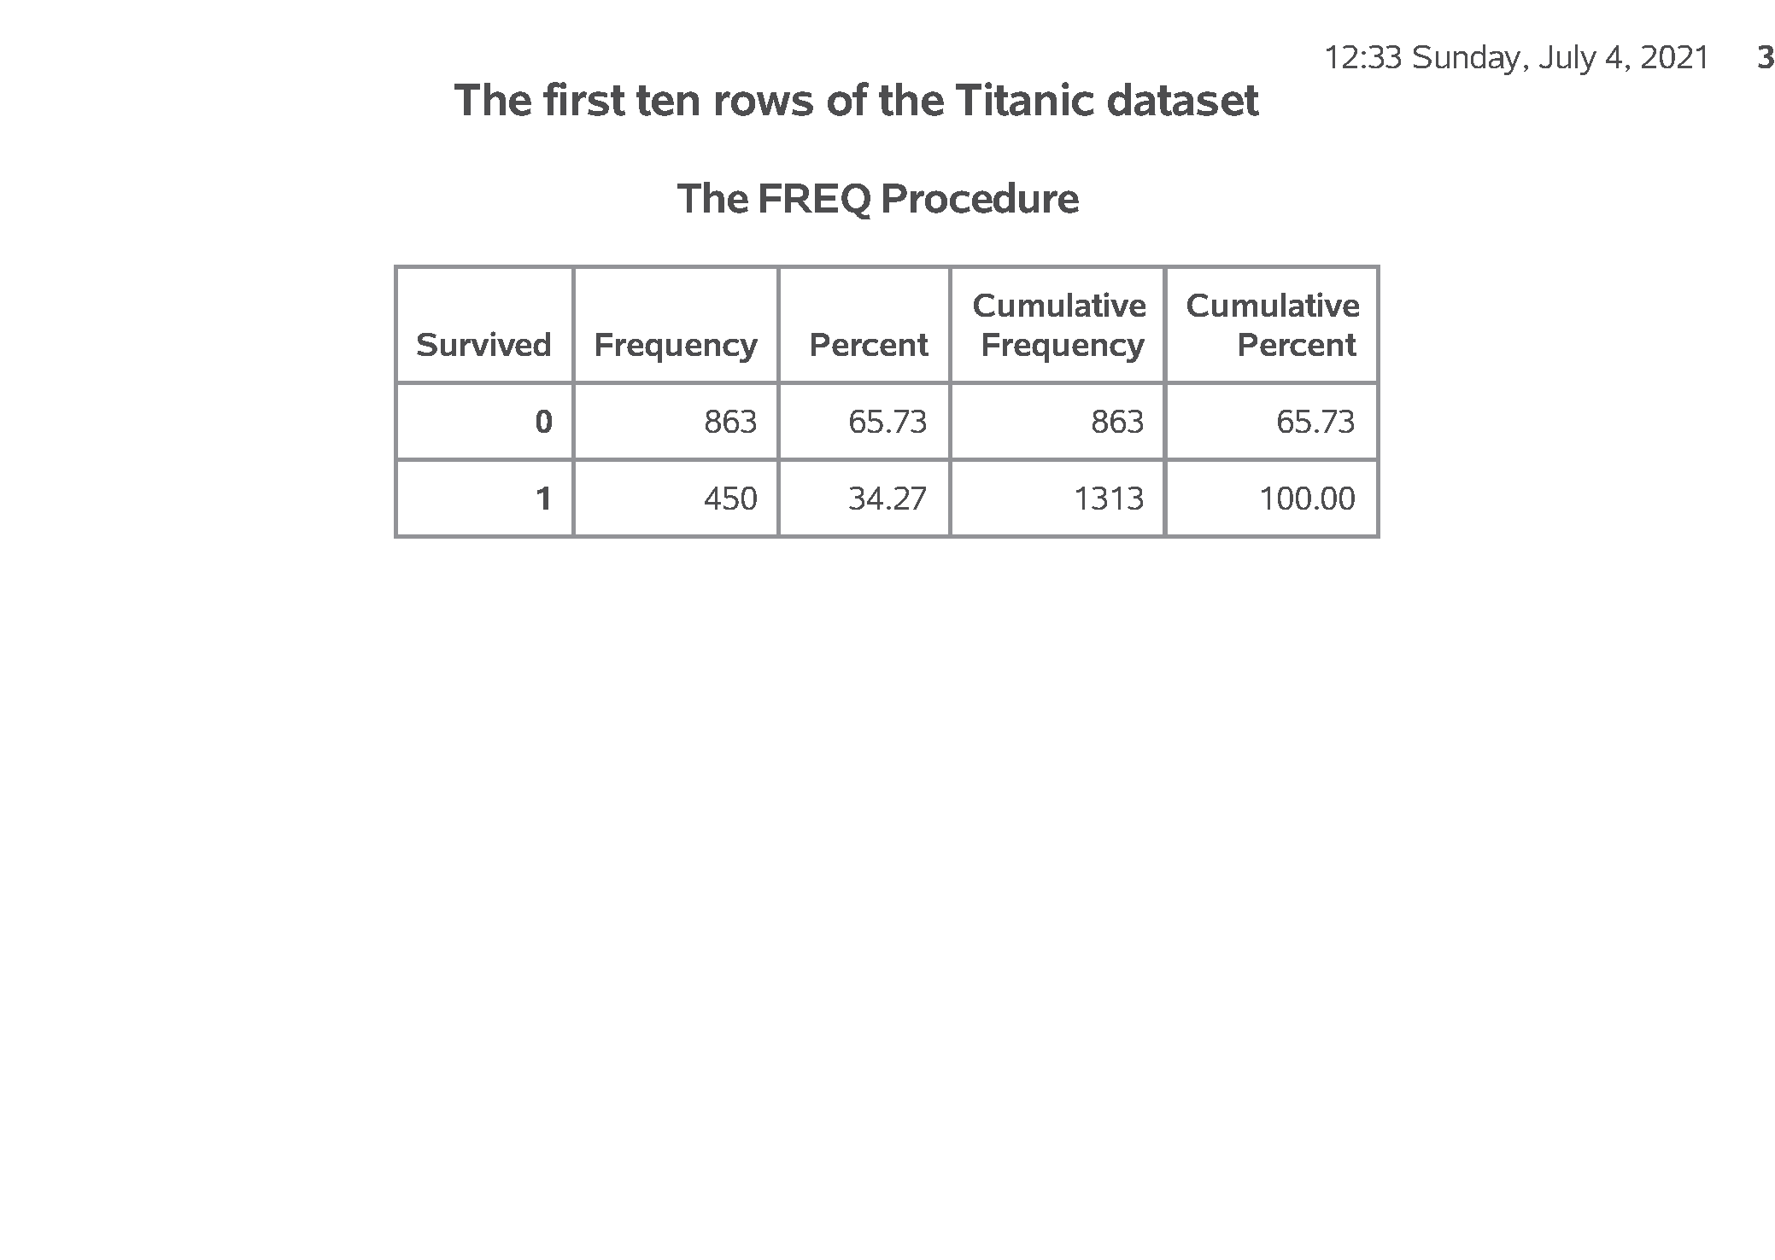
SAS output: Counts, proc freq; (2/2)
SAS Output
Notes:
Output, page 3. The survived variable is a number code. You should look at the data dictionary to find out that 1=survived and 2=died. Only about a third of the passengers survived.

Slide 11
SAS code: Convert string to numeric, data step;
data perm.titanic; set perm.titanic; age_c = input(age, ?? 8.); run; proc means n nmiss mean std min max data=perm.titanic; var age_c; title1 "Descriptive statistics for age"; run;
Notes:
Notes05. For the one continuous variable (age) you need to convert the code “NA” to the SAS missing value code, which is a dot. The easiest way to do this is to force the data to numeric with a simple arithmetic equation like adding a zero. But you get a warning message for each occurence of NA, which can get tedious. The input function with two question marks avoids this issue.

Slide 12
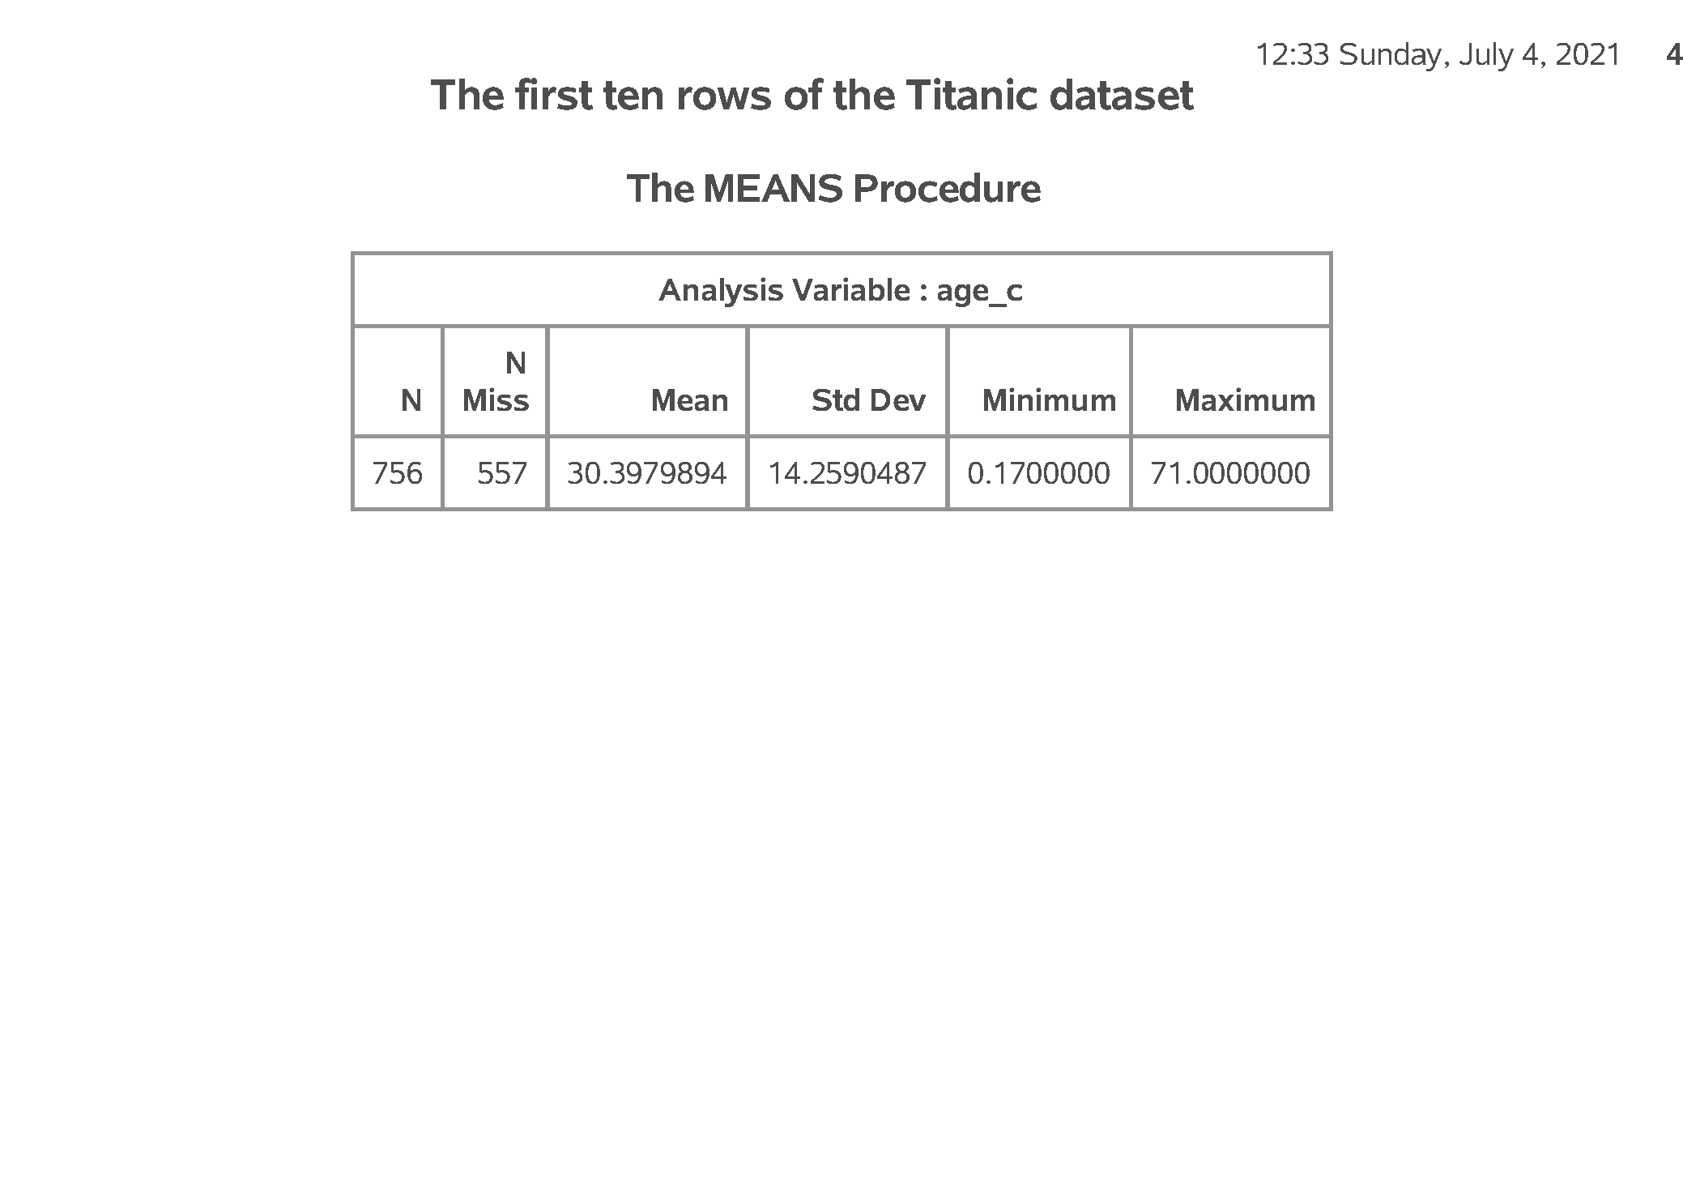
SAS output: Convert string to numeric, data step; (1/2)
SAS Output
Notes:
Output, page 4. The numeric variable, age_c, can now be analyzed using proc means. The average age is about 30, and there are a large number of missing values.

Slide 13
SAS code: Using proc format to code categorical data;
proc format; value f_survived 0 = "No" 1 = "Yes"; run; proc freq data=perm.titanic; tables Survived; format Survived f_survived.; title1 "Frequency counts for survived using labels"; run;
Notes:
Notes06. For variables like Survived which are numbers, but the numbers represent a particular category, you can document this using a format statement.
Output, page 5. Notice that the format statement replaces the cryptic 0-1 code with the words no and yes. It is almost always a good idea to attach labels to any categorical variable using number codes. It makes your output more readable and avoids any confusion or mixing up the codes.

Slide 14
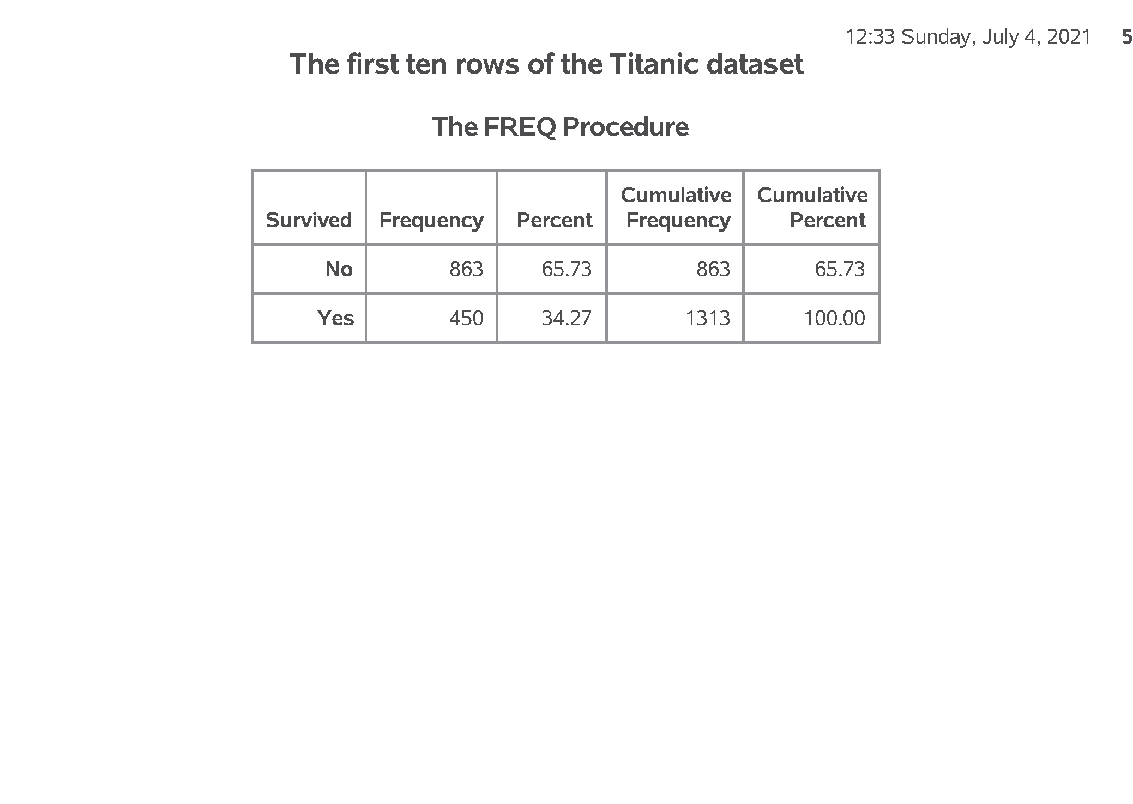
SAS output: Using proc format to code categorical data;
SAS Output
Notes:
Notes06. For variables like Survived which are numbers, but the numbers represent a particular category, you can document this using a format statement.
Output, page 5. Notice that the format statement replaces the cryptic 0-1 code with the words no and yes. It is almost always a good idea to attach labels to any categorical variable using number codes. It makes your output more readable and avoids any confusion or mixing up the codes.

Slide 15
SAS code: Bar charts, proc sgplot;
proc sgplot data=perm.titanic; vbar Survived; format Survived f_survived.; title1 "Bar chart for number surviving"; run;
Notes:
Notes07. I don’t normally like bar charts, but they do have their uses.

Slide 16
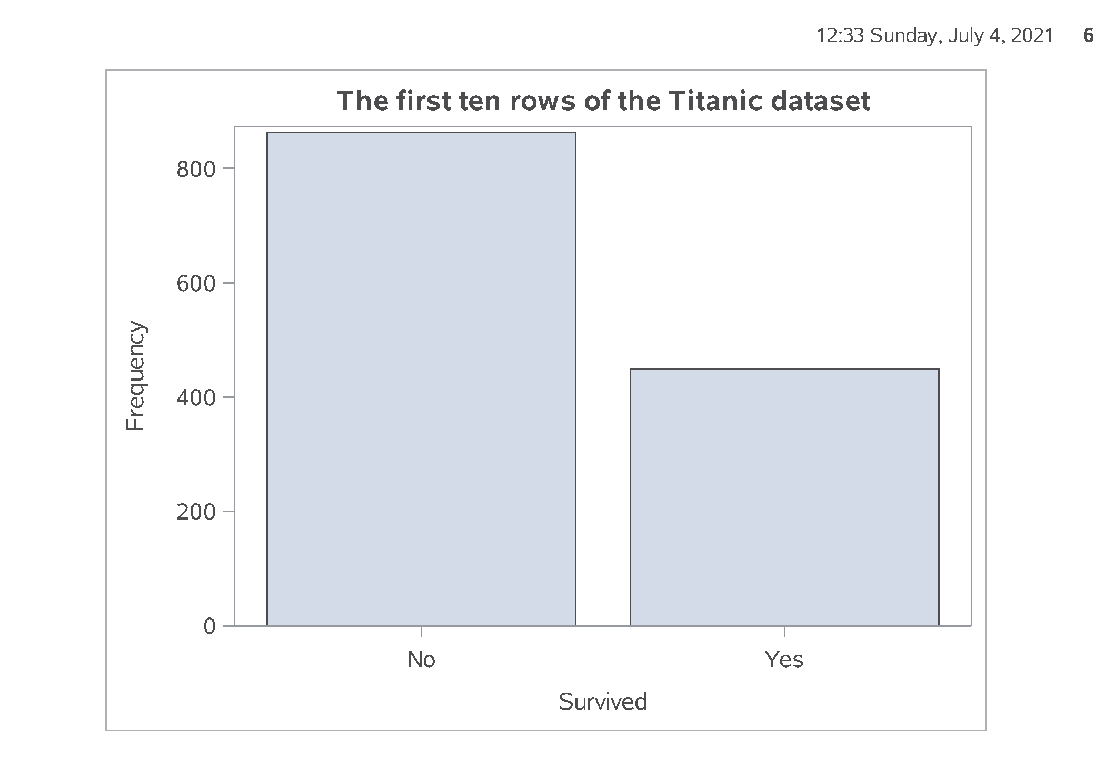
SAS output: Bar charts, proc sgplot;
SAS Output
Notes:
Output, page 6. This is a basic bar chart.

Slide 17
SAS code: Percentages for bar chart;
proc freq data=perm.titanic; tables Survived / noprint out=pct_survived; run; proc sgplot data=pct_survived; vbar Survived / response=Percent; yaxis max=100; format Survived f_survived.; title1 "Bar chart for percent surviving"; run;
Notes:
Notes08. Getting percentages is a bit tricky. You have to run proc freq and output the results to a new data file, pct_survived. I am using the noprint option, because I only want the percentages for internal use. It wouldn’t have hurt anything to print out a bit extra, but I want to encourage you to limit the amount of output that you present to a consulting client.
Output, page 7. Note that the yaxis max=100 statement expands the upper limit of the y axis to 100%.

Slide 18
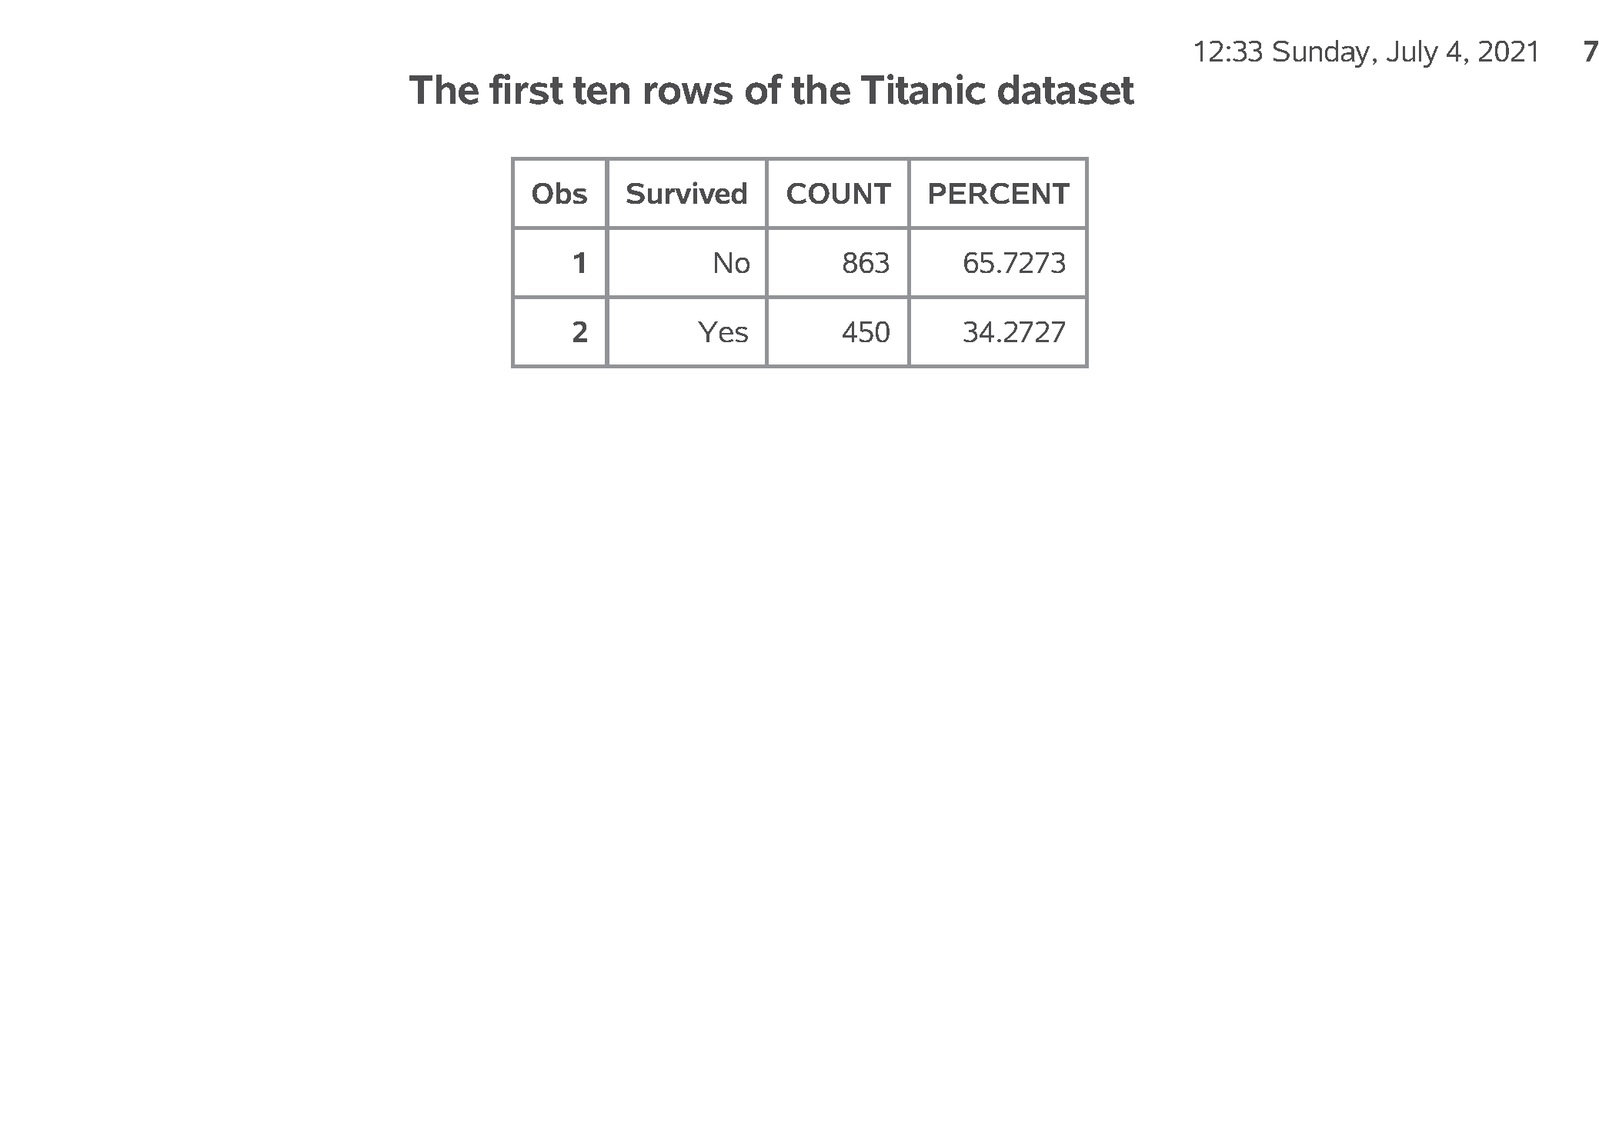
SAS output: Percentages for bar chart;
SAS Output
Notes:
Notes08. Getting percentages is a bit tricky. You have to run proc freq and output the results to a new data file, pct_survived. I am using the noprint option, because I only want the percentages for internal use. It wouldn’t have hurt anything to print out a bit extra, but I want to encourage you to limit the amount of output that you present to a consulting client.
Output, page 7. Note that the yaxis max=100 statement expands the upper limit of the y axis to 100%.

Slide 19
SAS code: Crosstabulation;
proc freq data=perm.titanic; tables Sex*Survived / nocol nopercent; format Survived f_survived.; title1 "Crosstabulation with row percentages"; run;
Notes:
Notes09. To examine relationships among categorical variables use a two dimensional crosstabulation.

Slide 20
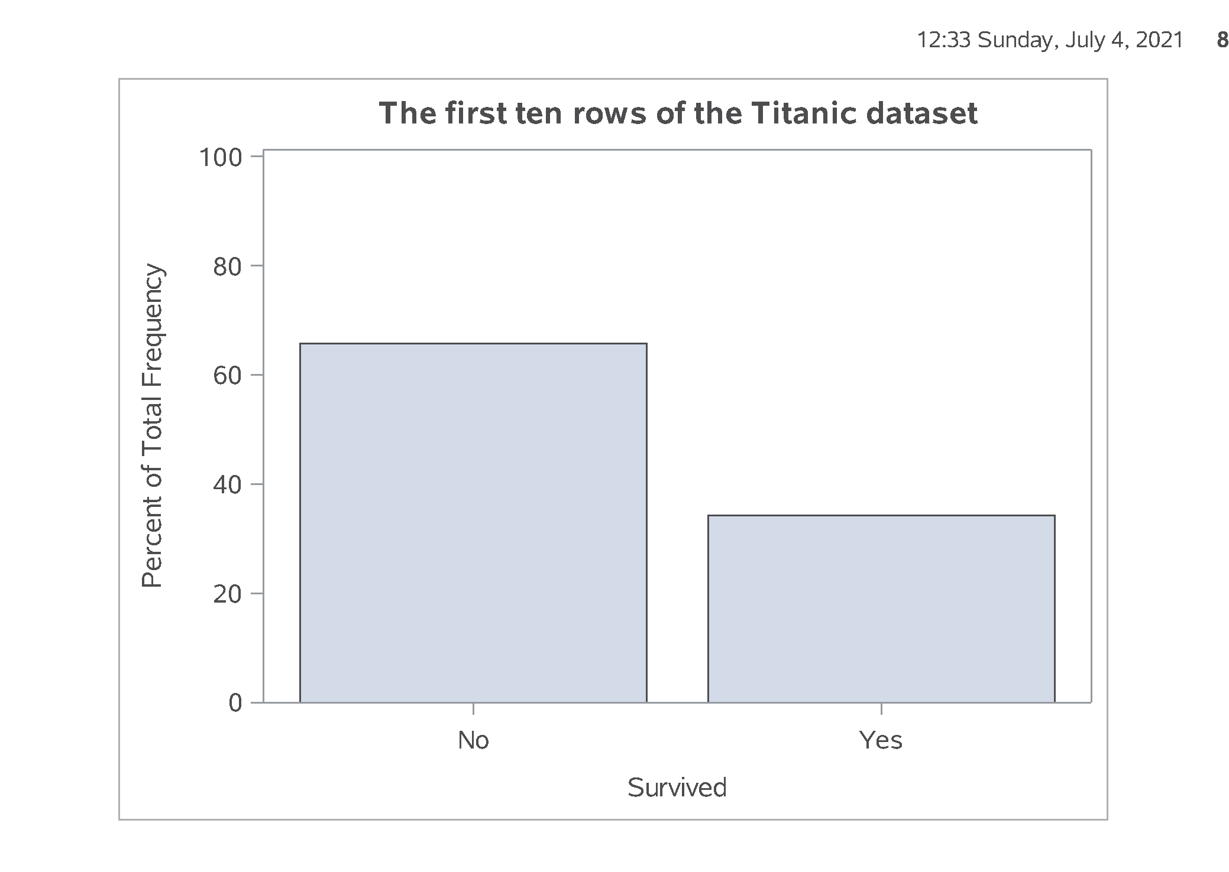
SAS output: Crosstabulation;
SAS Output
Notes:
Output, page 8. The mortality rate was 83% among the mean and 33% among the women

Slide 21
SAS code: Converting a continuous variable to categorical;
data age_categories; set perm.titanic; if age_c = . then age_cat = "missing "; else if age_c < 6 then age_cat = "toddler "; else if age_c < 13 then age_cat = "pre-teen"; else if age_c < 21 then age_cat = "teenager"; else age_cat = "adult "; run;
Notes:
Notes10. If you want to create categories from a continuous variable, use a series of
if - then - else
statements

Slide 22
SAS code: Quality check;
proc sort data=age_categories; by age_cat; run; proc means min max data=age_categories; by age_cat; var age_c; title1 "Quality check for conversion"; run;
Notes:
Notes11. Always cross check your results against the original variable.

Slide 23
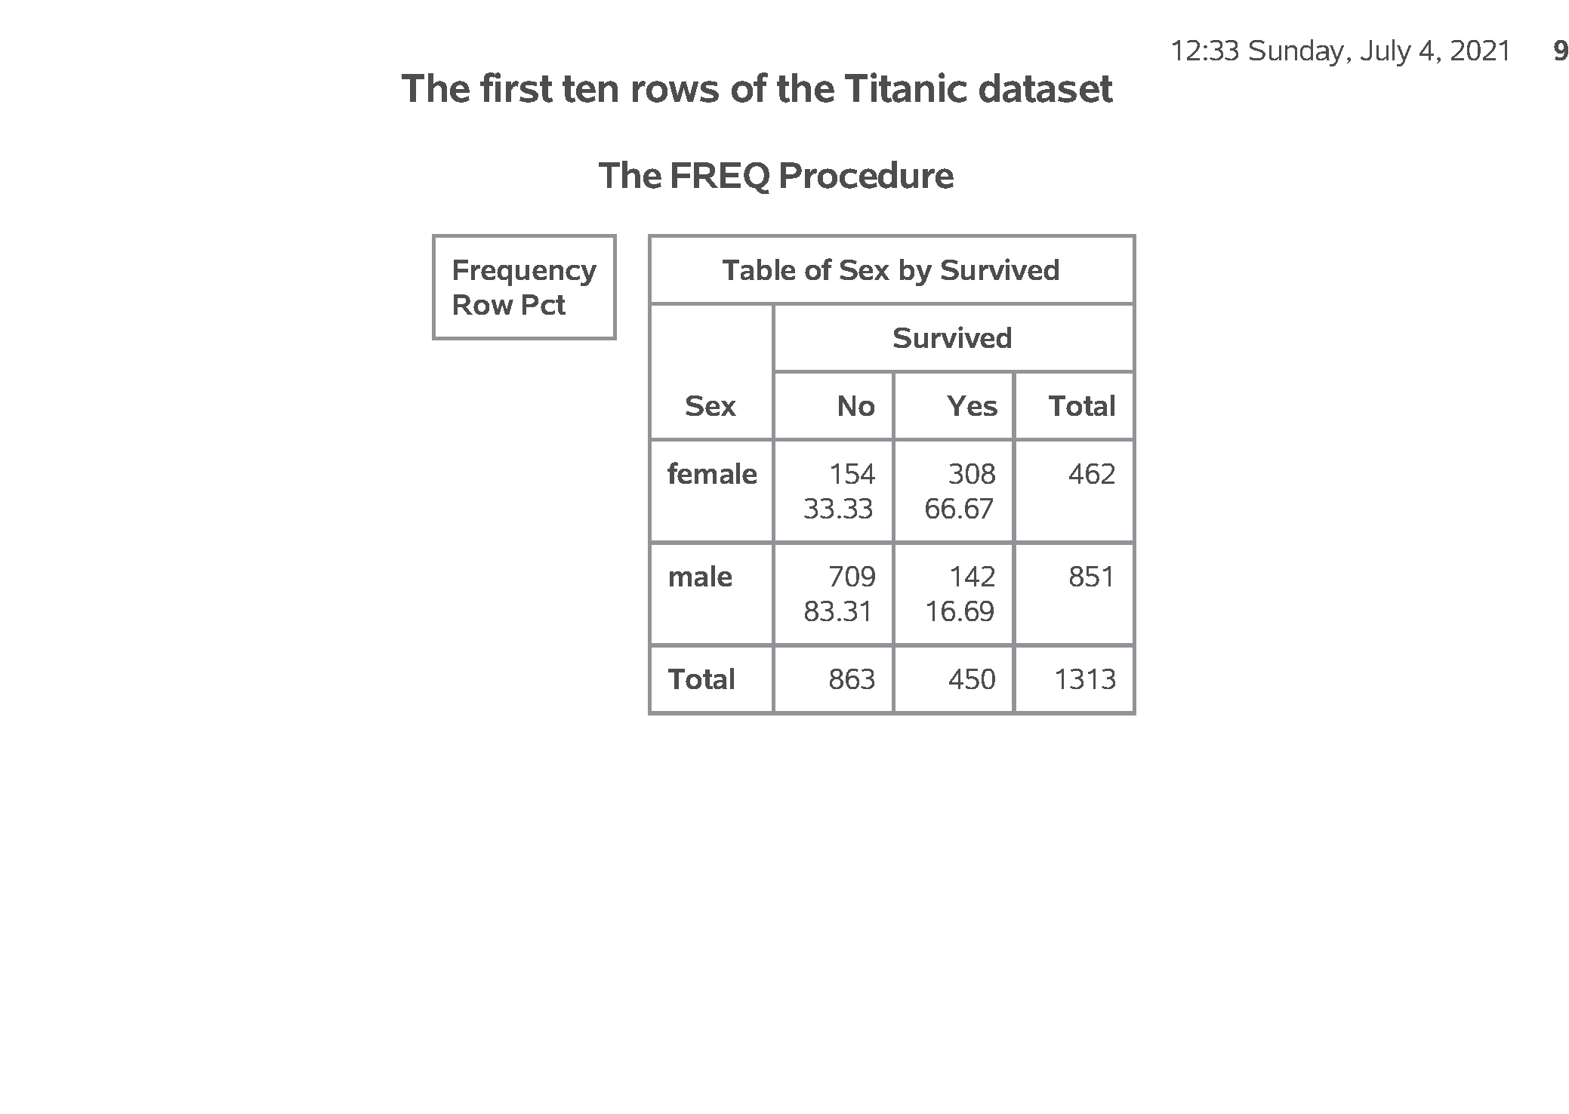
SAS output: Quality check;
SAS Output
Notes:
Output, page 9. These results look good. Notice, however, that the order for age_cat is alphabetical, which is probably not what you want.

Slide 24
SAS code: Controlling the display order;
data age_codes; set perm.titanic; if age_c = . then age_cat = 9; else if age_c < 6 then age_cat = 1; else if age_c < 13 then age_cat = 2; else if age_c < 21 then age_cat = 3; else age_cat = 4; run;
Notes:
Notes12. You can control the order by using number codes and formats.

Slide 25
SAS code: With number codes, use proc format;
proc format; value f_age 1 = "toddler" 2 = "pre-teen" 3 = "teenager" 4 = "adult" 9 = "unknown"; run;
Notes:
Notes13. The format statement attaches a label to each number code.

Slide 26
SAS code: Quality check;
proc sort data=age_codes; by age_cat; run; proc means min max data=age_codes; by age_cat; var age_c; format age_cat f_age.; run;
Notes:
Notes14. Again, a quality check is important.

Slide 27
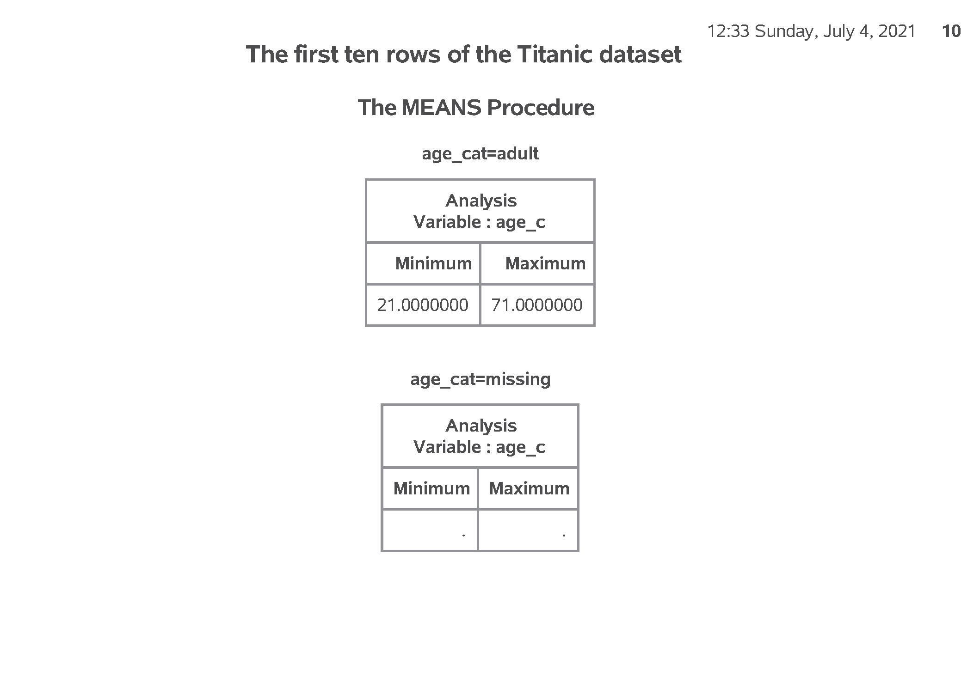
SAS output: Quality check;
SAS Output
Notes:
Output, page 10. The tables are ordered from toddler to pre-teen to teenager to adult, then missing.

Slide 28
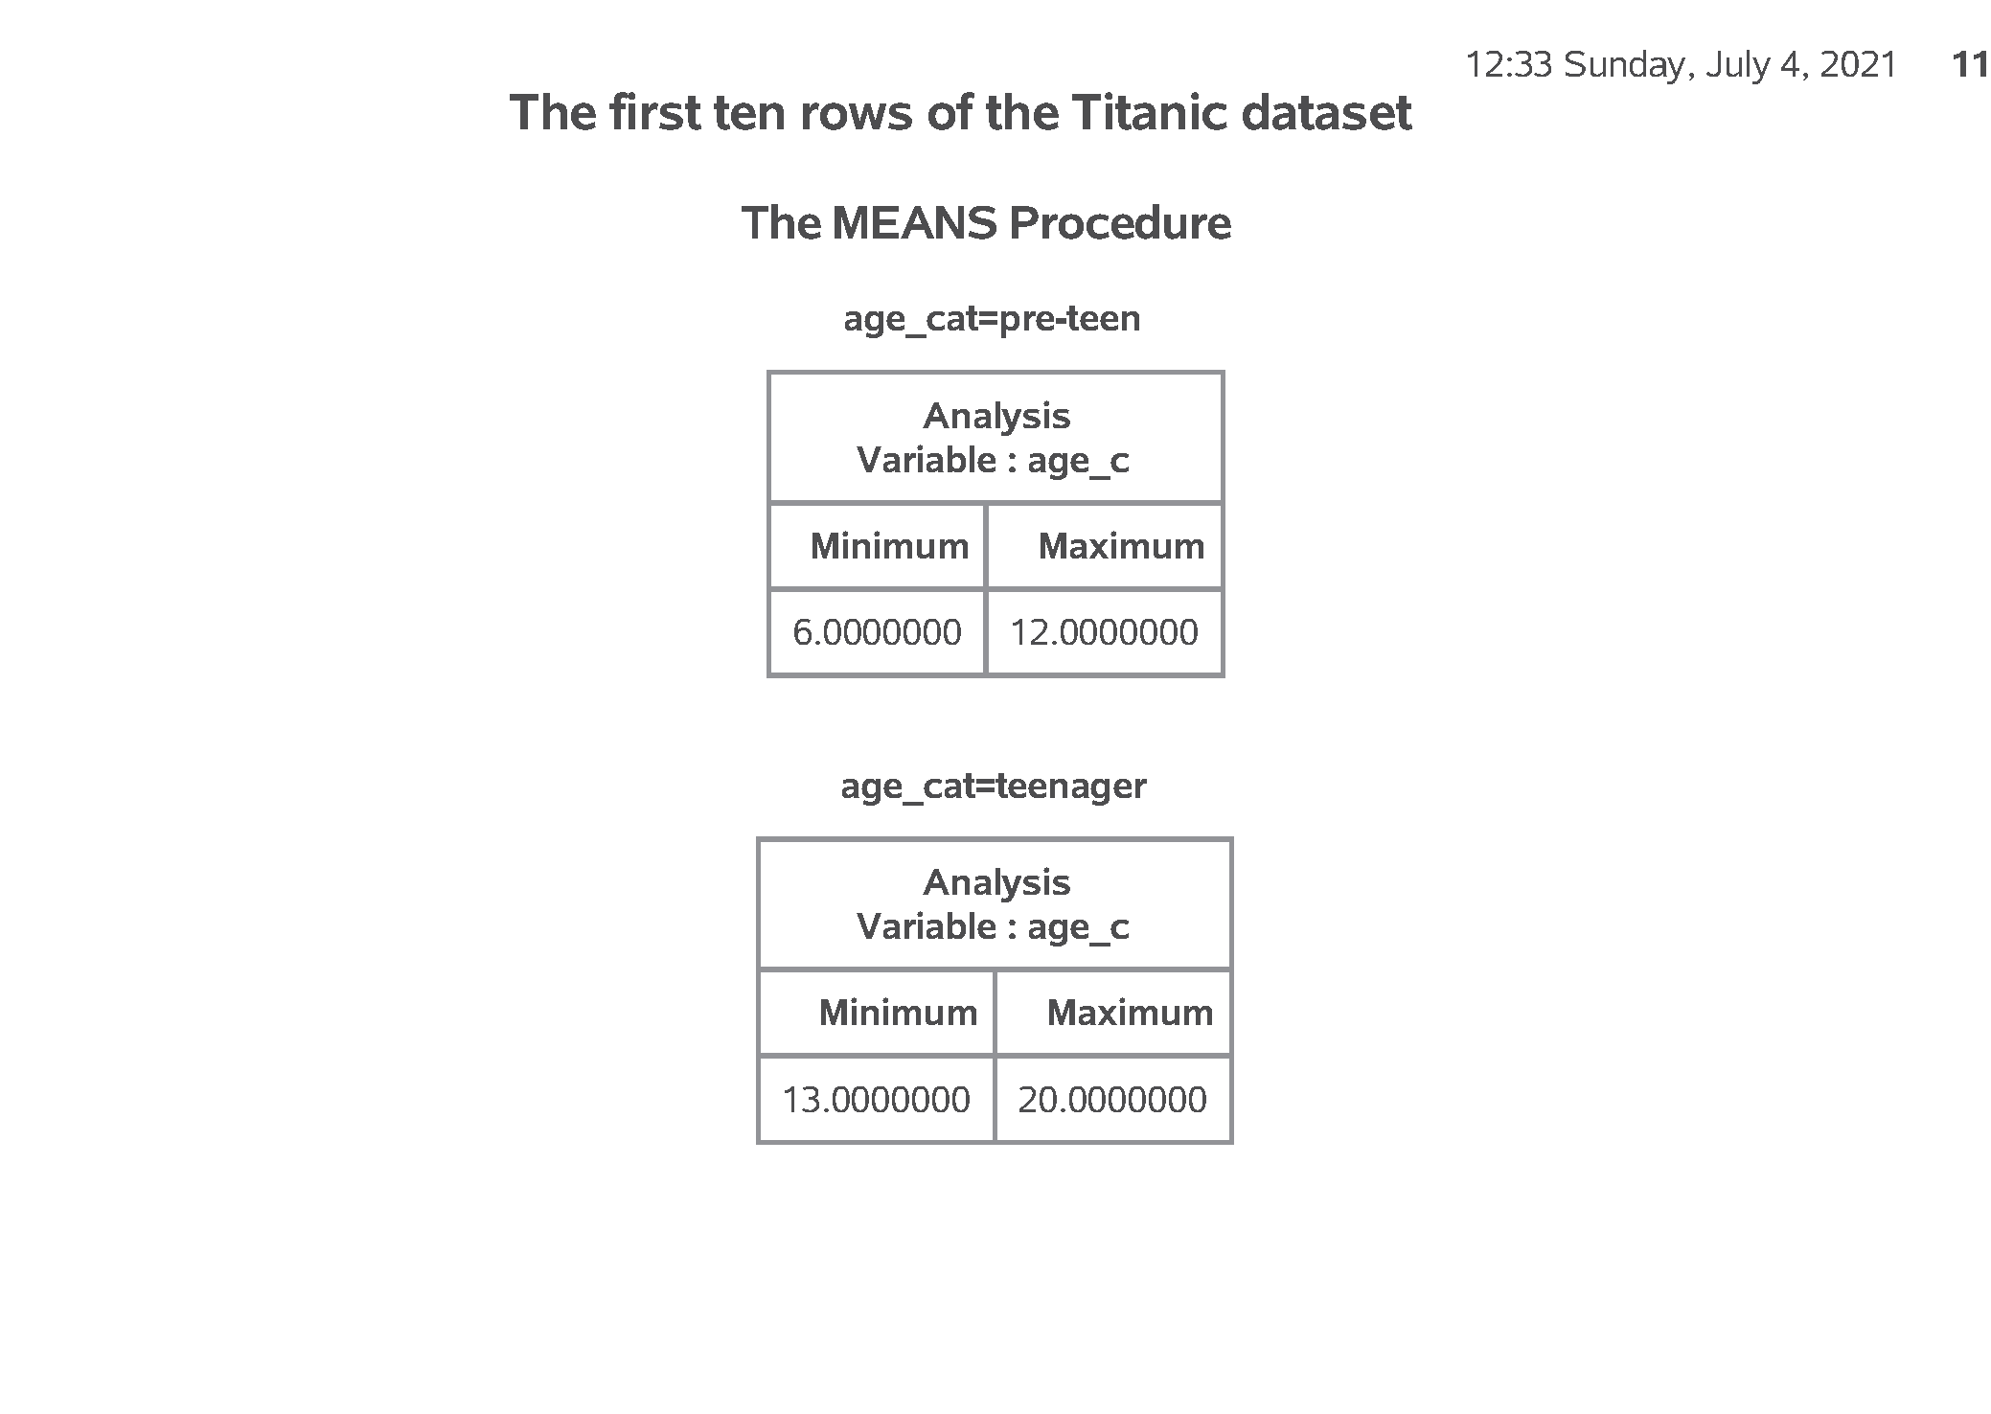
SAS output: Quality check;
SAS Output

Slide 29
Error,1,2,5

Slide 30
SAS code: Modifying a categorical variable;
data first_class; set perm.titanic; if PClass = "1st" then first_class = "Yes"; else first_class = "No"; run; proc freq data=first_class; table PClass*first_class / norow nocol nopercent; run; ods pdf close;
Notes:
Notes15. Here’s another example where you compare First Class passengers to Second and Third class passengers combined.

Slide 31
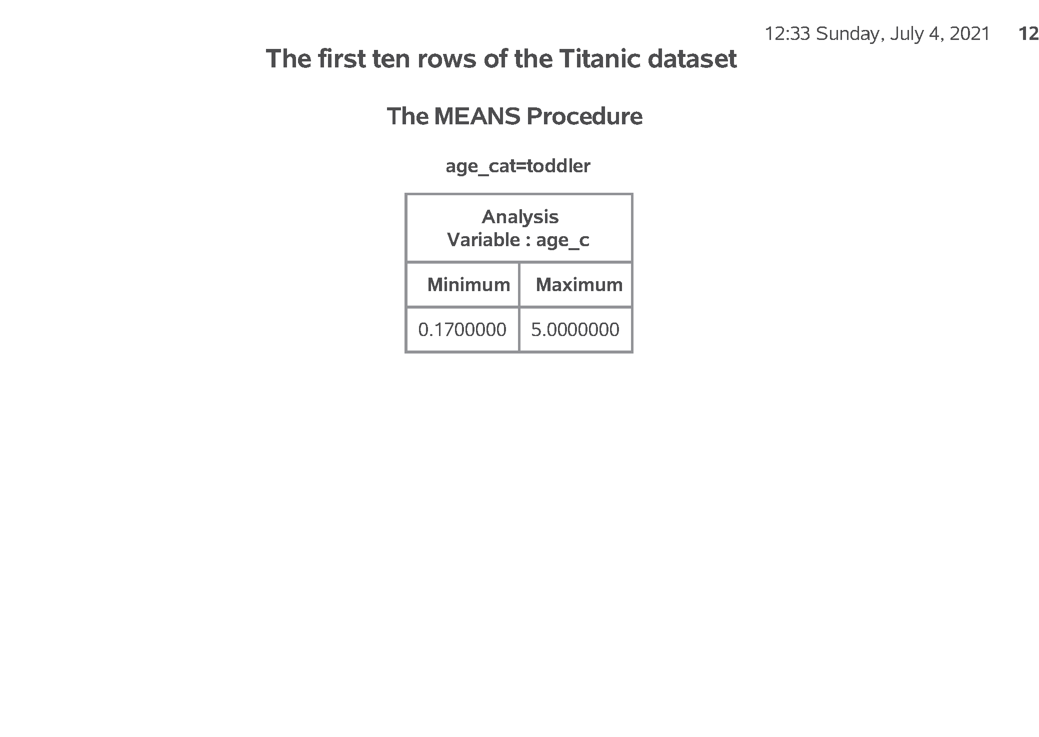
SAS output: Modifying a categorical variable;
SAS Output
Notes:
Output, page 11. You could have done these calcuations by hand, of course, but this helps others who are not as patient as you are.

Slide 32

SAS output:
SAS Output
Notes:
Output, page 11. You could have done these calcuations by hand, of course, but this helps others who are not as patient as you are.

Slide 33
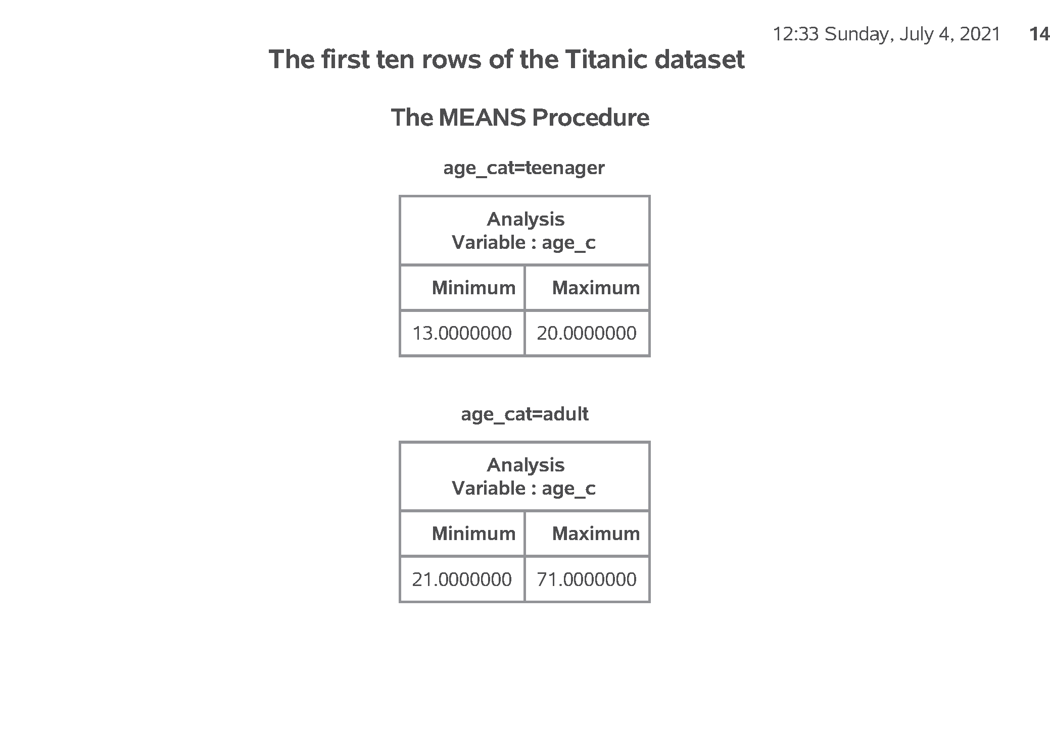
SAS output:
SAS Output
Notes:
Output, page 11. You could have done these calcuations by hand, of course, but this helps others who are not as patient as you are.

Slide 34
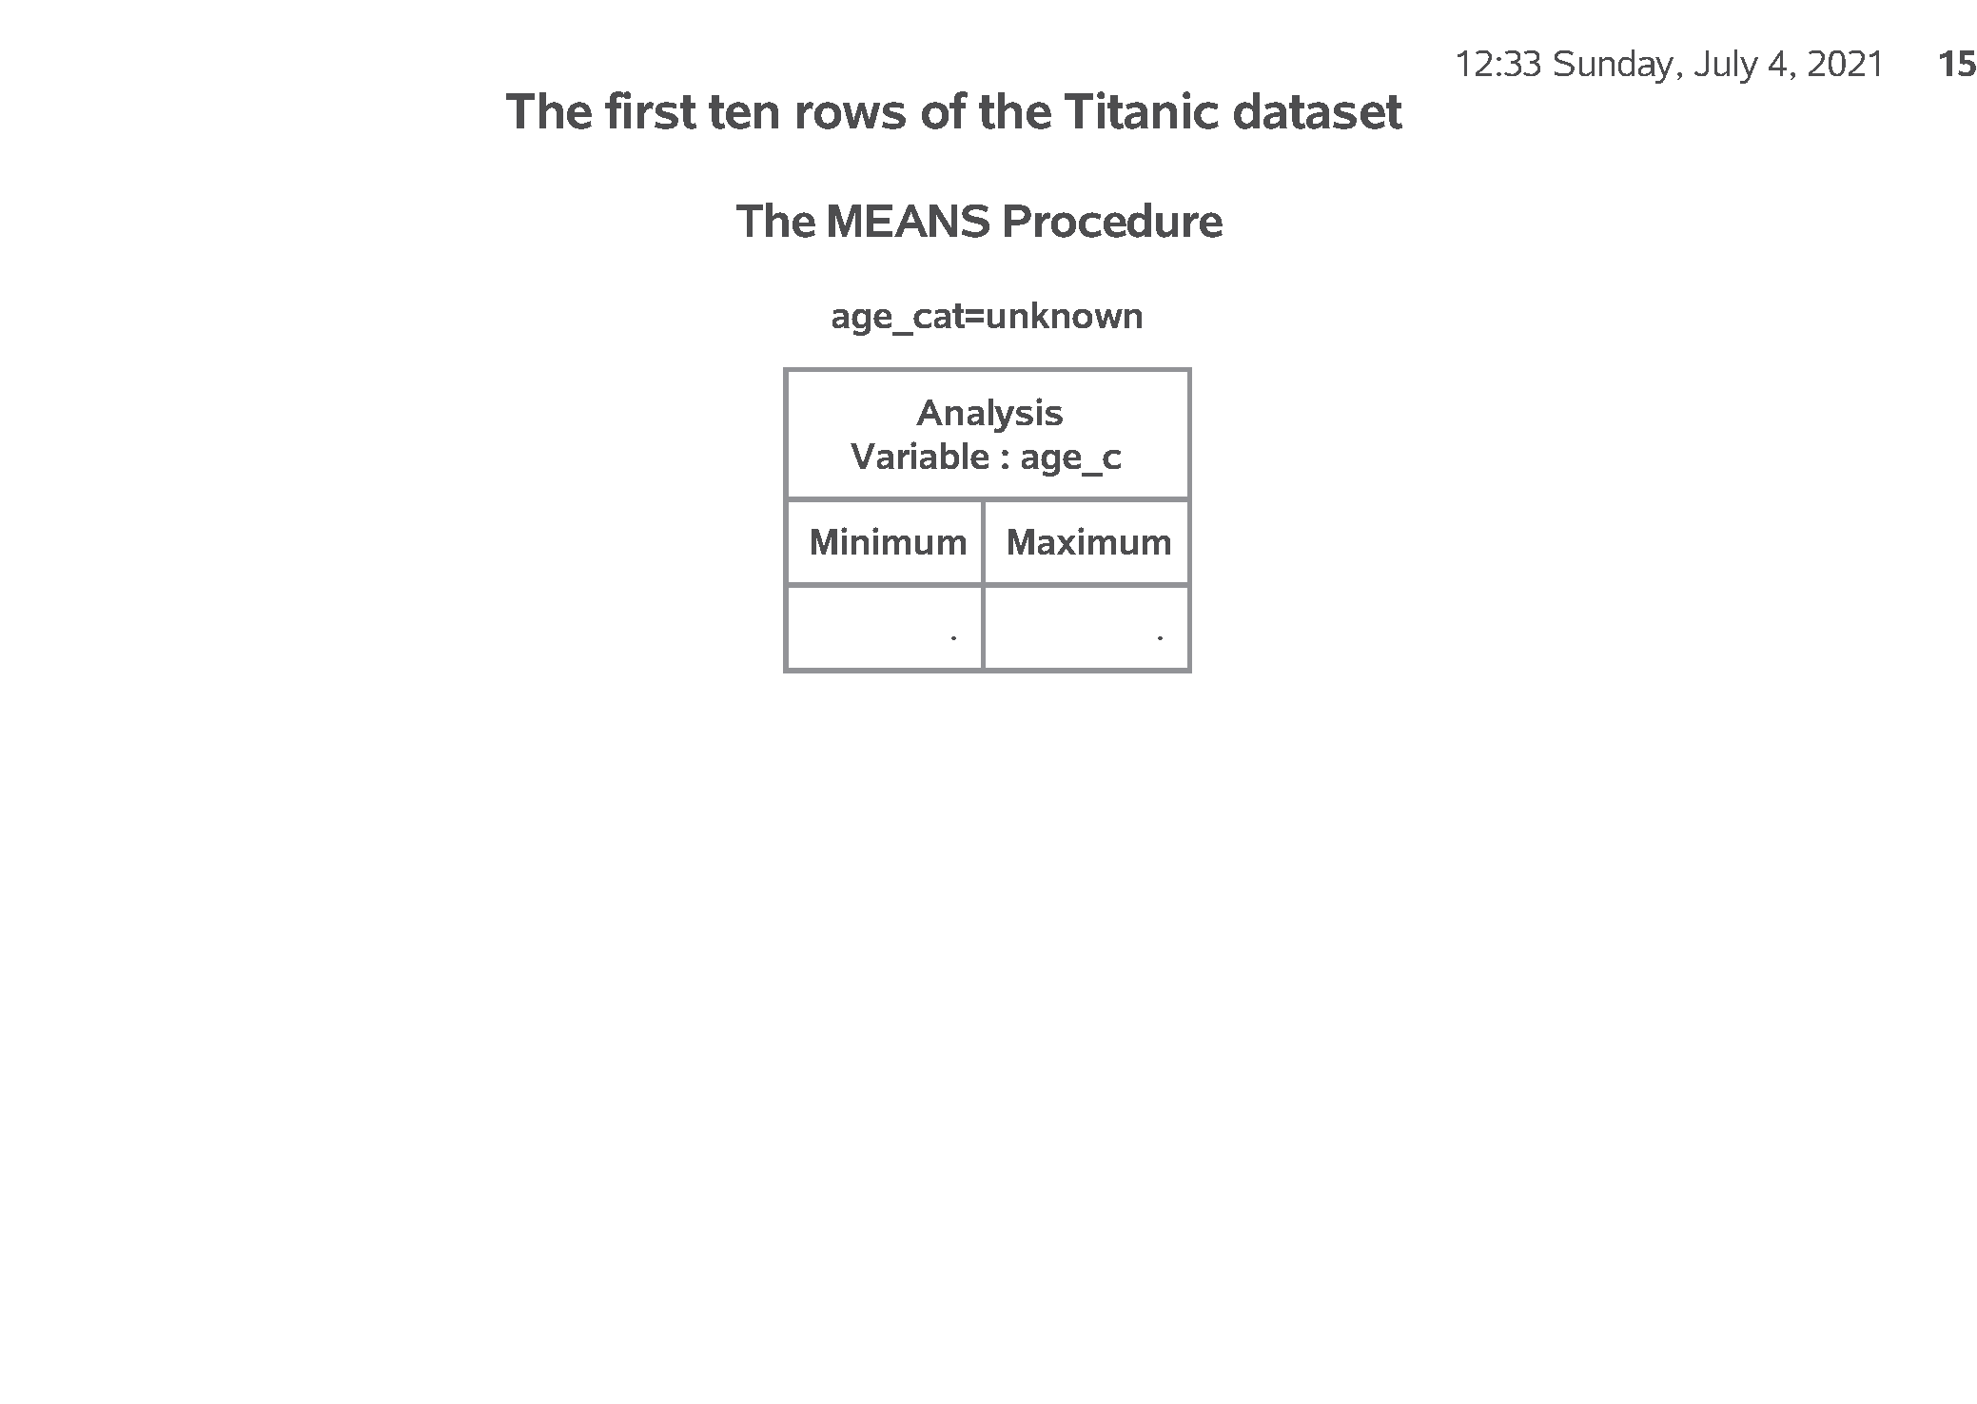
SAS output:
SAS Output
Notes:
Output, page 11. You could have done these calcuations by hand, of course, but this helps others who are not as patient as you are.

Slide 35
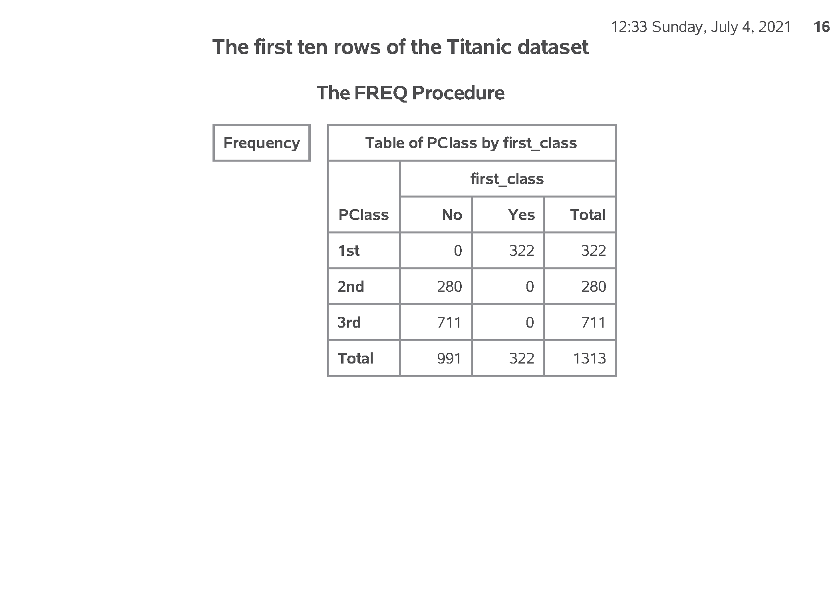
SAS output:
SAS Output
Notes:
Output, page 11. You could have done these calcuations by hand, of course, but this helps others who are not as patient as you are.

Slide 36
Bar chart
Here are the descriptive statistics for age. Notice the number of missing values.
Here is what the output from proc freq looks like. Just two rows.
Here is what the output from proc freq looks like. Just two rows.
Here is what the output from proc freq looks like. Among the males, almost 5/6 died. Among the females only 1/3 died.
Here is the quality check. Notice that adult starts at 21. Should adult start at 18 instead?
Are the ranges for pre-teen and teenager reasonable?
How about the ranges for toddler?
This shows the age categories starting at the youngest: toddler and pre-teen…
followed y teenager and adult…
with missing bring up the rear. This order was the order of the number codes. So if you want to display your results in a non-alphabetical order, use number codes.
Here is the quality check. PClass=1st codes to first_class=Yes. PClass=2nd or 3rd codes to first_class=No.

