Slide 1
Introduction to SAS, Working with categorical variables
Steve Simon

Slide 2
Overview
Notes:
author: Steve Simon date: created 2021-05-30 purpose: to produce slides for module04 videos license: public domain
Here is an overview of what I want to cover in module02.

Slide 3
Categorical data
proc format
recoding
proc freq
barcharts
Notes:
We’re going to look at a different data set, one with mostly categorical variables. I’ll introduce proc format, which allows you to attach labels to categorical data, talk about recoding, and show some tables using proc freq. I’ll also show you a simple bar chart.

Slide 4
SAS code: documentation header
/************************************************ m04-5507-simon-categorical-variables author: Steve Simon Date created: 2018-10-22 Purpose: To illustrate how to work with datasets with mostly continuous variables. License: public domain ************************************************/
Notes:
Here is the documentation header for a program that will show how to work with a dataset with mostly continuous variables.

Slide 5
SAS code: filename, libname, ods statements
* Part01. Tell SAS where to find and store things.; options papersize=(6 in 4 in); * needed to have the output fit on PowerPoint; %let path=q:/introduction-to-sas; ods pdf file="&path/results/m04-5507-simon-categorical.pdf"; filename raw_data "&path/data/titanic_v00.txt"; libname intro "&path/data";
Notes:
The filename statement tells you where the raw data is stored.
The libname statement tells you where SAS will store any permanent datsets.
The ods statement tells you that SAS is going to store the results with a particular filename and in pdf format.

Slide 6
Read the data using proc import
* Part02. Reading using proc import; proc import datafile=raw_data out=intro.titanic dbms=dlm replace; delimiter='09'x; getnames=yes; run;
As a general rule, proc import works best for simple delimited files where the first row contains the variable names. With complicated text files (such as files where the data for an individual extends across more than one line) or files without variable names in the first row are usually better handled by a data step.

Slide 7
SAS code:
* Part03. Pring the first ten lines.; proc print data=intro.titanic(obs=10); title1 "The first ten rows of the Titanic dataset"; run;

Slide 8
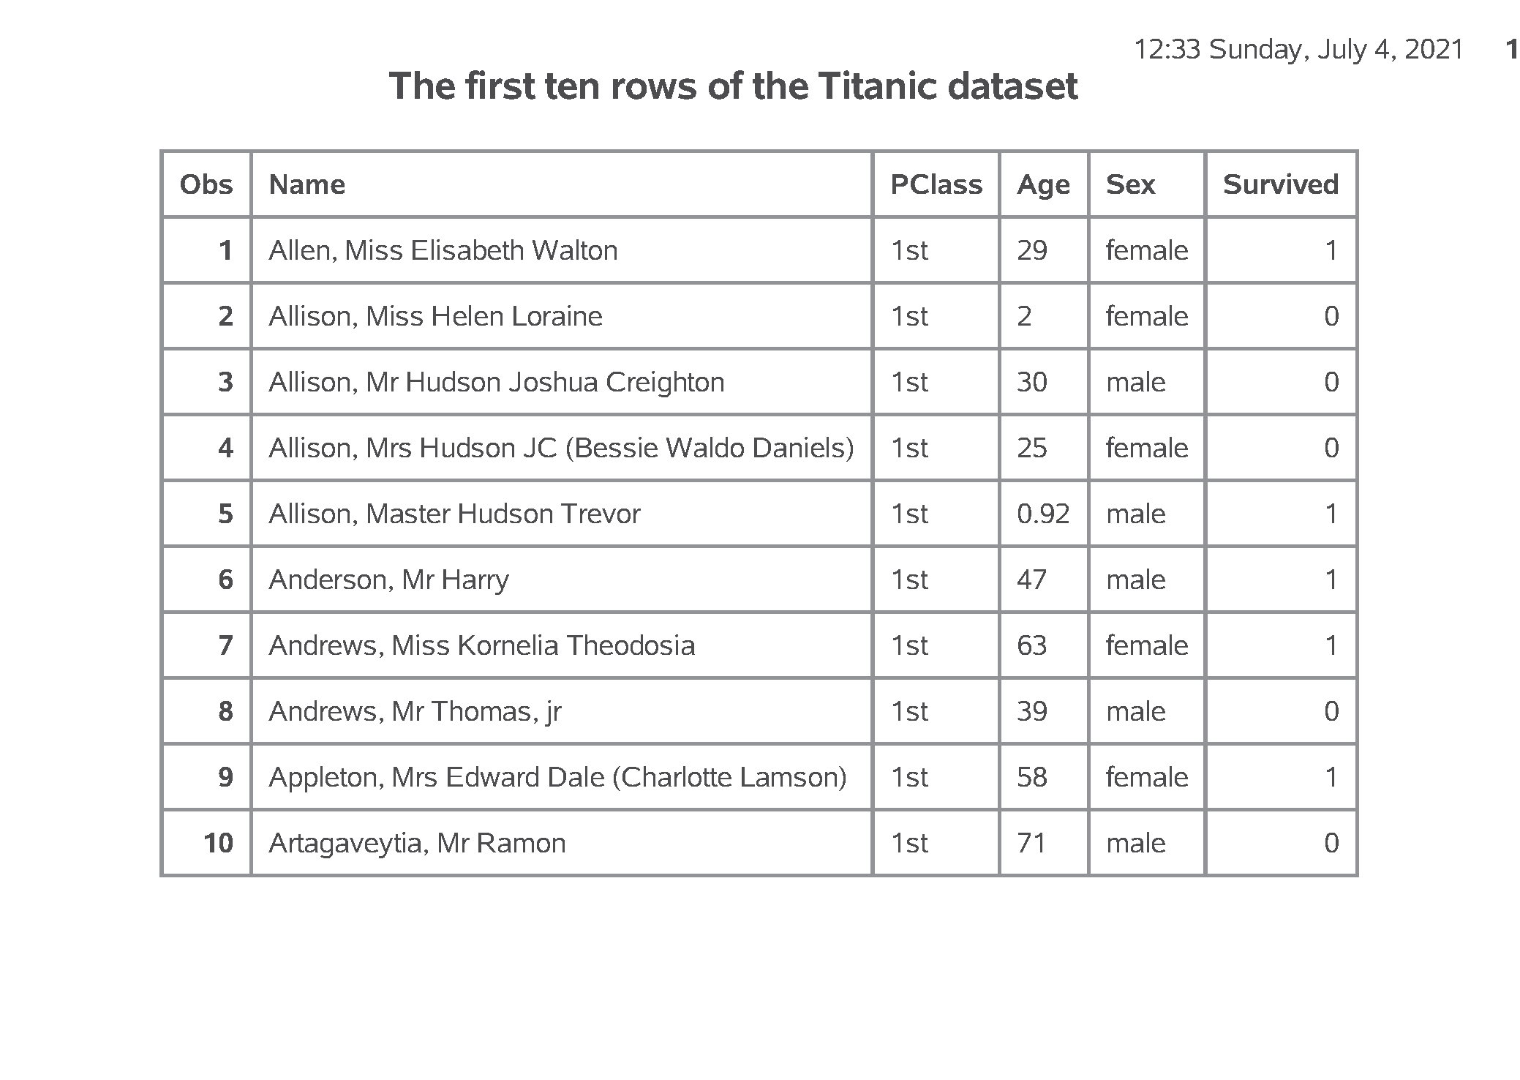
SAS output:
SAS Output
Notes:
If you look at the first few rows of data, you will see that the import went reasonably well. It is not always this easy. Do take notice that age is left justified. It is caused by a number of “NA” codes for missing values. You don’t see it here, but if you print a few more observations, you can see the “NA” values. It would have been easier to anticipate these ahead of time, but We’ll fix things up after the fact.

Slide 9
SAS code:
* Part04. Counts, proc freq.; proc freq data=intro.titanic; table PClass Sex Survived; run;
Notes:
For any categorical variables, your first step is to get frequency counts.

Slide 10
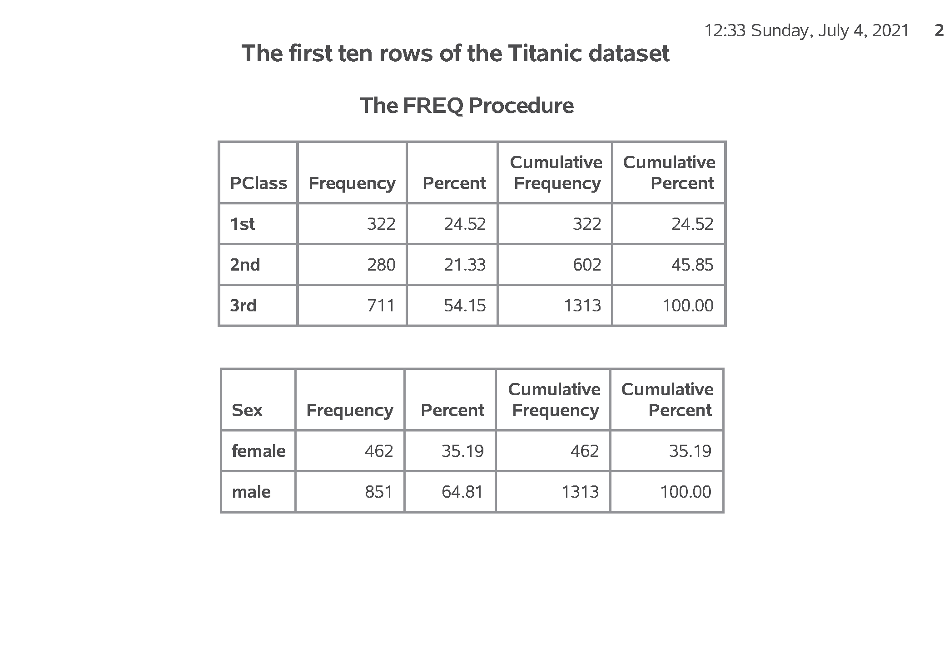
SAS output:
SAS Output

Slide 11
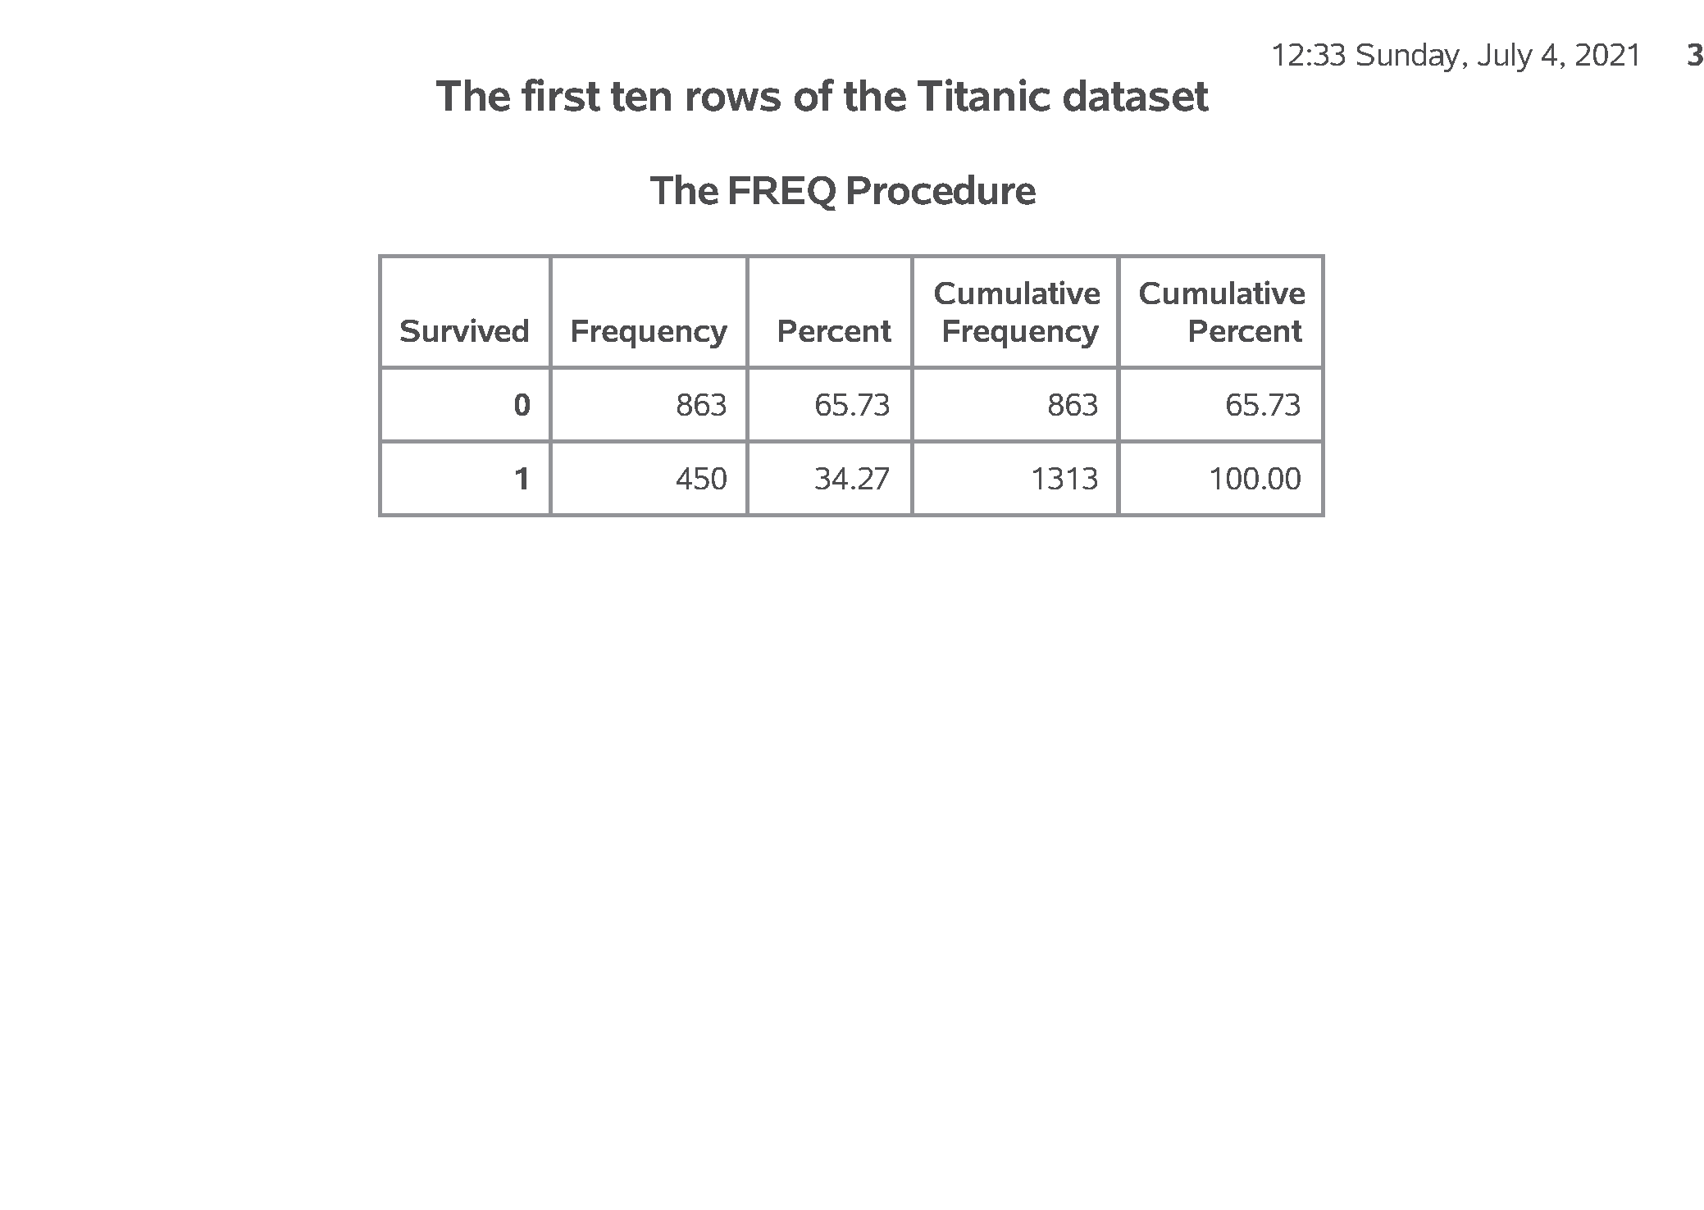
SAS output:
SAS Output

Slide 12
SAS code:
* Part05. Convert string to numeric, data step.; data intro.titanic; set intro.titanic; age_c = input(age, ?? 8.); run; proc means n nmiss mean std min max data=intro.titanic; var age_c; run;
Notes:
For the one continuous variable (age) you need to convert the code “NA” to the SAS missing value code, which is a dot. The easiest way to do this is to force the data to numeric with a simple arithmetic equation like adding a zero. But you get a warning message for each occurence of NA, which can get tedious. The input function with two question marks avoids this issue.

Slide 13
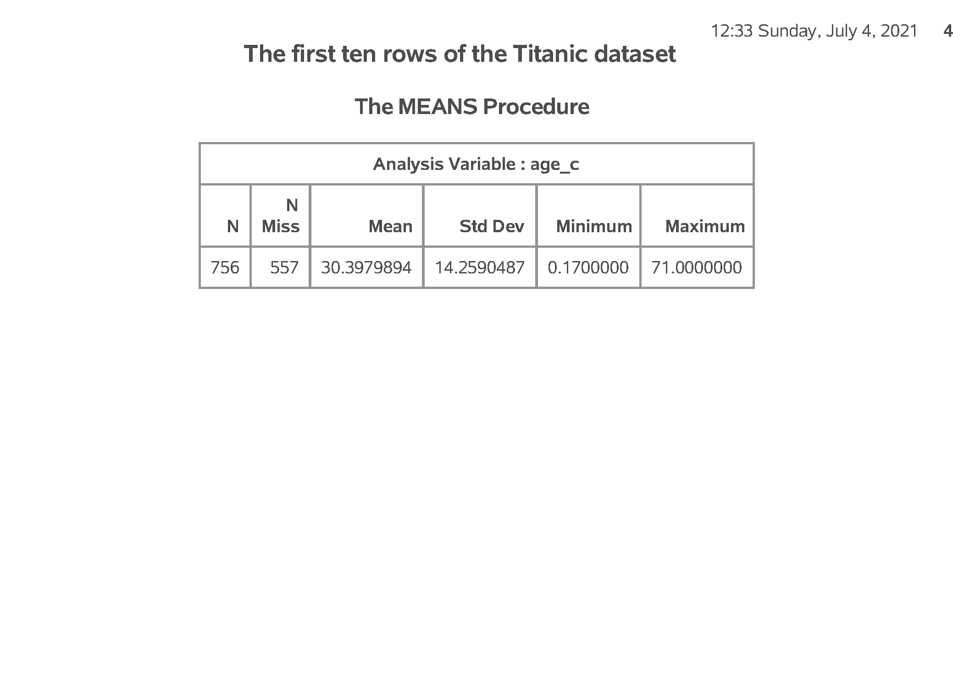
SAS output:
SAS Output

Slide 14
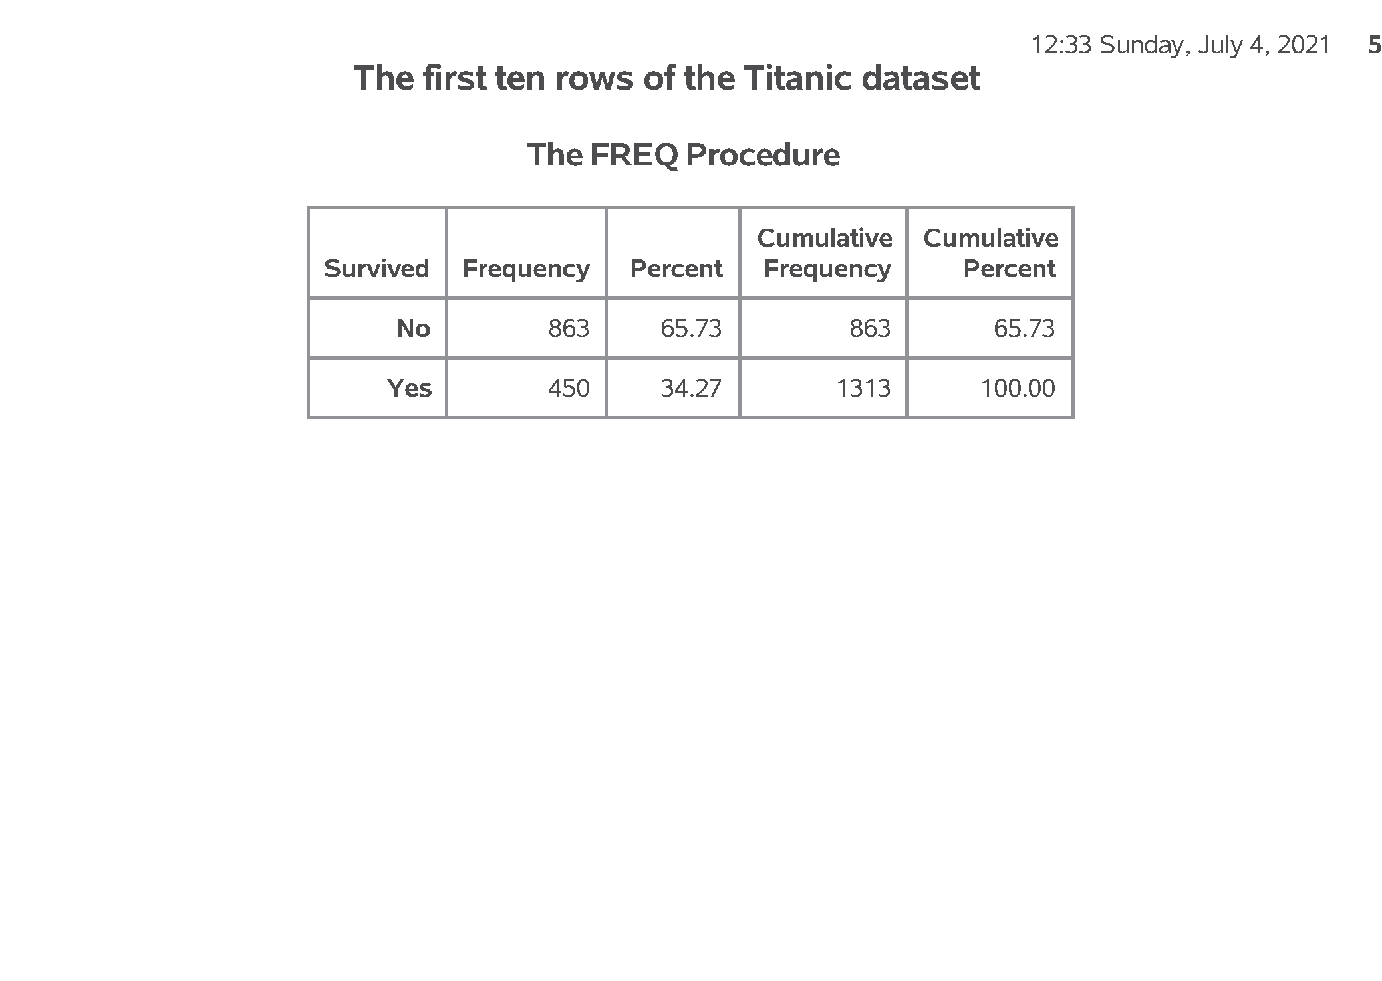
SAS output:
SAS Output

Slide 15
SAS code:
* Part06. Using proc format to code categorical data,; proc format; value f_survived 0 = "No" 1 = "Yes"; run; proc freq data=intro.titanic; tables Survived; format Survived f_survived.; run;
Notes:
For variables like Survived which are numbers, but the numbers represent a particular category, you can document this using a format statement.

Slide 16
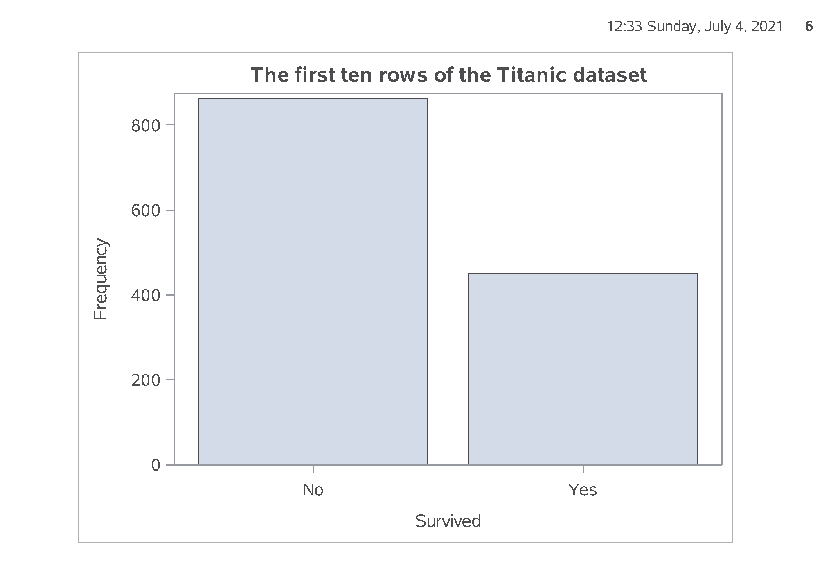
SAS output:
SAS Output

Slide 17
SAS code:
* Part07. Bar charts, proc sgplot.; proc sgplot data=intro.titanic; vbar Survived; format Survived f_survived.; run;
Notes:
I don’t normally like bar charts, but they do have their uses.

Slide 18
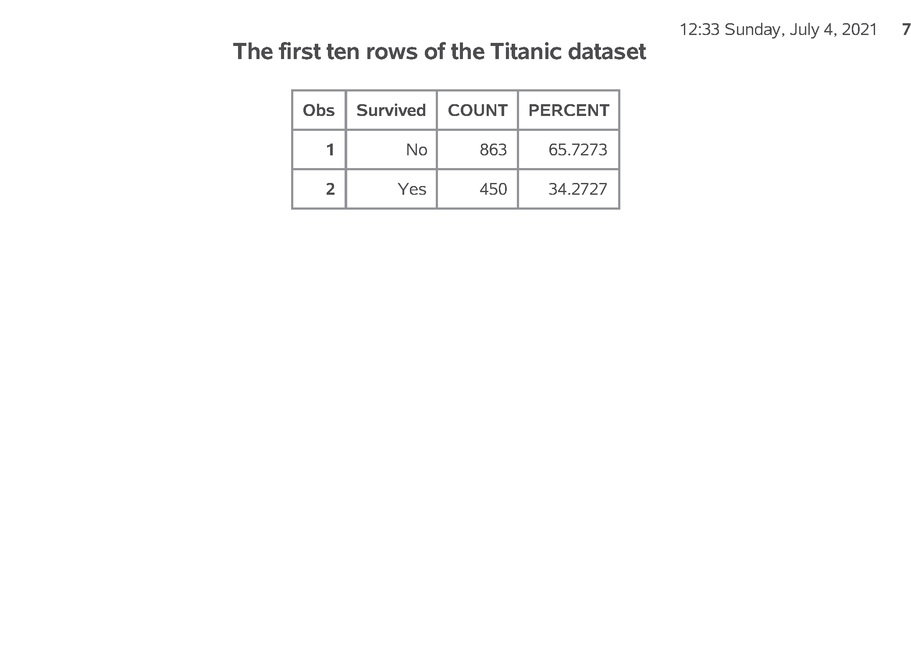
SAS output:
SAS Output

Slide 19
SAS code:
* Part08. Percentages for bar chart.; proc freq data=intro.titanic; tables Survived / noprint out=pct_survived; run; proc print data=pct_survived; format Survived f_survived.; run; proc sgplot data=pct_survived; vbar Survived / response=Percent; yaxis max=100; format Survived f_survived.; run;
Notes:
Getting percentages is a bit tricky. You have to run proc freq and output the results to a new data file, pct_survived. I am using the noprint option, because I only want the percentages for internal use. It wouldn’t have hurt anything to print out a bit extra, but I want to encourage you to limit the amount of output that you present to a consulting client.
Note the yaxis maxx=100 statement which expands the upper limit of the y axis to 100%.

Slide 20
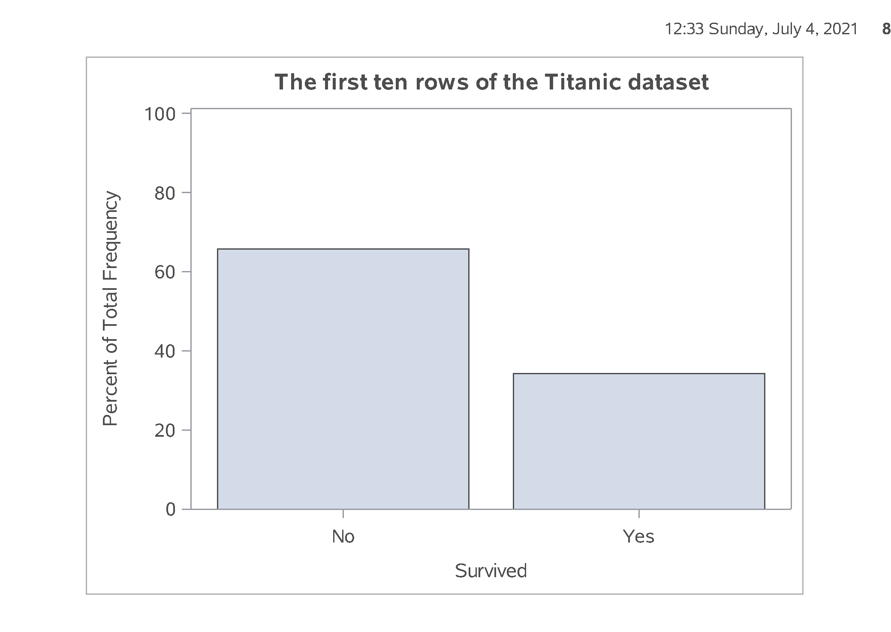
SAS output:
SAS Output

Slide 21
SAS code:
* Part09. Crosstabulation.; proc freq data=intro.titanic; tables Sex*Survived / nocol nopercent; format Survived f_survived.; run;
Notes:
To examine relationships among categorical variables use a two dimensional crosstabulation.

Slide 22
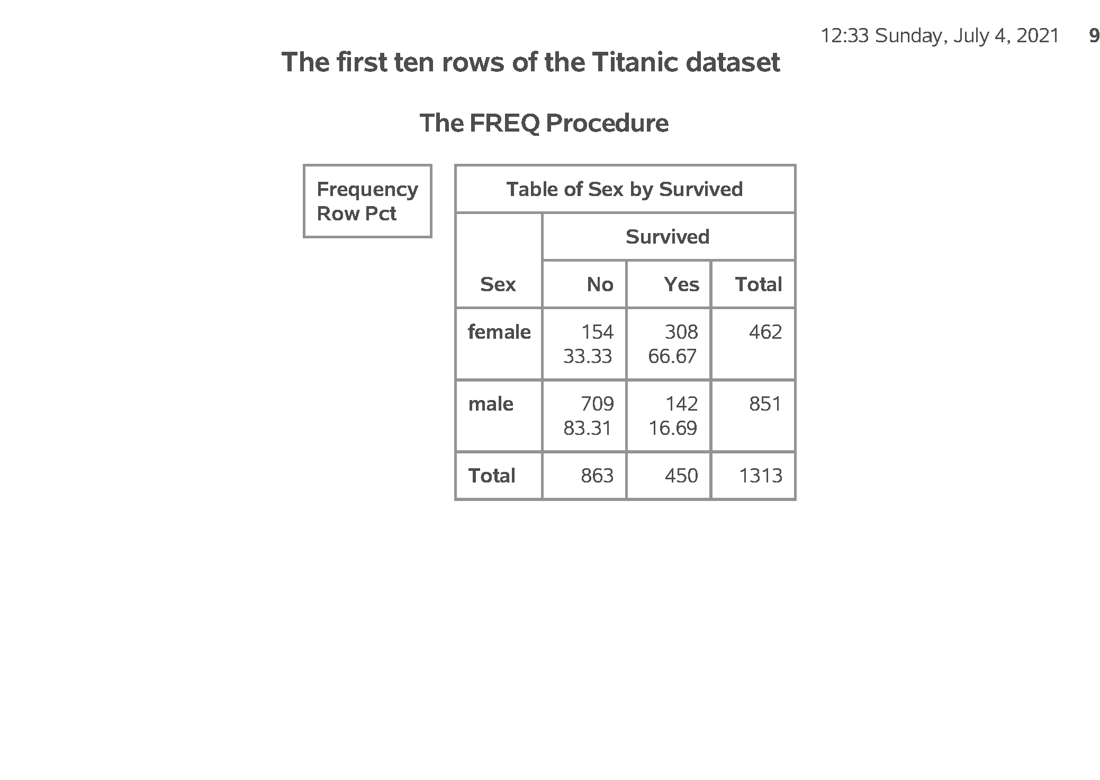
SAS output:
SAS Output

Slide 23
SAS code:
* Part10. Converting a continuous variable to categorical.; data age_categories; set intro.titanic; if age_c = . then age_cat = "missing "; else if age_c < 6 then age_cat = "toddler "; else if age_c < 13 then age_cat = "pre-teen"; else if age_c < 21 then age_cat = "teenager"; else age_cat = "adult "; run;
Notes:
If you want to create categories from a continuous variable, use a series of
if - then - else
statements

Slide 24
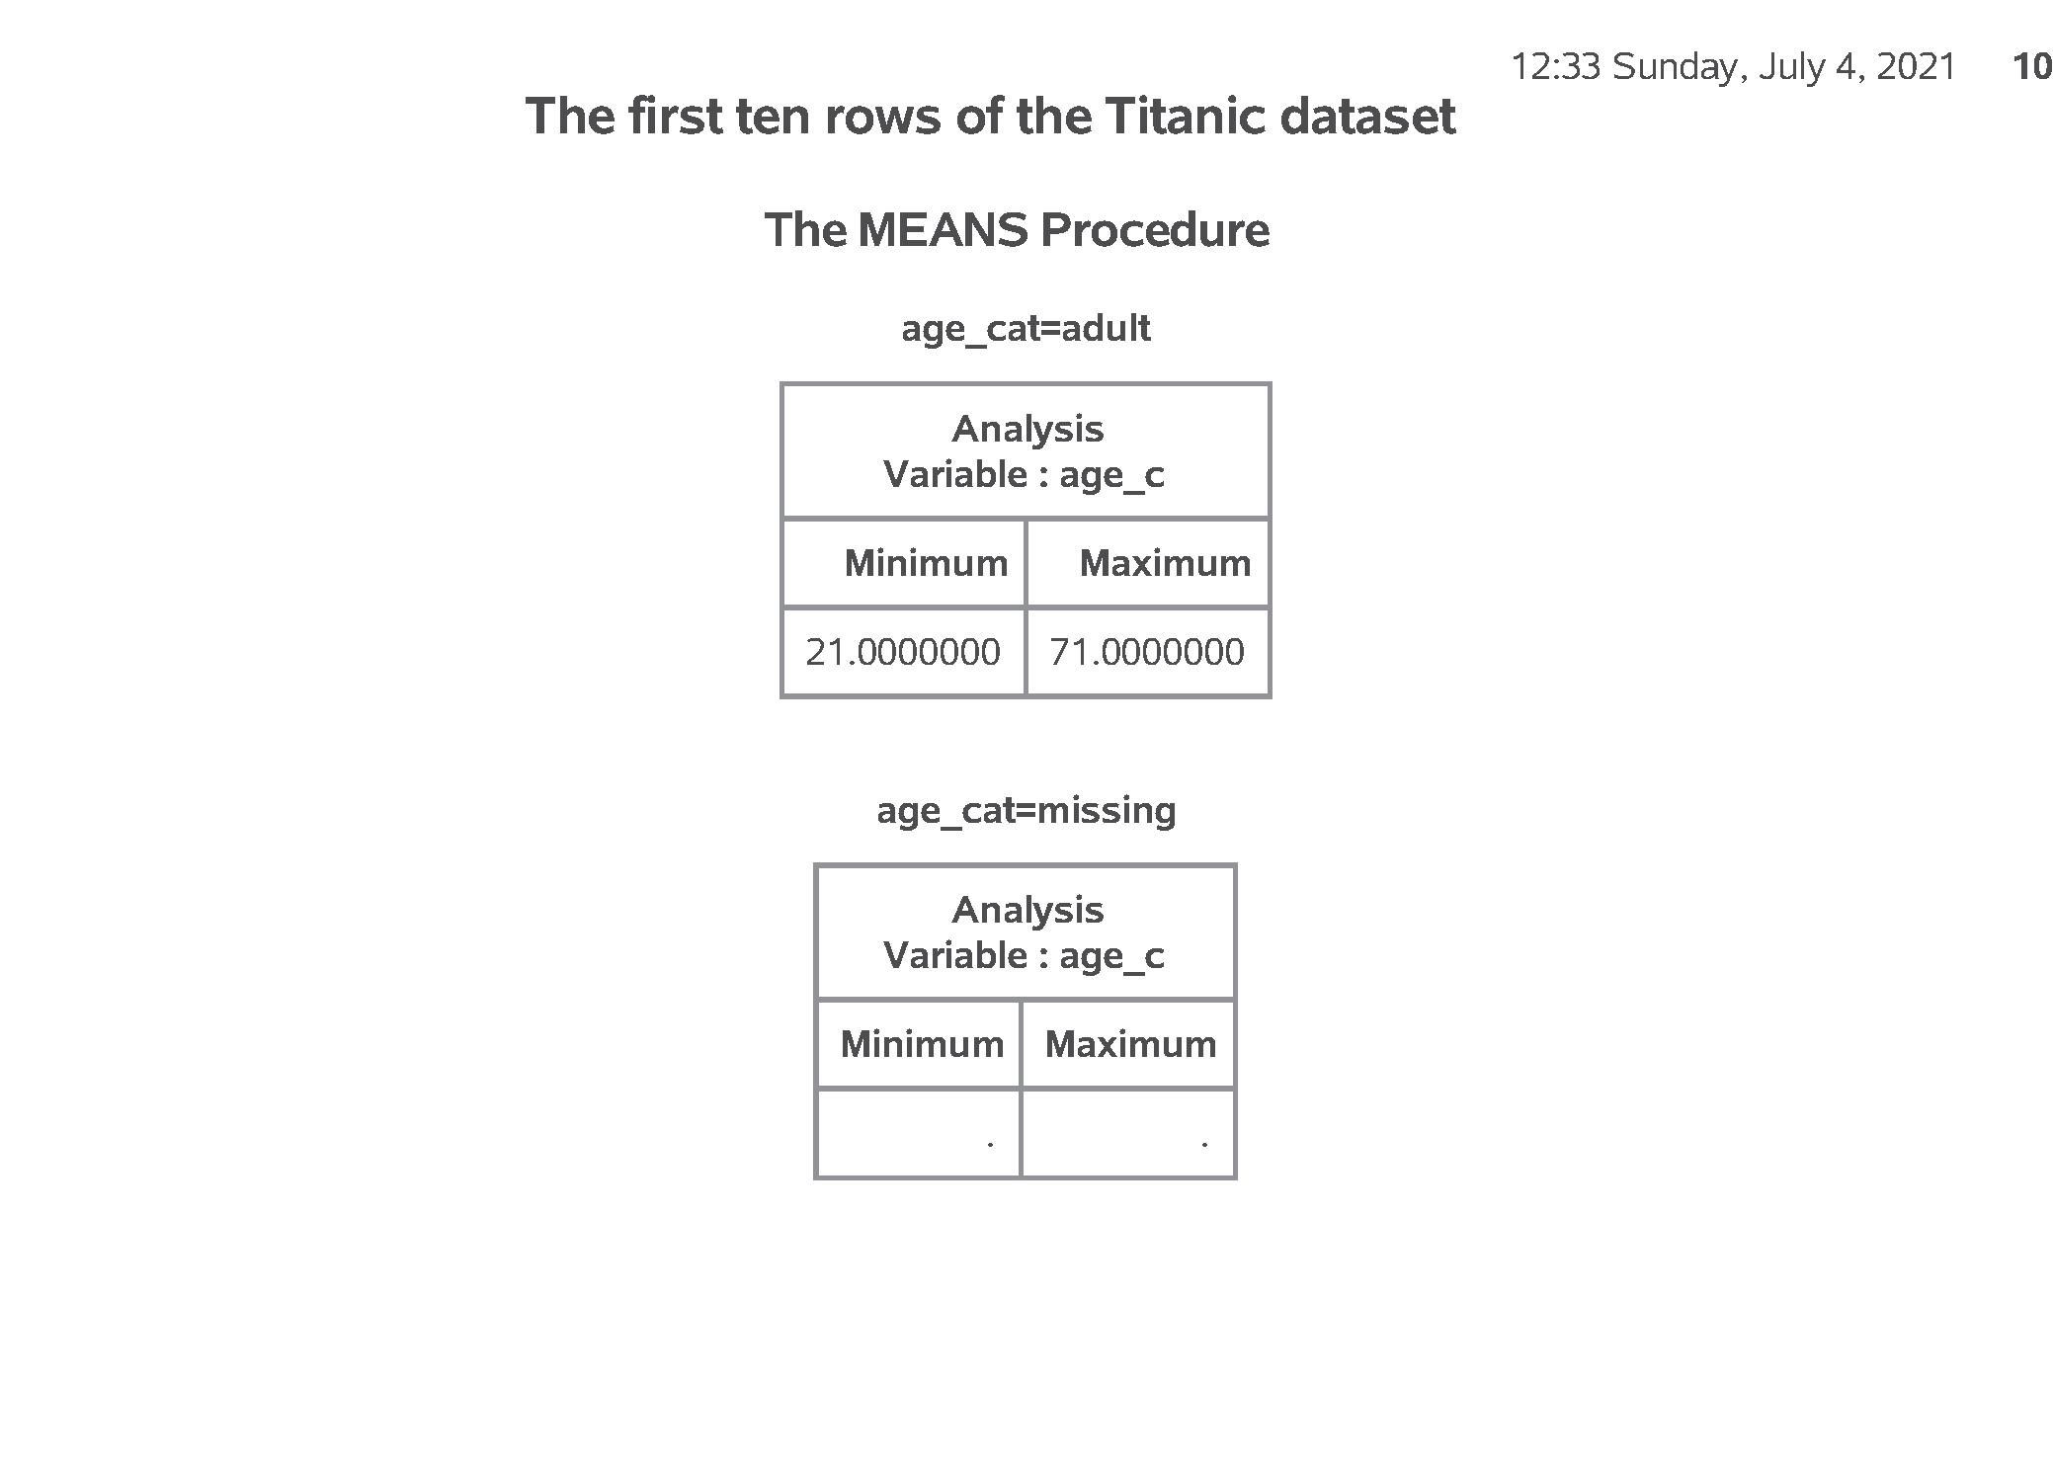
SAS output:
SAS Output

Slide 25
SAS code:
* Part11. Quality check.; proc sort data=age_categories; by age_cat; run; proc means min max data=age_categories; by age_cat; var age_c; run;
Notes:
Always cross check your results against the original variable.

Slide 26
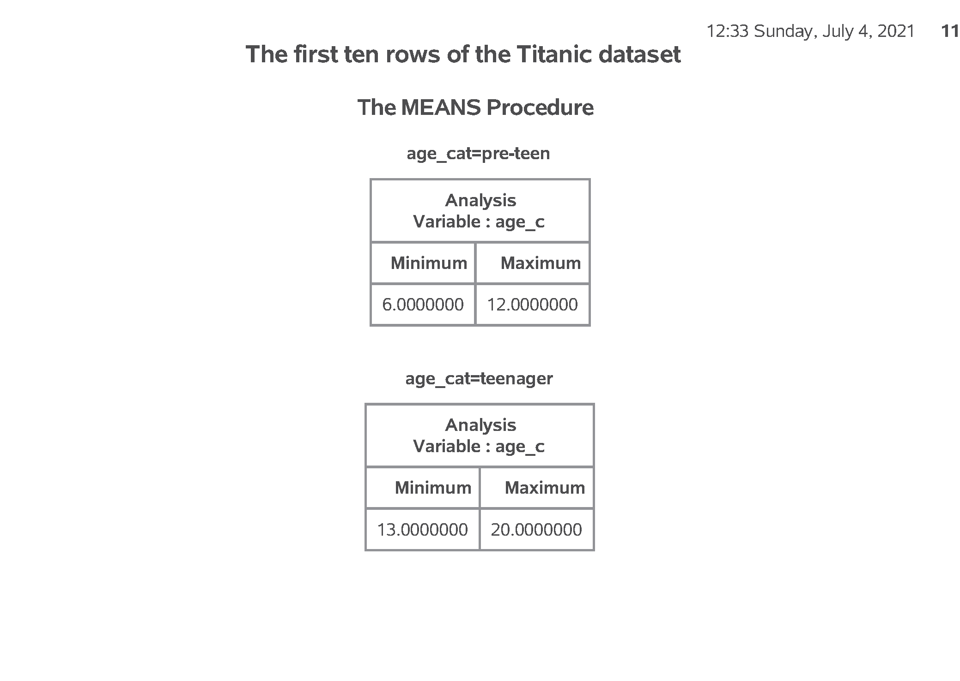
SAS output:
SAS Output

Slide 27
SAS code:
* Part12. Controlling the display order.; data age_codes; set intro.titanic; if age_c = . then age_cat = 9; else if age_c < 6 then age_cat = 1; else if age_c < 13 then age_cat = 2; else if age_c < 21 then age_cat = 3; else age_cat = 4; run;
Notes:
Notice that the order for age_cat is alphabetical, which is probably not what you want. You can control the order by using number codes and formats.

Slide 28
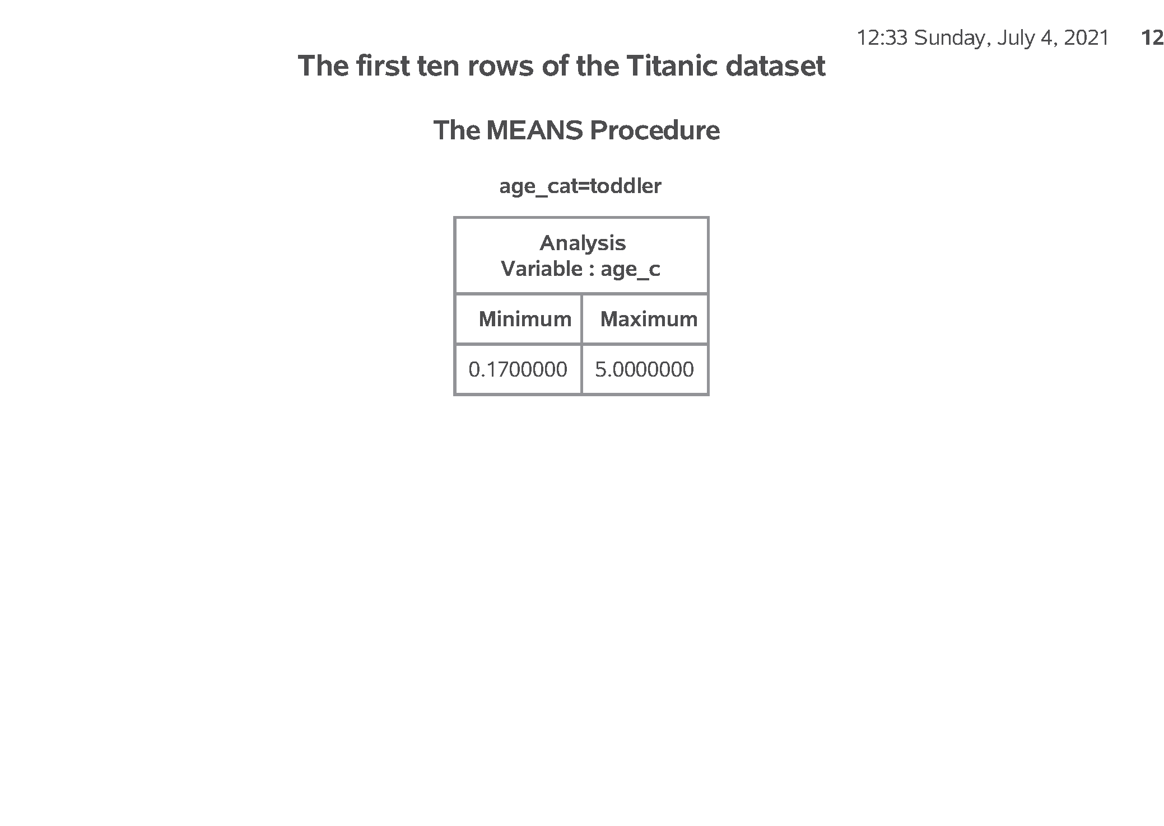
SAS output:
SAS Output

Slide 29
SAS code:
* Part13. With number codes, use proc format.; proc format; value f_age 1 = "toddler" 2 = "pre-teen" 3 = "teenager" 4 = "adult" 9 = "unknown"; run;
Notes:
Once you have the number codes, assign an interpretable label using proc format.

Slide 30

SAS output:
SAS Output

Slide 31
SAS code:
* Part14. Quality check.; proc sort data=age_codes; by age_cat; run; proc means min max data=age_codes; by age_cat; var age_c; format age_cat f_age.; run;
Notes:
Here’s the quality check again.

Slide 32
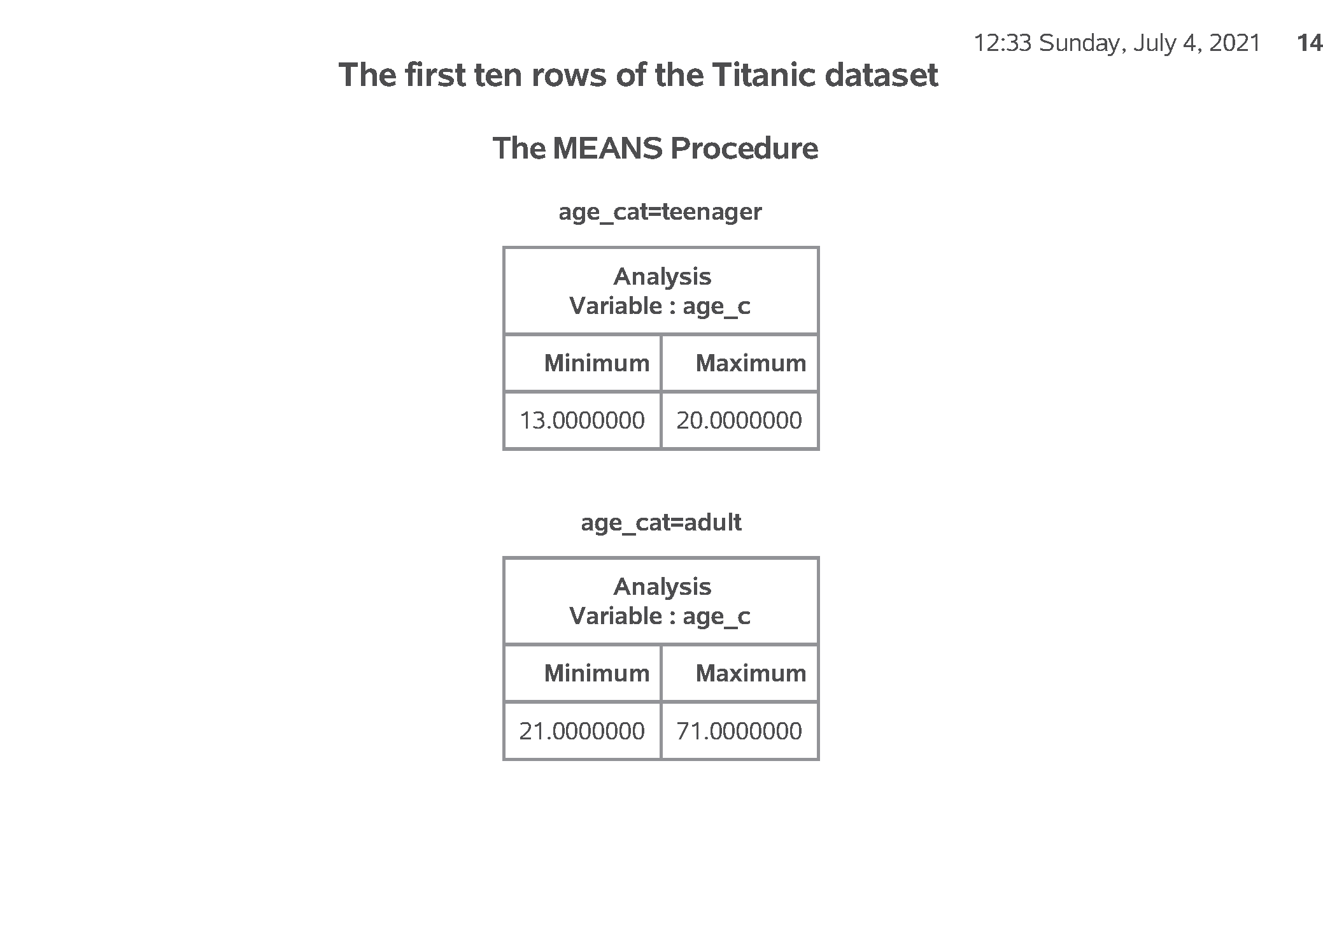
SAS output:
SAS Output

Slide 33
SAS code:
* Part15. Modifying a categorical variable.; data first_class; set intro.titanic; if PClass = "1st" then first_class = "Yes"; else first_class = "No"; run; proc freq data=first_class; table PClass*first_class / norow nocol nopercent; run; ods pdf close;
Notes:
Here’s another example where you compare First Class passengers to Second and Third class passengers combined.

Slide 34
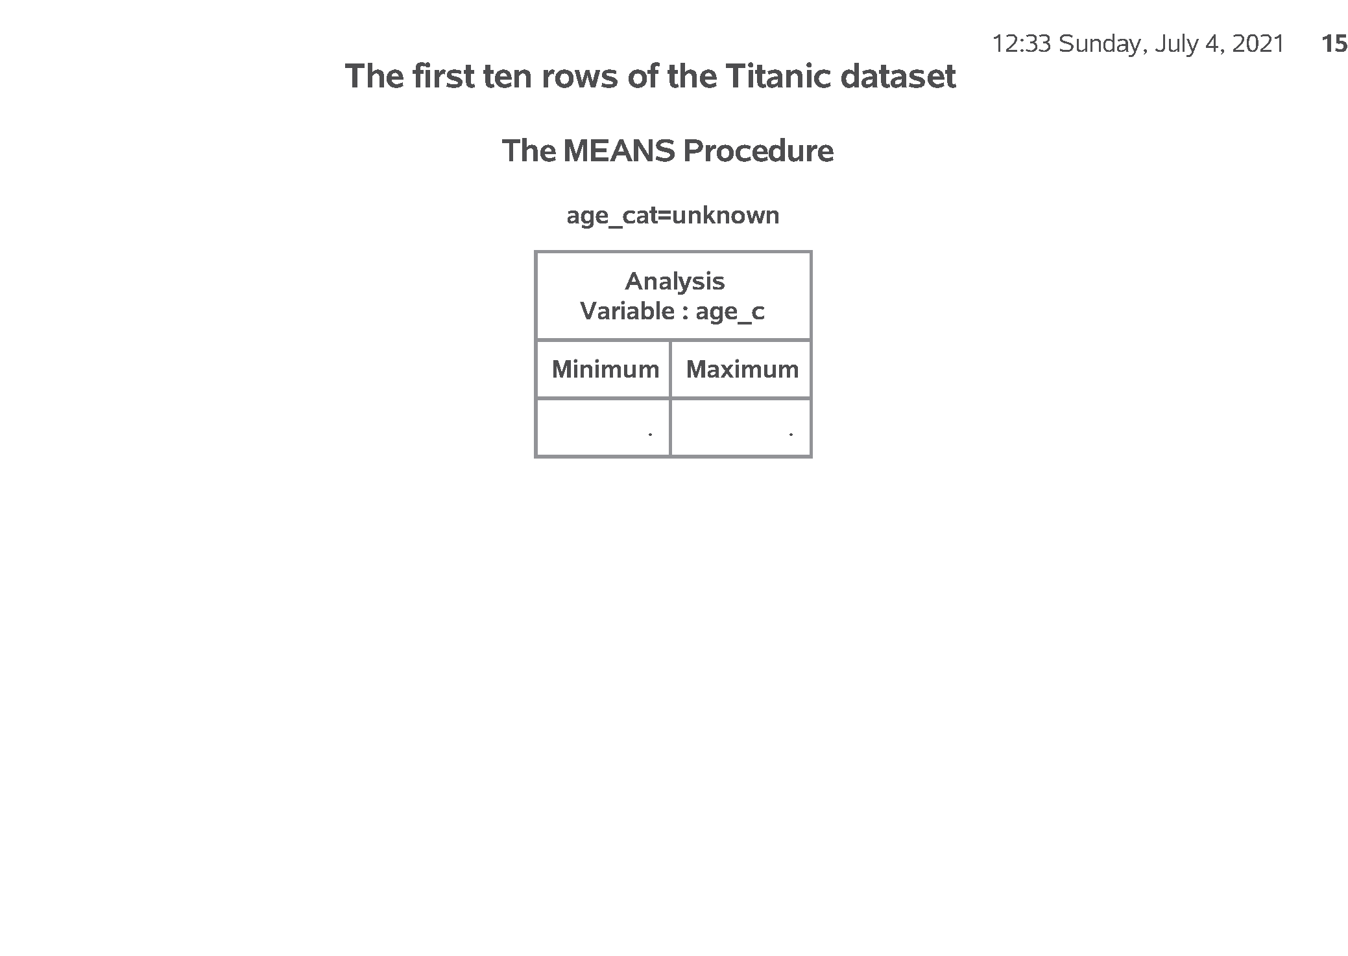
SAS output:
SAS Output

Slide 35
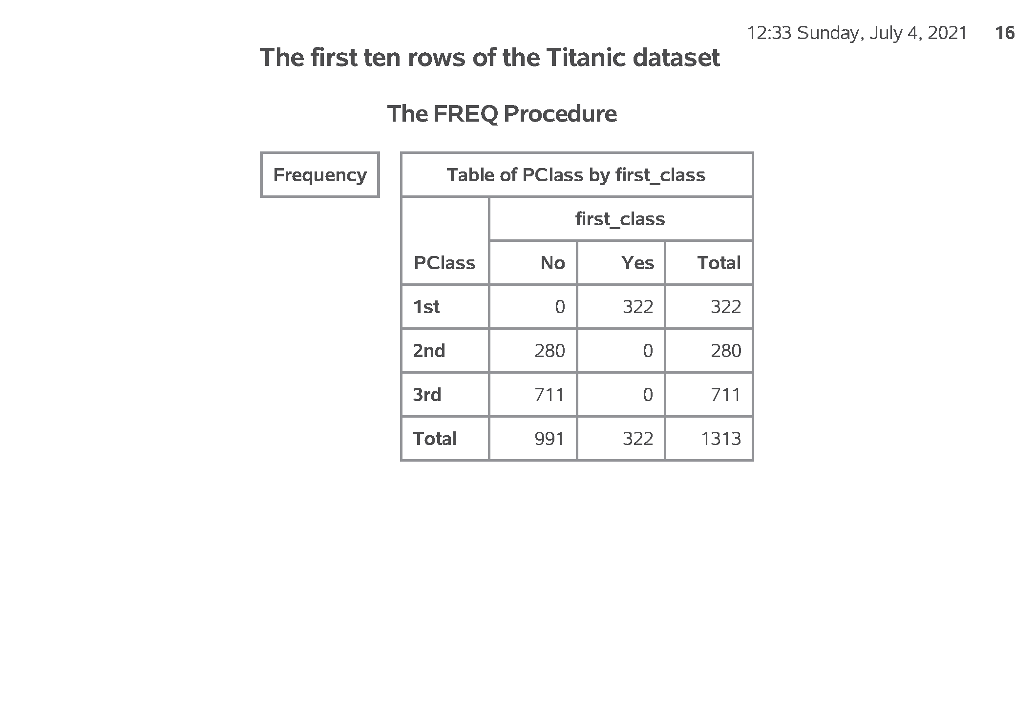
SAS output:
SAS Output

Slide 36
Titanic data set
Notes:
Here are the first ten rows of the Titanic data set.
At first glance, everything looks fine. But if you look closely, you will see that age is left justified. It is caused by the NA code for missing value, which doesn’t appear until about line 14 or 15 of the code.

Slide 37
Counts for categorical data (1/2)
Notes:
Here are the counts for passenger class and sex.

Slide 38
Counts for categorical data (2/2)
Notes:
Here are the counts for Survived.

Slide 39
Means and standard deviations for age
Notes:
Here are the descriptive statistics for age. Notice the number of missing values.

Slide 40
Nicely formatted counts for survival
Notes:
Notice that the format statement replaces the cryptic 0-1 code with the words no and yes.

Slide 41
Bar chart
Notes:
Here are the descriptive statistics for age. Notice the number of missing values.

Slide 42
Percentages, proc freq
Notes:
Here is what the output from proc freq looks like. Just two rows.

Slide 43
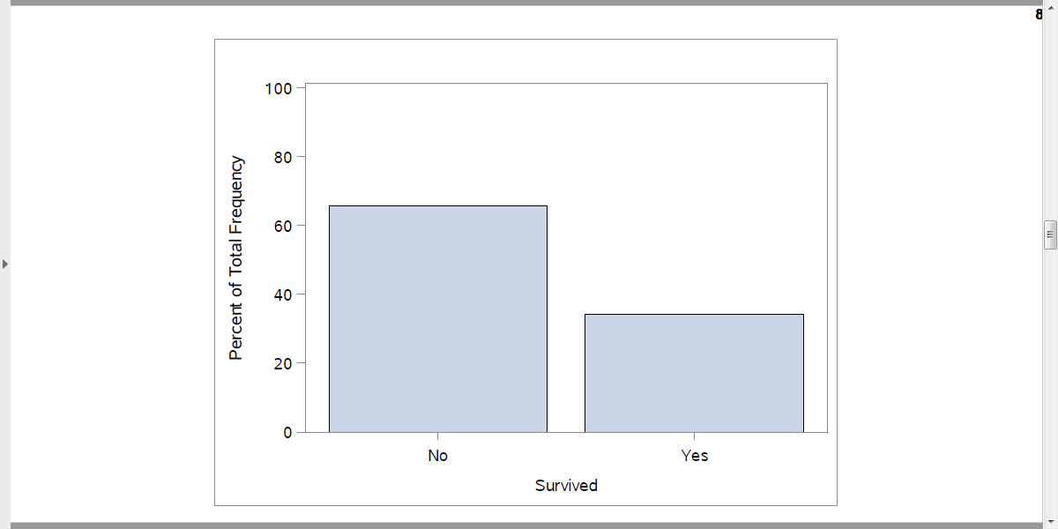
Percentages in a bar chart
Output, proc sgplot
Notes:
Here is what the output from proc freq looks like. Just two rows.

Slide 44
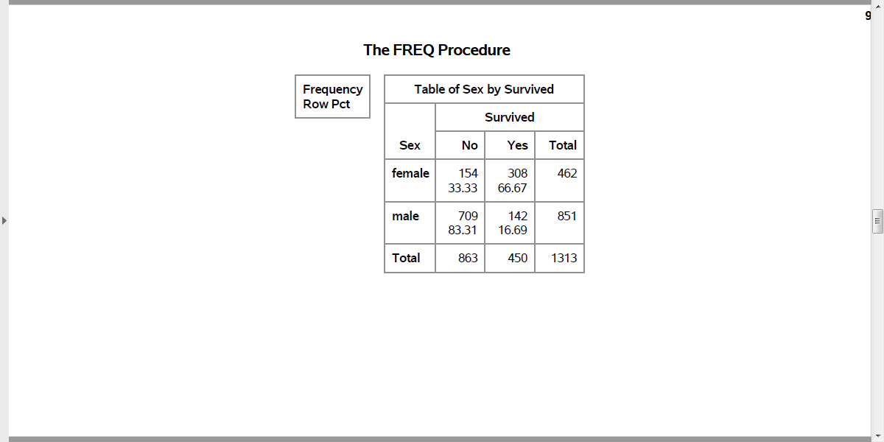
Percentages, proc freq
Output, proc freq
Notes:
Here is what the output from proc freq looks like. Among the males, almost 5/6 died. Among the females only 1/3 died.

Slide 45
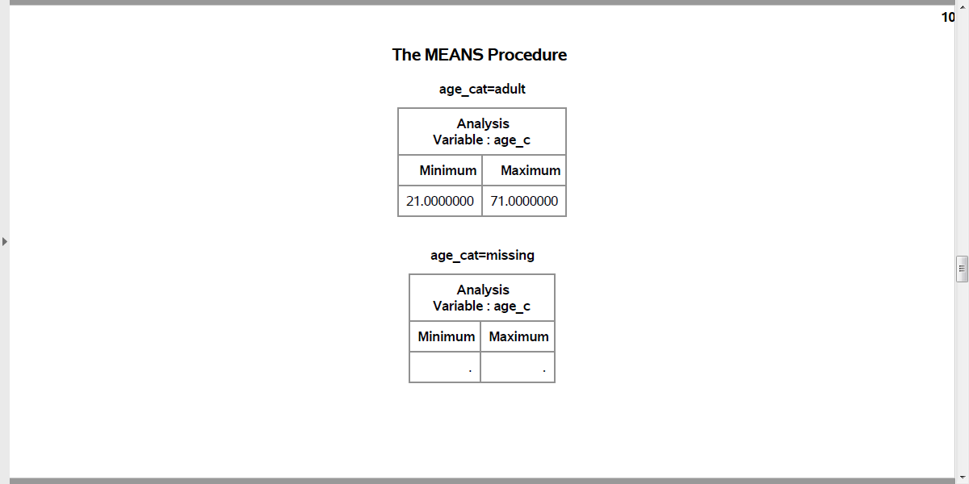
Recoding age (1 / 3)
Output, proc means
Notes:
Here is the quality check. Notice that adult starts at 21. Should adult start at 18 instead?

Slide 46
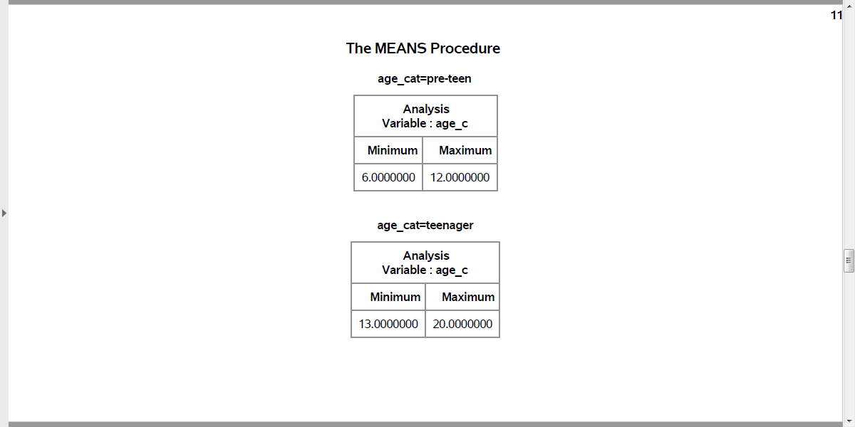
Recoding age (2 / 3)
Output, proc means
Notes:
Are the ranges for pre-teen and teenager reasonable?

Slide 47
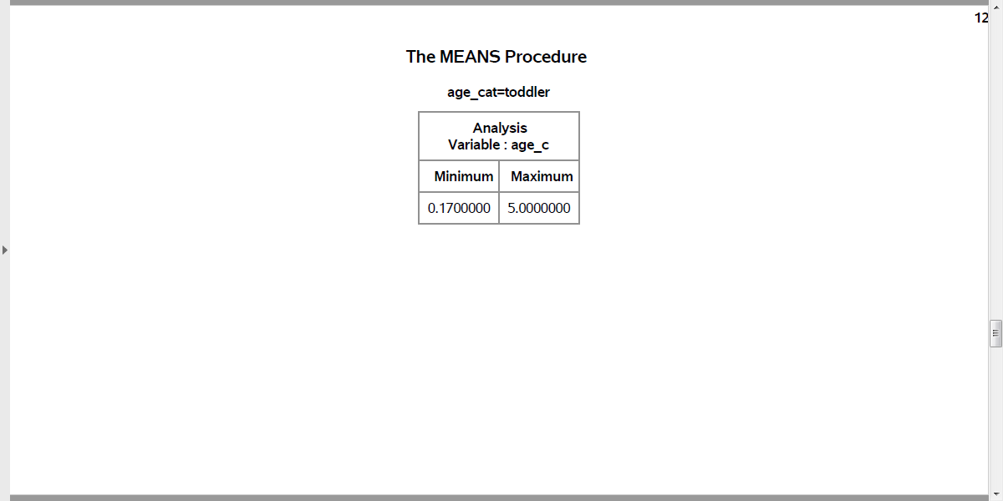
Recoding age (3 / 3)
Output, proc means
Notes:
How about the ranges for toddler?

Slide 48
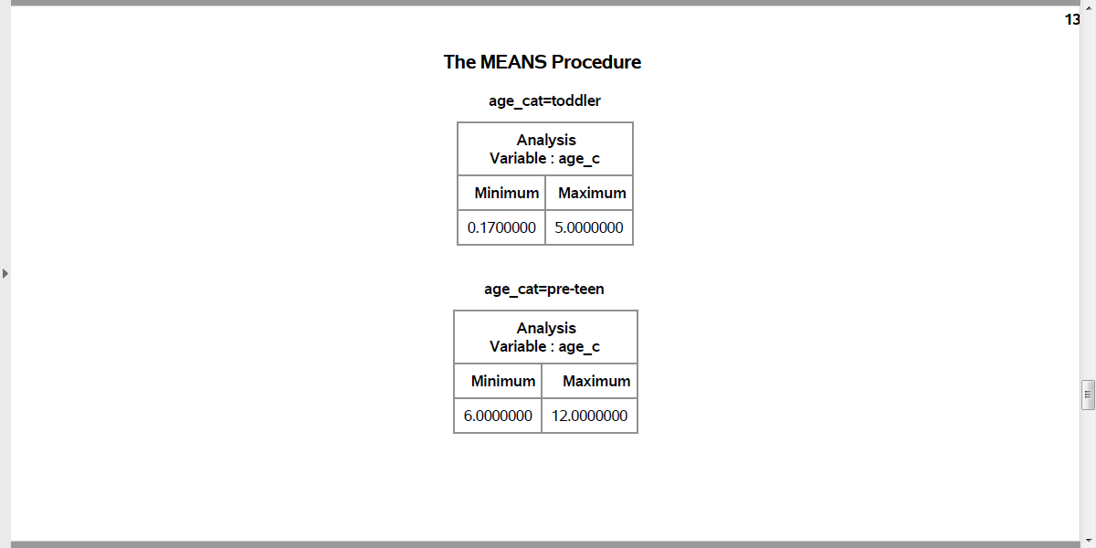
Better age recode (1 /3)
Output, proc means
Notes:
This shows the age categories starting at the youngest: toddler and pre-teen…

Slide 49
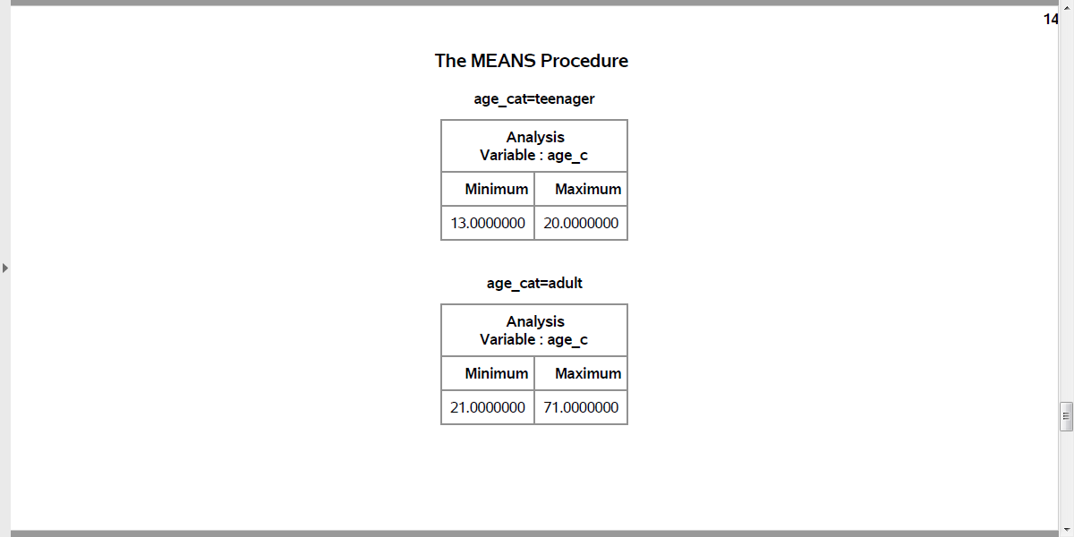
Better age recode (2 /3)
Output, proc means
Notes:
followed y teenager and adult…

Slide 50
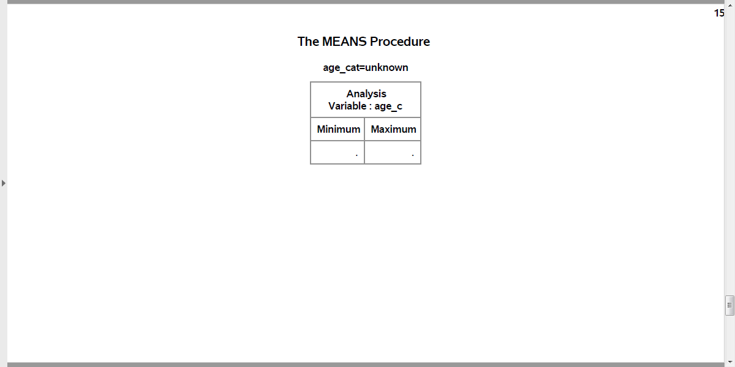
Better age recode (3 /3)
Output, proc means
Notes:
with missing bring up the rear. This order was the order of the number codes. So if you want to display your results in a non-alphabetical order, use number codes.

Slide 51
Quality check
Notes:
Here is the quality check. PClass=1st codes to first_class=Yes. PClass=2nd or 3rd codes to first_class=No.

