Slide 1
Course Introduction
Steve Simon

Slide 2
Overview
Introducing your instructor
Where you can get SAS
Your first SAS program
History of SAS
Directory structure and documentation header
Permanent storage
Saving your output
Getting data from a file
Notes:
[[Speaker notes]]
author: Steve Simon date: created 2018-08-29 purpose: to produce slides for module01 videos license: public domain
Here is an overview of what I want to cover in module02.
Okay. I want to get you started using SAS. It’s either going to be really easy or it’s going to be really really hard. I want to give you as much guidance as I can without staring over your shoulder. Just quickly, I wrote this PowerPoint presentation and all the PowerPoint presentations using R Markdown. If you are curious I have a repository. It has some beautiful output.
Greetings! My name is Steve Simon and I am the instructor for the class, MEDB 5507, Introduction to SAS.

Slide 3

Course instructor, Steve Simon
Photo of Steve Simon
Notes:
[[Speaker notes]]
Greetings! My name is Steve Simon and I am the instructor for the class, MEDB 5507, Introduction to SAS.

Slide 4
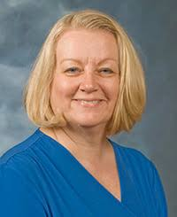
Original developer, Mary Gerkovich
Photo of Mary Gerkovich
Notes:
[[Speaker notes]]
This course was originally developed by Dr. Mary Gerkovich. I’ve changed a few things, but I owe a big debt of gratitude to Mary for all of her hard work.

Slide 5
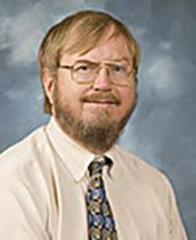
A bit about myself
Notes:
[[Speaker notes]]
Let me share a bit about myself.

Slide 6
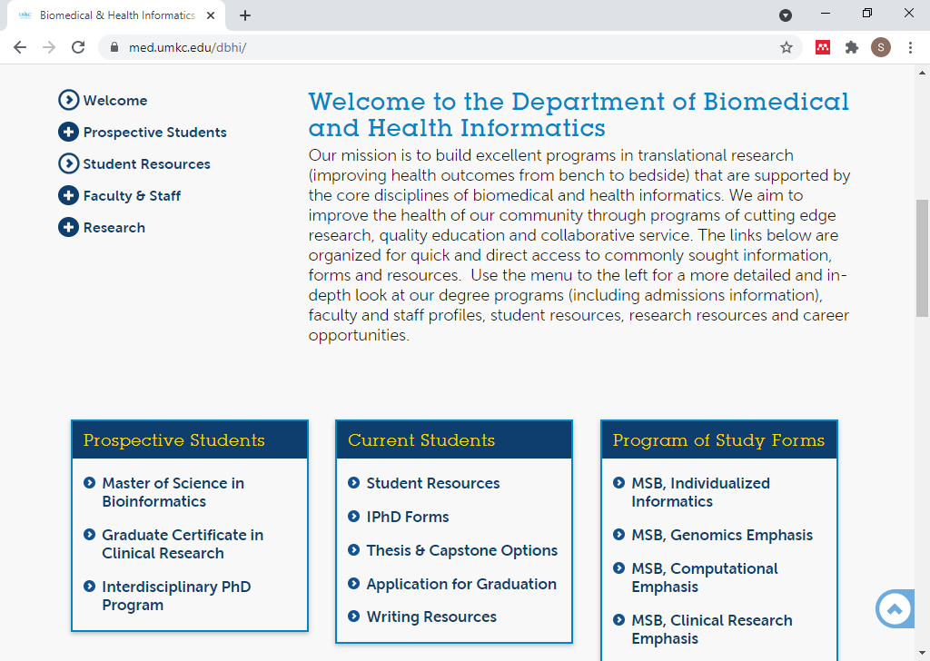
DBHI, http://med.umkc.edu/dbhi/
Notes:
[[Speaker notes]]
I am a part-time faculty member in the Department of Biomedical and Health Informatics.

Slide 7
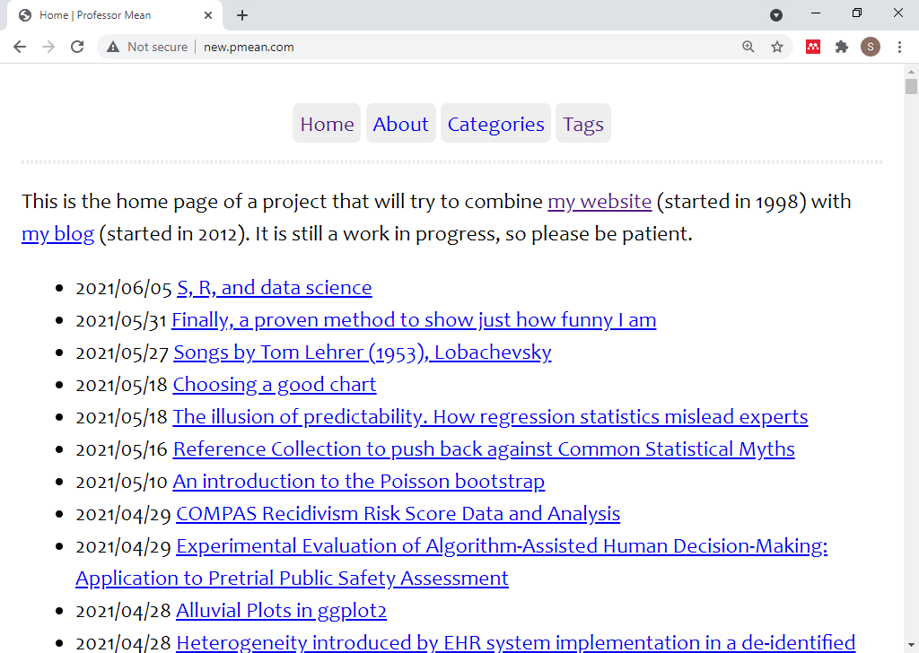
Website, http://new.pmean.com
Notes:
[[Speaker notes]]
I have a blog and a website. I am trying to combine the two into a single site. It’s a work in progress, but here is the url for my effort.

Slide 8
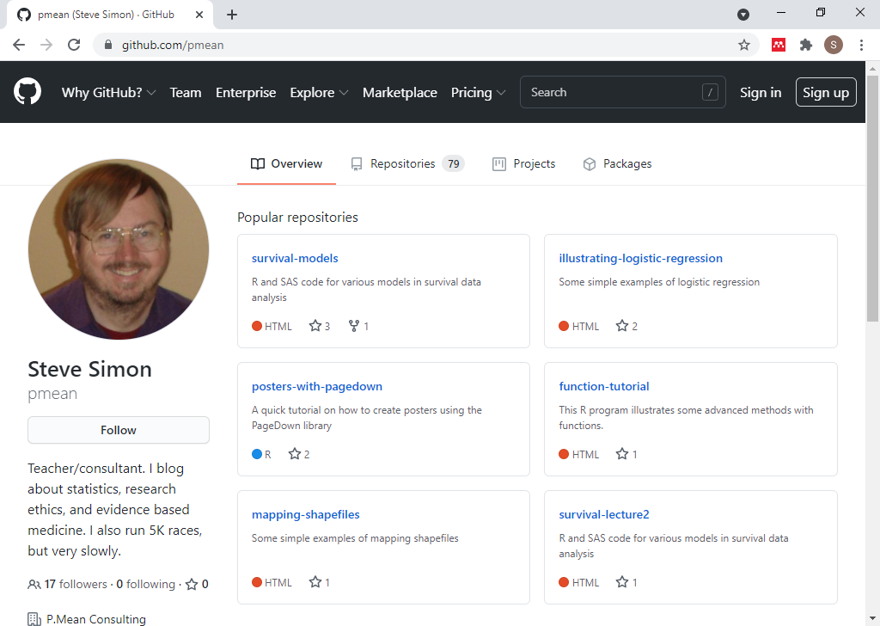
Github, https://github.com/pmean
Notes:
[[Speaker notes]]
I have a github site. It includes some of the programs used in this class. All the material is public domain, but please do not plagiarize your homework from this github site.

Slide 9
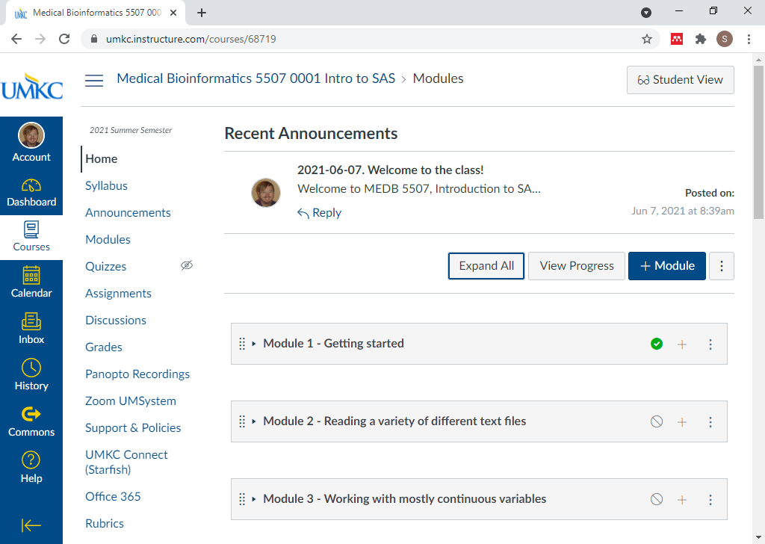
Canvas site
Screenshot of Canvas site
Notes:
[[Speaker notes]]
My course is currently under development in Canvas. This is the instructors view. You will see a slightly different interface.

Slide 10
Break #1
What have you learned
Information about me (Steve Simon)
What’s coming next
Where can you get SAS

Slide 11
Where can you get SAS
SAS OnDemand for Academics (SODA)
On your UMKC computer
Desktop, hard-wired to UMKC network
No laptops, no home computers
UMKC Student labs
Royall Hall 303, Lab #17 and #38
UMKC Remote Labs
Alternatives not covered in this class
SAS University
Jupyter lab
SASMarkdown. StatWeave
Notes:
[[Speaker notes]]
There are several ways that you can get access to SAS software. One of these three options should work for you.
The recommended option is SAS OnDemand for Academics. This version of SAS runs in the cloud. It is restricted to educational uses only.
You can get it running on your UMKC computer, and I will show you how to do this.
You can also access SAS on the UMKC Remote Labs. I’ll also show this.
There are some alternatives which I will not show, but if you are interested in investigating, let me know. I am glad to talk privately with anyone about this.
There is a very nice product that I have used in the past called SAS University. It is very difficult to install, but once you have it running, it is very easy to use.
If anyone is a fan of Jupyter, you should note that Jupyter lab can run SAS code. You probably need to have SAS already running on your computer, and I have not had time to experiment with this.
If you are familiar with the R programming environment, there are a couple of packages, SASMarkdown and StatWeave, that allow you to integrate SAS code and output into your workflow. I have not had time to experiment with this either.

Slide 12
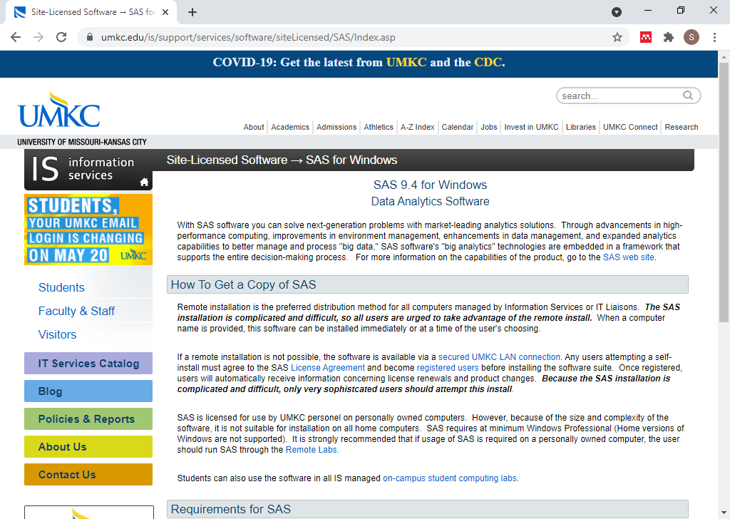
SAS on your UMKC computer
Screenshot of UMKC IS page on SAS software
Notes:
[[Speaker notes]]
This screenshot may be too small for you to read, but you can find the proper link on the recommended readings list for this week on the Canvas website. SAS works for any desktop computer on the UMKC campus. But it has to be hard-wired to the UMKC network. By hard-wired, I mean that there is an ethernet cable connecting your computer to a socket on the wall.
If you are fortunate enough to have access to a hard-wired computer, you can get SAS installed easily. Someone else will do it for you. It may already be sitting on your computer.
With a very few rare exceptions, you cannot get UMKC to load SAS on a laptop computer or on a home computer. This because of the license agreement that UMKC signed with SAS Institute. It does not allow for home use of SAS.

Slide 13
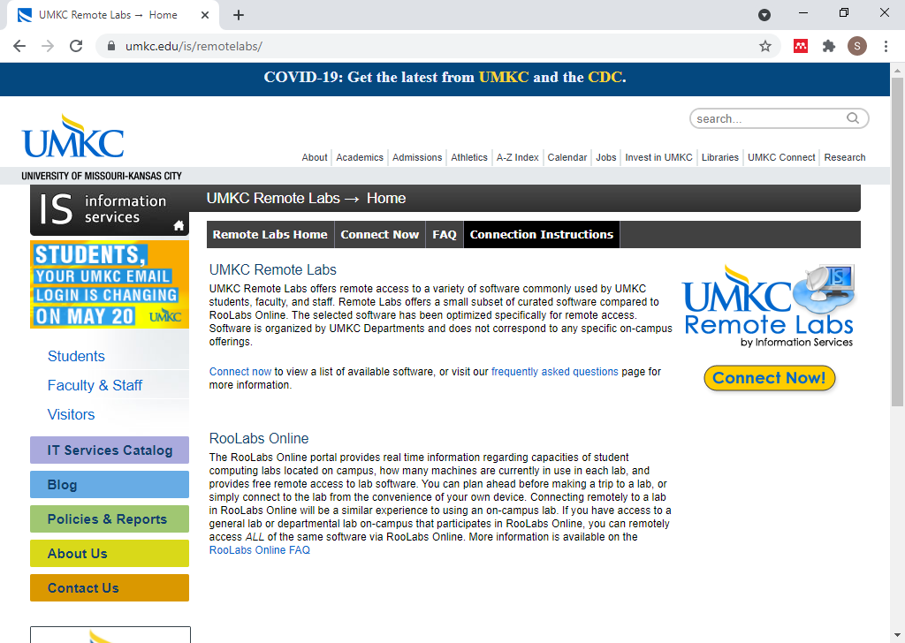
UMKC Remote Labs
UMKC Remote Labs home page
Notes:
[[Speaker notes]]
You can also run SAS through the UMKC Remote Labs. It should run fine on most browsers, though it can be a bit fussy.

Slide 14
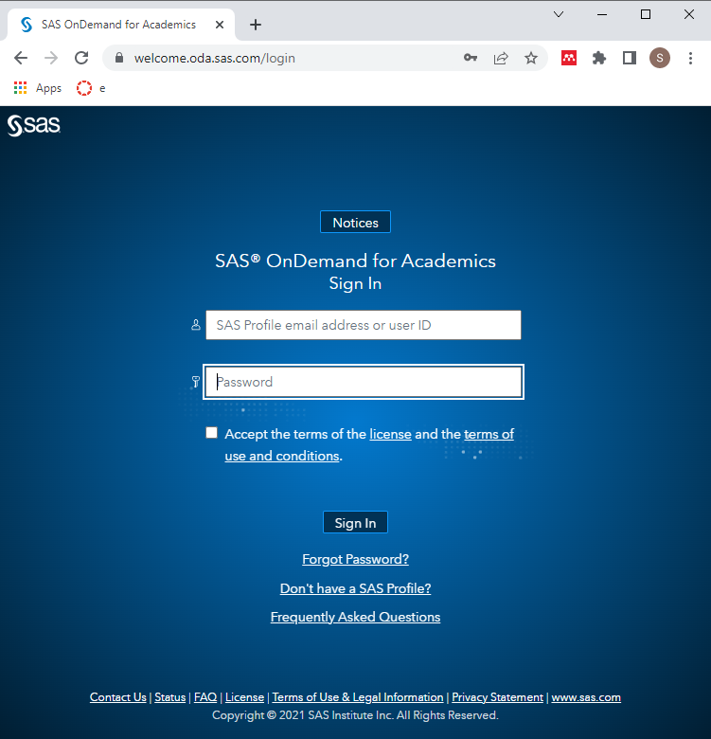
SODA login page
Screenshot of SODA login page
Notes:
[[Speaker notes]]
Here is the login page for SAS OnDemand for Academics. If you have used SAS a lot in the past, you may already have a SAS profile sign-in. More likely, you do not have such an account. You set it up by clicking on the “Don’t have a SAS Profile?” link.

Slide 15
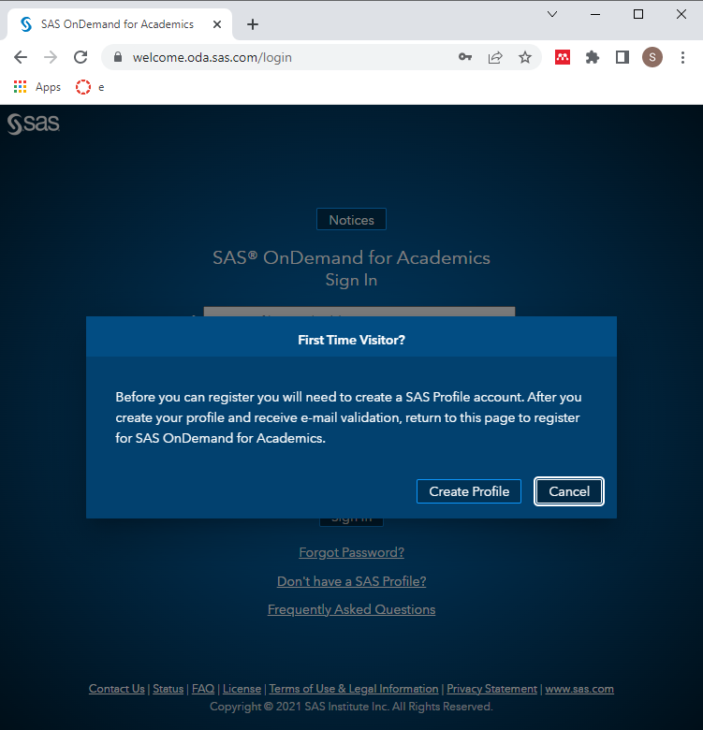
SODA create profile (1 of 2)
Screenshot of First Time Visitor dialog box
Notes:
[[Speaker notes]]
SAS guides you through the process fairly nicely. Read this dialog box. In particular, note that the profile by itself is not enough. You will still have to register for SAS OnDemand for Academics once the profile is created.

Slide 16
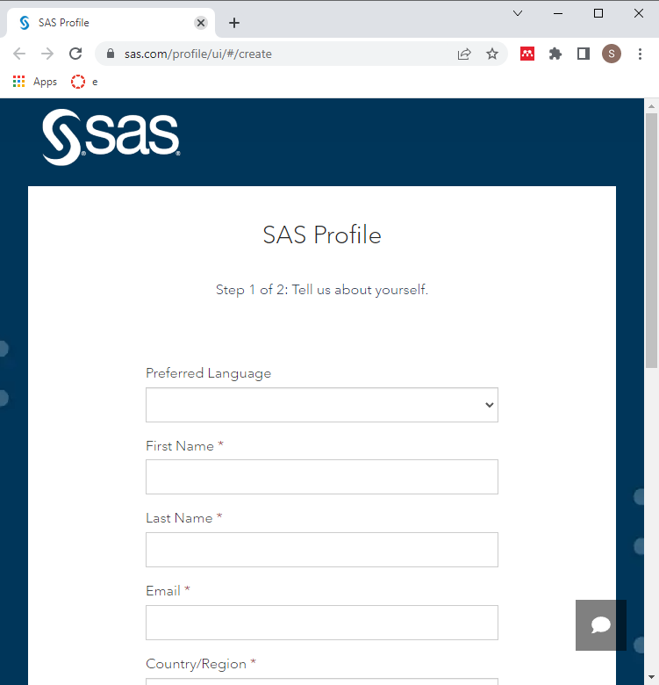
SODA create profile (2 of 2)
Screenshot of First Time Visitor dialog box
Notes:
[[Speaker notes]]
I won’t take you through all of the steps, but SAS is not asking for a lot of information. Note the box at the bottom of the screen (not shown in this screenshot) that asks if you want to get promotional emails from SAS Institute. It’s easy enough to say “Yes” here and then unsubscribe later if you find the emails are not worth the trouble. Or you can say “No” right away if you prefer.

Slide 17
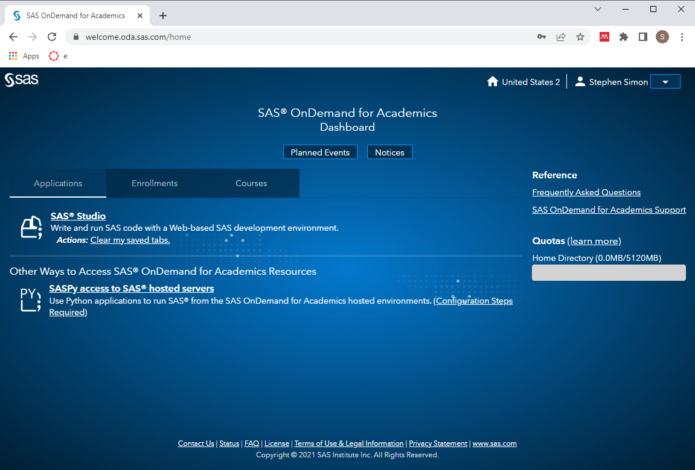
SODA dashboard (1 of 2)
Screenshot of SODA dashboard
Notes:
[[Speaker notes]]
This is the SAS OnDemand Dashboard. It offers two options, SAS Studio and a Python interface to SAS. I have not used the Python interface, but I’m sure it is pretty simple for someone already experienced with Python.
The top of the page has links to Planned Events and Notices. Beneath that are links to Applications, Enrollments, and Courses.
To load SAS Studio, click on the top link.

Slide 18
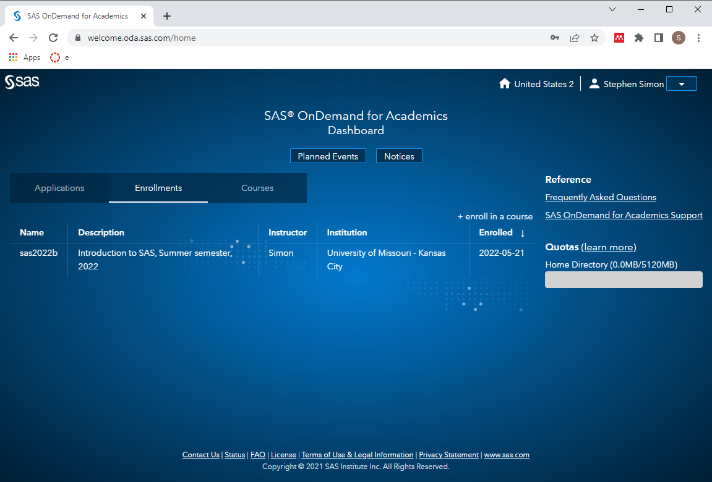
SODA enrollments
Screenshot of SODA enrollments page
Notes:
[[Speaker notes]]
The enrollments page allows you to “enroll” in my class. This isn’t really needed. It adds a folder with all the data files that I use in this class, but you could also get these from my github site.

Slide 19
SODA dashboard (2 of 2)
Screenshot of SODA dashboard
Notes:
[[Speaker notes]]
Go back to the dashboard by clicking on the Applications link. To load SAS Studio, click on SAS Studio link.

Slide 20
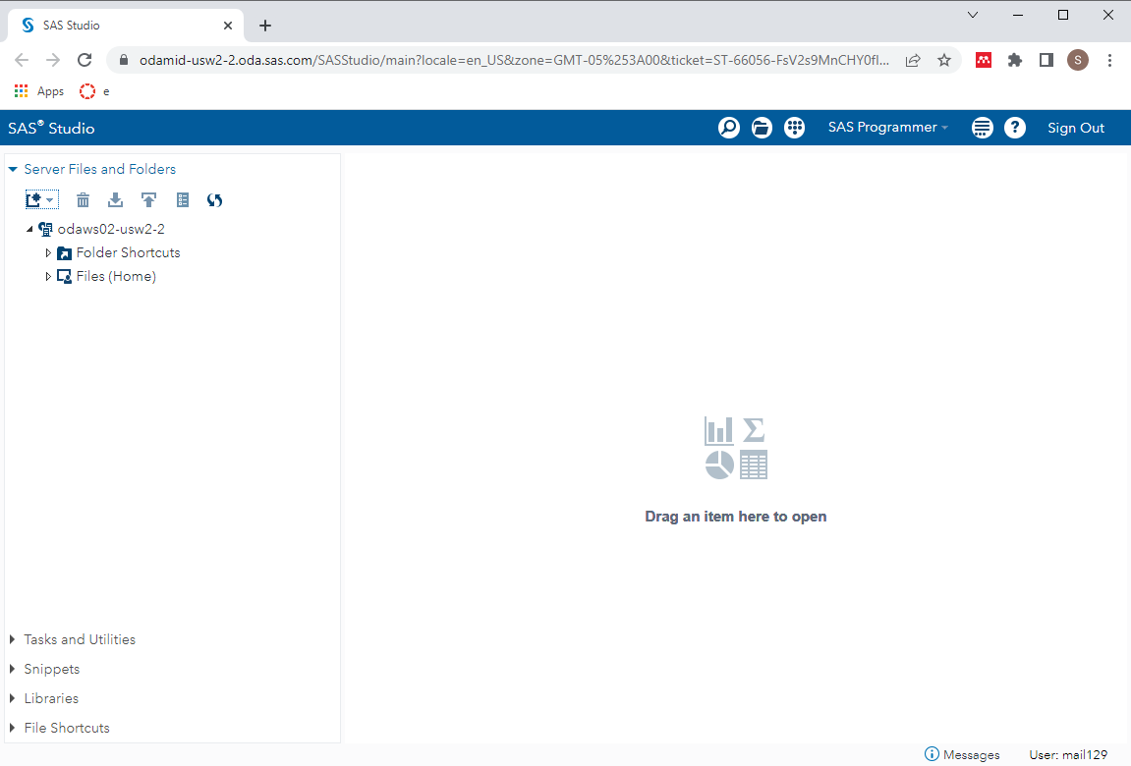
SODA studio (1 of 3)
Screenshot of SODA dashboard
Notes:
[[Speaker notes]]
This is what SAS Studio looks like. The first thing you should do is to create a directory structure.

Slide 21
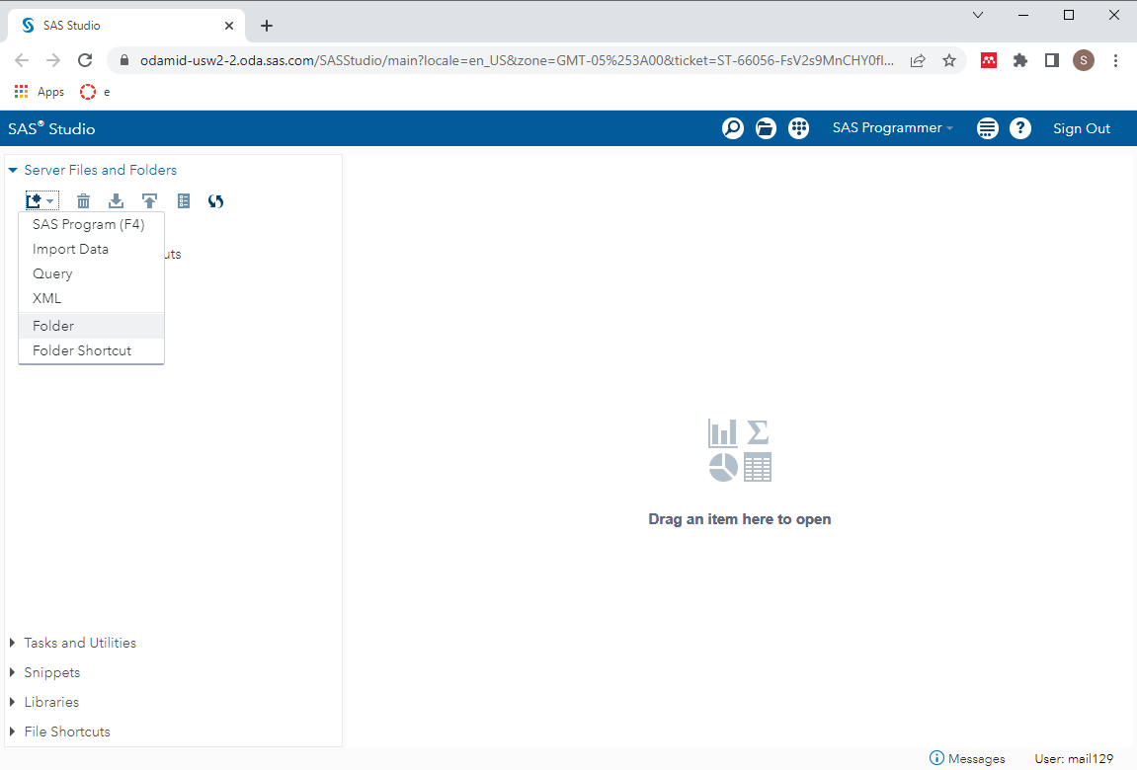
SODA studio (2 of 3)
Screenshot of SODA dashboard
Notes:
[[Speaker notes]]
Click on the leftmost icon beneath “Server Files and Folders”.
Create three directories: data, results, and src.

Slide 22
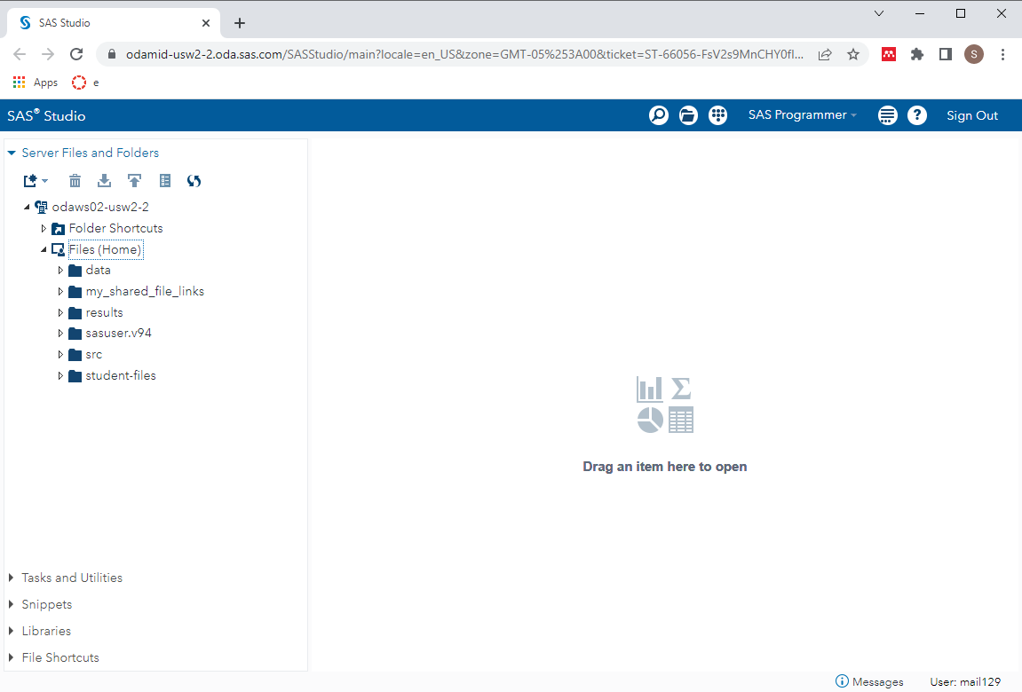
SODA studio (3 of 3)
Screenshot of SODA dashboard
Notes:
[[Speaker notes]]
Create three directories: data, results, and src.
There are some folders already in there from SAS, my_shared_file_links, sasuser.v94, and student-files. Don’t worry about these folders for now.

Slide 23
Directory structure
One directory for the entire class
Possibly one directory for each module
Subdirectory structure
src
results
data
others?
images
doc
Notes:
Make sure you store things consistently. This part of the requirements for this class.
Store all your programs for this class in a single directory. You can call it “sas” or “5507” or anything you like. Some people may prefer to create a separate directory for each module in this class. That’s fine also.
Most importantly, create three subdirectories, src, results, and data. Store your programs in src, your output in results and your raw and intermediate datasets in data. You may wish to create other subdirectories, such an images folder for any graphs you produce, a doc folder for any documentation you collect, but the three important subdirectory folders are src, results, and data.

Slide 24
Break #2
What have you learned
Where you can get SAS
What’s coming next
Your first SAS program

Slide 25
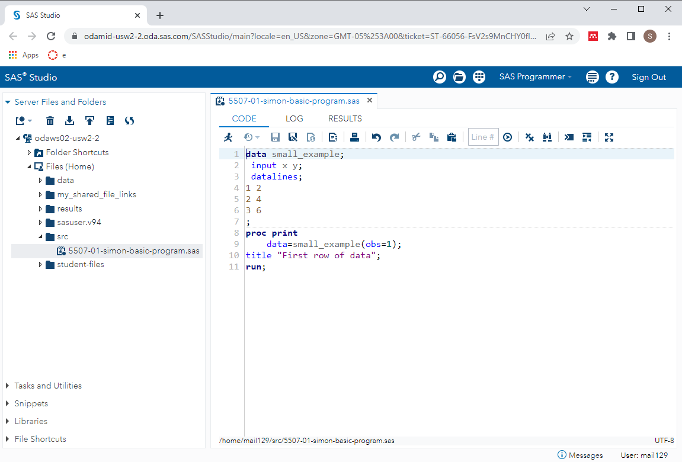
SAS program editor
Program editor window with simple SAS program
Notes:
[[Speaker notes]]
If you have SAS running, try running the following sample program. Here’s a simple test program. After you type this program in, click on FILE | SAVE and store your program somewhere safe. Save it to a location where you can remember things.
If you are using the computer labs, you need to save things on a network folder. You can’t use a USB stick.

Slide 26
SAS Test program (1 of 2)
data small_example; input x y; datalines; 1 2 2 4 3 6 ;
Notes:
[[Speaker notes]]
Here is the program I want you to type in.
I like to put lots of blank lines in.
The data statement creates a dataset with the name “small_example”. Normally you would use a two part name. Not here. This is a simple throw-away example, so it can use a one part name. That means it disappears once the program is done. We’ll explain this further in a later video.
The input statement tells SAS to expect two variables and assigns them the names x and y.
The datalines statement tells SAS to read the data directly below this line. This is NOT a recommended practice. You should normally keep your data separate from your code. I am doing this only for the sake of simplicity. You will see in just a minute how to handle data that comes in a separate file.
The three lines of data follow. A single semicolon tells SAS that this is the end of the data.

Slide 27
SAS Test program (2 of 2)
proc print data=small_example; var x y; title1 "First row of data"; run;
Notes:
[[Speaker notes]]
The print procedure will print part or all of a dataset.
You specify the name of the dataset with the data= option. The options obs=1 tells SAS to print only the first row. I like the obs option a lot.
The title1 statement prints a descriptive title on the first line of output.
The run statement tells SAS that there is no more information associated with this procedure.
The thing I always worry about is leaving out a semicolon. Please watch these closely.
Be careful and back up your programs regularly. There is no autosave feature in SAS.
When you finish the program, save it in the src directory. Then click on the run button. The run button is a guy who looks like he is running.
Try this yourself. It’s a baby step. If it works then you can take more baby steps.

Slide 28
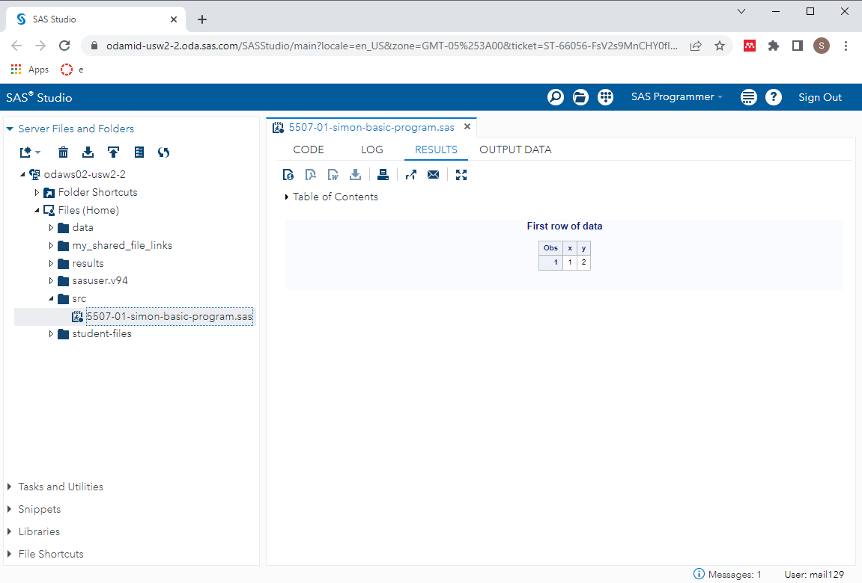
SAS results window (1 of 2)
Screenshot of results window
Notes:
[[Speaker notes]]
When the program runs, your output appears in the results window.

Slide 29
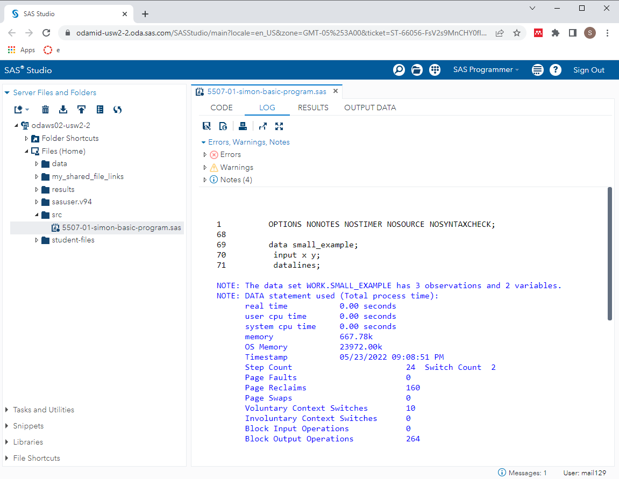
SAS log window (1 of 4)
Screenshot of log window
Notes:
[[Speaker notes]]
The font here is a bit small, but notice that there are no red messages indicating warnings or errors. We’re thrilled when we see no warnings or error messages. We’re always looking for warnings and errors. We also watch closely the number of observations.

Slide 30
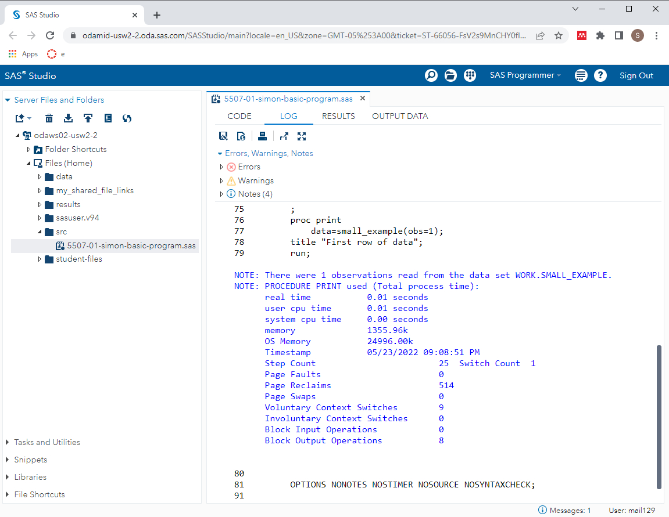
SAS log window (2 of 4)
Screenshot of log window
Notes:
[[Speaker notes]]
Always start looking from the top, and scroll slowly down to the bottom. No warnings or error messages here either.

Slide 31
SAS log window (3 of 4)
1 data test_example; 2 input x y; 3 cards; NOTE: The data set WORK.TEST_EXAMPLE has 3 observations and 2 variables.
Notes:
[[Speaker notes]]
Always watch the log to see that you have read in the proper number of observations.

Slide 32
Log messages (4 of 4)
75 ; 76 proc print 77 data=small_example(obs=1); 78 title "First row of data"; 79 run; NOTE: There were 1 observations read from the data set WORK.SMALL_EXAMPLE.
Notes:
[[Speaker notes]]
..and that you are analyzing the proper number of observations.

Slide 33
Where is the output?
SAS has several options for storing output.
In the output window
As an html file
As a pdf file
Notes:
[[Speaker notes]]
Output is tricky. I want to talk in more detail later about this, but you can take the output and save it several different ways.

Slide 34
Break #3
What have you learned
Your first SAS program
What’s coming next
Live demonstration (1 of 5)

Slide 35
Live demonstration (1 of 5)

Slide 36
Break #4
What have you learned
Live demonstration (1 of 5)
What’s coming next
History of SAS

Slide 37
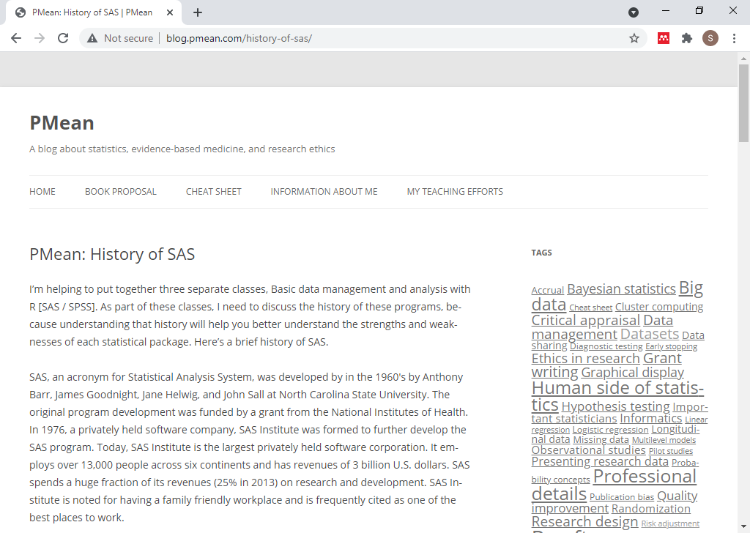
History of SAS
Blog post on the history of SAS
Notes:
[[Speaker notes]]
History of SAS. If you understand where SAS comes from, you understand some of the limitations.
This is on my blog.

Slide 38
History of SAS
SAS=Statistical Analysis System
Founders come from NCSU
Anthony Barr
James Goodnight
Jane Helwig
John Sall
Originally for IBM mainframes
PL/1, FORTRAN, Assembler
Translated to C in 1985
Notes:
[[Speaker notes]]
SAS was developed at NC State.
In the 1960’s, IBM mainframes dominated. So SAS was originally written just for these systems. Originally, SAS was written in a mix of PL/1, Fortran, and Assembler. Millions of lines of code re-written in C in 1985 so that SAS could run on personal computers.
SAS was built in the 1960s. There is very little software written in the 1960s that is still in regular use. It shows the staying power of SAS, but it is “long in the tooth.”

Slide 39
History of SAS
SAS Institute
Founded 1976
Privately held
Huge spending on R&D
Great place to work
Notes:
[[Speaker notes]]
SAS Institute was formed in 1976. It is a privately held company.
SAS spends over a quarter of its budget, which is a huge fraction, on Research and Development.
The SAS Headquarters is in Cary, NC, and it is huge. It is a pretty nice place to work with many family friendly policies even from the 1980s. SAS Institute has been rated in many magazine reviews as one of the top places to work.

Slide 40
History of SAS
SAS licensing model
Great for large organizations
Prohibitively expensive for individuals
Excellent training resources
SAS publications
Certification program
SAS user conferences
Other products
JMP, 1989
Viya, 2017
Notes:
[[Speaker notes]]
SAS has a licensing model that is aggressively priced for large corporations but prohibitively expensive for individual consultants.
SAS is oriented around various data sets and procedures. There is a menu driven version of SAS, but it is not very good. If you want a good package that is totally menu driven, use SPSS.
SAS has a licensing model that is prohibitive for individual consultants. They offer a free product, SAS University, that is intended for teaching.
SAS has literally hundreds of books published through an in-house publisher. It has a certification program that allows you to earn credentials that can help you in your job search. SAS also sponsors some very extravagant user conferences.
SAS Institute has many products beyond SAS. Most notable of these is JMP (pronounced “jump”). This is an acronym for John’s Macintosh Product. it was released in 1989 when the Macintosh series of computers had many graphical user interface features that were not yet available for other personal computers. It pioneered (and continues to lead) in many interactive and dynamic graphic features.
SAS Viya is a cloud based platform with many advanced visualization and machine learning algorithms not found in SAS.

Slide 41
Break #5
What have you learned
History of SAS
What’s coming next
Documentation header

Slide 42
Documentation header
* 5507-01-[put your name here]-documentation-header.sas * author: Steve Simon and [put your name here] * date: created 2021-06-12 * purpose: to read and print a small dataset * license: public domain;
Notes:
Here is a documentation header. It belongs on the top of every SAS program that you run.

Slide 43
Break #6
What have you learned
Documentation header
What’s coming next
Live demonstration (2 of 5)

Slide 44
Live demonstration (2 of 5)

Slide 45
Break #7
What have you learned
Live demonstration (2 of 5)
What’s coming next
Permanent storage

Slide 46
Permanent storage (1 of 4)
* 5507-01-simon-permanent-storage.sas * author: Steve Simon * date: created 2021-05-30 * purpose: to store data set in a permanent location * license: public domain;
Notes:
Let’s look at a modified program that stores the data in a permanent location.
Here is the documentation header. You should include a documentation header with any program you run for this class.

Slide 47
Permanent storage (2 of 4)
libname perm "../data";
Notes:
Notice the top line in this section. This is the libname statement. It tells SAS that you want to establish a permanent storage location at ../data. The ../data tells the computer system to go one level closer to the root directory, and then slide into the data subdirectory.
You assign a brief name (no more than eight characters!) to this location. In my program, I use the name “perm” but anything is fine here.
Then you prefix the dataset name simple_example with the libname location and a dot. This is called a two part name by SAS. The first part gives the permanent location folder and the second part gives the file name.
Once you establish a two-part name for a dataset, you assure that it is stored for later re-use.

Slide 48
Permanent storage (3 of 4)
data perm.simple_example; input x y; datalines; 1 2 2 4 3 6 ;
Notes:
Notice the top line in this section. This is the libname statement. It tells SAS that you want to establish a permanent storage location at ../data. The ../data tells the computer system to go one level closer to the root directory, and then slide into the data subdirectory.
You assign a brief name (no more than eight characters!) to this location. In my program, I use the name “perm” but anything is fine here.
Then you prefix the dataset name simple_example with the libname location and a dot. This is called a two part name by SAS. The first part gives the permanent location folder and the second part gives the file name.
Once you establish a two-part name for a dataset, you assure that it is stored for later re-use.

Slide 49
Permanent storage (4 of 4)
proc print data=perm.simple_example(obs=1); title1 "First row"; run;
Notes:
Once you establish a two-part name, use it everywhere.

Slide 50
Re-using data in permanent storage, part 1
* 5507-01-simon-re-use.sas * author: Steve Simon * date: created 2021-05-30 * purpose: to re-use stored data * license: public domain;
Notes:
Here’s a program that re-uses the dataset you just placed in permanent storage.
First, let’s show the documentation header.

Slide 51
Re-using data in permanent storage, part 2
libname perm "../data"; proc means data=perm.simple_example; title1 "Descriptive statistics"; run;
Notes:
Notice that there is no data step in this program, you start with a libname statement that reminds SAS where you stored the permanent dataset. Then you just refer to the two-part name in the data= option of any SAS procedure. Here we are computing some simple descriptive statistics using proc means.

Slide 52
Break #8
What have you learned
Permanent storage
What’s coming next
Live demonstration (3 of 5)

Slide 53
Live demonstration (3 of 5)

Slide 54
Break #9
What have you learned
Live demonstration (3 of 5)
What’s coming next
Saving output as pdf

Slide 55
Saving output as pdf (1 of 4)
* 5507-01-simon-save-output.sas * author: Steve Simon and Steve Simon * date: created 2021-06-12 * purpose: to create a permanent dataset * license: public domain;
Notes:
Let’s look at a modified program that stores your output as a pdf file.
Here is the documentation header.

Slide 56
Saving output as pdf (2 of 4)
libname perm "../data"; ods pdf file= "../results/5507-01-simon-save-output.pdf";
Notes:
The ods statement should be placed near the top of the code, certainly before any SAS procedure that produces output.

Slide 57
Saving output as pdf (3 of 4)
data perm.small_example; input x y; datalines; 1 2 2 4 3 6 ;
Notes:
The ods statement should be placed near the top of the code, certainly before any SAS procedure that produces output.

Slide 58
Saving output as pdf (4 of 4)
proc print data=perm.small_example(obs=1); title1 "First row of data"; run; ods pdf close;
Notes:
Near the bottom, you turn off the output. Place this AFTER the last SAS procedure that produces output.

Slide 59
Break #10
What have you learned
Saving output as pdf
What’s coming next
Live demonstration (4 of 5)

Slide 60
Live demonstration (4 of 5)

Slide 61
Break #11
What have you learned
Live demonstration (4 of 5)
What’s coming next
Getting data from a file

Slide 62
Reading data from a file (1 of 4)
* 5507-01-simon-read-data.sas * author: Steve Simon and Steve Simon * date: created 2021-06-12 * purpose: to read data from a separate file * license: public domain;
Notes:
It is a very basic principle of good computing practices that you keep your data and your program in separate files. This code shows you how to do this using the infile statement.

Slide 63
Reading data from a file (2 of 4)
libname perm "&path/data"; filename rawdata "&path/data/six-numbers.txt"; ods pdf file= "&path/results/5507-01-simon-read-data.pdf";
Notes:
The filename statement tells SAS where a particular dataset is stored: both the path and the name of the file. It associates that path and filename with a variable that you refer to using the infile statement.

Slide 64
Reading data from a file (3 of 4)
data perm.small_example; infile rawdata; input x y; run;
Notes:
The filename statement tells SAS where a particular dataset is stored: both the path and the name of the file. It associates that path and filename with a variable that you refer to using the infile statement.

Slide 65
Reading data from a file (4 of 4)
proc print data=perm.small_example(obs=1); title1 "First row of data"; run; ods pdf close;
Notes:
The last part of the program remains unchanged.

Slide 66
Reading data from a file, part 4
1 2 2 4 3 6
Notes:
This is what your data file looks like. It is just six numbers arranged in a grid.
You will see many variations on the layout of data, and SAS can handle just about any variation. You will see how to handle many of those variations in an upcoming module.

Slide 67
Break #12
What have you learned
Getting data from a file
What’s coming next
Live demonstration (5 of 5)

Slide 68
Live demonstration (5 of 5)

Slide 69
Summary
What have you learned?
Introducing your instructor
Where you can get SAS
Your first SAS program
History of SAS
Directory structure and documentation header
Permanent storage
Saving your output
Getting data from a file

