Slide 1
Introduction to SAS, Working with a mix of categorical and continuous variables
Steve Simon

Slide 2
Overview
Notes:
author: Steve Simon date: created 2021-05-30 purpose: to produce slides for module05 videos license: public domain
Here is an overview of what I want to cover in this module.

Slide 3
SAS code: Documentation header
m05-working-with-a-mix-of-variables.sas author: Steve Simon date created: 2018-11-27 purpose: to illustrate how to work with data that has a mix of categorical and continuous variables. license: public domain;
Notes:
Notes00 This is the standard documentation header.

Slide 4
SAS code: Tell SAS where to find and store things.;
options papersize=(6in 4in); * This needed to have the output fit on PowerPoint; %let path=q:/introduction-to-sas; ods pdf file="&path/results/m04-5507-simon-categorical.pdf"; filename raw_data "&path/data/fev.txt"; libname perm "&path/data";
Notes:
Notes01. You should already be familiar with this. The filename statement tells you where the raw data is stored. The libname statement tells you where SAS will store any permanent datsets. The ods statement tells you that SAS is going to store the results with a particular filename and in pdf format.
Today, you will analyze some data sets that have a mix of categorical and continuous variables. The first data set looks at pulmonary function in a group of children.
You can find a description of this data set at
http://jse.amstat.org/datasets/fev.txt

Slide 5
SAS code: Label your categorical variables;
proc format; value fsex 0 = "Female" 1 = "Male" ; value fsmoke 0 = "Nonsmoker" 1 = "Smoker" ; run;
Notes:
Notes02. There are several categorical variables in this data set with number codes, so you should define labels for those codes.

Slide 6
SAS code: Reading the data using a data step;
data perm.fev; infile raw_data delimiter="," firstobs=2; input age fev ht sex smoke; label age=Age in years fev=Forced Expiratory Volume (liters) ht=Height in inches sex=Sex smoke=Smoking status ; run;
Notes:
Notes03. The data file is comma delimited and the first row includes variable names.
Normally, this means that you can save a bit of time by using proc import, but I chose to read in the data using a data step. The number of variables was so small that this didn’t matter that much. It also allowed me to define variable labels in the initial data step rather than later.

Slide 7
SAS code: Print the first ten rows of data;
proc print data=perm.fev(obs=10); format sex fsex. smoke fsmoke. ; title1 "Pulmonary function study"; title2 "Partial listing of fev data"; run;
Notes:
Notes04. It’s always a good idea to peek at the first few rows of data.

Slide 8
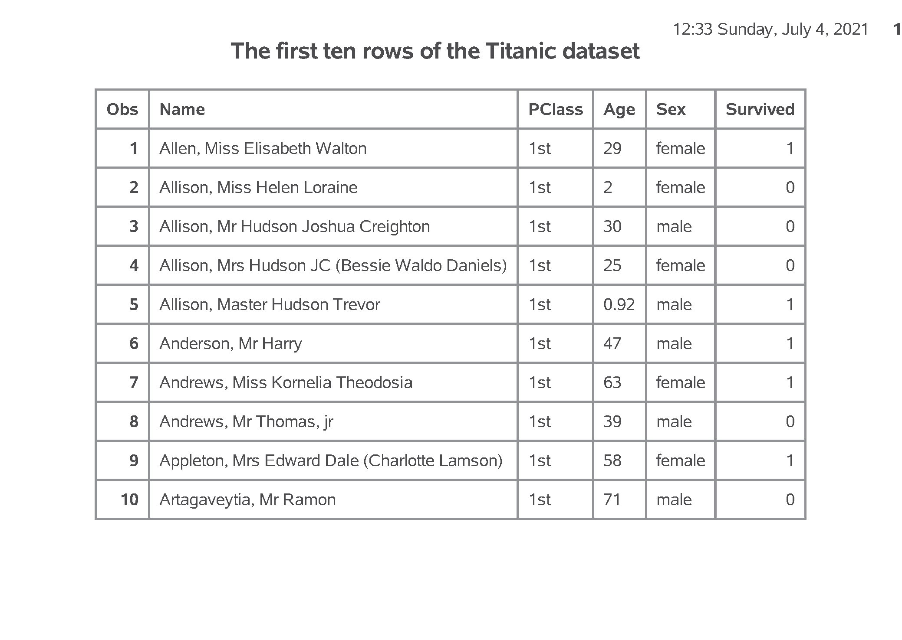
SAS output: Print the first ten rows of data;
SAS Output
Notes:
Output, page 1. There is no obvious problems with this dataset.

Slide 9
SAS code: Proc freq and proc means;
proc freq data=perm.fev; tables sex smoke / missing; format sex fsex. smoke fsmoke. ; title2 "Frequency counts"; run; proc means n nmiss mean std min max data=perm.fev; var age fev ht; title2 "Descriptive statistics"; run;
Notes:
Notes05. There is a mix of categorical and continuous variables in this data set. Recall that you use proc freq for categorical variables and proc means for continuous variables. Always get in the habit of checking for missing values.

Slide 10
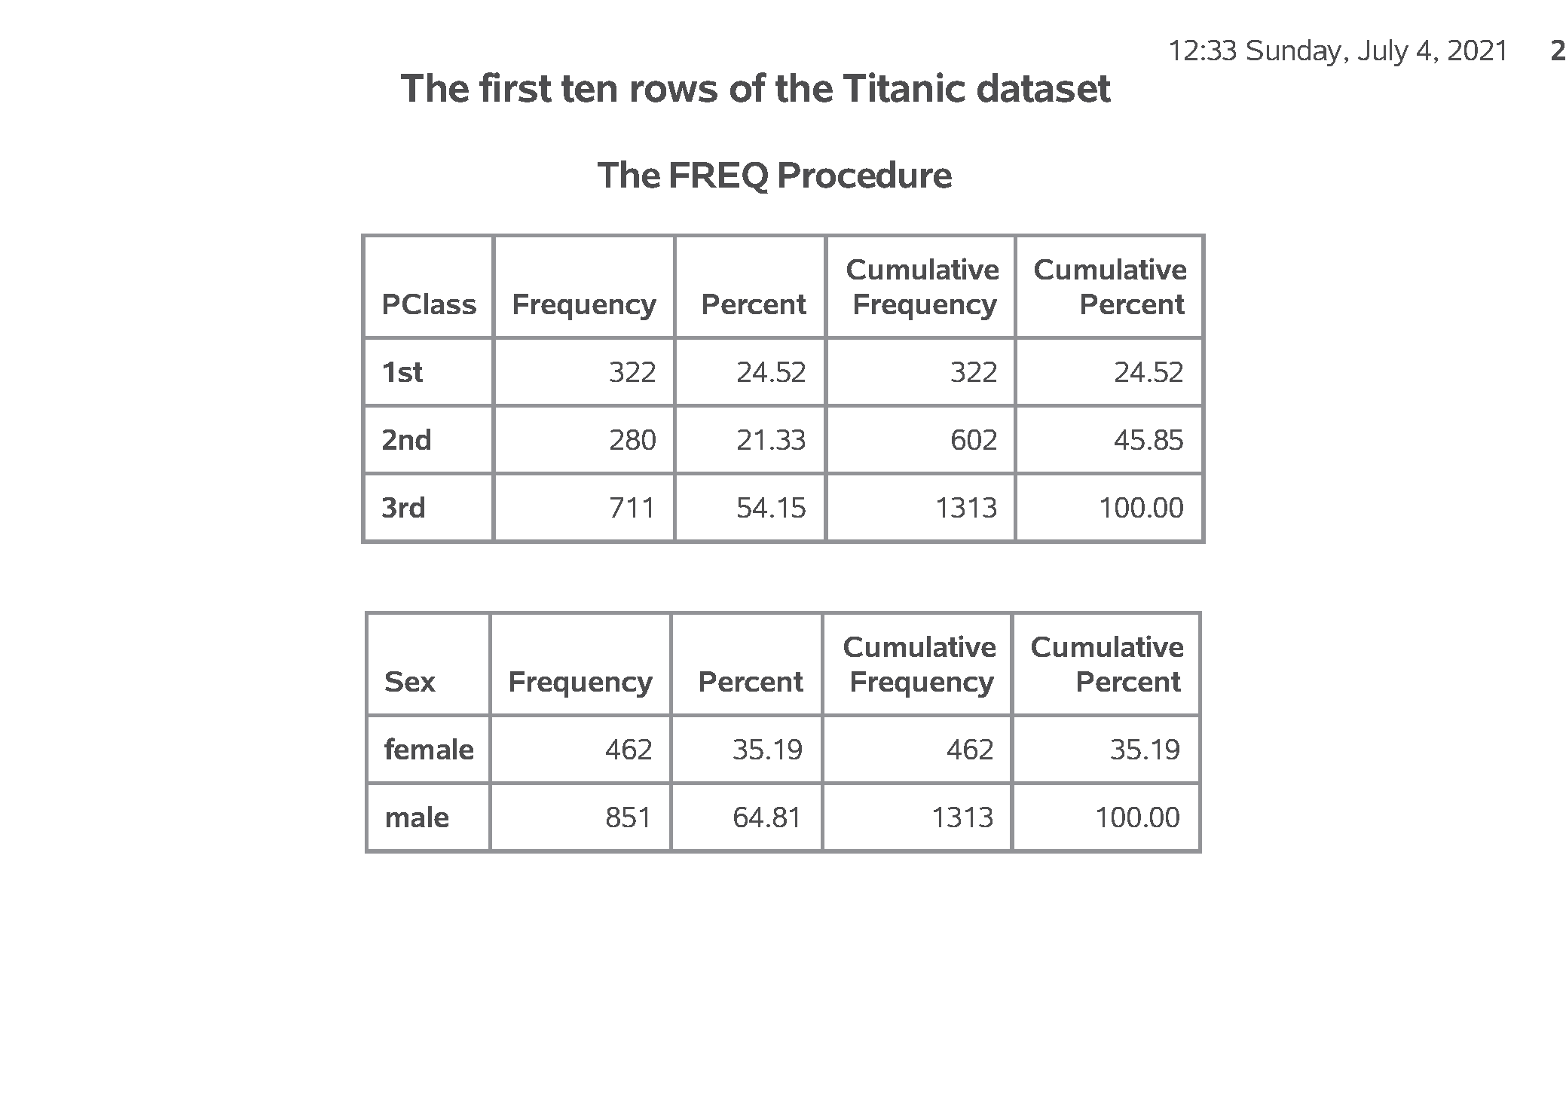
SAS output: Proc freq and proc means; (1/2)
SAS Output
Notes:
Output, page 2. Look for problems. This could mean a lot more categories than you expected, a particular category level that is unexpectedly small, or multiple categories caused by misspelling or inconsistent capitalization. There are no problems here.

Slide 11
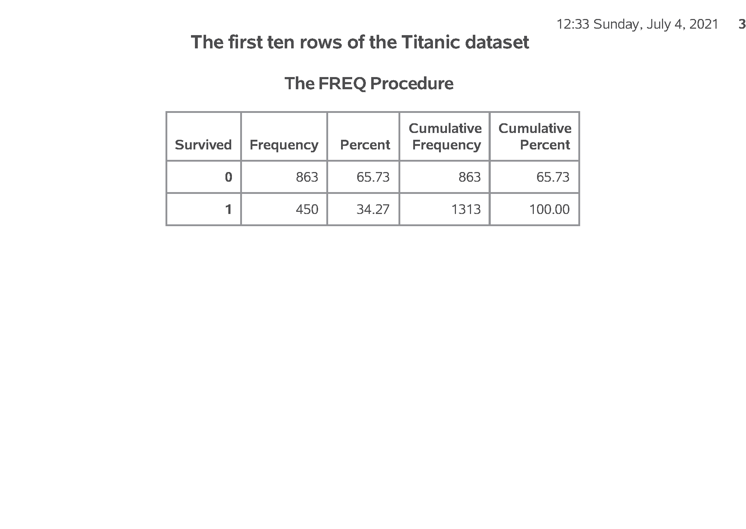
SAS output: Proc freq and proc means; (2/2)
SAS Output
Notes:
Output, page 2. Look for problems. This could mean a lot more categories than you expected, a particular category level that is unexpectedly small, or multiple categories caused by misspelling or inconsistent capitalization. There are no problems here.

Slide 12
SAS code: Pearson correlation, proc corr;
title2 "Correlations"; proc corr nosimple noprob data=perm.fev; var age fev ht; run;
Notes:
Notes06. The Pearson correlation coefficient gives you a numeric measure of the strength of association between two continuous variables.

Slide 13
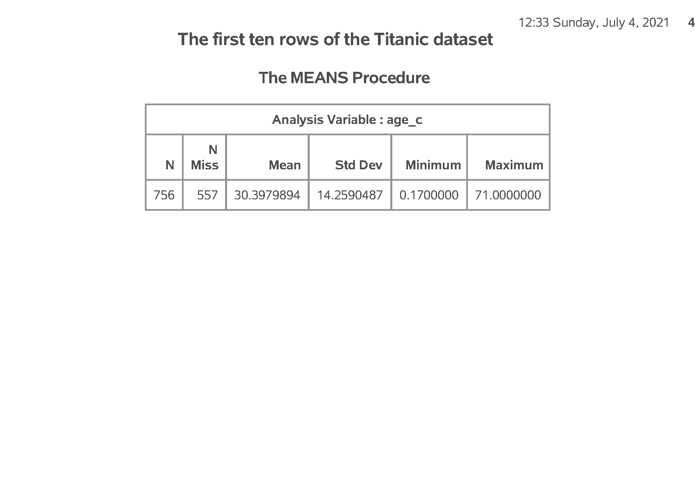
SAS output: Pearson correlation, proc corr;
SAS Output
Notes:
Output, page 4. Remember the cut-offs. A correlation between +0.7 and 1.0 implies a strong positive association. A correlation between +0.3 and +0.7 implies a weak positive association. A correlation between -0.3 and +0.3 implies little or no association. A correlation between -0.3 and -0.7 implies a weak negative association. A correlation between -0.7 and -1.0 implies a strong negative association.

Slide 14
SAS code: Scatterplot, proc sgplot
title2 "Scatterplots"; proc sgplot data=perm.fev; scatter x=ht y=fev; run;
Notes:
Notes07. You should also examine the association between continuous variables using a scatterplot.

Slide 15
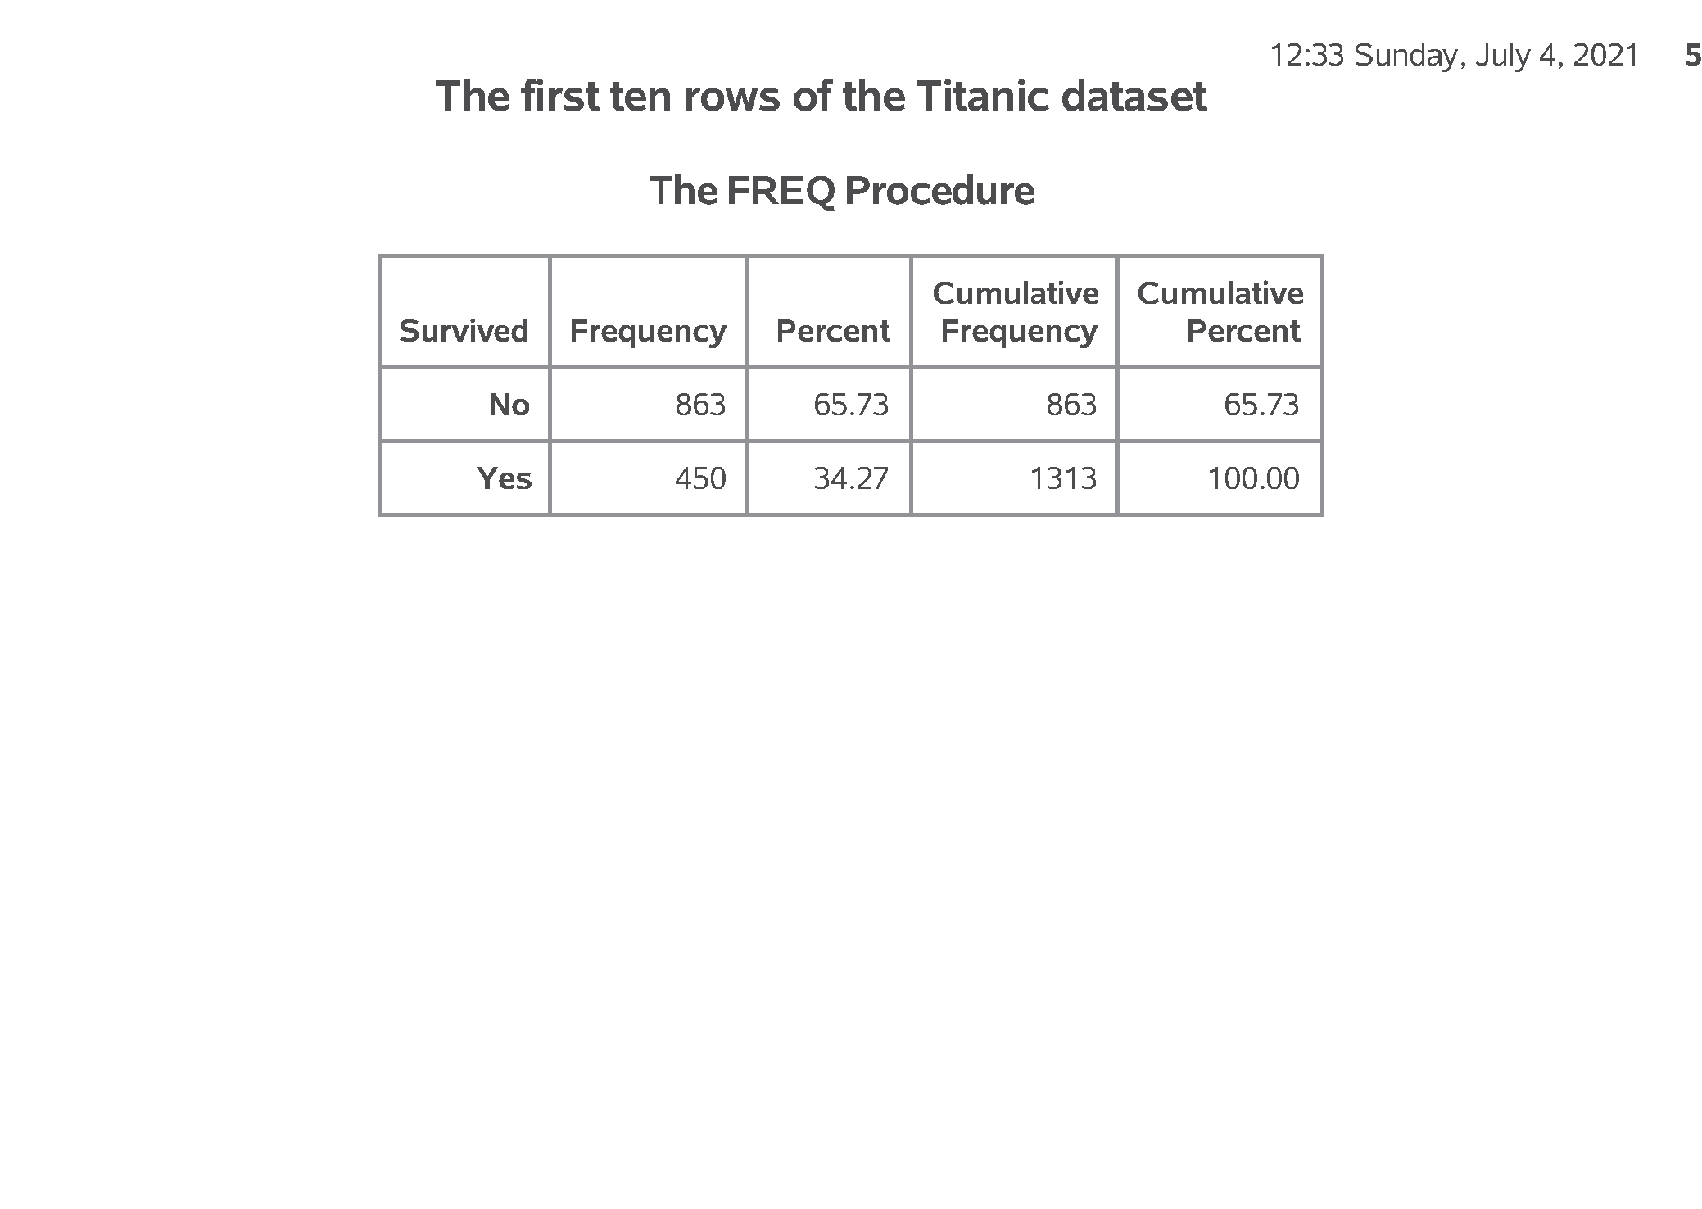
SAS output: Scatterplot, proc sgplot
SAS Output
Notes:
Output, page 5. I am only showing the plot of ht versus fev, but you should also examine the plot of age versus fev.

Slide 16
SAS code: Scatterplot, smoothing curve
title3 "with loess, smooth=0.1"; proc sgplot data=perm.fev; scatter x=ht y=fev; loess x=ht y=fev / nomarkers smooth=0.1 lineattrs=(color=Red); run;
Notes:
Notes08. Sometimes a trend line can help. You should consider a smoothing method like loess or pbspline, as this will help you visualize any potential nonlinear relationships.
Output, page 6. The relationship looks reasonably close to linear.

Slide 17
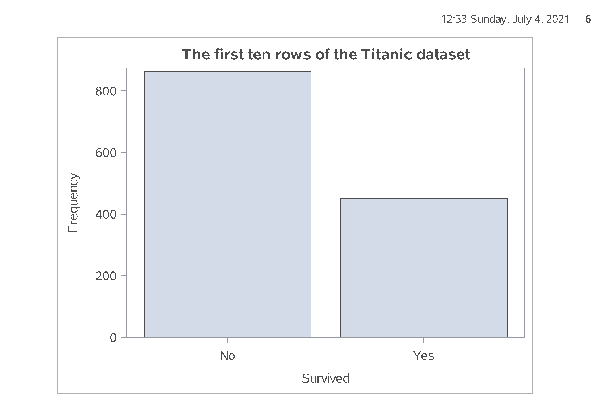
SAS output: Scatterplot, smoothing curve
SAS Output
Notes:
Notes08. Sometimes a trend line can help. You should consider a smoothing method like loess or pbspline, as this will help you visualize any potential nonlinear relationships.
Output, page 6. The relationship looks reasonably close to linear.

Slide 18
SAS code: Boxplot, proc sgplot
title2 "Boxplots"; proc sgplot data=perm.fev; vbox fev / category=smoke; format smoke fsmoke.; run;
Notes:
Notes09. When you want to look at a relationship between a categorical variable and a continuous variable, you should use a boxplot. Notice that you use proc sgplot for both a scatterplot and a boxplot. This is a big improvement over previous methods in SAS to produce plots because it is easier to learn one procedure and minor variations in that procedure rather than having to learn multiple procedures.

Slide 19
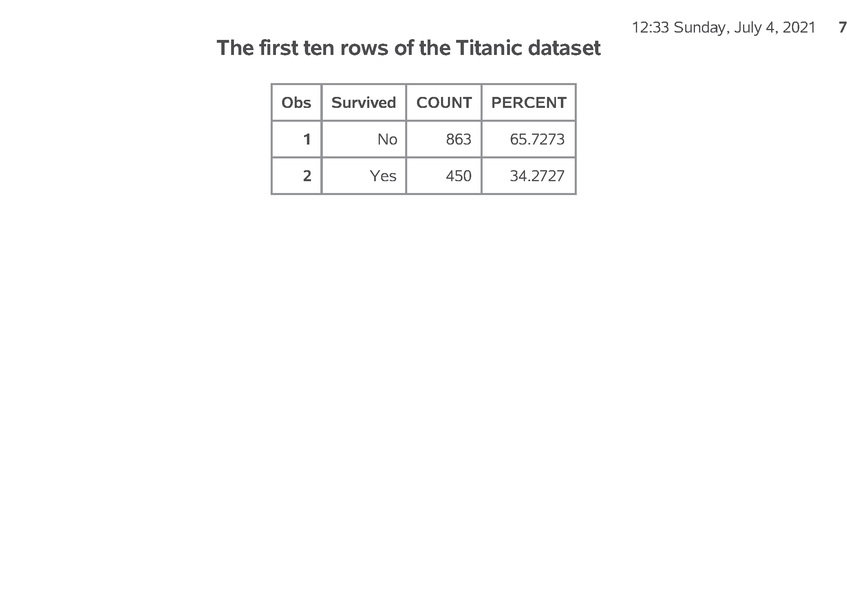
SAS output: Boxplot, proc sgplot (1/2)
SAS Output
Notes:
Output, page 7. The bottom and top of the boxplot represents the 25th and 75th percentiles, respectively. A thin line, or whisker, is drawn down to the minimum value and up to the maximum value. Extreme values are shown as individual data points. Notice the discrepancy in fev. Smokers seem to have a much higher FEV than non-smokers. This is quite surprising.

Slide 20
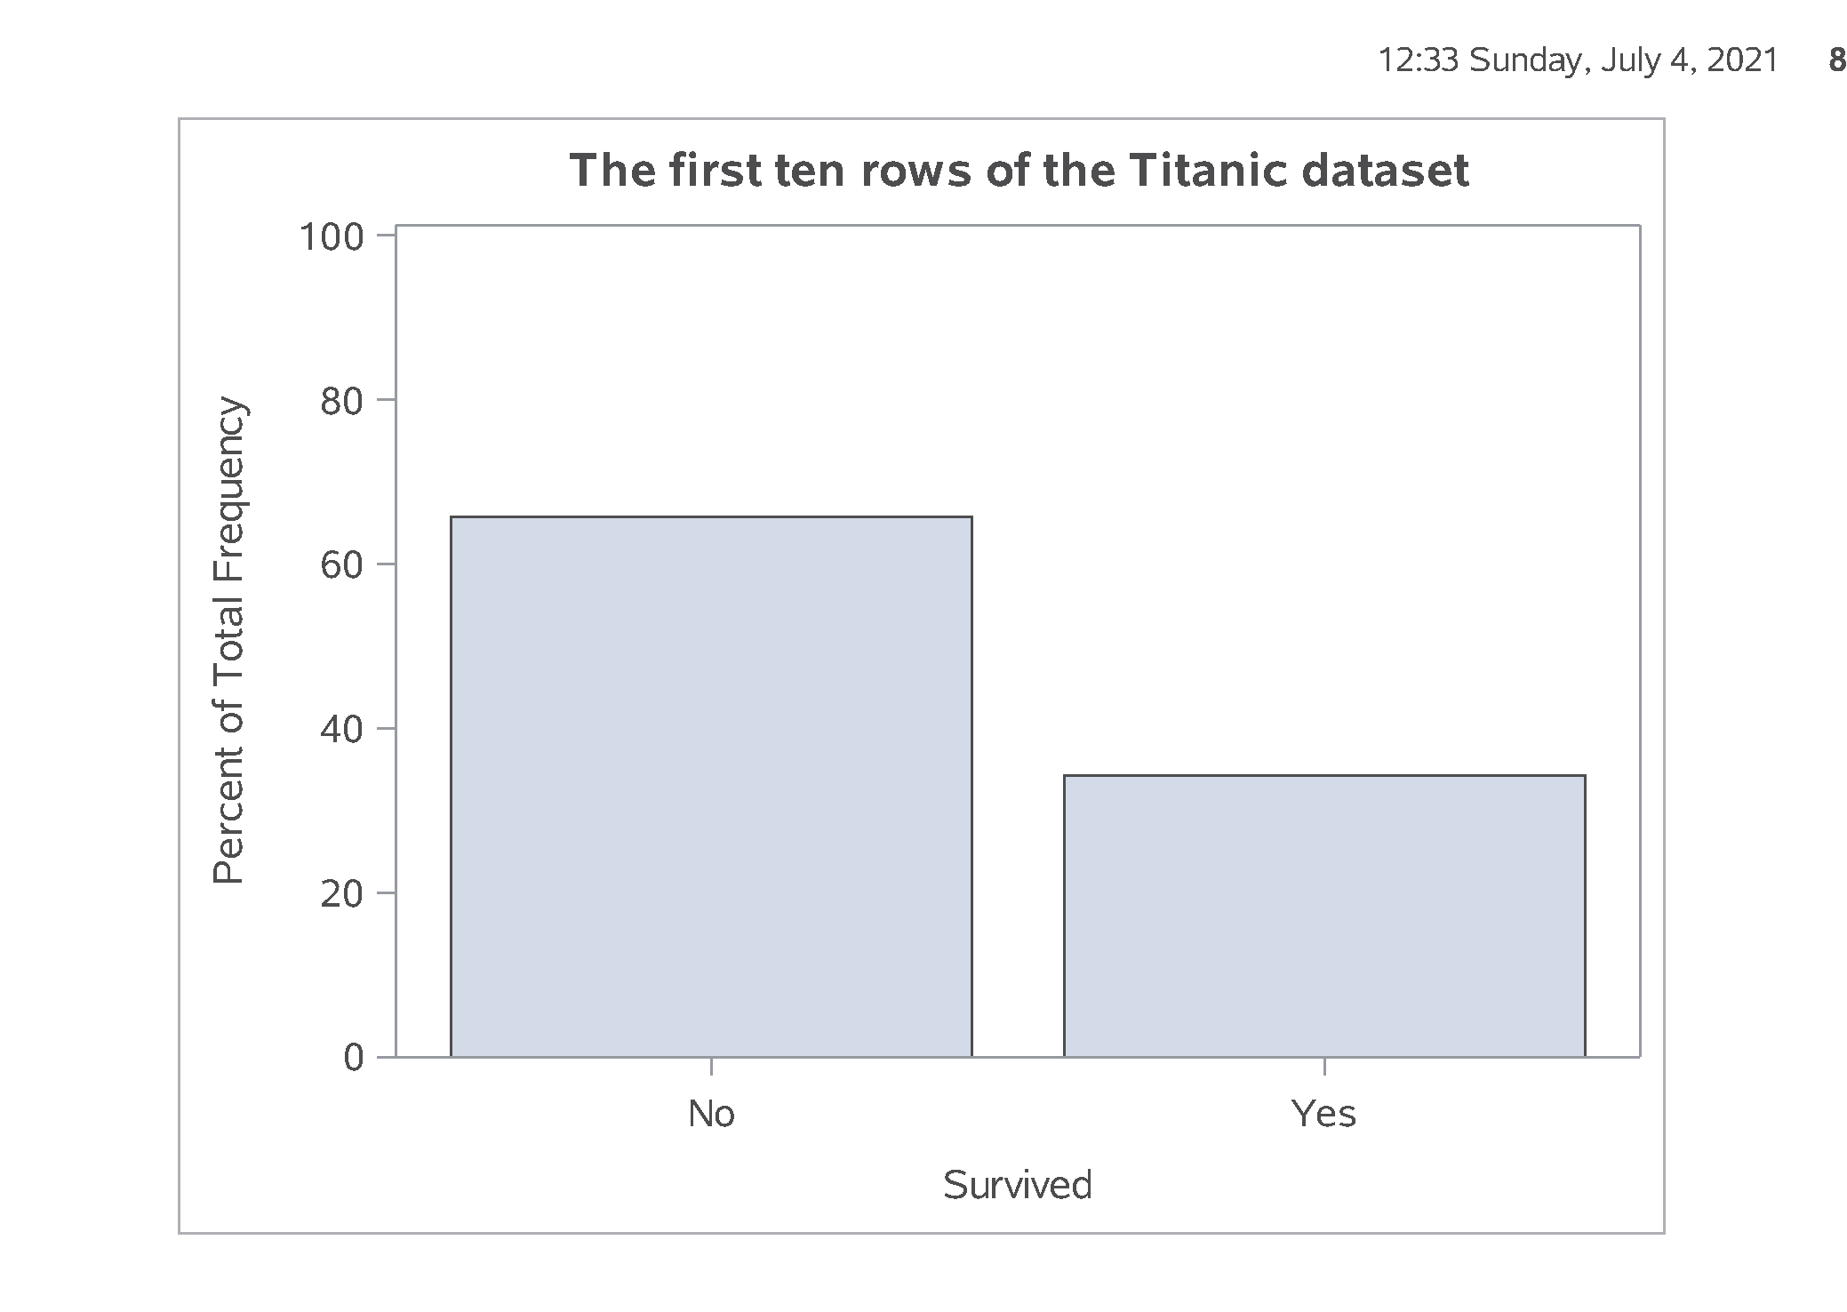
SAS output: Boxplot, proc sgplot (2/2)
SAS Output
Notes:
Output, page 7. The bottom and top of the boxplot represents the 25th and 75th percentiles, respectively. A thin line, or whisker, is drawn down to the minimum value and up to the maximum value. Extreme values are shown as individual data points. Notice the discrepancy in fev. Smokers seem to have a much higher FEV than non-smokers. This is quite surprising.

Slide 21
SAS code: Descriptive statistics, by statement;
proc sort data=perm.fev; by smoke; run; proc means data=perm.fev; var fev; by smoke; format smoke fsmoke.; title2 "Descriptive statistics by group"; run;
Notes:
Notes10. Also look at how the means and standard deviations of your continuous variable change for each level of your categorical variable.
Output, page 8. Notice again the discrepancy in fev by smoking status. This is quite surprising.

Slide 22
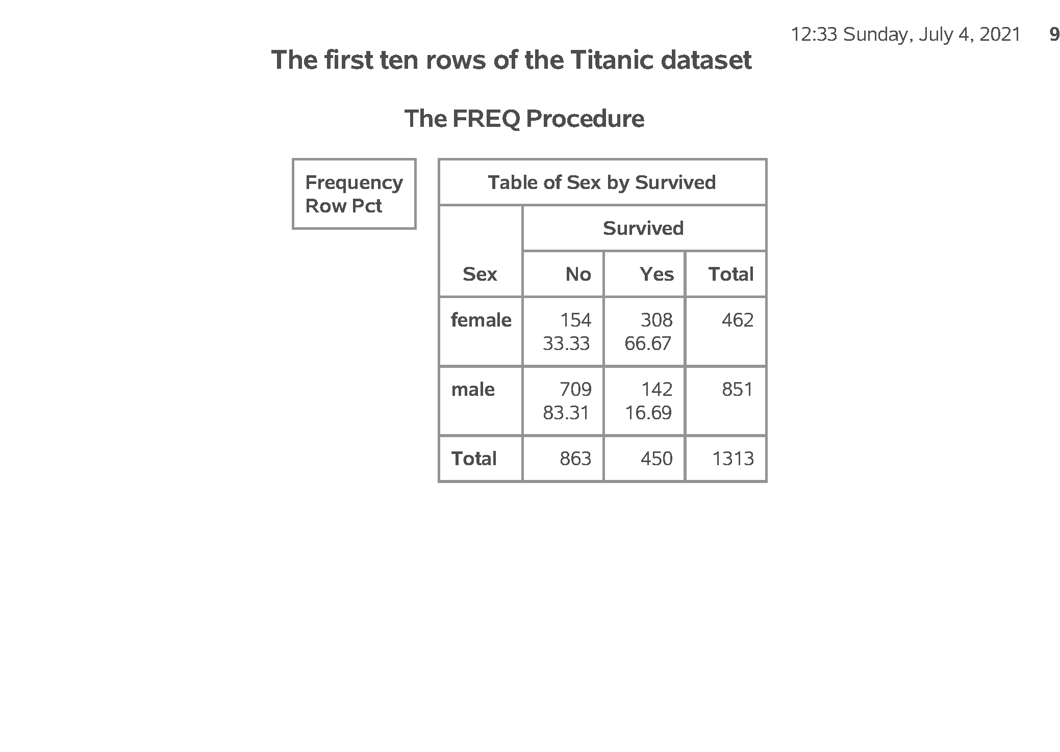
SAS output: Descriptive statistics, by statement; (1/2)
SAS Output
Notes:
Output, page 8. Notice again the discrepancy in fev by smoking status. This is quite surprising.

Slide 23
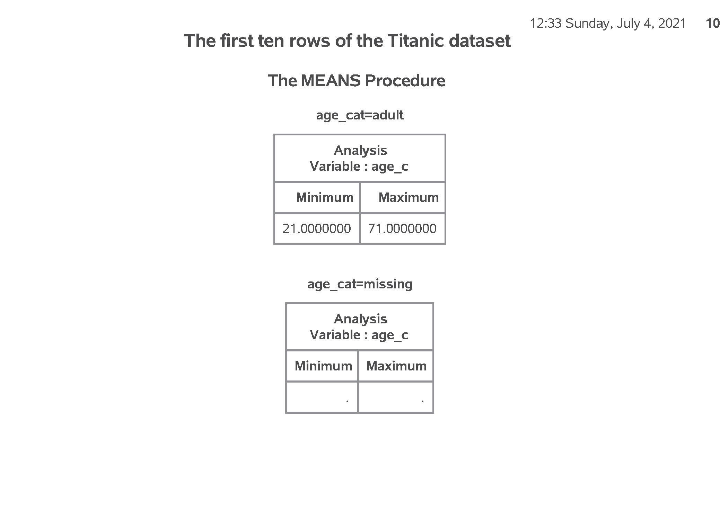
SAS output: Descriptive statistics, by statement; (2/2)
SAS Output
Notes:
Output, page 8. Notice again the discrepancy in fev by smoking status. This is quite surprising.

