Slide 1
Introduction to SAS, Working with continuous variables
Steve Simon

Slide 2
Overview
Notes:
author: Steve Simon date: created 2021-05-30 purpose: to produce slides for module01 videos license: public domain
Here is an overview of what I want to cover in module02.

Slide 3
Review definitions
Categorical
Small number of possible values
Each value associated with a category
Continuous
Large number of possible values
Potentially any value in an interval
Notes:
Before we start, let’s review a couple of definitions.
A categorical variable is a variable that can only take on a small number of values. Each value is usually associated with a particular category.
Examples of categorical variables are
sex (Male or Female),
race (White, Black, Native American, etc.),
cancer stage (I, II, III, or IV),
birth delivery type (Vaginal, C-section).
A continuous variable is a variable that can take on a large number of possible values, potentially any value in some interval.
Examples of continuous variables are
Birth weight in grams,
gestational age,
fasting LDL level.
There are some variables that are on the boundary between categorical and continuous, but it is not worth quibbling about here.
The point to remember is that the types of graphs that you use and the types of statistics that you compute are dependent on many things, but first and foremost on whether the variables are categorical, continuous, or a mixture.
Today, you will see examples involving mostly continuous variables.

Slide 4
Semicolons are important
Ends every SAS statement
Easy to forget
Use this to your advantage
Several short lines
Indent continuations
Notes:
Before I go too far, let me mention and important thing. Every SAS statement ends in a semicolon. This is important. You will forget a semicolon and it will lead to a cryptic error message. So here’s a quick hint. If you get an error message on a certain line of code, look to see if you forgot a semicolon on the previous line. It happens to me all the time and I’ve been using SAS for decades.

Slide 5
Example of stretching statement across multiple lines.
One long line
statement option1 option2 option3 option4;
versus several short lines.
statement option1 option2 option3 option4;
Notes:
The use of semicolons is nice, in a way, because it allows you to stretch a complicated SAS statement across two or more rows of your program. This can often make your program more readable. It is hard to read a long line of code. Your eye has to scan left to right and you can sometimes lose track of which line you are on. Most newpapers place their articles in narrow columns because it makes them easier to read.
There is no official rule of thumb on this, but I do try to keep my lines below 50 characters. I also try to indent substatements with a data step or procedure. I use blank lines between data steps and procedures.
Don’t obsess about this now, but you’ll see a fairly consistent coding style that I use for my SAS code. You don’t have to follow my format, of course, which might be a bit too extreme for your tastes. Just experiment with things a bit until you can settle on a layout that you are comfortable with.

Slide 6
m02-5507-simon-continuous-variables.sas, part 1
* m02-5507-simon-continuous-variables.sas * author: Steve Simon * date: created 2021-05-30 * purpose: to work with continuous variables * license: public domain;
Notes:
Here is the documentation header for a program that will show how to work with a dataset with mostly continuous variables.

Slide 7
m02-5507-simon-continuous-variables.sas, part 2
filename fat "../data/fat.txt"; libname intro "../data"; ods pdf file= "../results/m02-5507-simon-continuous-variables.pdf";
Notes:
The filename statement tells you where the raw data is stored.
The libname statement tells you where SAS will store any permanent datsets.
The ods statement tells you that SAS is going to store the results with a particular filename and in pdf format.

Slide 8
m02-5507-simon-continuous-variables.sas, part 3
data intro.fat; infile fat; input case fat_b fat_s dens age wt ht bmi
Notes:
data intro.fat; infile fat; input case fat_b fat_s dens age wt ht bmi
The input statement is very long.

Slide 9
Data and infile statements
filename fat "&path/data01/fat.txt"; libname intro "&path/data01"; data intro.fat; infile fat delimiter=' ';
Notes:
I’m carrying over the filename and libname statements from the previous page so you can see how it affects the next two statements.
The data statement creates a new data set. If you want a permanent data set, specify a two part name. The part before the period is the libname and tells SAS where to store your file. The part after the period gives the name of the file.
If you peek at the file after it is created, you will see an extension, .sas7bdat. This the default extension used by all the internal SAS data sets.
The infile statement tells SAS where to find the raw data. The delimiter option tells SAS how to tell when one number stops and when another begins. In this example, spaces are delimiters.

Slide 10
Input statement
input case fat_b fat_s dens age wt ht bmi ffw neck . . . wrist;
Notes:
The input statement tells SAS what the names are for the variables you are reading in. There are lots of variables, so I can only show part of the input statement.
Generally, you should use short names, but not so short as to be cryptic. I recommend lengths of about 8 to 16 characters for a variable name. I am a bit more terse here because I want to minimize the amount of typing that you have to do.
This data set did not have a header, a line at the very top of the file that lists variable names. For files with a header, you should consider using the import procedure, which I will describe later.

Slide 11
Label statement
label case="Case number" fat_b="Percentage body fatusing Brozek's equation, 457/Density - 414.2" fat_s="Percent body fat using Siri's equation, 495/Density - 450" dens="Density" age="Age (yrs)" wt="Weight (lbs)" . . . wrist="Wrist circumference (cm) distal to the styloid processes" ; run;
Notes:
The label statement provides descriptive labels for your variables. You can use special characters like parentheses, slashes, and dashes that would not be allowed in a variable name. The variable label provides you with the opportunity to give a more detailed description of your variable, including the units of measurement. The variable labels will appear on some of the SAS output, which helps you clarify what the tables and graphs are representing.
The run statement tells SAS that you are ready to go and there is nothing more to input or manipulate.

Slide 12
Print procedure
proc print data=intro.fat(obs=10); var case fat_b fat_s dens age; title1 "The first ten rows and five columns"; title2 "of the fat data set"; run;
Notes:
It’s always a good idea to print out a small piece of your data to make sure everything is okay.
The data option tells SAS what data set you want to print. If you omit this, SAS will print the most recently created data set.
The obs=10 option limits the number of rows printed to the first 10. For large data sets, you should always take advantage of this option. ALWAYS. Always, always, always.
The var statement limits the variables that you print to those that you specify. Again, a great idea for large data sets.
The title statement tells SAS to provide a descriptive title at the top of the page of output.
The run statement says you’re done with the procedure.
This data set shows data various body measurements. A brief description of this file is available at
http://www.amstat.org/publications/jse/datasets/fat.txt

Slide 13
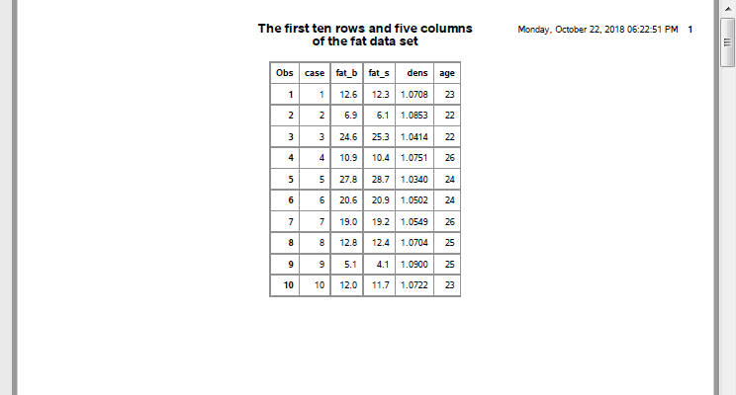
output, page 1
SAS output
Notes:
This is what your output looks like.

Slide 14
Break #1
What have you learned
libname and filename statements
input statement
label statement
proc print
What’s next
Rules for variable names
proc means

Slide 15
Variable names
Brief but descriptive
Avoid special symbols
No blanks
Anecdote: Writer’s Exchange website
underscore_delimited_name
dot.delimited.name
CamelCaseName
Notes:
I’m using the variable names provided but if you create your own names, use brief (but descriptive) name for EVERY variable in your data set. There’s no precise rule, but names should be around 8 characters long. Longer variable names make your typing tedious and much shorter variable names makes your code terse and cryptic.
I’m a bit more terse with these variable names than I normally would be just to reduce the amount of typing you have to do.
You should avoid special symbols in your variable names especially symbols that are likely to cause confusion (the dash symbol, for example, which is also the symbol for subtraction). You should also avoid blanks. These rules are pretty much universal across most statistical software packages.
There are times when you’d like to have a blank in your variable name and you can use two special symbols in SAS (and most other statistical pacakges).
Before I talk too much about this, let me share an anecdote. There was a working group of writers called The Writer’s Exchange, and in the early years of the Internet, they decided to create a website: www.writersexchage.com with no space, of course between writers and exchange because the Internet is not to fond of spaces in domain names. It sounded like a natural web site address to use, but then someone noticed something unfortunate. When you run the words writers exchange together, it can also be read as three words: writer sex change. So you need to be careful that your variable names are not so easily misconstrued when you run two or more words together to get a single variable name.
Here’s how you can simulate blanks without actually using blanks.
the underscore symbol (above the minus key on most keyboards) and
the dot (period).
These symbols create some artificial spacing that mimics the blanks. Another approach is “CamelCase” which is the mixture of upper and lower case within a variable name with each uppercase designating the beginning of a new “word”. ;

Slide 16
Means procedure
proc means n mean std min max data=intro.fat; var ht; title1 "Simple descriptive statistics for ht"; title2 "Notice the unusual minimum value"; run;
Notes:
Let’s try to do something useful now. Let’s calculated some descriptive statistics on height.
The means procedure will produce descriptive statistics for your data. By default, it will produce the count of non-missing values, the mean, the standard deviation, and the minimum and maximum values, but I am listing them explicitly here, just for show.
The data option tells SAS which data set you want descriptive statistics on, and the var statement tells SAS which variable(s) you want descriptive statistics on.

Slide 17
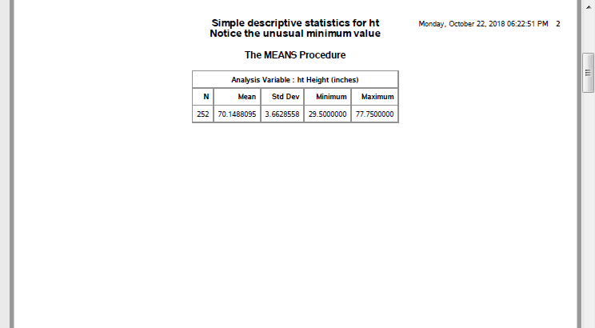
output, page 2.
SAS output
Notes:
Here’s the output. There is an unusual data value for ht, 29.5 inches. While this is not totally outside the realm of possibility, you should always ask when you see something unusual like this.

Slide 18
Break #2
What have you learned
Rules for variable names
proc means
What’s next
Missing values

Slide 19
Look at unusual row
proc sort data=intro.fat; by ht; run; proc print data=intro.fat(obs=1); title1 "The row with the smallest ht"; run;
Notes:
First, let’s look at this value in the context of the other values in this row of data.
You do this by sorting the data so that the shortest subject becomes the first row of the data and the tallest subject becomes the last. Then print just the very first row of your data.
Warning: be careful about sorting your data if you can’t get the data easily back to the original order. It might be okay, but there are times when you’d like your data all the way back and that means data in the original order. This data set has a case variable that you can resort by in order to get bakc ot the original order.
If you don’t have a case variable, store the sorted data in a separate location: something along the lines of proc sort data=x out=y.

Slide 20
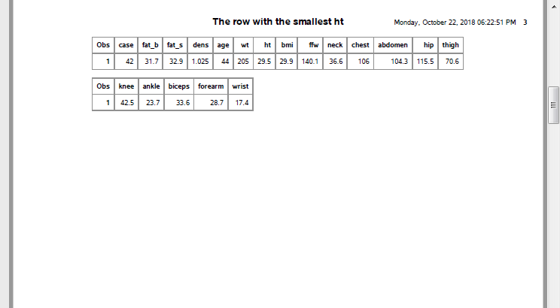
output, page 3
SAS output
Notes:
Clearly something is wrong. There’s no way that a person with such a small height would have such a big weight.

Slide 21
Look at opposite end
proc sort data=intro.fat; by descending ht; run; proc print data=intro.fat(obs=1); title1 "The row with the largest ht"; run;
Notes:
There are several ways to handle this outlier, but first, let’s check to see if something weird is happening for the tallest person in the data set.

Slide 22
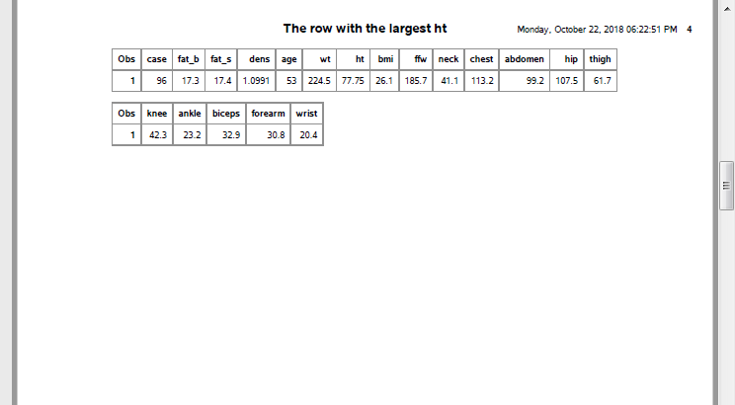
output, page 4
SAS output
Notes:
No, that looks just fine.
With this outlier on the low end, you might consider doing nothing other than noting the unusual value.
Alternately, you could delete the entire row associated with this value.
Finally, you might consider converting the small ht value to a missing value code.

Slide 23
Remove outlier
data intro.fat1; set intro.fat; if ht > 29.5; run;
Notes:
This code removes the entire row of data. Notice that I store the modified data under a new name. That way, if I regret tossing the entire row out, I can easily revert to the original data.

Slide 24
Change to missing value
data intro.fat2; set intro.fat; if ht=29.5 then ht=.; run;
Notes:
This code converts the height to a missing value, but keeps the original data.
There is no one method that is preferred in this setting. If you encounter an unusual value, you should discuss it with your research team, investigate the original data sources, if possible, and review any procedures for handling unusual data values that might be specified in your research protocol.
Your data set may arrive with missing values in it already. Data might be designated as missing for a variety of reasons (lab result lost, value below the limit of detection, patient refused to answer this question) and how you handle missing values is way beyond the scope of this class. Just remember to tread cautiously around missing values as they are a minefield.
Notice that I store the revised data sets with the row removed and with the 29.5 replaced by a missing value in different data frames. This is good programming practice. If you ever have to make a destructive change to your data set (a change that wipes out one or more values or a change that is difficult to undo), it is good form to store the new results in a fresh spot. That way, if you get cold feet, you can easily backtrack.
We’ll use the data set with the 29.5 changed to a missing value for all of the remaining analyses of this data set.

Slide 25
Logic statements and missing values
proc print data=intro.fat2; where ht < 0; title "ht < 0 will include ht = ."; run;
Notes:
Logic statements involving missing value codes are tricky. Look at the output from this sample code.

Slide 26
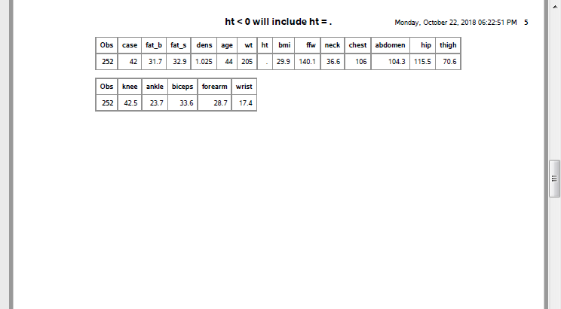
output, page 5
SAS output
Notes:
SAS stores missing value codes as the most extreme legal negative number. So if you want, for example, to exclude negative values, make sure that you account for missing values as well.
Every procedure in SAS has its own default approach to missing values and often provides you with one or more alternatives. You have to review this carefully for each and every statistical procedure that you run. If you do data manipulations involving missing values, you have to make sure that the result correctly reflects what you want.

Slide 27
The proper way to search for negative ht values
where (ht < 0) & (ht ~= .)
Notes:
You may hate having to do this and wish that SAS would have handled things differently. Different packages, like R, have a three valued logic system where every logic statement (well, almost every logic statement) involving missing values codes to MISSING rather than to TRUE or FALSE. This sometimes works better, but sometimes the SAS approach works better.

Slide 28
nmiss option
proc means n nmiss mean std min max data=intro.fat2; var ht; title "Using the nmiss statistic"; run;
Notes:
If you are concerned at all about missing values, ask for the number of missing values in proc means using nmiss. ;

Slide 29
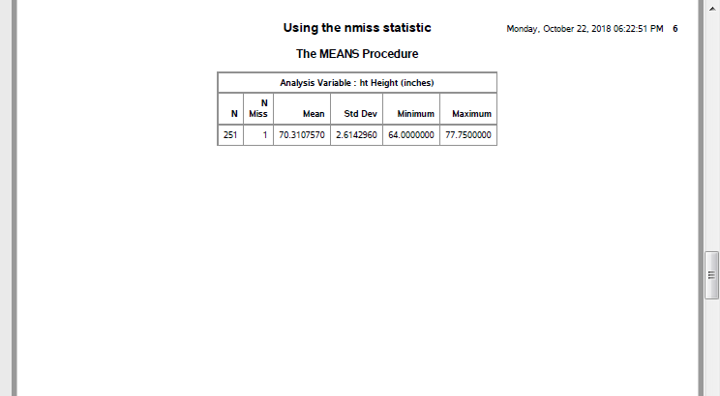
output, page 6
SAS output
Notes:
Note that your data set has 251 observations and 1 missing value.

Slide 30
Break #3
What have you learned
Missing values
What’s next
Simple transformations
Histograms

Slide 31
Simple transformations
data converted_units; set intro.fat2; ht_cm = ht * 2.54; wt_kg = wt / 2.2; run; proc print data=converted_units(obs=10); var ht ht_cm wt wt_kg; title "Original and converted units"; run;
Notes:
You can also make simple transformations of your data, such as converting from English units to metric units.
I want to talk more about transformations later, especially the log transformation.

Slide 32
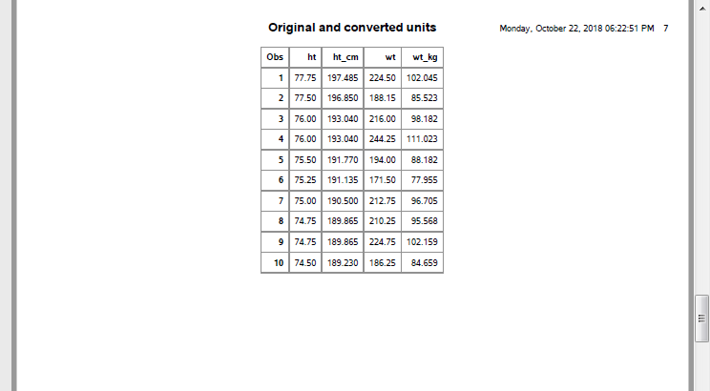
output, page 7
SAS output
Notes:
This is your output with measurements both in the original units and metric. Notice that I did not print any more than 10 rows of data.

Slide 33
Histogram
proc sgplot data=intro.fat2; histogram ht; title "Histogram with default bins"; run;
Notes:
A histogram is useful for displaying a continuous variable graphically.

Slide 34
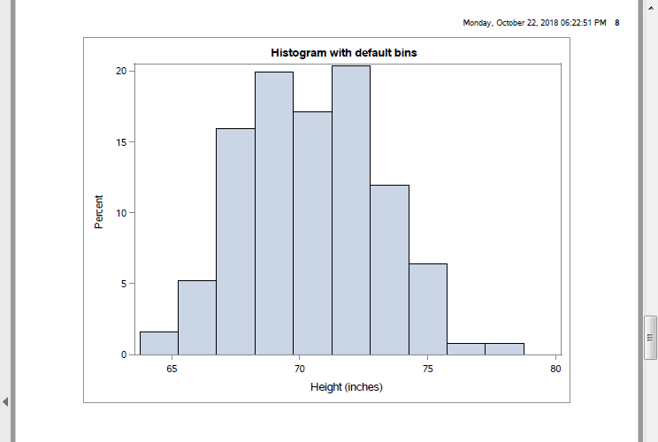
output, page 8
SAS output
Notes:
You should not accept the default width and starting values for your histogram, but should specify values that are meaningful to you.

Slide 35
Histogram with one unit wide intervals
proc sgplot data=intro.fat2; histogram ht / binstart=60 binwidth=1; title "Histogram with narrow bins"; run;

Slide 36
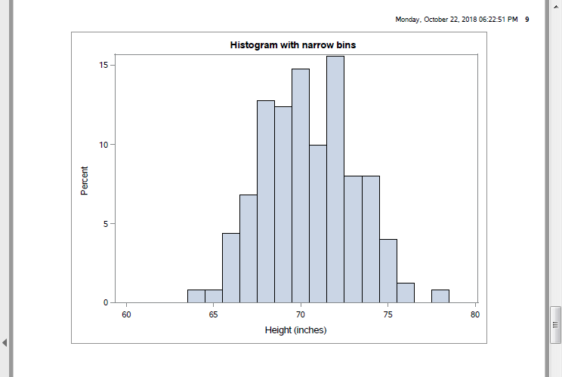
output, page 9
SAS output
Notes:
This might be a bit too narrow. The only way you can set the widths properly is through trial and error.

Slide 37
Histogram with five unit wide intervals
proc sgplot data=intro.fat2; histogram ht / binstart=60 binwidth=5; title "Histogram with wide bins"; run;
Notes:
It is easy enough to try different interval widths.

Slide 38
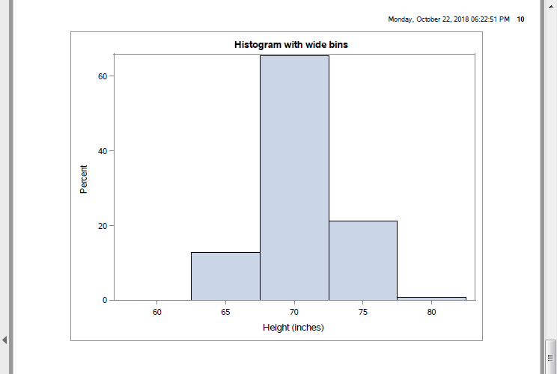
output, page 10
SAS output
Notes:
These bars are maybe too wide. The ideal width is probably 2. But I’ll stop here, except to note that the labels for this histogram are not ideal.

Slide 39
Nice labels
proc format; value range_fmt 60="58-62" 65="63-67" 70="68-72" 75="73-77" 80="78-82"; run; proc sgplot data=intro.fat2; histogram ht / binstart=60 binwidth=5; xaxis valuesformat=range_fmt.; title "Histogram with re-labeled bins"; run;
Notes:
We’ll talk more about proc format next week, but a simple application is providing nicer labels for your graphs and tables. The value of 60 that appears on the graph is actually 58 to 62. The value of 65 is actually 63 to 67. Spell out this relationship in proc format to get better labels. Note, however, that if you modify the widths of the bars, you will have to go back and modify the format as well.

Slide 40
Break #4
What have you learned
Simple transformations
Histograms
What’s next
Correlations
Scatterplots

Slide 41
Correlations
proc corr data=intro.fat2 noprob nosimple; var fat_b fat_s; with neck -- wrist; title "Correlation matrix"; run;
Notes:
Note to myself. Talk about saving graphs to a png file, datasets to a csv file. ;
The correlation coefficient is a single number between -1 and +1 that quantifies the strength and direction of a relationship between two continuous variables. As a rough rule of thumb, a correlation larger than +0.7 indicates a strong positive association and a correlation smaller than -0.7 indicates a strong negative association. A correlation between +0.3 and +0.7 (-0.3 and -0.7) indicates a weak positive (negative) association. A correlation between -0.3 and +0.3 indicates little or no association.
Don’t take these rules too literally. You’re not trying to make definitive statements about your data set. You are just trying to get comfortable with some general patterns that occur in your data set. A complex and definitive statistical analysis will almost certainly not agree with at least some of the preliminary correlations noted here.
The corr procedure produces, by default, a square correlation matrix of all the numeric variables. The noprob and nosimple options cut down on the amount of information printed. The with statement produces a rectangular correlation matrix.

Slide 42
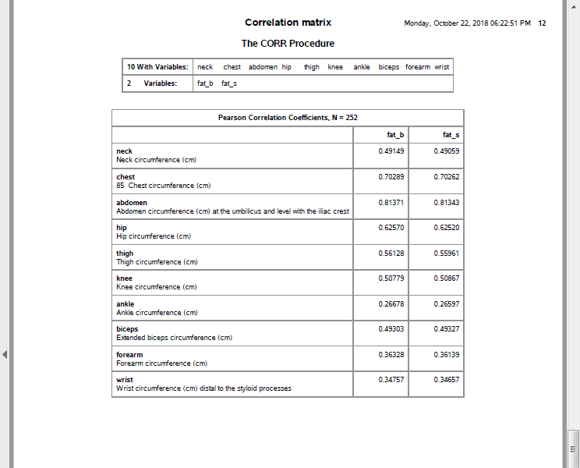
output, page 12
SAS output
Notes:
Notice that I deliberately avoided printing out the entire corelation matrix, which would span several pages of output. This is something you yourself should strive for, especially when you are running something that you want to share with others. Don’t overwhelm your reader with things that they may not need. If your readers do want more information, it is better for them to tell you rather than you giving them more in the first meeting that they need.

Slide 43
Save correlations
proc corr data=intro.fat2 noprint outp=correlations; var fat_b fat_s; with neck -- wrist; run; proc print data=correlations; title "Correlation matrix output to a data set"; run;
Notes:
You can save the correlations in a separate data file.

Slide 44
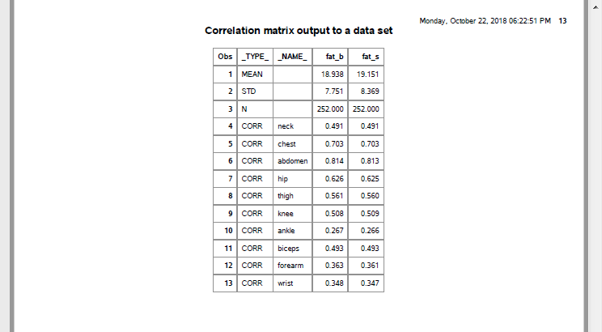
output, page 13
SAS output
Notes:
The output is a bit unusual because SAS wants to include means and standard deviations in your output. You can and should remove this. It would be easy enough to do (use the where statement), but I wanted to show you the full data set.

Slide 45
SAS code to round correlations
data correlations; set correlations; if _type_="CORR"; drop type; fat_b=round(100*fat_b); fat_s=round(100*fat_s); run;
Notes:
Saving as a data file allows you to manipulate the individual correlations. Here we multiply the correlations by 100, round them, and sort them. This can often simplify the interpretation of large correlation matrices.
I’m splitting the code onto two PowerPoint slides. This code does the rounding.

Slide 46
SAS code to reorder correlations
proc sort data=correlations; by descending fat_b; run; proc print data=correlations; title "Rounded and re-ordered correlation matrix"; run;
Notes:
This code does the reordering and printing.

Slide 47
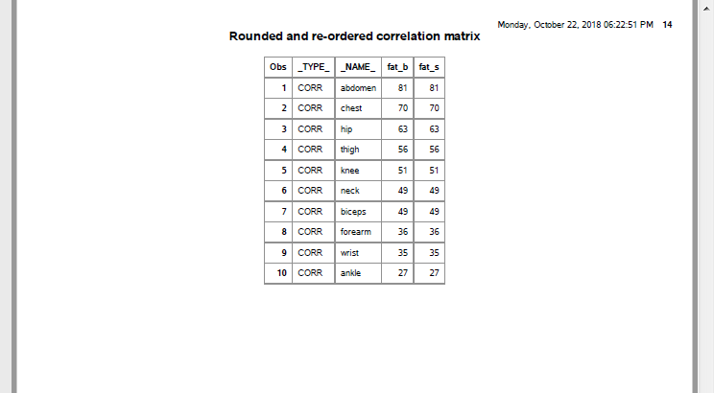
output, page 14
SAS output
Notes:
This is the output. You can see that measurements at the extremities are poor predictors of body fat. Apparently, we grow fat from the middle outward.

Slide 48
Scatterplot
proc sgplot data=intro.fat2; scatter x=abdomen y=fat_b; title "Simple scatterplot"; run;
Notes:
A scatterplot is also useful for examining the relationship among variables. You can produce scatterplots several different ways, but the scatterplots produced by the sgplot procedure have the most flexibility. ;

Slide 49
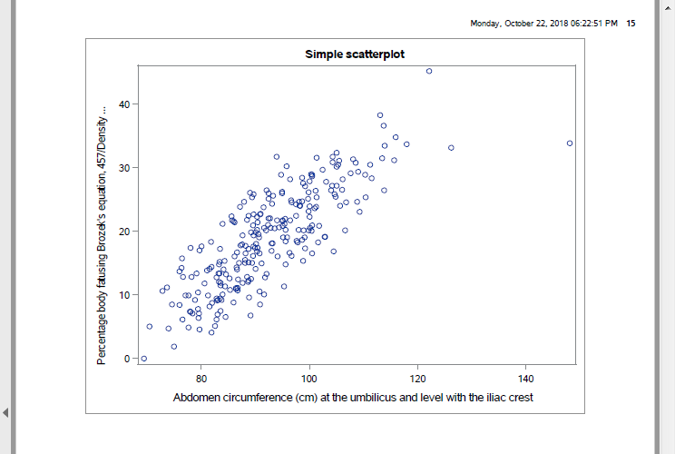
output, page 15
SAS output
Notes:
This plot shows a general upward trend.

Slide 50
Trend line
proc sgplot data=intro.fat2; scatter x=abdomen y=fat_b; reg x=abdomen y=fat_b; title "Scatterplot with linear regression line"; run;
Notes:
The reg statement adds a least squares trend line to your graph.

Slide 51
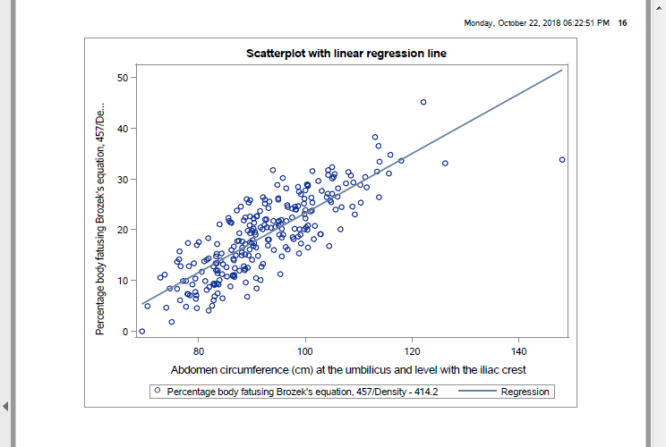
output, page 16
SAS output
Notes:
The trend line is very useful for large and noisy data sets. It also allows you to more quickly visualize extreme values. Notice, for example, that the person with the largest abdomen measure (the biggest gut, if I can be informal) is quite out of line with what you might expect the relationship to be.

Slide 52
Smoothing spline
proc sgplot data=intro.fat2; scatter x=abdomen y=fat_b; pbspline x=abdomen y=fat_b; title "Simple scatterplot"; run;
Notes:
The pbspline statement adds a smoothing spline to your graph. This allows you to informally investigate more complex relationships.

Slide 53
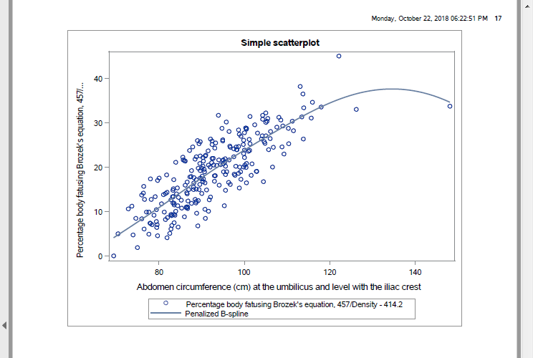
output, page 17
SAS output
Notes:
The smoothing spline provides some evidence that the relationship is roughly linear a low and medium abdomen measurements, but tends to level off a bit at higher levels. Interpret this with caution, of course, because you have very little data at extrmemy high adbomen measures.

Slide 54
Don’t forget!
ods pdf close;
Notes:
I always seem to forget this last statement and then I get upset with SAS for not providing the PDF output. But SAS can’t produce the PDF output until you tell it you are done. So don’t yell at your computer when it’s your own darn fault (just like Jimmy Buffet in the Margaritaville song).

Slide 55
Summary
What have you learned
libname and filename statements
input and label statements
proc print and proc means
Missing values and simple transformations
Histograms, correlations, scatterplots

Slide 56
Homework01 (1 of 7)
Having reviewed these analyses, I would like you to turn in some simple analyses that you run on a fresh data set. This homework assignment will be graded pass/fail.

Slide 57
Homework01 (2 of 7)
There is a second data set on sleep in mammals. You can find a brief description of this data set at
–> http://www.statsci.org/data/general/sleep.html
and you can download the actual data at
–> http://www.statsci.org/data/general/sleep.txt

Slide 58
Homework01 (3 of 7)
For every question, include the relevant SAS output and a brief written commentary explaining what the results mean. When you send your answers, please include the original questions.

Slide 59
Homework01 (4 of 7)
Notice that there is a huge range in body weight. Display the information for the smallest and the largest mammals.
Which variables have missing data?
Calculate the mean and standard deviation for TotalSleep.

Slide 60
Homework01 (5 of 7)
Draw a histogram for the BodyWt variable. Note that this variable is highly skewed. Re-draw the histogram on the log scale. For exta credit, relabel the axes with values at 0.001, 0.01, etc.
Calculate the ratio of BrainWt to BodyWt and express it as a percentage. Be sure to convert grams to kilograms (or vice versa) before computing the ratio. What animal has the smallest/largest ratio?

Slide 61
Homework01 (6 of 7)
Do bigger animals sleep longer or live longer? Show your results using a correlation coefficient.
Do animals who have high degrees of Predation, Exposure, or Danger sleep less? Show your results using a plot and a trendline.

Slide 62
Homework01 (7 of 7)
Place all the key results into a document and copy the original questions and include your own written answer along with the appropriate supporting tables or graphs. Do NOT submit uneditted and unannoted SAS output. You can use any program to prepare the output, but convert it to a PDF format before submission. If you have any difficulty producing a PDF document, please talk to me.

