Slide 1
Methods and Tools for Reproducible Research
Steve Simon

Slide 2
Abstract (1 of 2)
Have you ever experienced befuddlement when you dust off a data analysis that you ran six months ago? Ever gritted your teeth when your collaborator invalidates all your hard work by telling you that the data set you were working on had “a few minor changes”? Or panicked when someone running a big meta-analysis asks you to share your data? If any of these experiences rings true to you, then you need to adopt the philosophy of reproducible research.
Notes:
I want to talk about reproducible research. This is research that will help you if you are reviewinng your code from a data analysis you ran six months ago. It will help when your collaborators give you a few minor changes

Slide 3
Abstract (2 of 2)
Reproducible research refers to methods and tools developed by large software development teams but which can help you keep a sense of order in your data, analysis programs, and results.
In this webinar, we’ll review reproducible research methodology, using recent recommendations in the literature. Although these recommendations may ask you to break long entrenched habits, the approach is easy to implement, even for data analysts who are new to computation.
Notes:
I want to talk about software tools, but you don’t have to be a programmer to understand how to use these tools.

Slide 4
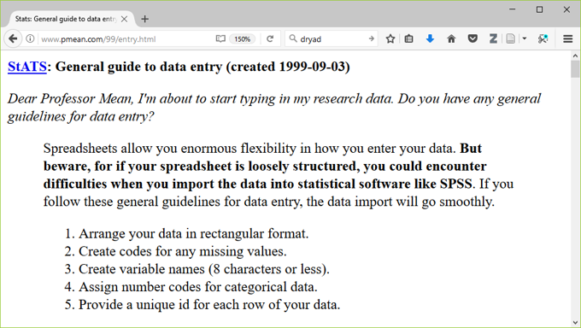
Recommendations from 1999
Notes:
I wrote about this issue in 1999, but much of the advice I offered back then is obsolete today.

Slide 5
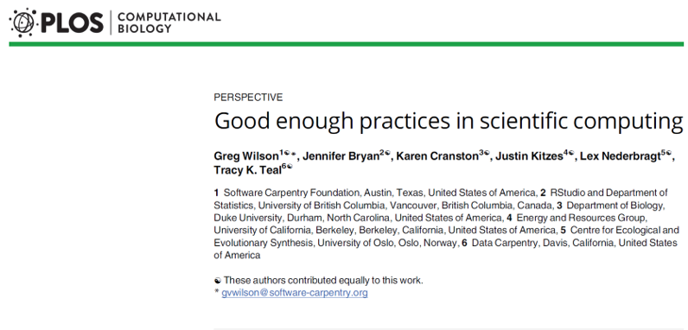
Much newer (and better) recommendations
Notes:
http://journals.plos.org/ploscompbiol/article?id=10.1371/journal.pcbi.1005510

Slide 6
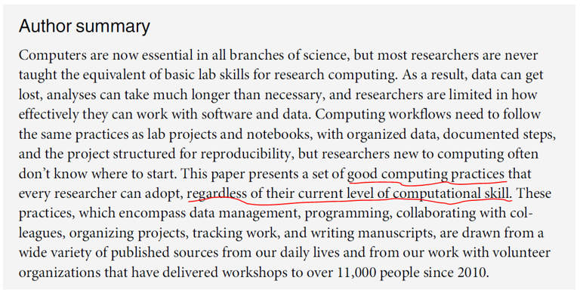
Methods and Tools for Reproducible Research
Notes:
http://journals.plos.org/ploscompbiol/article?id=10.1371/journal.pcbi.1005510

Slide 7
Change is never easy
Good programming practices require time and energy.
You have to break old habits.
You cannot retrofit these recommendations.

Slide 8
Why should you adopt good programming practices?
These recommendations will
make your job easier today.
Only partially true!
make your job easier six months down the road.
help everyone who is currently working with you.
encourage future collaborators to work with you.
make your research more reproducible.
enhance the quality of your publications.

Slide 9
Recommendations in six areas
Data management.
Software.
Collaboration.
Project organization.
Keeping track of changes.
Manuscripts.

Slide 10
Data management recommendations
Save the raw data.
Ensure that raw data are backed up in more than one location.
Create the data you wish to see in the world.
Create analysis-friendly data.
Record all the steps used to process data.
Use a unique identifier for every record.
Submit data to a reputable DOI-issuing repository.

Slide 11
Save the raw data.
Never make changes directly on top of the data you receive.
Note the version number and date of any data you receive remotely.
Wilson et al (2017) page 2, recommendation 1a.

Slide 12
Ensure that raw data are backed up in more than one location.
Your company/university network may include remote back up, but check first.
You can also use cloud services or your own USB stick/drive, but be sure to encrypt anything confidential.
Wilson et al (2017) page 4, recommendation 1b.

Slide 13
Create the data you wish to see in the world
Use open formats like csv, json , yaml , or xml.
Replace cryptic names with self-explaining alternatives.
Wilson et al (2017) page 4, recommendation 1c.

Slide 14
What is json?
http://json.org/example.html

Slide 15
Create analysis-friendly data.
Each column is a variable. (No double dipping).
Make each row an observation (use a tall/thin format).
Wilson et al (2017) page 5, recommendation 1d.

Slide 16
What is tidy data?
https://cran.r-project.org/web/packages/tidyr/vignettes/tidy-data.html

Slide 17
Record all the steps used to process data.
Write scripts/use syntax instead of a graphical user interface.
If you can’t use scripts/syntax, hand document all your steps.
Wilson et al (2017) page 5, recommendation 1e.

Slide 18
Anticipate the need to use multiple tables and use a unique identifier for every record.
This allows you to split your data into pieces
Time-constant and time-varying data in a longitudinal study.
Wilson et al (2017) page 5, recommendation 1f.

Slide 19
Submit data to a reputable DOI-issuing repository
Only for non-proprietary data
No personal identifiers
This will allow others to access and cite your data.
Include a README file.
Wilson et al (2017) page 6, recommendation 1g.
Notes:
If your data is proprietary, skip this step. But if your data is not proprietary, think about how it might benefit others.
Strip out any personal identifiers. Keep in mind that a single variable may not allow someone to de-identify your data, but a combination might.
DOI is Digital Object Identifier, which assigns a permanent, unchanging URL. This avoids the problem of “link rot.”

Slide 20
Dryad, an examploe of a DOI-issuing repository
http://datadryad.org

Slide 21
Review of data management recommendations
Save the raw data.
Ensure that raw data are backed up in more than one location.
Create the data you wish to see in the world.
Create analysis-friendly data.
Record all the steps used to process data.
Use a unique identifier for every record.
Submit data to a reputable DOI-issuing repository.

Slide 22
Software recommendations
Place a brief explanatory comment at the start of every program.
Decompose programs into functions.
Be ruthless about eliminating duplication.
Always search for well-maintained libraries that do what you need.
Test libraries before relying on them.

Slide 23
Place a brief explanatory comment at the start of every program.
Give an example of how it is used, and explain what parameters are needed.
Write the explanatory comment BEFORE you write your program
Revise comment as needed as you revise your program.
Wilson et al (2017) page 6, recommendation 2a.

Slide 24
Decompose programs into functions.
This really means using macros for programs like SPSS and SAS.
Keep it short: one page and no more than 6 input parameters.
Do not reference information outside the function.
Wilson et al (2017) page 7, recommendation 2b.

Slide 25
Be ruthless about eliminating duplication.
DRY code (don’t repeat yourself).
Cut, paste, and slightly modify is your enemy.
Wilson et al (2017) page 7, recommendation 2c.

Slide 26
Always search for well-maintained libraries that do what you need.
The “buy” versus “build” trade-off.
Don’t be a Frank Sinatra programmer (“I did it my way.”)
Wilson et al (2017) page 7, recommendation 2d.

Slide 27
Example of well-maintained libraries
https://cran.r-project.org/web/packages/index.html

Slide 28
Test libraries before relying on them.
Run textbook examples.
Evaluate instead of test?
Wilson et al (2017) page 7, recommendation 2e.

Slide 29
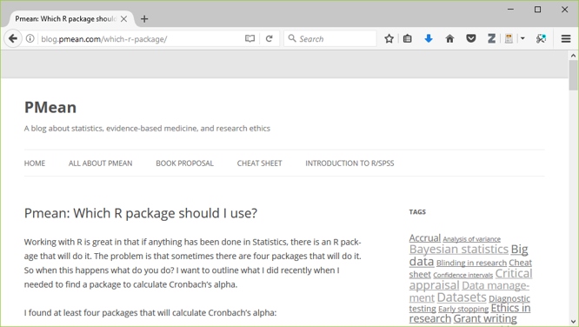
Suggestions for evaluation

Slide 30
Review of software recommendations
Place a brief explanatory comment at the start of every program.
Decompose programs into functions.
Be ruthless about eliminating duplication.
Always search for well-maintained libraries that do what you need.
Test libraries before relying on them.

Slide 31
Methods and Tools for Reproducible Research
Give functions and variables meaningful names.
Functions are verbs and variables are nouns.
With the exception of loop counters, avoid one character variable names.
Be consistent with your delimiters (CamelCase, dot.delimiters , or underscore_delimiters ) and with case ( lower_case , Title_Case , or UPPER_CASE).
Software
Wilson et al (2017) page 7.

Slide 32
Methods and Tools for Reproducible Research
Make dependencies explicit.
Dependencies include what version of the software you need (e.g., 3.1.0 or later) and what additional software or libraries you need.
Document this as part of README, or in REQUIREMENTS.TXT.
Software
Wilson et al (2017) page 7.

Slide 33
Methods and Tools for Reproducible Research
Do not comment and uncomment sections of code to control a program?s behavior.
Use if/else statements and verbose/debug flags instead.
Don?t keep old code around for historical reference, use version control instead.
Software
Wilson et al (2017) page 8.

Slide 34
Methods and Tools for Reproducible Research
i . Provide a simple example or test data set.
Run these tests when you switch computers, upgrade to a new software version, or add new pieces to your program.
Software
Wilson et al (2017) page 8.

Slide 35
Methods and Tools for Reproducible Research
Submit your code to a reputable DOI-issuing repository.
When you share both your data and your code, you help insure reproducibility and you encourage new collaborations.
Software
Wilson et al (2017) page 8.

Slide 36
Methods and Tools for Reproducible Research
Give functions and variables meaningful names.
Make dependencies explicit.
Do not comment and uncomment sections of code to control a program?s behavior.
i . Provide a simple example or test data set.
Submit your code to a reputable DOI-issuing repository.
Software (What do you think?)
Wilson et al (2017) page 8.

Slide 37
Methods and Tools for Reproducible Research
Data management.
Software.
Collaboration.
Project organization.
Keeping track of changes.
Manuscripts.
Recommendations in six areas

Slide 38
Methods and Tools for Reproducible Research
Create an overview of your project.
This is useful even if you work alone, because it gives a focus to your work.
Store the overview in a README file.
Include information about opportunities for collaboration in a CONTRIBUTING file.
Collaboration
Wilson et al (2017) page 8.

Slide 39
Methods and Tools for Reproducible Research
Create a shared to-do list.
Document this well enough for an outsider to understand.
Collaboration
Wilson et al (2017) page 8.

Slide 40
Methods and Tools for Reproducible Research
Decide on communication strategies.
Where and how will your team meet to resolve issues.
Explain how new collaborators can get involved.
Specify where key documents are stored and who can modify them.
Collaboration
Wilson et al (2017) page 8.

Slide 41
Methods and Tools for Reproducible Research
Make the license explicit.
Use a liberal license to makes it easy for future collaborators to join in the fun.
Remember that you are far better off being the pioneer in a new research area that everyone is working in than a new research area that no one is working in.
?A candle loses nothing by lighting another candle.? James Keller
Collaboration
Wilson et al (2017) page 9.

Slide 42
Methods and Tools for Reproducible Research
Make the project citable.
Include a suggested citation for your work in a CITATION file.
Here?s what I put in my CITATION file
You are free to use any of the material in this repository without
restriction. If you do wish to give credit, however, when you use
this work, it would be appreciated. An example of appropriate credit
would be "thanks to Steve Simon (list the url of this repository)
for sharing this material."
Collaboration
Wilson et al (2017) page 9.

Slide 43
Methods and Tools for Reproducible Research
Create an overview of your project.
Create a shared to-do list.
Decide on communication strategies.
Make the license explicit.
Make the project citable.
Collaboration (What do you think?)

Slide 44
Methods and Tools for Reproducible Research
Data management.
Software.
Collaboration.
Project organization.
Keeping track of changes.
Manuscripts.
Recommendations in six areas

Slide 45
Methods and Tools for Reproducible Research
Put each project in its own directory, which is named for the project.
If two projects share more than 50% of the code or data, then they can be safely combined into one project.
Two projects that share no code or data belong in separate directories.
Project organization
Wilson et al (2017) page 9.

Slide 46
Methods and Tools for Reproducible Research
Use standard names for subdirectories.
DOC for most other documentation.
DATA for raw data, RESULTS for intermediate data sets and program output.
SRC for source code.
BIN for compiled programs.
README, LICENSE, CITATION, REQUIREMENTS go in root directory.
Project organization
Wilson et al (2017) page 10.

Slide 47
Methods and Tools for Reproducible Research
Wilson et al (2017) page 11.

Slide 48
Methods and Tools for Reproducible Research
Name all files to reflect their content or function.
Avoid sequence names like logistic_model1, logistic_model2, ? as these are not descriptive and subject to frequent renumbering. Better would be simple_logistic_model , cubic_spline_logistic_model , ?
Project organization
Wilson et al (2017) page 11.

Slide 49
Methods and Tools for Reproducible Research
Put each project in its own directory, which is named for the project (4a, page 9).
b-e. Use standard names for subdirectories.
Name all files to reflect their content or function.
Project organization (What do you think?)

Slide 50
Methods and Tools for Reproducible Research
Data management.
Software.
Collaboration.
Project organization.
Keeping track of changes.
Manuscripts.
Recommendations in six areas

Slide 51
Methods and Tools for Reproducible Research
Back up (almost) everything created by a human being as soon as it is created.
This is easily automated.
If your team is all within the same organization, a shared network folder works well.
Keeping track of changes.
Wilson et al (2017) page 12.

Slide 52
Methods and Tools for Reproducible Research
Keep changes small.
Any group of edits that you might think about undoing as a batch should be considered a single change.
Keeping track of changes.
Wilson et al (2017) page 12.

Slide 53
Methods and Tools for Reproducible Research
Share changes frequently.
Do not allow different investigator versions to drift apart.
This is even a problem if you run analyses on both a work and home computer.
Keeping track of changes.
Wilson et al (2017) page 12.

Slide 54
Methods and Tools for Reproducible Research
Back up (almost) everything created by a human being as soon as it is created.
Keep changes small.
Share changes frequently.
Keeping track of changes (What do you think?)

Slide 55
Methods and Tools for Reproducible Research
Create, maintain, and use a checklist for saving and sharing changes to the project.
This is stored as TODO.txt.
Keeping track of changes.
Wilson et al (2017) page 12.

Slide 56
Methods and Tools for Reproducible Research
Store each project in a folder that is mirrored off the researcher?s working machine.
Several products can automate this process. I use Dropbox, but there are a lot of excellent alternatives out there.
Keeping track of changes.
Wilson et al (2017) page 12.

Slide 57
Methods and Tools for Reproducible Research
Add a file called CHANGELOG.txt to the project?s DOC subfolder (5f, page 13).
Date entries and put most recent changes as the top.
Keeping track of changes.
Wilson et al (2017) page 13.

Slide 58
Methods and Tools for Reproducible Research
Wilson et al (2017) page 13.

Slide 59
Methods and Tools for Reproducible Research
Copy the entire project whenever a significant change has been made.
It is better to waste hardware resources than to waste your time.
Keeping track of changes.
Wilson et al (2017) page 13.

Slide 60
Methods and Tools for Reproducible Research
https://en.wikipedia.org/wiki/History_of_IBM_magnetic_disk_drives#IBM_350

Slide 61
Methods and Tools for Reproducible Research
Wilson et al (2017) page 13.

Slide 62
Methods and Tools for Reproducible Research
Create, maintain, and use a checklist for saving and sharing changes to the project.
Store each project in a folder that is mirrored off the researcher?s working machine.
Add a file called CHANGELOG.txt to the project?s DOC subfolder.
Copy the entire project whenever a significant change has been made.
Keeping track of changes (What do you think?)

Slide 63
Methods and Tools for Reproducible Research
Use a version control system to manage changes to a project.
Version control tracks the actual changes rather than what you think the changes were.
Version control handles dating automatically.
Version control can rollback changes that you end up regretting.
But?
Do not put large binary files in your version control system.
Avoid putting confidential or proprietary information on a public version control system.
Don?t store passwords for database access on a public version control system.
Keeping track of changes.
Wilson et al (2017) page 13.

Slide 64
Methods and Tools for Reproducible Research
https://github.com/pmean

Slide 65
Methods and Tools for Reproducible Research
Private coorespondance

Slide 66
Methods and Tools for Reproducible Research
Private correspondance

Slide 67
Methods and Tools for Reproducible Research
Use a version control system to manage changes to a project.
Keeping track of changes (What do you think?)

Slide 68
Methods and Tools for Reproducible Research
Data management.
Software.
Collaboration.
Project organization.
Keeping track of changes.
Manuscripts.
Recommendations in six areas

Slide 69
Methods and Tools for Reproducible Research
Either
Write manuscripts using online tools with rich text formatting, change tracking, and reference management.
Google Docs
Microsoft Word
Or
Write the manuscript in a plain text format that allows version control.
LaTeX .
Markdown.
Manuscripts
Wilson et al (2017) page 16.

Slide 70
Methods and Tools for Reproducible Research
Wilson et al (2017) page 16.

Slide 71
Methods and Tools for Reproducible Research
Wilson et al (2017) page 16.

Slide 72
Methods and Tools for Reproducible Research
Wilson et al (2017) page 16.

Slide 73
Methods and Tools for Reproducible Research
Wilson et al (2017) page 16.

Slide 74
Methods and Tools for Reproducible Research
Either
Write manuscripts using online tools with rich text formatting, change tracking, and reference management.
Google Docs
Microsoft Word
Or
Write the manuscript in a plain text format that allows version control.
LaTeX .
Markdown.
Manuscripts (What do you think?)

Slide 75
Methods and Tools for Reproducible Research
Branches: allows better control over changes in version control.
Build tools: ?re-compile? everything down to the final paper if your data changes.
Unit tests: rigorous approach to insure quality of your functions.
Coverage: measures what lines are used/ignored to winnow out unused code.
Continuous integration: automate your testing process whenever you make changes.
But wait, there?s more!

Slide 76
Methods and Tools for Reproducible Research
Profiling: identify parts of your code that are bottlenecks.
The semantic web: using consensus standards for naming things.
Documentation: meaning more than just a few comments here and there.
Bibliography manager: EndNotes / Zotero / Mendeley and get an ORCID number.
Code reviews and pair programming: have a partner to check your work.
But wait, there?s more!

Slide 77
Methods and Tools for Reproducible Research
Here are the recommendations I see as most important:
Document and save all your data preparation work.
Take the time to write decent code.
Standardize how you archive information from your work.
Share liberally, if you can.
Conclusion

