Slide 1
Getting started
Steve Simon

Slide 2
Then set up SAS code chunks with
## The MEANS Procedure ## ## Variable N Mean Std Dev Minimum Maximum ## ------------------------------------------------------------------------- ## Age 19 13.3157895 1.4926722 11.0000000 16.0000000 ## Height 19 62.3368421 5.1270752 51.3000000 72.0000000 ## Weight 19 100.0263158 22.7739335 50.5000000 150.0000000 ## -------------------------------------------------------------------------
Course instructor, Steve Simon

Slide 3


Slide 4
These slides were printed on 2019-06-09 17:21:08.
Notes:
Greetings! My name is Steve Simon and I am the instructor for the class, MEDB 5507, Introduction to SAS.

Slide 5
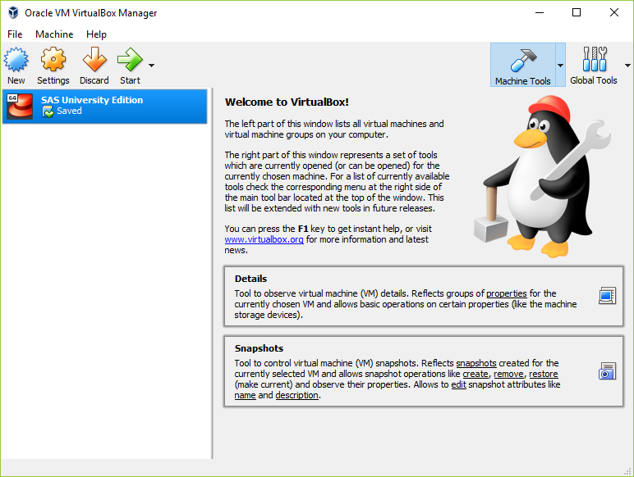
Notes:
If you are using SAS University, you start by opening Oracle Virtualbox.
Installation instructions are available.
http://support.sas.com/software/products/university-edition/docs/en/SASUniversityEditionQuickStartVirtualBox.pdf

Slide 6
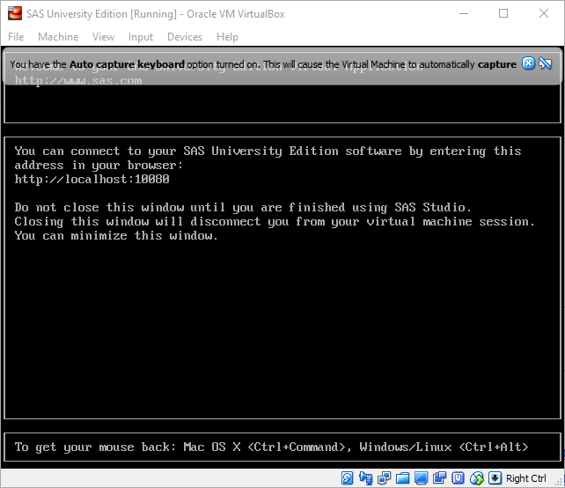
Notes:
Click on the SAS University Edition tab and a new window opens up. It explains that you need to point your web browser to a particular location. It also warns you to keep this window open.

Slide 7
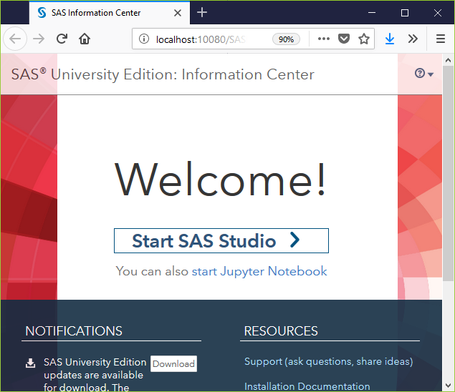
Notes:
When you open your web browser to http://localhost:10080, you get the option of starting with SAS Studio or with a Jupyter notebook. I have not had much luck with Jupyter, but you are welcome to try this on your own.

Slide 8
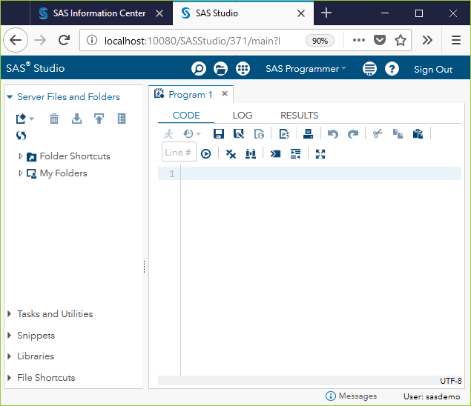
Notes:
When you open your web browser to http://localhost:10080, you get the option of starting with SAS Studio or with a Jupyter notebook. I have not had much luck with Jupyter, but you are welcome to try this on your own.

Slide 9
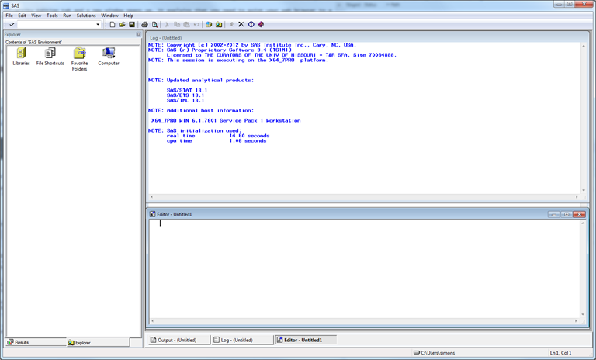
Notes:
If you are running the “regular” version of SAS, here’s an image of what the opening screen looks like. For the benefit of this presentation, I am going to resize everything, close some of the windows, and maximize the one window of greatest importance, the program editor window.

Slide 10
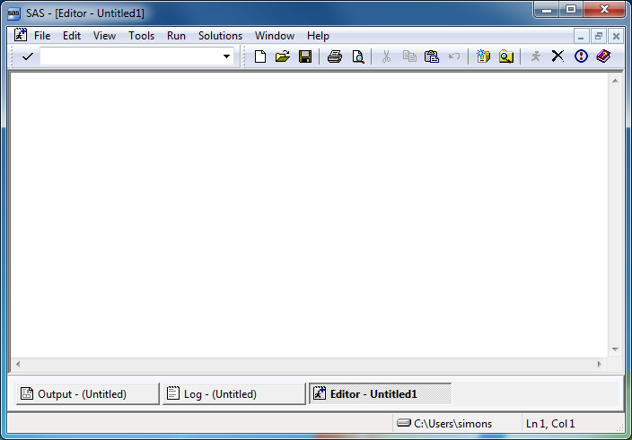
Notes:
This is the program editor window. You type in your program in this window, or read an existing program from another window. The other two remaining tabs, the log window, and the output window, are also important.

Slide 11
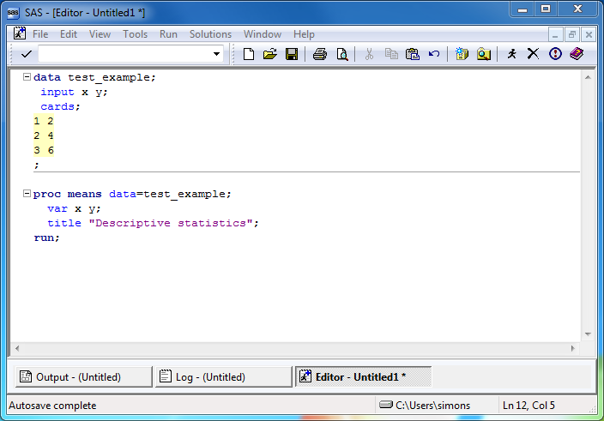
Notes:
Here’s a simple test program. After you type this program in, click on FILE | SAVE and store your program somewhere safe.

Slide 12
Test program
data test_example; input x y; cards; 1 2 2 4 3 6 ; proc means data=test_example; var x y; title "Descriptive statistics"; run;
Notes:
After you type this program in, click on FILE | SAVE and store your program somewhere safe.

Slide 13
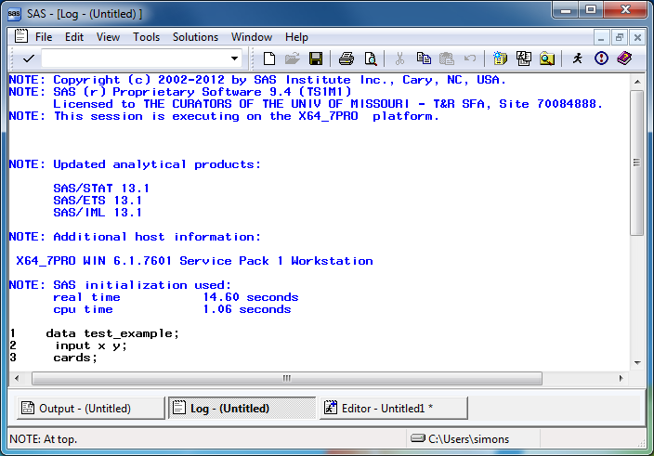
Notes:
The font here is a bit small, but notice that there are no red messages indicating warnings or errors.

Slide 14
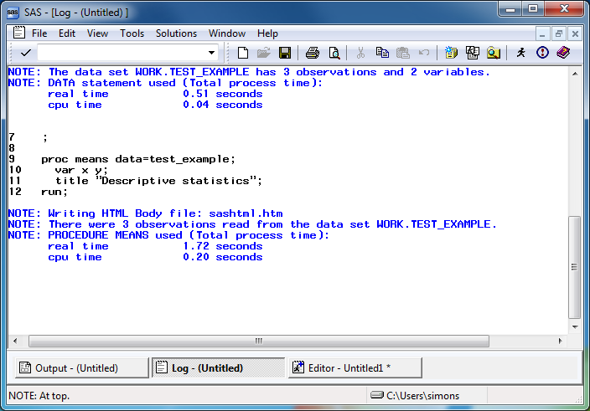
Notes:
Always start looking for error messages at the top. The very first error or warning message is most likely to be helpful, and later errors/warnings are often of less value.

Slide 15
Log messages
1 data test_example; 2 input x y; 3 cards; NOTE: The data set WORK.TEST_EXAMPLE has 3 observations and 2 variables. NOTE: DATA statement used (Total process time): real time 0.51 seconds cpu time 0.04 seconds
Log messages
9 proc means data=test_example; 10 var x y; 11 title "Descriptive statistics"; 12 run; NOTE: Writing HTML Body file: sashtml.htm NOTE: There were 3 observations read from the data set WORK.TEST_EXAMPLE. NOTE: PROCEDURE MEANS used (Total process time): real time 1.72 seconds cpu time 0.20 seconds
Where is the output?
SAS has several options for storing output.
In the output window
As an html file
As a pdf file
Notes:
Always watch the log to see that you have read in the proper number of observations.
..and that you are analyzing the proper number of observations.
There are additional options for storing graphics, which I will talk about later. You control where SAS places its output in the results tab of the preferences dialog box. Select TOOLS | OPTIONS | PREFERENCES from the menu and click on the RESULTS tab.

Slide 16
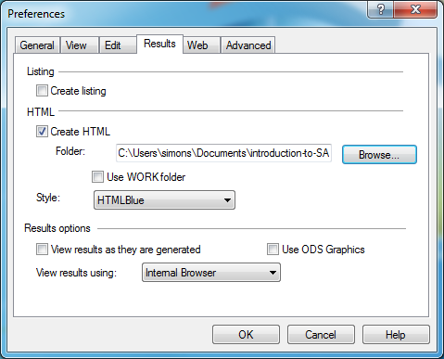
Notes:
Click on the CREATE LISTING option box to send the output to the output window. Click on the CREATE HTML option box to send the output to an html file. Click on the BROWSE button to select a default folder for your html file.

Slide 17
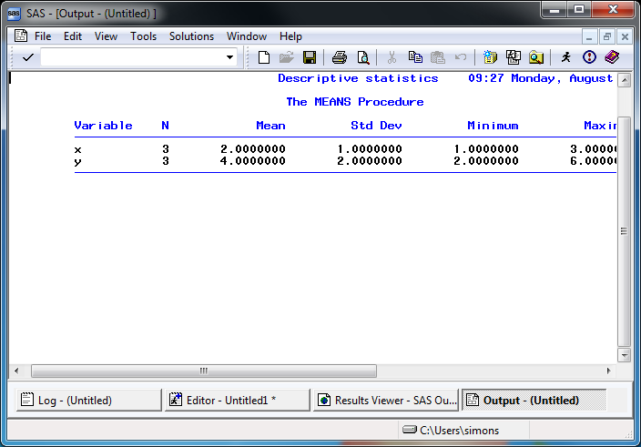
Notes:
Here’s what the output window looks like. Notice that SAS uses a monospaced font here.

Slide 18
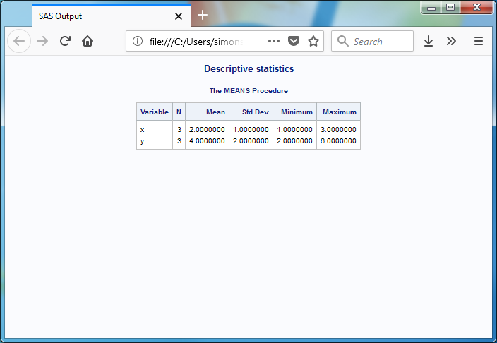
Notes:
Here’s what the html output looks like. Notice variety of font sizes and colors.

Slide 19
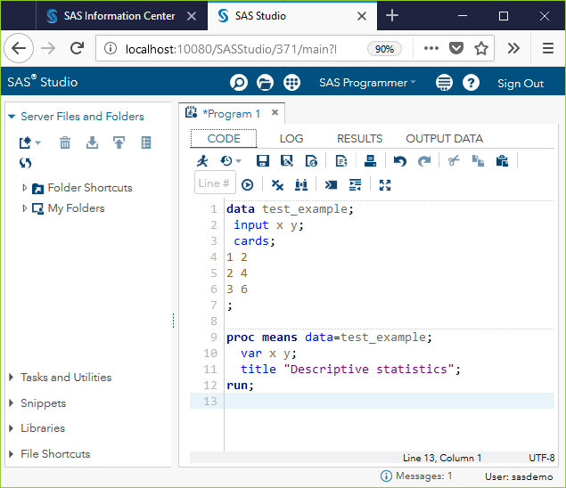
Notes:
You will notice a slightly different appearance with SAS University. Here is the program window.

Slide 20
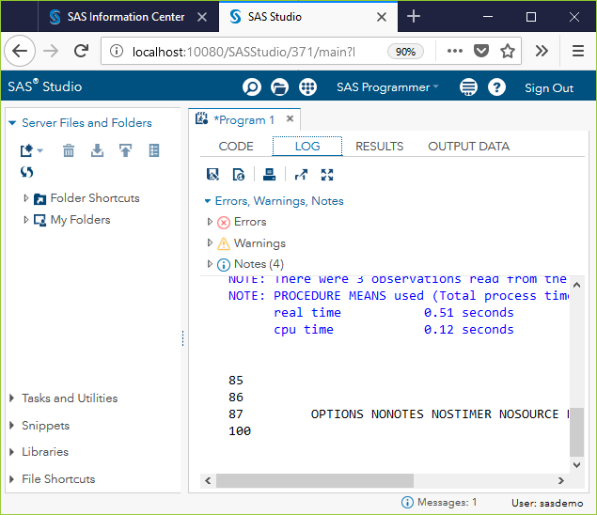

Slide 21
Here is the log window. Notice that the counts for errors, warnings, and notes appear at the top, and a missing count means zero errors and zero warnings. Hooray!

Slide 22
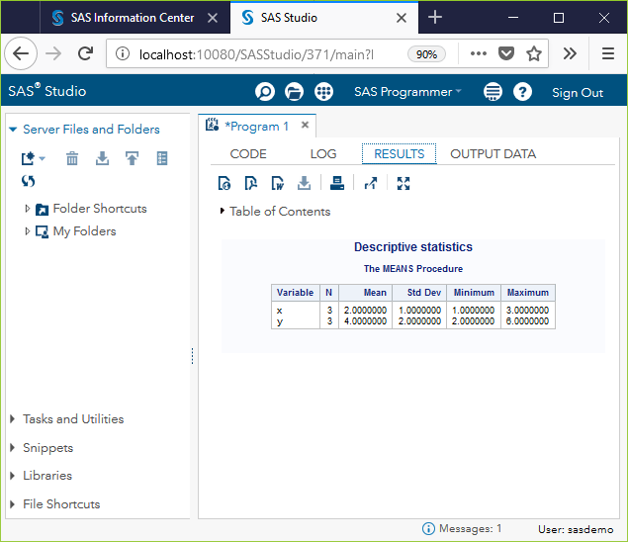
Notes:
Here is the results window. The icons near the top offer a variety of export options, among other things.

