Slide 1
第七次上机

Slide 2
NOTICE
本次上机，代码检查加入换行缩进规范机制，如果代码看起来比较 丑 (最终解释权归助教所有)，该题不予检查，望周知。
养成良好编程习惯，从大一开始

Slide 3
1. Build recursive function to convert an integer into a binary number

Slide 4
2. Enter a date, calculate and output the accurate number of day of corresponding year. Function for judging leap year is required.

Slide 5
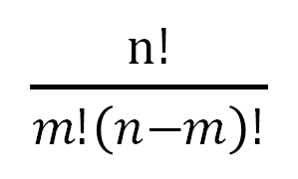
3. Calculate combinatorial number C (n, m), enter the value of n and m (n > m) and output combinatorial number

Slide 6
4. There are five students in a class taking four courses totally. Build functions for following requirements. Array as function parameter is required.
(1) Input all scores
(2) Calculate each student’s failing courses number
(3) Calculate the pass rate of each course
(4) Output all scores in the format of 2D

Slide 7
附加题（课后） 无

