Slide 1
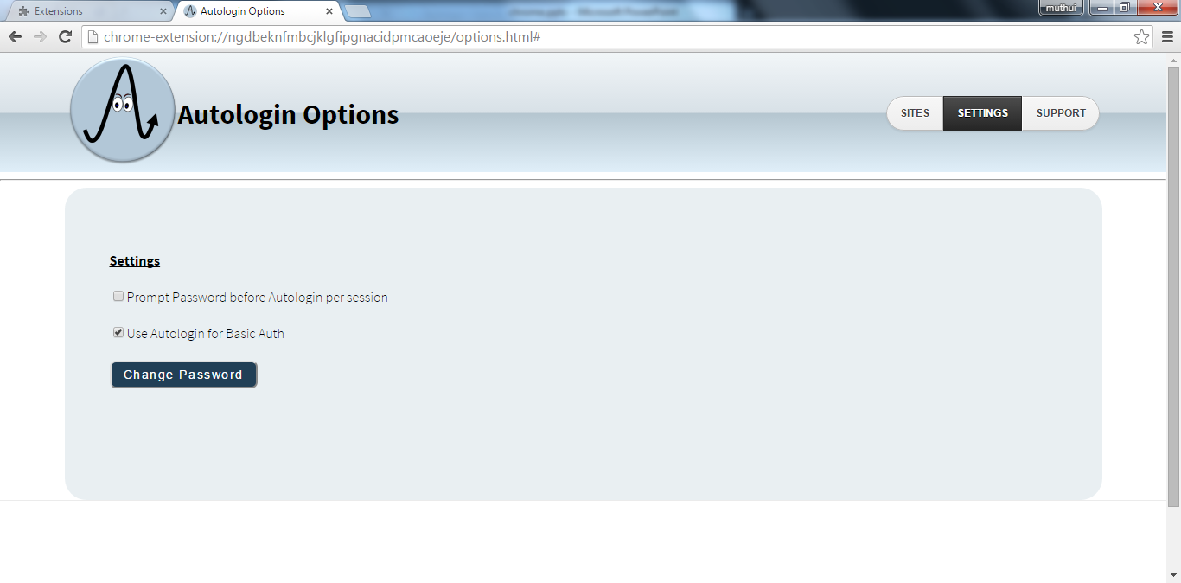
Prompt Password before Auto login
Set Master password for Auto login

Slide 2
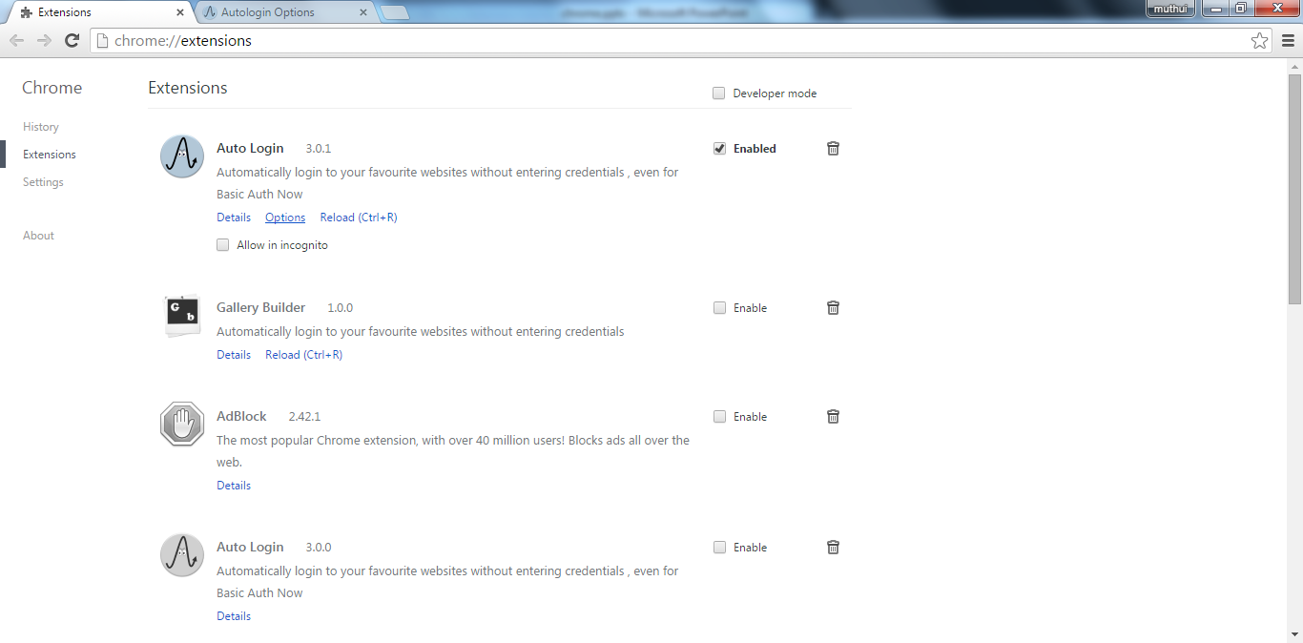
Goto
Auto Login Options

Slide 3
