Slide 1
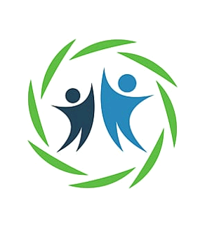
Online-Insurance Application
Team: Kartikey Vishnoi Amish Agarwal Dhanuj Renganadhan Aitha Sathwika

Slide 2
OUTLINE:
Problem Statement
Objective
Microservices
Project Overview
Onboarding-Architecture
Project Flow
Technology and Tools Used
Conclusion

Slide 3

Applying for Insurance in online without stepping outside where all types of Insurance available.
Problem Statement

Slide 4
Objective
Our objective is to Develop a web application where users can opt for an insurance policy based on their needs.
The insurance platform aims to provide a centralized system for users to explore, select, and manage various insurance policies.
This application is a kind of insurance platform where a number of insurance policy is available for different users.

Slide 5
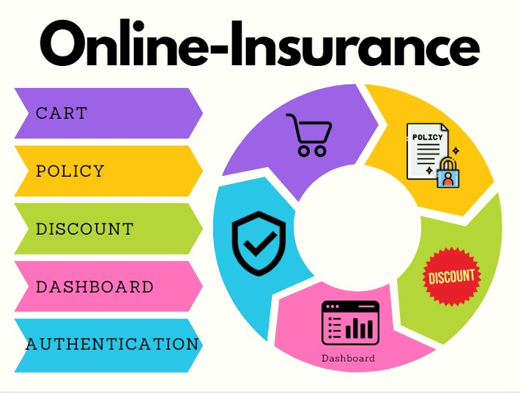
MICROSERVICES:

Slide 6

Project overview

Slide 7
Growth by sector table
Feedback
User-Dashboard API
Policy API
Discount API
Feedback API
Cart API
User
Login
Apply
Add/Delete Policy
Home
Admin
Add/Delete Discount
Register
SQL
Server
SQL
Server
SQL
Server
SQL
Server
SQL
Server

Slide 8
Onboarding Architecture

Slide 9
Policy API
GET
SQL Server
Token generated
Cart API
Add to Cart , Delete from cart
POST/DELETE
SQL Server
User-Dashboard API
Dashboard API
User-owned-policy
SQL Server
GET
Front End
React
Authentication API
Login , Register , Forget Password
Feedback API
POST
SQL Server
Policy API
Add Policy , Delete Policy
POST/DELETE
SQL Server
POST
Admin-Dashboard API
SQL Server
Discount API
Add Discount , Delete Discount
POST/DELETE
SQL Server

Slide 10
Company overview

Slide 11
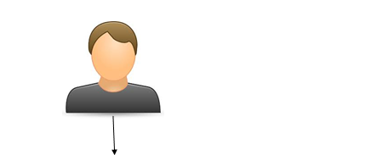
Project Flow
Home
Login
Register
Forget Password
User
Admin
Applied Policy
Feedback
Add Policy
Available Policy
Cart
Add Policy
Delete Policy
Feedback

Slide 12







Technologies and Tools Used

Slide 13
Conclusion
In conclusion, the Online-Insurance Application successfully addresses the diverse needs of users, administrators, and application owners. It provides a secure, user-friendly environment for exploring, selecting, and managing insurance policies.

Slide 14


Slide 15

Thank you
Thanks to your commitment and strong work ethic.
We look forward to working together.
Contoso
get@sunlife.com

