Slide 1
19CS3113S
Analysis and Design of Algorithms
PRAM ALGORITHMS
Session-4

Slide 2
PRAM Algorithms
Introduction:
So far we have discussed algorithms for single processor
In this session, we introduce parallel machines
Example: weather forecasting
If you start today to forecast tomorrow's weather using single processor you may get result after few days (since its a Compute-intensive problem)

Slide 3
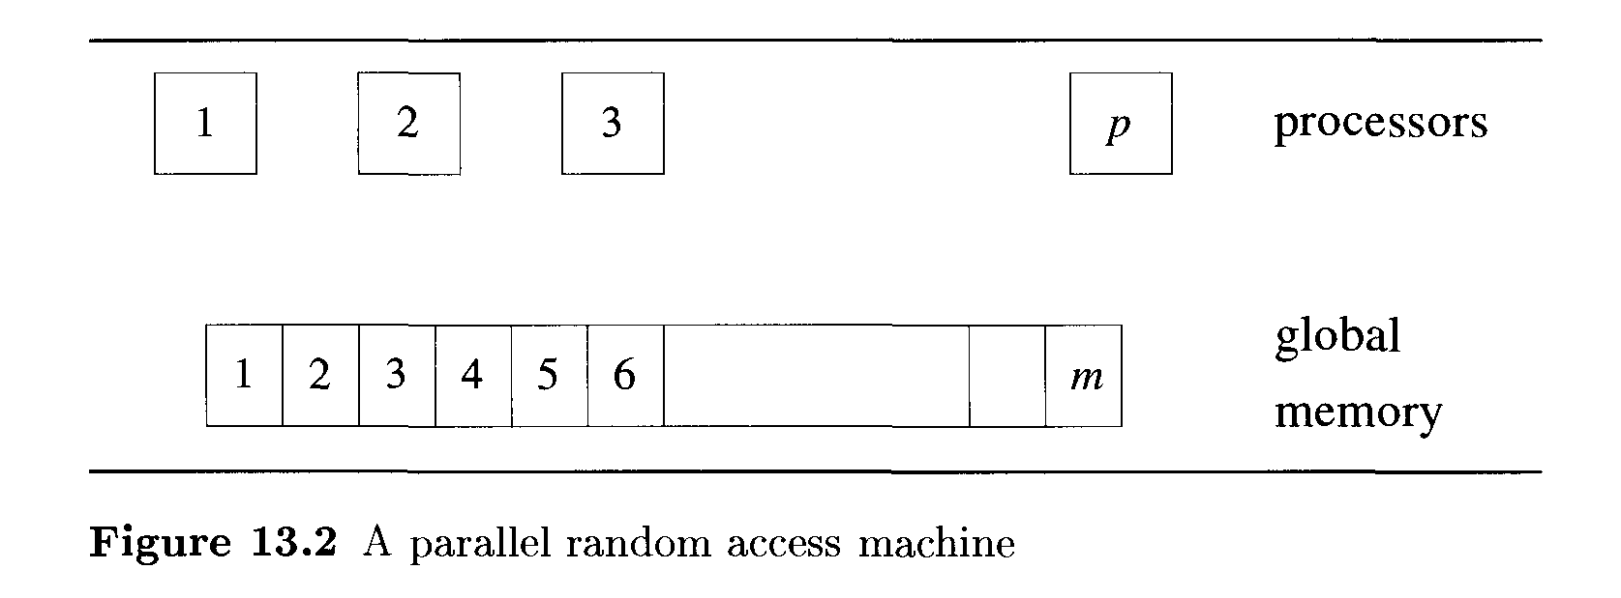
PRAM Model
So we need multiple machines/processors to solve such type of problems.
Parallel machines offer the potential of decreasing the solution time enormously.

Slide 4
The idea of parallel computing is very similar.
Given a problem to solve, we partition the problem into many subproblems; let each processor work on a subproblem; and when all the processors are done, the partial solutions are combined to arrive at the final answer.
Any algorithm designed for a single-processor machine as a sequential algorithm
Any designed for a multiprocessor machine as a parallel algorithm.

Slide 5
Merging
Given two sorted sequences, the problem of merging is to combine two sorted sequences into a single sorted sequence.

Slide 6
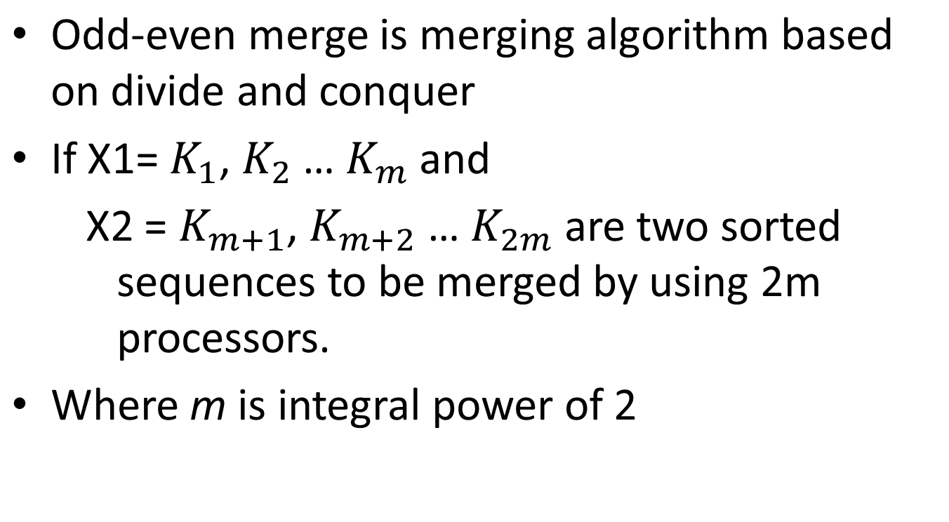
Odd-Even Merge

Slide 7
PRAM(Parallel Random Access Machines):
MERGING:
ODD-EVEN Merge algorithm:
Step 0: if m=1, merge the sequence with one comparison.
Step 1: Partition X₁ nad X₂ into their odd and even parts. That is, partition X₁ into X₁^{odd} = k₁,k₃….k_{m-1} and X₁^{even} = k₂,k₄,….k_{m}. Similarly, partition X₂ into X₂^{odd} and X₂^{even}.

Slide 8
Step 2: Recursively merge X₁^{odd} with X₂^{odd} using m processors. Let L₁ = l₁,l₂,l₃,….lm be the result. Note that X₁^{odd}, X₁^{even},X₂^{odd}, and X₂^{even} are in sorted order. At the same time merge X₁^{even} with X₂^{even} using the other m processors to get L₂ = l_{m+1}, l_{m+2},…..l_{2m}.
Step 3: Shuffle L₁ and L₂; that is form the sequence L = l₁, l_{m+1},l₂, l_{m+2}, … l_{m},l_{2m}. Compare every pair (l_{m+i},l_{i+1}) interchange them if they are out of order. That is, compare l_{m+1} with l₂ and interchange them if need be, compare l_{m+2} with l₃ and interchange them if need be, and so on. Output the result sequence.

Slide 9
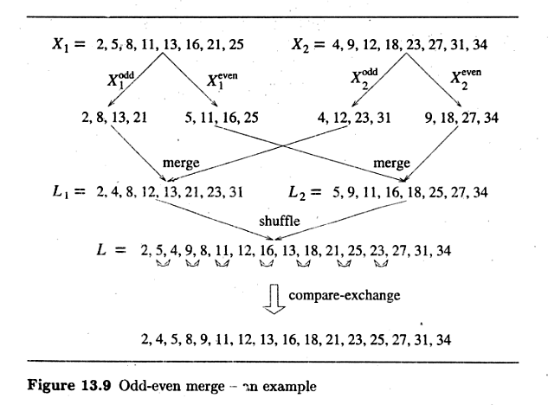

Slide 10
Sort the following two lists using odd-even merge algorithm X1={ 2,8,11,13,14,18,21,29} and X2={ 3,6,11,15,16,20,23,31}

Slide 11
Thank you

