Slide 1
PROJECT BATCH-IOT SPECIALISATION
Guide Name-Atul O Thakare
Project Batch IOT DT-Group 9
Project Batch members:-
B.AshaJyothi 190030117
JMN.Rajesh 190030664
V.Jaswanthi 190031726

Slide 2
TITLE OF THE PROJECT A STEP TOWARDS HOME AUTOMATION USING IOT

Slide 3
ABSTRACT
Man has developed many technologies that make any extreme tasks work just as a cake walk. But everything man improvised, periodically require man's involvement.
This must change because to compete in this running world of technologies we need to look into the broader image so that the future can be carved extremely well.
To fulfil this, Smart Environment is one efficient solution that erases manpower by bringing all the fields that majorly require the human intervention. Smart Environment usually includes smart transport, smart home, smart health, smart building etc.
For our project we have chosen smart home as our domain because every activity we do begins from our home.
For accomplishing this we have come up with a Smart Automation task also known as Home Automation wherein we monitor simple tasks like turning the lights, fans, motors, Tv etc. This majorly involves IOT components like sensors and actuators and controllers.

Slide 4
LITERATURE STUDY
There are different smart home systems such as central controller-based smart home systems, Bluetooth- based smart home systems, mobile-based smart home systems, and Internet-based smart home systems.
We use central controller -based smart home systems because it is easily scalable and accessible, and it is in demand and generally it is used for communication method in nowadays.
Flexibility and scalability are the two most important features and the must requitements for any smart home systems.
This is best supplied by the central controller-based systems because they allow us to connect to different appliances, devices and other supportive systems at any range from the main controller.
We have also made our survey by studying various research papers for a better understanding of home automation. Our understandings are organized in the below tables.

Slide 5
SURVEY
Paper name | Authors | Our insights | Future Improvements
A step towards Home Automation using IOT | Harsh Kumar Singh, Saurabh Verma, Shashank Pal, Kavita Pandey | A web portal has been designed to check the working of the appliances and the user can simply log in to the portal and turn off/on the devices. A Wi-Fi based microcontroller, nodemcu are the primary tools used. | A possible collaboration of machine learning and iot can be made possible to improve the automation of appliances based on the behavior of the user.
Domicile - An IoT Based Smart Home Automation System | Md. Sadad Mahamud, Md. Saniat Rahman ZishanSyed Ishmam Ahmad, Ahmed Rezaur Rahman, Mehedi Hasan, Md.Lutfur Rahman | users can change the load number according to their requirement through the web portal. And if the server is hosted on a public IP then the user can control this server and monitor this server from anywhere in this world.ESP32 Wi-Fi module, Arduino UNO are the primary tools used. | The server can be made more user friendly. More than one house can be connected into the server from there is possibility to monitor power consumption of an area.
IoT Based Smart Security and Home Automation | Shradha Somani, Parikshit Solunke, Shaunak Oke, Parth Medhi, Prof. P.P. Laturkar | The prime objective of our project is to use an android smart phone to control the home appliances conveniently and to provide robust home security and safety measures. raspberry pi is the primary tool used. | The system can be improved by integrating the voice call feature within the same smart phone application through which the user can control his home appliances. Login can also be done with different upcoming technologies like retina/fingerprint scanning. We can add image processing to improve accuracy of the security system.

Slide 6
SURVEY
Paper name | Authors | Our insights | Future Improvements
Smart-Home Automation using IoT-based Sensing and Monitoring Platform | Majid Al-Kuwari, Abdulrhman Ramadan, Yousef Ismael, Laith Al-Sughair, Adel Gastli, Senior Member, IEEE, Mohieddine Benammar, Senior Member, IEEE | We have observed that we can build an application for smart home automation in the future and also they proposed a model EMONCMS which collects and visualizes data which will be useful for analysis and we able to sense the data through nodemcu and can download the data from the EMOCMS server. | In the future, we will try to learn how to use the applications and we have to gain the knowledge on developing the android application for smart home automation
Smart Home Automation System Using Internet of Things | Urvi Singh , M. A. Ansari | Due to the rapid development in technology, we have observed that the authors are tried to implement the proposed SHA model which can control the home automation devices and also provides security through sensors and actuators as long as they are in WiFi usage Range | The improvement in this model is the proposed system has a limited range so we have to increase the mobile network usage and can be compatible with all the devices with the help of IoT

Slide 7
SURVEY
Paper name | Authors | Our insights | Future Improvements
Controlling Smart Home Activities Using IoT | Rafidh Khalaf Ahmed Mohammed Hussein Ali Essa Essa | The smart home activities providing a facility to the user where we can continuously monitor the surrounding parameters inside the house and can control them by collection and exchange of data between the things for example switching on/off devices (like fan and light based on these parameters). | None
Smart Home Automation System Using Internet of Things | Urvi Singh M. A. Ansari, SMIEEE | The SHA has been working by using the ESP8266 Wi-Fi module and internet over mobile phones, tablets, and laptops. Also, the system is not only used in controlling of home appliances but it is also designed for monitoring purpose which is done with the help of the sensor used in it for safety and security purpose. So, in this way, it presents a prototype and implementation of "smart home automation" using Wi-Fi technology over mobile phones, laptops, and tablets. | This whole system can be extended for controlling many other appliances of the home by using Smart Home Automation application and ESP8266 Wi-Fi module and data which are obtained with the help of sensors can also be expanded for monitoring purpose as well as for safety purpose of the home by analyzing over the internet for future improvements.

Slide 8
REQUIREMENT ANALYSIS
At the most basic level, home automation systems are made up of three elements:
a smart device, a hub, and a connected application.
sensors, controllers, and actuators.
IoT-Related Components if any required
Software Requirements –
Latest updated version OS like Windows 11 or Windows 10
Arduino UNO software
An IoT- Cloud Platform Like ThingSpeak , IoT Cloud
Tinkercad

Slide 9
WORKING MECHANISM
In this Home Automation we perform the following tasks:-
When the user turns on the system, the lcd starts presenting a welcome note followed by the instructions for the further usage.
It directs the user to start by pressing the power button on the remote which gradually turns on the automation system.
In this system we have planned to automate quite a few tasks like turning on the Tv, turning on the light, turning on the motors and finally turning on the fan.
The motors in our system represent different complex devices which can be paired with them for example refrigerators, washing machines etc.
For user friendly automation we have placed a dashboard which guides the user with the details of how to turn on/off the devices.
We have assigned different keys for each device to turn it on/off. This smoothens the flow of working of the system.
A set of batteries are used to provide the power to the system which will be replaced with the direct power source in a practical automation system.

Slide 10
COMPONENTS DESCRIPTION
The different components (sensors, actuators, controller) used are as follows:
Multimeter-A multimeter is a measuring instrument that can measure multiple electrical properties.
IR sensor : An infrared (IR) sensor is an electronic device that measures and detects infrared radiation in its surrounding environment.
Arduino board : Arduino is an open-source electronics platform based on easy-to-use hardware and software. Arduino boards are able to read inputs - light on a sensor
Light Bulbs : An incandescent light bulb, incandescent lamp or incandescent light globe is an electric light with a wire filament heated until it glows.
Resistors: A resister is one who resists, one who stands firm against something, refuses compliance or withstands temptation
Relay SPDT : Single Pole Double Throw relays offer a normally open and a normally closed contact set in one relay
9V battery : The nine-volt battery, or 9-volt battery, is an electric battery that supplies a nominal voltage of 9 volts.
LCD 16*2 : A 16x2 LCD means it can display 16 characters per line and there are 2 such lines.
Potentiometer : A potentiometer is a three-terminal resistor with a sliding or rotating contact that forms an adjustable voltage divider
Motors- An electric motor is an electrical machine that converts electrical energy into mechanical energy
LEDs- Light-emitting diode (LED) is a widely used standard source of light in electrical equipment. It has a wide range of applications ranging from your mobile phone to large advertising billboard.

Slide 11
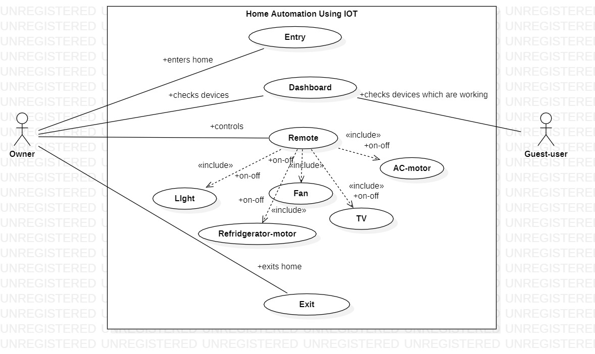
UML DIAGRAMS
Use-Case Diagram

Slide 12
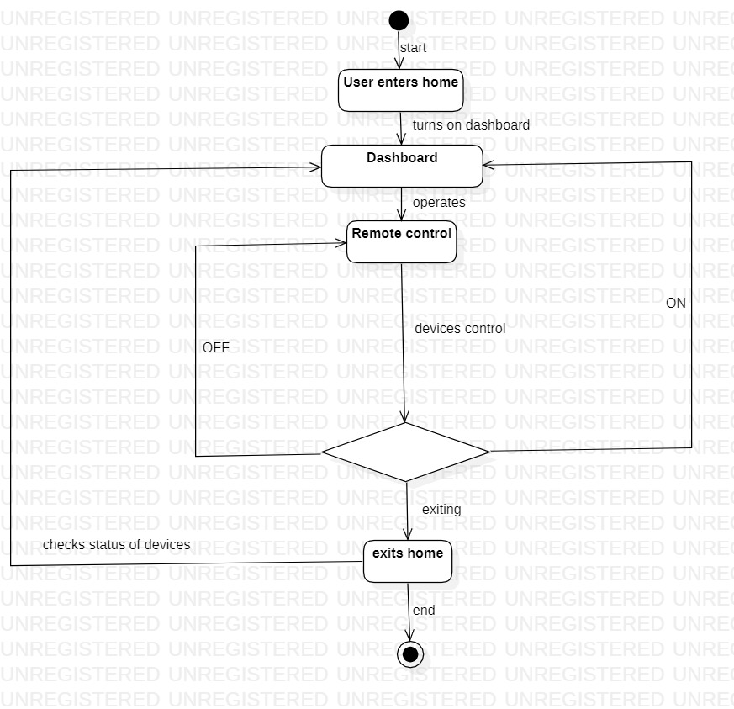
UML DIAGRAMS
Activity Diagram

Slide 13
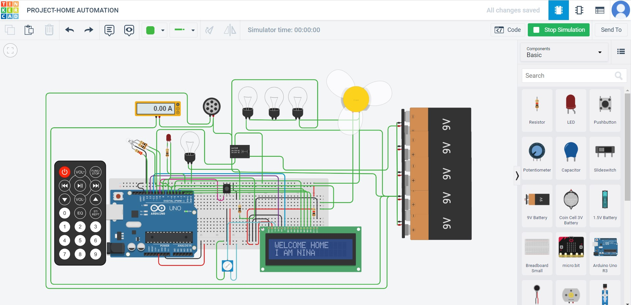
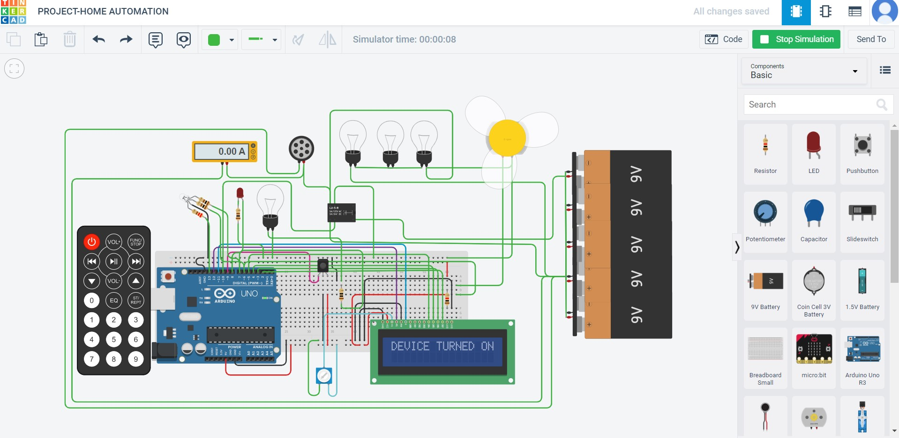
RESULTS

Slide 14


RESULTS

Slide 15
ADVANTAGES
Coming to the advantages of Home Automation, there are a quite many of them which actually support the development process. Traits like interconnectivity, Remote monitoring User customization are the extra feathers which are added ,thereby making it an efficient automation system.
Some prominent pros of Smart Home Automation:
Increased Safety-Through the interconnectivity of smart home technology, and real-time surveillance and monitoring, homeowners can know exactly what’s happening, and receive real-time alerts on any questionable occurrences.
Energy Management-As aforementioned, managing utilities such as heating, cooling, and lighting can save on energy costs. Pre-programming your thermostat to a specific temperature during certain times of the day ensures comfort, while cutting down on waste. Consider smart outlets to manage auto shut-off for electronic devices such as TVs and gaming systems. Smart LED bulbs enable users to turn lights on and off at certain times for security and convenience.
Video Analytics-Perhaps one of the most standout features of smart home automation is video analytics. This advanced technology can be added as another security layer in line with motion detection. Intelligent enough to differentiate among images of animals, humans, or vehicles, it decreases false notifications and deciphers movement to help prevent false alarms. Pre-programmed tripwires and activity zones also provide real-time alert triggers to ward off potential intruders, such as activating indoor/outdoor lights.
The Several other Smart Home Benefits are:
It is an Energy Efficient and Hands-free convenience
It also contains Enhance Security
Here we can Save Time with Automated Tasks
Save Energy with Smart Energy Consumption.-

Slide 16
Conclusion
The Internet of Things-based home automation has been experimentally proven to work satisfactorily by connecting simple appliances to it, and the appliances were successfully connected.
Remotely controlled via the internet The created system not only monitors sensor data such as temperature, gas, light, and motion sensors but also actuates a process based on the requirement, such as turning on the light when it is dark it becomes dark It also saves sensor parameters to the cloud.
In a timely manner (Gmail) This will aid the user’s analysis. The state of various parameters in the home at any time, anywhere.

Slide 17
Future Work Implementation
Using this system as a foundation, the system can be expanded to include a variety of other options, such as home security features such as photographing a person moving around the house and storing it on the cloud.
This requires less data storage than a CCTV camera, which continuously records and stores data.
The system can be expanded to include energy monitoring and weather stations.
This type of system, with appropriate modifications, can be implemented in hospitals for disabled people or in industries where human invasion is impossible or dangerous, and it can also be implemented for environmental monitoring.

Slide 18
REFERENCES
https://doi.org/10.32628/CSEIT195190 409/
http://ieeexplore.ieee.org/document/8844945/
https://ieeexplore.ieee.org/document/8644349
https://ieeexplore.ieee.org/document/8697610
https://ieeexplore.ieee.org/document/7753232
https://ieeexplore.ieee.org/document/8830664

Slide 19
THANK YOU

