Slide 1
PROJECT FACIAL EMOTION RECOGNITION
190030716- PRATHYUSHA
190031893- RIDA MOGAL
190032042- VINEELA VORSU

Slide 2
agenda
INTRODUCTION 3
ABSTRACT 8
THEORITICAL ANALYSIS 12
DATASET 16
REFERENCE PAPERS 20

Slide 3

INTRODUCTION
The facial recognition technology has many uses like providing security whereas the facial expression recognition technology will be useful for detection of truthfulness or potential deception. This is of great use for the police department for solving a crime. The police can analyse if the eyewitness or the suspect is lying which is very useful in analysing the crime scene. By using this technology, it gets easy to know persons way of thinking and his interest in various aspects which will be very advantageous for various companies for improving their sales.

Slide 4
Facial expressions can be used in providing the human to machine interactions. Facial expressions and other gestures are very important in the non-verbal communication which plays a major role in interpersonal relations. So, facial expression recognition, as it extracts and analyses the information taken from the images or videos, it will be able to deliver the exact or the unbiased emotional responses as data. We achieve the facial recognition by detecting the faces and by analysing the movement of our eyes, nose, lips etc. and analysing changes in the appearance of the facial features and classifying various expressions.

Slide 5
Analysing the facial expressions helps the companies in market research. Market research is very important for the companies to have a clear picture on what the people have their interest in. If a company launches a product without any market research, there will be very high chances of failure. So, the companies perform some market research prior to launching the product. The market research is done in many ways, one of which is analysing the facial expressions of people when they are viewing the product which helps in determining their interest in it.

Slide 6
Facial expression recognition technology can also be used in video game testing. During the video game testing, certain users are asked to play the game for a specified period and their expressions, and their behaviour are monitored and analysed. The game developers usually use the facial expression recognition and get the required insights and draw the conclusions and provide their feedback in the making of the final product. This testing is done on many people and it takes many days for the process to complete. In this project, deep learning with the convolutional neural networks (CNN) approach is used.

Slide 7
Neural networks need to be trained with large amounts of data and have a higher computational power . It takes more time to train the model. Neural networks provide a more accurate output as they are trained with large amounts of data and hence, they are preferred in the development of facial expression recognition technology despite few of their disadvantages.

Slide 8
ABSTRACT
Recognition of Facial expression in technology plays a major role in many sectors. It has many advantages because of which it is very important. It is mainly used in market research and testing. Many companies require a good and accurate testing method which contributes to their development by providing the necessary insights and drawing the accurate conclusions. Facial expression recognition technology can be developed through various methods. This technology can be developed by using the deep learning with the convolutional neural networks (CNN).

Slide 9
The main objective here is to classify each face based on the emotions shown into seven categories which include Anger, Disgust, Fear, Happiness, Sadness, Surprise and Neutrality.
Face recognition technology can be used in many fields, one of which is attendance monitoring system. Attendance can be taken without wasting time as the system marks the attendance of the person entering the class automatically.

Slide 10
This system is also useful in knowing the entry and exit time of a person. It can also detect if other people who doesn’t belong to the class are entering the class and with this information, it can alert the concerned people. This is also very useful in case of burglary.
The main objective here in this project is, to read the facial expressions of the people and displaying them. OpenCV is used for automatic detection of faces and drawing bounding boxes around them OpenCV contains libraries which helps in detecting the faces. Face detection using the Hear cascades is a machine learning based algorithm where a cascade function will be trained with a set of input data.

Slide 11
Many pre-trained classifiers for face, eyes, smile etc. are present in OpenCV. The deep learning is a part or a subset of machine learning. Deep learning is used by Google to translate the information form one language to another using deep learning approach. The network should be trained with relatively more data in deep learning.

Slide 12
THEORITICAL ANALYSIS
Machine Learning:
Machine learning is a part or subset of Artificial Intelligence. It contains software applications to become more accurate at predicting the outcomes without having to be explicitly programmed to do that. Algorithms in Machine learning use historical data or the previous data as input to predict new output values.
Machine learning uses 4 basic approaches. They are, Supervised Learning, Unsupervised Learning, Semi-Supervised learning and reinforcement learning, Supervised learning

Slide 13
Deep learning:
Deep learning is a type of machine learning which is inspired by the structure of human brain. It mimics the structure of the neural
networks of the brain. It is also known as deep neural learning.
Applications of deep learning include, Image recognition, Natural language processing, Drug discovery, Medical imaging, Genome mapping, Insurance fraud detection, Alzheimer’s disease, Pixel restoration, Automatic Handwriting generation, Self-driving cars etc.
It is a subset or a part of Machine Learning. It uses the cutting-edge technology. It is also used in showing recommendations.

Slide 14
Neural networks:
They form the base of the neural networks. They are used for many applications like Facial recognition, Real-time translation, Music composition etc. They take the data and train themselves with that data to recognise the patterns in the data which was taken and then predict the outputs of some new related data.
They are made up of layers neurons. The neurons are the core or the processing units of the network. There are two types of propagations which are, forward propagation and backward propagation.

Slide 15
Convolutional neural networks:
They are a type of neural networks. They are also known as ConvNet. They are mainly used for image analysis. They can also be used for data analysis and classification problems as well. They identify a pattern between the data. This pattern detection makes them useful in the image analysis. Even for the facial expression recognition, it is so necessary to detect the pattern as this will be useful for differentiating the various facial expressions.
In a CNN, the hidden layers consist of convolutional layers. There can also be non-convolutional hidden layers, but the basis of CNN are the convolutional layers. Convolutional layers are the ones which decide the pattern in the CNN.

Slide 16
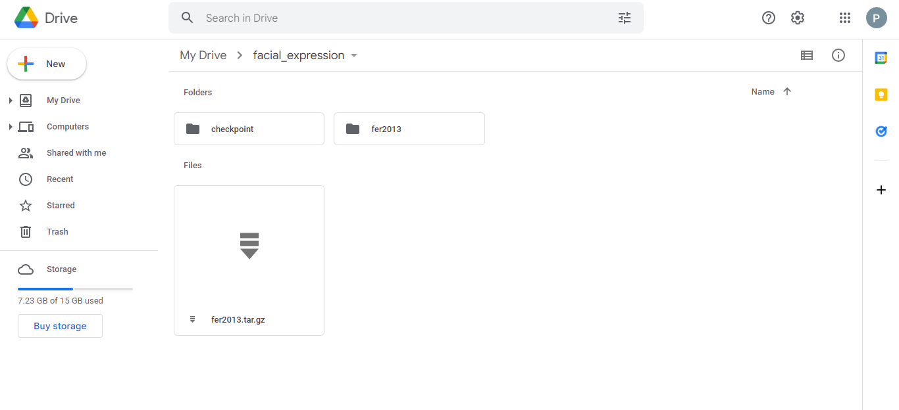
DATASET

Slide 17
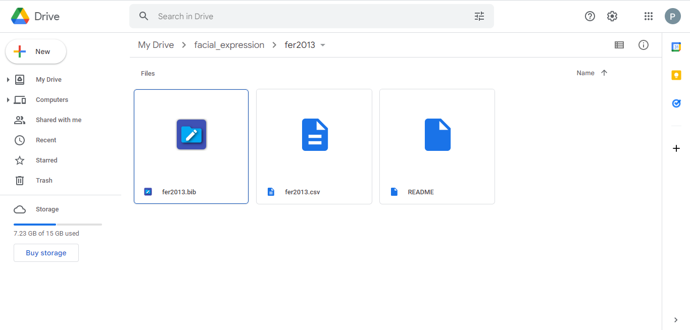

Slide 18
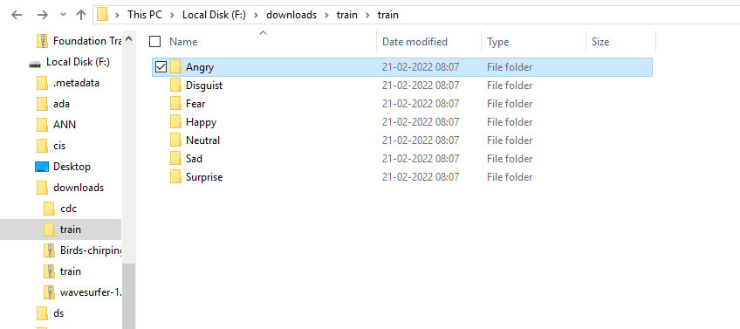
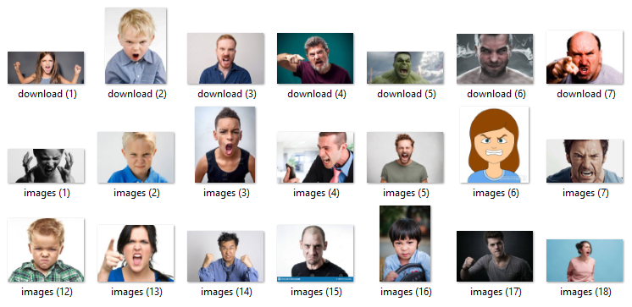

Slide 19
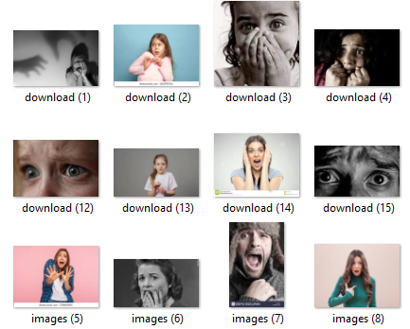
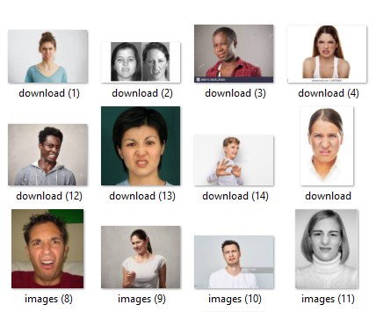
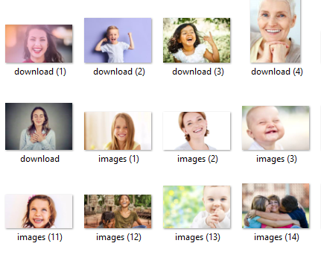
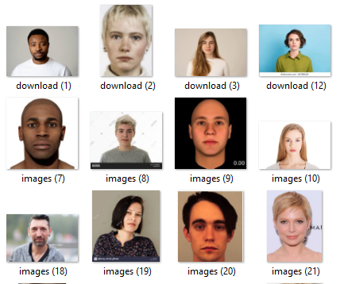
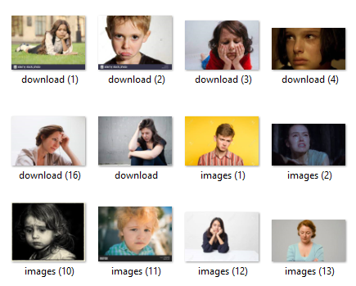
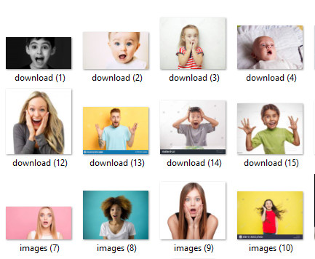

Slide 20
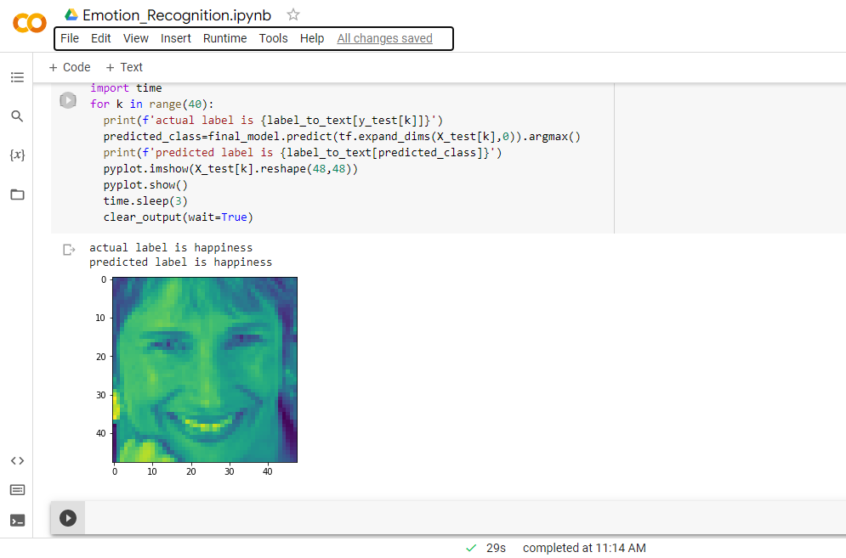
OUTPUT

Slide 21
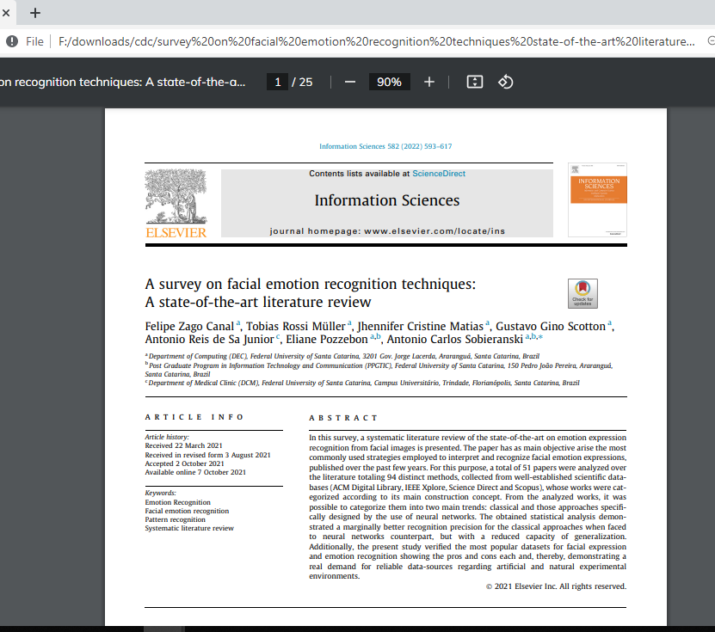
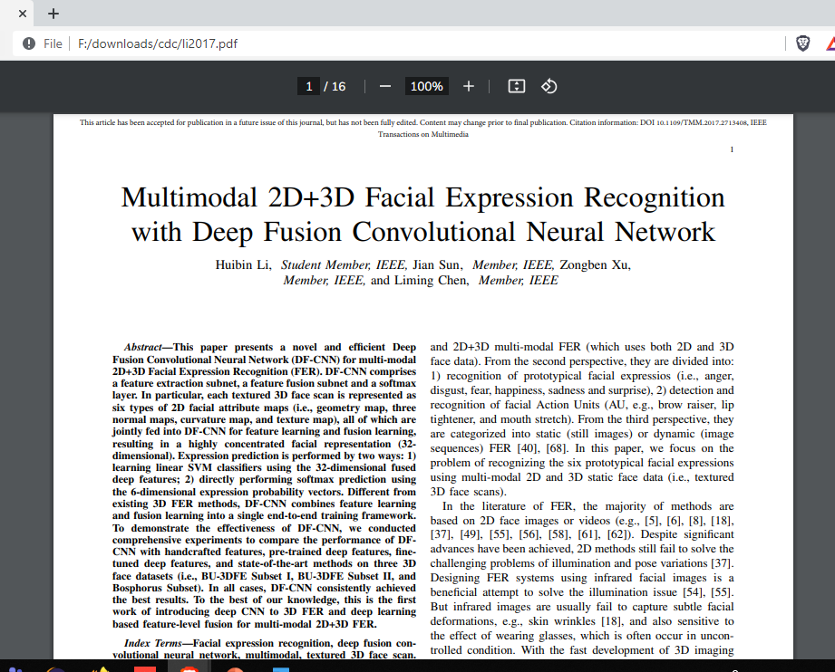
REFERENCE PAPERS

Slide 22
thank you

