Slide 1
Using Predicate Logic

Slide 2
Representing simple facts in logic
Demonstrating the use of Propositional logic
Simple to deal with and decision procedure exist.
Real world facts can be represented as logical propositions written as well formed formulas(wff’s) in propositional logic
It is raining.
RAINING
It is sunny.
SUNNY
It is Windy
WINDY
It is raining then it is not sunny
RAINING-> ¬ SUNNY
Problems with propositional logic
Consider the statement
Socrates is a man represented as SOCRATESMAN
Pluto is a man represented as PLUTOMAN
Both are separate assertion and cannot draw any conclusion about similarities
If these facts are represented as MAN(SOCRATES) MAN(PLUTO). Now the structure of representation reflects the structure of knowledge. We should apply predicates to arguments

Slide 3
Representing simple facts in logic
If the statement
All men are Mortal is represented as
MORTALMAN
Fails to capture the relationship between any individual being a man and individual being Mortal.
Predicate Logic
Represents real world facts as statements written in wffs
If knowledge is represented as logical statements then we can reason with that knowledge.
It does not have a decision procedure but has a procedure that will find a solution to proposed theorem so it is semi decidable.
It is useful in representing and manipulating some of the kinds of knowledge that AI system might need.
Example:
Marcus was a man- man(Marcus)
Marcus was a pompeian.-Pomopeian(Marcus)

Slide 4
Representing simple facts in logic
3. All Pompeians were Romans-
∀x: pompeian(x)->Roman(x)
4. Caesar was a ruler-
ruler(Caesar)
5. All Romans were either loyal to Caesar or hated him.-
∀x:Roman(x)->loyalto(x,Caesar) ∨ hate(x,Caesar)
6. Everyone is loyal to someone-
∀x:->y:loyalto(x,y)
7. People only try to assassinate rulers they are not loyal to.
∀x: ∀y:person(x) ^ruler(y) ^tryassasinate(x,y)->¬loyalto(x,y)
8. Marcus tried to assassinate Caesar-
tryassasinate(Marcus,Caesar)

Slide 5
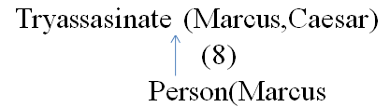
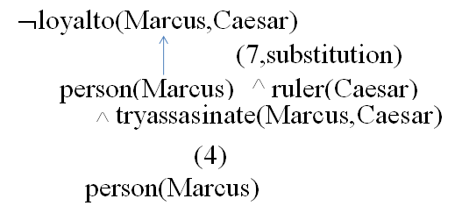
Representing simple facts in logic
Was Marcus loyal to Caesar?
∀:man(x)→ person(x)

Slide 6
Representing simple facts in logic
Three important issues that must be addressed in the process of converting English sentences to logical statements
Many English are ambiguous.
There is a choice among representation. Simple representations are desirable, but they may prevent certain kinds of reasoning.
Even in simple situations a set of sentences may not contain all the necessary information.
Another problem is we do not know in advance is which statement to deduce
For example for the question Was Marcuse loyal to Caesar?
Which one to prove
Loyalto(Marcus,Caesar)
¬Loyalto(Marcus,Caesar)

Slide 7
Representing Instance and isa Relationship
Instance(Marcus,man)
Instance(marcus,pompeian)
∀x:instance(x,pompeian)→instance(x,Roman)
Instance(Caesar,ruler)
∀x:instance(x,Roman)→loyalto(x,Caesar) ∨hate(x,Caesar)
Instance(Marcus,man)
Instance(marcus,pompeian)
Isa(pompeian,Roman)
Instance(Caesar,ruler)
∀x:instance(x,Roman)→loyalto(x,Caesar) ∨ hate(x,Caesar)
∀x: ∀y: ∀z:instance(x,y) ∧ isa(y,z)→ instance )x,z)

Slide 8
Representing Instance and isa Relationship
The class and super class memberships need not always be represented with the predicates Isa and instance, instead unary predicates corresponding to class can be used.
There are several ways a fact can be represented within a particular representational frame work. But within a knowledge base consistency of representation is critical.
The inference mechanisms are not just important because of inference of superclass memberships but because it permits inference of properties associated with the membership in that superclass.
If an exception has to be added then the old assertions has to be changed otherwise the knowledge base will be inconsistent.
Example for Exception : Pompeian(Paulus)
[loyalto(Paulus,Caesar) ∨ hate(Paulus,Caesar)]
Changes in corresponding assertion
∀x: Roman(x) ∧ ¬eq(x,Paulus) → loyalto(Paulus,Caesar) ∨ hate(Paulus,Caesar)

Slide 9
Computable functions and predicates
If the number of facts are very large then it cannot be represented as individual predicates
Example: greater than and less than relationships of numbers
Gt(1,0) Gt(2,1)……..
lt(0,1 ), lt(1,2)…….
In such cases it is useful to have computable predicates where a procedure can be invoked which will evaluate and return true and false.
Examples for conflict and their resolution
1. All Pompeians died when the volcano erupted in 79 A.D
Erupted(volcano,79) ^ ∀x:[Pompeian(x)→died(x,79) ]
2. No Mortal lives longer than 150 years
∀x: ∀t1: ∀t2:mortal(x) ∧ born(x,t1) ∧ gt(t2-t1,150) →dead(x,t2)
3. It is now 1991
Now=1991 // example of equality
4. Alive means not dead
∀x: ∀t :[alive(x,t)→ ¬ dead(x,t) ]^ [ ¬ dead(x,t) →alive(x,t) ]
5. If someone is dead he is dead at all later times
∀x: ∀t1: ∀t2:diedd(x,t1) ^ gt(t2,t1) -> dead(x,t2)

Slide 10
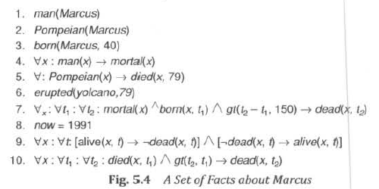
facts
Is Marcus Alive?

Slide 11
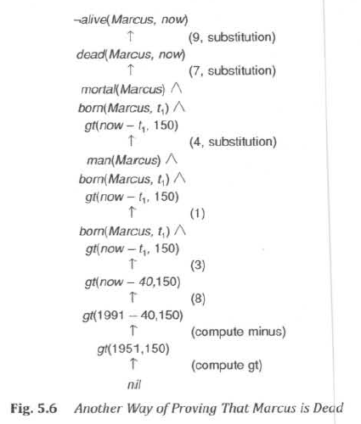
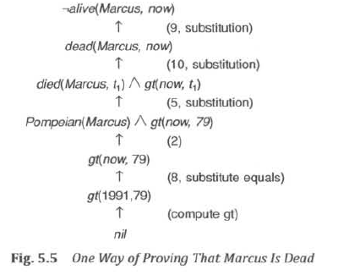
Proofs

Slide 12
Computable functions and predicates
Observations:
Even a very simple conclusion may require many steps to prove.
A variety of processes such as matching, substitution and application of modus ponens are involved in the production of a proof.

Slide 13
Resolution
Resolution is a procedure that operates on statements that have been converted to a very convenient standard form.
Resolution produces proofs by refutation- proves a statement by showing that its negation is a contradiction with the given statements.
Suppose we know that all Romans who know Marcus either hate Caesar or think that anyone who hates anyone is crazy. We could represent that in the following wff:
∀x: [Roman(x) ∧ know(x, Marcus)] →
[hate(x, Caesar) V (∀y : ∃z : hate (y, z) → thinkcrazy(x, y))]
To use this formula in a proof requires a complex matching process.
The formula would be easier to work with if
It were flatter, i.e., there was less embedding of components .
The quantifiers were separated from the rest of the formula so that they did not need to be considered.

Slide 14
Resolution Cont..
Conjunctive normal form [Davis and Putnam, 1960] has both of these properties.
For example, the formula
∀x: [Roman(x) ∧ know(x, Marcus)] →
[hate(x, Caesar) V (∀y : ∃z : hate (y, z) → thinkcrazy(x, y))]
would be represented in conjunctive normal form as
¬ Roman(x) ∧ ¬ know(x, Marcus) ∨ hate(x, Caesar) ∨ ¬ hate(y, z) ∨ thinkcrazy(x, z)
We need to reduce a set of wff's to a set of clauses, where a clause is defined to be a wff in conjunctive normal form but with no instances of the connector A

Slide 15
Resolution Cont..
Algorithm: Convert to Clause Form
1. Eliminate → using the fact that
a → b is equivalent to ¬ a V b.
Performing this transformation on the wff given above yields
∀x: ¬ [Roman(x) ∧ know(x, Marcus)] V
[hate(x, Caesar) V (∀y : ¬(∃z : hate(y, z)) V thinkcrazy(x, y))]
2. Reduce the scope of each ¬ to a single term, using the fact that
¬ (¬ p) = p
DeMorgan's laws : ¬ (a ∧ b) = ¬ a V ¬ b and ¬ (a V b) = ¬ a ∧ ¬ b ]
The standard correspondences between quantifiers :
¬ ∀x: P(x) = ∃x: ¬ P(x)
¬ ∃x: P(x) = ∀ x: ¬P(x)
Performing this transformation on the wff from step 1 yields
∀x: [¬ Roman(x) V ¬ know(x, Marcus)] V
[hate(x, Caesar) V (∀y: ∀z: ¬ hate(y, z) V thinkcrazy(x, y))]

Slide 16
Resolution Cont.. Algorithm: Convert to Clause Form cont..
3. Standardize variables so that each quantifier binds a unique variable
∀x: P(x) V ∀x: Q(x) would be converted to ∀x: P(x) V ∀y: Q(y)
4. Move all quantifiers to the left of the formula without changing their relative order
∀x: ∀y: ∀ z: [¬ Roman(x) V ¬ know(x, Marcus)] V
[hate(x, Caesar) V (¬ hale(y, z) V thinkcrazy(x, y))]
At this point, the formula is in what is known as prenex normal form. It consists of a prefix of quantifiers followed by a matrix, which is quantifier-free.

Slide 17
Resolution Cont.. Algorithm: Convert to Clause Form cont..
5. Eliminate existential quantifiers.
A formula that contains an existentially quantified variable asserts that there is a value that can be substituted for the variable that makes the formula true.
We can eliminate the quantifier by substituting for the variable a reference to a function that produces the desired value.
Since we do not necessarily know how to produce the value, we must create a new function name for every such replacement. for example, the formula
∃y : President(y) can be transformed into President(S1)
where S1 is a function with no arguments that somehow produces a value that satisfies President.
If existential quantifiers occur within the scope of universal quantifiers, then the value that satisfies the predicate may depend on the values of the universally quantified variables. For example, in the formula
∀x: ∃y: father-of(y, x) transformed into ∀x: father-of(S2(x), x)
These generated functions are called Skolem functions. Sometimes ones with no arguments are called Skolem constants.

Slide 18
Resolution Cont.. Algorithm: Convert to Clause Form cont..
6. Drop the prefix.
At this point, all remaining variables are universally quantified, so the prefix can be dropped
Now the formula produced in step 4 appears as
[¬ Roman(x) V ¬ know(x, Marcus)] V
[hate(x, Caesar) V (¬ hate(y, z) V thinkcrazy(x, y))]
7. Convert the matrix into a conjunction of disjuncts. In the our example, there are no and’s, so simply remove the parentheses, giving
¬ Roman(x) V ¬ know(x, Marcus) V hate(x, Caesar) V ¬ hate(y, z) V thinkcrazy(x, y)
Here we can exploit the associative property (a ∧ b) V c = (a V c) ∧ (b ∧ c)] or the distributive property- (a ∧ b) V c = (a V c) ∧ (b V c)]
For example, the formula
(winter ∧ wearingboots) V (summer ∧ wearingsandals)
becomes, after one application of the rule
[winter V (summer ∧ wearingsandals)] ∧ [wearingboots V (summer ∧ wearingsandals)]
and then, after a second application, required since there are still conjuncts joined by OR's,
(winter V summer) ∧ (winter V wearingsandals) ∧ (wearingboots V summer) ∧
(wearingboots V wearingsandals)

Slide 19
Resolution Cont.. Algorithm: Convert to Clause Form cont..
8. Create a separate clause corresponding to each conjunct.
In order for a wff to be true, all the clauses that are generated from it must be true.
If there are several wff’s, all the clauses generated by each of them can now be combined to represent the same set of facts as were represented by the original wff's.
9. Standardize apart the variables (rename the variables so that no two clauses make reference to the same variable).
In making this transformation, the following fact can be used
(∀x: P(x) ∧ Q(x)) = ∀x: P(x) ∧ ∀x: Q(x)
Thus since each clause is a separate conjunct and since all the variables are universally quantified, there need not be a relationship between the variables of two clauses, even if they were generated from the same wff.
After applying this entire procedure to a set of wff's, we will have a set of clauses, each of which is a disjunction of literals.

Slide 20
Resolution Cont.. The basis of resolution
The resolution procedure is a simple iterative process
At each step, two clauses, called the parent clauses, are compared yielding a new clause that has been inferred from them.
The new clause represents ways that the two parent clauses interact with each other.
Suppose that there are two clauses in the system:
winter V summer
¬ winter V cold
From this we can deduce summer V cold (Resolvent)
If the clause that is produced is the empty clause, then a contradiction has been found. For example, the two clauses
winter
¬ winter
The theoretical basis of the resolution procedure in predicate logic is Herbrand's theorem [Chang and Lee, 1973J, which tells us the following:
To show that a set of clauses S is unsatisfiable, it is necessary to consider only interpretations over a particular set, called the Herbrand universe of S.
A set of clauses S is unsatisfiable if and only if a finite subset of ground instances (in which all bound variables have had a value substituted for them) of S is unsatisfiable

Slide 21
Resolution Cont.. Resolution in propositional logic
In propositional logic, the procedure for producing a proof by resolution of proposition P with respect to a set of axioms F is the following.
Algorithm: Propositional Resolution
1 Convert all the propositions of F to clause form.
2. Negate P and convert the result to clause form. Add it to the set of clauses obtained in step 1.
3. Repeat until either a contradiction is found or no progress can be made:
(a) Select two clauses. Call these the parent clauses.
(b) Resolve them together. The resulting clause, called the resolvent, will be the disjunction of all of the literals of both of the parent clauses with the following exception: If there are any pairs of literals
L and ¬ L such that one of the parent clauses contains L and the other contains ¬ L, then select one such pair and eliminate both L and ¬ L from the resolvent.
(c) If the resolvent is the empty clause, then a contradiction has been found. If it is not, then add it to the set of clauses available to the procedure.

Slide 22
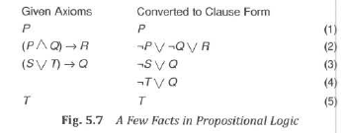
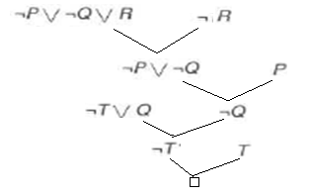
Resolution Cont.. Resolution in propositional logic
Example:
we want to prove R
First we convert the axioms to clause form, as shown in the second column
Then we negate R, producing ¬ R

Slide 23
The unification algorithm
In predicate logic, this matching process is more complicated since the arguments of the predicates must be considered.
For example, man(John) and ¬ man(John) is a contradiction, while man(John) and ¬ man(Spot) is not.
Thus, in order to determine contradictions, a matching procedure is needed that compares two literals and discovers whether there exists a set of substitutions that makes them identical.
The unification algorithm, is a straightforward recursive procedure that does this.
The basic idea –If the initial predicate symbols are the same we can proceed. Otherwise, they cannot be unified.
Example- tryassassinate (Marcus, Caesar)
hate(Marcus, Caesar)
If the predicate symbols match, then we must check the arguments, one pair at a time.

Slide 24
Resolution Cont.. The unification algorithm
The matching rules:-
Different constants or predicates cannot match; identical ones can.
A variable can match another variable, any constant, or a predicate expression, with the restriction that the predicate expression must not contain any instances of the variable being matched.
There must be a single, consistent substitution for the entire literal . Each substitution that is found should be applied it to the remainder of the literals before we continue trying to unify them.
For example, suppose we want to unify the expressions
P(x, x)
P(y, z)
if y is substituted for x y/x then
P(y, y)
P(y, z)
attempt to unify arguments y and z, which succeeds with the substitution z/y
The entire unification process has now succeeded with a substitution that is the composition of the two substitutions . The composition is written as (z/y)(y/x)
In general, the substitution (a1/a2, a3/a4, …)(b1/b2, b3/b4, …)… means to apply all the substitutions of the right- most list, then take the result and apply all the ones of the next list, and so forth, until all substitutions have been applied.
Try to unify f(x, x) and g(x),g(x))

Slide 25
Resolution Cont.. The unification algorithm
The objective of the unification procedure is to discover at least one substitution that causes two literals to match
procedure Unify(L1 , L2), returns as its value a list representing the composition of the substitutions that were performed during the match
The empty list, NIL, indicates that a match was found without any substitutions. The list consisting of the single value FAIL indicates that the unification procedure failed.
Algorithm: Unify(L1, L2)
I. If L1 or L2 are both variables or constants, then:
(a) If L1 and L2 are identical, then return NIL.
(b) Else if L1 is a variable, then if L1 occurs in L2 then return {FAIL}, else return (L2/L1).
(c) Else if L2 is a variable, then if L2 occurs in L1 then return {FAIL} , else return (L1/L2).
(d) Else return {FAIL}.
2. If the initial predicate symbols in L1 and L2 are not identical, then return {FAIL}.
3. If LI and L2 have a different number of arguments, then return {FAIL}.
4. Set SUBST to NIL.

Slide 26
Resolution Cont.. The algorithm unify continues
For i ← 1 to number of arguments in L1 :
(a) Call Unify with the ith argument of L1 and the ith argument of L2, putting result in S.
(b) If S contains FAIL then return {FAIL}.
(c) If S is not equal to NIL then:
(i) Apply S to the remainder of both L1 and L2.
(ii) SUBST: = APPEND(S, SUBST).
6. Return SUBST.

Slide 27
Resolution Cont.. Resolution in predicate logic
Two literals are contradictory- if one of them can be unified with the negation of the other. , for example, man(x) and ¬ man(Spot) are contradictory.
For example. suppose we want to resolve two clauses:
1. man(Marcus)
2. ¬ man(x1) V mortal(x1)
Substitution Marcus/x
Resolvent mortal(x1)
The resolution process can then proceed from there to discover whether mortal(Marcus) leads to a contradiction with other available clauses.

Slide 28
Resolution Cont.. Algorithm resolution
1. Convert all the statements of F to clause form.
2. Negate P and convert the result to clause form. Add it to the set of clauses obtained in 1.
3. Repeat until either a contradiction is found , no progress can be made, or a predetermined amount of effort has been expended.
(a) Select two clauses. Call these the parent clauses.
(b) Resolve them together. The resolvent will be the disjunction of all the literals of both parent clauses with appropriate substitutions performed and with the following exception:
If there is one pair of literals T1 and ¬ T2 such that one of the parent clauses contains T2 and the other contains T1 and if T1 and T2 are unifiable, then neither T1 nor T2 should appear in the resolvent. We call T1 and T2 Complementary literals. Use the substitution produced by the unification to create the resolvent.
If there is more than one pair of complementary literals, only one pair should be omitted from the resolvent.
(c) If the resolvent is the empty clause, then a contradiction has been found. If it is not, then add it to the set of clauses available to the procedure.

Slide 29
Resolution Cont.. Resolution in predicate logic
strategies for making the choice that can speed up the process considerably:
Only resolve pairs of clauses that contain complementary literals, To facilitate this, index clauses by the predicates they contain, combined with an indication of whether the predicate is negated.
Eliminate certain clauses as soon as they are generated so that they cannot participate in later resolutions. Two kinds of clauses should be eliminated: tautologies (which can never be unsatisfied) and clauses that are subsumed by other clauses (i.e., they are easier to satisfy. For example, P V Q is subsumed by P.)
Whenever possible, resolve either with one of the clauses that is part of the statement we are trying to refute or with a clause generated by a resolution with such a clause. This is called the set-of-support strategy and corresponds to the intuition that the contradiction we are looking for must involve the statement we are trying to prove. Any other contradiction would say that the previously believed statements were inconsistent.
Whenever possible, resolve with clauses that have a single literal. Such resolutions generate new clauses with fewer literals than the larger of their parent clauses and thus are probably closer to the goal of a resolvent with zero terms. This method is called the unit-preference strategy.

Slide 30
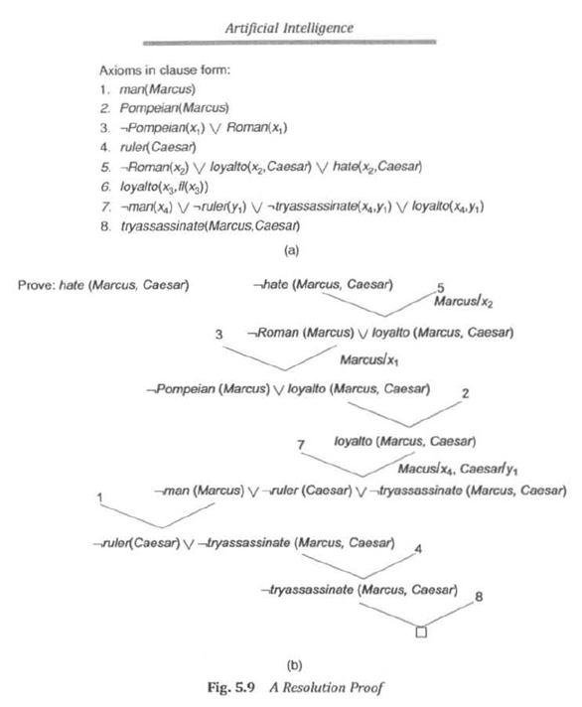
Resolution proof of the statement hate(Marcus,Caesar)

Slide 31
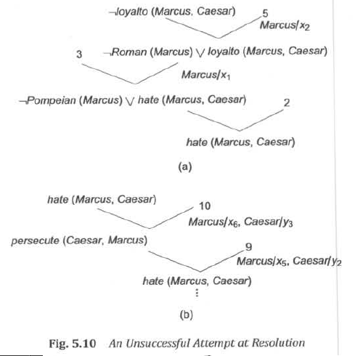
Resolution Cont.. Resolution in predicate logic
Did Marcus hate Caesar?
If the previous proof was an answer to the above question then we could even prove
¬hate(Marcus, Caesar) then we should add hate(Marcus, Caesar but there are no clause to create a contradiction.
But sometimes these contradictions are identified at a later stage.
For example

Slide 32
Resolution Cont.. Resolution in predicate logic
If the knowledge base contains two additional statements
9. persecute(x, y) → hate(y, x)
10. hate(x, y) → persecute(y, x)
Converting to clause form, we get
9. ¬ persecute(x5, y2) V hate(y2, x5)
10. ¬ hate(x6, y3) V persecute (y3, x6)
Although resolvents can be generated new ones cannot be generated.

Slide 33
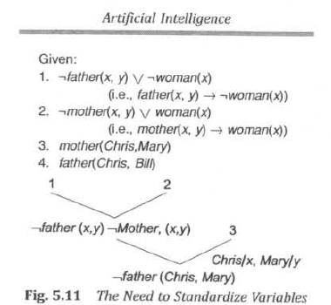
Resolution Cont.. Resolution in predicate logic
Example showing the need to standardize variables
if clause 2 had been rewritten as
¬ mother(a, b) V woman(a)
Then the clause
¬ father(Chris, y) will be produced and the contradiction with clause 4 would have emerged

Slide 34
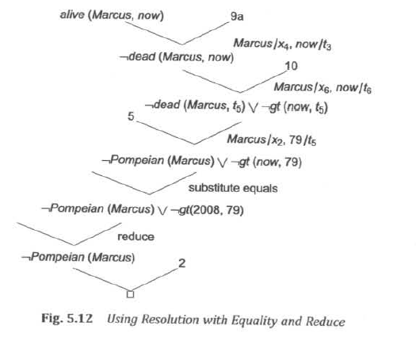
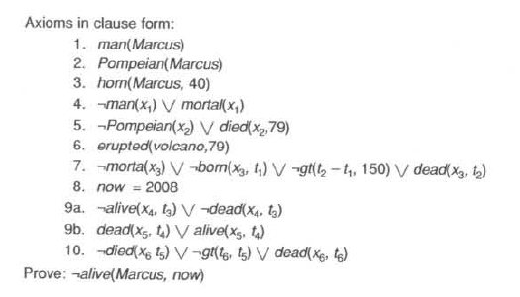
Example demonstrates two ways of generating new clauses, in addition to the resolution rule:
Substitution of one value for another to which it is equal.
Reduction of computable predicates

Slide 35
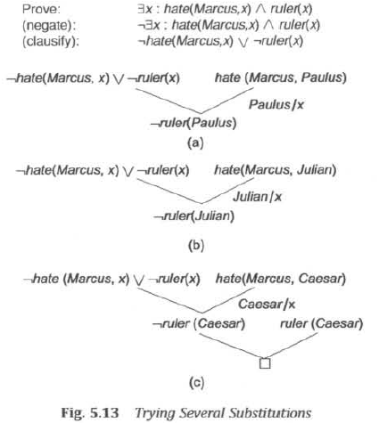
Resolution Cont.. Need to try several substitutions
hate(Marcus, Paulus)
hate(Marcus, Julian)

Slide 36
Resolution Cont.. Question Answering
Resolution can be used to answer fill-in-the-blank questions, such as "When did Marcus die?" or "Who tried to assassinate a ruler?”
To answer the question as "When did Marcus die?" we need a statement like died(Marcus, ??) i.e died(Marcus, 79) answer will be 79.
In order to be able to answer this question, it must first be true that Marcus died. Thus it must be the case that
∃t: died(Marcus, t)
A reasonable first step then might be to try to prove this. To do so using resolution, we attempt to show that
¬ ∃t: died(Marcus, i) produces a contradiction.
which means it conflicts with a statement of the form
∀t: died(Marcus, t)
where t is a variable, in which case we can either answer the question by reporting that there are many times at which Marcus died, or we can simply pick one such time and respond with it

Slide 37
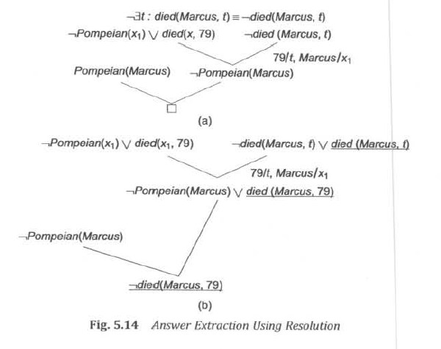
Answer extraction using resolution
Adding an expression that we are trying to prove

Slide 38
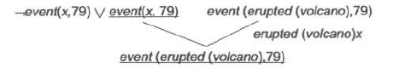
Resolution Cont.. Question Answering
There are some questions that cannot be answered using this mechanism.
For example, suppose that we want to answer the question
"What happened in 79 A.D.?”
In order to answer the question, we need to prove that something happened in 79. We need to prove ∃x: event(x, 79) and to discover a value for x. But we do not have any statements of the form event(x, y).
However, the question can be answered ,if we change our representation from erupted(volcano, 79) to event(erupted(volcano), 79)
Drawback
It is more complex.
It still does not make it possible to answer all conceivable questions

Slide 39
Natural Deduction
Disadvantages of resolution
Since everything looks the same, there is no easy way to select those statements that are the most likely to be useful in solving a particular problem.
In converting everything to clause form, we lose valuable heuristic information that is contained in the original representation of the facts.
For example, suppose we believe that all judges who are not crooked are well-educated, which can be represented as
∀x: judge(x) ∧ ¬ crooked(x) → educated(x)
In this form, the statement suggests a way of deducing that someone is educated. But when the same statement is converted to clause form
¬ judge(x) V crooked(x) V educated(x)
people do not think in resolution
Machine theorem proving that corresponds more closely to the processes used in human theorem proving is defined as natural deduction.
It describes a method in which various techniques are used in combination to solve problems that are not tractable by any one method alone.
One common technique is to arrange knowledge, not by predicates but rather by the objects involved in the predicates.

