Slide 1
Gender Statistics
Revature
List the average increase in female education in the U.S. from the year 2000.
List the % of change in male employment from the year 2000.
List the % of change in female employment from the year 2000.

Slide 2
List the average increase in female education in the U.S. from the year 2000.
Within the indicator code, there are 2 sub codes.
CUAT & FE: Meaning - Females with a cumulative educational attainment percentages with respect to a specified year.
Filtered out and then averaged together.
When it this job gets sent to the reducer, the reducer takes a final average of all the averages. (Answer: United States 0.1956%)

Slide 3
List the % of change in male employment from the year 2000.
Values used are male employment percentages.
Mapper grabs the first and last value within the same row as the Indicator Code
  SL.EMP.TOTL.SP.MA.ZS
Those values are then averaged together and sent to the reducer, alongside their respective country.

Slide 4
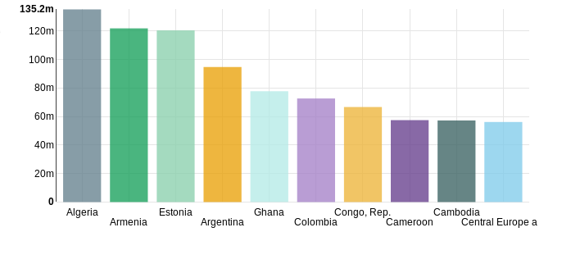
Top 10 Countries For Male Employment Increase Since 2000

Slide 5
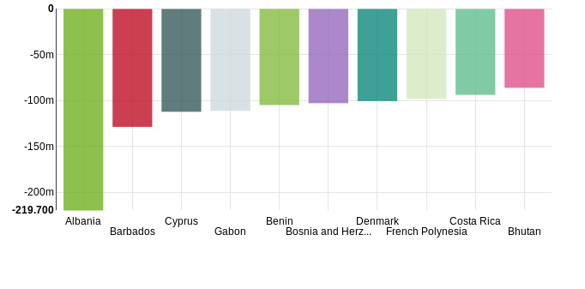
Top 10 Countries For Male Employment Decrease Since 2000

Slide 6
List the % of change in female employment from the year 2000.
Values used are male employment percentages.
Mapper grabs the first and last value within the same row as the Indicator Code
  SL.EMP.TOTL.SP.FE.ZS
Those values are then averaged together and sent to the reducer, alongside their respective country.

Slide 7
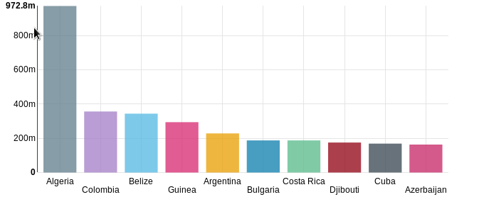
Top 10 Countries For Female Employment Increase Since 2000

Slide 8
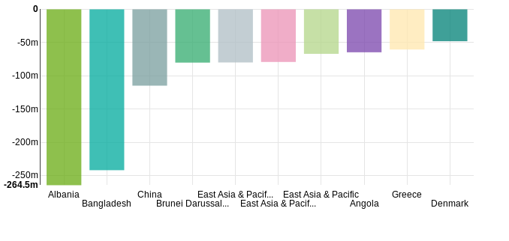
Top 10 Countries For Female Employment Decrease Since 2000

