Slide 1
Project 1
By Andrew Ha

Slide 2
Goal
Create an Expense Reimbursement System
Employees and Managers can log in/out
Employees submit a request
View pending/resolved requests and who resolved the request
View/edit profile
Managers can approve/reject pending reimbursement requests
Managers can see all employees
Managers can view reimbursement requests from a single employee

Slide 3
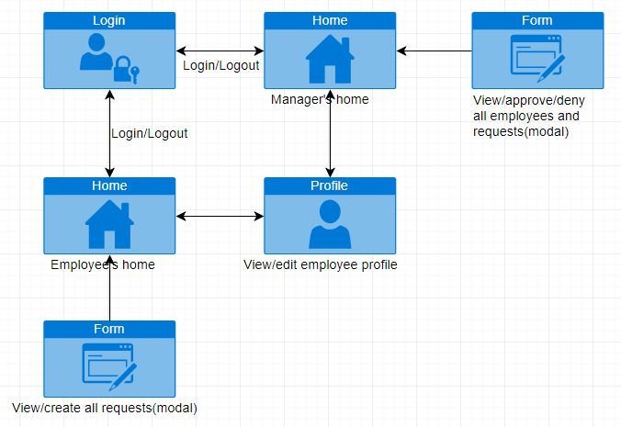
Site Map

