Slide 2
Overview LEC # 18
Iterative combinational circuits
Binary adders
  Half and full adders
  Ripple carry and carry lookahead adders
Binary subtraction
Binary adder-subtractors
  Signed binary numbers
  Signed binary addition and subtraction
  Overflow
Binary multiplication
Other arithmetic functions
  Design by contraction
Chapter 4 <number>

Slide 3
Iterative Combinational Circuits
Arithmetic functions
  Operate on binary vectors
  Use the same subfunction in each bit position
Can design functional block for subfunction and repeat to obtain functional block for overall function
Cell - subfunction block
Iterative array - a array of interconnected cells
An iterative array can be in a single dimension (1D) or multiple dimensions
Chapter 4 <number>

Slide 4
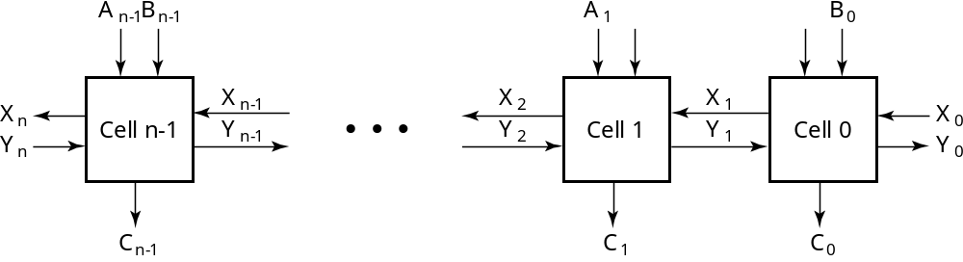
Block Diagram of a 1D Iterative Array
Example: n = 32
  Number of inputs = ?
  Truth table rows = ?
  Equations with up to ? input variables
  Equations with huge number of terms
  Design impractical!
Iterative array takes advantage of the regularity to make design feasible
Chapter 4 <number>
Notes:
Number of Inputs = 66
Truth Table Rows = 2⁶⁶
Equations with up to 66 variables

Slide 5
Functional Blocks: Addition
Binary addition used frequently
Addition Development:
  Half-Adder (HA), a 2-input bit-wise addition functional block,
  Full-Adder (FA), a 3-input bit-wise addition functional block,
  Ripple Carry Adder, an iterative array to perform binary addition, and
  Carry-Look-Ahead Adder (CLA), a hierarchical structure to improve performance.
Chapter 4 <number>

Slide 6
Functional Block: Half-Adder
A 2-input, 1-bit width binary adder that performs the following computations:
A half adder adds two bits to produce a two-bit sum
The sum is expressed as a sum bit , S and a carry bit, C
The half adder can be specified as a truth table for S and C ⇒
X
0
0
1
1
+ Y
+ 0
+ 1
+ 0
+ 1
C S
0 0
0 1
0 1
1 0
X
Y
C
S
0
0
0
0
0
1
0
1
1
0
0
1
1
1
1
0
Chapter 4 <number>

Slide 7
Logic Simplification: Half-Adder
The K-Map for S, C is:
This is a pretty trivial map!
By inspection:
and
These equations lead to several implementations.
S
Y
C
Y
1
0
1
0
1
X
1
X
1
S
=
X
⋅
Y
+
X
⋅
Y
=
X
⊕
Y
2
3
2
3
S
=
(
X
+
Y
)
⋅
(
X
+
Y
)
C
=
X
⋅
Y
C
=
(
(
X
⋅
Y
)
)
Chapter 4 <number>

Slide 8
Five Implementations: Half-Adder
We can derive following sets of equations for a half-adder:
(a), (b), and (e) are SOP, POS, and XOR implementations for S.
In (c), the C function is used as a term in the AND-NOR implementation of S, and in (d), the function is used in a POS term for S.
(
a
)
S
=
X
⋅
Y
+
X
⋅
Y
(
d
)
S
=
(
X
+
Y
)
⋅
C
C
=
X
⋅
Y
C
=
(
X
+
Y
)
(
b
)
S
=
(
X
+
Y
)
⋅
(
X
+
Y
)
(
e
)
S
=
X
⊕
Y
C
=
X
⋅
Y
C
=
X
⋅
Y
(
c
)
S
=
(
C
+
X
⋅
Y
)
C
=
X
⋅
Y
C
Chapter 4 <number>

Slide 9
Implementations: Half-Adder
The most common half adder implementation is: (e)
A NAND only implementation is:
X
S
Y
S
=
X
⊕
Y
C
C
=
X
⋅
Y
C
X
S
=
(
X
+
Y
)
⋅
C
C
=
(
(
X
⋅
Y
)
)
S
Y
Chapter 4 <number>

Slide 10
Functional Block: Full-Adder
A full adder is similar to a half adder, but includes a carry-in bit from lower stages. Like the half-adder, it computes a sum bit, S and a carry bit, C.
  For a carry-in (Z) of 0, it is the same as the half-adder:
  For a carry- in
  (Z) of 1:
Z
0
0
0
0
X
0
0
1
1
+ Y
+ 0
+ 1
+ 0
+ 1
C S
0
0
0 1
0 1
1 0
Z
1
1
1
1
X
0
0
1
1
+ Y
+ 0
+ 1
+ 0
+ 1
C S
0 1
1 0
1 0
1
1
Chapter 4 <number>

Slide 11
Logic Optimization: Full-Adder
Full-Adder Truth Table:
Full-Adder K-Map:
X
Y
Z
C
S
0
0
0
0
0
0
0
1
0
1
0
1
0
0
1
0
1
1
1
0
1
0
0
0
1
1
0
1
1
0
1
1
0
1
0
1
1
1
1
1
S
Y
C
Y
1
1
1
0
1
3
2
0
1
3
2
X
1
1
X
1
1
1
4
5
7
6
4
5
7
6
Z
Z
Chapter 4 <number>

Slide 12
Equations: Full-Adder
From the K-Map, we get:
The S function is the three-bit XOR function (Odd Function):
The Carry bit C is 1 if both X and Y are 1 (the sum is 2), or if the sum is 1 and a carry-in (Z) occurs. Thus C can be re-written as:
The term X·Y is carry generate.
The term X⊕Y is carry propagate.
S
=
X
Y
Z
+
X
Y
Z
+
X
Y
Z
+
X
Y
Z
C
=
X
Y
+
X
Z
+
Y
Z
S
=
X
⊕
Y
⊕
Z
C
=
X
Y
+
(
X
⊕
Y
)
Z
Chapter 4 <number>

Slide 13
Implementation: Full Adder
Ai
Bi
Full Adder Schematic
Here X, Y, and Z, and C
(from the previous pages)
are A, B, C_{i} and C_{o},
respectively. Also,
G = generate and
P = propagate.
Note: This is really a combination
of a 3-bit odd function (for S)) and
Carry logic (for C_{o}):
(G = Generate) OR (P =Propagate AND C_{i} = Carry In)
Co = G + P · Ci
Gi
Pi
Ci
Ci+1
Si
Chapter 4 <number>

Slide 14
LEC # 19
To add multiple operands, we “bundle” logical signals together into vectors and use functional blocks that operate on the vectors
Example: 4-bit ripple carry
adder: Adds input vectors A(3:0) and B(3:0) to get
a sum vector S(3:0)
Note: carry out of cell i
becomes carry in of cell
i + 1
Description
Subscript
Name
3 2 1 0
Carry In
0 1 1 0
Ci
Augend
1 0 1 1
Ai
Addend
0 0 1 1
Bi
Sum
1 1 1 0
Si
Carry out
0 0 1 1
Ci+1
Chapter 4 <number>

Slide 15
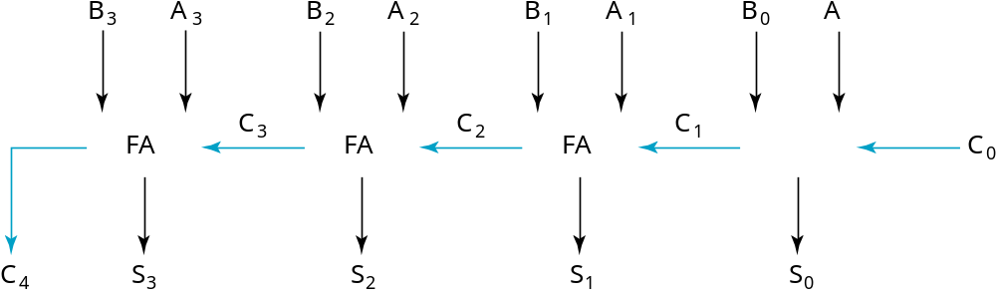
4-bit Ripple-Carry Binary Adder
A four-bit Ripple Carry Adder made from four 1-bit Full Adders:
Chapter 4 <number>

Slide 16
Unsigned Subtraction
Algorithm:
  Subtract the subtrahend N from the minuend M
  If no end borrow occurs, then M ≥ N, and the result is a non-negative number and correct.
  If an end borrow occurs, the N > M and the difference M − N + 2n is subtracted from 2n, and a minus sign is appended to the result.
Examples:
0 1
1001 0100
− 0111 − 0111
0010 1101
10000
− 1101
(−) 0011
Chapter 4 <number>

Slide 17
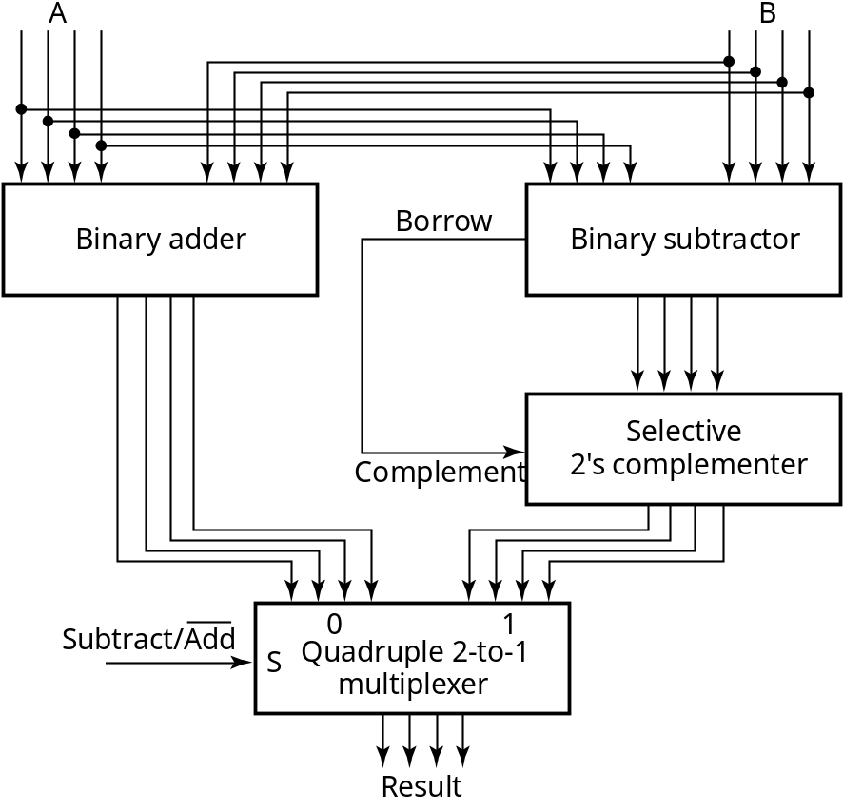
Unsigned Subtraction (continued)
The subtraction, 2^{n} − N, is taking the 2’s complement of N
To do both unsigned addition and unsigned subtraction requires:
Quite complex!
Goal: Shared simpler
logic for both addition
and subtraction
Introduce complements
as an approach
Chapter 4 <number>

Slide 18
Complements
Two complements:
  Diminished Radix Complement of N
    (r − 1)’s complement for radix r
    1’s complement for radix 2
    Defined as (r^{n} − 1) − Ν
  Radix Complement
    r’s complement for radix r
    2’s complement in binary
    Defined as r^{n} − N
Subtraction is done by adding the complement of the subtrahend
If the result is negative, takes its 2’s complement
Chapter 4 <number>

Slide 19
Binary 1's Complement
For r = 2, N = 01110011₂, n = 8 (8 digits):
(r^{n} – 1) = 256 -1 = 255₁₀ or 11111111₂
The 1's complement of 01110011₂ is then:
11111111
– 01110011
10001100
Since the 2^{n} – 1 factor consists of all 1's and since 1 – 0 = 1 and 1 – 1 = 0, the one's complement is obtained by complementing each individual bit (bitwise NOT).
Chapter 4 <number>

Slide 20
Binary 2's Complement
For r = 2, N = 01110011₂, n = 8 (8 digits), we have:
(r^{n} ) = 256₁₀ or 100000000₂
The 2's complement of 01110011 is then:
100000000
– 01110011
10001101
Note the result is the 1's complement plus 1, a fact that can be used in designing hardware
Chapter 4 <number>

Slide 21
Alternate 2’s Complement Method
Given: an n-bit binary number, beginning at the least significant bit and proceeding upward:
  Copy all least significant 0’s
  Copy the first 1
  Complement all bits thereafter.
2’s Complement Example:
  10010100
  Copy underlined bits:
  100
  and complement bits to the left:
  01101100
Chapter 4 <number>

Slide 22
Subtraction with 2’s Complement
For n-digit, unsigned numbers M and N, find M − N in base 2:
  Add the 2's complement of the subtrahend N to the minuend M:
  M + (2^{n} − N) = M − N + 2^{n}
  If M > N, the sum produces end carry r^{n} which is discarded; from above, M − N remains.
  If M < N, the sum does not produce an end carry and, from above, is equal to 2^{n} − ( N − M ), the 2's complement of ( N − M ).
  To obtain the result − (N – M) , take the 2's complement of the sum and place a − to its left.
Chapter 4 <number>

Slide 23
Unsigned 2’s Complement Subtraction Example 1
Find 01010100₂ – 01000011₂
01010100 01010100
– 01000011 + 10111101
00010001
The carry of 1 indicates that no correction of the result is required.
1
2’s comp
Chapter 4 <number>

Slide 24
Unsigned 2’s Complement Subtraction Example 2
Find 01000011₂ – 01010100₂
01000011 01000011
– 01010100 + 10101100
11101111
00010001
The carry of 0 indicates that a correction of the result is required.
Result = – (00010001)
0
2’s comp
2’s comp
Chapter 4 <number>

Slide 25
LEC # 19
Positive numbers and zero can be represented by unsigned n-digit, radix r numbers. We need a representation for negative numbers.
To represent a sign (+ or –) we need exactly one more bit of information (1 binary digit gives 2¹ = 2 elements which is exactly what is needed).
Since computers use binary numbers, by convention, the most significant bit is interpreted as a sign bit:
s a_{n–2} … a₂a₁a₀
where:
s = 0 for Positive numbers
s = 1 for Negative numbers
and a_{i} = 0 or 1 represent the magnitude in some form.
Chapter 4 <number>

Slide 26
Signed Integer Representations
Signed-Magnitude – here the n – 1 digits are interpreted as a positive magnitude.
Signed-Complement – here the digits are interpreted as the rest of the complement of the number. There are two possibilities here:
  Signed 1's Complement
    Uses 1's Complement Arithmetic
  Signed 2's Complement
    Uses 2's Complement Arithmetic
Chapter 4 <number>

Slide 27
Signed Integer Representation Example
r =2, n=3
Number
Sign
-
Mag.
1's Comp.
2's Comp.
+3
011
011
011
+2
010
010
010
+1
001
001
001
+0
000
000
000
–
0
100
111
—
–
1
101
110
111
–
2
110
101
110
–
3
111
100
101
–
4
—
—
100
Chapter 4 <number>

Slide 28
Signed-Magnitude Arithmetic
If the parity of the three signs is 0:
    1. Add the magnitudes.
    2. Check for overflow (a carry out of the MSB)
    3. The sign of the result is the same as the sign of the
    first operand.
If the parity of the three signs is 1:
    1. Subtract the second magnitude from the first.
    2. If a borrow occurs:
      take the two’s complement of result
      and make the result sign the complement of the sign of the first operand.
    3. Overflow will never occur.
Chapter 4 <number>

Slide 29
Sign-Magnitude Arithmetic Examples
Example 1: 0010
+ 0101
Example 2: 0010
+ 1101
Example 3: 1010
− 0101
Chapter 4 <number>
Notes:
Example 1: Since the parity of the signs is 0: ADD magnitudes giving 111
Append the sign of the first operand to obtain 0111
Example 2: Since the parity of the signs is 1: SUBTRACT 010
- 101
101 Borrow of 1
Taking the 2’s complement and appending the complement of the sign: 1011
Example 3: Since the parity of the signs is 0, ADD the magnitudes 010
101
111
Appending the sign if the top operand: 1111

Slide 30
Signed-Complement Arithmetic
Addition:
  1. Add the numbers including the sign bits, discarding a carry out of the sign bits (2's Complement), or using an end-around carry (1's Complement).
  2. If the sign bits were the same for both numbers and the sign of the result is different, an overflow has occurred.
  3. The sign of the result is computed in step 1.
Subtraction:
  Form the complement of the number you are subtracting and follow the rules for addition.
Chapter 4 <number>

Slide 31
Signed 2’s Complement Examples
Example 1: 1101
+ 0011
Example 2: 1101
− 0011
Chapter 4 <number>
Notes:
Example 1: Result is 0000. The carry out of the MSB is discarded.
Example 2: Complement 0011 to 1101 and add. Result is 1010. The carry out of the MSB is discarded.

Slide 32
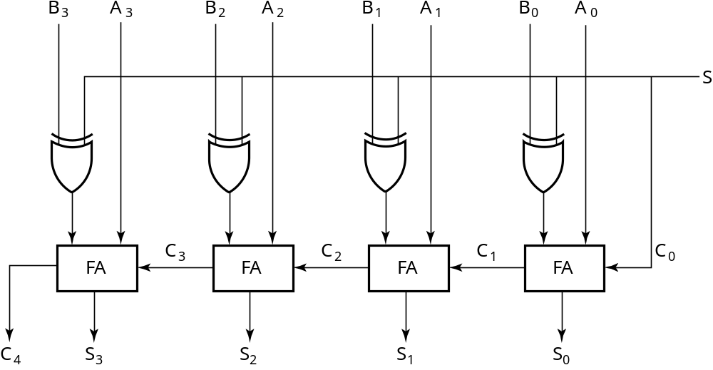
2’s Complement Adder/Subtractor
Subtraction can be done by addition of the 2's Complement.
1. Complement each bit (1's Complement.)
2. Add 1 to the result.
The circuit shown computes A + B and A – B:
For S = 1, subtract,
the 2’s complement
of B is formed by using
XORs to form the 1’s
comp and adding the 1
applied to C₀.
For S = 0, add, B is
passed through
unchanged
Chapter 4 <number>

Slide 33
Overflow Detection
Overflow occurs if n + 1 bits are required to contain the result from an n-bit addition or subtraction
Overflow can occur for:
  Addition of two operands with the same sign
  Subtraction of operands with different signs
Signed number overflow cases with correct result sign
0 0 1 1
+ 0 − 1 − 0 + 1
0 0 1 1
Detection can be performed by examining the result signs which should match the signs of the top operand
Chapter 4 <number>

Slide 34
Overflow Detection
Signed number cases with carries C_{n} and C_{n−1} shown for correct result signs:
0 0 0 0 1 1 1 1
0 0 1 1
+ 0 − 1 − 0 + 1
0 0 1 1
Signed number cases with carries shown for erroneous result signs (indicating overflow):
0 1 0 1 1 0 1 0
0 0 1 1
+ 0 − 1 −0 + 1
1 1 0 0
Simplest way to implement overflow V = C_{n} + C_{n − 1}
This works correctly only if 1’s complement and the addition of the carry in of 1 is used to implement the complementation! Otherwise fails for − 10 ... 0
Chapter 4 <number>

