Slide 1
Lectures of Week
Chapter # 2
Combinational Logic
Hasina Attaullah
Courtesy © 2008 by Pearson Education, Inc.

Slide 2
Circuit Optimization
Goal: To obtain the simplest implementation for a given function
Optimization is a more formal approach to simplification that is performed using a specific procedure or algorithm
Optimization requires a cost criterion to measure the simplicity of a circuit
Distinct cost criteria we will use:
  Literal cost (L)
  Gate input cost (G)
  Gate input cost with NOTs (GN)

Slide 3
Literal Cost
Literal – a variable or it complement
Literal cost – the number of literal appearances in a Boolean expression corresponding to the logic circuit diagram
Examples:
  F = BD + A C + A L = 8
  F = BD + A C + A + AB L =
  F = (A + B)(A + D)(B + C + )( + + D) L =
  Which solution is best?
B
C
D
B
D
C
B
B
C
D
Notes:
2nd Literal Cost = 11
3rd Literal Cost = 10
The first solution is best

Slide 4
Gate Input Cost
Gate input costs - the number of inputs to the gates in the implementation corresponding exactly to the given equation or equations. (G - inverters not counted, GN - inverters counted)
For SOP and POS equations, it can be found from the equation(s) by finding the sum of:
  all literal appearances
  the number of terms excluding single literal terms,(G) and
  optionally, the number of distinct complemented single literals (GN).
Example:
  F = BD + A C + A G = 8, GN = 11
  F = BD + A C + A + AB G = , GN =
  F = (A + )(A + D)(B + C + )( + + D) G = , GN =
  Which solution is best?
B
C
D
B
B
D
C
B
D
B
C
Notes:
G = 15, GN = 18 (second value includes inverter inputs)
G = 14, GN = 17
1st solution is best

Slide 5
Cost Criteria (continued)
GN = G + 2 = 9
Example 1:
F = A + B C +
L = 5
C
B
G = L + 2 = 7
B
C
A
F
L (literal count) counts the AND inputs and the single
literal OR input.
G (gate input count) adds the remaining OR gate inputs
GN(gate input count with NOTs) adds the inverter inputs

Slide 6
Plotting Functions on the
K-map
SOP Form

Slide 7
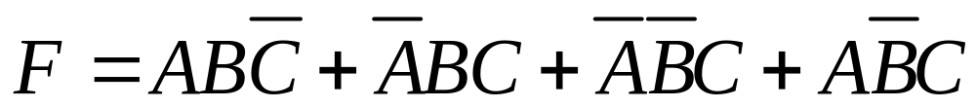
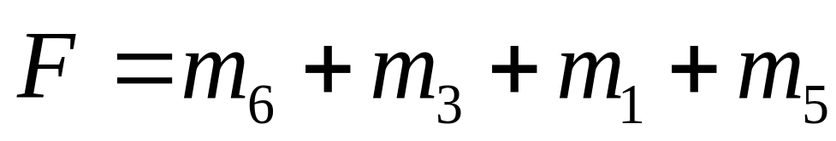
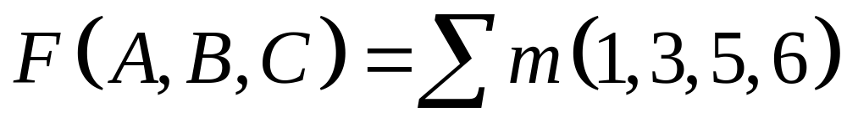
Canonical SOP Form
Three Variable Example
using shorthand notation

Slide 8
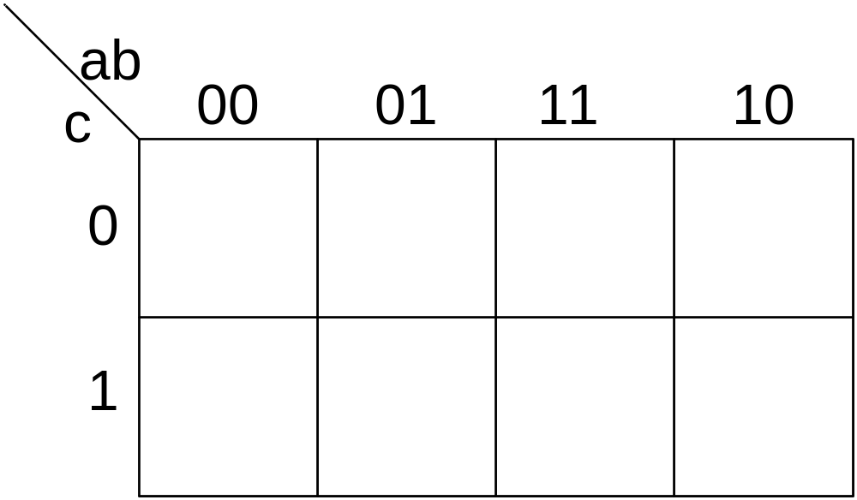
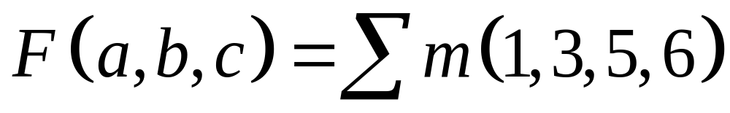
Three-Variable K-Map Example
Plot 1’s (minterms) of switching function
1
1
1
1

Slide 9
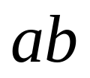
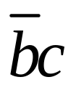
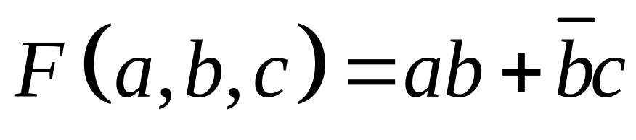
Three-Variable K-Map Example
Plot 1’s (minterms) of switching function
1
1
1
1

Slide 10
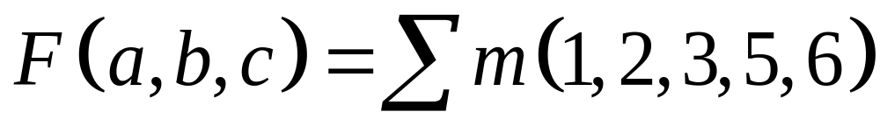
Example
Use a K-Map to simplify the following Boolean expression

Slide 11
Three-Variable K-Map Example
Step 1: Plot the K-map
1
1
1
1
1

Slide 12
Three-Variable K-Map Example
Step 2: Circle ALL Prime Implicants
1
1
1
1
1

Slide 13
Three-Variable K-Map Example
Step 3: Identify Essential Prime Implicants
PI
EPI
PI
1
1
1
1
EPI
1

Slide 14
Three-Variable K-Map Example
Step 4: Select minimum subset of remaining
Prime Implicants to complete the cover.
PI
EPI
1
1
1
1
EPI
1

Slide 15
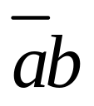
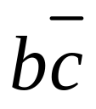
Three-Variable K-Map Example
Step 5: Read the map.
1
1
1
1
1

Slide 16
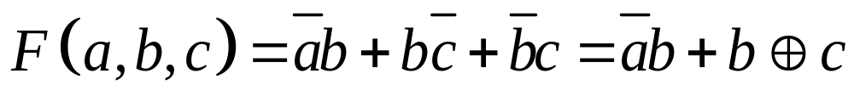
Solution

Slide 17
Four Variable Terms
Four variable maps can have rectangles corresponding to:
  A single 1 = 4 variables, (i.e. Minterm)
  Two 1s = 3 variables,
  Four 1s = 2 variables
  Eight 1s = 1 variable,
  Sixteen 1s = zero variables (i.e.
  Constant "1")
Chapter 2 - Part 2 <number>

Slide 18
Four-Variable Maps
Example Shapes of Rectangles:
Y
0
1
3
2
4
5
7
6
12
13
15
14
X
W
8
9
11
10
Z
Chapter 2 - Part 2 <number>

Slide 19
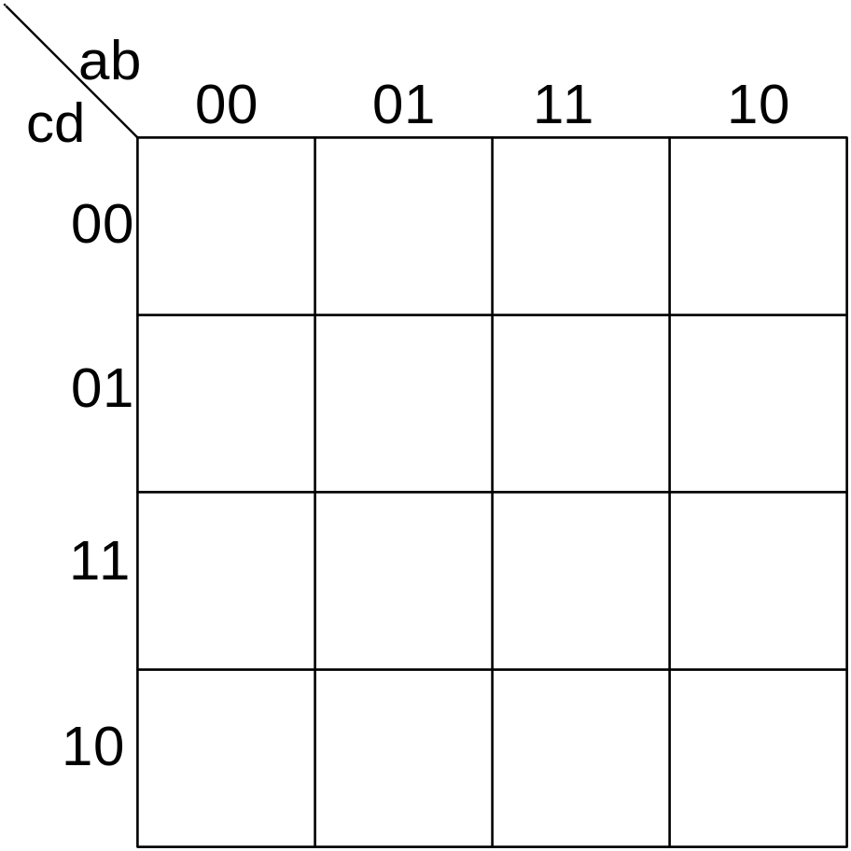
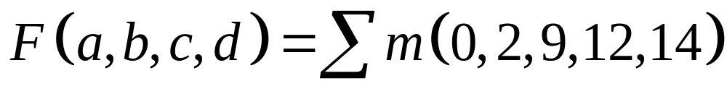
Four-variable K-Map Example
1
1
1
1
1

Slide 20
Systematic Simplification
A Prime Implicant is a product term obtained by combining the maximum possible number of adjacent squares in the map into a rectangle with the number of squares a power of 2.
A prime implicant is called an Essential Prime Implicant if it is the only prime implicant that covers (includes) one or more minterms.
Prime Implicants and Essential Prime Implicants can be determined by inspection of a K-Map.
A set of prime implicants "covers all minterms" if, for each minterm of the function, at least one prime implicant in the set of prime implicants includes the minterm.

Slide 21
Example of Prime Implicants
Find ALL Prime Implicants
CD
ESSENTIAL Prime Implicants
C
C
B
D
B
D
1
1
1
1
1
1
BD
1
1
BD
1
1
B
B
1
1
1
1
A
A
1
1
1
1
1
1
1
1
A
B
D
D
AD
Minterms covered by single prime implicant
B
C

Slide 22
Don't Cares in K-Maps
Sometimes a function table or map contains entries for which it is known:
  the input values for the minterm will never occur, or
  The output value for the minterm is not used
In these cases, the output value need not be defined
Instead, the output value is defined as a “don't care”
By placing “don't cares” ( an “x” entry) in the function table or map, the cost of the logic circuit may be lowered.
Example 1: A logic function having the binary codes for the BCD digits as its inputs. Only the codes for 0 through 9 are used. The six codes, 1010 through 1111 never occur, so the output values for these codes are “x” to represent “don’t cares.”

Slide 23
Don't Cares in K-Maps
Example 2: A circuit that represents a very common situation that occurs in computer design has two distinct sets of input variables:
  A, B, and C which take on all possible combinations, and
  Y which takes on values 0 or 1.
and a single output Z. The circuit that receives the output Z observes it only for combinations of A, B, and C such A = 1 and B = 1 or C = 0, otherwise ignoring it. Thus, Z is specified only for those combinations, and for all other combinations of A, B, and C, Z is a don’t care. Specifically, Z must be specified for AB + C = 1, and is a don’t care for :
AB + C = (A + B)C = AC + BC = 1
Ultimately, each don’t care “x” entry may take on either a 0 or 1 value in resulting solutions
For example, an “x” may take on value “0” in an SOP solution and value “1” in a POS solution, or vice-versa.
Any minterm with value “x” need not be covered by a prime implicant.

Slide 24
Example: BCD “5 or More”
The map below gives a function F1(w,x,y,z) which is defined as "5 or more" over BCD inputs. With the don't cares used for the 6 non-BCD combinations:
        F1 (w,x,y,z) = w + x z + x y G = 7
        This is much lower in cost than F2 where the “don't cares” were treated as "0s."
        G = 12
        For this particular function, cost G for the POS solution for F₁(w,x,y,z) is not changed by using the don't cares.
y
0
0
0
0
0
1
3
2
0
1
1
1
4
5
7
6
x
F₂(w,
x,
y,
z)
=
w
x
z
+
w
x
y
+
w
x
y
X
X
X
X
w
12
13
15
14
1
1
X
X
8
9
11
10
z

