Slide 2
Overview (continued)
Part 2 – Combinational Logic
  Functions and functional blocks
  Decoding using Decoders
    Implementing Combinational Functions with Decoders
  Encoding using Encoders
  Selecting using Multiplexers
    Implementing Combinational Functions with Multiplexers
Chapter 3 - Part 1 <number>

Slide 3
Combinational Circuits
A combinational logic circuit has:
  A set of m Boolean inputs,
  A set of n Boolean outputs, and
  n switching functions, each mapping the 2^{m} input combinations to an output such that the current output depends only on the current input values
A block diagram:
Combinatorial
Logic
Circuit
m Boolean Inputs
n Boolean Outputs
Chapter 3 - Part 1 <number>

Slide 4
Technology Mapping
Mapping Procedures
  To NAND gates
  To NOR gates
  Mapping to multiple types of logic blocks in covered in the reading supplement: Advanced Technology Mapping.
Chapter 3 - Part 1 <number>

Slide 5
Mapping to NAND gates
Assumptions:
  Gate loading and delay are ignored
  Cell library contains an inverter and n-input NAND gates, n = 2, 3, …
  An AND, OR, inverter schematic for the circuit is available
The mapping is accomplished by:
  Replacing AND and OR symbols,
  Pushing inverters through circuit fan-out points, and
  Canceling inverter pairs
Chapter 3 - Part 1 <number>

Slide 6
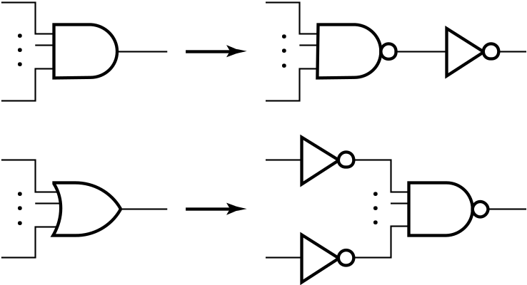
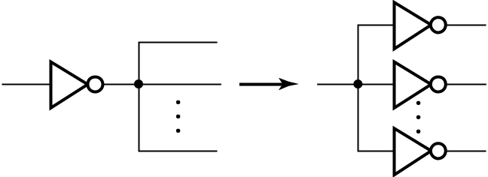

NAND Mapping Algorithm
Replace ANDs and ORs:
Repeat the following pair of actions until there is at most one inverter between :
  A circuit input or driving NAND gate output, and
  The attached NAND gate inputs.
Chapter 3 - Part 1 <number>

Slide 7
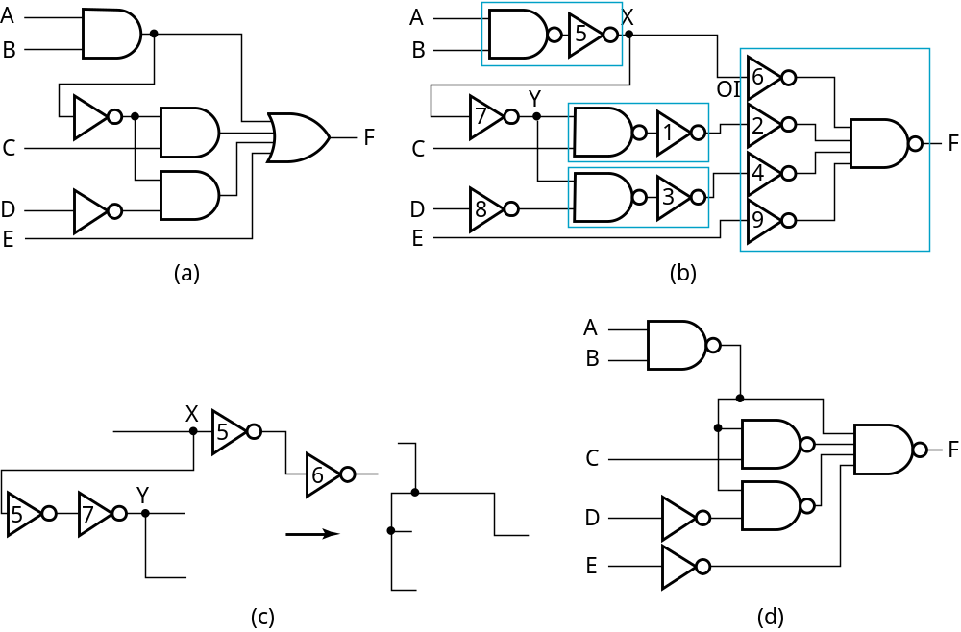
NAND Mapping Example
Chapter 3 - Part 1 <number>

Slide 8
Mapping to NOR gates
Assumptions:
  Gate loading and delay are ignored
  Cell library contains an inverter and n-input NOR gates, n = 2, 3, …
  An AND, OR, inverter schematic for the circuit is available
The mapping is accomplished by:
  Replacing AND and OR symbols,
  Pushing inverters through circuit fan-out points, and
  Canceling inverter pairs
Chapter 3 - Part 1 <number>

Slide 9
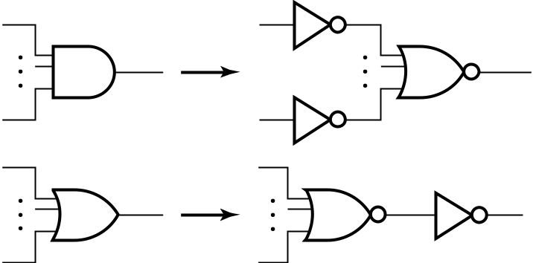
NOR Mapping Algorithm
Replace ANDs and ORs:
Repeat the following pair of actions until there is at most one inverter between :
  A circuit input or driving NAND gate output, and
  The attached NAND gate inputs.
Chapter 3 - Part 1 <number>

Slide 10
NOR Mapping Example
A
A
B
B
2
1
X
C
F
C
3
F
D
D
E
E
(a)
A
(b)
B
C
F
D
E
(c)
Chapter 3 - Part 1 <number>

