Slide 2
Overview
Part 2 – Combinational Logic
  Functions and functional blocks
  Decoding using Decoders
    Implementing Combinational Functions with Decoders
  Encoding using Encoders
  Selecting using Multiplexers
    Implementing Combinational Functions with Multiplexers
Chapter 3 <number>

Slide 3
Functions and Functional Blocks
The functions considered are those found to be very useful in design
Corresponding to each of the functions is a combinational circuit implementation called a functional block.
In the past, functional blocks were packaged as small-scale-integrated (SSI), medium-scale integrated (MSI), and large-scale-integrated (LSI) circuits.
Today, they are often simply implemented within a very-large-scale-integrated (VLSI) circuit.
Chapter 3 <number>

Slide 4
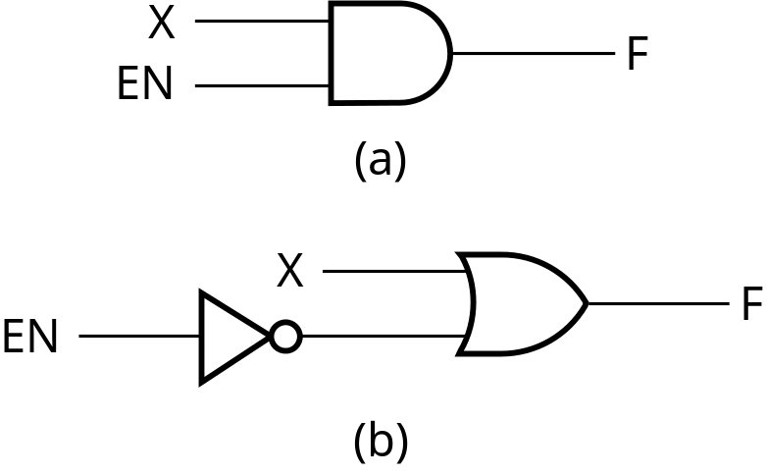
Enabling Function
Enabling permits an input signal to pass through to an output
Disabling blocks an input signal from passing through to an output, replacing it with a fixed value
The value on the output when it is disable can be Hi-Z (as for three-state buffers and transmission gates), 0 , or 1
When disabled, 0 output
When disabled, 1 output
See Enabling App in text
Chapter 3 <number>

Slide 5
Decoding
Decoding - the conversion of an n-bit input code to an m-bit output code with
n ≤ m ≤ 2^{n} such that each valid code word produces a unique output code
Circuits that perform decoding are called decoders
Here, functional blocks for decoding are
  called n-to-m line decoders, where m ≤ 2^{n}, and
  generate 2^{n} (or fewer) minterms for the n input variables
Chapter 3 <number>

Slide 6
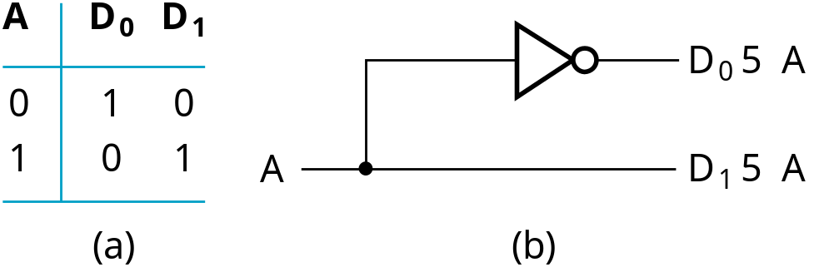
Decoder Examples
1-to-2-Line Decoder
2-to-4-Line Decoder
A
0
A
1
A
0
D
0
D
1
D
2
D
3
A
1
0
0
1
0
0
0
D
5
A
A
0
1
0
1
0
0
0
1
0
1
0
0
0
1
0
1
1
0
0
0
1
D
1
5
A
1
A
0
(a)
D
2
5
A
1
A
0
Note that the 2-4-line
made up of 2 1-to-2-
line decoders and 4 AND gates.
D
3
5
A
1
A
0
(b)
Chapter 3 <number>

Slide 7
Decoder Expansion
General procedure given in book for any decoder with n inputs and 2^{n} outputs.
This procedure builds a decoder backward from the outputs.
The output AND gates are driven by two decoders with their numbers of inputs either equal or differing by 1.
These decoders are then designed using the same procedure until 2-to-1-line decoders are reached.
The procedure can be modified to apply to decoders with the number of outputs ≠ 2^{n}
Chapter 3 <number>

Slide 8
Decoder Expansion - Example 1
3-to-8-line decoder
  Number of output ANDs = 8
  Number of inputs to decoders driving output ANDs = 3
  Closest possible split to equal
    2-to-4-line decoder
    1-to-2-line decoder
  2-to-4-line decoder
    Number of output ANDs = 4
    Number of inputs to decoders driving output ANDs = 2
    Closest possible split to equal
      Two 1-to-2-line decoders
See next slide for result
Chapter 3 <number>

Slide 9
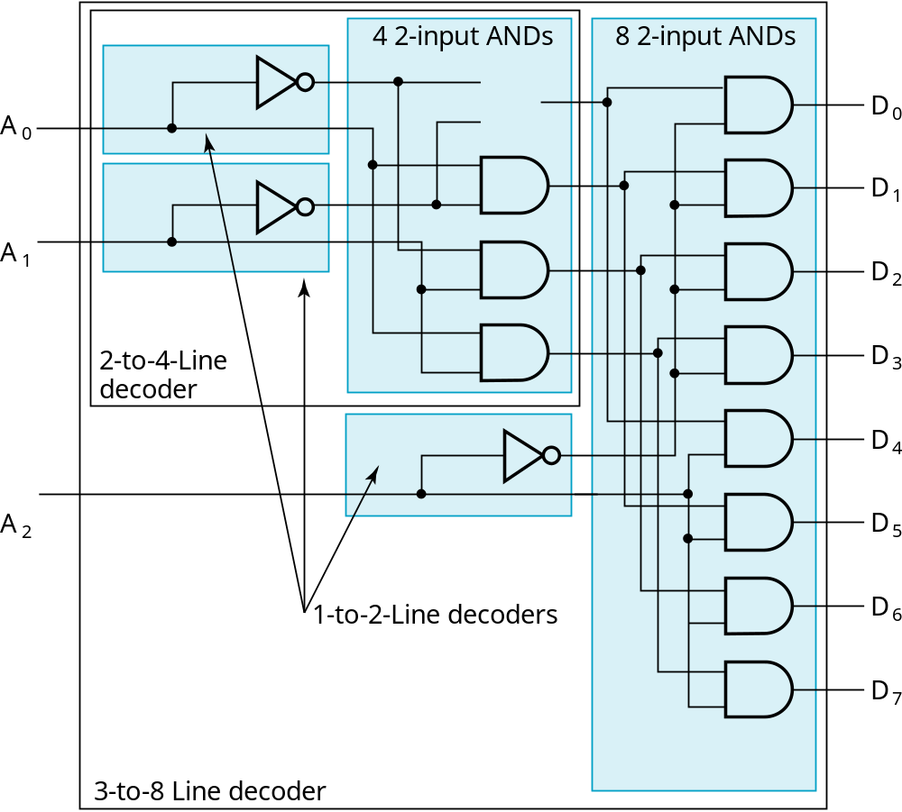
Decoder Expansion - Example 1
Result
Chapter 3 <number>

Slide 10
Decoder Expansion - Example 2
7-to-128-line decoder
  Number of output ANDs = 128
  Number of inputs to decoders driving output ANDs = 7
  Closest possible split to equal
    4-to-16-line decoder
    3-to-8-line decoder
  4-to-16-line decoder
    Number of output ANDs = 16
    Number of inputs to decoders driving output ANDs = 2
    Closest possible split to equal
      2 2-to-4-line decoders
  Complete using known 3-8 and 2-to-4 line decoders
Chapter 3 <number>

Slide 11
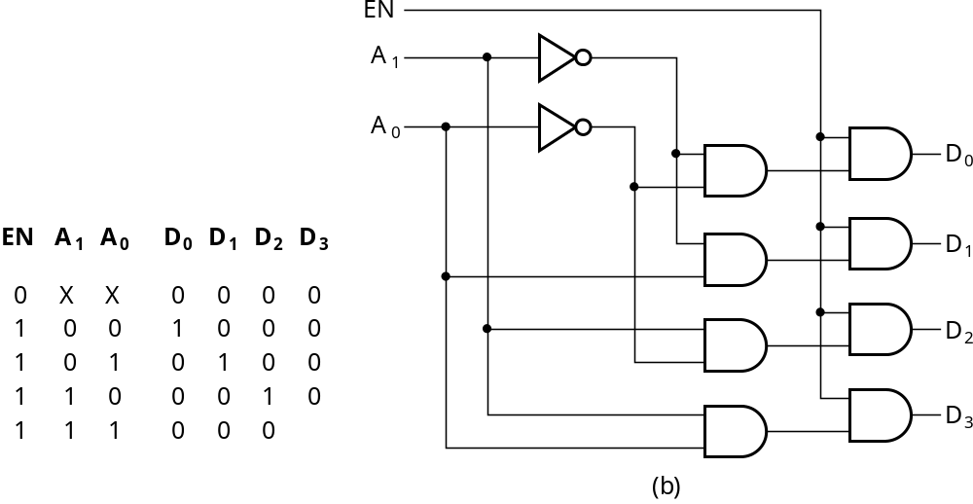
Decoder with Enable
In general, attach m-enabling circuits to the outputs
See truth table below for function
  Note use of X’s to denote both 0 and 1
  Combination containing two X’s represent four binary combinations
Alternatively, can be viewed as distributing value of signal EN to 1 of 4 outputs
In this case, called a
demultiplexer
Chapter 3 <number>

Slide 12
Combinational Logic Implementation
- Decoder and OR Gates
Implement m functions of n variables with:
  Sum-of-minterms expressions
  One n-to-2^{n}-line decoder
  m OR gates, one for each output
Approach 1:
  Find the truth table for the functions
  Make a connection to the corresponding OR from the corresponding decoder output wherever a 1 appears in the truth table
Approach 2
  Find the minterms for each output function
  OR the minterms together
Chapter 3 <number>

Slide 13
Decoder and OR Gates Example
Implement the following set of odd parity functions of (A₇, A₆, A₅, A₃)
P₁ = A₇ A₅ A₃
P₂ = A₇ A₆ A₃
P₄ = A₇ A₆ A₅
Finding sum of
minterms expressions
P₁ = Σ_{m}(1,2,5,6,8,11,12,15)
P₂ = Σ_{m}(1,3,4,6,8,10,13,15)
P₄ = Σ_{m}(2,3,4,5,8,9,14,15)
Find circuit
Is this a good idea?
+
+
A7
A6
A5
A4
P1
0
1
2
3
4
5
6
7
8
9
10
11
12
13
14
15
+
+
+
+
P2
P4
Chapter 3 <number>
Notes:
No. The complexity is high. Much better to implement the functions with XOR gates.
Also, the sharing of logic can cause 2 bits in error, which for this application
(a Hamming encoder) is not detectable! Note that XOR gates should not be shared in the implementation as well.

Slide 14
Encoding
Encoding - the opposite of decoding - the conversion of an m-bit input code to a n-bit output code with n ≤ m ≤ 2^{n} such that each valid code word produces a unique output code
Circuits that perform encoding are called encoders
An encoder has 2^{n} (or fewer) input lines and n output lines which generate the binary code corresponding to the input values
Typically, an encoder converts a code containing exactly one bit that is 1 to a binary code corres-ponding to the position in which the 1 appears.
Chapter 3 <number>

Slide 15
Encoder Example
A decimal-to-BCD encoder
  Inputs: 10 bits corresponding to decimal digits 0 through 9, (D₀, …, D₉)
  Outputs: 4 bits with BCD codes
  Function: If input bit D_{i} is a 1, then the output (A₃, A₂, A₁, A₀) is the BCD code for i,
The truth table could be formed, but alternatively, the equations for each of the four outputs can be obtained directly.
Chapter 3 <number>

Slide 16
Encoder Example (continued)
Input D_{i} is a term in equation A_{j} if bit A_{j} is 1 in the binary value for i.
Equations:
  A₃ = D₈ + D₉
  A₂ = D₄ + D₅ + D₆ + D₇
  A₁ = D₂ + D₃ + D₆ + D₇
  A₀ = D₁ + D₃ + D₅ + D₇ + D₉
F₁ = D₆ + D₇ can be extracted from A₂ and A₁ Is there any cost saving?
Chapter 3 <number>
Notes:
No. The total gate input cost remains the same.

