Slide 1
Software Engineering I
Lecture 4
Zaheer Ahmed

Slide 2
Incremental Model
Requirements phase
Verify
Specification phase
Verify
Architectural design
Verify
For each build:
  Perform detailed design,
  implementation and integration,
  test, deliver to client
Maintenance phase
Development
Maintenance
Retirement

Slide 3
Incremental Model (cont.)
Build 1
Specification
Design
Implementation, integration
Deliver to client
Build 2
Specification
Design
Implementation, integration
Deliver to client
Build 3
Specification
Design
Implementation, integration
Deliver to client
Build n
Specification
Design
Implementation, integration
Deliver to client
Specification team
Implementation, integration team
Design team

Slide 4

Example
In the diagram above when we work incrementally we are adding piece by piece but expect that each piece is fully finished. Thus keep on adding the pieces until it’s complete.

Slide 5
Advantages of Incremental model:
Generates working software quickly and early during the software life cycle.
This model is more flexible – less costly to change scope and requirements.
It is easier to test and debug during a smaller iteration.
In this model customer can respond to each built.
Lowers initial delivery cost.
Easier to manage risk because risky pieces are identified and handled during it’d iteration.

Slide 6
Disadvantages of Incremental model:
Needs good planning and design.
Needs a clear and complete definition of the whole system before it can be broken down and built incrementally.
Total cost is higher than waterfall.

Slide 7
Rapid Application Development (RAD)
Rapid application development is another form of incremental model. It is a high speed adaptation of the linear sequential model in which fully functional system in a very short time (2-3 months). This model is only applicable in the projects where requirements are well understood and project scope is constrained. Because of this reason it is used primarily for information systems.

Slide 8
The main phase of RAD model
Requirements & Planning
User Design
Development
Cutover
Requirements & Planning
User Design
Development
Cut Over

Slide 9
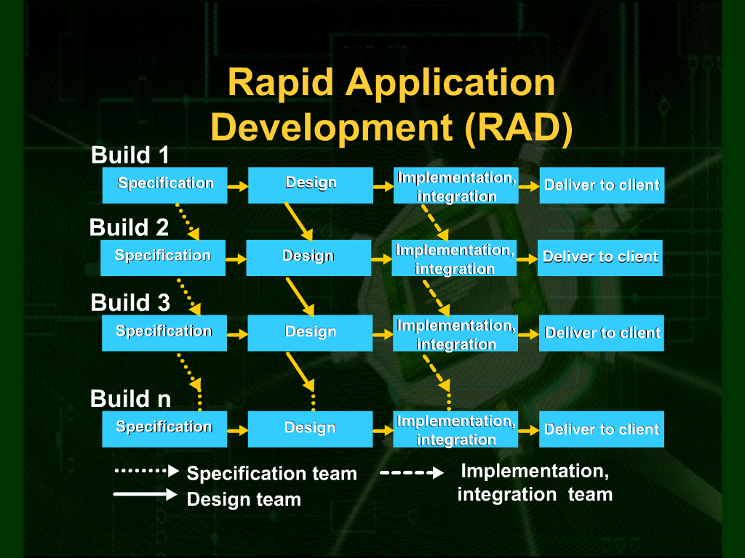

Slide 10
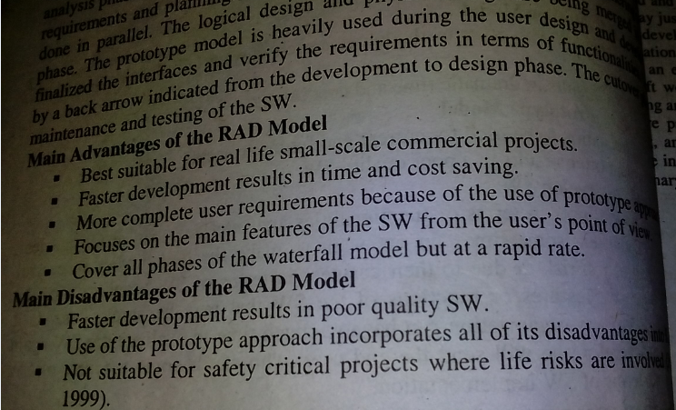

Slide 11
Spiral Model
This model was developed by Barry Boehm. The main idea of this model is to avert risk as there is always an element of risk in development of software. For example, key personnel may resign at a critical juncture, the manufacturer of the software development may go bankrupt, etc.

Slide 12
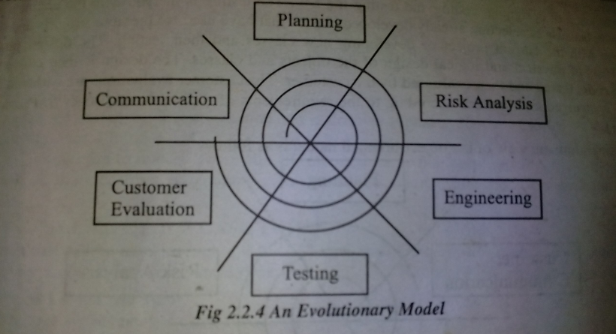
Spiral Model

Slide 13
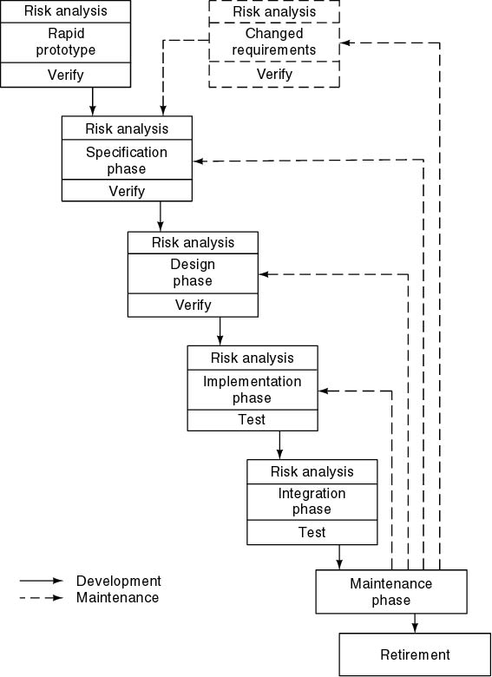
Spiral Model
Precede each phase by
  Alternatives
  Risk analysis
Follow each phase by
  Evaluation
  Planning of next phase

Slide 14
Simplified Spiral Model
Risk Analysis
If risks cannot be resolved, project is immediately terminated
Rapid Prototype
Specification
Design
Implementation
Verify
Integration

Slide 15
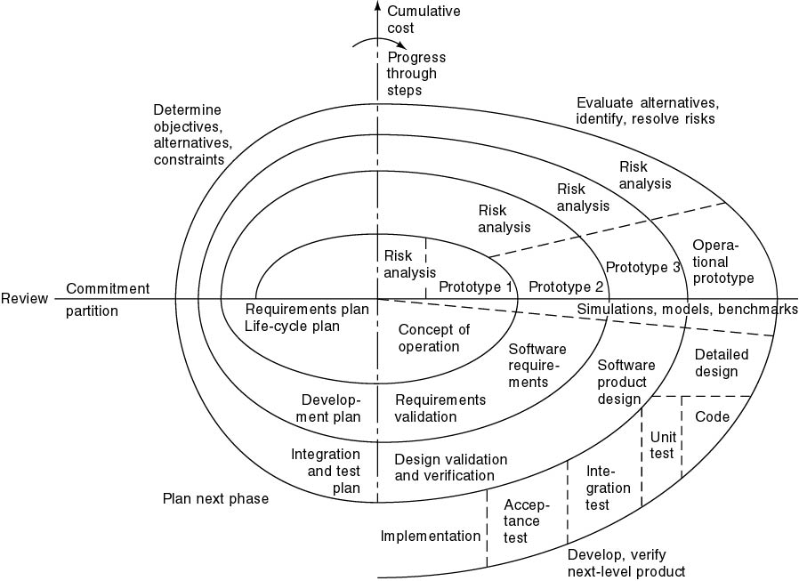
Full Spiral Model
Angular dimension (progress)
Radial dimension (cost)

Slide 16
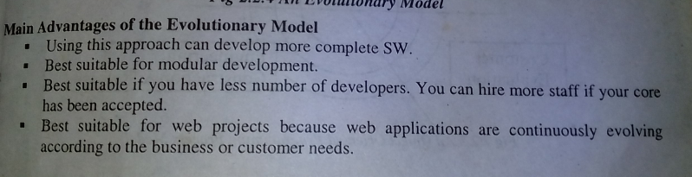
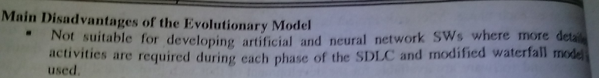

Slide 17
Object-Oriented
Lifestyle Models

Slide 18
Maintenance
Further development
Fountain Model
Operations
Features
  Overlap (parallelism)
  Arrows (iteration)
  Smaller maintenance circle
Implementation and integration
Implementation
Object-oriented design
Object-oriented analysis
Requirements

